Slide 1
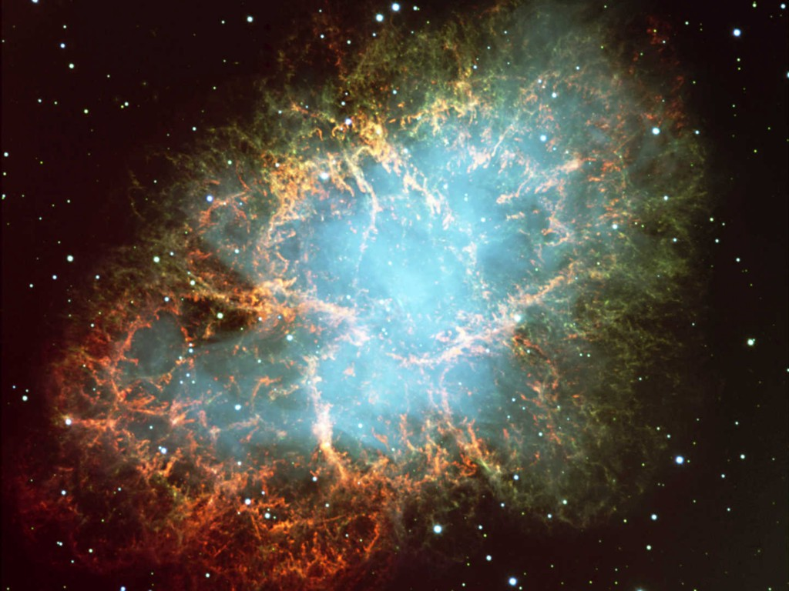
Crab Nebula
Neutrinos
in Astrophysics and Cosmology
Neutrinos and the Stars 2
Georg G. Raffelt
Max-Planck-Institut für Physik, München, Germany

Slide 2
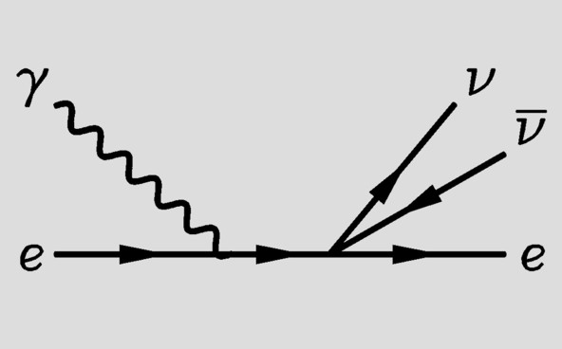
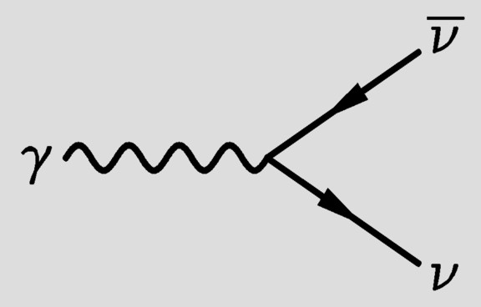
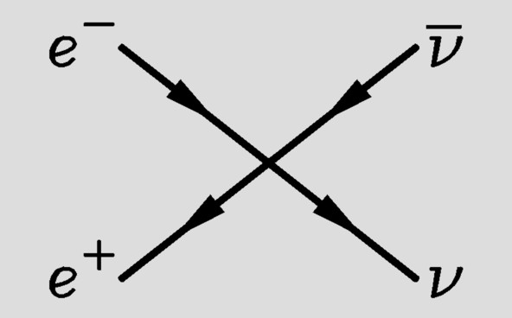
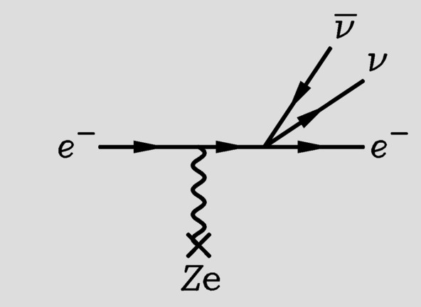
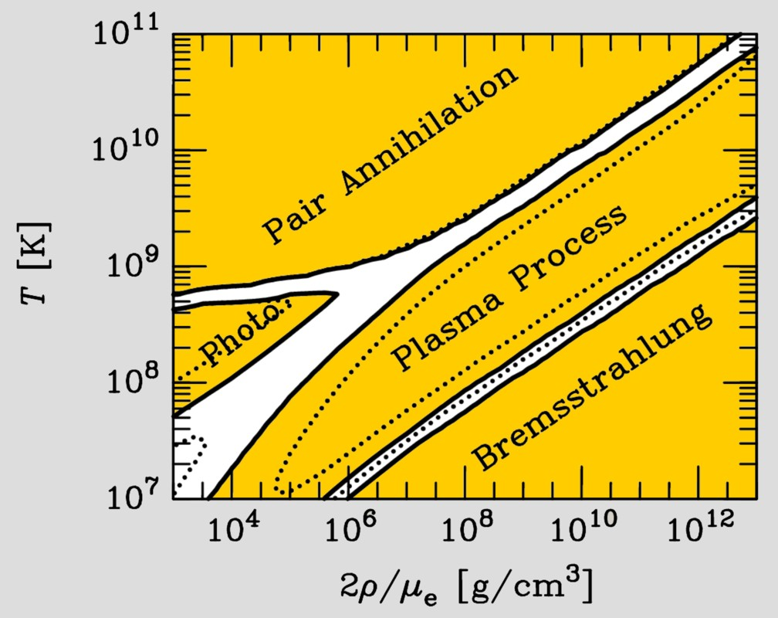
Neutrinos from Thermal Processes
Photo (Compton)
Plasmon decay
Pair annihilation
Bremsstrahlung
These processes were first
discussed in 1961−63
after V−A theory

Slide 3
Refraction and Forward Scattering
Plane wave in vacuum
$$Φ\left(r,t\right)∝e^{−iωt+ik⋅r}$$
With scattering centers
$$Φ\left(r,t\right)∝e^{−iωt}\left[e^{ik⋅r}+f\left(ω,θ\right)\frac{e^{ik⋅r}}{r}\right]$$
In forward direction, adds
coherently to a plane wave
with modified wave number
$$k=n_{refr}ω$$
$$n_{refr}=1+\frac{2π}{ω^{2}} N f\left(ω,0\right)$$
$N$ = number density of scattering centers
$f\left(ω,0\right)$ = forward scattering amplitude

Slide 4
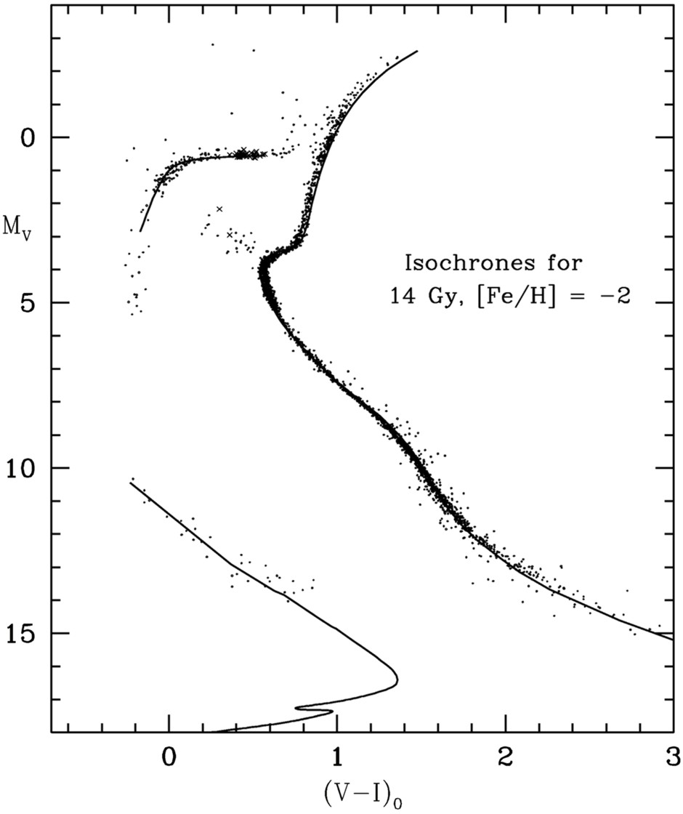
Color-Magnitude Diagram for Globular Clusters
Stars with M so
large that they
have burnt out
in a Hubble time
No new star
formation in
globular clusters
Mass
H
Main-Sequence
Hot, blue
cold, red
Color-magnitude diagram synthesized from several low-metallicity globular
clusters and compared with theoretical isochrones (W.Harris, 2000)

Slide 5
Color-Magnitude Diagram for Globular Clusters
H
H
He
C O
He
Asymptotic Giant
Red Giant
H
H
He
C O
White
Dwarfs
Horizontal Branch
Main-Sequence
Hot, blue
cold, red
Color-magnitude diagram synthesized from several low-metallicity globular
clusters and compared with theoretical isochrones (W.Harris, 2000)

Slide 6
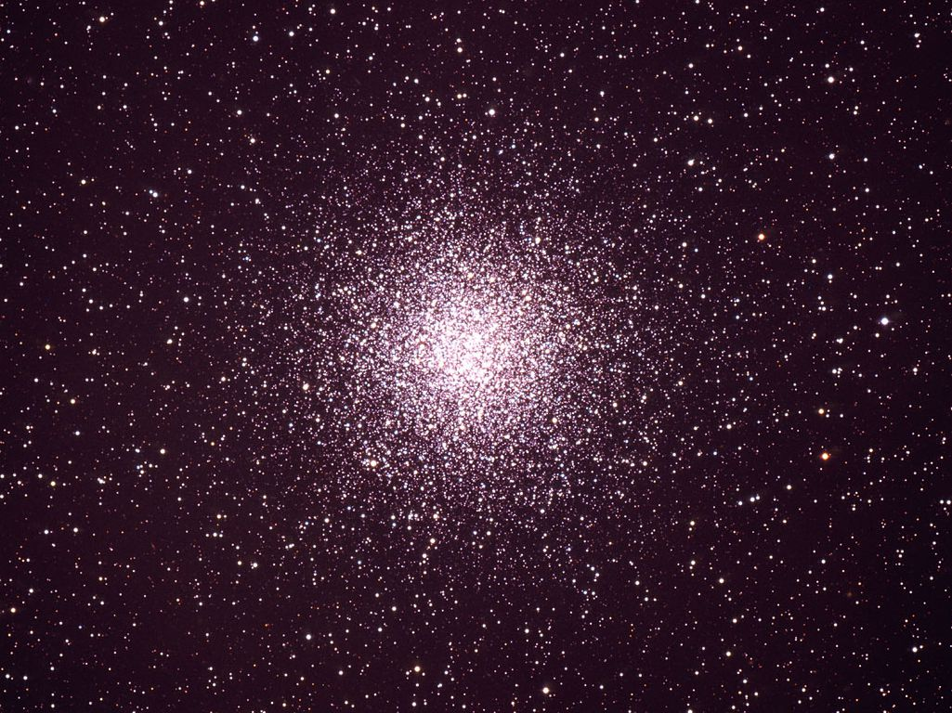
Bounds on Particle Properties

Slide 7
Basic Argument: Stars as Bolometers
Flux of weakly interacting particles
Low-mass weakly-interacting particles can be emitted from stars
New energy-loss channel
Back-reaction on stellar properties and evolution
What are the emission processes?
What are the observable consequences?

Slide 8
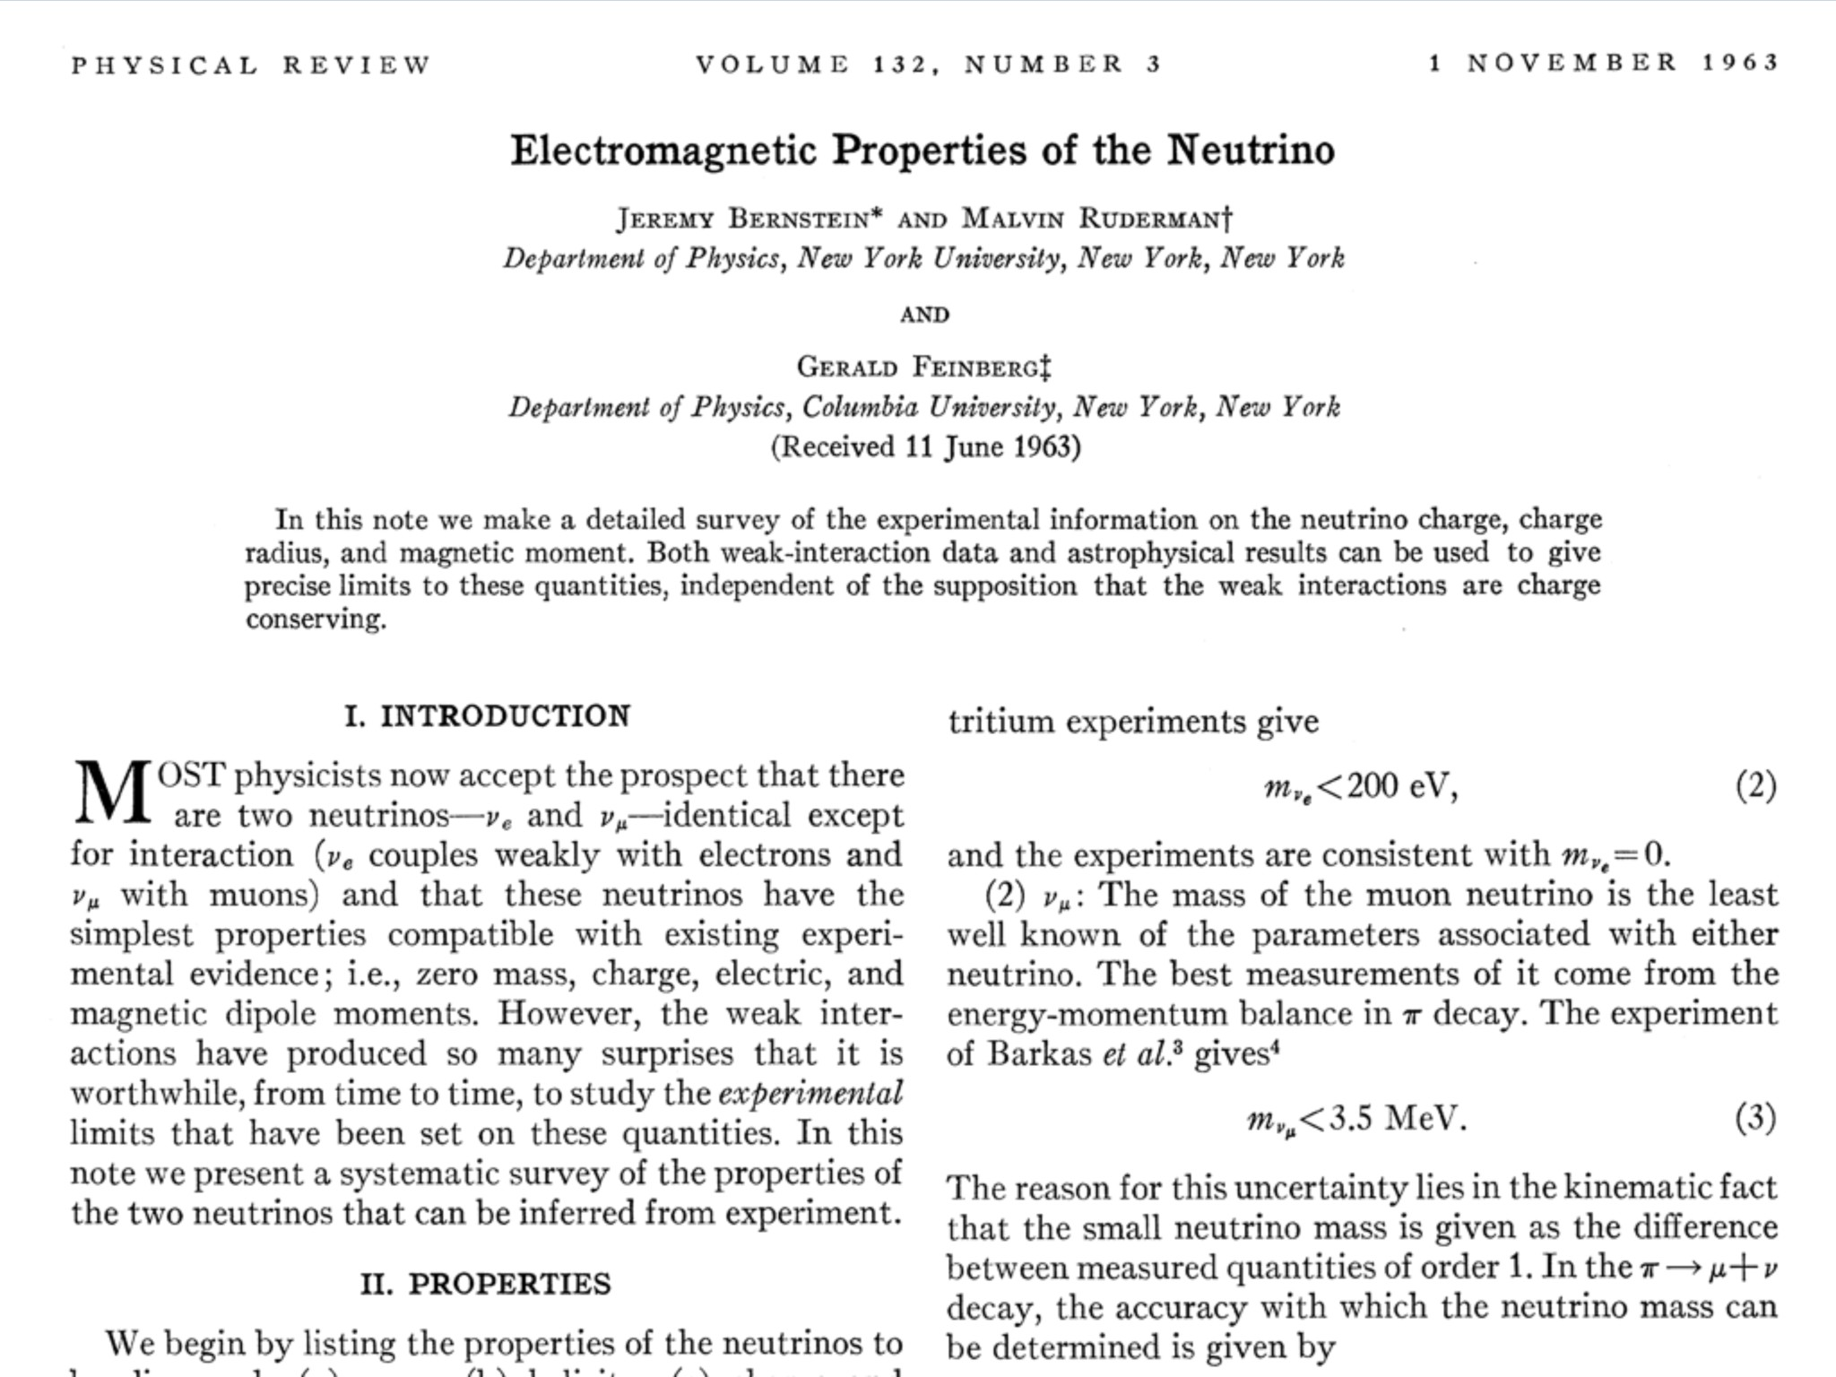
Electromagnetic Properties of Neutrinos

Slide 9
Neutrino Electromagnetic Form Factors
$$L_{eff}=−F_{1}\overline{Ψ}γ_{μ}Ψ A^{μ}$$
$$−G_{1}\overline{Ψ}γ_{μ}γ_{5}Ψ ∂_{ν}F^{μν}$$
$$−\frac{1}{2}F_{2} \overline{Ψ}σ_{μν}Ψ F^{μν}$$
$$−\frac{1}{2}G_{2} \overline{Ψ}σ_{μν}γ_{5}Ψ F^{μν}$$
Effective
coupling of
electromagnetic
field to a
neutral fermion
Charge e_{ν} = F₁(0) = 0
Anapole moment G₁(0)
Magnetic dipole moment μ = F₂(0)
Electric dipole moment ε = G₂(0)
Charge form factor F₁(q²) and anapole G₁(q²) are short-range interactions
if charge F₁(0) = 0
Connect states of equal helicity
In the standard model they represent radiative corrections to weak interaction
Dipole moments connect states of opposite helicity
Violation of individual flavor lepton numbers (neutrino mixing)
→ Magnetic or electric dipole moments can connect different flavors
or different mass eigenstates (“Transition moments”)
Usually measured in “Bohr magnetons” μ_{B} = e/2m_{e}

Slide 10
Plasmon Decay and Stellar Energy Loss Rates
Assume photon dispersion relation like a
massive particle (nonrelativistic plasma)
$$E_{γ}^{2}−p_{γ}^{2}=ω_{pl}^{2}=\frac{4παn_{e}}{m_{e}}$$
Photon decay rate
(transverse plasmon)
with energy E_{γ}
Millicharge
Dipole moment
Standard model
$$Γ\left(γ→ν\overline{ν}\right)=\frac{4π}{3E_{γ}}×\left\{\begin{matrix}α_{ν}\left({ω_{pl}^{2}}/{4π}\right) \\ \left({μ_{ν}^{2}}/2\right){\left({ω_{pl}^{2}}/{4π}\right)}^{2} \\ \left({C_{V}^{2}G_{F}^{2}}/α\right){\left({ω_{pl}^{2}}/{4π}\right)}^{3}\end{matrix}\right.$$
Energy-loss rate
of stellar plasma
$$Q\left(γ→ν\overline{ν}\right)=\int{\frac{2d^{3}p}{{\left(2π\right)}^{3}}}\frac{E_{γ}Γ_{γ→ν\overline{ν}}}{e^{{E_{γ}}/T}−1}=\frac{8ζ_{3}T^{3}}{3π}×\left\{\begin{matrix}α_{ν}\left({ω_{pl}^{2}}/{4π}\right) \\ \left({μ_{ν}^{2}}/2\right){\left({ω_{pl}^{2}}/{4π}\right)}^{2} \\ \left({C_{V}^{2}G_{F}^{2}}/α\right){\left({ω_{pl}^{2}}/{4π}\right)}^{3}\end{matrix}\right.$$

Slide 11
Color-Magnitude Diagram for Globular Clusters
H
Particle emission
delays He ignition, i.e.
core mass increased
H
He
C O
He
Asymptotic Giant
Red Giant
H
Particle emission reduces
helium burning lifetime,
i.e. number of HB stars
H
He
C O
White
Dwarfs
Horizontal Branch
Main-Sequence
Hot, blue
cold, red
Color-magnitude diagram synthesized from several low-metallicity globular
clusters and compared with theoretical isochrones (W.Harris, 2000)

Slide 12
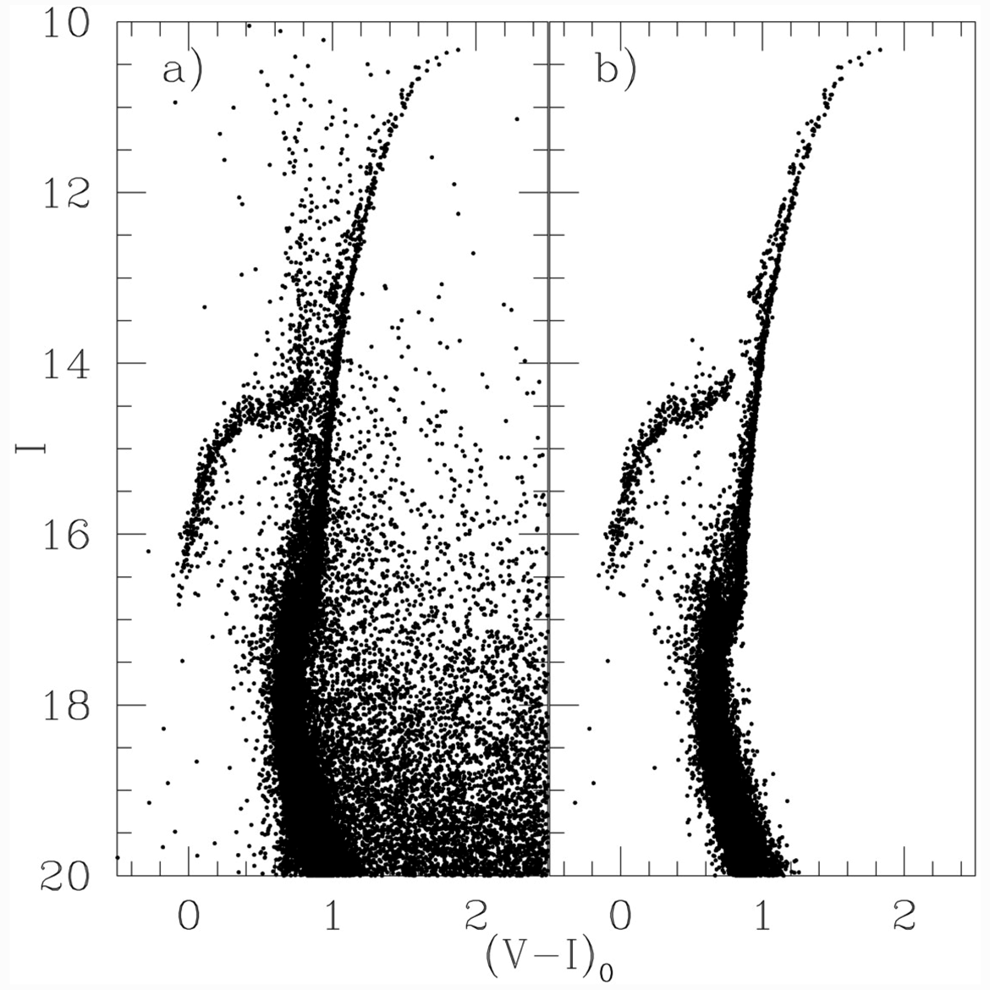
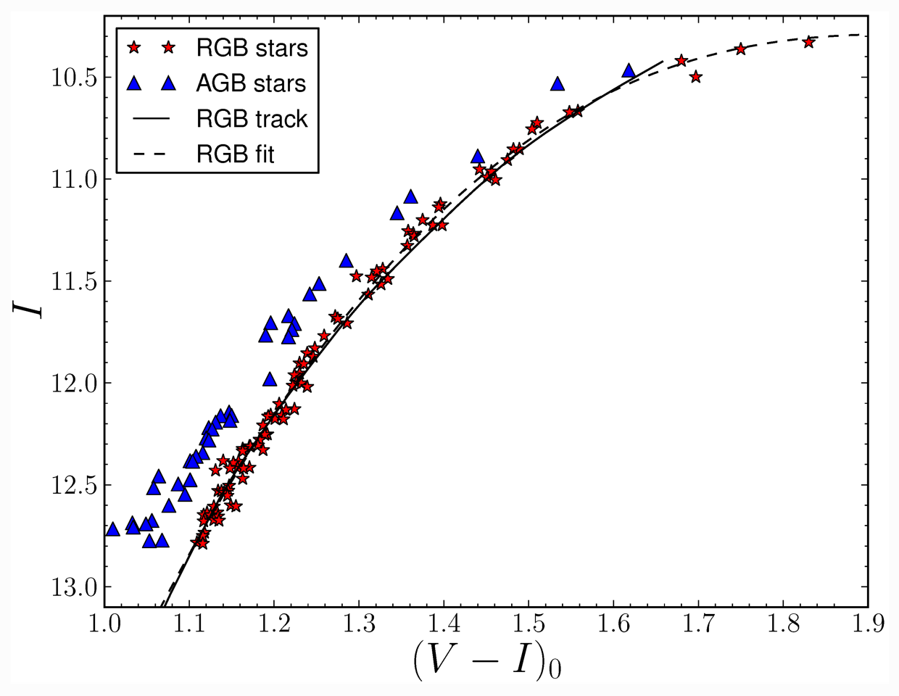
Color-Magnitude Diagram of Globular Cluster M5
Brightest red giant
measures nonstandard energy loss
CMD (a) before and (b) after cleaning
CMD of brightest 2.5 mag of RGB
Viaux, Catelan, Stetson, Raffelt, Redondo, Valcarce & Weiss, arXiv:1308.4627

Slide 13
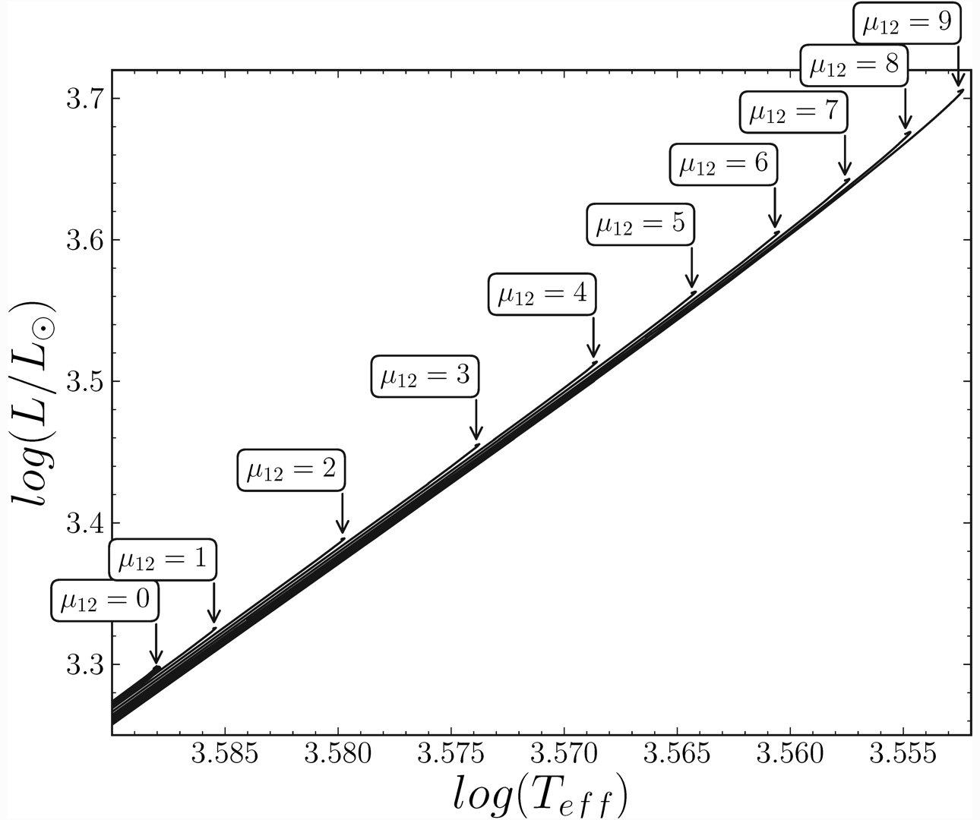
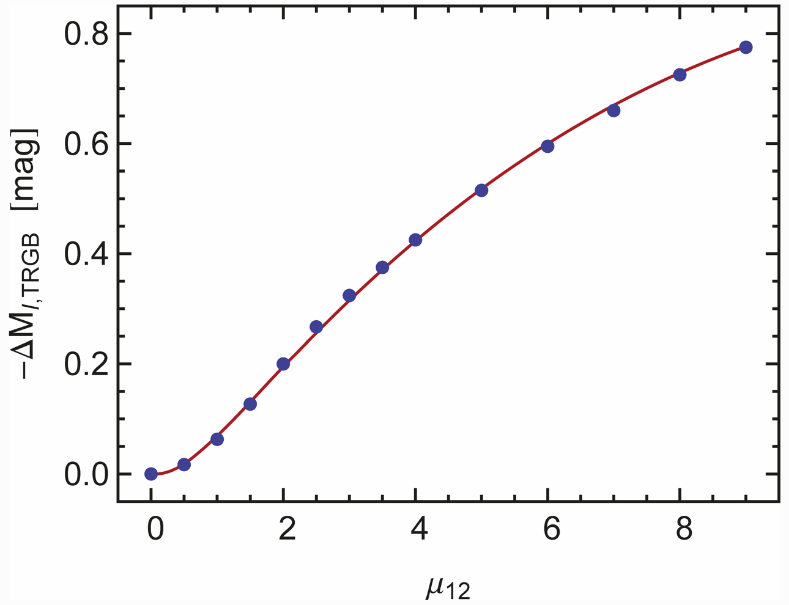
Helium Ignition for Low-Mass Red Giants
Brightness increase at He ignition by nonstanderd neutrino losses
$$\log\left(L/L_{sun}\right)$$
$$\log\left(T_{eff}\right)$$
Neutrino magnetic dipole moment
[${10}^{−12}μ_{B}]$
Viaux, Catelan, Stetson, Raffelt, Redondo, Valcarce & Weiss, arXiv:1308.4627

Slide 14
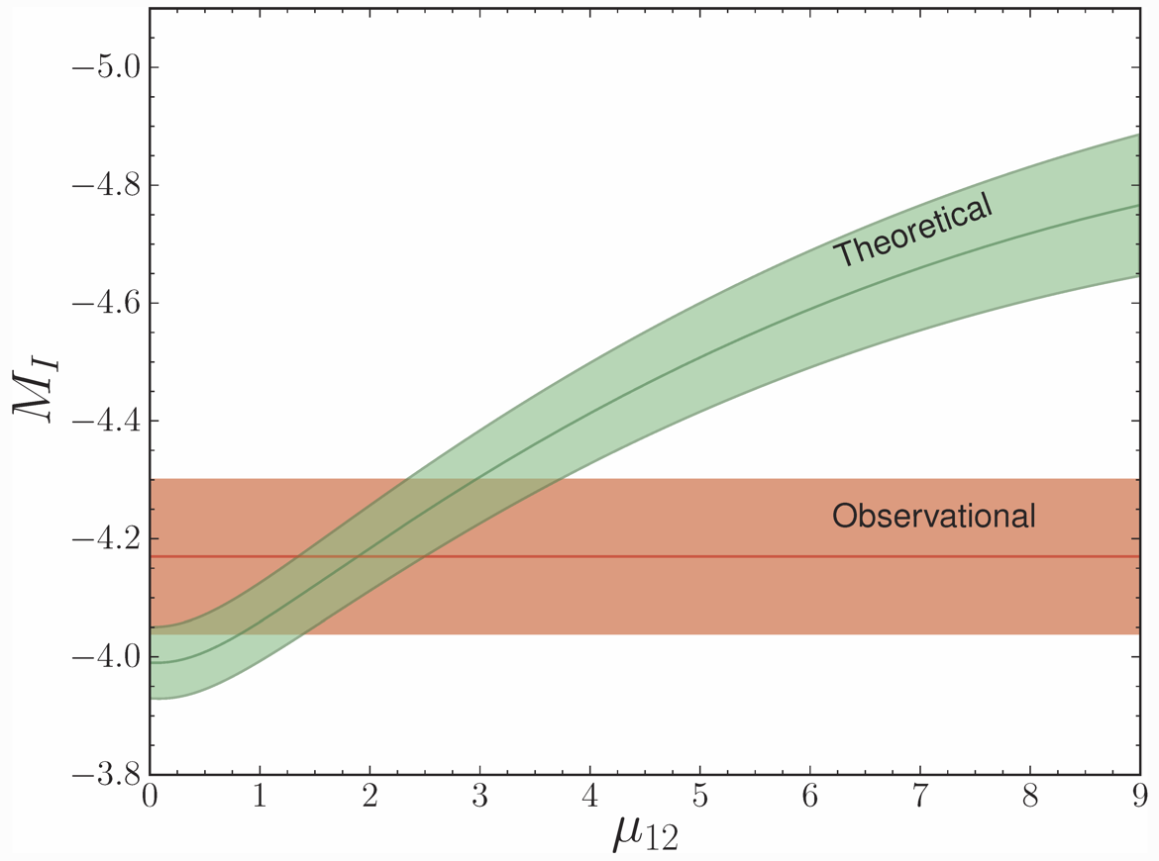
Neutrino Dipole Limits from Globular Cluster M5
I-band brightness
of tip of red-giant brach
[magnitudes]
Detailed account of theoretical and observational uncertainties
• Uncertainty dominated
by distance
• Can be improved in
future (GAIA mission)
Neutrino magnetic dipole moment [${10}^{−12}μ_{B}]$
Most restrictive limit on
neutrino electromagnetic
properties
$$μ_{ν}<\left\{\begin{matrix}2.6×{10}^{−12}μ_{B} & (68\% CL) \\ 4.5×{10}^{−12}μ_{B} & (95\% CL)\end{matrix}\right.$$
Viaux, Catelan, Stetson, Raffelt, Redondo, Valcarce & Weiss, arXiv:1308.4627

Slide 15
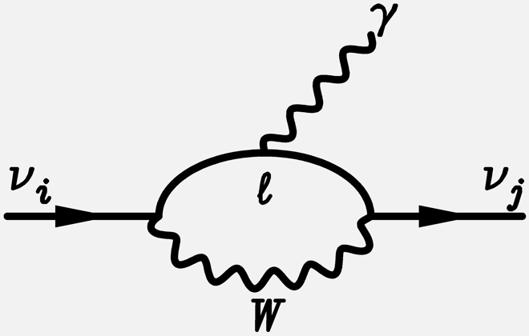
Standard Dipole Moments for Massive Neutrinos
Standard electroweak model:
Neutrino dipole and
transition moments
are induced at higher order
Massive neutrinos $ν_{i}$ ($i=1, 2, 3$)
mixed to form weak eigenstates
$$ν_{ℓ}=\sum_{i=1}^{3}{U_{ℓi}ν_{i}}$$
Explicitly for Dirac neutrinos
Magnetic moments $μ_{ij}$
Electric moments $ε_{ij}$
$$μ_{ij}=\frac{{e\sqrt{2}G}_{F}}{{\left(4π\right)}^{2}}\left(m_{i}+m_{j}\right)\sum_{ℓ=e,μ,τ}{U_{ℓj}U_{ℓi}^{∗}}f\left(\frac{m_{ℓ}}{m_{W}}\right)$$
$$ε_{ij} = …\left(m_{i}−m_{j}\right) …$$
$$f\left(\frac{m_{ℓ}}{m_{W}}\right)=−\frac{3}{2}+\frac{3}{4} {\left(\frac{m_{ℓ}}{m_{W}}\right)}^{2}+𝒪{\left(\frac{m_{ℓ}}{m_{W}}\right)}^{4}$$

Slide 16
Standard Dipole Moments for Massive Neutrinos
Diagonal case:
Magnetic moments
of Dirac neutrinos
$$μ_{ii}=\frac{3e\sqrt{2}G_{F}}{{\left(4π\right)}^{2}}m_{i}=3.20×{10}^{−19}μ_{B}\frac{m_{i}}{eV}$$
$$ε_{ii} =0$$
$$μ_{B}=\frac{e}{2m_{e}}$$
Off-diagonal case
(Transition moments)
First term in $f({m_{ℓ}}/{m_{W}})$
does not contribute:
“GIM cancellation”
$$μ_{ij}=\frac{3e\sqrt{2}G_{F}}{{4\left(4π\right)}^{2}}{(m}_{i}+m_{j}){\left(\frac{m_{τ}}{m_{W}}\right)}^{2}\sum_{ℓ=e,μ,τ}{U_{ℓj}U_{ℓi}^{∗}{\left(\frac{m_{ℓ}}{m_{τ}}\right)}^{2}}$$
$$=3.96×{10}^{−23}μ_{B}\frac{m_{i}+m_{j}}{eV} \sum_{ℓ=e,μ,τ}{U_{ℓj}U_{ℓi}^{∗}{\left(\frac{m_{ℓ}}{m_{τ}}\right)}^{2}}$$
Largest neutrino mass eigenstate $0.05 eV < m < 0.2 eV$
For Dirac neutrino expect
$$1.6×{10}^{−20}μ_{B}<μ_{ν}<6.4×{10}^{−20}μ_{B}$$

Slide 17
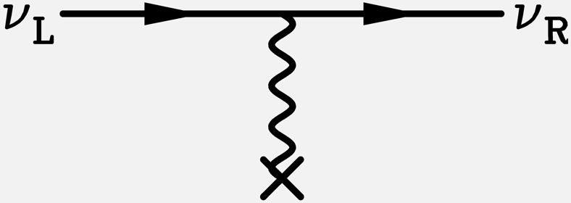
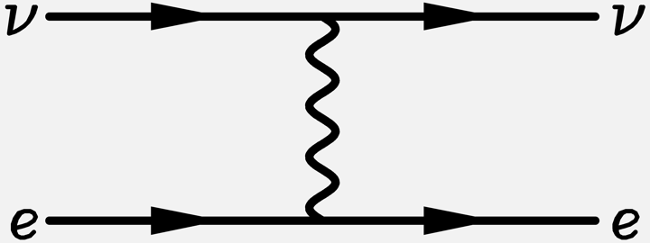
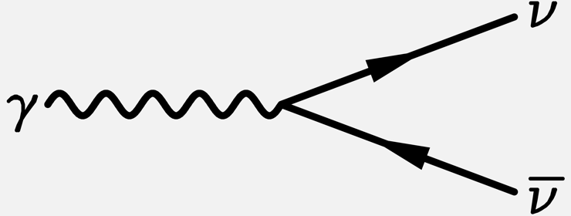
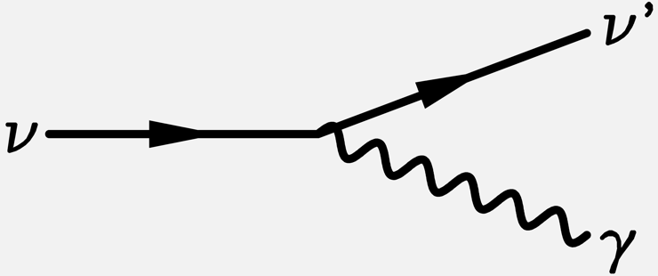
Consequences of Neutrino Dipole Moments
Spin precession
in external
E or B fields
$$i\frac{∂}{∂t}\left(\begin{matrix}ν_{L} \\ ν_{R}\end{matrix}\right)=\left(\begin{matrix}0 & μ_{ν}B_{⊥} \\ μ_{ν}B_{⊥} & 0\end{matrix}\right)\left(\begin{matrix}ν_{L} \\ ν_{R}\end{matrix}\right)$$
Scattering
$$\frac{dσ}{dT}=\frac{G_{F}^{2}m_{e}}{2π}\left[{\left(C_{V}+C_{A}\right)}^{2}+{\left(C_{V}−C_{A}\right)}^{2}{\left(1−\frac{T}{E}\right)}^{2}+\left(C_{V}^{2}−C_{A}^{2}\right)\frac{m_{e}T}{E^{2}}\right]$$
$$+αμ_{ν}^{2}\left(\frac{1}{T}+\frac{1}{E}\right)$$
T electron recoil energy
Plasmon
decay in
stars
$$Γ=\frac{μ_{ν}^{2}}{24π} ω_{pl}^{3}$$
Decay or
Cherenkov
effect
$$Γ=\frac{μ_{ν}^{2}}{8π}{\left(\frac{m_{2}^{2}−m_{1}^{2}}{m_{2}}\right)}^{3}$$

Slide 18
Neutrino Spin Oscillations
Spin Precession in external E or B fields
$$i∂_{t}\left(\begin{matrix}ν_{L} \\ ν_{R}\end{matrix}\right)=\left(\begin{matrix}0 & μ_{ν}B_{T} \\ μ_{ν}B_{T} & 0\end{matrix}\right)\left(\begin{matrix}ν_{L} \\ ν_{R}\end{matrix}\right)$$
For relativistic neutrinos the oscillation equation
• is independent of energy
• involves only the transverse B field
Probability ν_{L} → ν_{R}
Distance for helicity reversal
$$\frac{π}{2μ_{ν}B_{T}}=5.36×{10}^{13}cm\frac{{10}^{−10}μ_{B}}{μ_{ν}}\frac{1G}{B_{T}}$$
1
z
0
Oscillation
Length
$$\frac{π}{μ_{ν}B_{T}}$$

Slide 19
Spin-Flavor Oscillations
Spin-flavor precession in external E or B fields
$$i∂_{t}\left(\begin{matrix}ν_{1} \\ {\overline{ν}}_{2}\end{matrix}\right)=\left(\begin{matrix}0 & μ_{ν}B_{T} \\ {−μ}_{ν}B_{T} & 0\end{matrix}\right)\left(\begin{matrix}ν_{1} \\ {\overline{ν}}_{2}\end{matrix}\right)$$
Majorana neutrinos:
• Diagonal dipole moments vanish
• Transition moments inevitably exist, couple neutrinos with anti-neutrinos
• Standard model calculation $\sim$ Dirac case
$$ν_{1}$$
$${\overline{ν}}_{2}$$
$$ν_{1}^{L}$$
$$ν_{1}^{R}$$
$${\overline{ν}}_{1}^{L}$$
$${\overline{ν}}_{1}^{R}$$
$$ν_{1}^{L}$$
$${\overline{ν}}_{1}^{L}$$
Transition
moments
$$ν_{2}^{L}$$
$$ν_{2}^{R}$$
$${\overline{ν}}_{2}^{L}$$
$${\overline{ν}}_{2}^{R}$$
$$ν_{2}^{L}$$
$${\overline{ν}}_{2}^{L}$$
Dirac
neutrinos
Dirac
anti-neutrinos
Majorana

Slide 20
Neutrino Spin-Flavor Oscillations in a Medium
Two-flavor oscillations of Majorana neutrinos with a transition magnetic moment μ
and ordinary flavor mixing in a medium
$$i∂_{r}\left(\begin{matrix}ν_{e} \\ ν_{μ} \\ {\overline{ν}}_{e} \\ {\overline{ν}}_{μ}\end{matrix}\right)=\left(\begin{matrix}cΔ+a_{e} & sΔ & 0 & μB \\ sΔ & −cΔ+a_{μ} & −μB & 0 \\ 0 & −μB & cΔ−a_{e} & sΔ \\ μB & 0 & sΔ & −cΔ−a_{μ}\end{matrix}\right)\left(\begin{matrix}ν_{e} \\ ν_{μ} \\ {\overline{ν}}_{e} \\ {\overline{ν}}_{μ}\end{matrix}\right)$$
with $c=\cos{(2Θ)}$, $s=\sin{(2Θ)}$,
$Δ={{(m}_{2}^{2}−m_{1}^{2})}/{4E}$, $a_{e}=\sqrt{2}G_{F}\left(n_{e}−\frac{1}{2}n_{n}\right)$ and $a_{μ}=\sqrt{2}G_{F}\left(−\frac{1}{2}n_{n}\right)$
• Resonant spin-flavor precession (RSFP) can be a subdominant effect for solar
neutrino conversion and can produce a small solar anti-neutrino flux
• Can be important for supernova neutrinos

Slide 21
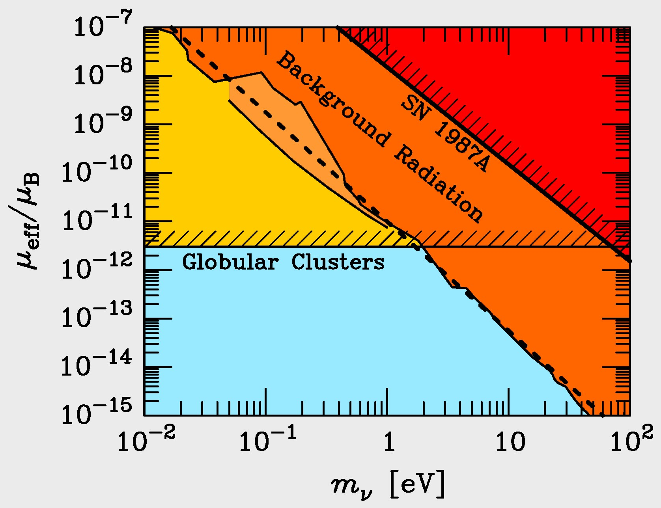
Neutrino Radiative Lifetime Limits
$$Γ_{ν→ν^{′}γ}=\frac{μ_{eff}^{2}}{8π} m_{ν}^{3}$$
Radiative
decay
$$ν→ν^{′}+γ$$
$$Γ_{γ→ν\overline{ν}}=\frac{μ_{eff}^{2}}{24π}ω_{pl}^{3}$$
Plasmon
decay
$$γ_{pl}→ν+\overline{ν}$$
For low-mass neutrinos, plasmon decay in globular cluster stars
yields the most restrictive limits

Slide 22
Further Reading on Particle Limits from Stars
Georg Raffelt:
Astrophysical Methods to Constrain Axions
and Other Novel Particle Phenomena
Phys. Rept. 198 (1990) 1–113
Stars as Laboratories for Fundamental Physics
(University of Chicago Press, 1996)
http://wwwth.mpp.mpg.de/members/raffelt/mypapers/199613.pdf
Neutrinos and the Stars
Proc. ISAPP 2012 “Neutrino Physics and Astrophysics”
(26 July–5 August 2011, Varenna, Lake Como, Italy) arXiv:1201.1637

