Slide 1
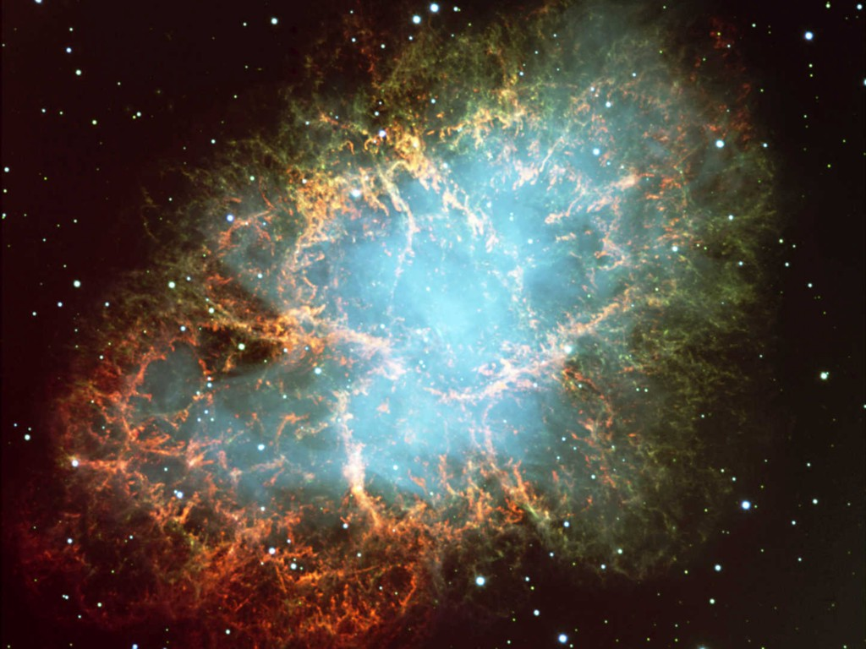
Crab Nebula
Neutrinos
in Astrophysics and Cosmology
Neutrinos from the Sun
Georg G. Raffelt
Max-Planck-Institut für Physik, München, Germany

Slide 2
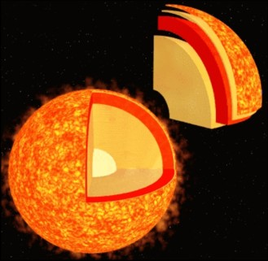
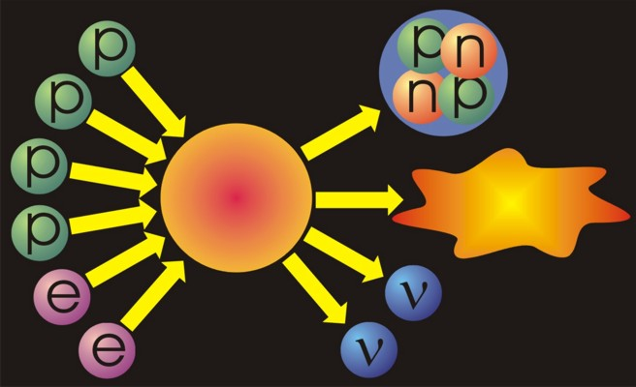
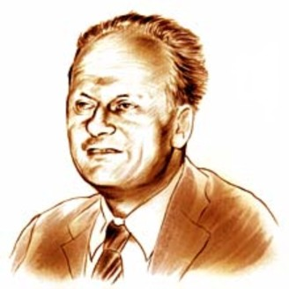
Neutrinos from the Sun
Helium
Reaction-
chains
Energy
26.7 MeV
Solar radiation: 98 % light (photons)
2 % neutrinos
At Earth 66 billion neutrinos/cm² sec
Hans Bethe (1906−2005, Nobel prize 1967)
Thermonuclear reaction chains (1938)

Slide 3
Hydrogen Burning: Proton-Proton Chains
$$\text{p}+\text{p}→{}_{}^{2}{\text{H}}+{\text{e}}^{+}+ν_{e}$$
$$\text{p}+{\text{e}}^{−}+\text{p}→{}_{}^{2}{\text{H}}+ν_{e}$$
< 0.420 MeV
1.442 MeV
100%
0.24%
$${}_{}^{2}{\text{H}}+\text{p}→{}_{}^{3}{\text{H}\text{e}}+γ$$
PP-I
85%
15%
hep
$${}_{}^{3}{\text{He}}+{}_{}^{3}{\text{He}}→{}_{}^{4}{\text{He}}+2\text{p}$$
$${}_{}^{3}{\text{He}}+{}_{}^{4}{\text{He}}→{}_{}^{7}{\text{Be}}+γ$$
$${}_{}^{3}{\text{He}}+\text{p}→{}_{}^{4}{\text{He}}+{\text{e}}^{+}+ν_{e}$$
90%
10%
0.02%
< 18.8 MeV
$${}_{}^{7}{\text{B}\text{e}}+{\text{e}}^{−}→{}_{}^{7}{\text{Li}}+ν_{e}$$
$${}_{}^{7}{\text{B}\text{e}}+{\text{e}}^{−}→{}_{}^{7}{{\text{Li}}^{∗}}+ν_{e}$$
$${}_{}^{7}{\text{B}\text{e}}+\text{p}→{}_{}^{8}{\text{B}}+γ$$
0.862 MeV
0.384 MeV
$${}_{}^{8}{\text{B}}→{}_{}^{8}{{\text{Be}}^{∗}}+{\text{e}}^{+}+ν_{e}$$
< 15 MeV
PP-II
$${}_{}^{7}{\text{Li}}+\text{p}→{}_{}^{4}{\text{He}}+{}_{}^{4}{\text{He}}$$
PP-III
$${}_{}^{8}{{\text{Be}}^{∗}}→{}_{}^{4}{\text{He}}+{}_{}^{4}{\text{He}}$$

Slide 4
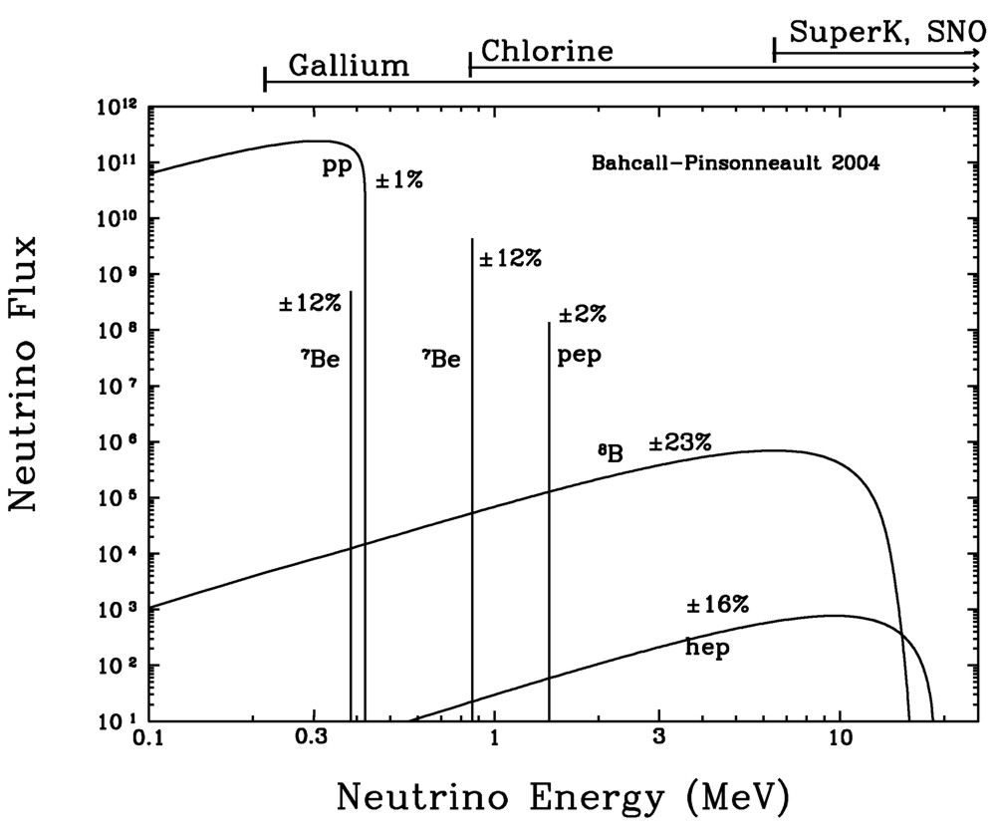
Solar Neutrino Spectrum

Slide 5
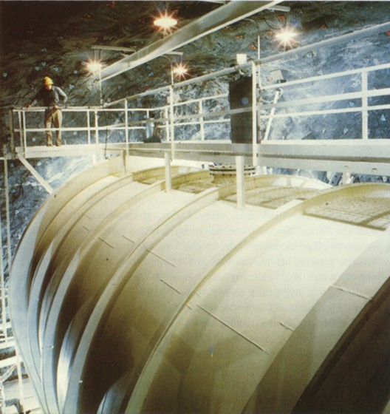
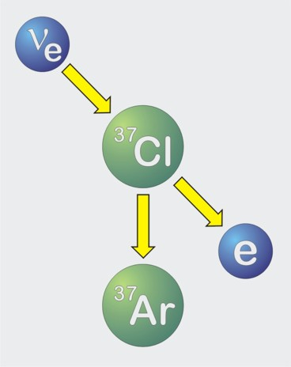
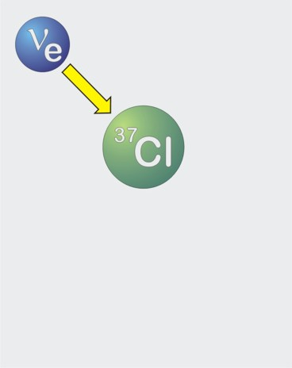
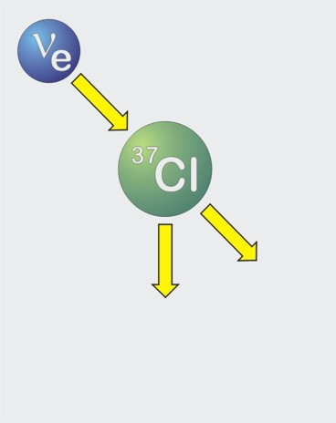
First Measurement of Solar Neutrinos
Inverse beta decay
of chlorine
600 tons of
Perchloroethylene
Homestake solar neutrino
observatory (1967–2002)

Slide 6
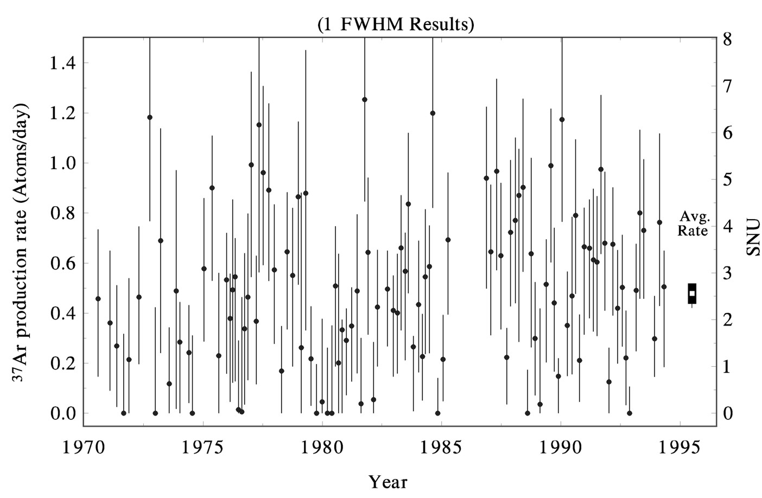
Results of Chlorine Experiment (Homestake)
ApJ 496:505, 1998
Theoretical
Expectation
Average
Rate
Average (1970−1994) 2.56 ± 0.16_{stat} ± 0.16_{sys} SNU
(SNU = Solar Neutrino Unit = 1 Absorption / sec / 10³⁶ Atoms)
Theoretical Prediction 6−9 SNU
“Solar Neutrino Problem” since 1968

Slide 7
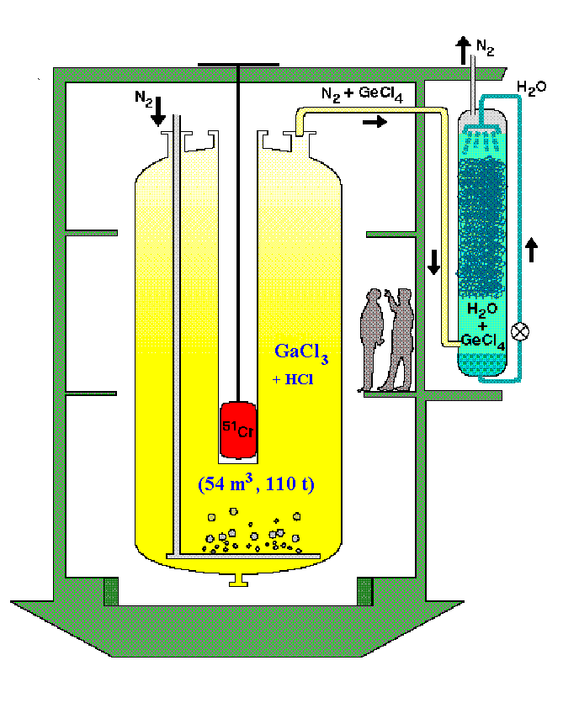
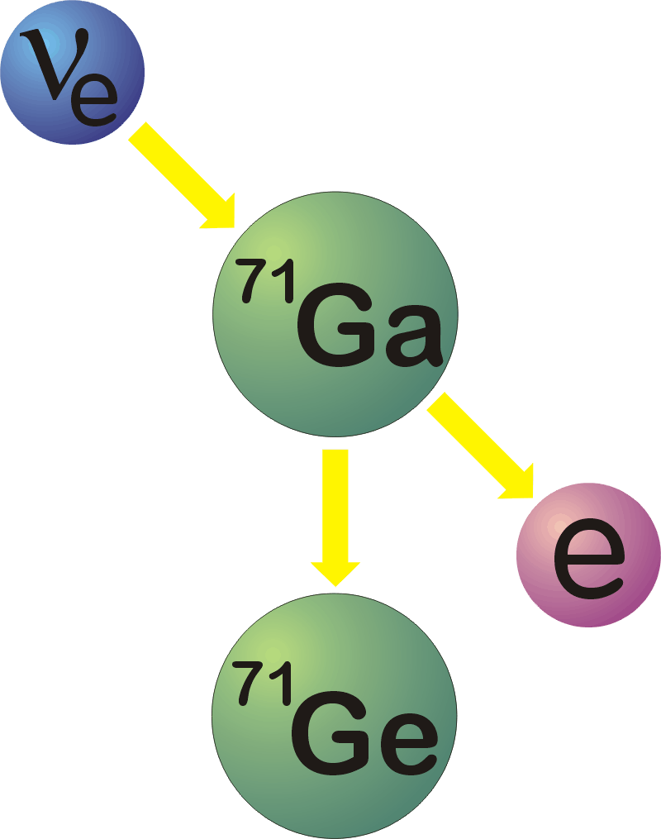
GALLEX/GNO and SAGE
Inverse Beta Decay
Gallium → Germanium
GALLEX/GNO (1991–2003)

Slide 8
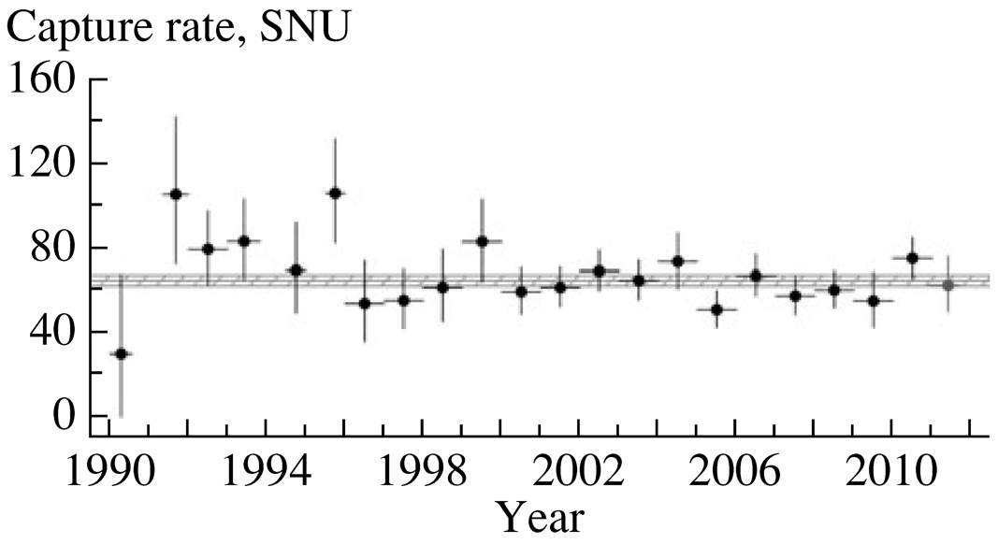
Gallium Results
Shown at Neutrino 2006
Gavrin, Phys. At. Nucl. 76 (2013) 1238
SAGE: $65.1±2.6 SNU$

Slide 9
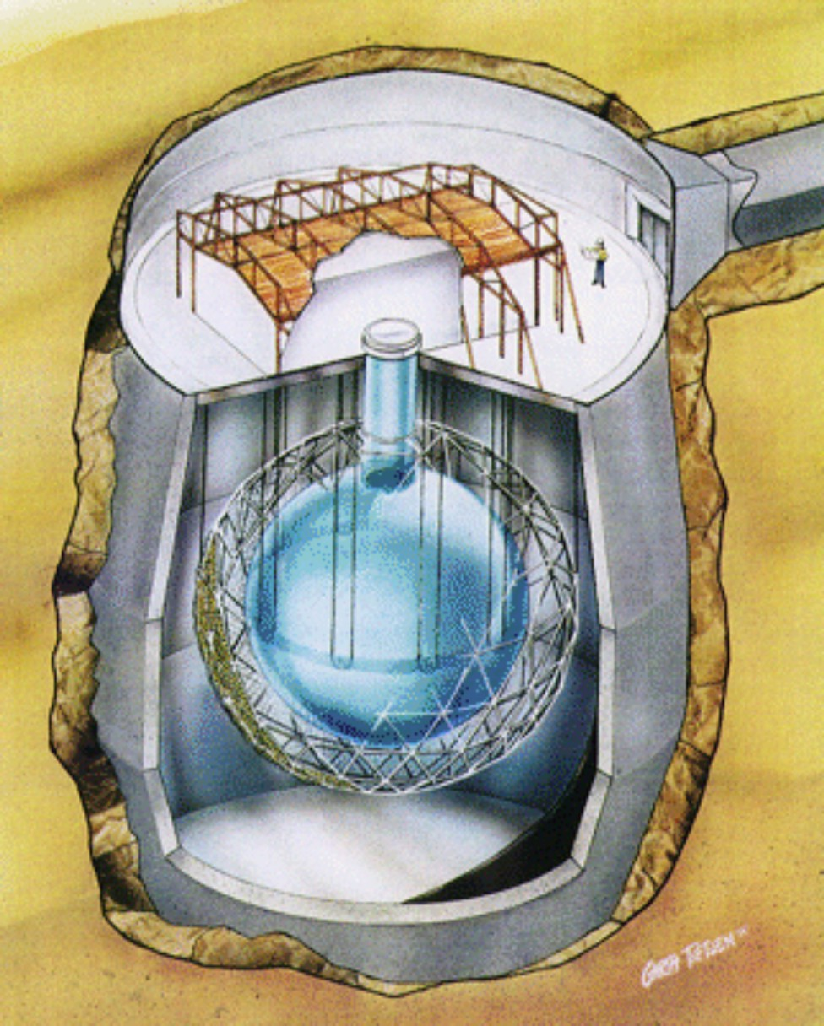
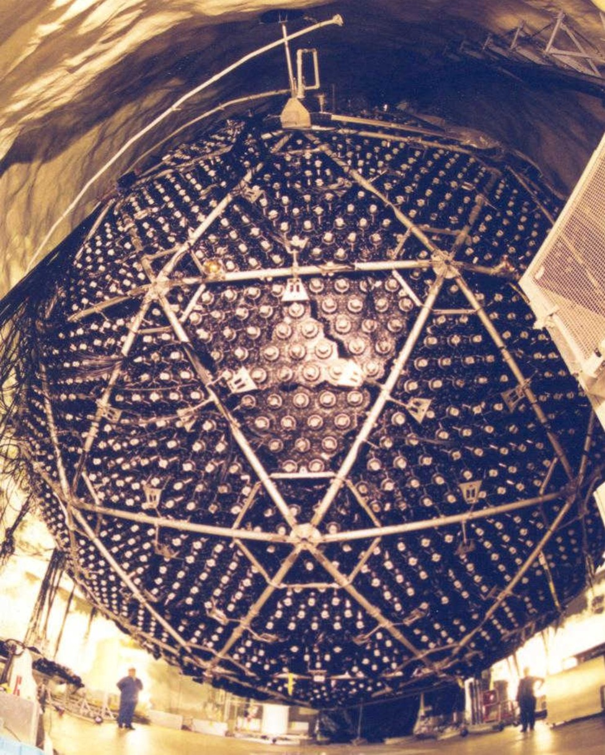
Sudbury Neutrino Observatory (SNO) 1999–2006
1000 tons of heavy water

Slide 10
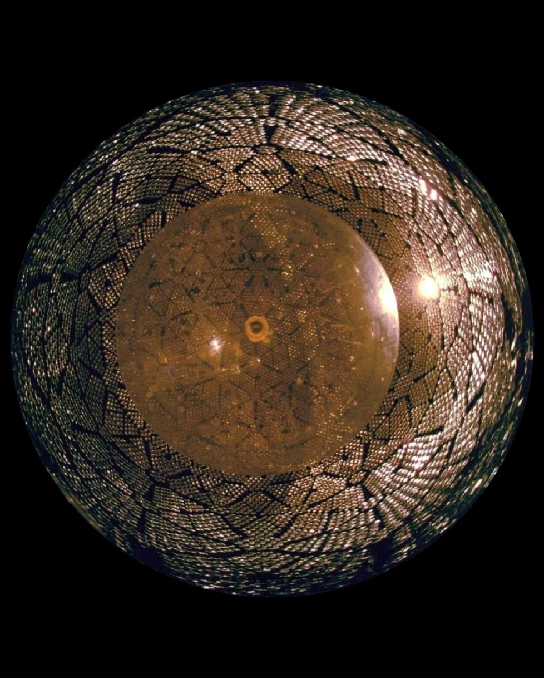
Sudbury Neutrino Observatory (SNO) 1999–2006
1000 tons of heavy water

Slide 11
Sudbury Neutrino Observatory (SNO) 1999–2006
1000 tons of heavy water
Normal (light) water
H₂0
Heavy water
D₂0
Nucleus of hydrogen (proton)
Nucleus of heavy hydrogen
(deuterium)

Slide 12
Sudbury Neutrino Observatory (SNO) 1999–2006
Heavy
hydrogen
(deuterium)
Heavy
hydrogen
(deuterium)
Electron neutrinos
All neutrino flavors

Slide 13
Missing Neutrinos from the Sun
Electron-Neutrino Detectors
All Flavors
Water
Heavy Water
Chlorine
Gallium
Water
Heavy Water
ν + e⁻→ ν + e⁻
ν_{e}+ e⁻→ ν_{e}+ e⁻
ν_{e}+ d → p + p + e⁻
ν + d → p + n + ν
⁸B
⁸B
⁸B
⁸B
⁸B
⁸B
CNO
⁷Be
pp
CNO
⁷Be
Homestake
Gallex/GNO
SAGE
(Super-)
Kamiokande
SNO
SNO

Slide 14
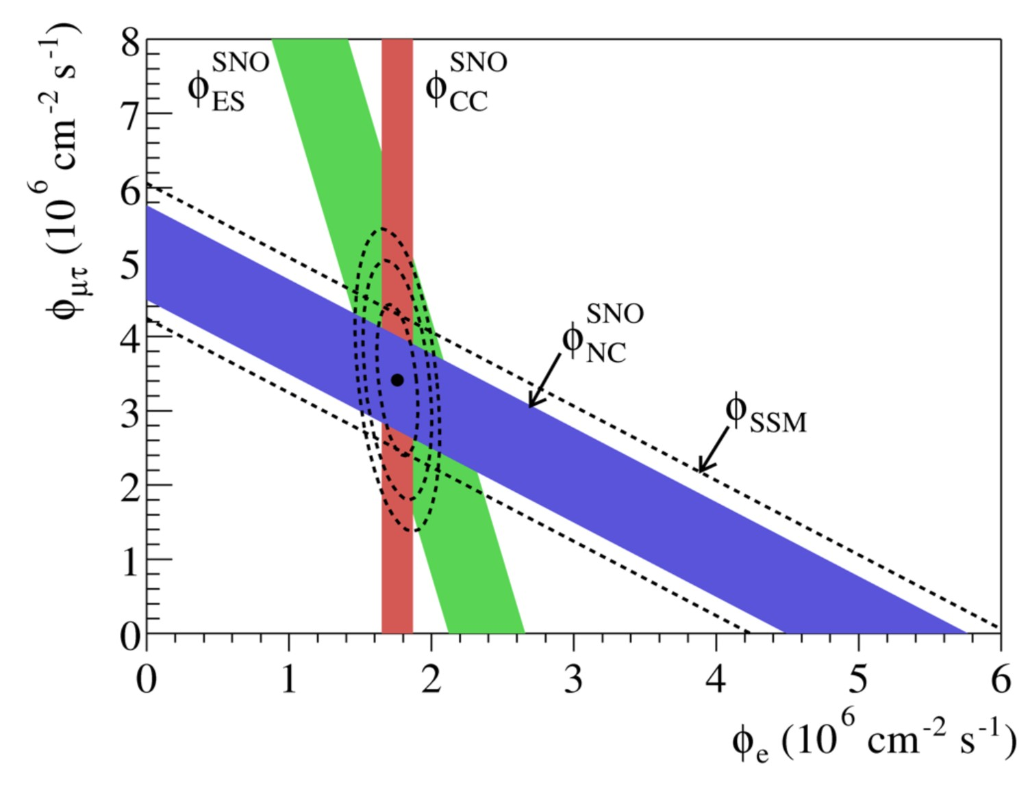
Charged and Neutral-Current SNO Measurements
Ahmad et al. (SNO Collaboration), PRL 89:011301,2002
(nucl-ex/0204008)

Slide 15
Solar Neutrino Spectrum
Be-7 line measured
by Borexino (2007)
pep line measured
by Borexino (2011)

Slide 16
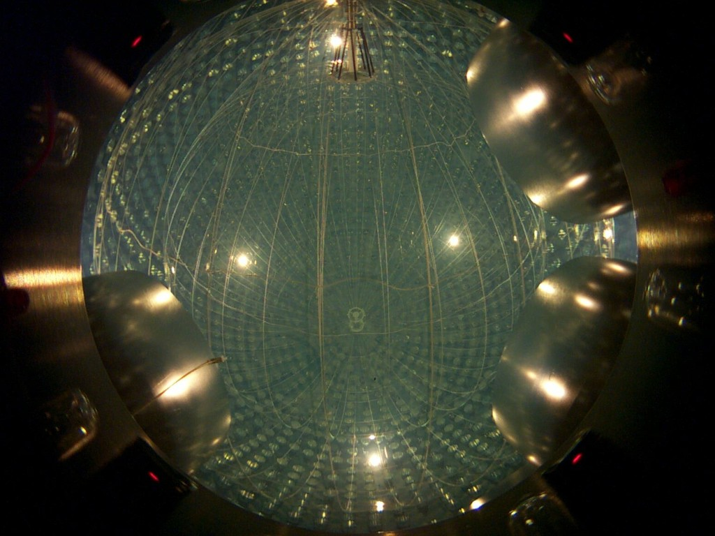
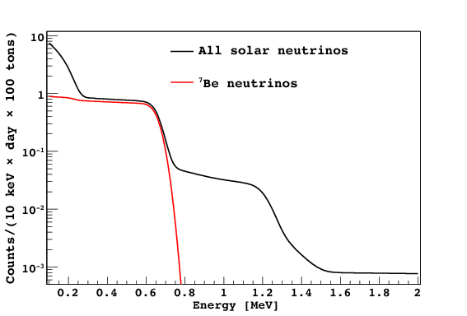
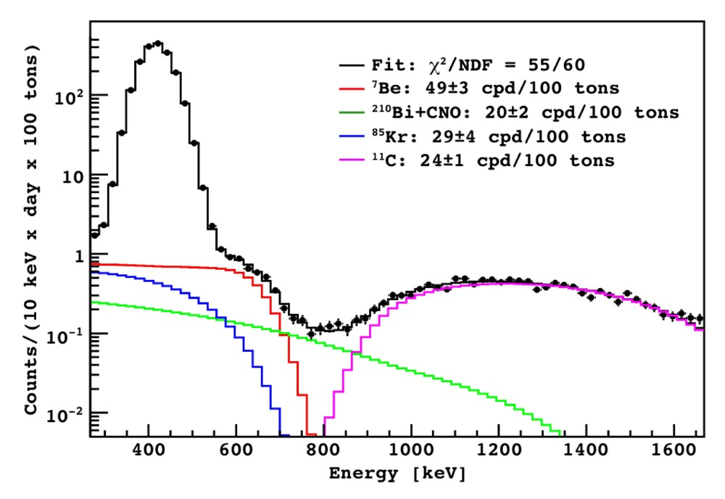
Solar Neutrino Spectroscopy with BOREXINO
Neutrino electron scattering
Liquid scintillator technology
($\sim$ 300 tons)
Low energy threshold
($\sim$ 60 keV)
Online since 16 May 2007
Shoulder
in e recoil
spectrum
Expected without flavor oscillations
75 ± 4 counts/100 t/d
Expected with oscillations
49 ± 4 counts/100 t/d
BOREXINO result (May 2008)
49 ± 3_{stat} ± 4_{sys} cnts/100 t/d
arXiv:0805.3843 (25 May 2008)

Slide 17
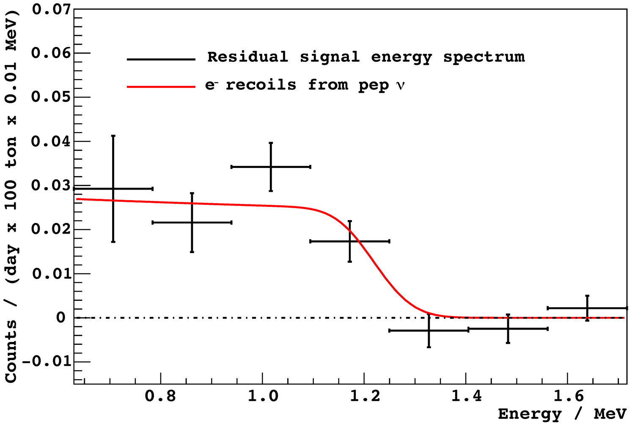
pep Neutrinos in Borexino
Borexino Collaboration, arXiv:1110.3230v1

Slide 18
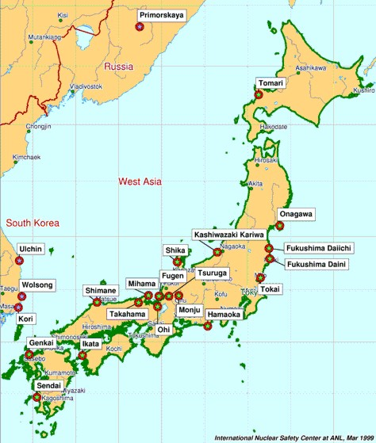
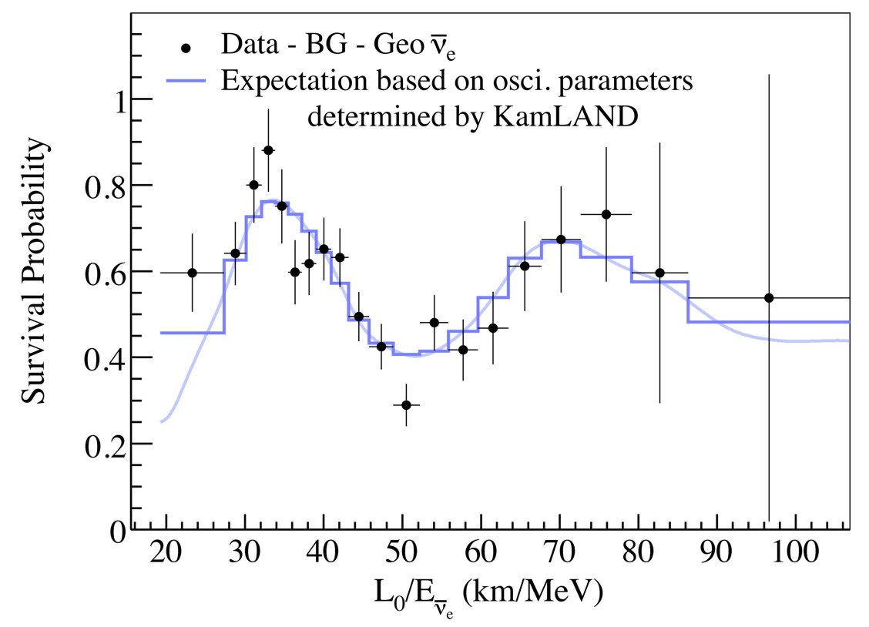
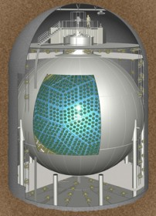
Oscillation of Reactor Neutrinos at KamLAND (Japan)
Oscillation pattern for anti-electron neutrinos from
Japanese power reactors as a function of L/E
Average distance 180 km, flux 6 × 10⁵ cm⁻² s⁻¹ ,
Without oscillations $\sim$ 2 captures per day
KamLAND Scintillator
detector (1000 t)

Slide 19
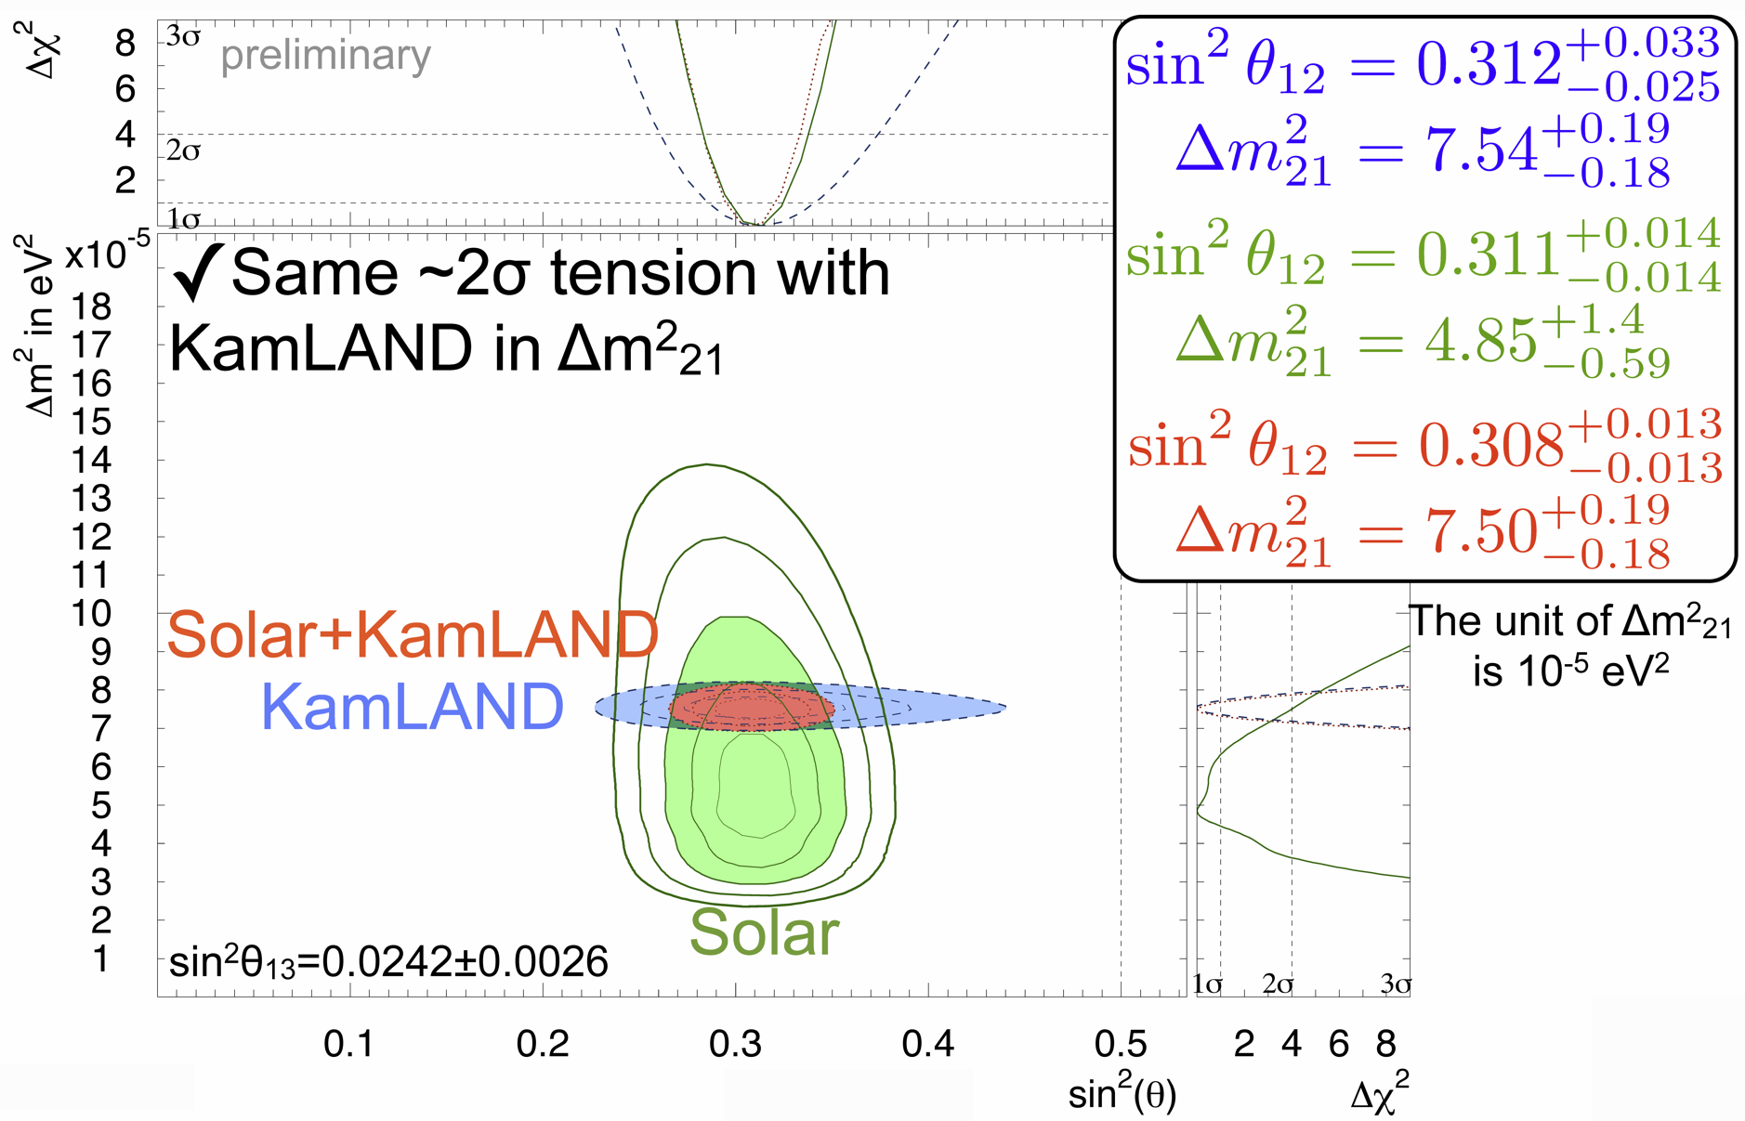
Best-fit “solar” oscillation parameters
Yusuke Koshio at Neutrino 2014

Slide 20
Three-Flavor Neutrino Parameters
Three mixing angles $θ_{12}$, $θ_{13}$, $θ_{23}$ (Euler angles for 3D rotation), $c_{ij}=\cos{θ_{ij}}$,
a CP-violating “Dirac phase” $δ$, and two “Majorana phases” $α_{2}$ and $α_{3}$
v
$$\left(\begin{matrix}ν_{e} \\ ν_{μ} \\ ν_{τ}\end{matrix}\right)=\left(\begin{matrix}1 & 0 & 0 \\ 0 & c_{23} & s_{23} \\ 0 & −s_{23} & c_{23}\end{matrix}\right)\left(\begin{matrix}c_{13} & 0 & {e^{−iδ}s}_{13} \\ 0 & 1 & 0 \\ {{−e}^{iδ}s}_{13} & 0 & c_{13}\end{matrix}\right)\left(\begin{matrix}c_{12} & s_{12} & 0 \\ −s_{12} & c_{12} & 0 \\ 0 & 0 & 1\end{matrix}\right)\left(\begin{matrix}1 & 0 & 0 \\ 0 & e^{i\frac{α_{2}}{2}} & 0 \\ 0 & 0 & e^{i\frac{α_{3}}{2}}\end{matrix}\right)\left(\begin{matrix}ν_{1} \\ ν_{2} \\ ν_{3}\end{matrix}\right)$$
$${39}^{∘}<θ_{23}<{53}^{∘}$$
$${7^{∘}<θ}_{13}<{11}^{∘}$$
$${33}^{∘}<θ_{12}<{37}^{∘}$$
Relevant for
0ν2β decay
Atmospheric/LBL-Beams
Reactor
Solar/KamLAND
Normal
Inverted
Tasks and Open Questions
Precision for all angles
CP-violating phase δ ?
Mass ordering ?
(normal vs inverted)
Absolute masses ?
(hierarchical vs degenerate)
Dirac or Majorana ?
3
μ
τ
2
e
μ
τ
$Δm^{2}$
72–80 meV²
Atmospheric
Solar
1
e
μ
τ
Atmospheric
2180–2640 meV²
2
e
μ
τ
Solar
1
e
μ
τ
3
μ
τ

Slide 21
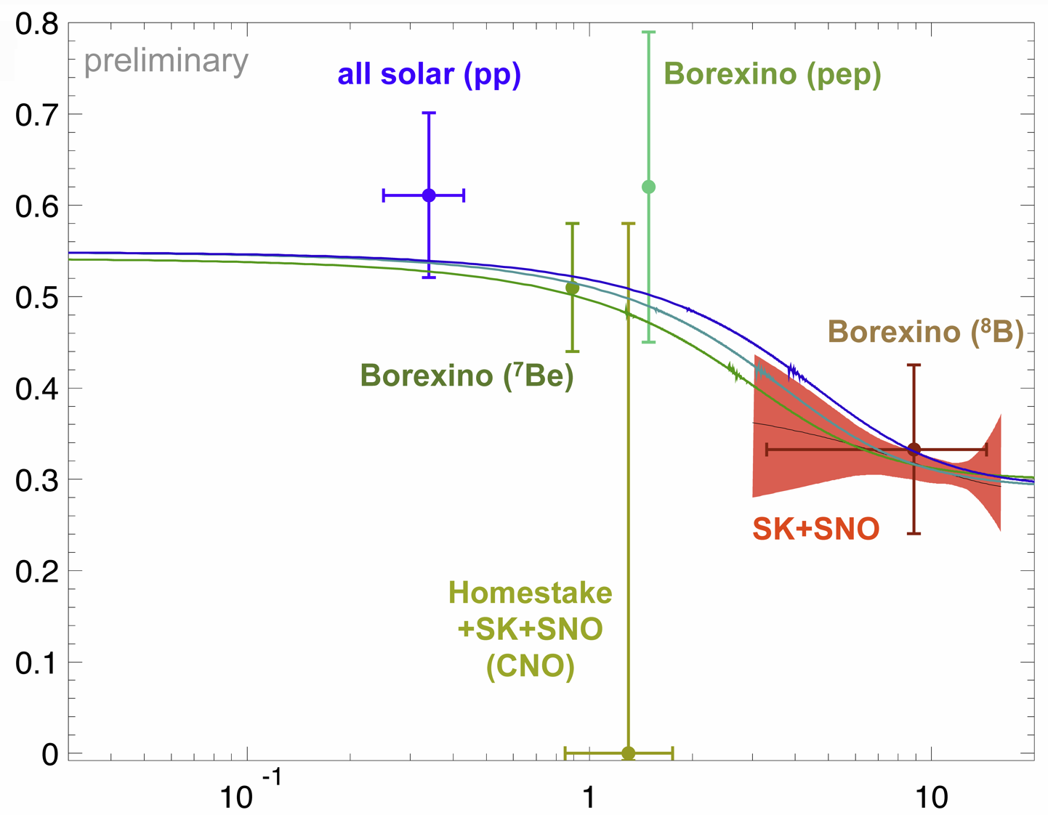
Matter Effect on Flavor Oscillations in the Sun
Low energy (E ≲ 1 MeV)
Phase-averaged vacuum oscillations
High energy (E ≳ 5 MeV)
MSW conversion
$1−\frac{1}{2}\sin^{2}{2Θ}_{12}$
$ν_{e}$ survival
probability
$\sin^{2}Θ_{12}$
Yusuke Koshio Neutrino 2014
Energy [MeV]

Slide 22
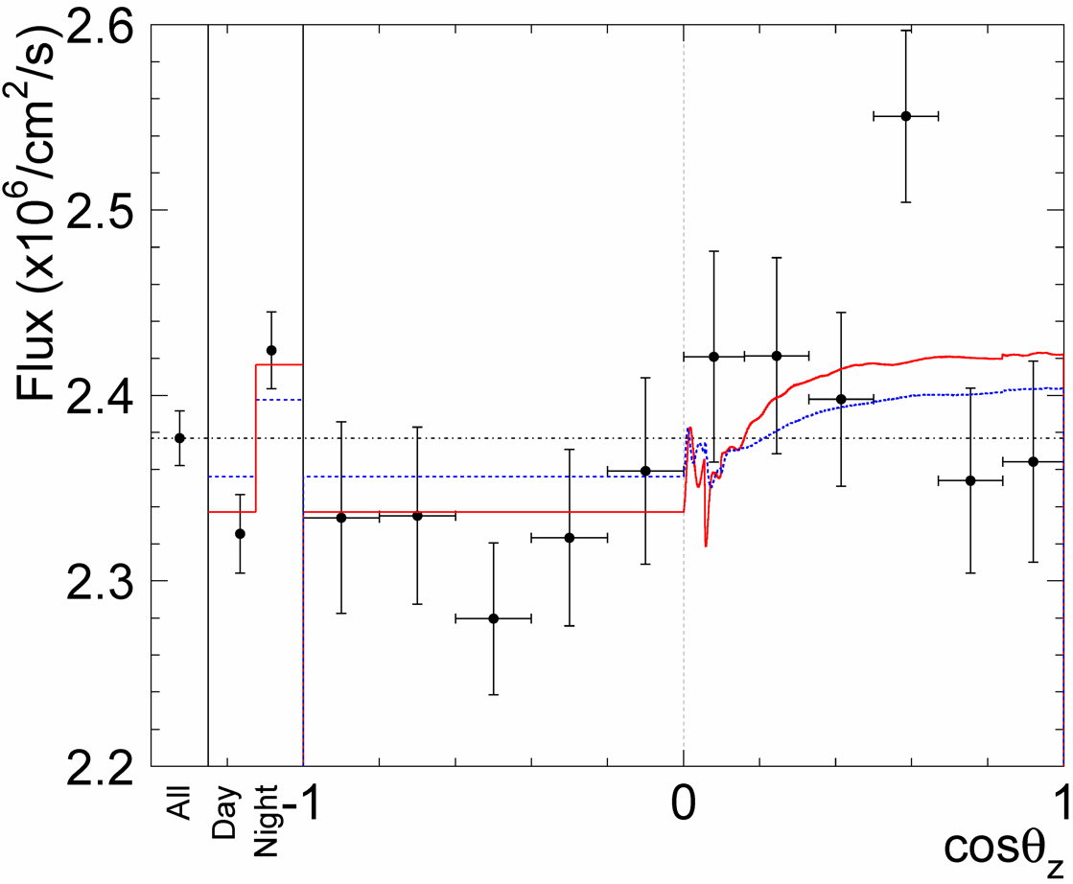
Neutrinos are Brighter at Night
Mixed $ν$ from Sun
Regenerated $ν_{e}$
Regeneration by
Earth matter effect:
More $ν_{e}$ at night!
(2.7σ effect)
Super-Kamiokande
Collaboration
arXiv:1312.5176

Slide 23
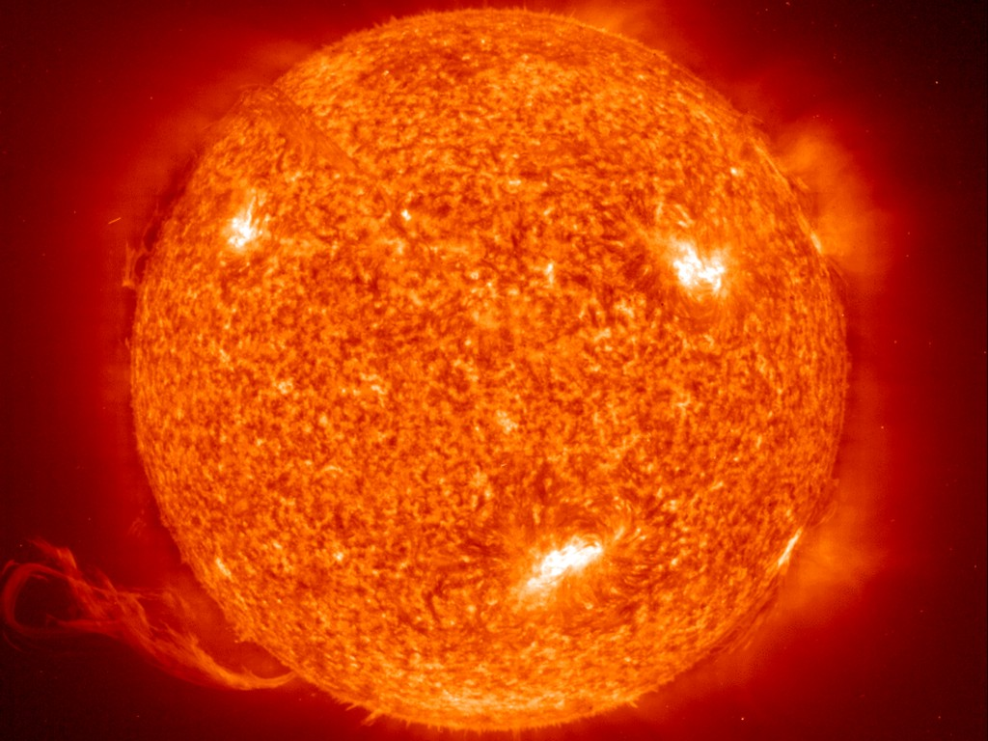
Solar Models
Solar Models

Slide 24
Equations of Stellar Structure
Assume spherical symmetry and static structure (neglect kinetic energy)
Excludes: Rotation, convection, magnetic fields, supernova-dynamics, …
Hydrostatic equilibrium
$$\frac{dP}{dr}=−\frac{G_{N}M_{r}ρ}{r^{2}}$$
Energy conservation
$$\frac{dL_{r}}{dr}=4πr^{2}ερ$$
Energy transfer
$$L_{r}=\frac{4πr^{2}}{3κρ}\frac{d\left(aT^{4}\right)}{dr}$$
Literature
Clayton: Principles of stellar evolution and
nucleosynthesis (Univ. Chicago Press 1968)
Kippenhahn & Weigert: Stellar structure
and evolution (Springer 1990)
$r$
$P$
$GN$
$ρ$
$M_{r}$
$L_{r}$
$ε$
$$κ$$
$$κ_{γ}$$
$$κ_{c}$$
Radius from center
Pressure
Newton’s constant
Mass density
Integrated mass up to r
Luminosity (energy flux)
Local rate of energy
generation $[erg g^{−1}s^{−1}]$
$$ε=ε_{nuc}+ε_{grav}−ε_{ν}$$
Opacity
$$κ^{−1}=κ_{γ}^{−1}+κ_{c}^{−1}$$
Radiative opacity
$$κ_{γ}ρ={〈λ_{γ}〉}_{Rosseland}^{−1}$$
Electron conduction

Slide 25
Constructing a Solar Model: Fixed Inputs
Solve stellar structure equations with good microphysics, starting from a
zero-age main-sequence model (chemically homogeneous) to present age
Fixed quantities
Mass | M⊙ = 1.989 × 10³³ g 0.1% | Kepler’s 3rd law
Age | t⊙ = 4.57 × 10⁹ yrs 0.5% | Meteorites
Quantities to match
Luminosity | L⊙ = 3.842 × 10³³ erg s⁻¹ 0.4% | Solar constant
Radius | R⊙ = 6.9598 × 10¹⁰ cm 0.1% | Angular diameter
Metals/hydrogen ratio | (Z/X)⊙ = 0.0229 | Photosphere and meteorites
Adapted from A. Serenelli’s lectures at Scottish Universities Summer School in Physics 2006

Slide 26
Constructing a Solar Model: Free Parameters
3 free parameters
Convection theory has 1 free parameter:
Mixing length parameter a_{MLT}
determines the temperature stratification where convection
is not adiabatic (upper layers of solar envelope)
2 of 3 quantities determining the initial composition:
X_{ini}, Y_{ini}, Z_{ini} (linked by X_{ini} + Y_{ini} + Z_{ini} = 1).
Individual elements grouped in Z_{ini} have relative abundances
given by solar abundance measurements (e.g. GS98, AGS05)
Construct 1 M⊙ initial model with X_{ini}, Z_{ini}, Y_{ini} = 1 − X_{ini} − Z_{ini} and a_{MLT}
Evolve for the solar age t⊙
Match (Z/X)⊙, L⊙ and R⊙ to better than 10⁻⁵
Adapted from A. Serenelli’s lectures at Scottish Universities Summer School in Physics 2006

Slide 27
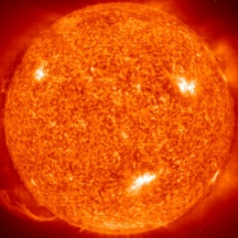
Standard Solar Model Output Information
Eight neutrino fluxes:
Production profiles and integrated values
Chemical profiles X(r), Y(r), Z_{i}(r)
electron and neutron density profiles
Thermodynamic quantities as a function of radius:
T, P, density ρ, sound speed c
Surface helium abundance Y_{surf}
(Z/X and 1 = X + Y + Z leave 1 degree of freedom)
Depth of the convective envelope R_{CZ}
Adapted from A. Serenelli’s lectures at Scottish Universities Summer School in Physics 2006

Slide 28
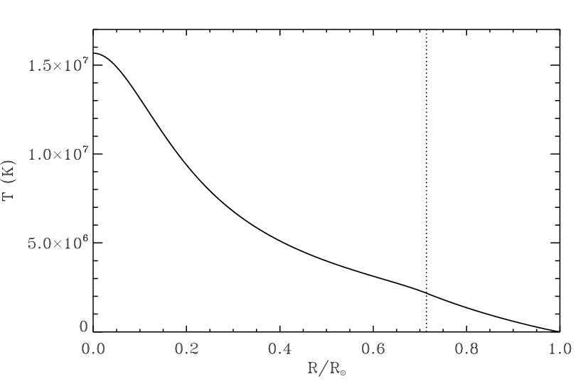
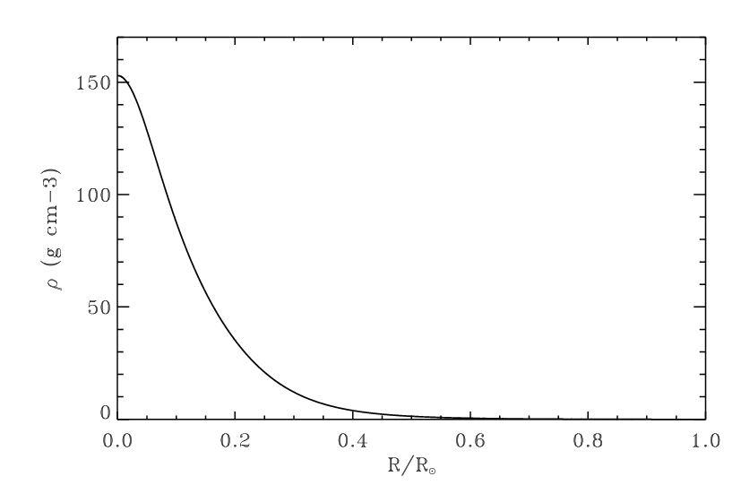
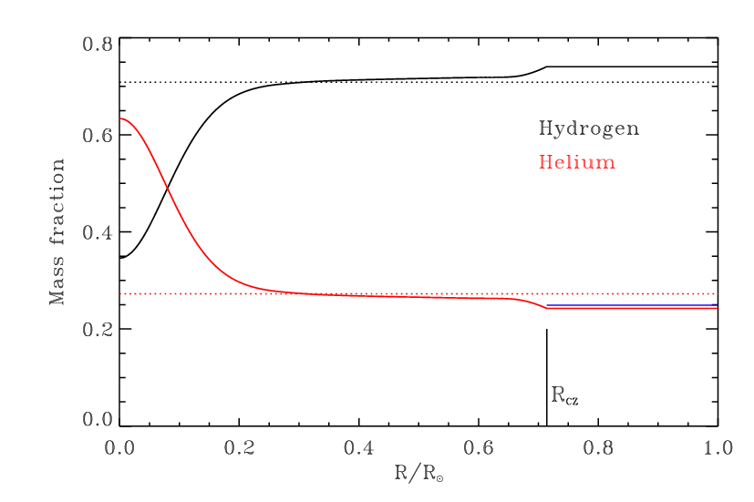
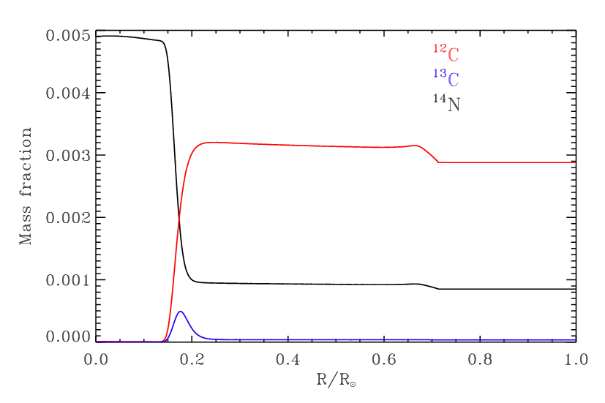
Standard Solar Model: Internal Structure
Temperature
Mass density
Hydrogen
¹⁴N
¹²C
Helium
Convection
Convection
R_{CZ}
¹³C

Slide 29
Solar Models
Helioseismology
and the
New Opacity Problem

Slide 30
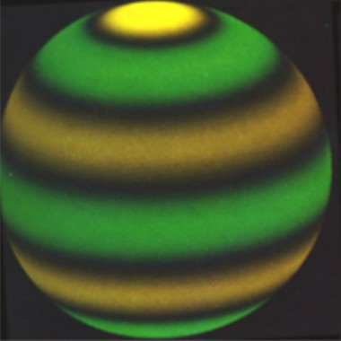
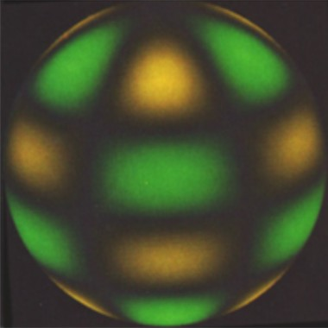
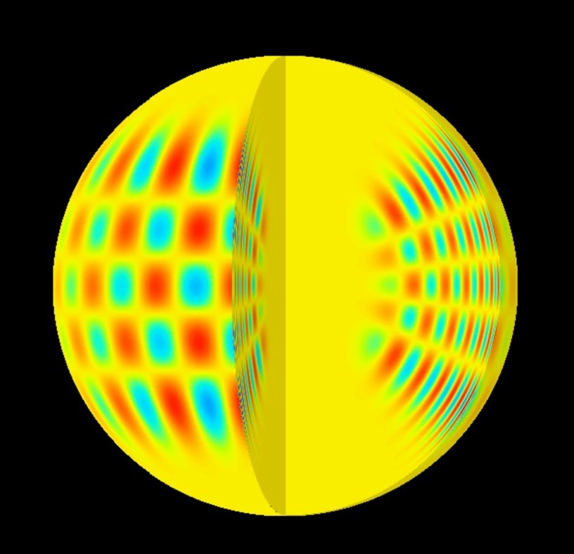
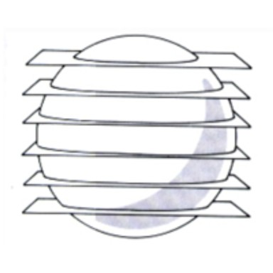
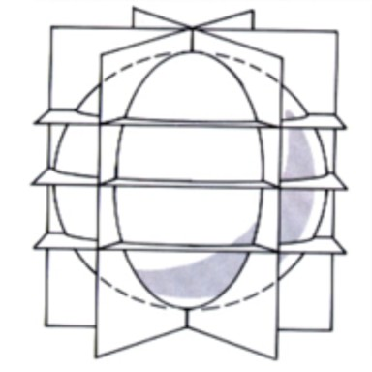
Helioseismology: Sun as a Pulsating Star
Discovery of oscillations: Leighton et al. (1962)
Sun oscillates in > 10⁵ eigenmodes
Frequencies of order mHz (5-min oscillations)
Individual modes characterized by
radial n, angular $ℓ$ and longitudinal m numbers
Adapted from A. Serenelli’s lectures at Scottish Universities Summer School in Physics 2006

Slide 31
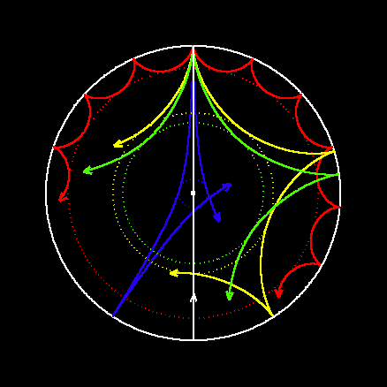
Helioseismology: p-Modes
Solar oscillations are acoustic waves
(p-modes, pressure is the restoring force)
stochastically excited by convective motions
Outer turning-point located close to temperature inversion layer
Inner turning-point varies, strongly depends on $ℓ$ (centrifugal barrier)
Credit: Jørgen Christensen-Dalsgaard

Slide 32
Examples for Solar Oscillations
+
+
=
http://astro.phys.au.dk/helio_outreach/english/

Slide 33
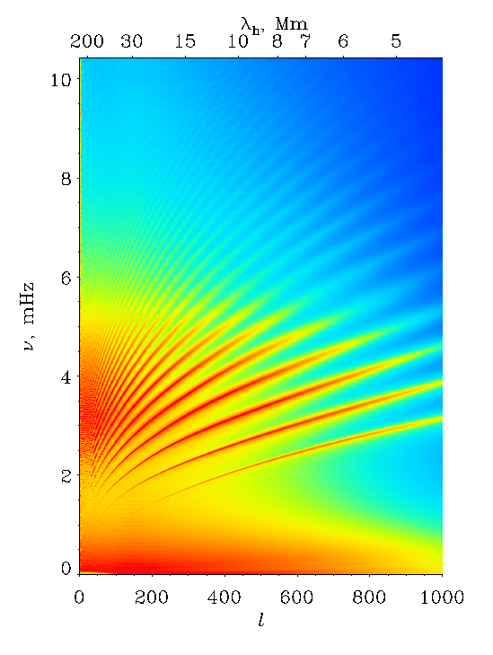
Helioseismology: Observations
Doppler observations of spectral
lines measure velocities of a few cm/s
Differences in the frequencies
of order mHz
Very long observations needed.
BiSON network (low-l modes)
has data for ∼ 5000 days
Relative accuracy in frequencies is 10⁻⁵

Slide 34
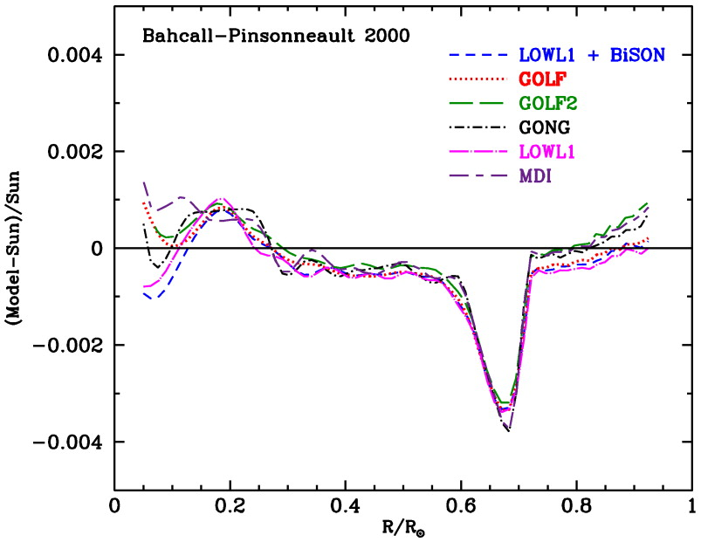
Helioseismology: Comparison with Solar Models
Oscillation frequencies depend on ρ, P, g, c
Inversion problem:
From measured frequencies and from a reference solar model
determine solar structure
Output of inversion procedure: δc²(r), δρ(r), R_{CZ}, Y_{SURF}
Relative sound-speed
difference between
helioseismological model
and standard solar model

Slide 35
New Solar Opacities (Asplund, et al. 2005, 2009)
Large change in solar composition:
Mostly reduction in C, N, O, Ne
Results presented in many papers by the “Asplund group”
Summarized in Asplund, Grevesse, Sauval & Scott (2009)
Authors | (Z/X)⊙ | Main changes (dex)
Grevesse 1984 | 0.0277
Anders & Grevesse 1989 | 0.0267 | ΔC = −0.1, ΔN = +0.06
Grevesse & Noels 1993 | 0.0245
Grevesse & Sauval 1998 | 0.0229 | ΔC = −0.04, ΔN = −0.07, ΔO = −0.1
Asplund, Grevesse & Sauval 2005 | 0.0165 | ΔC = −0.13, ΔN = −0.14, ΔO = −0.17 ΔNe = −0.24, ΔSi = −0.05
Asplund, Grevesse, Sauval & Scott (arXiv:0909.0948, 2009) | 0.0178
Adapted from A. Serenelli’s lectures at Scottish Universities Summer School in Physics 2006

Slide 36
Origin of Changes
Spectral lines
from solar
photosphere
and corona
Improved modeling
3D model atmospheres
MHD equations solved
NLTE effects accounted for in most cases
Improved data
Better selection of spectral lines
Previous sets had blended lines
(e.g. oxygen line blended with nickel line)
Meteorites
Volatile elements
do not aggregate easily into solid bodies
e.g. C, N, O, Ne, Ar only in solar spectrum
Refractory elements
e.g. Mg, Si, S, Fe, Ni
both in solar spectrum and meteorites
meteoritic measurements more robust
Adapted from A. Serenelli’s lectures at Scottish Universities Summer School in Physics 2006

Slide 37
Consequences of New Element Abundances
What is good
Much improved modeling
Different lines of same element give
same abundance (e.g. CO and CH lines)
Sun has now similar composition
to solar neighborhood
New problems
Agreement between helioseismology
and SSM very much degraded
Was previous agreement a coincidence?
Adapted from A. Serenelli’s lectures at Scottish Universities Summer School in Physics 2006

Slide 38
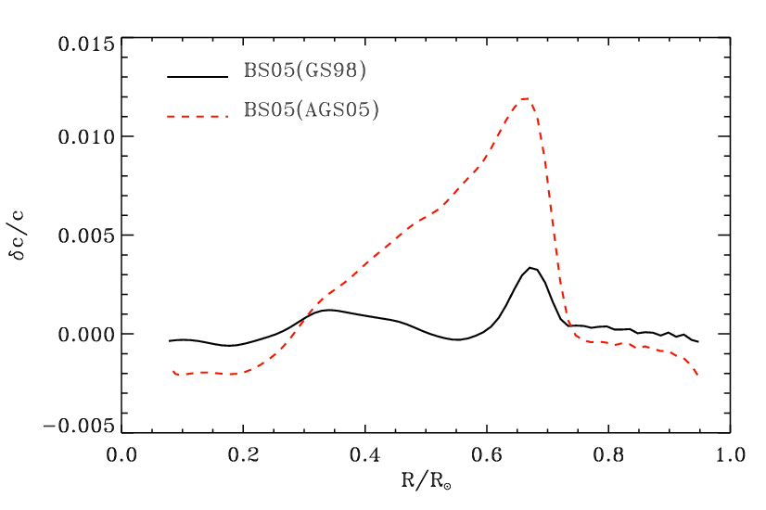
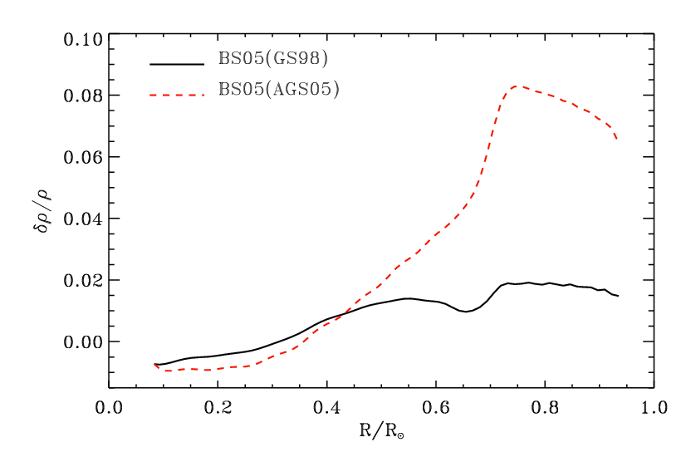
Standard Solar Model 2005: Old and New Opacity
Sound Speed
Density
 | Old: BS05 (GS98) | New: BS05 (ASG05) | Helioseismology
R_{CZ} | 0.713 | 0.728 | 0.713 ± 0.001
Y_{SURF} | 0.243 | 0.229 | 0.2485 ± 0.0035
<δc> | 0.001 | 0.005 | —
<δr> | 0.012 | 0.044 | —
Adapted from A. Serenelli’s lectures at Scottish Universities Summer School in Physics 2006

Slide 39
Old and New Neutrino Fluxes
 | Old: (GS98) |  | New: (AGSS09) |  | Best Measurements
 | Flux cm⁻² s⁻¹ | Error % | Flux cm⁻² s⁻¹ | Error % | Flux cm⁻² s⁻¹ | Error %
pp | 5.98 × 10¹⁰ | ±0.6 | 6.03 × 10¹⁰ | ±0.6 | 6.05 × 10¹⁰ | ±0.6
pep | 1.44 × 10⁸ | ±1.1 | 1.47 × 10⁸ | ±1.2 | 1.46 × 10⁸ | ±1.2
hep | 8.04 × 10³ | ±30 | 8.31 × 10³ | ±30 | 18 × 10³ | ±45
⁷Be | 5.00 × 10⁹ | ±7 | 4.56 × 10⁹ | ±7 | 4.82 × 10⁹ | ±4.5
⁸B | 5.58 × 10⁶ | ±14 | 4.59 × 10⁶ | ±14 | 5.0 × 10⁶ | ±3
¹³N | 2.96 × 10⁸ | ±14 | 2.17 × 10⁸ | ±14 | < 6.7 × 10⁸
¹⁵O | 2.23 × 10⁸ | ±15 | 1.56 × 10⁸ | ±15 | < 3.2 × 10⁸
¹⁷F | 5.52 × 10⁶ | ±17 | 3.40 × 10⁶ | ±16 | < 59 × 10⁶
• Directly measured 7-Be (Borexino) and 8-B (SNO) fluxes are halfway between models
• CN fluxes depend linearly on abundances, measurements needed

Slide 40
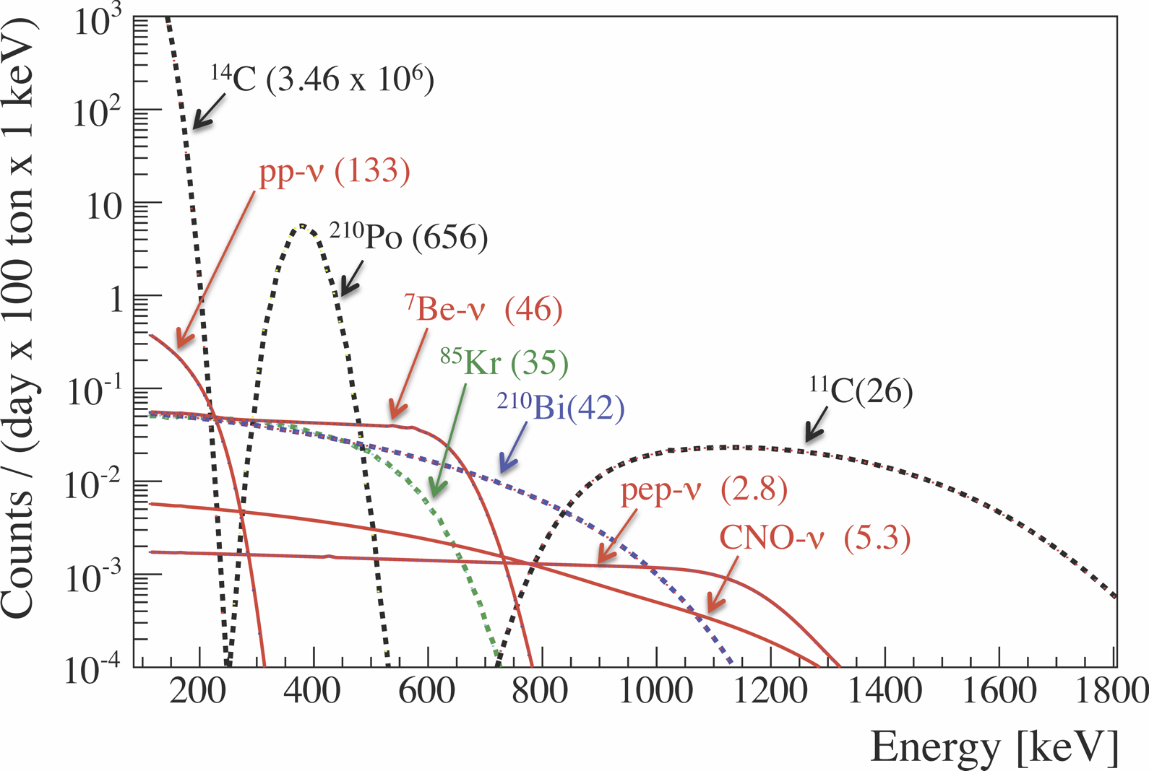
Prospect for CNO Flux Measurements
CNO neutrino measurements require excellent background reduction/subtraction
Not achievable in Borexino in near future. Perhaps in SNO+ ?
Borexino Collaboration, arXiv:1308.0443

Slide 41
Solar Models
Particle Bounds

Slide 42
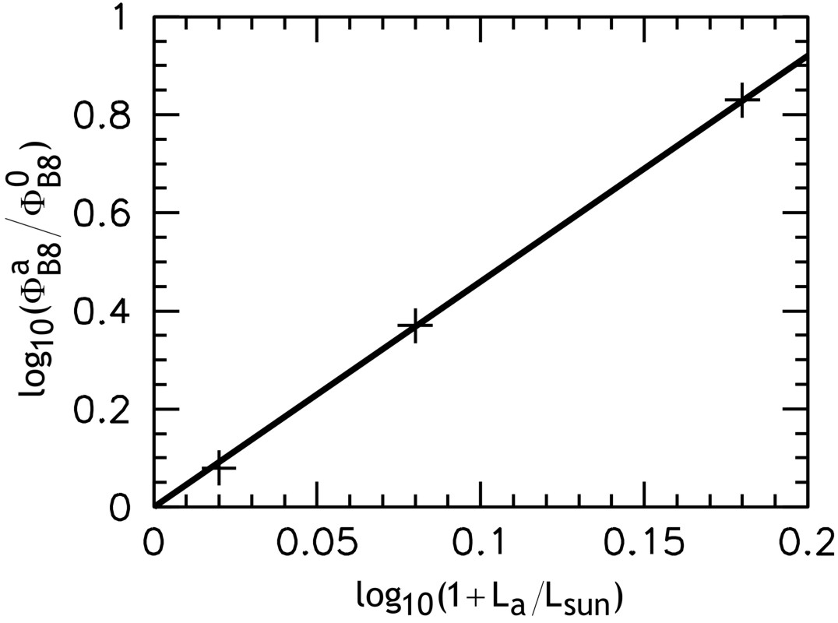
Solar Neutrino Limit on Solar Energy Losses
Self-consistent models of the present-day Sun provide a simple power-law connection
between a new energy loss L_{a} (e.g. axions) and the all-flavor solar neutrino flux from
the B8 reaction as measured by SNO
$$Φ_{B8}^{a}=Φ_{B8}^{0}{\left(\frac{L_{⊙}+L_{a}}{L_{⊙}}\right)}^{4.6}$$
Solar model prediction and SNO
measurements imply roughly
$$L_{a}≲0.10 L_{⊙}$$
Gondolo & Raffelt, arXiv:0807.2926
Schlattl, Weiss & Raffelt, hep-ph/9807476

Slide 43
Hidden Photons (HPs)
New U(1) gauge boson (HP) with small mass $m$ and kinetic mixing parameter $χ$
$$ℒ=−\frac{1}{4}A_{μν}A^{μν}−\frac{1}{4}B_{μν}B^{μν}+\frac{m^{2}}{2}B_{μ}B^{μ}−\frac{χ}{2}A_{μν}B^{μν}$$
Normal photons oscillate into HPs, lose coherence by collisions, HPs escape from Sun
Dispersion relation of longitudinal plasmons to lowest order independet of $k$
$ω_{L}=ω_{Pl}={\left(\frac{4παn_{e}}{m_{e}}\right)}^{1/2}$ (Plasma frequency)
At any position in the Sun, L-plasmons with
$$k_{L}=\sqrt{ω_{L}^{2}−m^{2}}$$
match HP dispersion relation: Resonant conversion!
$$Γ_{HP}^{prod}\left(ω\right)=\frac{χ^{2}m^{2}}{e^{ω/T}−1} \frac{ω^{2}Γ_{L}}{{\left(ω^{2}−ω_{Pl}^{2}\right)}^{2}+{\left(ωΓ_{L}\right)}^{2}}∼\frac{χ^{2}m^{2}}{e^{ω/T}−1} \frac{π}{2}δ(ω−ω_{Pl})$$
(Redondo, arXiv:0801.1527. An, Pospelov & Pradler, arXiv:1302.3884.
Redondo & Raffelt, arXiv:1305.2920)

Slide 44
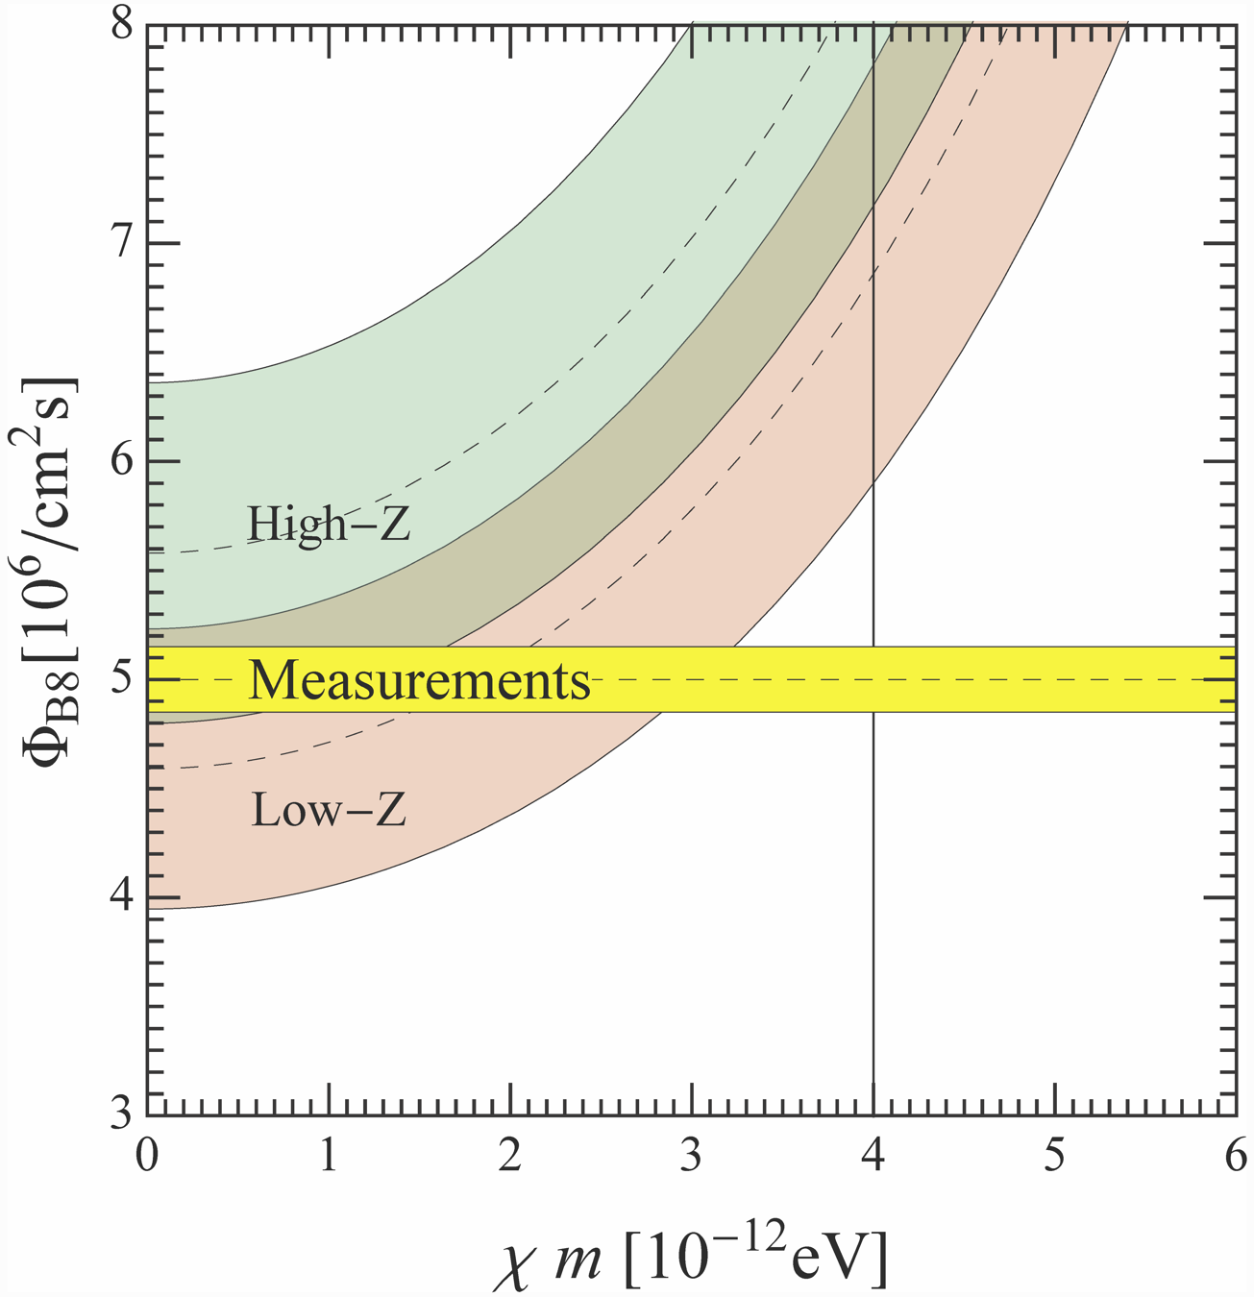
Solar Hidden Photon Constraints
Energy loss in hidden photons (HPs)
in solar plasma
$$Q_{HP}=χ^{2}m^{2}\frac{α T{ n}_{e}}{m_{e}}$$
Solar energy loss
$$L_{HP}=χ^{2}{\left(\frac{m}{eV}\right)}^{2}5.7×{10}^{21}L_{⊙}$$
Nominal limit
$$χ m<4×{10}^{−12} eV$$
(old)
(new)
Nominal
limit
Redondo & Raffelt, arXiv:1305.2920

Slide 45
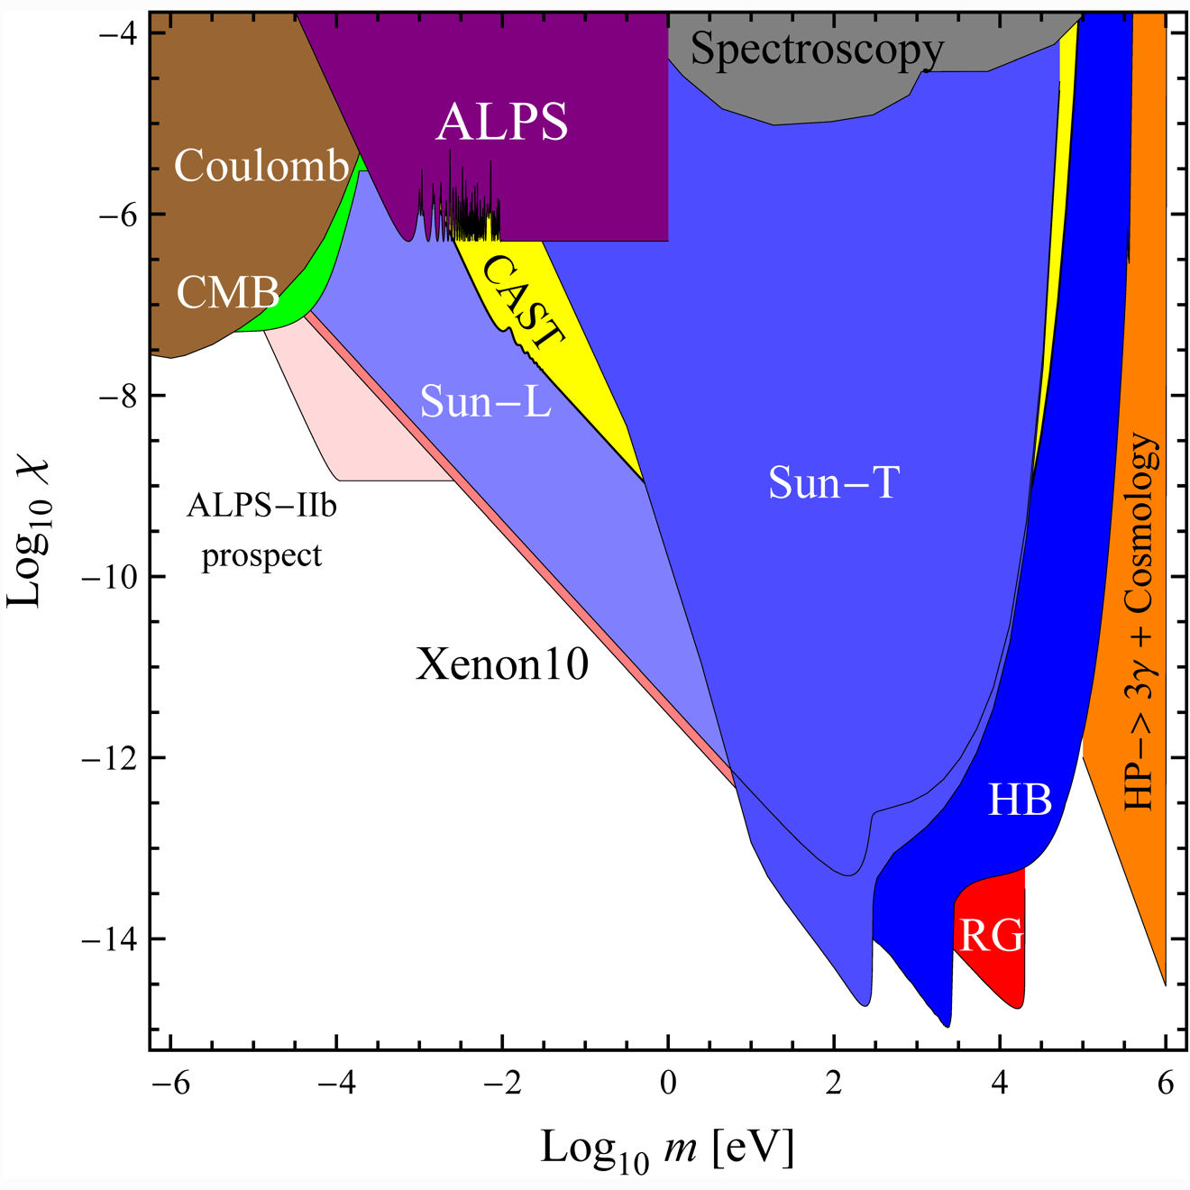
Summary of Hidden Photon Limits
Redondo & Raffelt, arXiv:1305.2920

Slide 46
Solar Models
Search for
Solar Axions

Slide 47
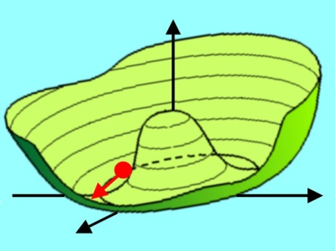
Axion Physics in a Nut Shell
Particle-Physics Motivation
Solar and Stellar Axions
CP conservation in QCD by
Peccei-Quinn mechanism
Axions thermally produced in stars,
e.g. by Primakoff production
γ
γ
a
→ Axions a ~ π⁰
a
m_{π}f_{π} ≈ m_{a}f_{a}
Limits from avoiding excessive
energy drain
Solar axion searches (CAST, Sumico)
γ
For f_{a} ≫ f_{π} axions are “invisible”
and very light
Cosmology
Search for Axion Dark Matter
In spite of small mass, axions are born
non-relativistically
(non-thermal relics)
Microwave resonator
(1 GHz = 4 μeV)
N
a
γ
Primakoff
conversion
Cold dark matter
candidate
m_{a} ~ 10 μeV or even smaller
B_{ext}
S
ADMX-LF (UW Seattle)
ADMX-HF (Yale)

Slide 48
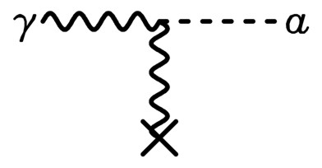
Experimental Tests of Invisible Axions
Primakoff effect:
Axion-photon transition in external
static E or B field
(Originally discussed for $π^{0}$
by Henri Primakoff 1951)
Pierre Sikivie:
Macroscopic B-field can provide a
large coherent transition rate over
a big volume (low-mass axions)
Axion helioscope:
Look at the Sun through a dipole magnet
Axion haloscope:
Look for dark-matter axions with
A microwave resonant cavity

Slide 49
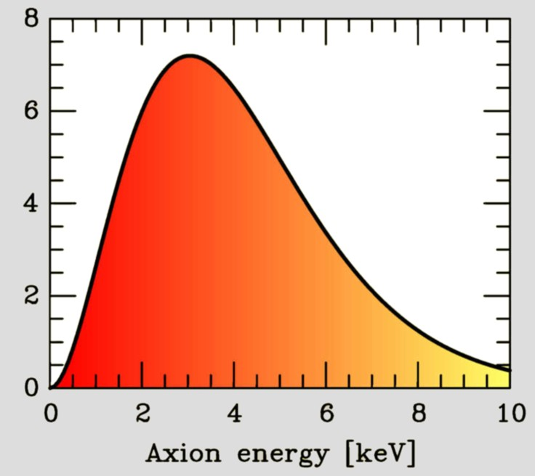
Search for Solar Axions
Axion Helioscope
(Sikivie 1983)
Primakoff
production
Axion flux
N
γ
a
a
γ
Magnet S
Axion-Photon-Oscillation
Sun
Tokyo Axion Helioscope (“Sumico”)
(Results since 1998, up again 2008)
CERN Axion Solar Telescope (CAST)
(Data since 2003)
Alternative technique:
Bragg conversion in crystal
Experimental limits on solar axion flux
from dark-matter experiments
(SOLAX, COSME, DAMA, CDMS ...)

Slide 50
Axion-Photon-Transitions as Particle Oscillations
Raffelt & Stodolsky, PRD 37 (1988) 1237
Photon refractive and birefringence effects
(Faraday rotation, Cotton-Mouton-effect)
$$\left[ω^{2}+∇^{2}+2ω^{2}\left(\begin{matrix}n_{⊥}−1 & n_{F} & 0 \\ n_{F} & n_{∥} & \frac{g_{aγ}B}{2ω} \\ 0 & \frac{g_{aγ}B}{2ω} & −\frac{m_{a}^{2}}{2ω^{2}}\end{matrix}\right)\right]\left(\begin{matrix}A_{⊥} \\ A_{∥} \\ a\end{matrix}\right)=0$$
Stationary Klein-Gordon
equation
for coupled
a-γ-system
Axion-photon transitions
Axions roughly like another photon polarization state
In a homogeneous or slowly varying B-field, a photon beam
develops a coherent axion component

Slide 51
CERN Axion Solar Telescope (CAST)

Slide 52
Extending to higher mass values with gas filling
Axion-photon transition probability
$${ P}_{a→γ}={\left(\frac{g_{aγ}B}{q}\right)}^{2}\sin^{2}\left(\frac{qL}{2}\right)$$
Axion-photon momentum transfer
$$q=\left|\frac{m_{a}^{2}−m_{γ}^{2}}{2E}\right|$$
Transition is suppressed for $qL≳1$
Gas filling: Give photons a refractive mass
to restore full transition strength
$${ m}_{γ}^{2}=\frac{4πα}{m_{e}} n_{e}$$
$$m_{γ}=28.9 eV {\left(\frac{Z}{A} ρ_{gas}\right)}^{1/2}$$
He-4 vapour pressure at 1.8 K is
$$ρ≈0.2×{10}^{−3} g cm^{−3}$$
$${ m}_{γ}=0.26 eV$$

Slide 53
Helioscope Limits
First experimental
crossing of the KSVZ line
CAST-I results: PRL 94:121301 (2005) and JCAP 0704 (2007) 010
CAST-II results (He-4 filling): JCAP 0902 (2009) 008
CAST-II results (He-3 filling): PRL 107: 261302 (2011) and in preparation (2013)

Slide 54
Next Generation Axion Helioscope (IAXO) at CERN
Need new magnet w/
– Much bigger aperture:
$\sim 1 \text{m}2$ per bore
– Lighter (no iron yoke)
– Bores at T_{room}
• Irastorza et al.: Towards a new generation axion helioscope, arXiv:1103.5334
• Armengaud et al.:
Conceptual Design of the International Axion Observatory (IAXO), arXiv:1401.3233

Slide 55
Geo Neutrinos
Geo Neutrinos

Slide 56
Geo Neutrinos: What is it all about?
We know surprisingly little about
the Earth’s interior
Deepest drill hole $\sim$ 12 km
Samples of crust for chemical
analysis available (e.g. vulcanoes)
Reconstructed density profile
from seismic measurements
Heat flux from measured
temperature gradient 30−44 TW
(Expectation from canonical BSE
model $\sim$ 19 TW from crust and
mantle, nothing from core)
Neutrinos escape unscathed
Carry information about chemical composition, radioactive energy
production or even a hypothetical reactor in the Earth’s core

Slide 57
Geo Neutrino Spectrum
Kinematical Threshold for
detection reaction
$${\overline{ν}}_{e}+p→n+e^{+}$$
⁴⁰K
²³²Th
²³⁸U
Bellini, Ianni, Ludhova, Mantovani & McDonough, arXiv:1310.3732

Slide 58
Extreme Geo Neutrino Fluxes
Schematic radioactive element distribution for fixed heat flux
Minimal neutrino flux
at detector
Maximal neutrino flux
at detector
Bellini, Ianni, Ludhova, Mantovani & McDonough, arXiv:1310.3732

Slide 59
Geo Neutrinos
Expected Geoneutrino Flux
KamLAND Scintillator-Detector (1000 t)
Reactor Background

Slide 60
KamLAND Geo-Neutrino Flux
${116}_{−27}^{+28}$ Geoneutrino events
(U/Th = 3.9 fixed)
Separately free fitting:
U 116 events
Th 8 events
Beginning of
neutrino geophysics!
KamLAND Collaboration, arXiv:1303.4667 (2013)

Slide 61
Reactor On-Off KamLAND Data
2011 Earthquake
Reactors shut down
Scintillator
Purification
KamLAND-Zen
Construction
KamLAND Collaboration, arXiv:1303.4667 (2013)

Slide 62
Applied Anti-Neutrino Physics (AAP)
Applied Anti-Neutrino Physics (AAP)
Annual Conference Series since 2004
• Neutrino geophysics
• Reactor monitoring
(“Neutrinos for Peace”)
Relatively small detectors can
measure nuclear activity
without intrusion
Of interest for monitoring by
International Atomic Energy Agency
(Monitors fissile material in civil
nuclear cycles)

