Slide 1
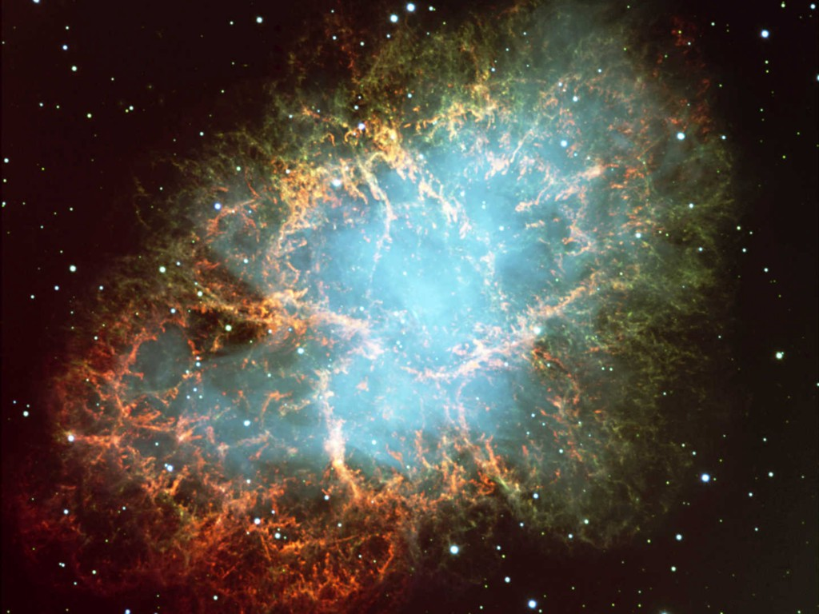
Crab Nebula
Neutrinos
in Astrophysics and Cosmology
Cosmological Neutrinos 3
Georg G. Raffelt
Max-Planck-Institut für Physik, München, Germany

Slide 2
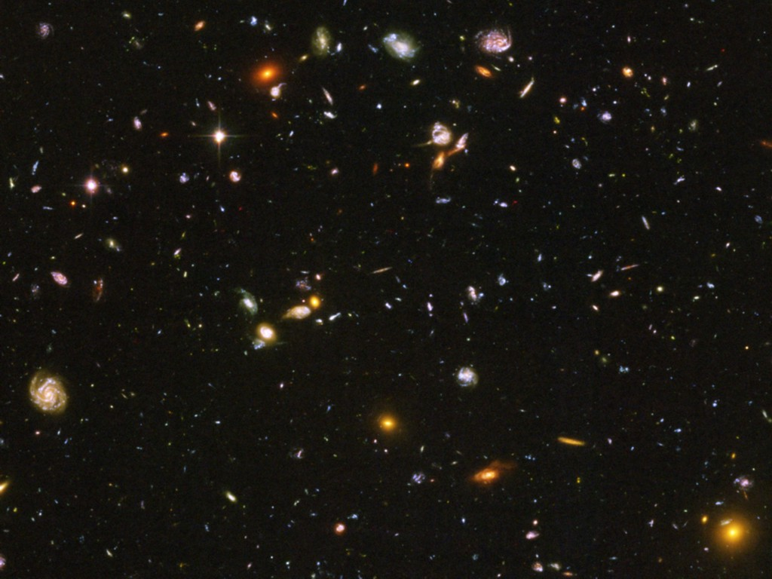
Neutrinos in Cosmology
• How Many Neutrinos?
(Dark radiation/sterile neutrinos?)
• Absolute mass determination and limits
• Big Bang Nucleosynthesis – BBN
(Origin of light elements)
• Leptogenesis
(Origin of Matter Abundance)

Slide 3
Neutrino Thermal Equilibrium
Neutrino reaction rate
Cosmic expansion rate
Examples for neutrino processes
Friedmann equation (flat universe)
$$e^{+}+e^{−}↔\overline{ν}+ν$$
$$\overline{ν}+ν↔\overline{ν}+ν$$
$$ν+e^{±}↔ν+e^{±}$$
$$H^{2}=\frac{8π}{3}\frac{ρ}{m_{Pl}^{2}}$$
$$\left(G_{N}=\frac{1}{m_{Pl}^{2}}\right)$$
G_{F}
Radiation dominates
$$ρ∼T^{4}$$
Dimensional analysis of reaction rate
in a thermal medium for T ≪ m_{W,Z}
Expansion rate
$$H∼\frac{T^{2}}{m_{Pl}}$$
$$Γ∼G_{F}^{2}T^{5}$$
Condition for thermal equilibrium: $Γ>H$
$$T>{\left(m_{Pl}G_{F}^{2}\right)}^{−1/3}∼{\left[{10}^{19}GeV {\left({10}^{−5}GeV^{−2}\right)}^{2}\right]}^{−1/3}=1 MeV$$
Neutrinos are in thermal equilibrium for T ≳ 1 MeV
corresponding to t ≲ 1 sec

Slide 4
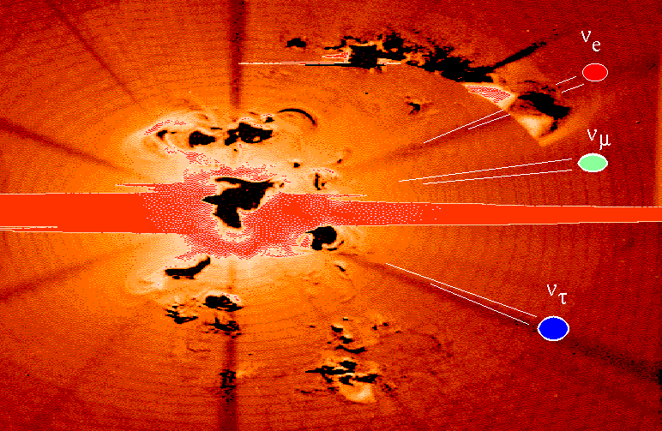
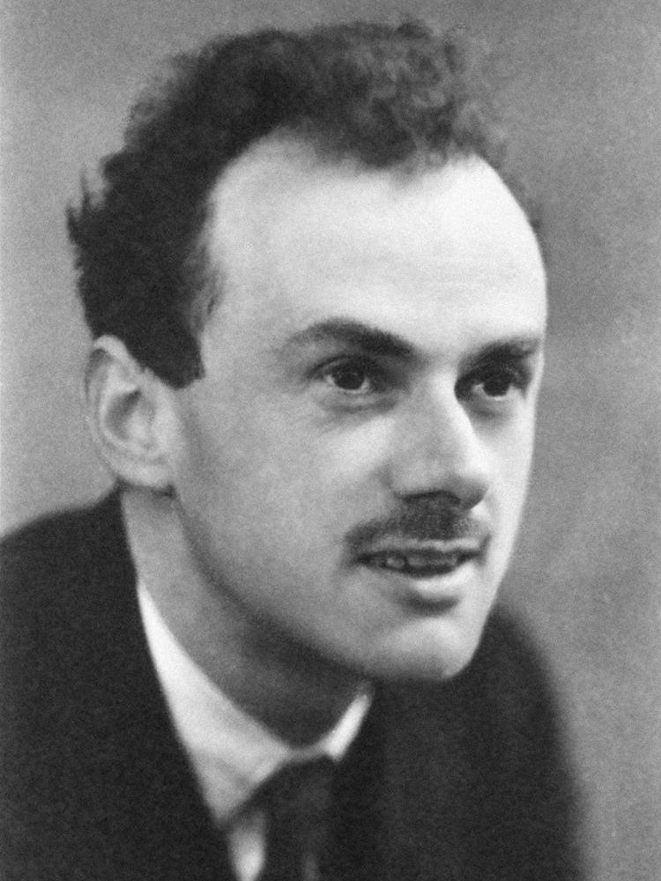
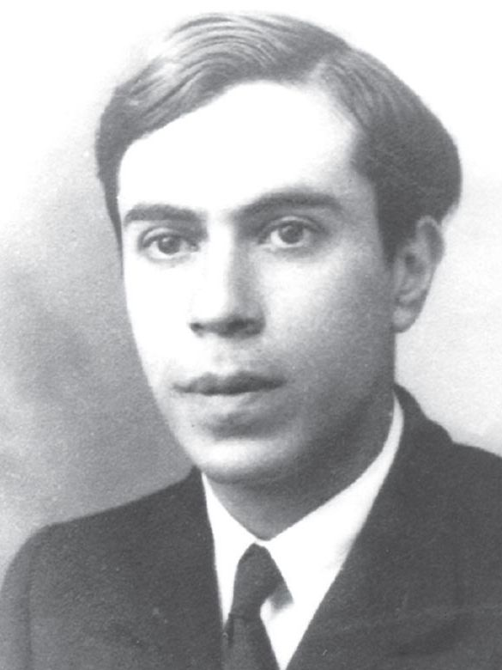
Dirac vs Majorana Neutrinos
Paul Dirac
Ettore Majorana
4 states per flavor
Twice the radiation
density?
2 states per flavor
Standard assumption
in cosmology
Not thermalized

Slide 5
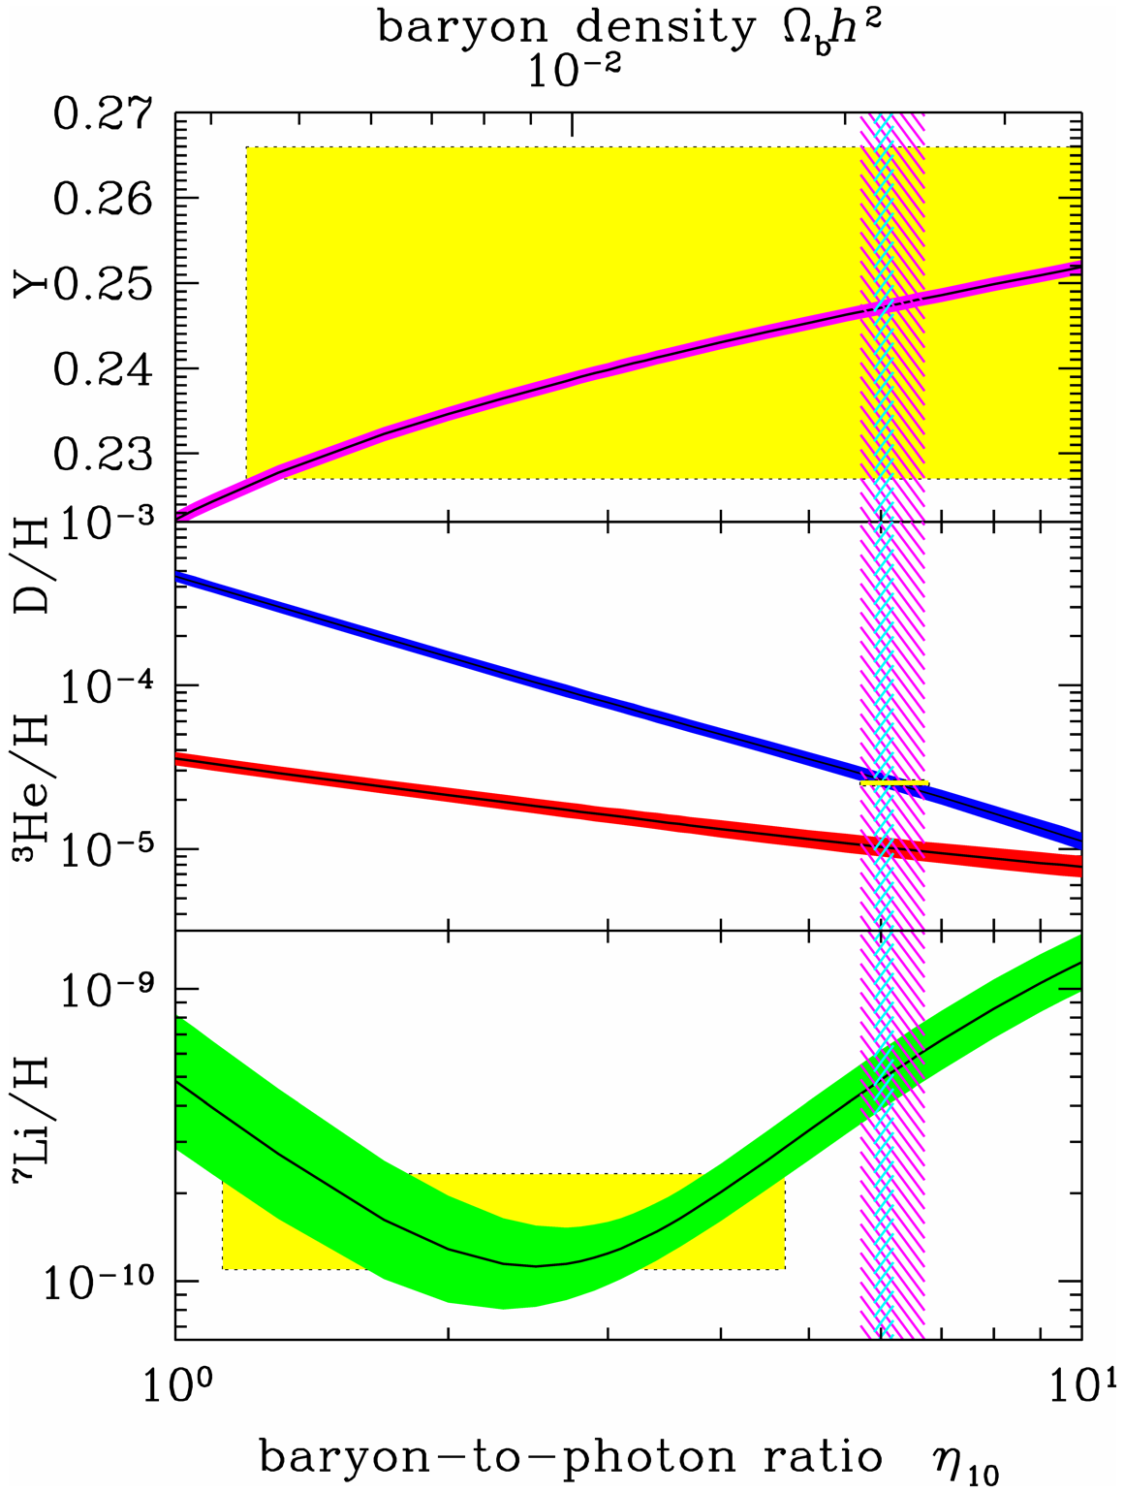
BBN Theory vs Observations
Review of Particle Properties (2014)
Precision cosmology
1
2
3
4
5
6
7
10
Baryon/Photon $η×{10}^{10}$

Slide 6
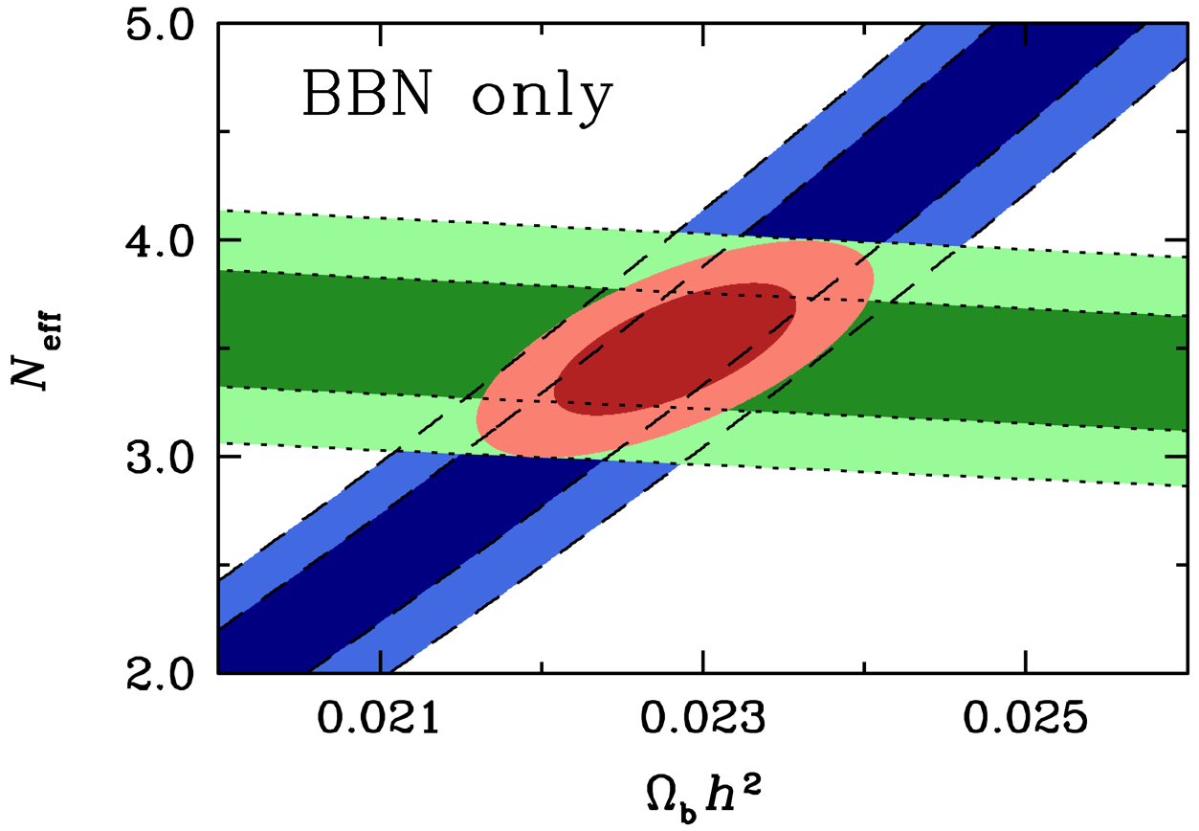
Baryon and Radiation Density from BBN
D
Cooke et al., arXiv:1308.3240
⁴He
D abundance from Cook et al. (2013) and He-4 from Izotov et al. (2013)
BBN hint for extra radiation (evidence driven by He abundance)

Slide 7
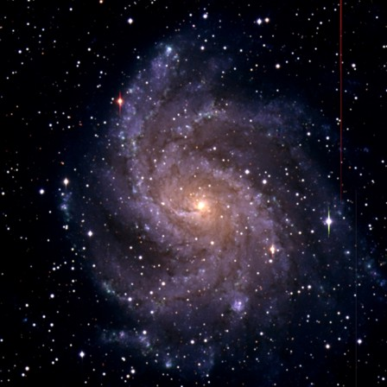
What is wrong with neutrino dark matter?
Galactic Phase Space (“Tremaine-Gunn-Limit”)
Maximum mass density of a degenerate
Fermi gas
Spiral galaxies
m_{ν} > 20–40 eV
Dwarf galaxies
m_{ν} > 100–200 eV
$$ρ_{max}=m_{ν}\underset{n_{max}}{\underbrace{\frac{p_{max}^{3}}{3π^{2}}}}=\frac{m_{ν}{\left(m_{ν}v_{escape}\right)}^{3}}{3π^{2}}$$
Neutrino Free Streaming (Collisionless Phase Mixing)
At T < 1 MeV neutrino scattering in early universe is ineffective
Stream freely until non-relativistic
Wash out density contrasts on small scales
Neutrinos
Neutrinos
Neutrinos are “Hot Dark Matter”
Ruled out by structure formation
Over-density

Slide 8
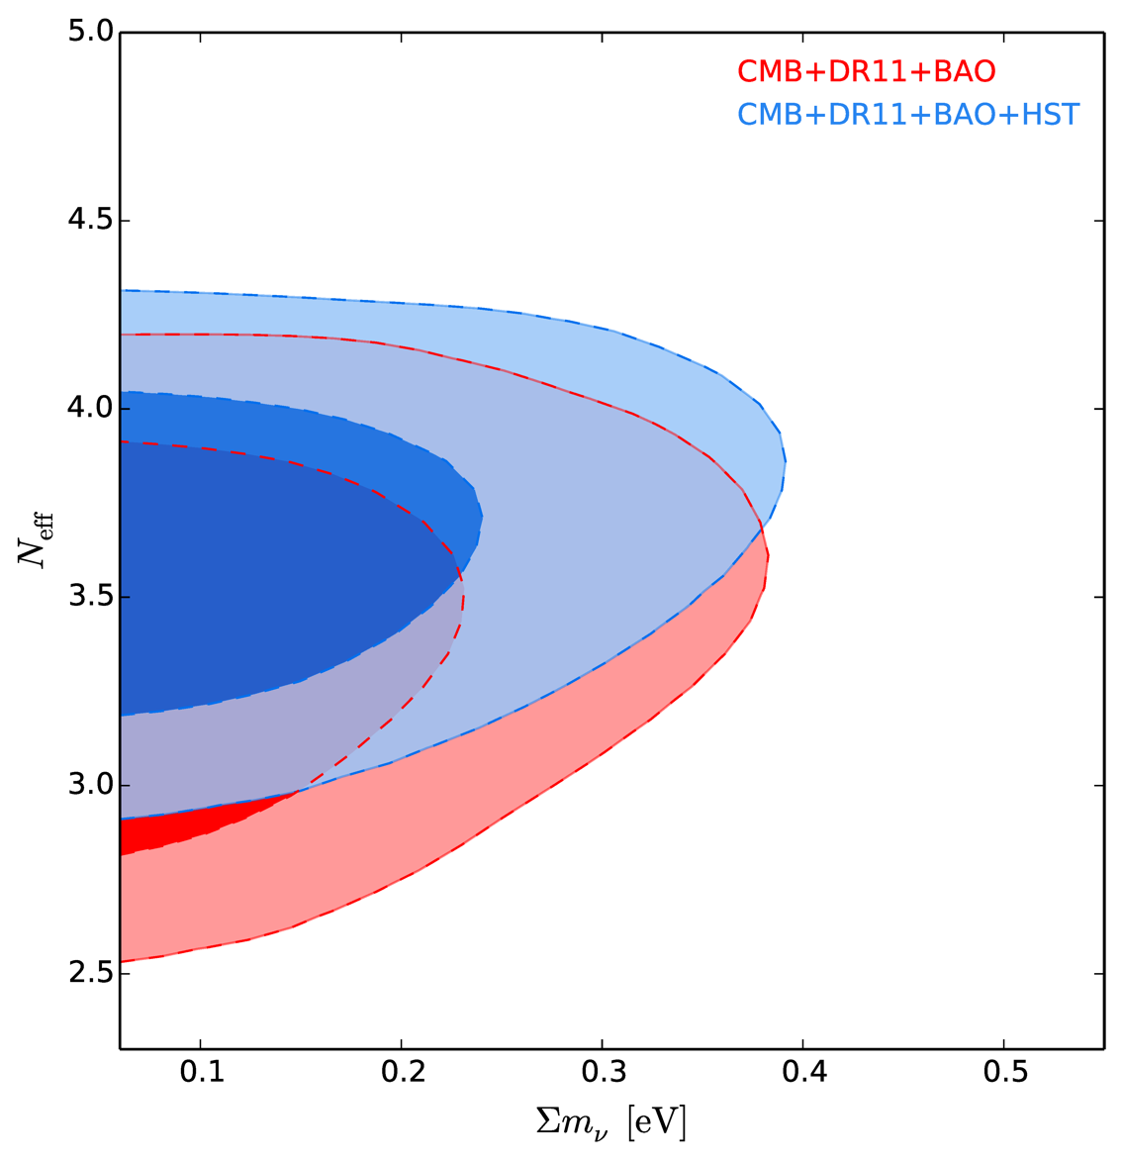
Neutrino Mass and N_{eff} Limits
with HST prior
Giusarma, Di Valentino, Lattanzi, Melchiorri & Mena, arXiv:1403.4852

Slide 9
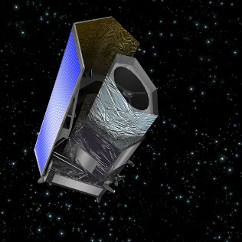
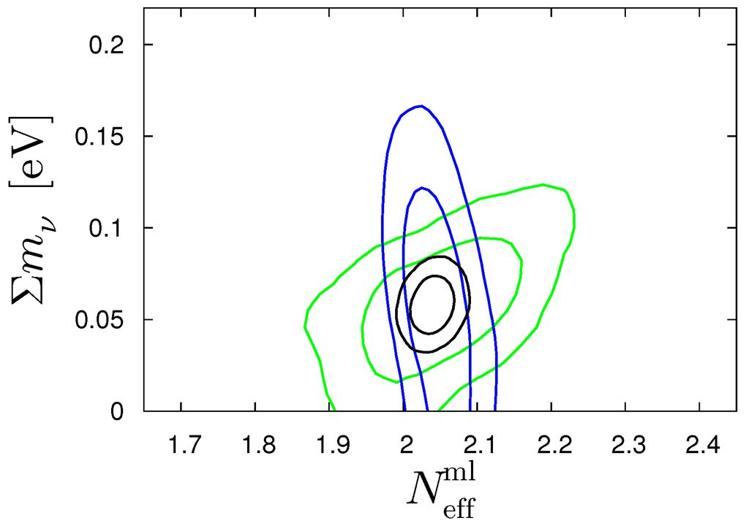
Future Cosmological Neutrino Mass Sensitivity
Pin down the neutrino mass in the sky!
ESA’s Euclid satellite to be
launched in 2020
Precision measurement of the
universe out to redshift of 2
Basse, Bjælde, Hamann, Hannestad & Wong, arXiv:1304.2321:
Dark energy and neutrino constraints from a future EUCLID-like survey

Slide 10
Sterile Neutrinos
Sterile Neutrinos

Slide 11
Sterile Neutrino Oscillations
Sterile (right-handed) neutrinos $ν_{s}$ may exist that are not the Dirac partner to an
ordinary (active) neutrino $ν_{a}=ν_{e}$, $ν_{μ}$, or $ν_{τ}$ (White Paper arXiv:1204.5379)
Unknown mass $ms$
Unknown mixing angles with ordinary neutrinos $Θ_{es}$, $Θ_{μs}$, and $Θ_{τs}$
Some experimental “anomalies” explained by $ν_{s}$
Experimental constraints imply that mixing angle must be small
Production in the early universe?
Naïve average population $\left\langle p_{ν_{a}→ν_{s}}\right\rangle =\frac{1}{2}\sin^{2}\left(2θ_{as}\right)≪1$(ignoring matter effects)
Probability $ν_{a}→ν_{s}$
$$sin2(2θ_{as})$$
t

Slide 12
Flavor Relaxation in a Medium
Active neutrinos suffer collisions in a medium (rate $Γ$), but not $ν_{s}$
Mixed state “collapses” to $ν_{a}$ or $ν_{s}$
Flavor content is “measured” by the medium
at intervals $τ∼Γ^{−1}$
Oscillations begin from scratch
Average oscillation probability $1/2\sin^{2}(2Θ)$
}
Flavor conversion rate
$$\frac{1}{2}\sin^{2}\left(2Θ\right) Γ$$
prob(ν_{a})
Single
energy
With energy
distribution
With collisions

Slide 13
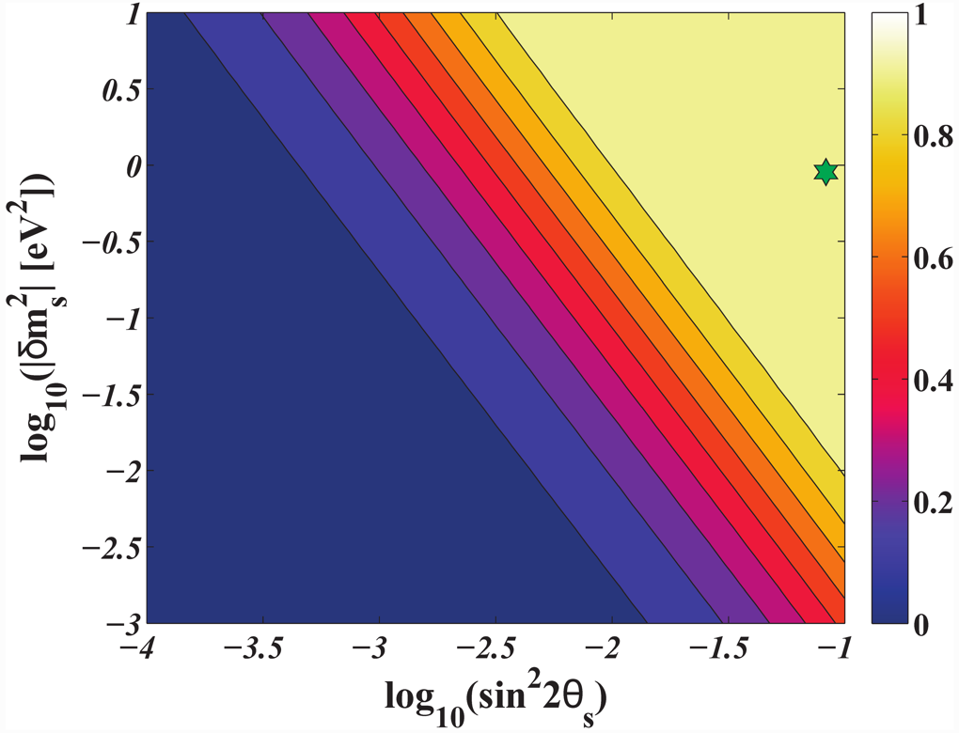
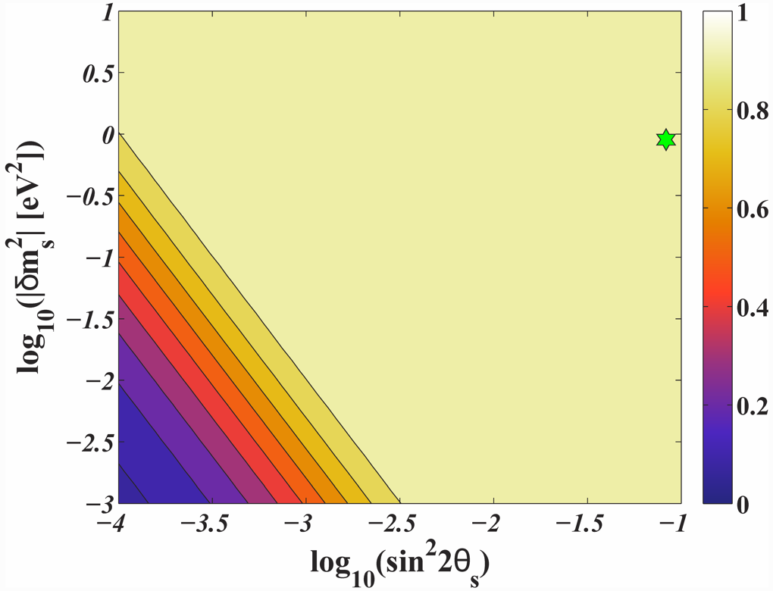
Parameters for Thermalisation
Matter effect implies that thermalisation depends on mass ordering
$$ν_{s}$$
$$ν_{a}$$
$$m_{s}>m_{a}$$
$$m_{s}<m_{a}$$
$$ν_{a}$$
$$ν_{s}$$
Fully
thermalized
Fully
thermalized
Hannestad, Tamborra and Tram, arXiv:1204.5861

Slide 14
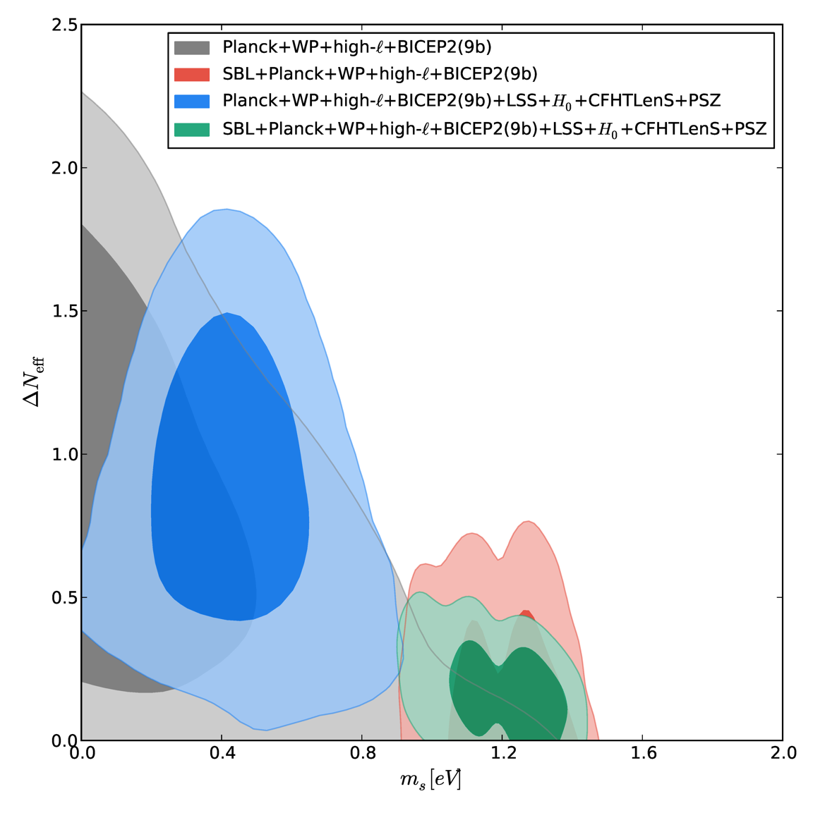
Constraints on Light Sterile Neutrinos
Sterile neutrinos with
parameters favored by
short-baseline (SBL)
experiments are in conflict
with cosmology unless their
thermalisation is not complete
(e.g. suppressed by matter
effect from new interactions
or by neutrino asymmetries
or by other effects)
$$ΔN_{eff}^{s}$$
Fully thermalised
Includes
SBL data
$m_{s}$ [eV]
Archidiacono, Fornengo, Gariazzo, Giunti, Hannestad, Laveder, arXiv:1404.1794

Slide 15
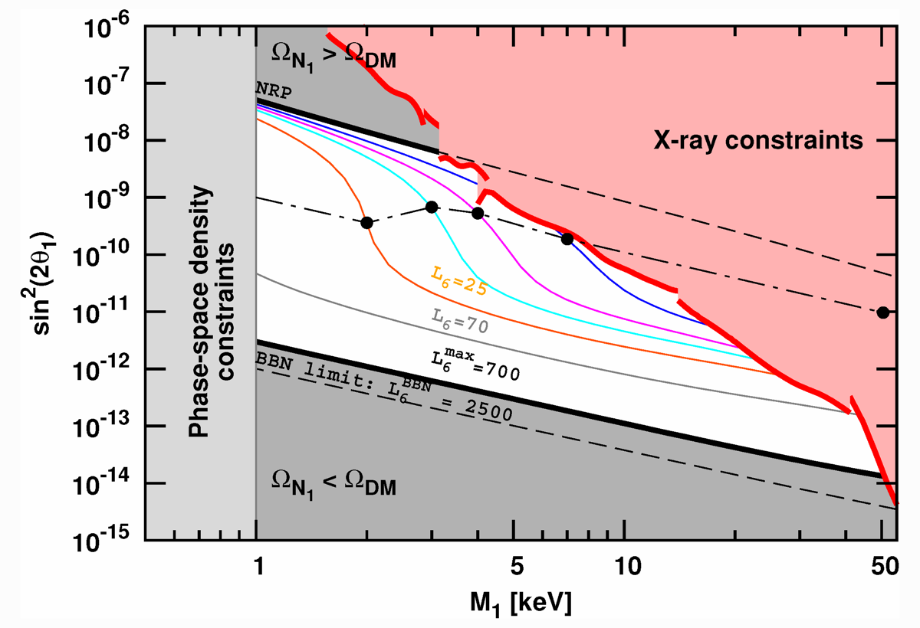
Sterile Neutrino Dark Matter
Resonant production, requires large lepton asymmetry caused
by other sterile neutrinos flavors
Unidentified
tentative
x-ray line
(3.55 keV)
arXiv:1402.2301
& 1402.4119
Sterile Neutrino White Paper, arXiv:1204.5379

Slide 16
Sterile Neutrino Summary
• Fully thermalised sterile neutrino (eV-mass)
excluded
• Partially thermalised allowed
or even favored, needs new ingredients
• keV-range sterile neutrinos
possible as dark matter
• 3.55 keV x-ray line hint for this scenario?

Slide 17
Leptogenesis
Leptogenesis

Slide 18
Basics of Cosmology
• More matter than anti-matter in the universe
(BAU – Baryon Asymmetry of the Universe)
• Not from initial conditions (inflationary universe)
• Should be generated by physical processes:
“Baryogenesis”
• Requires an absolute difference between matter
and anti-matter in physical laws

Slide 19
Quark Soup Before QCD Confinement
$$q$$
$$\overline{q}$$
$$q$$
$$q$$
$$q$$
$$\overline{q}$$
$$q$$
$$\overline{q}$$
$$q$$
$$\overline{q}$$
$$q$$
$$\overline{q}$$
$$q$$
$$q$$
$$\overline{q}$$
$$q$$
$$\overline{q}$$
$$\overline{q}$$
$$q$$
$$\overline{q}$$
$$q$$
$$q$$
$$q$$
$$q$$
$$q$$
$$\overline{q}$$
$$\overline{q}$$
$$q$$
$$q$$
$$q$$
$$q$$
$$\overline{q}$$
$$q$$
$$\overline{q}$$
$$\overline{q}$$
$$\overline{q}$$
$$q$$
$$\overline{q}$$
$$q$$
$$\overline{q}$$
$$q$$
$$q$$
$$\overline{q}$$
$$q$$
$$q$$
$$\overline{q}$$
$$\overline{q}$$
$$q$$
$$q$$
$$q$$
$$q$$
$$q$$
$$\overline{q}$$
$$q$$
$$\overline{q}$$
$$q$$
$$\overline{q}$$
$$\overline{q}$$
$$\overline{q}$$
$$q$$
$$\overline{q}$$
$$\overline{q}$$
$$\overline{q}$$
$$\overline{q}$$
$$q$$
$$\overline{q}$$
$$q$$
$$q$$
$$q$$
$$\overline{q}$$
$$q$$
$$q$$
$$q$$
$$q$$
$$\overline{q}$$
$$\overline{q}$$
$$q$$
$$\overline{q}$$
$$q$$
$$q$$
$$q$$
$$\overline{q}$$
$$\overline{q}$$
$$q$$
$$\overline{q}$$
$$\overline{q}$$
$$\overline{q}$$
$$q$$
$$\overline{q}$$
$$q$$
$$\overline{q}$$
$$q$$
$$\overline{q}$$
$$q$$
$$\overline{q}$$
$$q$$
$$\overline{q}$$
$$\overline{q}$$
$$\overline{q}$$
$$\overline{q}$$
$$\overline{q}$$
$$\overline{q}$$
$$q$$
$$\overline{q}$$
$$q$$
$$q$$
$$q$$
$$\overline{q}$$
$$q$$
$$q$$
$$q$$
$$q$$
$$\overline{q}$$
$$q$$
$$\overline{q}$$
$$\overline{q}$$
$$q$$
$$q$$
$$\overline{q}$$
$$q$$
$$\overline{q}$$
$$\overline{q}$$
$$\overline{q}$$
$$q$$
$$\overline{q}$$
$$q$$
$$\overline{q}$$
$$\overline{q}$$
$$q$$
$$q$$
$$\overline{q}$$
$$\overline{q}$$
$$\overline{q}$$
$$q$$
$$q$$
$$q$$
$$q$$
$$q$$
$$q$$
$$q$$
$$\overline{q}$$
$$q$$
$$q$$
$$\overline{q}$$
$$\overline{q}$$
$$q$$
$$q$$
$$\overline{q}$$
$$q$$
$$\overline{q}$$
$$q$$
$$\overline{q}$$
$$q$$
$$q$$
$$\overline{q}$$
$$\overline{q}$$
$$\overline{q}$$
$$\overline{q}$$
$$q$$
$$q$$
$$q$$
$$\overline{q}$$
$$q$$
$$\overline{q}$$
$$q$$
$$\overline{q}$$
$$q$$
$$\overline{q}$$
$$q$$
$$\overline{q}$$
$$q$$
$$\overline{q}$$
$$\overline{q}$$
$$\overline{q}$$
$$q$$
$$\overline{q}$$
$$q$$
$$q$$
$$\overline{q}$$
$$q$$
$$\overline{q}$$
$$q$$
$$\overline{q}$$
$$\overline{q}$$
$$q$$
$$\overline{q}$$
$$\overline{q}$$
$$q$$
$$\overline{q}$$
$$q$$
$$q$$
$$\overline{q}$$
$$\overline{q}$$
$$q$$
$$q$$
$$\overline{q}$$
$$q$$
$$\overline{q}$$
$$q$$
$$\overline{q}$$
$$q$$
$$q$$
$$q$$
$$q$$
$$q$$
$$\overline{q}$$
$$q$$
$$\overline{q}$$
$$\overline{q}$$
$$q$$
$$\overline{q}$$
$$\overline{q}$$
$$\overline{q}$$
$$\overline{q}$$
$$\overline{q}$$
$$q$$
$$\overline{q}$$
$$q$$
$$\overline{q}$$
$$\overline{q}$$
$$\overline{q}$$
$$q$$
$$\overline{q}$$
$$q$$
$$\overline{q}$$
$$q$$
$$\overline{q}$$
$$q$$
$$\overline{q}$$
$$q$$
$$\overline{q}$$
$$q$$
$$\overline{q}$$
$$\overline{q}$$
$$q$$
$$\overline{q}$$
$$q$$
$$\overline{q}$$
$$q$$
$$\overline{q}$$
$$\overline{q}$$
$$\overline{q}$$
$$\overline{q}$$
$$\overline{q}$$
$$q$$
$$q$$
$$q$$
$$\overline{q}$$
$$q$$
$$\overline{q}$$
$$q$$
$$\overline{q}$$
$$q$$
$$q$$
$$\overline{q}$$
$$\overline{q}$$
$$q$$
$$q$$
$$\overline{q}$$
$$q$$
$$\overline{q}$$
$$q$$
$$q$$
$$q$$
$$q$$
$$\overline{q}$$
$$\overline{q}$$
$$q$$
$$\overline{q}$$
$$q$$
$$q$$
$$q$$
$$\overline{q}$$
$$q$$
$$\overline{q}$$
$$q$$
$$\overline{q}$$
$$\overline{q}$$
$$q$$
$$q$$
$$\overline{q}$$
$$q$$
$$\overline{q}$$
$$\overline{q}$$
$$q$$
$$q$$
$$q$$
$$q$$
$$\overline{q}$$
$$q$$
$$\overline{q}$$
$$\overline{q}$$
$$\overline{q}$$
$$\overline{q}$$
$$\overline{q}$$
$$\overline{q}$$
$$\overline{q}$$
$$q$$
$$\overline{q}$$
$$\overline{q}$$
$$q$$
$$q$$
$$q$$
$$q$$
$$q$$
$$\overline{q}$$
$$q$$
$$\overline{q}$$
$$q$$
$$q$$
$$q$$
$$\overline{q}$$
$$q$$
$$q$$
$$q$$
$$q$$
$$\overline{q}$$
$$q$$
$$\overline{q}$$
$$q$$
$$\overline{q}$$
$$q$$
$$\overline{q}$$
$$\overline{q}$$
$$\overline{q}$$
$$q$$
$$q$$
$$\overline{q}$$
$$q$$
$$\overline{q}$$
$$\overline{q}$$
$$q$$
$$\overline{q}$$
$$q$$
$$q$$
$$q$$
$$q$$
$$\overline{q}$$
$$\overline{q}$$
$$q$$
$$\overline{q}$$
$$\overline{q}$$
$$q$$
$$\overline{q}$$
$$\overline{q}$$
$$q$$
$$q$$
$$\overline{q}$$
$$q$$
$$\overline{q}$$
$$q$$
$$\overline{q}$$
$$q$$
$$\overline{q}$$
$$q$$
$$q$$
$$\overline{q}$$
$$q$$
$$\overline{q}$$
$$\overline{q}$$
$$\overline{q}$$
$$\overline{q}$$
$$\overline{q}$$
$$q$$
$$\overline{q}$$
$$\overline{q}$$
$$q$$
$$\overline{q}$$
$$q$$
$$\overline{q}$$
$$\overline{q}$$
$$q$$
$$\overline{q}$$
$$q$$
$$q$$
$$q$$
$$q$$
$$q$$
$$q$$
$$q$$
$$q$$
$$q$$
$$\overline{q}$$
$$\overline{q}$$
$$q$$
$$\overline{q}$$
$$q$$
$$\overline{q}$$
$$q$$
$$\overline{q}$$
$$q$$
$$\overline{q}$$
$$q$$
$$\overline{q}$$
$$\overline{q}$$
$$q$$
$$\overline{q}$$
$$\overline{q}$$
$$\overline{q}$$
$$\overline{q}$$
$$q$$
$$q$$
$$q$$
$$\overline{q}$$
$$\overline{q}$$
$$\overline{q}$$
$$q$$
$$q$$
$$q$$
$$q$$
$$q$$
$$\overline{q}$$
$$q$$
$$q$$
$$q$$
$$q$$
$$\overline{q}$$
$$\overline{q}$$
$$\overline{q}$$
$$q$$
$$\overline{q}$$
$$\overline{q}$$
$$\overline{q}$$
$$q$$
$$\overline{q}$$
$$q$$
$$\overline{q}$$
$$q$$
$$\overline{q}$$
$$\overline{q}$$
$$q$$
$$\overline{q}$$
$$q$$
$$\overline{q}$$
$$q$$
$$q$$
$$\overline{q}$$
$$\overline{q}$$
$$q$$
$$\overline{q}$$
$$q$$
$$\overline{q}$$
$$q$$
$$q$$
$$\overline{q}$$
$$q$$
$$\overline{q}$$
$$q$$
$$\overline{q}$$
$$\overline{q}$$
$$q$$
$$\overline{q}$$
$$\overline{q}$$
$$q$$
$$\overline{q}$$
$$\overline{q}$$
$$\overline{q}$$
$$\overline{q}$$
$$q$$
$$\overline{q}$$
$$q$$
$$\overline{q}$$
$$q$$
$$\overline{q}$$
$$q$$
$$q$$
$$\overline{q}$$
$$q$$
$$q$$
$$\overline{q}$$
$$q$$
$$\overline{q}$$
$$\overline{q}$$
$$q$$
$$\overline{q}$$
$$q$$
$$\overline{q}$$
$$\overline{q}$$
$$\overline{q}$$
$$q$$
$$\overline{q}$$
$$\overline{q}$$
$$q$$
$$\overline{q}$$
$$\overline{q}$$
$$\overline{q}$$
$$q$$
$$q$$
$$\overline{q}$$
$$q$$
$$\overline{q}$$
$$q$$
$$\overline{q}$$
$$q$$
$$\overline{q}$$
$$q$$
$$\overline{q}$$
$$q$$
$$\overline{q}$$
$$\overline{q}$$
$$\overline{q}$$
$$q$$
$$\overline{q}$$
$$q$$
$$\overline{q}$$
$$\overline{q}$$
$$\overline{q}$$
$$q$$
$$q$$
$$\overline{q}$$
$$q$$
$$q$$
$$\overline{q}$$
$$\overline{q}$$
$$q$$

Slide 20
After QCD Confinement
3,000,000,003
quarks
3,000,000,000
anti-quarks
$$uud$$
1 proton
Initial Asymmetry $∼{10}^{−9}$ (Baryon-to-Photon-Ratio)

Slide 21
Baryogenesis in the Early Universe
Sakharov conditions for creating the
Baryon Asymmetry of the Universe (BAU)
C and CP violation
Baryon number violation
Deviation from thermal equilibrium
Particle-physics standard model
Violates C and CP
Violates B and L by EW instanton effects
(B − L conserved)
Andrei Sakharov
1921–1989
However, electroweak baryogenesis not quantitatively
possible within particle-physics standard model
Works in SUSY models for small range of parameters
A.Riotto & M.Trodden: Recent progress in baryogenesis
Ann. Rev. Nucl. Part. Sci. 49 (1999) 35

Slide 22
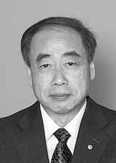
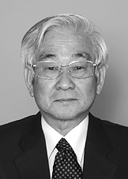
CP Violation in Particle Physics
Discrete symmetries in particle physics
C – Charge conjugation, transforms particles to antiparticles
violated by weak interactions
P – Parity, changes left-handedness to right-handedness
violated by weak interactions
T – Time reversal, changes direction of motion (forward to backward)
CPT – exactly conserved in quantum field theory
CP – conserved by all gauge interactions
violated by three-flavor quark mixing matrix
All measured CP-violating effects derive
from a single phase in the quark mass matrix
(Kobayashi-Maskawa phase),
i.e. from complex Yukawa couplings
Cosmic matter-antimatter asymmetry
requires new ingredients
M. Kobayashi
T. Maskawa
Physics Nobel Prize 2008

Slide 23
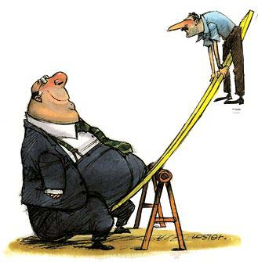
See-Saw Model for Neutrino Masses
Cosmological
constant
QCD
scale
Electroweak
scale
GUT
scale
Planck
mass
$${10}^{−3}$$
$$1$$
$${10}^{3}$$
$${10}^{6}$$
$${10}^{9}$$
$${10}^{12}$$
$${10}^{15}$$
$${10}^{18}$$
$${10}^{21}$$
$${10}^{24}$$
$${10}^{27}$$
eV
$${m_{D}^{2}}/M$$
$$m_{D}$$
$$M$$
Mass matrix for one family of ordinary and heavy r.h. neutrinos
$$\left({\overline{ν}}_{L}^{′},{\overline{N}}_{R}^{′}\right)\left(\begin{matrix}0 & m_{D} \\ m_{D} & M\end{matrix}\right)\left(\begin{matrix}ν_{L}^{′} \\ N_{R}^{′}\end{matrix}\right)$$
Diagonalization
$$\left({\overline{ν}}_{L},{\overline{N}}_{R}\right)\left(\begin{matrix}{m_{D}^{2}}/M & 0 \\ 0 & M\end{matrix}\right)\left(\begin{matrix}ν_{L} \\ N_{R}\end{matrix}\right)$$
One light and one heavy Majorana neutrino

Slide 24
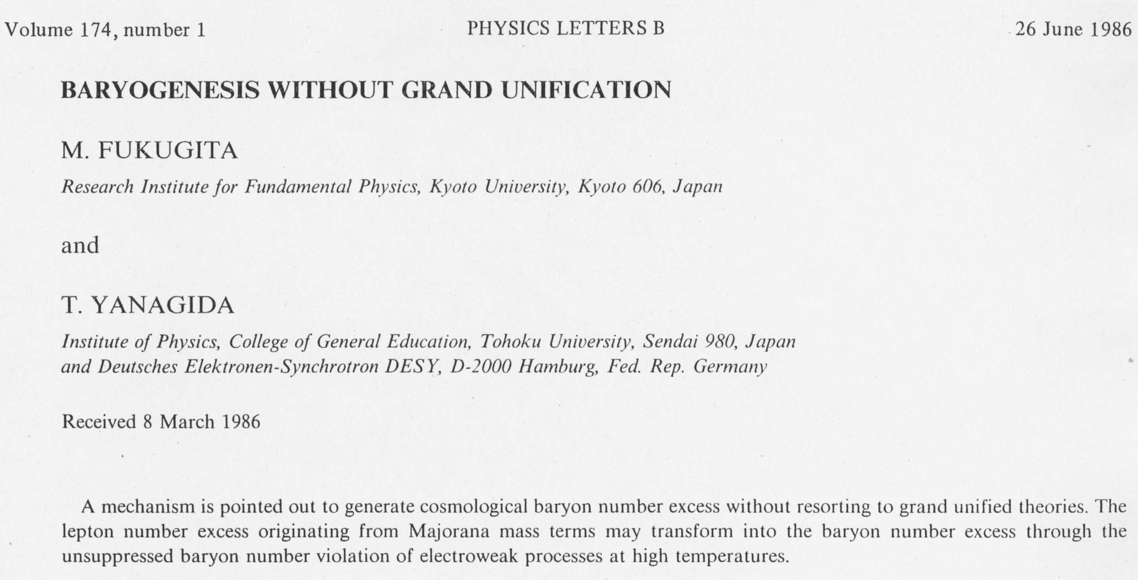
Leptogenesis by Majorana Neutrino Decays
Lepton $ℓ$
$$ℓ$$
CP-violating decays of
heavy sterile neutrinos by
interference of tree-level
with one-loop diagram
$$Φ$$
Heavy sterile
neutrino N
+
N
N
Higgs $Φ$
$$Φ$$

Slide 25
Leptogenesis by Out-of-Equilibrium Decay
M. Fukugita & T. Yanagida:
Baryogenesis without Grand
Unification
Phys. Lett. B 174 (1986) 45
Equilibrium
abundance of
heavy Majorana
neutrinos
Equilibrium
abundance of
heavy Majorana
neutrinos
Equilibrium
abundance of
heavy Majorana
neutrinos
Real abundance
determined by
decay rate
Real abundance
determined by
decay rate
CP-violating decays by
interference of tree-level
with one-loop diagram
Created
lepton-number
abundance
$$Γ_{Decay}=g_{ν}^{2}\frac{M}{8π}$$
W. Buchmüller & M. Plümacher: Neutrino masses and the baryon asymmetry
Int. J. Mod. Phys. A15 (2000) 5047-5086

Slide 26
Dow Jones Index for Leptogenesis
inSPIRE: Citations of Fukugita & Yanagida, PLB 174 (1986) 45
or “Leptogenesis” in title

Slide 27
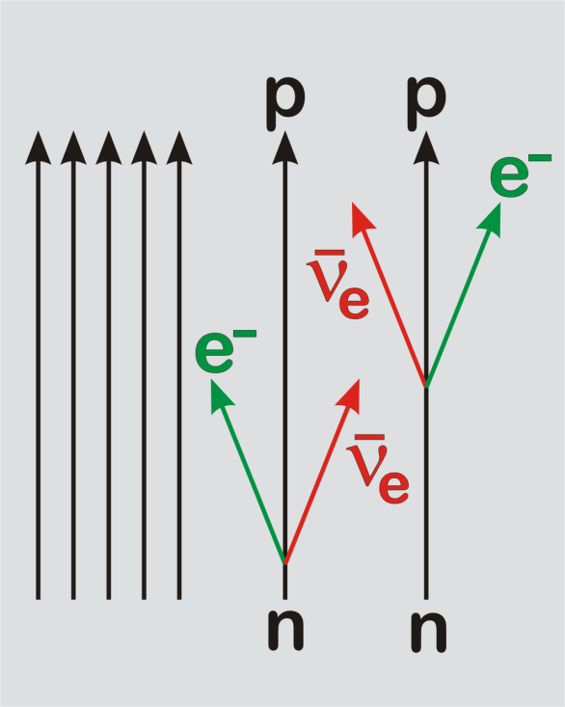
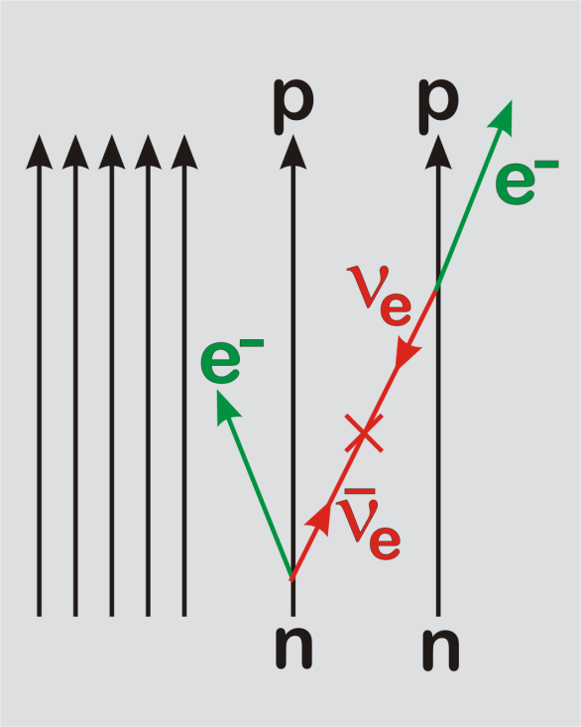
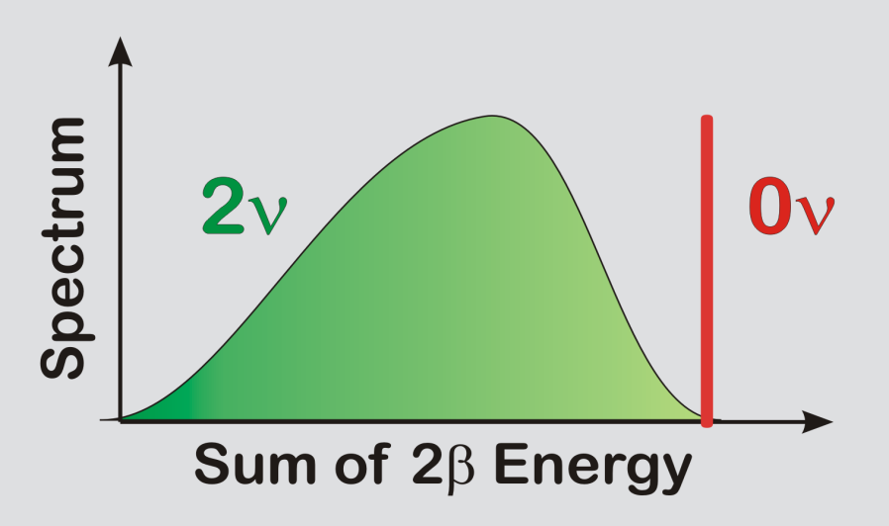
Neutrinoless ββ Decay
Some nuclei decay only by
the ββ mode, e.g. Ge-76
⁷⁶As
2⁻
⁷⁶Ge
0⁺
⁷⁶Se
2⁺
0⁺
Standard 2ν mode
0ν mode, enabled
by Majorana mass
Half life $\sim$ 10²¹ yr
$$\left|m_{ee}\right|=\left|\sum_{i=1}^{N}{λ_{i}{\left|U_{ei}\right|}^{2}m_{i}}\right|$$
Measured
quantity
Best limit
from ⁷⁶Ge
$$\left|m_{ee}\right|<0.35 \text{eV}$$

Slide 28
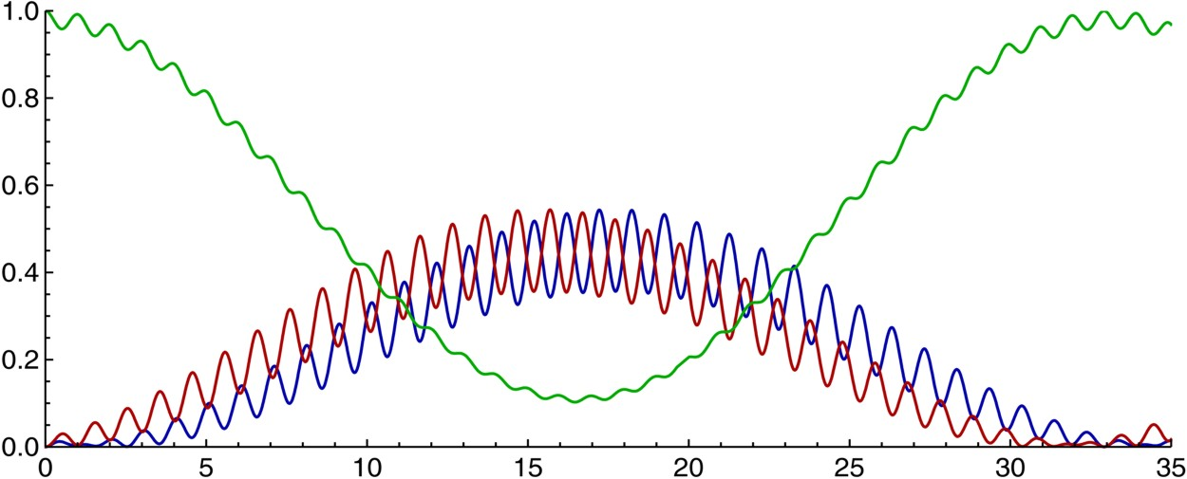
Antineutrino Oscillations Different from Neutrinos?
$$ν_{e} =c_{12}c_{13}{ ν}_{1} +s_{12}c_{13}{ ν}_{2} +s_{13}e^{−iδ} ν_{3}$$
$${\overline{ν}}_{e} =c_{12}c_{13} {\overline{ν}}_{1} +s_{12}c_{13} {\overline{ν}}_{2} +s_{13}e^{+iδ} {\overline{ν}}_{3}$$
Dirac phase causes different 3-flavor oscillations
for neutrinos and antineutrinos
$$ν_{e}→ν_{e}$$
same as ${\overline{ν}}_{e}→{\overline{ν}}_{e}$
$$ν_{e}→ν_{μ}$$
$${\overline{ν}}_{e}→{\overline{ν}}_{μ}$$
Distance [1000 km] for E = 1 GeV

Slide 29
Leptogenesis Summary
• See-saw model for small Majorana masses
provides a generic way for BAU generation
• Observing lepton-number violation
(neutrinoless double beta decay)
and leptonic CP violation (LBL oscillation)
would provide strong support (not proof)
for this scenario

