Slide 1
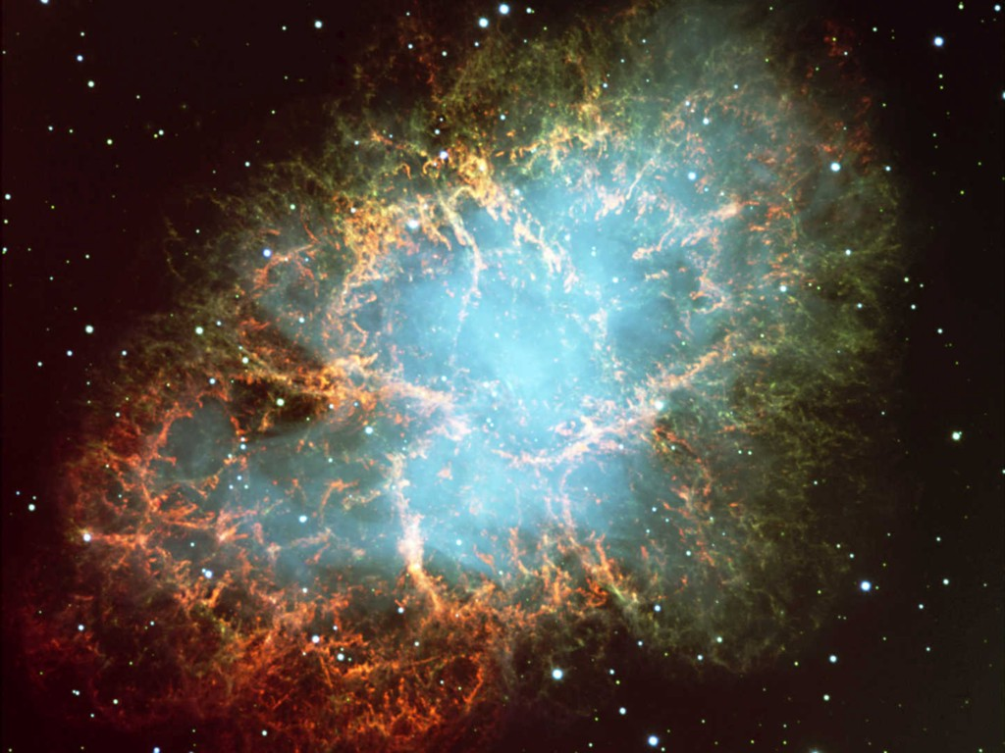
Crab Nebula
Neutrinos
in Astrophysics and Cosmology
Neutrinos and the Stars 1
Georg G. Raffelt
Max-Planck-Institut für Physik, München, Germany

Slide 2
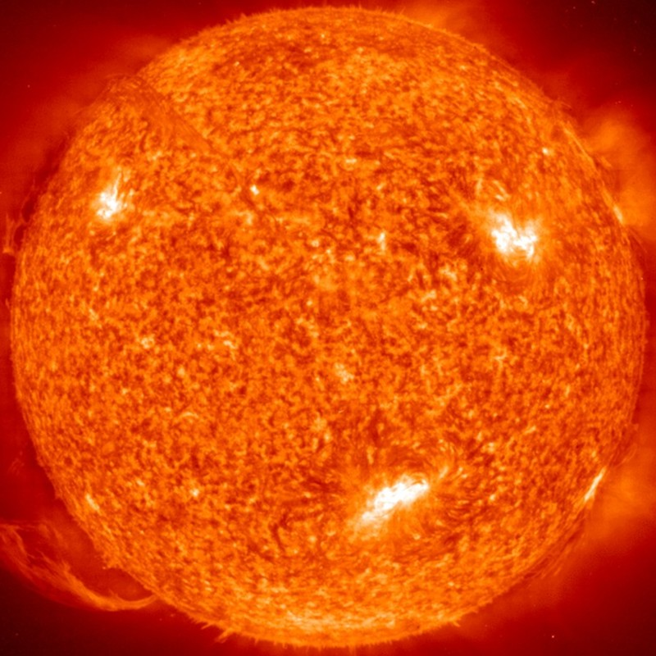
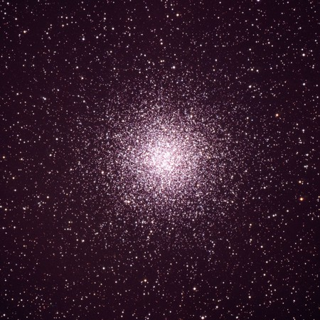
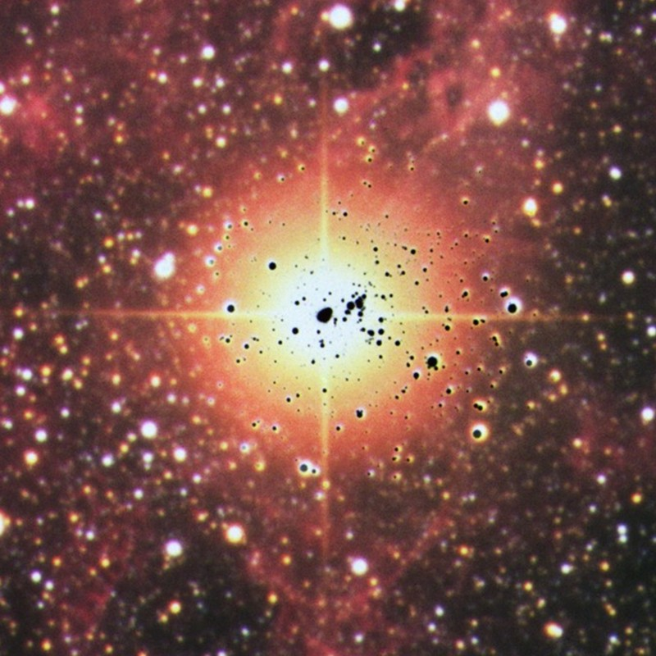
Neutrinos and the Stars
• Strongest local neutrino flux
• Long history of detailed measurements
• Crucial for flavor oscillation physics
• Resolve solar metal abundance problem in future?
• Use Sun as source for other particles (especially axions)
Sun
• Neutrino energy loss crucial in stellar evolution theory
• Backreaction on stars provides limits,
e.g. neutrino magnetic dipole moments
Globular Cluster
• Collapsing stars most powerful neutrino sources
• Once observed from SN 1987A
• Provides well-established particle-physics constraints
• Next galactic supernova: learn about astrophyiscs of core collapse
• Diffuse Supernova Neutrino Background (DSNB) is detectable
Supernova 1987A

Slide 3
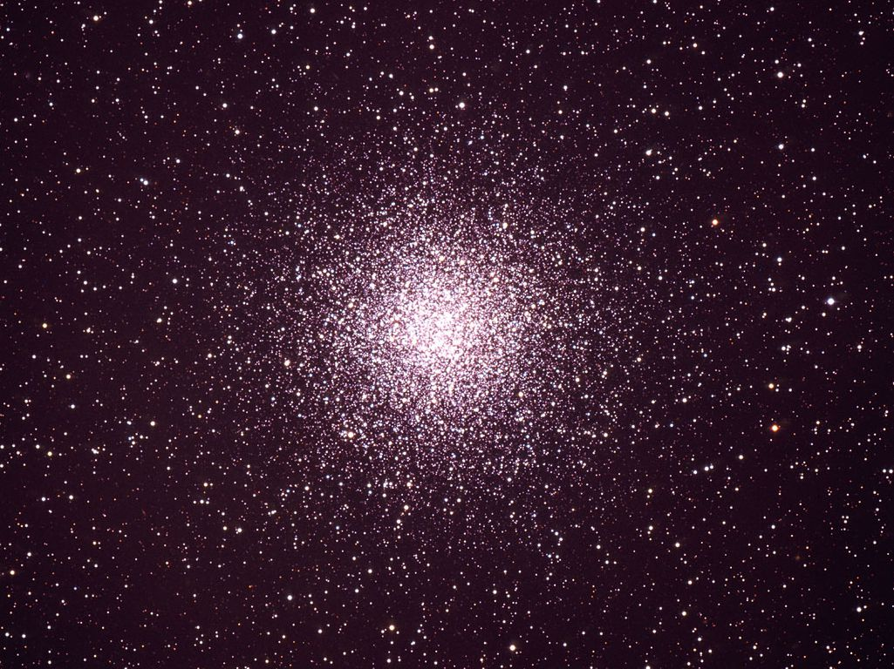
Basics of Stellar Evolution

Slide 4
Equations of Stellar Structure
Assume spherical symmetry and static structure (neglect kinetic energy)
Excludes: Rotation, convection, magnetic fields, supernova-dynamics, …
Hydrostatic equilibrium
$$\frac{dP}{dr}=−\frac{G_{N}M_{r}ρ}{r^{2}}$$
Energy conservation
$$\frac{dL_{r}}{dr}=4πr^{2}ερ$$
Energy transfer
$$L_{r}=\frac{4πr^{2}}{3κρ}\frac{d\left(aT^{4}\right)}{dr}$$
Literature
Clayton: Principles of stellar evolution and
nucleosynthesis (Univ. Chicago Press 1968)
Kippenhahn & Weigert: Stellar structure
and evolution (Springer 1990)
$r$
$P$
$GN$
$ρ$
$M_{r}$
$L_{r}$
$ε$
$$κ$$
$$κ_{γ}$$
$$κ_{c}$$
Radius from center
Pressure
Newton’s constant
Mass density
Integrated mass up to r
Luminosity (energy flux)
Local rate of energy
generation $[erg g^{−1}s^{−1}]$
$$ε=ε_{nuc}+ε_{grav}−ε_{ν}$$
Opacity
$$κ^{−1}=κ_{γ}^{−1}+κ_{c}^{−1}$$
Radiative opacity
$$κ_{γ}ρ={〈λ_{γ}〉}_{Rosseland}^{−1}$$
Electron conduction

Slide 5
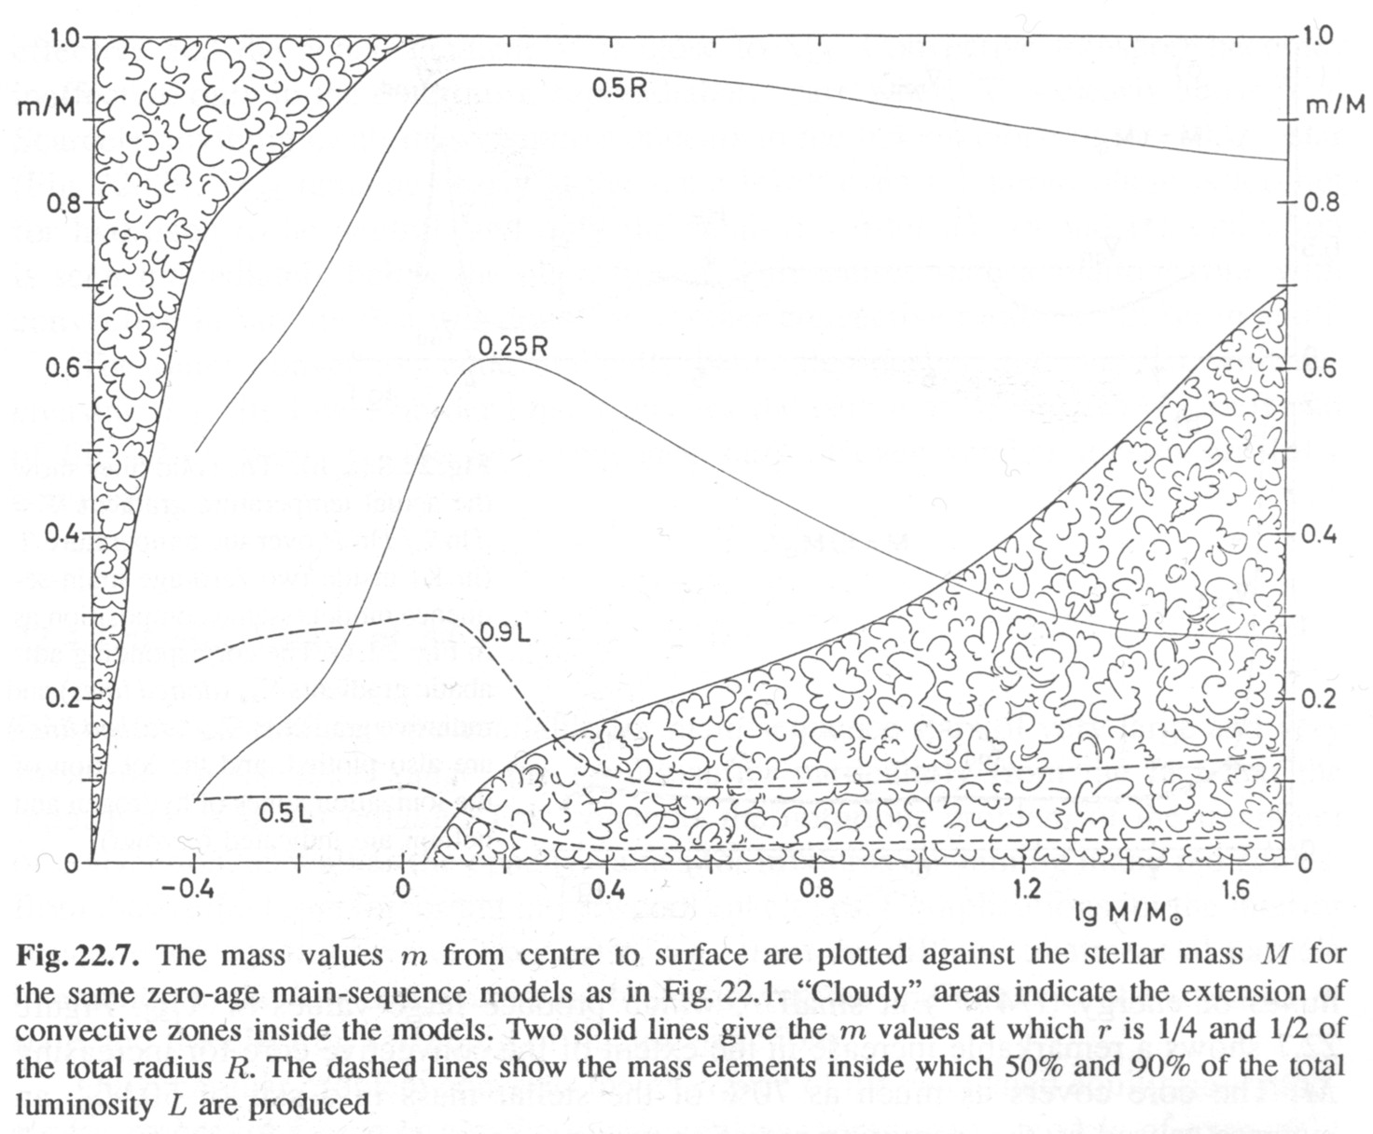
Convection in Main-Sequence Stars
Sun
Kippenhahn & Weigert, Stellar Structure and Evolution

Slide 6
Virial Theorem and Hydrostatic Equilibrium
Hydrostatic equilibrium
$$\frac{dP}{dr}=\frac{G_{N}M_{r}ρ}{r^{2}}$$
Integrate both sides
$$\int_{0}^{R}{dr}4πr^{3}P^{′}=−\int_{0}^{R}{dr}4πr^{3}\frac{G_{N}M_{r}ρ}{r^{2}}$$
L.h.s. partial integration
with $P=0$ at surface $R$
$$−3\int_{0}^{R}{dr}4πr^{2}P=E_{grav}^{tot}$$
Monatomic gas: $P=\frac{2}{3}U$
(U density of internal energy)
$$U^{tot}=−\frac{1}{2}E_{grav}^{tot}$$
Average energy of single
“atoms” of the gas
$$〈E_{kin}〉=−\frac{1}{2}〈E_{grav}〉$$
Virial Theorem:
Most important tool to study
self-gravitating systems

Slide 7
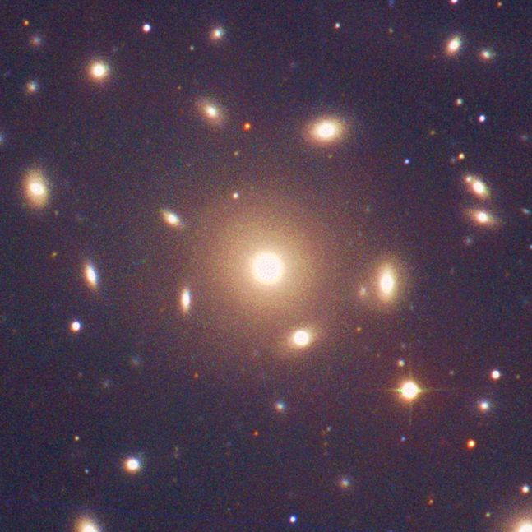
Dark Matter in Galaxy Clusters
A gravitationally bound
system of many particles
obeys the virial theorem
$$2〈E_{kin}〉=−〈E_{grav}〉$$
$$2\left\langle \frac{mv^{2}}{2}\right\rangle =\left\langle \frac{G_{N}M_{r}m}{r}\right\rangle$$
$$\left\langle v^{2}\right\rangle ≈G_{N}M_{r}\left\langle r^{−1}\right\rangle$$
Velocity dispersion
from Doppler shifts
and geometric size
Total Mass
Coma Cluster

Slide 8
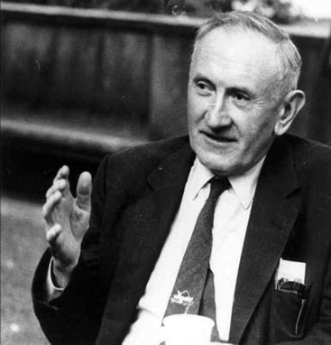
Dark Matter in Galaxy Clusters
Fritz Zwicky:
Die Rotverschiebung von
Extragalaktischen Nebeln
(The redshift of extragalactic nebulae)
Helv. Phys. Acta 6 (1933) 110
In order to obtain the observed average Doppler effect of 1000 km/s or
more, the average density of the Coma cluster would have to be at least
400 times larger than what is found from observations of the luminous
matter. Should this be confirmed one would find the surprising result that
dark matter is far more abundant than luminous matter.

Slide 9
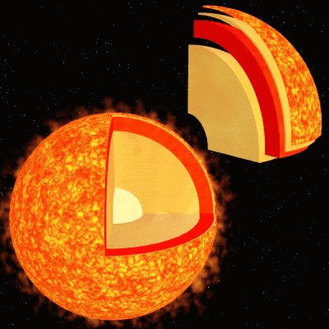
Virial Theorem Applied to the Sun
Virial Theorem $〈E_{kin}〉=−\frac{1}{2}〈E_{grav}〉$
Approximate Sun as a homogeneous
sphere with
Mass $M_{sun}=1.99×{10}^{33}g$
Radius $R_{sun}=6.96×{10}^{10}cm$
Gravitational potential energy of a
proton near center of the sphere
$〈E_{grav}〉=−\frac{3}{2}\frac{G_{N}M_{sun}m_{p}}{R_{sun}}=−3.2 keV$
Thermal velocity distribution
$〈E_{kin}〉=\frac{3}{2}k_{B}T=−\frac{1}{2}〈E_{grav}〉$
Estimated temperature
$T=1.1 keV$
Central temperature from
standard solar models
$$T_{c}=1.56×{10}^{7}K=1.34 keV$$

Slide 10
Nuclear Binding Energy
Fe
Mass Number

Slide 11
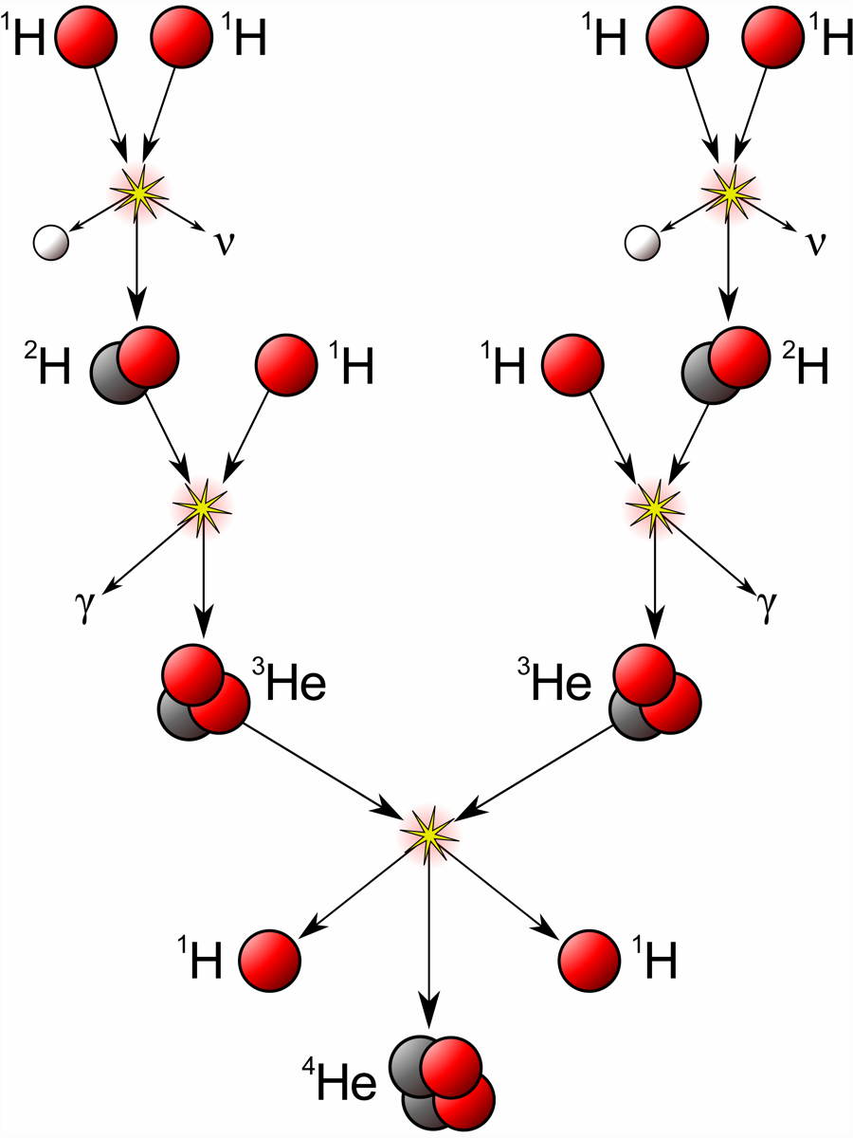
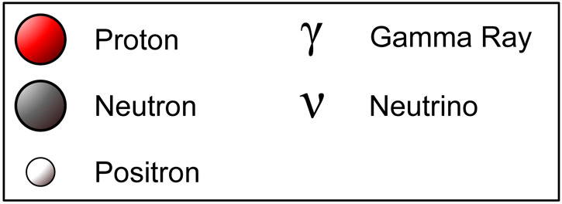
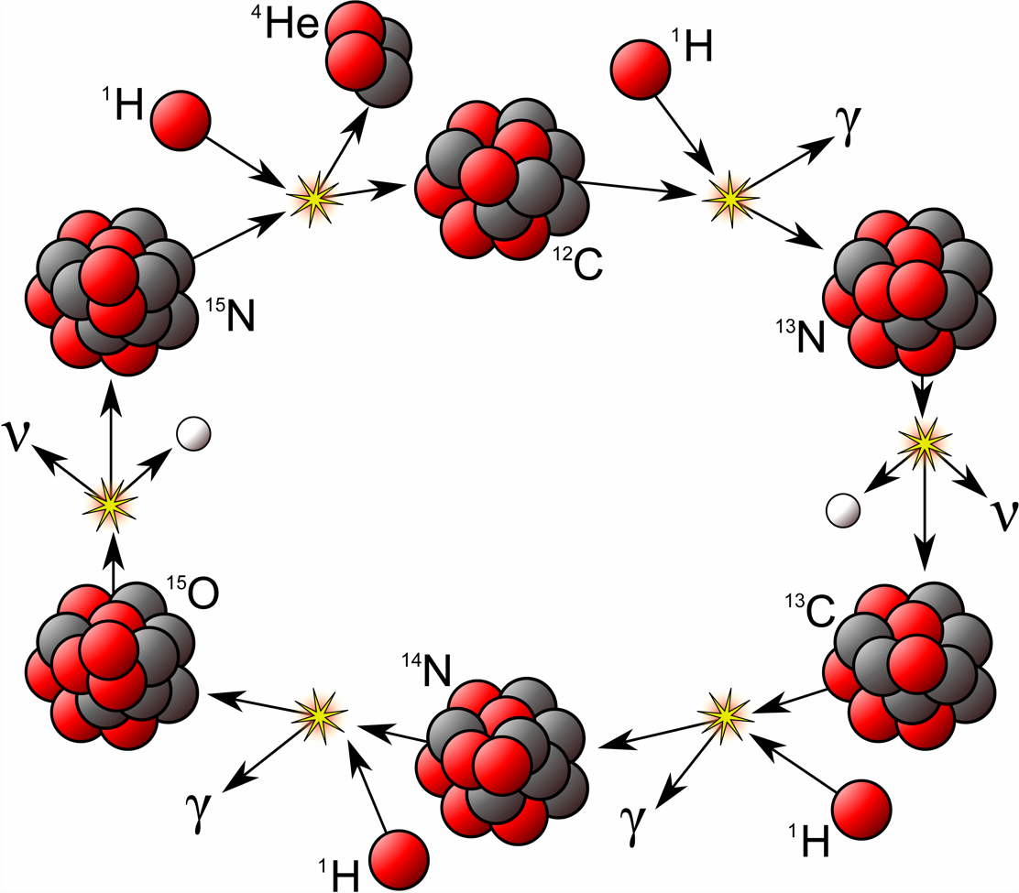
Hydrogen Burning
PP-I Chain
CNO Cycle

Slide 12
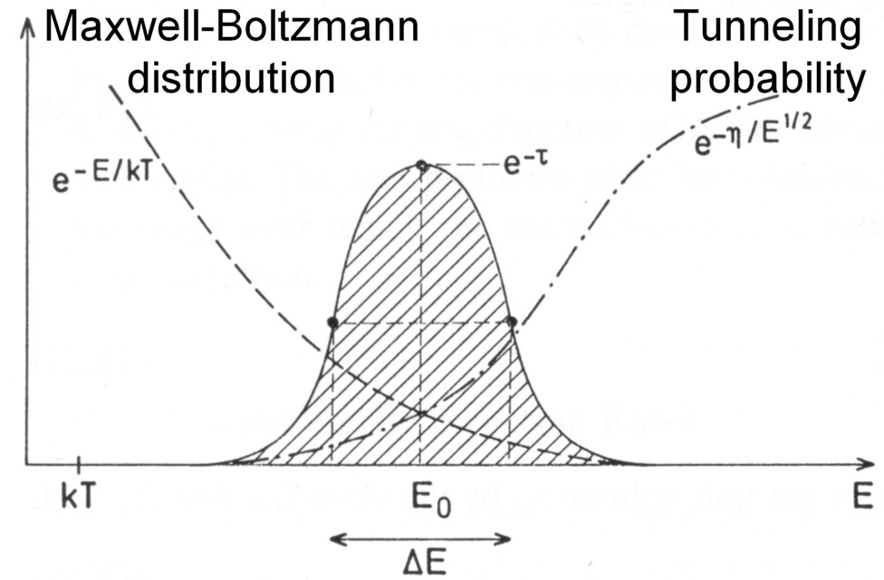
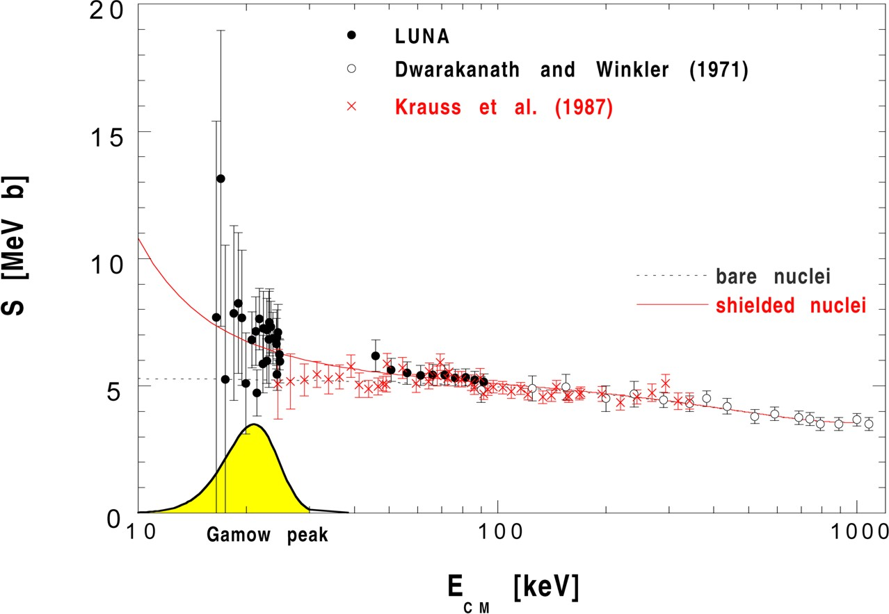
Thermonuclear Reactions and Gamow Peak
Coulomb repulsion prevents nuclear
reactions, except for Gamow tunneling
Tunneling probability
$$p∝E^{−1/2}e^{−2πη}$$
where the Sommerfeld parameter is
$$η={\left(\frac{m}{2E}\right)}^{1/2}Z_{1}Z_{2}e^{2}$$
Parameterize cross section with
astrophysical S-factor
$S\left(E\right)=σ\left(E\right) E e^{2πη\left(E\right)}$
$${}_{}^{3}{He}+{}_{}^{3}{He}→{}_{}^{4}{He}+2p$$
LUNA Collaboration, nucl-ex/9902004

Slide 13
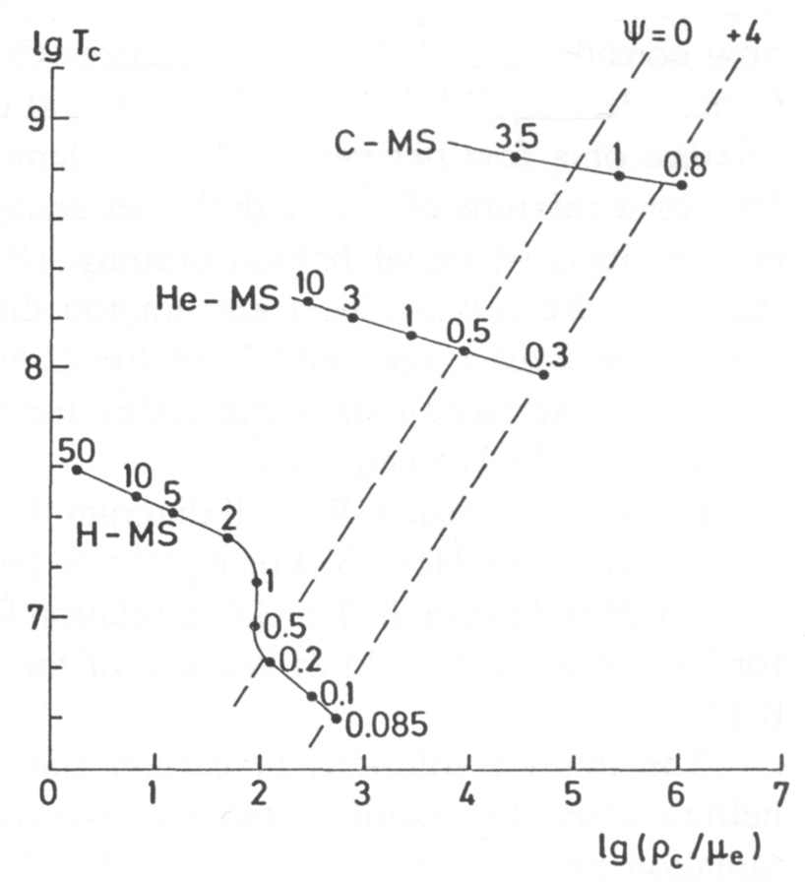
Main Nuclear Burning Stages
Hydrogen burning $4p+2e^{−}→{}_{}^{4}{He}+2ν_{e}$
Proceeds by pp chains and CNO cycle
No higher elements are formed because
no stable isotope with mass number 8
Neutrinos from p → n conversion
Typical temperatures: 10⁷ K ($∼$1 keV)
Each type of burning occurs
at a very different T but a
broad range of densities
Never co-exist in the same
location
Helium burning
$${}_{}^{4}{He}+{}_{}^{4}{He}+{}_{}^{4}{He}↔{}_{}^{8}{Be}+{}_{}^{4}{He}→{}_{}^{12}C$$
“Triple alpha reaction” because $8Be$ unstable,
builds up with concentration $∼{10}^{−9}$
$${}_{}^{12}C+{}_{}^{4}{He}→{}_{}^{16}O$$
$${}_{}^{16}O+{}_{}^{4}{He}→{}_{}^{20}{Ne}$$
Typical temperatures: ${10}^{8} K$ ($\sim$10 keV)
Carbon burning
Many reactions, for example
${}_{}^{12}C+{}_{}^{12}C→{}_{}^{23}{Na}+p$ or ${}_{}^{20}{Ne}+{}_{}^{4}{He}$ etc
Typical temperatures: $109 K$ $(\sim 100 keV)$

Slide 14
Hydrogen Exhaustion
Main-sequence star
Helium-burning star
Hydrogen Burning
Helium
Burning
Hydrogen
Burning

Slide 15
Burning Phases of a 15 Solar-Mass Star
L_{γ} [10⁴ L_{sun}]
Burning Phase
Dominant
Process
T_{c}
[keV]
ρ_{c}
[g/cm³]
L_{ν}/L_{γ}
Duration
[years]
Hydrogen
H → He
3
5.9
2.1
−
1.2×10⁷
Helium
He → C, O
14
1.3×10³
6.0
1.7×10⁻⁵
1.3×10⁶
Carbon
C → Ne, Mg
53
1.7×10⁵
8.6
1.0
6.3×10³
Neon
Ne → O, Mg
110
1.6×10⁷
9.6
1.8×10³
7.0
Oxygen
O → Si
160
9.7×10⁷
9.6
2.1×10⁴
1.7
Silicon
Si → Fe, Ni
270
2.3×10⁸
9.6
9.2×10⁵
6 days

Slide 16
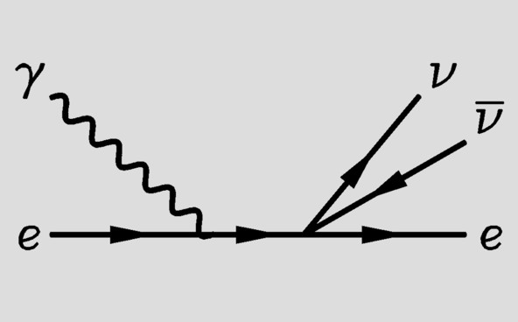
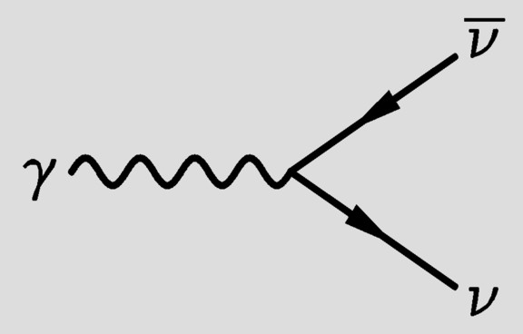
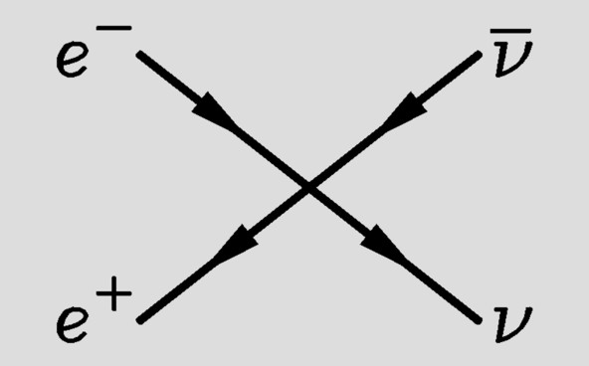
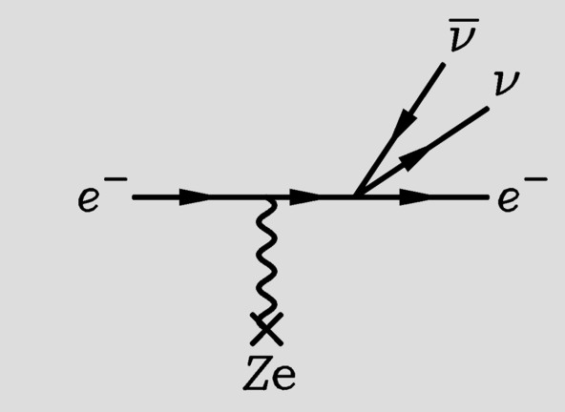
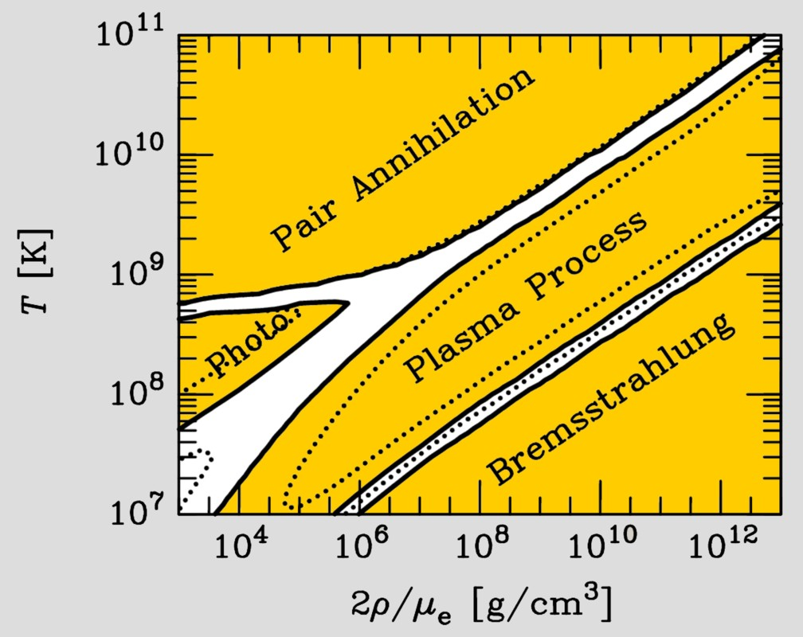
Neutrinos from Thermal Processes
Photo (Compton)
Plasmon decay
Pair annihilation
Bremsstrahlung
These processes were first
discussed in 1961−63
after V−A theory

Slide 17
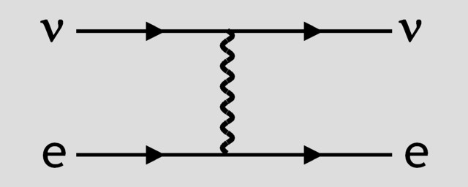
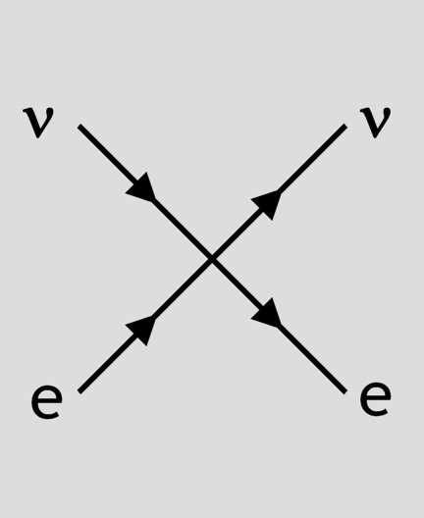
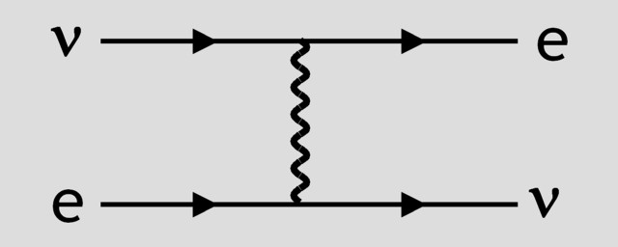
Effective Neutrino Neutral-Current Couplings
Neutral
current
Effective
four
fermion
coupling
$$Z$$
E ≪ M_{W,Z}
Charged
current
$$W$$
$$H_{int}=\frac{G_{F}}{\sqrt{2}}{\overline{Ψ}}_{f}γ_{μ}\left(C_{V}−C_{A}γ_{5}\right)Ψ_{f} {\overline{Ψ}}_{ν}γ^{μ}\left(1−γ_{5}\right)Ψ_{ν}$$
Neutrino
Fermion
C_{V}
C_{A}
Fermi constant $G_{F}$
$$1.166×{10}^{−5}GeV^{−2}$$
Weak mixing angle
$$\sin^{2}{Θ_{W}}=0.231$$
$$ν_{e}$$
Electron
$+\frac{1}{2}+2\sin^{2}{Θ_{W}}≈1$
$+\frac{1}{2}$
$ν_{μ}$ $ν_{τ}$
$−\frac{1}{2}+2\sin^{2}{Θ_{W}}≈0$
$−\frac{1}{2}$
$$ν_{e} ν_{μ} ν_{τ}$$
Proton
$+\frac{1}{2}−2\sin^{2}{Θ_{W}}≈0$
$+\frac{1.26}{2}$
Neutron
$−\frac{1}{2}$
$−\frac{1.26}{2}$

Slide 18
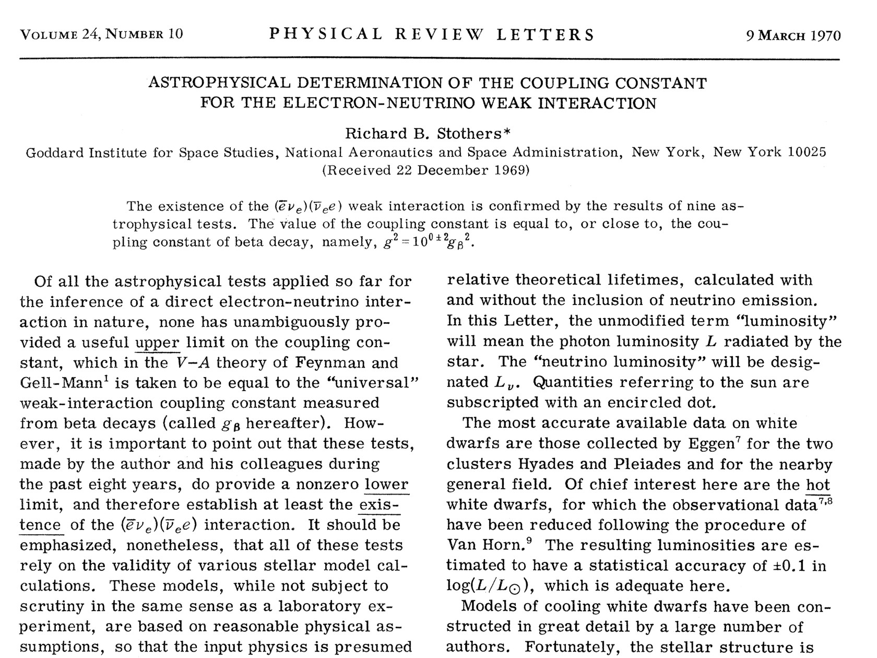
Existence of Direct Neutrino-Electron Coupling

Slide 19
Neutrinos from Thermal Processes
Photo (Compton)
Plasmon decay
Pair annihilation
Bremsstrahlung
These processes were first
discussed in 1961−63
after V−A theory

Slide 20
Plasmon Decay in Neutrinos
Propagation in vacuum:
Photon massless
Can not decay into other
particles, even if they
themselves are massless
Interaction in vacuum:
Massless neutrinos do
not couple to photons
May have dipole moments
or even “millicharges”
Plasmon decay
Propagation in a medium:
Photon acquires a “refractive index”
In a non-relativistic plasma
(e.g. Sun, white dwarfs, core of red
giant before helium ignition, …)
behaves like a massive particle:
$ω^{2}−k^{2}=ω_{pl}^{2}$
Plasma frequency $ω_{pl}^{2}={4παn_{e}}/{m_{e}}$
(electron density $n_{e}$)
Degenerate helium core $ω_{pl}=18 keV$
($ρ={10}^{6}g cm^{−3}$, $T=8.6 keV$)
Interaction in a medium:
Neutrinos interact coherently with
the charged particles which
themselves couple to photons
Induces an “effective charge”
In a degenerate plasma
(electron Fermi energy E_{F} and
Fermi momentum p_{F})
$$\frac{e_{ν}}{e}=16\sqrt{2} C_{V} G_{F} E_{F} p_{F}$$
Degenerate helium core (and C_{V} = 1)
$$e_{ν}=6×{10}^{−11}e$$

Slide 21
Particle Dispersion in Media

Slide 22
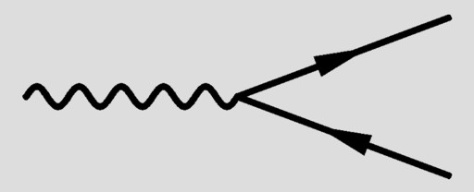
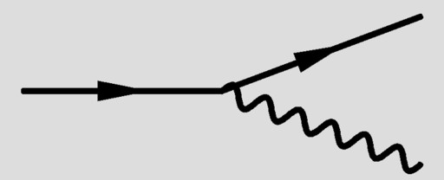
Plasmon Decay vs. Cherenkov Effect
Photon dispersion in
a medium can be
“Time-like”
ω² − k² > 0
“Space-like”
ω² − k² < 0
Refractive index n
(k = n ω)
n < 1
n > 1
Example
Ionized plasma
Normal matter for
large photon energies
Water (n ≈ 1.3),
air, glass
for visible frequencies
Allowed process
that is forbidden
in vacuum
Plasmon decay to
neutrinos
$$γ→ν\overline{ν}$$
Cherenkov effect
$$e→e+γ$$

Slide 23
Particle Dispersion in Media
Vacuum
Most general Lorentz-invariant dispersion relation
$$ω^{2}−k^{2}=m^{2}$$
$ω$ = frequency, $k$ = wave number, $m$ = mass
Gauge invariance implies $m = 0$ for photons and gravitons
Medium
Particle interaction with medium breaks Lorentz invariance so that
$$ω^{2}−k^{2}=π(ω,k)$$
Implies a relationship between $ω$ and $k$ (dispersion relation)
Often written in terms of
Refractive index $n$
$$k = n ω$$
Effective mass (note that $m_{eff}$ can be negative)
$$ω^{2}−k^{2}=m_{eff}^{2}$$
Effective potential (natural for neutrinos with $m$ the vacuum mass)
$${\left(ω−V\right)}^{2}−k^{2}=m^{2}$$
Which form to use depends on convenience

Slide 24
Refraction and Forward Scattering
Plane wave in vacuum
$$Φ\left(r,t\right)∝e^{−iωt+ik⋅r}$$
With scattering centers
$$Φ\left(r,t\right)∝e^{−iωt}\left[e^{ik⋅r}+f\left(ω,θ\right)\frac{e^{ik⋅r}}{r}\right]$$
In forward direction, adds
coherently to a plane wave
with modified wave number
$$k=n_{refr}ω$$
$$n_{refr}=1+\frac{2π}{ω^{2}} N f\left(ω,0\right)$$
$N$ = number density of scattering centers
$f\left(ω,0\right)$ = forward scattering amplitude

Slide 25
Electromagnetic Polarization Tensor
Klein-Gordon-Equation
in Fourier space
$$\left(−K^{2}g^{μν}+K^{μ}K^{ν}+Π^{μν}\right)A_{ν}=0$$
Polarization tensor
(self-energy of photon)
Gauge invariance and
current conservation
$${ Π}^{μν}K_{μ}=Π^{μν}K_{ν}=0$$
Medium: Four-velocity U available to construct $Π$
Vacuum: $Π^{μν}=ag^{μν}+bK^{μ}K^{ν}$
$→a=b=0$ (photon massless)
QED
Plasma
$$Π^{μν}\left(K\right)=$$
$$16πα\int{\frac{d^{3}p}{2E{\left(2π\right)}^{3}}}f_{e}\left(p\right)\frac{{\left(PK\right)}^{2}g^{μν}+K^{2}P^{μ}K^{ν}−PK\left(P^{μ}K^{ν}+K^{μ}P^{ν}\right)}{{\left(PK\right)}^{2}−\frac{1}{4}{\left(K^{2}\right)}^{2}}$$
Photon: $K=(ω,k)$ Electron/positron: $P=\left(E,p\right)$ with $E=\sqrt{p^{2}+m_{e}^{2}}$
Electron/positron phase-space distribution with chemical potenial $μ_{e}$
$$f_{e}\left(p\right)=\frac{1}{e^{\frac{E−μ_{e}}{T}}+1}+\frac{1}{e^{\frac{E+μ_{e}}{T}}+1}$$

Slide 26
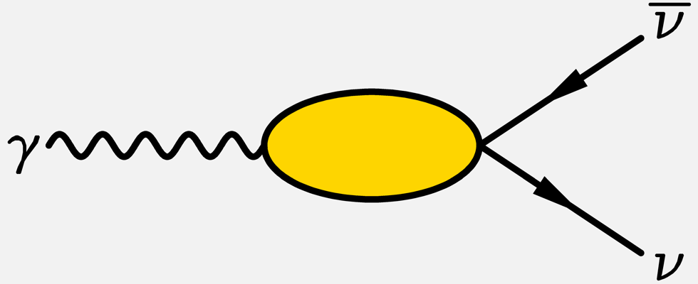
Neutrino-Photon-Coupling in a Plasma
Neutrino effective in-medium coupling
$$L_{eff}=−\sqrt{2}G_{F}\overline{Ψ}γ_{α}\frac{1}{2}\left(1−γ_{5}\right)ΨΛ^{αβ}A_{β}$$
$$Λ^{μν}$$
For vector current it is analogous
to photon polarization tensor
$$Λ_{V}^{μν}\left(K\right)=4eC_{V}\int{\frac{d^{3}p}{2E{\left(2π\right)}^{3}}}\left[f_{e}\left(p\right)+f_{\overline{e}}\left(p\right)\right] \frac{{\left(PK\right)}^{2}g^{μν}+K^{2}P^{μ}P^{ν}−PK\left(P^{μ}K^{ν}+K^{μ}P^{ν}\right)}{{\left(PK\right)}^{2}−\frac{1}{4}{\left(K^{2}\right)}^{2}}$$
$$=\frac{C_{V}}{e} Π_{V}^{μν}(K)$$
$$Λ_{A}^{μν}\left(K\right)=2ieC_{A}ε^{μναβ}\int{\frac{d^{3}p}{2E{\left(2π\right)}^{3}}}\left[f_{e}\left(p\right)−f_{\overline{e}}\left(p\right)\right] \frac{K^{2}P_{α}K_{β}}{{\left(PK\right)}^{2}−\frac{1}{4}{\left(K^{2}\right)}^{2}}$$
Usually
negligible

Slide 27
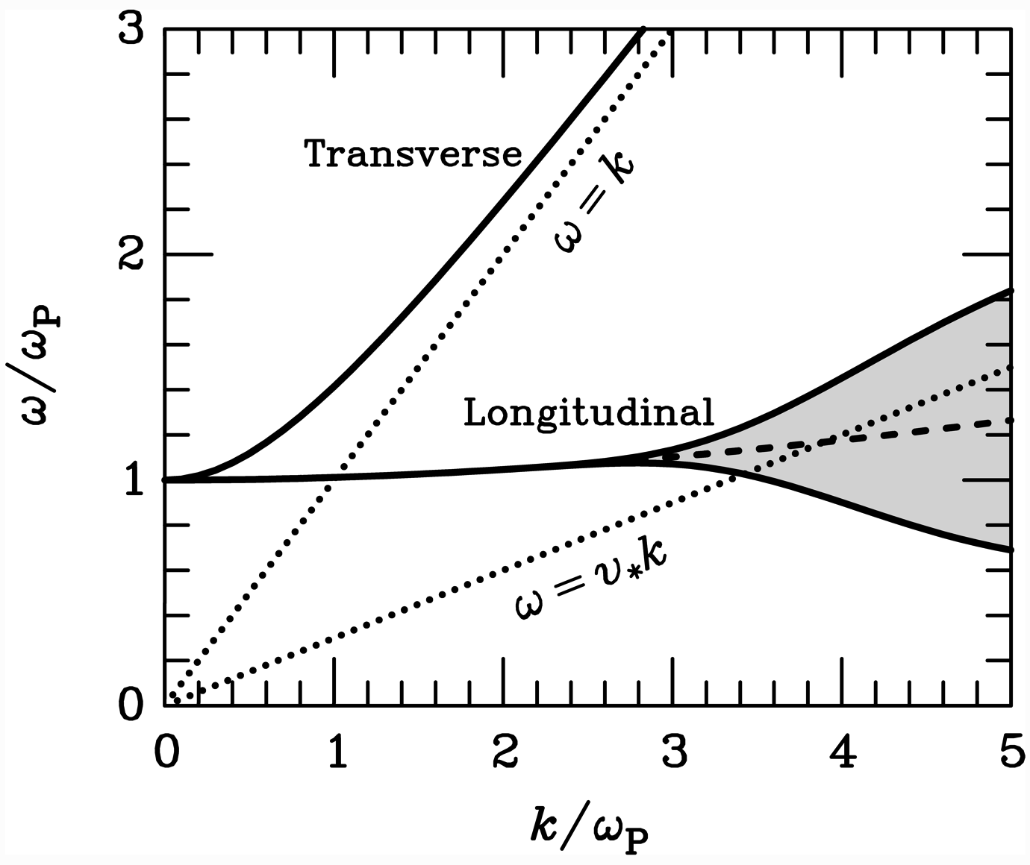
Transverse and Longitudinal “Plasmons”
Dispersion relation in a
non-relativistic,
non-degenerate plasma
Time-like
$$ω^{2}−k^{2}>0$$
Space-like
$$ω^{2}−k^{2}<0$$
Landau
damping
Transverse Excitation
$$E$$
$$p$$
$$B$$
Longitudinal Excitation
(oscillation of electrons
against positive charges)
$$E$$
$$p$$
$$B=0$$

Slide 28
Electron (Positron) Dispersion Relation
Electron (positron)
Electron (positron) plasmino,
a collective spin ½ excitation
of the medium
E. Braaten, Neutrino emissivity of an ultrarelativistic plasma from positron
and plasmino annihilation, Astrophys. J. 392 (1992) 70

Slide 29
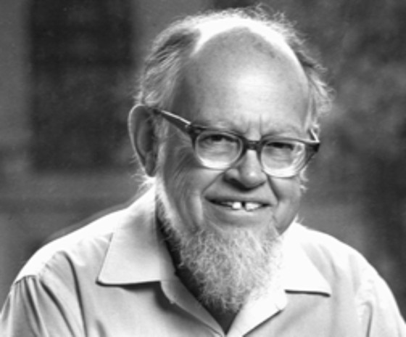
Neutrino Oscillations in Matter
3700 citations
Neutrinos in a medium suffer flavor-dependent
refraction
W
f
ν
ν
ν
Z
ν
f
$V_{\text{weak}}=\sqrt{2}G_{\text{F}}×\left\{\begin{matrix}N_{\text{e}}−{N_{\text{n}}}/2 \\ {{−N}_{\text{n}}}/2\end{matrix} \begin{matrix}\text{f}\text{or} { ν}_{\text{e}} \\ \text{f}\text{or} ν_{μ}\end{matrix}\right.$
Lincoln Wolfenstein
Typical density of Earth: 5 g/cm³
$$ΔV_{\text{weak}}≈2×{10}^{−13} \text{eV}=0.2 \text{peV}$$

Slide 30
Citations of Wolfenstein’s Paper on Matter Effects
inSPIRE: 3700 citations of Wolfenstein, Phys. Rev. D17 (1978) 2369
Atmospheric
oscillations
SNO
KamLAND
Gallium
experiments
MSW effect
SN 1987A
Solar neutrinos
no longer central
Nobody believes
flavor oscillations

Slide 31
Generic Types of Stars

Slide 32
Self-Regulated Nuclear Burning
Virial Theorem: $〈E_{kin}〉=−\frac{1}{2}〈E_{grav}〉$
Small Contraction
Heating
Increased nuclear burning
Increased pressure
Expansion
Additional energy loss (“cooling”)
Loss of pressure
Contraction
Heating
Increased nuclear burning
Hydrogen burning at nearly fixed T
Gravitational potential nearly fixed:
${G_{N}M}/R∼constant$
$R∝M$ (More massive stars bigger)
Main-Sequence
Star

Slide 33
Modified Stellar Properties by Particle Emission
Assume that some small perturbation (e.g. axion emission) leads to a “homologous”
modification: Every point is mapped to a new position $r^{′}=yr$
Requires power-law relations for constitutive relations
Nuclear burning rate $ε∝ρ^{n}T^{m}$
Mean opacity $κ∝ρ^{s}T^{t}$
Implications for other quantities
Density $ρ^{′}\left(r^{′}\right)=y^{−3}ρ\left(r\right)$
Pressure $p^{′}\left(r^{′}\right)=y^{−4}p\left(r\right)$
Temperature gradient ${dT^{′}\left(r^{′}\right)}/{dr^{′}}=y^{−2}{dT\left(r\right)}/{dr}$
Impact of small novel energy loss
Modified nuclear burning rate $ε=\left(1−δ_{x}\right) ε_{nuc}$
Assume Kramers opacity law $s=1$ and $t=−3.5$
Hydrogen burning $n=1$ and $m=4–6$
Star contracts, heats, and shines brighter in photons:
$$\frac{δR}{R}=−\frac{2δ_{x}}{2m+5} \frac{δT}{T}=\frac{δ_{x}}{2m+5} \frac{δL_{γ}}{L_{γ}}=\frac{δ_{x}}{2m+5}$$

Slide 34
Degenerate Stars (“White Dwarfs”)
Assume temperature very small
→ No thermal pressure
→ Electron degeneracy is pressure source
Pressure ~ Momentum density × Velocity
Electron density $n_{e}={p_{F}^{3}}/{\left(3π^{3}\right)}$
Momentum $p_{F}$ (Fermi momentum)
Velocity $v∝{p_{F}}/{m_{e}}$
Pressure $P∝p_{F}^{5}∝ρ^{5/3}∝M^{5/3}R^{−5}$
Density $ρ∝MR^{−3}$
Hydrostatic equilibrium
$$\frac{dP}{dr}=−\frac{G_{N}M_{r}ρ}{r^{2}}$$
With ${dP}/{dr}∼−P/R$ we have
$$P∝G_{N}MρR^{−1}∝G_{N}M^{2}R^{−4}$$
Inverse mass radius relationship
$R∝M^{−1/3}$
$$R=10,500 km {\left(\frac{0.6 M_{⊙}}{M}\right)}^{1/3}{\left(2Y_{e}\right)}^{5/3}$$
($Y_{e}$ electrons per nucleon)
For sufficiently large stellar mass $M$,
electrons become relativistic
Velocity = speed of light
Pressure
$$P∝p_{F}^{4}∝ρ^{4/3}∝M^{4/3}R^{−4}$$
No stable configuration
Chandrasekhar mass limit
$$M_{Ch}=1.457 M_{⊙} {\left(2Y_{e}\right)}^{2}$$

Slide 35
Degenerate Stars (“White Dwarfs”)
$$R=10,500 km {\left(\frac{0.6 M_{⊙}}{M}\right)}^{1/3}{\left(2Y_{e}\right)}^{5/3}$$
($Y_{e}$ electrons per nucleon)
For sufficiently large stellar mass $M$,
electrons become relativistic
Velocity = speed of light
Pressure
$$P∝p_{F}^{4}∝ρ^{4/3}∝M^{4/3}R^{−4}$$
No stable configuration
Chandrasekhar mass limit
$$M_{Ch}=1.457 M_{⊙} {\left(2Y_{e}\right)}^{2}$$

Slide 36
Giant Stars
Main-sequence star 1M⊙
(Hydrogen burning)
Helium-burning star 1M⊙
Large surface area
→ low temperature
→ “red giant”
Large luminosity
→ mass loss
Envelope
convective
$$1 R_{⊙}$$
$ε_{nuc}\left(He\right)$ depends on
$T∝Φ_{grav}$ $∝M/R$
of core
$$10 R_{⊙}$$
$$0.3 R_{⊙}$$
$ε_{nuc}\left(H\right)$ depends on
$$T∝Φ_{grav}∝M/R$$
of entire star
$ε_{nuc}\left(H\right)$ depends on
$T∝Φ_{grav}$ of core
→ huge $L(H)$

Slide 37
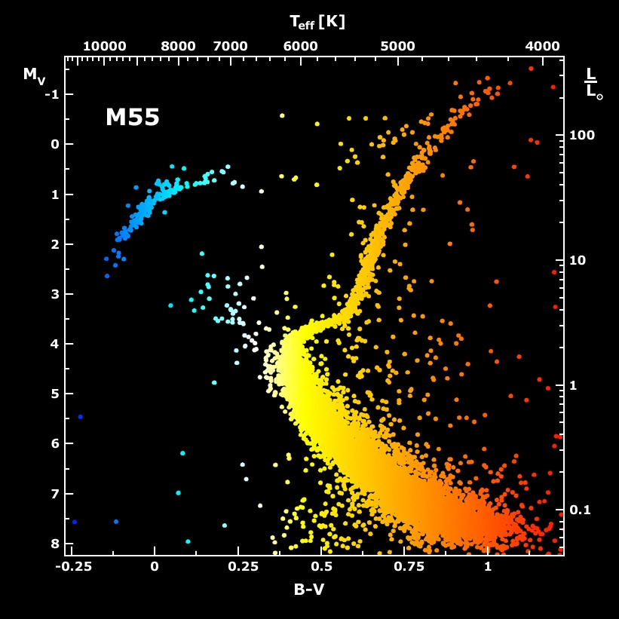
Galactic Globular Cluster M55

Slide 38
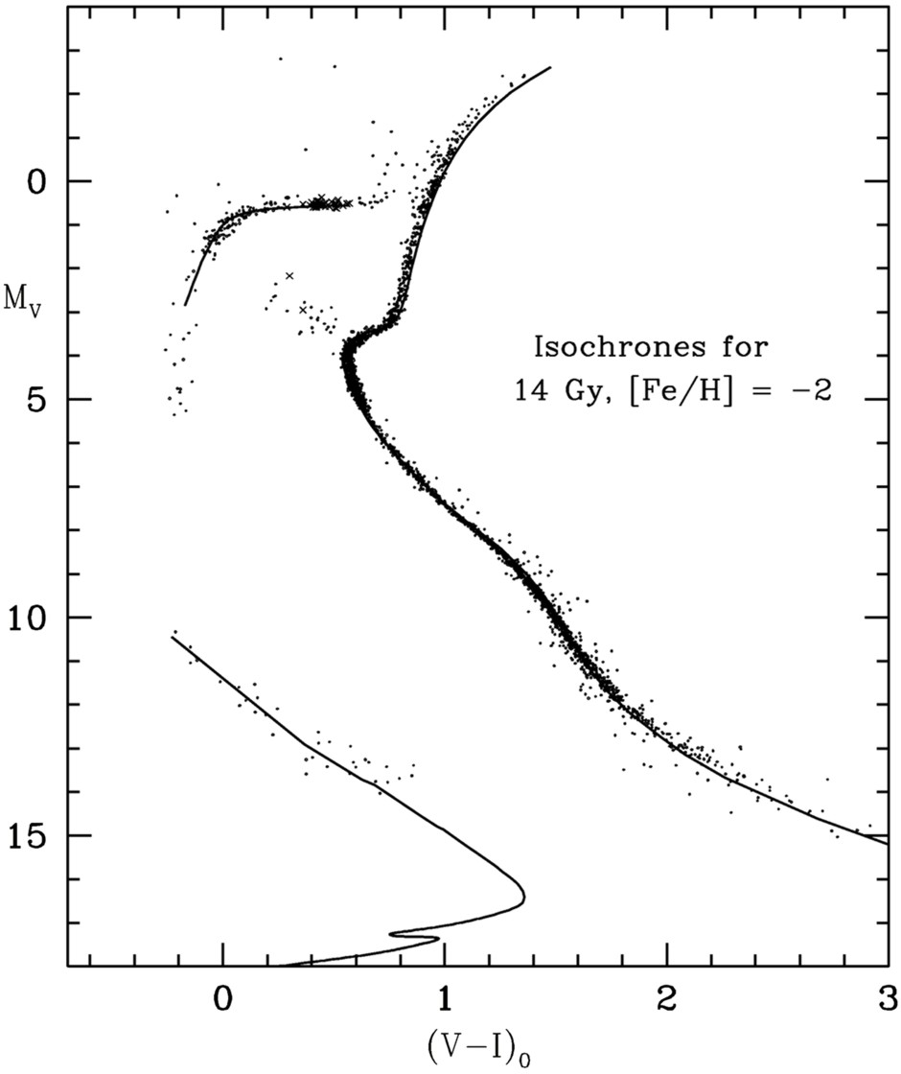
Color-Magnitude Diagram for Globular Clusters
Stars with M so
large that they
have burnt out
in a Hubble time
No new star
formation in
globular clusters
Mass
H
Main-Sequence
Hot, blue
cold, red
Color-magnitude diagram synthesized from several low-metallicity globular
clusters and compared with theoretical isochrones (W.Harris, 2000)

Slide 39
Color-Magnitude Diagram for Globular Clusters
H
H
He
C O
He
Asymptotic Giant
Red Giant
H
H
He
C O
White
Dwarfs
Horizontal Branch
Main-Sequence
Hot, blue
cold, red
Color-magnitude diagram synthesized from several low-metallicity globular
clusters and compared with theoretical isochrones (W.Harris, 2000)

Slide 40
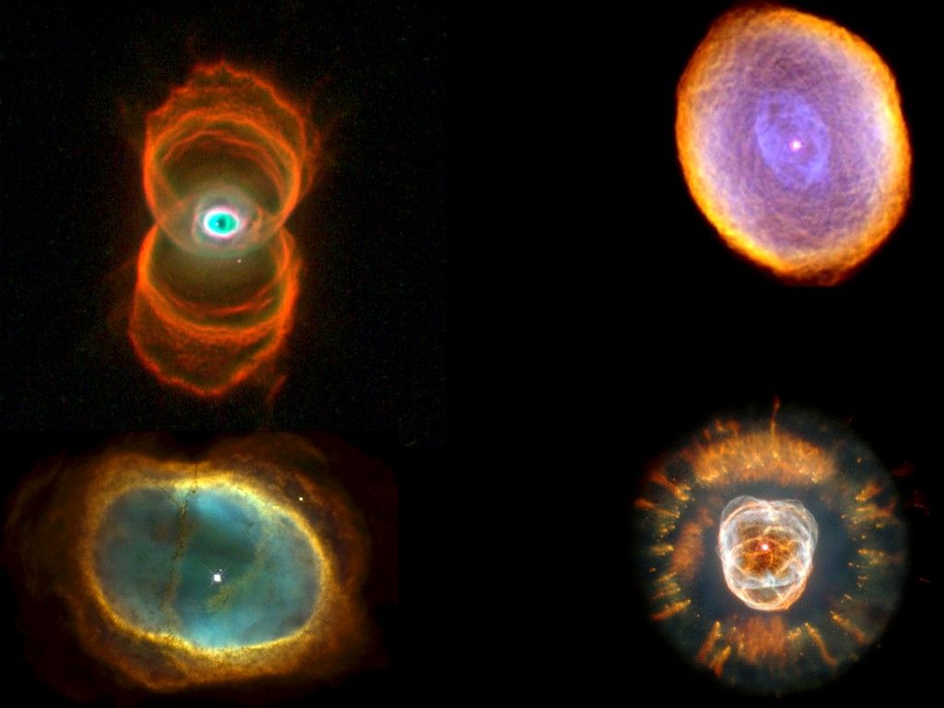
Planetary Nebulae
Hour
Glass
Nebula
Planetary
Nebula IC 418
Eskimo
Nebula
Planetary
Nebula NGC 3132

Slide 41
Evolution of Stars
M < 0.08 M_{sun}
Never ignites hydrogen → cools
(“hydrogen white dwarf”)
Brown dwarf
0.08 < M ≲ 0.8 M_{sun}
Hydrogen burning not completed
in Hubble time
Low-mass
main-squence star
0.8 ≲ M ≲ 2 M_{sun}
Degenerate helium core
after hydrogen exhaustion
Carbon-oxygen
white dwarf
Planetary nebula
2 ≲ M ≲ 5−8 M_{sun}
Helium ignition non-degenerate
8 M_{sun} ≲ M < ???
All burning cycles
Onion skin
structure with
degenerate iron
core
Core
collapse
supernova
Neutron star
(often pulsar)
Sometimes
black hole?
Supernova
remnant (SNR),
e.g. crab nebula

