Slide 1
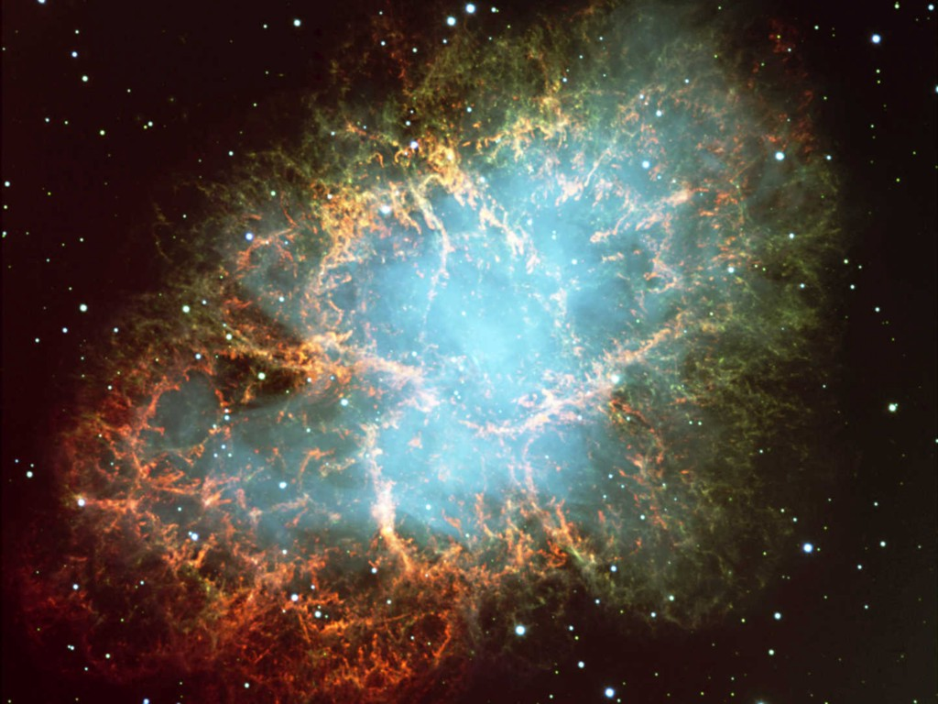
Crab Nebula
Neutrinos
in Astrophysics and Cosmology
Cosmological Neutrinos 2
Georg G. Raffelt
Max-Planck-Institut für Physik, München, Germany

Slide 2
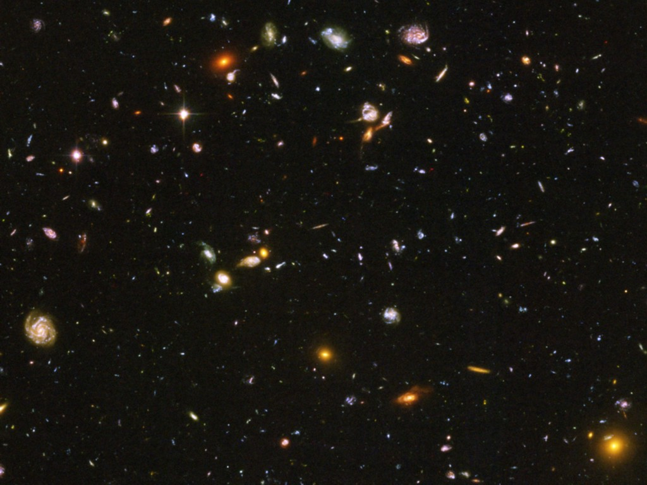
Neutrinos in Cosmology
• How Many Neutrinos?
(Dark radiation/sterile neutrinos?)
• Absolute mass determination and limits
• Big Bang Nucleosynthesis – BBN
(Origin of light elements)
• Leptogenesis
(Origin of Matter Abundance)

Slide 3
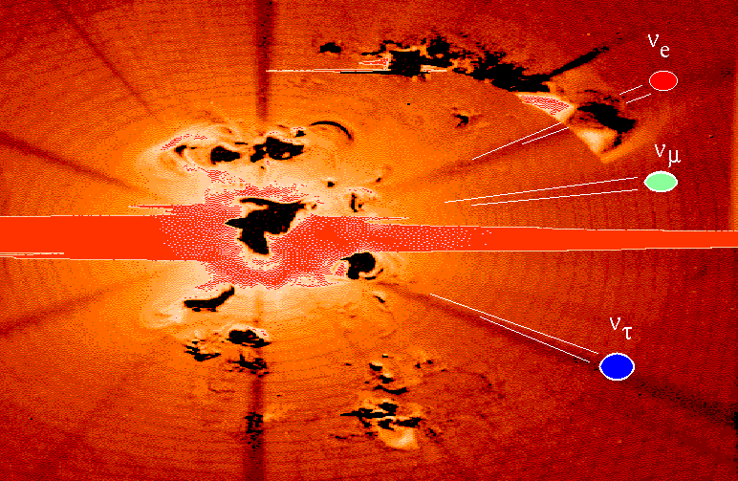
Creation of the Universe
Cosmic
Neutrino Sea

Slide 4
Neutrino Thermal Equilibrium
Neutrino reaction rate
Cosmic expansion rate
Examples for neutrino processes
Friedmann equation (flat universe)
$$e^{+}+e^{−}↔\overline{ν}+ν$$
$$\overline{ν}+ν↔\overline{ν}+ν$$
$$ν+e^{±}↔ν+e^{±}$$
$$H^{2}=\frac{8π}{3}\frac{ρ}{m_{Pl}^{2}}$$
$$\left(G_{N}=\frac{1}{m_{Pl}^{2}}\right)$$
G_{F}
Radiation dominates
$$ρ∼T^{4}$$
Dimensional analysis of reaction rate
in a thermal medium for T ≪ m_{W,Z}
Expansion rate
$$H∼\frac{T^{2}}{m_{Pl}}$$
$$Γ∼G_{F}^{2}T^{5}$$
Condition for thermal equilibrium: $Γ>H$
$$T>{\left(m_{Pl}G_{F}^{2}\right)}^{−1/3}∼{\left[{10}^{19}GeV {\left({10}^{−5}GeV^{−2}\right)}^{2}\right]}^{−1/3}=1 MeV$$
Neutrinos are in thermal equilibrium for T ≳ 1 MeV
corresponding to t ≲ 1 sec

Slide 5
Thermal Radiations
General
Bosons
Fermions
Number density n
$$g\int{\frac{d^{3}p}{{\left(2π\right)}^{3}}}\frac{1}{e^{{E_{p}}/T}±1}$$
$$g_{B}\frac{ζ_{3}}{π^{2}} T^{3}$$
$$\frac{3}{4} g_{F}\frac{ζ_{3}}{π^{2}} T^{3}$$
Energy density ρ
$$g\int{\frac{d^{3}p}{{\left(2π\right)}^{3}}}\frac{E_{p}}{e^{{E_{p}}/T}±1}$$
$$g_{B}\frac{π^{2}}{30} T^{4}$$
$$\frac{7}{8} g_{F}\frac{π^{2}}{30} T^{4}$$
Energy density ρ
$$g\int{\frac{d^{3}p}{{\left(2π\right)}^{3}}}\frac{E_{p}}{e^{{E_{p}}/T}±1}$$
Pressure P
$$\frac{ρ}{3}$$
Entropy density s
$$\frac{ρ+P}{T}=\frac{4}{3} \frac{ρ}{T}$$
$$g_{B}\frac{{2π}^{2}}{45} T^{3}$$
$$\frac{7}{8} g_{F}\frac{{2π}^{2}}{45} T^{3}$$
Riemann Zeta Function
$$ζ_{3}=1.2020569…$$

Slide 6
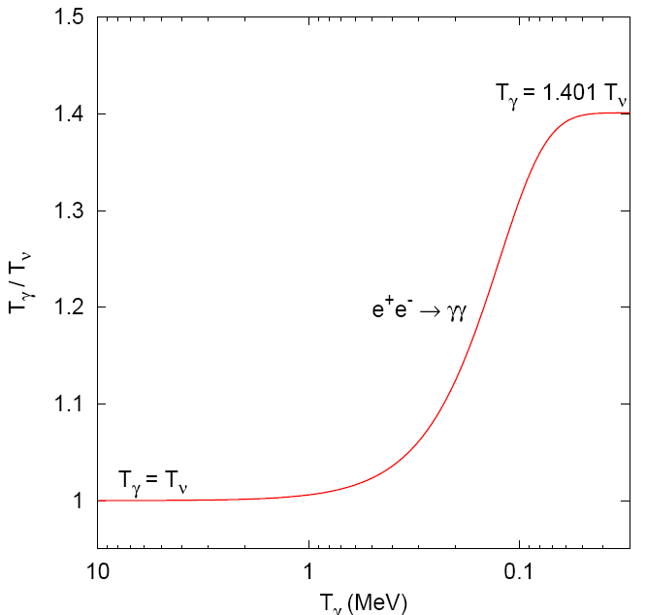
Photon Heating by Electron-Positron Annihilation
$$T_{γ}={\left(\frac{11}{4}\right)}^{1/3}T_{ν}=1.401 T_{ν}$$
$$m_{e}$$
T_{γ} (MeV)

Slide 7
Present-Day Neutrino Density
Neutrino decoupling
(freeze out)
$H∼Γ$
$T≈2.4 MeV$ (electron flavor)
$T≈3.7 MeV$ (other flavors)
$$\frac{dn_{ν\overline{ν}}}{dE}=\frac{1}{π^{2}}\frac{E^{2}}{e^{E/T}+1}$$
Redshift of Fermi-Dirac
distribution (“nothing
changes at freeze-out”)
Temperature
scales with redshift
$$T_{ν}=T_{γ}∝\left(z+1\right)$$
Electron-positron
annihilation beginning
at T ≈ m_{e} = 0.511 MeV
QED plasma is “strongly” coupled
Stays in thermal equilibrium (adiabatic process)
Entropy of e⁺e⁻ transfered to photons
$$g_{∗}T_{γ}^{3}{\left.​\right|}_{before}=g_{∗}T_{γ}^{3}{\left.​\right|}_{after}$$
$$\}$$
$$T_{γ}^{3}{\left.​\right|}_{before}=\frac{4}{11}T_{γ}^{3}{\left.​\right|}_{after}$$
$\overbrace{2+\frac{7}{8}4=\frac{11}{2}}$
$\overbrace{2}$
Redshift of
neutrino and photon
thermal distributions
so that today we have
$n_{ν\overline{ν}}\left(1 flavor\right)=\frac{4}{11}×\frac{3}{4}×n_{γ}=\frac{3}{11}n_{γ}≈112 cm^{−3}$
$T_{ν}={\left(\frac{4}{11}\right)}^{1/3}T_{γ}≈1.95 K$ for massless neutrinos

Slide 8
Present-Day Neutrino Distribution
Minimal neutrino masses
from oscillation experiments
Normal
Inverted
m₃ ≳ 50 meV
m₁ ≈ m₂ ≳ 50 meV
m₂ ≳ 8 meV
m₁ ≥ 0
m₃ ≥ 0
Temperature of massless
cosmic background neutrinos
T = 1.95 K = 0.17 meV
Cosmic redshift of momenta
(not energies)
$$\frac{dn_{ν\overline{ν}}}{dp}=\frac{1}{π^{2}}\frac{p^{2}}{e^{p/T}+1}$$
Not a thermal
distribution
unless T ≫ m
Average velocity for m ≫ T
$$\left\langle v\right\rangle ≈\frac{3T}{m}$$
Normal hierarchy neutrinos
$$\left\langle v_{3}\right\rangle <1×{10}^{−2}c \left\langle v_{2}\right\rangle <6×{10}^{−2}c$$

Slide 9
Cosmic radiation density after e⁺e⁻ annihilation
Radiation density for N_{ν} = 3 standard neutrino flavors
$$ρ_{rad}=ρ_{γ}+ρ_{ν}=\frac{π^{2}}{15}\left(T_{γ}^{4}+N_{ν}\frac{7}{8} T_{ν}^{4}\right)=\left[1+N_{ν}\frac{7}{8} {\left(\frac{4}{11}\right)}^{4/3}\right]ρ_{γ}$$
Cosmic radiation density is expressed in terms of
“effective number of thermally excited neutrino species” N_{eff}
$$ρ_{rad}=\left[1+N_{eff} \frac{7}{8} {\left(\frac{4}{11}\right)}^{4/3}\right]ρ_{γ}=\left[1+N_{eff} 0.2271\right]ρ_{γ}$$
N_{eff} is a measure for the radiation density, not necessarily related to neutrinos
Residual neutrino heating by e⁺e⁻ annihilation and corrections for plasma
effects and neutrino flavor oscillations implies
$N_{eff}=3.046$ Standard value
$${ ρ}_{rad}=\left(1+0.6918+{0.2271 ΔN}_{eff}\right) ρ_{γ}$$
Of course, the number of known neutrino species $ν_{e}$, $ν_{μ}, { ν}_{τ}$ is exactly 3

Slide 10
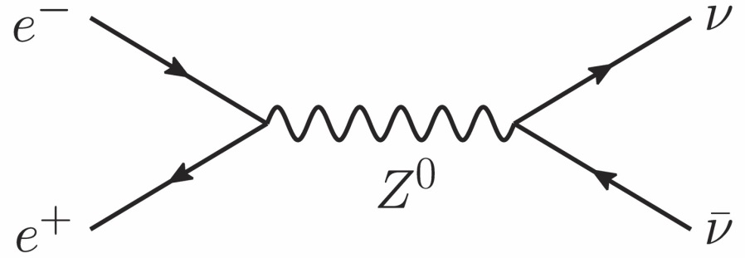
Neutrino Counting in Particle Physics
Resonant Z-Boson production at LEP
(Electron-positron collider at CERN before LHC, in the same tunnel)
Cross section follows resonance curve
$$\frac{dσ}{dE}∝\frac{Γ/2}{{\left(E−m_{Z}\right)}^{2}+{\left(Γ/2\right)}^{2}}$$
Contribution to Γ_{invis} of one standard neutrino family
$$Γ_{ν\overline{ν}}=167.2 MeV$$
$$\frac{Γ_{invis}}{Γ_{ν\overline{ν}}}=2.984±0.008$$
No room for weakly interacting particles that couple to the Z unless m > m_{Z}/2
or strongly reduced coupling strength
Or other final states
$q\overline{q}$, $e^{+}e^{−}$, $μ^{+}μ^{−}$, $τ^{+}τ^{−}$
Measured properties
$${ m}_{Z} =\left(91.1876±0.0021\right) GeV$$
$${ Γ}_{tot} =\left(2.4952±0.0023\right) GeV$$
$${ Γ}_{invis}=\left(499.0±1.5\right) MeV$$

Slide 11
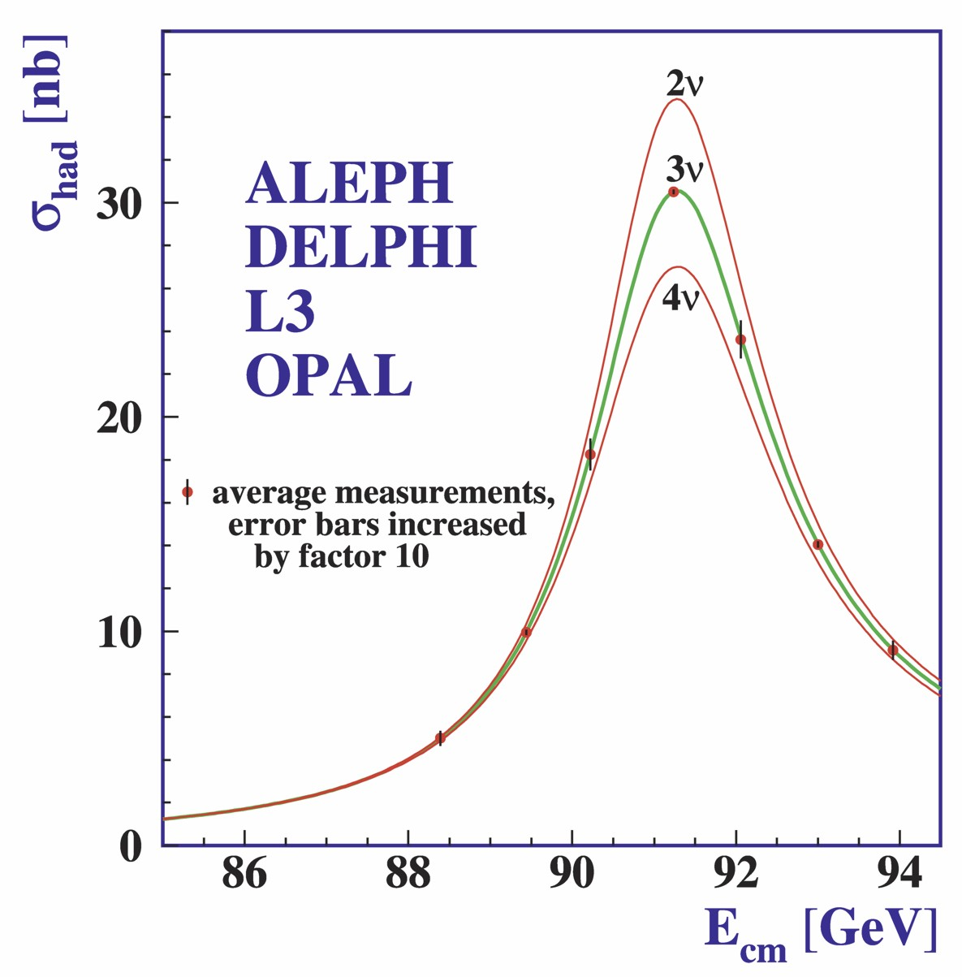
Measured Z⁰ Width at LEP (ca 1990)
Cosmological
consequences:
Standard radiation
density fixed
No “trivial” weakly
interacting dark
matter particles

Slide 12
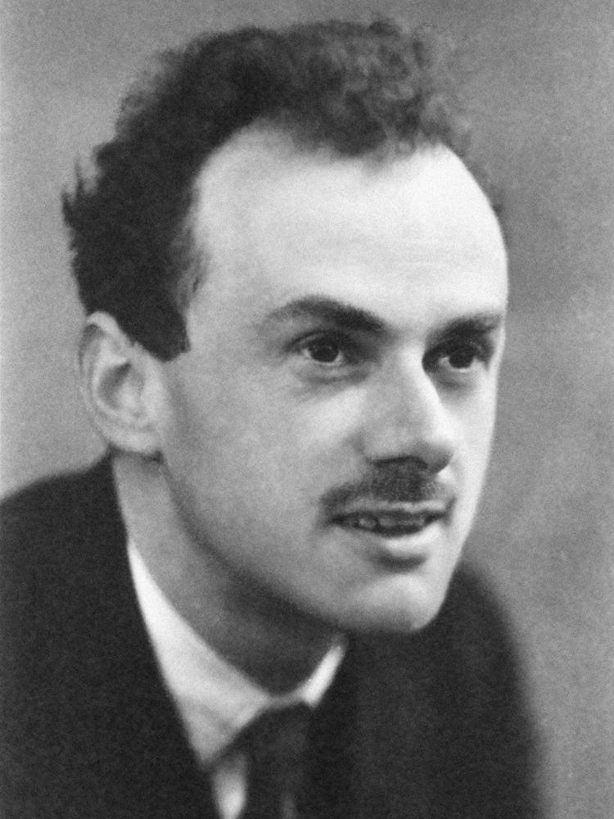
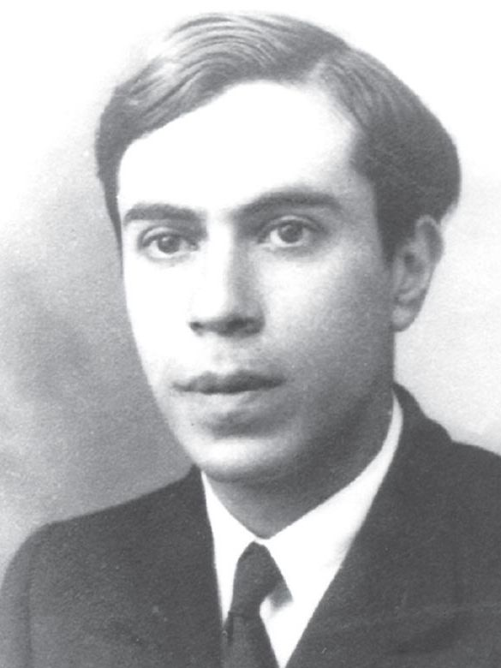
Dirac vs Majorana Neutrinos
Paul Dirac
Ettore Majorana
4 states per flavor
Twice the radiation
density?
2 states per flavor
Standard assumption
in cosmology

Slide 13
How many neutrino degrees of freedom?
Charged fermions (leptons, quarks)
each have four degrees of freedom:
2 spin states
2 charge states
Neutrinos may have only two degrees
of freedom
2 spin states
2 charge conjugate states?
Electron
Positron
Neutrino
Antineutrino
p
s
In “chiral limit”
(ultrarelativistic)
only left-handed
states interact
with W bosons
In “chiral limit”
only “left-handed”
states interact with
W or Z bosons
Sterile states need not exist
would only interact gravitationally
For massless particles, helicity is a relativistic invariant (“chirality”)

Slide 14
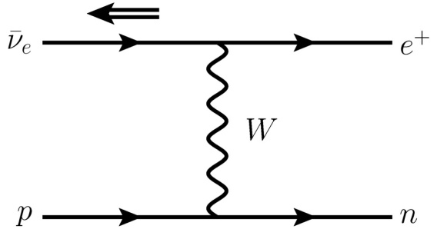
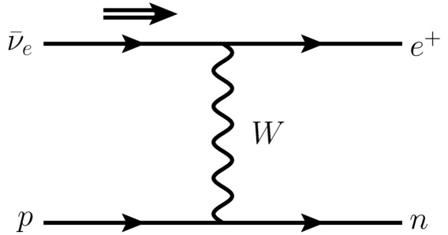
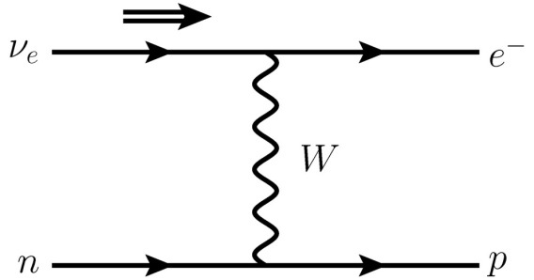
Role of Handedness
Allowed by
left-handedness of
weak interactions
Interpret as polarization
states of one “neutrino”
Handedness distinguishes
between “particles”
and “antiparticles”

Slide 15
Role of Mass
Massless,
left-handed
neutrino with
E ≫ m_{e}
Relativistic electron
is strongly, but not
perfectly polarized
“Wrong” helicity
state with probability
~ (m_{e}/E)²
Right-handed
neutrino with
small mass
E ≫ m_{ν}
Rate smaller by
~ (m_{ν}/E)²

Slide 16
Neutrinos with Mass: Dirac vs. Majorana
Dirac neutrinos are like charged leptons
2 spin states
2 “charge” states
Majorana neutrinos
2 spin states
Neutrino
Antineutrino
Neutrino
Antineutrino
Full strength
interaction for
relativistic states
Neutrino can produce
wrong-sign charged lepton:
Lepton-number violation
Interaction rates reduced by ~ (m_{ν}/E)²
from chirality projection

Slide 17
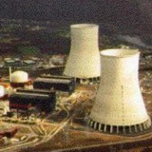
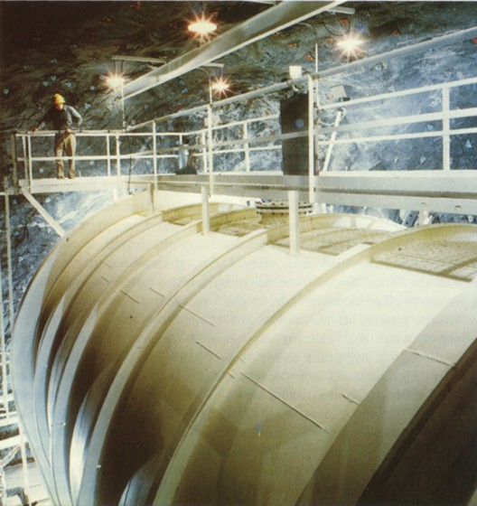
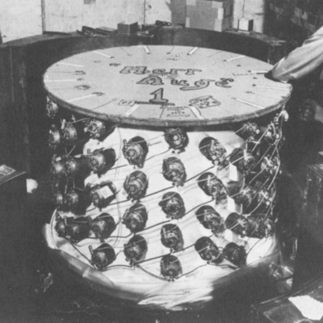
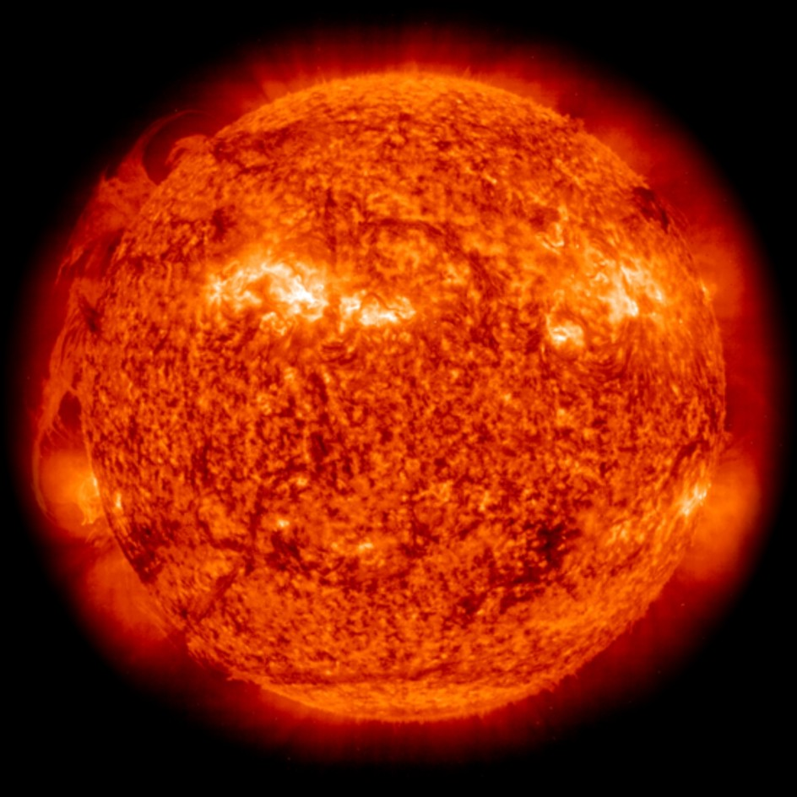
Role of Neutrino Helicity (Handedness)
Basic production process
in reactors
Anti-neutrinos always
right-handed helicity
Basic production process
in the Sun
Neutrinos always
left-handed helicity
Cowan & Reines ${\overline{ν}}_{e}$detector
in fast-moving rocket,
overtakes small-mass solar $ν_{e}$
Majorana neutrinos:
Helicity flip $→$ anti-neutrino
${ν_{e}}/{{\overline{ν}}_{e}}$ property depends
on Lorentz frame

Slide 18
Neutrino Thermal Equilibrium for Dirac Neutrinos
Neutrino reaction rate
Cosmic expansion rate
Examples for neutrino processes
Friedmann equation (flat universe)
$$e^{+}+e^{−}↔\overline{ν}+ν$$
$$\overline{ν}+ν↔\overline{ν}+ν$$
$$ν+e^{±}↔ν+e^{±}$$
$$H^{2}=\frac{8π}{3}\frac{ρ}{m_{Pl}^{2}}$$
$$\left(G_{N}=\frac{1}{m_{Pl}^{2}}\right)$$
G_{F}
Radiation dominates
$$ρ∼T^{4}$$
Dimensional analysis of reaction rate
in a thermal medium for T ≪ m_{W,Z}
Expansion rate
$$H∼\frac{T^{2}}{m_{Pl}}$$
$$Γ∼G_{F}^{2}T^{5}×{\left({m_{ν}}/T\right)}^{2}$$
Condition for thermal equilibrium: $Γ>H$
$${ m}_{ν}>G_{F}^{−1}{\left(m_{Pl}T\right)}^{{−1}/2}$$
To avoid excessive dilution at quark-hadron phase transition: $T<T_{QCD}∼170 MeV$
$${ m}_{ν}>60 keV$$
For eV-scale Dirac neutrinos, r.h. helicity degrees not thermally excited

Slide 19
Dirac vs Majorana Neutrinos
Paul Dirac
Ettore Majorana
4 states per flavor
Twice the radiation
density?
2 states per flavor
Standard assumption
in cosmology
Not thermalized

Slide 20
Big Bang Nucleosynthesis
Big Bang
Nucleosynthesis

Slide 21
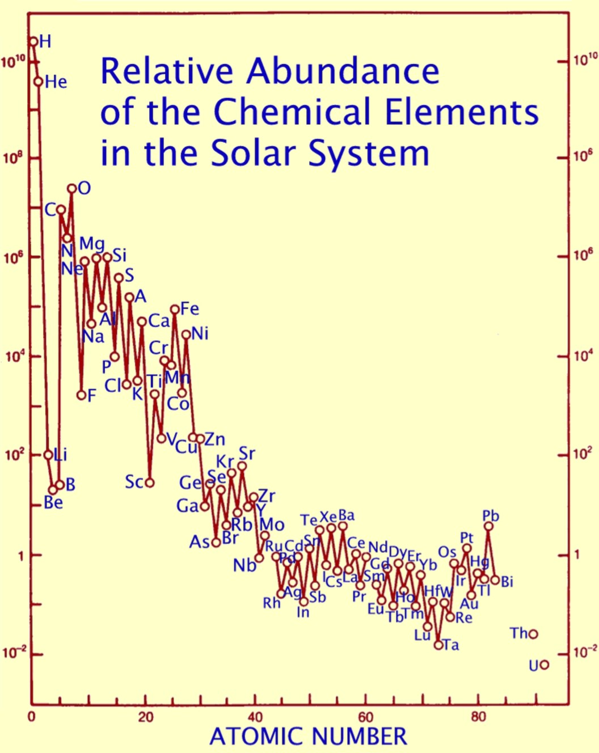
Origin of Elements
Mass fraction of helium $\sim$ 25%
everywhere in the universe
Most of it not produced in stars
(far too little star light from
liberated energy)
Big-bang nucleosynthesis (BBN)
is a pillar of modern cosmology
Neutrinos play a crucial role
$$\}$$
Produced in stars
(Fusion liberates
energy up to
iron-group nuclei)

Slide 22
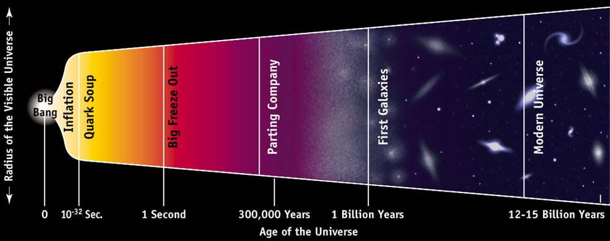
Where, When and What?
Epoch:
1 sec – 3 minutes
Temperature:
1 MeV – 30 keV
Constituents:
Photons, neutrinos, e⁺e⁻
Baryon density:
0.07 g cm⁻³ (at 1 sec)

Slide 23
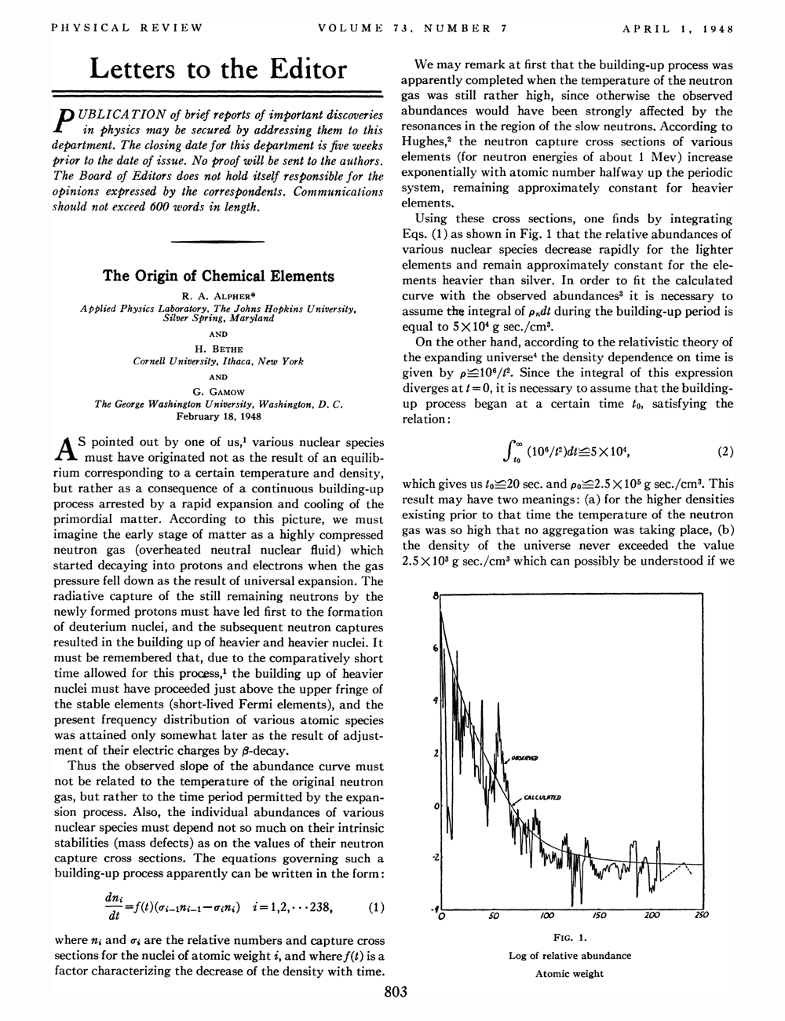
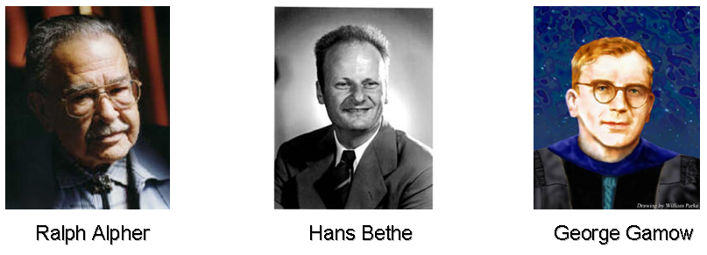
Alpha-Beta-Gamma

Slide 24
Helium Synthesis – Three Easy Steps
t
sec
T
MeV
β equilibrium
$$p+e^{−}↔n+ν_{e}$$
$$p+{\overline{ν}}_{e}↔n+e^{+}$$
$\frac{n}{p}=\exp\left(−\frac{m_{n}−m_{p}}{T}\right)≈1$
$$m_{n}−m_{p}=1.293 MeV$$
β freeze-out
$$\frac{n}{p}≈\frac{1}{6}$$
β rates fall below
expansion rate H
1
1
Neutron decay
Nuclear statist.
equilibrium
$n_{n}∝\exp\left(−\frac{t}{τ_{n}}\right)$
$τ_{n}=880 sec$ (?)
$$2p+2n↔{}_{ }^{4}{He}+γ$$
Helium suppressed
by large entropy
Neutrons freeze
in helium
$$\frac{n}{p}≈\frac{1}{7}$$
Helium mass fraction
Y_{P} ≈ 25%
100
0.1
Thermonuclear
reaction chains
Production and destruction of traces of
D, ³He, ⁶Li, ⁷Li, ⁷Be
All done
10⁴
0.01

Slide 25
Why do nuclei form so late?
Thermal equilibrium → all nuclei present
Binding energies much larger than MeV, so why are they still dissociated
at weak-interaction freeze-out? Why not everything in iron?
Basic answer: High-entropy environment with $\sim 109$photons per baryon
$Nn+Zp↔\left(A,Z\right)+photons$
High-E tail of photon distribution enough to keep nuclei dissociated
B
(MeV)
B/A
(MeV)
D
2.23
1.1
³H
6.92
2.3
³He
7.72
2.6
⁴He
28.30
7.1
⁶Li
31.99
5.3
⁷Li
39.25
5.6
⁷Be
37.60
5.4
¹²C
92.2
7.7

Slide 26
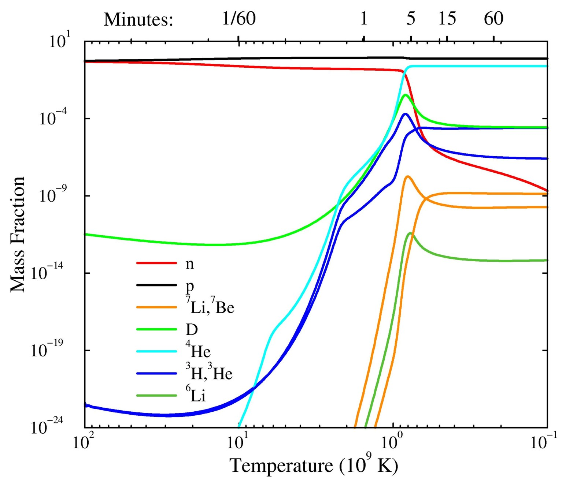
Formation of Light Elements
Protons
Helium 4
Neutrons
Deuterium
astro-ph/9903300

Slide 27
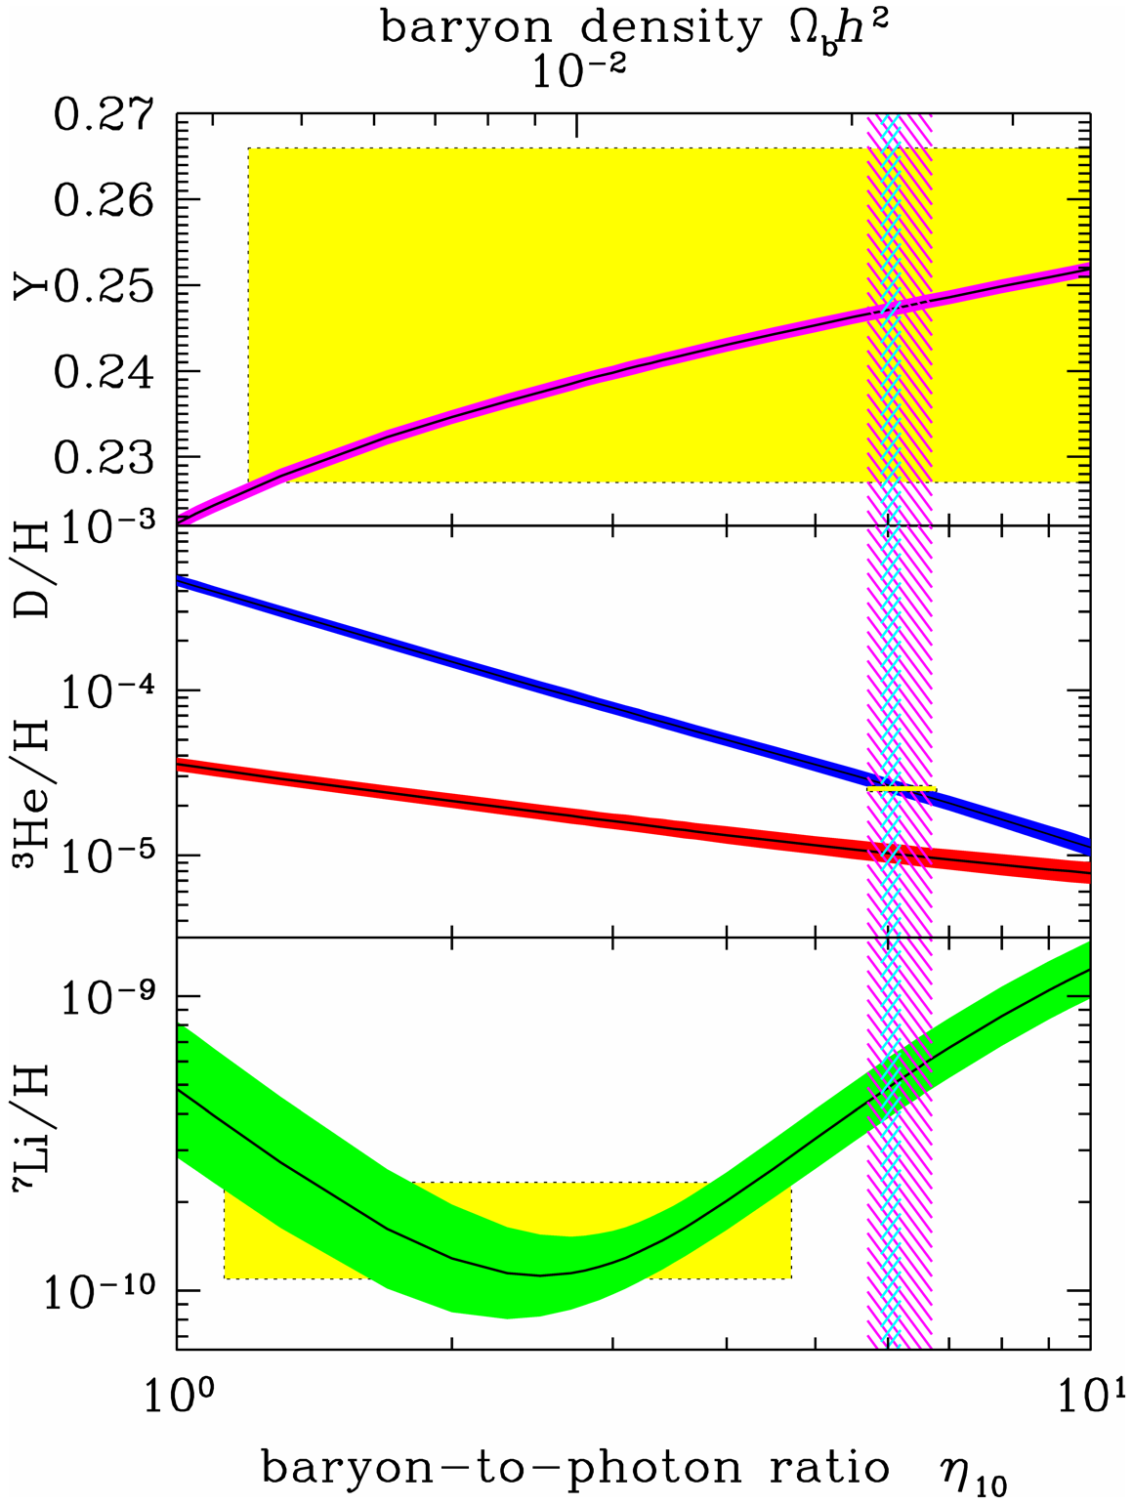
BBN Theory vs Observations
Review of Particle Properties (2014)
Precision cosmology
1
2
3
4
5
6
7
10
Baryon/Photon $η×{10}^{10}$

Slide 28
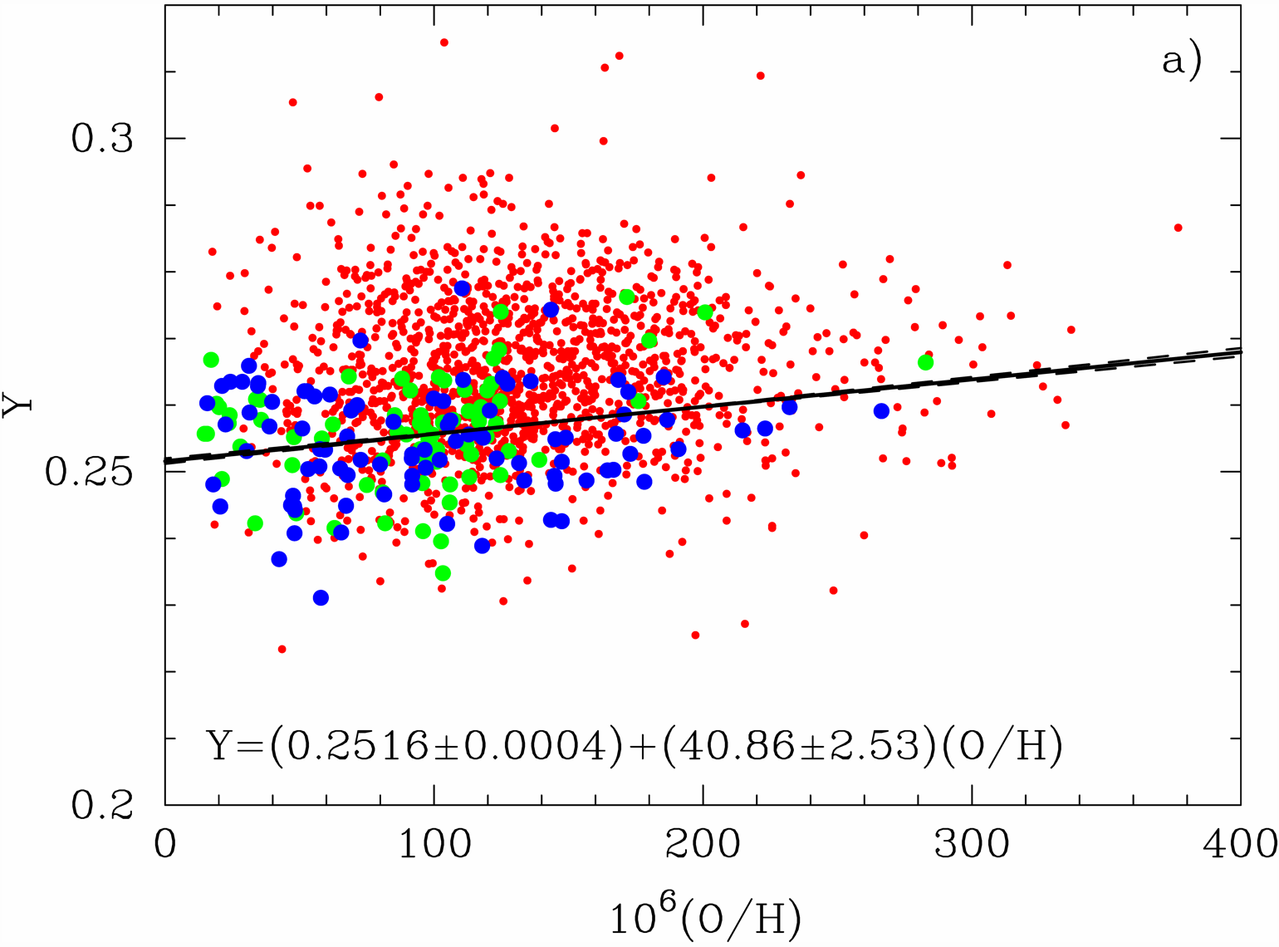
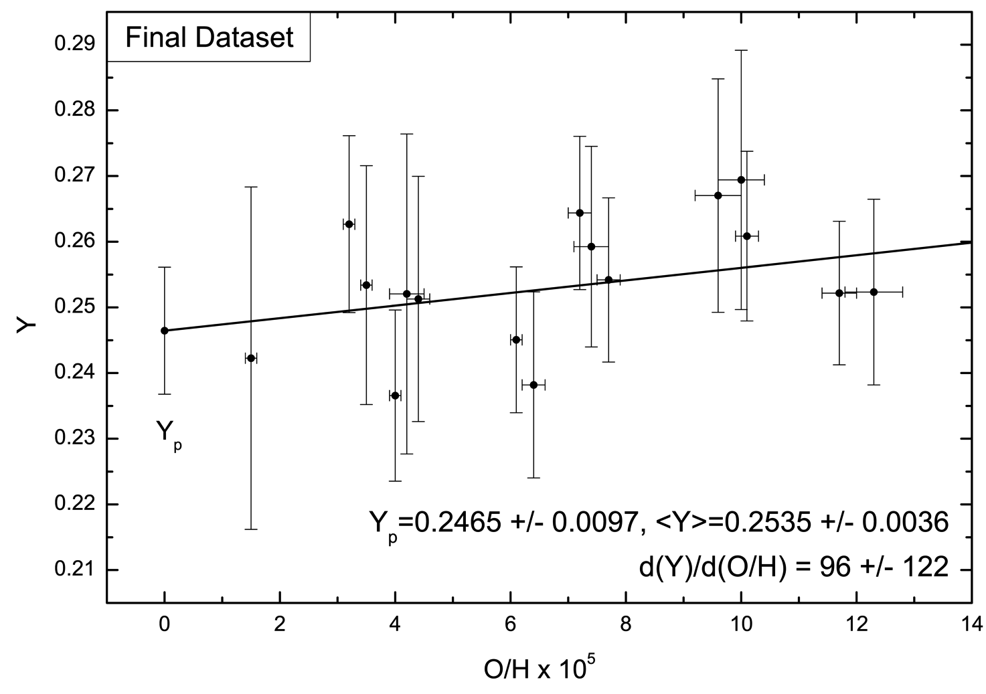
Helium Mass Fraction from HII Regions
Extrapolation to zero metalicity in many HII regions
Izotov, Stasinska & Guseva
arXiv:1308.2100
Aver, Olive, Porter & Skillman
arXiv:1309.0047
$$Y_{P}=0.254 ± 0.003$$
$$Y_{P} = 0.2465 ± 0.0097$$

Slide 29
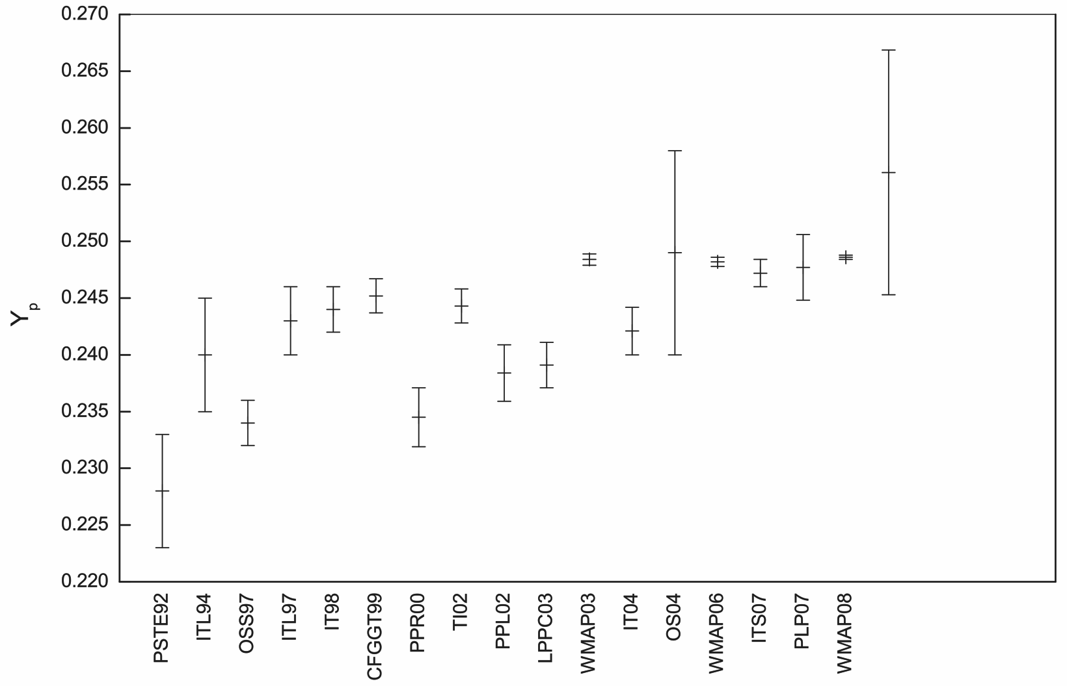
Progression of Best-Fit Helium Abundance
Adapted from Aver, Olive & Skillman, arXiv:1001.5218
IT10
AOPS13
AOS10
ISG13

Slide 30
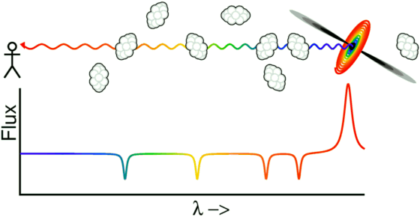
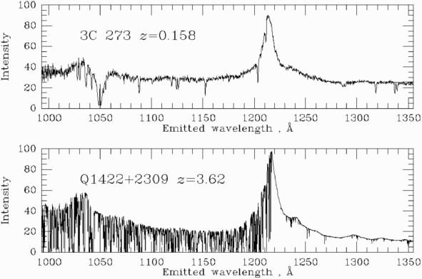
Lyman Alpha Forest
Hydrogen clouds absorb from QSO
continuum emission spectrum
Absorption dips at Ly-α wavelengh
corresponding to redshift
www.astro.ucla.edu/~wright/Lyman-alpha-forest.html
Examples for Lyman-α forest in
low- and high-redshift quasars
http://www.astr.ua.edu/keel/agn/forest.gif

Slide 31
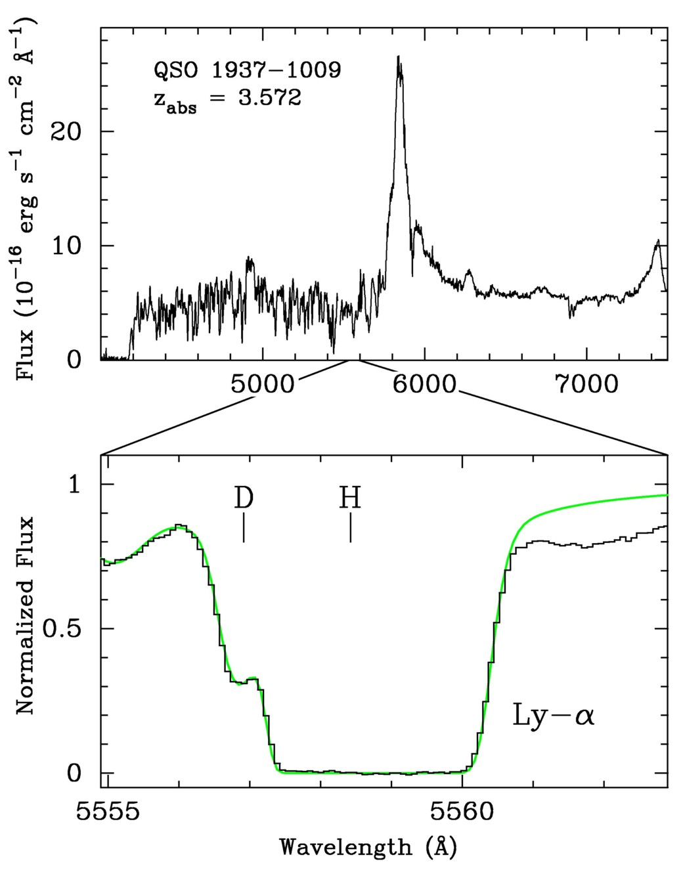
Measuring Primordial Deuterium
Hydrogen absorption spectrum of a background quasar in
high-redshift hydrogen clouds
astro-ph/9903300
Isotopic shift
$$0.33Å\left(1+z_{cloud}\right)$$
Deuterium Lyman-α in the
flank of the saturated
hydrogen Lyman-α line

Slide 32
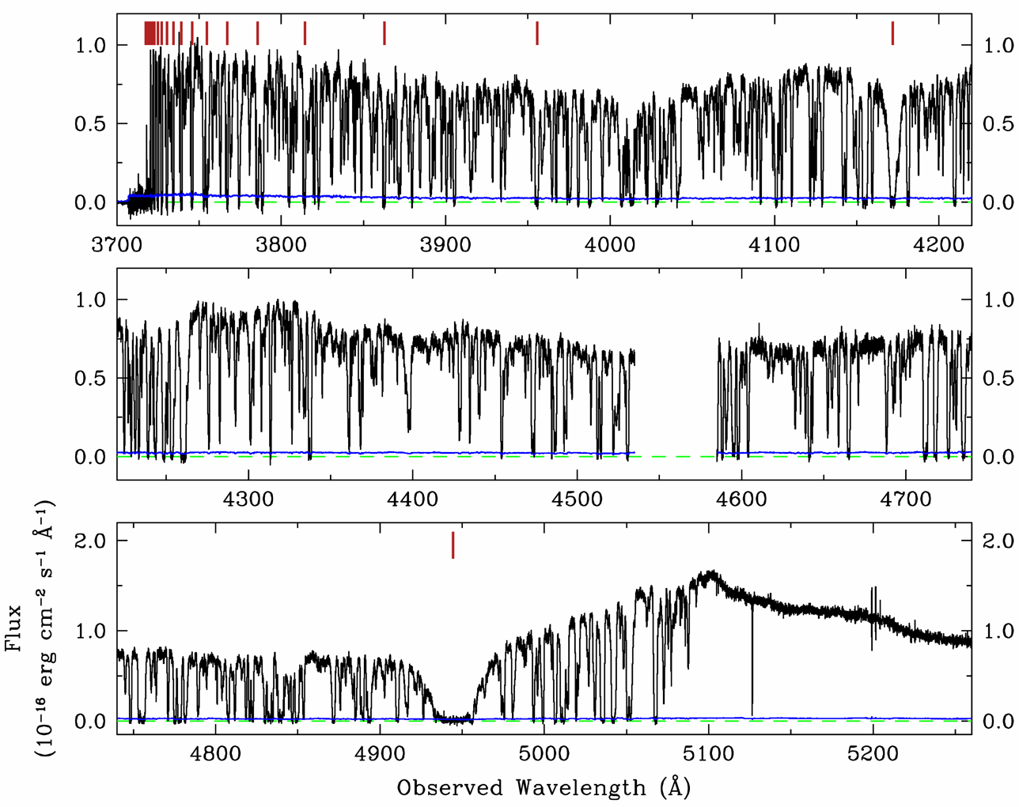
Lyman Absorption in QSO SDSS J1358+6522
Lyman Series
arXiv:1308.3240
Lyman alpha

Slide 33
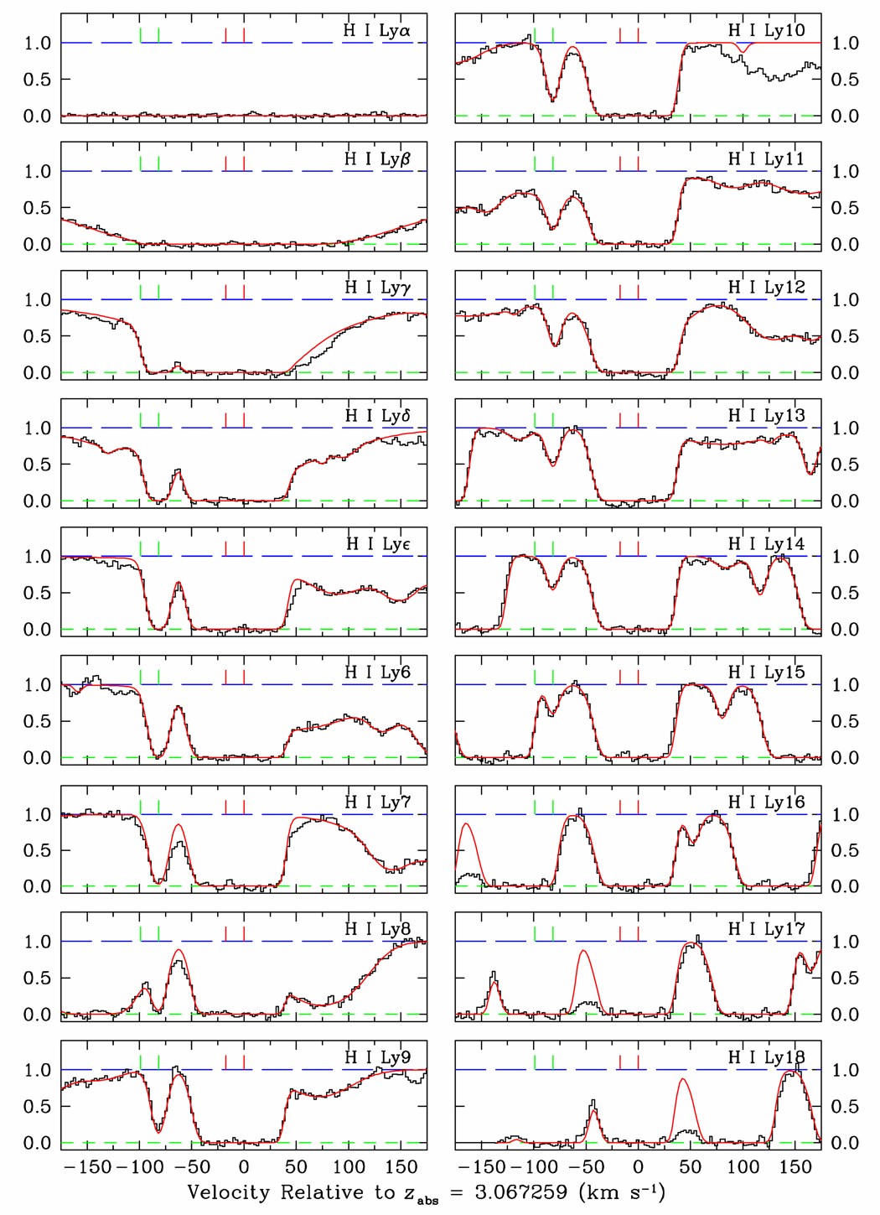
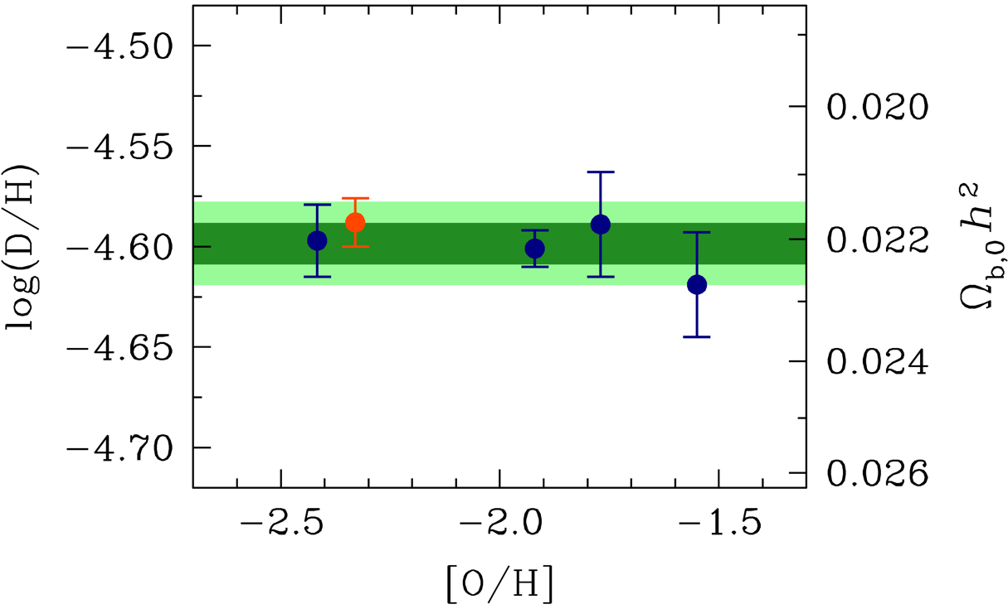
Lyman Absorption in QSO SDSS J1358+6522
D
H
Deuterium determination
$${\left(\frac{D}{H}\right)}_{P}=\left(2.53±0.04\right)×{10}^{−5}$$
Corresponding with standard BBN to
$$Ω_{B}h^{2}=0.02202±0.00046$$
[Cooke et al., arXiv:1308.3240]

Slide 34
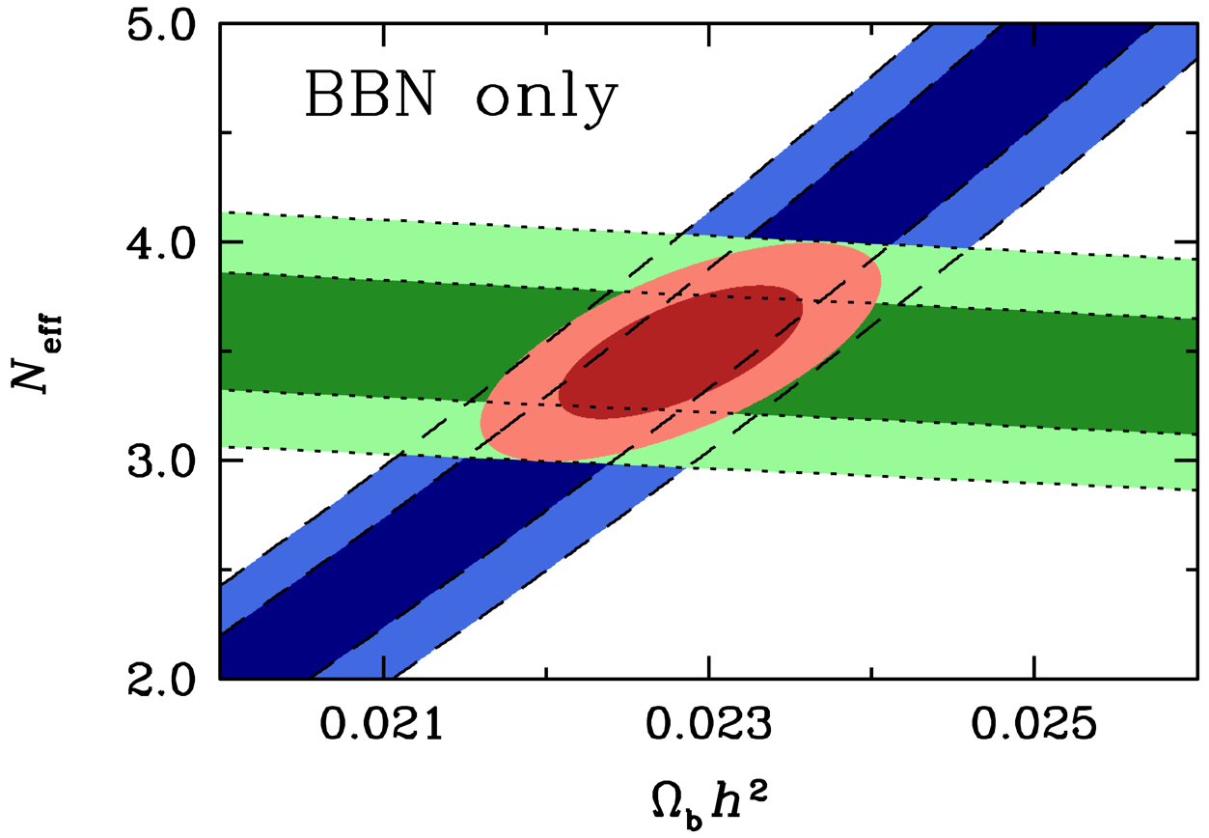
Baryon and Radiation Density from BBN
D
Cooke et al., arXiv:1308.3240
⁴He
D abundance from Cook et al. (2013) and He-4 from Izotov et al. (2013)
BBN hint for extra radiation (evidence driven by He abundance)

Slide 35
Big Bang Nucleosynthesis
Large Neutrino
Asymmetries?

Slide 36
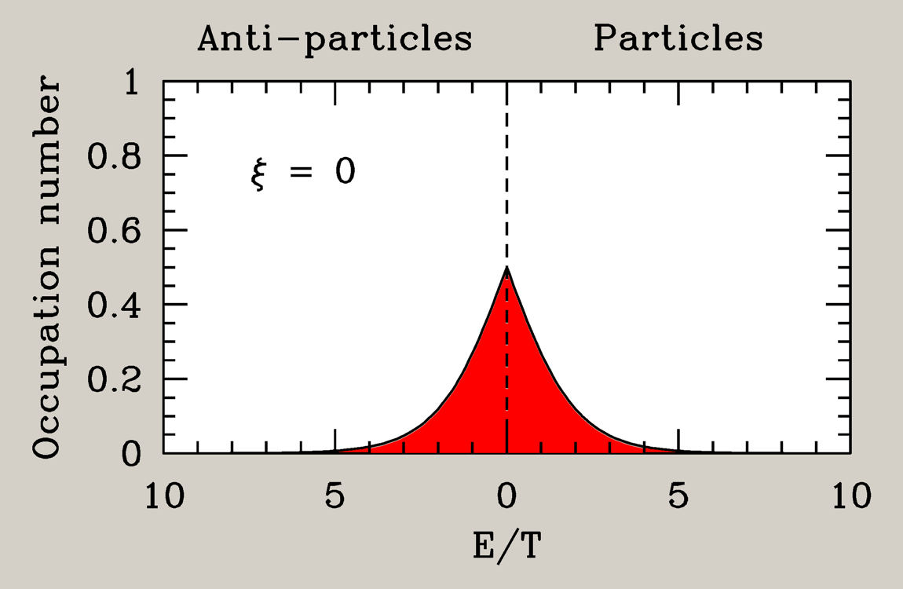
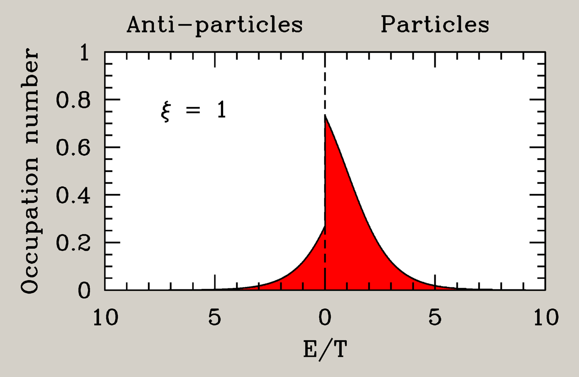
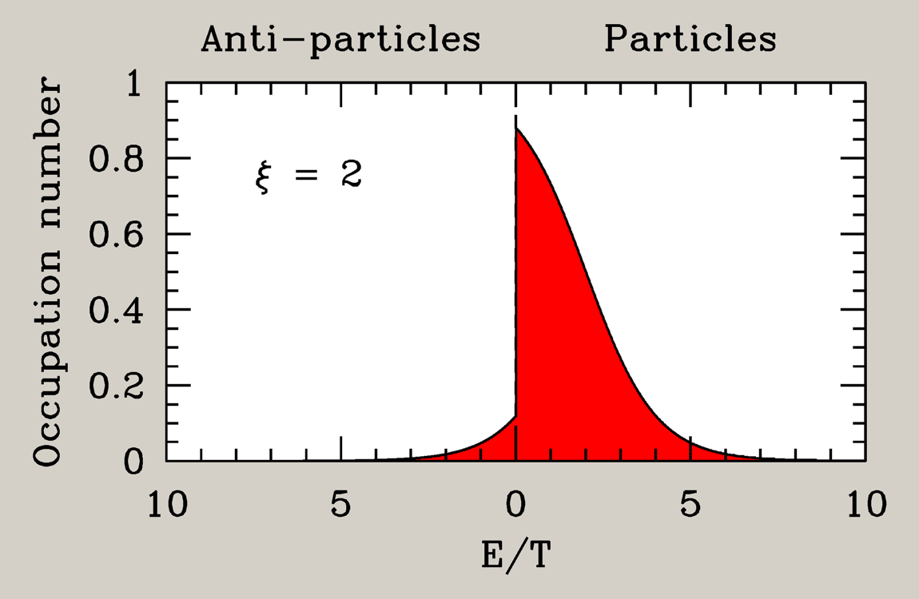
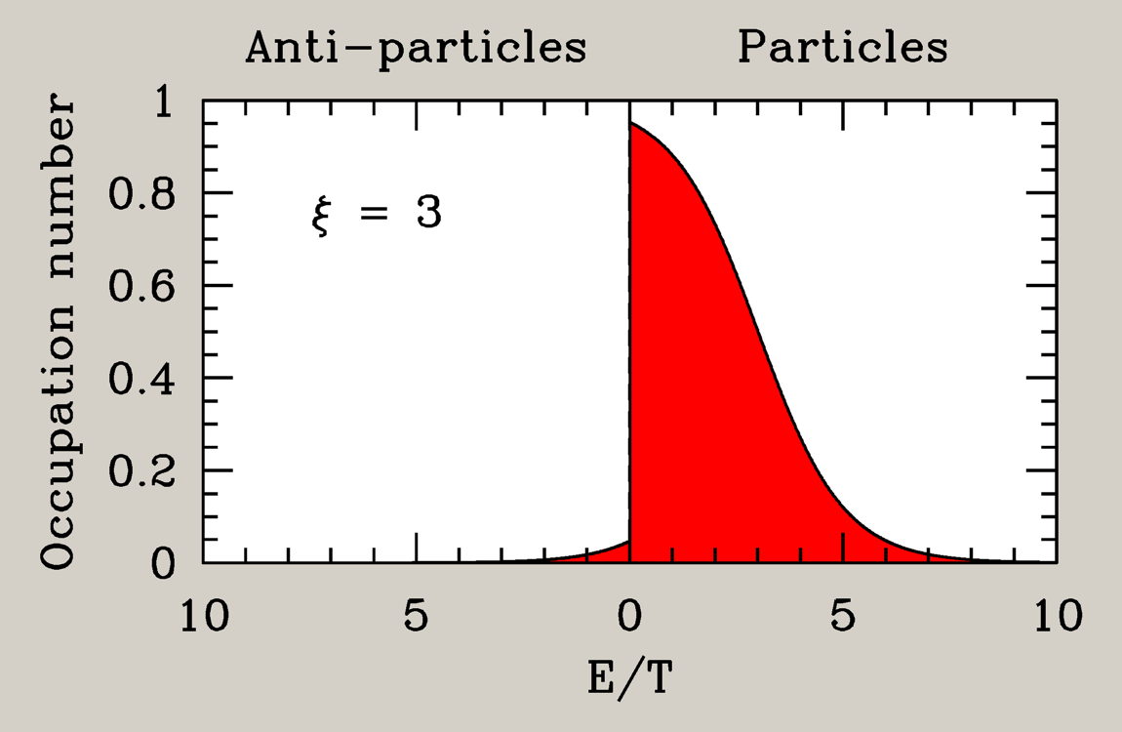
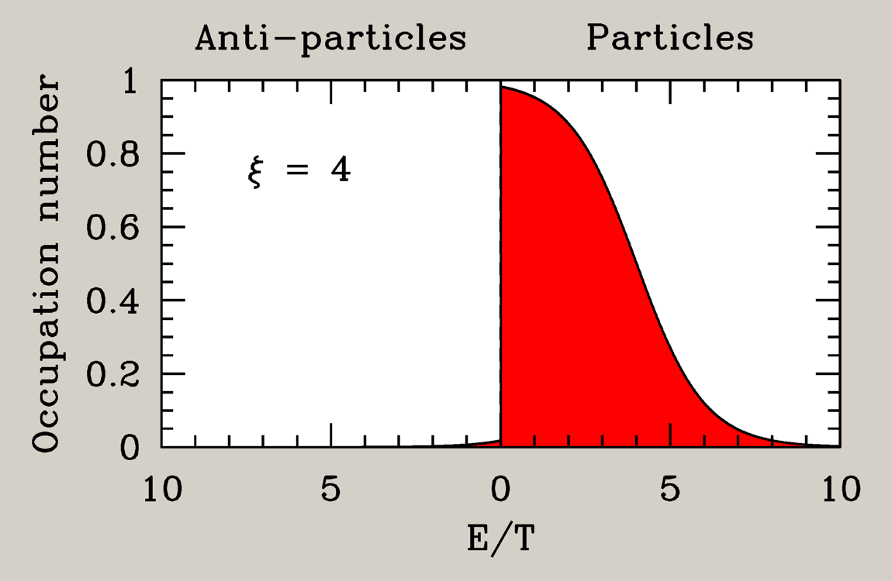
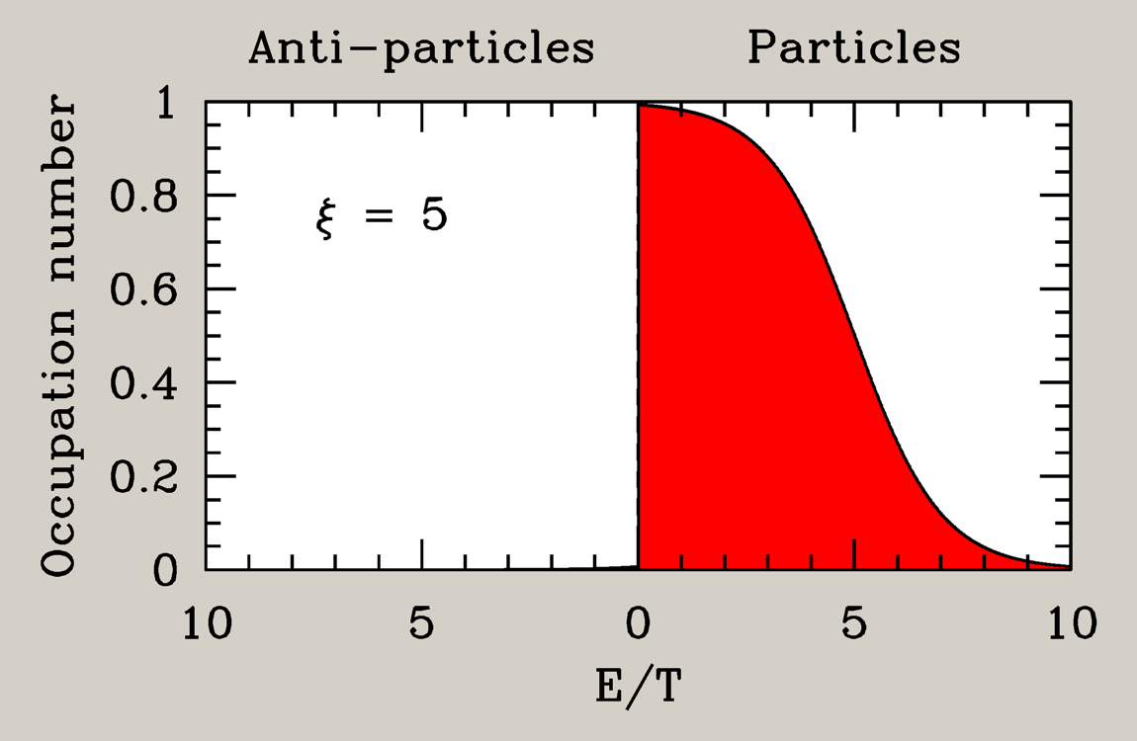
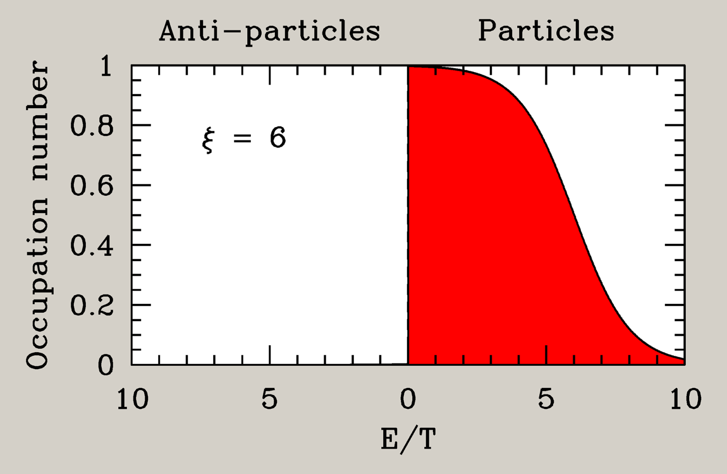
Thermal Neutrino Distribution
Fermi-Dirac distribution
Temperature $T$
Chemical potential $μ$
$μ>0$ Particles
$μ<0$ Anti-particles
$${ f}_{p}=\frac{1}{e^{(E_{p}−μ)/T}+1}$$
Degeneracy parameter Invariant under cosmic expansion
$$ξ=\frac{μ}{T}$$
Number density
$$n_{ν\overline{ν}}=\int{dE\frac{4π}{{\left(2π\right)}^{3}}}\left(\frac{E^{2}}{1+e^{E/T−ξ}}+\frac{E^{2}}{1+e^{E/T+ξ}}\right)$$
$$=\frac{3}{2π^{2}}T^{3}\left[ζ_{3}+\frac{2\ln\left(2\right)}{3}ξ^{2}+\frac{ξ^{4}}{72}+…\right]$$

Slide 37
BBN and Neutrino Chemical Potentials
Expansion rate effect
(all flavors)
Energy density in one neutrino flavor with
degeneracy parameter ξ = η/T
$${ ρ}_{ν\overline{ν}}=\frac{7π^{2}}{120} T_{ν}^{4} \left[1+\underbrace{\frac{30}{7}{\left(\frac{ξ}{π}\right)}^{2}+\frac{15}{7}{\left(\frac{ξ}{π}\right)}^{4}}\right]$$
$$ΔN_{eff}$$
Beta equilibrium effect
for electron flavor
$$n+ν_{e}↔p+e^{−}$$
Helium abundance essentially fixed by n/p ratio
at beta freeze-out
$$\frac{n}{p}=e^{−{\left(m_{n}−m_{p}\right)}/{T_{F}}−ξ_{ν_{e}}}$$
Effect on helium equivalent to
$$ΔN_{eff}∼−18 ξ_{ν_{e}}$$
ν_{e} beta effect can compensate expansion-rate effect of ν_{μ,τ}
Naively, no significant BBN limit on neutrino number density
However, flavor oscillations equalize chemical potentials before BBN

Slide 38
Chemical Potentials and Flavor Oscillations
Flavor mixing
(neutrino oscillations)
Flavor equilibrium before n/p freeze out
assured because no mixing angle small
Our knowledge of the cosmic neutrino
density depends on measured oscillation
parameters!
Flavor lepton numbers
not conserved
Only one common neutrino
chemical potential
Stringent ξ_{νe} limit
applies to all flavors
|ξ_{νe,μ,τ}| < 0.07
Extra neutrino density
ΔN_{eff} < 0.0064
arXiv:hep-ph/0012056 , hep-ph/0201287,
astro-ph/0203442, hep-ph/0203180,
arXiv:0808.3137, 1011.0916, 1110.4335
Cosmic neutrino density
close to standard value

Slide 39
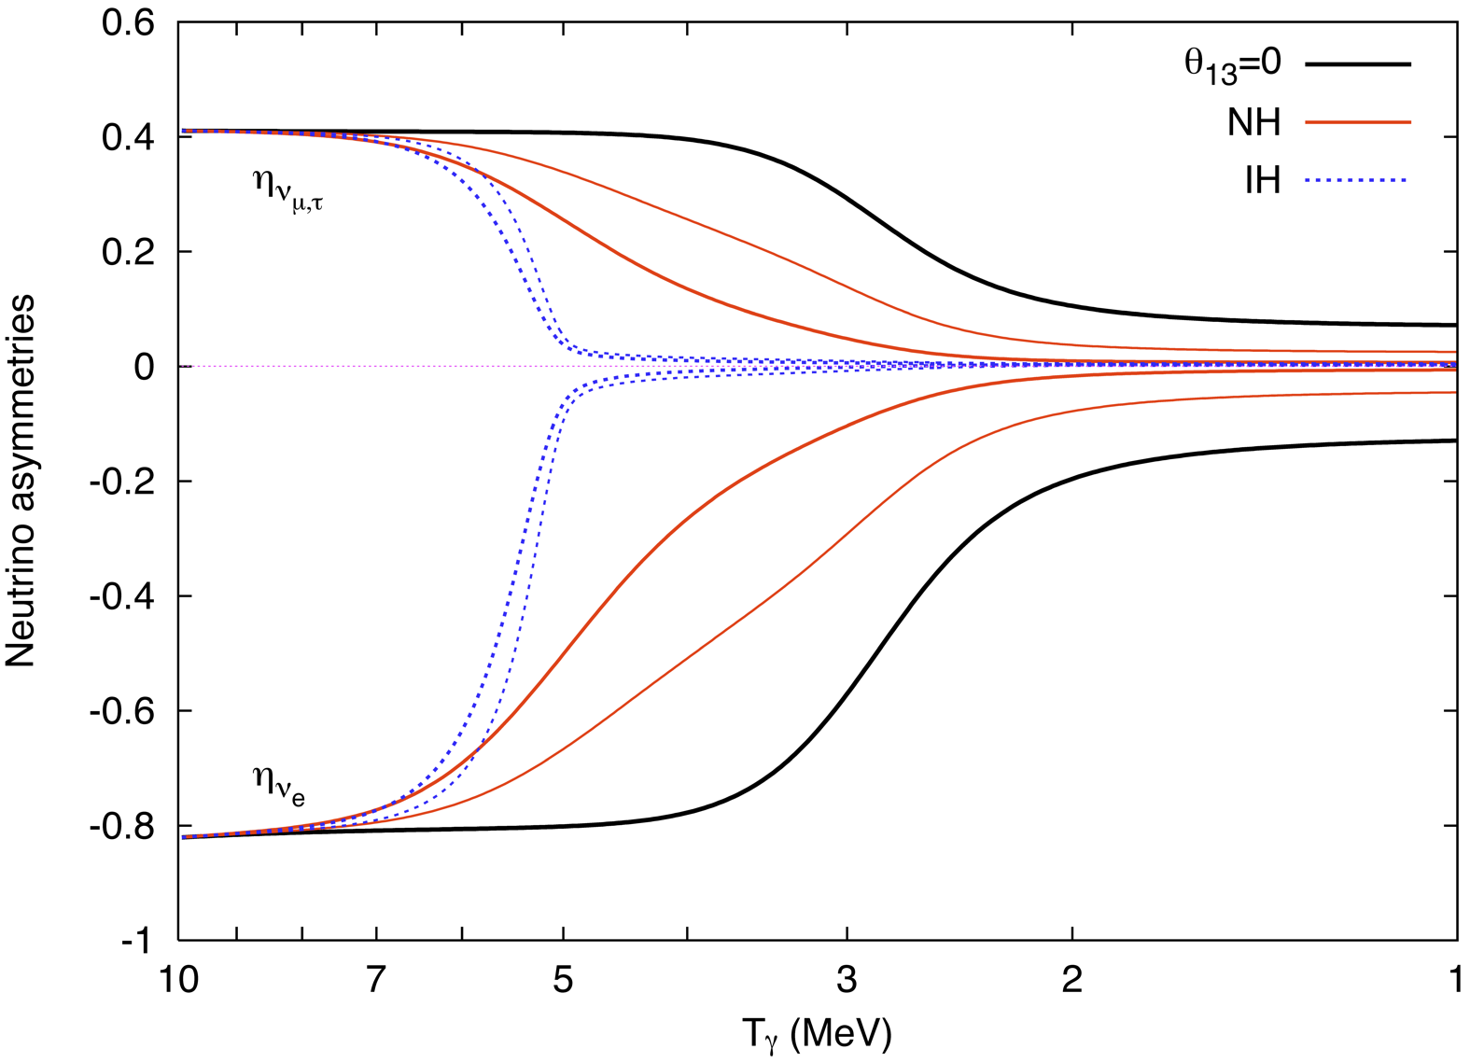
Flavor Conversion before BBN (Θ₁₃ not small)
Inverted Hierarchy
$$Θ_{13}=0.03±0.01$$
Normal Hierarchy
$$Θ_{13}=0.03±0.01$$
$$Θ_{13}=0$$
Mangano, Miele, Pastor, Pisanti & Sarikas, arXiv:1110.4335

Slide 40
BBN Summary
• BBN accounts well for He and D abundance
• Lithium-7 problem unresolved
• Weak hint for extra radiation
• Large neutrino asymmetries not possible
• Cosmic neutrino background exists
with roughly the predicted abundance

Slide 41
Mass Bounds
Mass Bounds

Slide 42
Fermion Mass Spectrum
Quarks (Q = −1/3)
d
s
b
Quarks (Q = +2/3)
u
c
t
Charged Leptons (Q = −1)
e
μ
τ
All flavors
Neutrinos, upper limit from cosmology
ν₃
Lower limit from flavor oscillations
1
10
100
1
10
100
1
10
100
1
10
100
1
10
100
1
meV
eV
keV
MeV
GeV
TeV

Slide 43
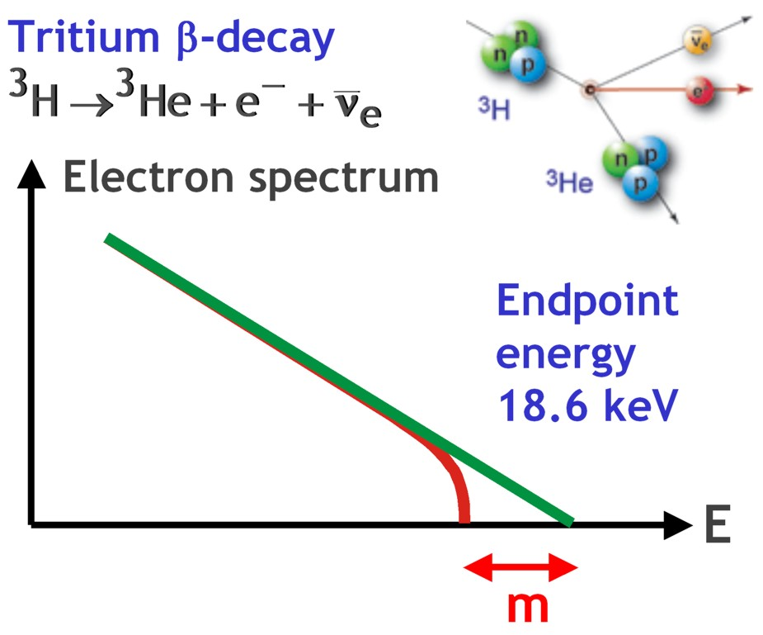
“Weighing” Neutrinos with KATRIN
Sensitive to common mass scale m
for all flavors because of small mass
differences from oscillations
Best limit from Mainz und Troitsk
m < 2.2 eV (95% CL)
KATRIN can reach 0.2 eV
Under construction
Data taking to begin 2015/16
http://www.katrin.kit.edu

Slide 44
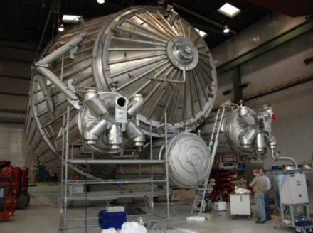
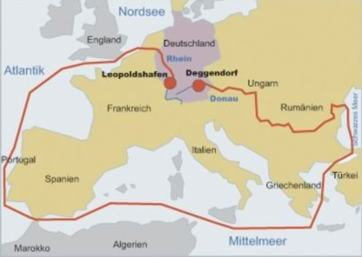
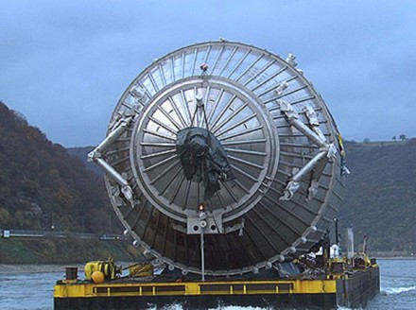
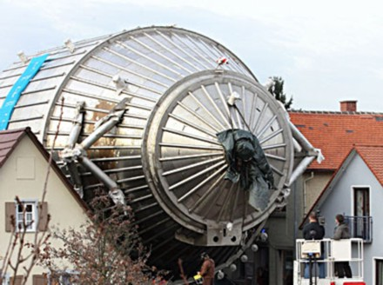
“KATRIN Coming” (25 Nov 2006)

Slide 45
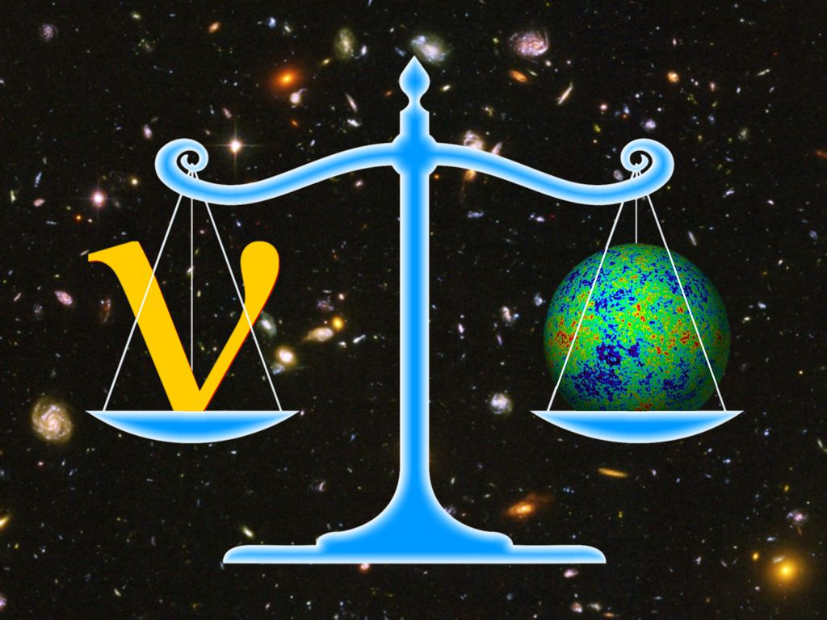
Weighing Neutrinos with the Universe

Slide 46
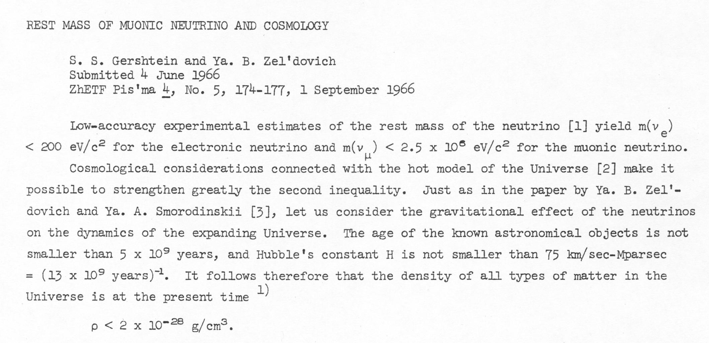
Cosmological Limit on Neutrino Masses
Cosmic neutrino “sea” $\sim$112 cm⁻³ neutrinos + anti-neutrinos per flavor
$$Ω_{ν}h^{2}=\sum{\frac{m_{ν}}{93 \text{eV}}}<0.23$$
For all
stable flavors
$$∑m_{ν}≲20 \text{eV}$$
JETP Lett. 4 (1966) 120

Slide 47
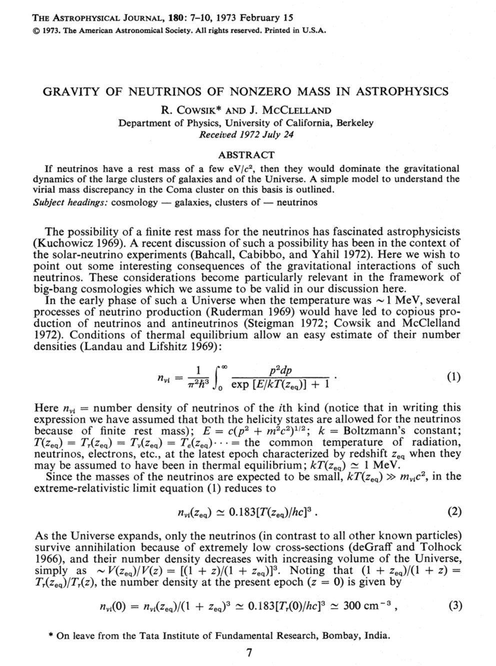
Weakly Interacting Particles as Dark Matter
Almost 40 years ago,
beginnings of the idea of
weakly interacting particles
(neutrinos) as dark matter
Massive neutrinos are no
longer a good candidate
(hot dark matter)
However, the idea of
weakly interacting massive
particles (WIMPs) as
dark matter is now standard

Slide 48
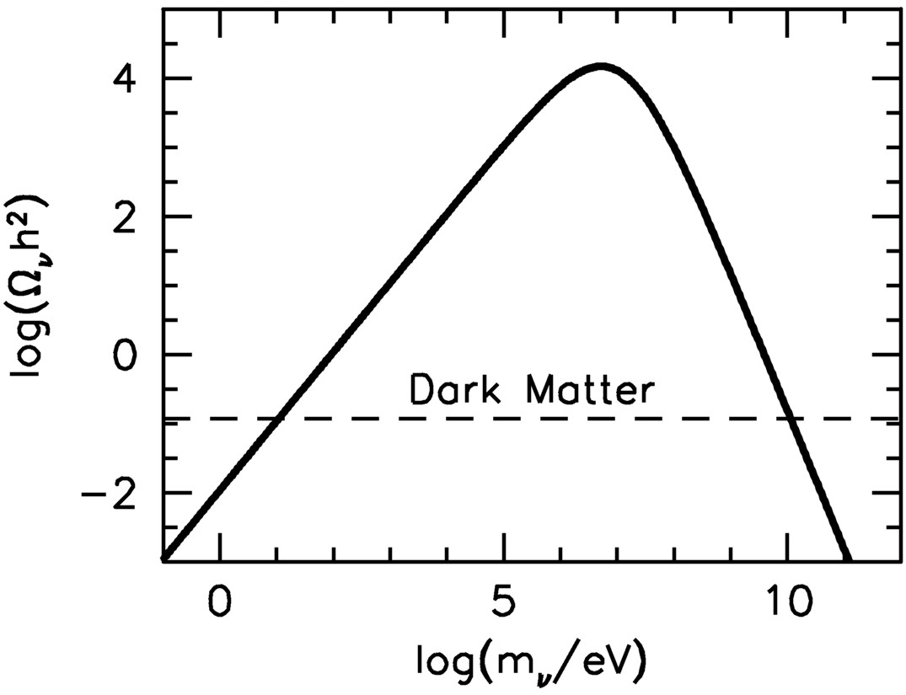
Lee Weinberg Curve
Cosmic matter fraction
as a function of neutrino mass
For m_{ν} ≳ 1 MeV
neutrinos freeze out
nonrelativistically
Density suppressed
by annihilation
before freeze-out
Hot dark
matter
Dark matter
Weakly interacting
massive particles
(WIMPs) possible as
cold dark matter

Slide 49
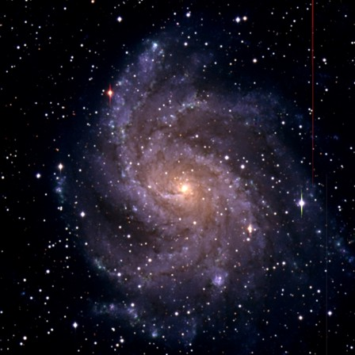
What is wrong with neutrino dark matter?
Galactic Phase Space (“Tremaine-Gunn-Limit”)
Maximum mass density of a degenerate
Fermi gas
Spiral galaxies
m_{ν} > 20–40 eV
Dwarf galaxies
m_{ν} > 100–200 eV
$$ρ_{max}=m_{ν}\underset{n_{max}}{\underbrace{\frac{p_{max}^{3}}{3π^{2}}}}=\frac{m_{ν}{\left(m_{ν}v_{escape}\right)}^{3}}{3π^{2}}$$
Neutrino Free Streaming (Collisionless Phase Mixing)
At T < 1 MeV neutrino scattering in early universe is ineffective
Stream freely until non-relativistic
Wash out density contrasts on small scales
Neutrinos
Neutrinos
Neutrinos are “Hot Dark Matter”
Ruled out by structure formation
Over-density

Slide 50
Hot dark matter ruled out in 1983
1000 particle simulation by Frenk, White & Davis, ApJ 271 (1983) 417
The coherence length of the neutrino distribution […] is too large
to be consistent with the observed clustering scale of galaxies […]
The conventional neutrino-dominated picture appears to be ruled
out. White, Frenk & Davis, ApJ 274 (1983) L1.

Slide 51
Structure Formation with Hot Dark Matter
Standard ΛCDM Model
Neutrinos with Σm_{ν} = 6.9 eV
Structure fromation simulated with Gadget code
Cube size 256 Mpc at zero redshift
Troels Haugbølle, http://users-phys.au.dk/haugboel

Slide 52
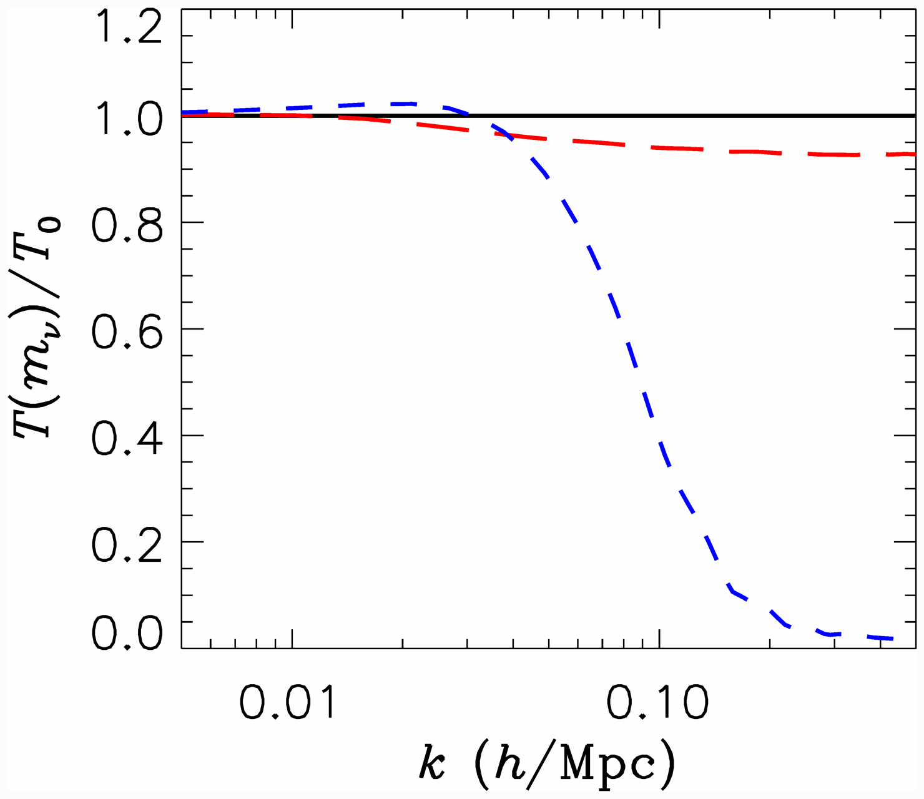
Neutrino Free Streaming: Transfer Function
Power suppression for λ_{FS} ≳ 100 Mpc/h
(k_{FS} = 2π/λ_{FS})
hep-ph/0404239
Transfer function
P(k) = T(k) P₀(k)
Effect of neutrino free
streaming on small scales
T(k) = 1 − 8 Ω_{ν}/Ω_{M}
valid for 8Ω_{ν}/Ω_{M} ≪ 1
Power suppression much
larger (factor 8) than
corresponds to neutrino
mass fraction!
$$m_{ν}=0$$
$$m_{ν}=0.3 eV$$
$$m_{ν}=1 eV$$
0.50

Slide 53
Power Spectrum of Cosmic Density Fluctuations
Tegmark, TAUP 2003

Slide 54
Neutrino Mass Limits Post Planck (2013)
Depends on used data sets
Many different analyses in the literature
Planck alone: Σm_{ν} < 1.08 eV (95% CL)
CMB + BAO limit: Σm_{ν} < 0.23 eV (95% CL)
Ade et al. (Planck Collaboration), arXiv:1303.5076

Slide 55
Neutrino Mass from Cosmology (Hannestad)
More data
+Ly-alpha
~ 0.2 eV
0.2–0.3 eV
0.2–0.3 eV
+ SNI-a
+WL
~ 0.5 eV
0.5–0.6 eV
0.5–0.6 eV
+ SDSS
0.4 eV
~ 1 eV
1–2 eV
CMB only
1.1 eV
~ 2 eV
2.? eV
??? eV
Minimal
ΛCDM
+N_{ν}
+w+……
Larger model
space

Slide 56
Weak Lensing − A Powerful Probe for the Future
Distortion of background images by foreground matter
Unlensed
Lensed

Slide 57
Future Cosmological Neutrino Mass Sensitivity
Pin down the neutrino mass in the sky!
ESA’s Euclid satellite to be
launched in 2020
Precision measurement of the
universe out to redshift of 2
Basse, Bjælde, Hamann, Hannestad & Wong, arXiv:1304.2321:
Dark energy and neutrino constraints from a future EUCLID-like survey

Slide 58
Transfer Function with Massive Neutrinos
Measuring few-percent
suppression requires
structure-formation theory beyond linear order!
Community Planning Study: Snowmass 2013, arXiv:1309.5383

Slide 59
Mass-Energy-Inventory of the Universe
10⁻³
10⁻²
10⁻¹
1
Ω
Luminous
Baryons
Total
Dark Matter
Λ
10⁻²
10⁻¹
1
10 eV
$$\sum{\frac{m_{ν}}{3}}$$
Oscillations
Neutrinos
Tritium (Mainz/Troitsk)
Future Tritium (KATRIN)
CMB & LSS
Forecast, e.g. Euclid

Slide 60
Cosmic Neutrino Capture in Tritium Beta Decay
Electron
spectrum
Tritium β decay
Tritium inverse β decay
capturing cosmic neutrinos
$${}_{}^{3}H→{}_{}^{3}{He+{\overline{ν}}_{e}+e^{−}}$$
$$ν_{e}+{}_{}^{3}H→{}_{}^{3}{He+e^{−}}$$
Events above
endpoint energy
m
m
Energy
Ptolemy project in Princeton (Chris Tully et al.)

Slide 61
Neutrino Clustering in the Galaxy
Excess nu density
in the galaxy above
cosmic mean of
56 cm⁻³/flavor/spin
Ringwald & Wong, arXiv:hep-ph/0408241

Slide 62
Mass Bounds
Radiation Density
from
Precision Cosmology

Slide 63
Cosmic History
Cosmic radiation density can be measured
at BBN and at CMB decoupling

Slide 64
Power Spectrum of CMB Temperature Fluctuations
Sky map of CMBR temperature
fluctuations
$$Δ\left(θ,φ\right)=\frac{T\left(θ,φ\right)−〈T〉}{〈T〉}$$
Multipole expansion
$$Δ\left(θ,φ\right)=\sum_{ℓ=0}^{∞}{ \sum_{m=−ℓ}^{ℓ}{a_{ℓm}Y_{ℓm}\left(θ,φ\right)}}$$
Angular power spectrum
$${ C}_{ℓ}=〈a_{ℓm}^{∗}a_{ℓm}〉$$
$$=\frac{1}{2ℓ+1}\sum_{m=−ℓ}^{ℓ}{a_{ℓm}^{∗}a_{ℓm}}$$
Provides “acoustic peaks” and a
wealth of cosmological information
Planck
Acoustic Peaks

Slide 65
Impact of extra radiation
Redshift of matter-radiation equality modified by N_{eff}
CMB angular power spectrum
Matter power spectrum

Slide 66
Hint for “Dark Radiation” in the Universe?
Depending on used data sets, indication for extra radiation at CMB decoupling
Same as pre-Planck situation based on WMAP-9 etc.
Including prior on H₀
provides
> 2σ “evidence”
for extra radiation
at CMB decoupling
Ade et al. (Planck Collaboration), arXiv:1303.5076

Slide 67
Degeneracy between N_{eff} and H₀
Extra radiation relaxes tension between H₀ determinations
Ade et al. (Planck Collaboration), arXiv:1303.5076

Slide 68
Neutrino Mass and N_{eff} Limits
with HST prior
Giusarma, Di Valentino, Lattanzi, Melchiorri & Mena, arXiv:1403.4852

