Slide 1
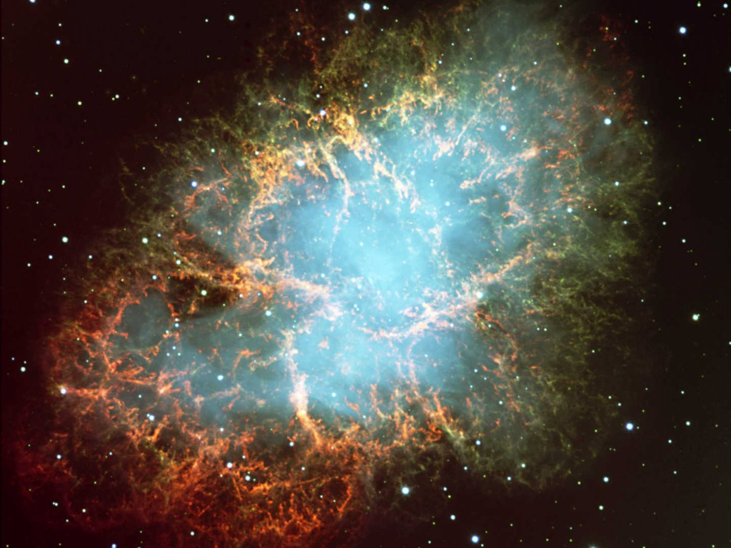

Crab Nebula
Neutrinos
in Astrophysics and Cosmology
Introductory Remarks
Georg G. Raffelt
Max-Planck-Institut für Physik, München, Germany

Slide 2
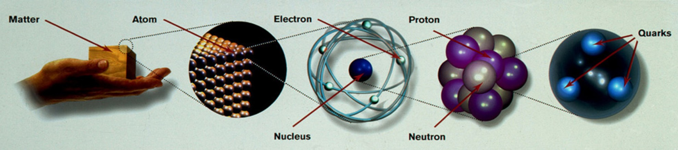
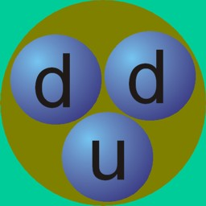
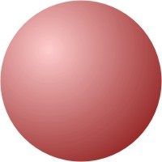
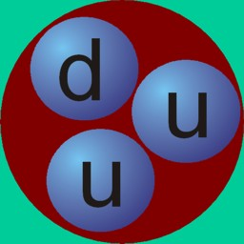
Periodic System of Elementary Particles
Quarks
Leptons
Charge −1/3
Charge +2/3
Charge −1
Charge 0
d
e
ν_{e}
d
Up
e
ν_{e}
Down
u
Electron
e-Neutrino
Up
1st Family
Down
u
Electron
e-Neutrino
2nd Family
s
μ
ν_{μ}
Strange
Charm
Muon
μ-Neutrino
c
3rd Family
b
τ
ν_{τ}
Bottom
Top
Neutron
t
Tau
τ-Neutrino
Higgs
Strong Interaction (8 Gluons)
Electromagnetic Interaction (Photon)
Proton
Weak Interaction (W and Z Bosons)
Gravitation (Gravitons?)

Slide 3
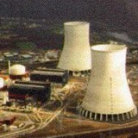
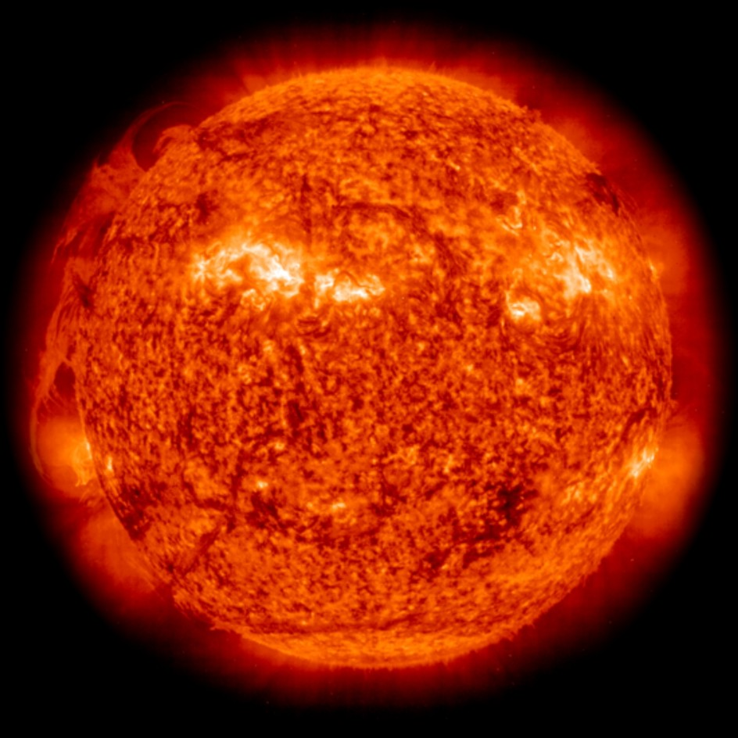

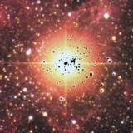
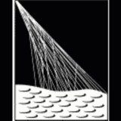
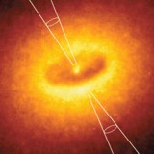


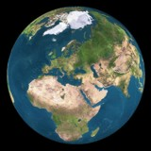
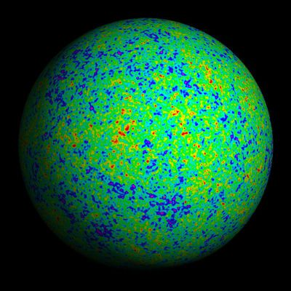
Where do Neutrinos Appear in Nature?
✓
Nuclear Reactors
✓
Sun
Supernovae
(Stellar Collapse)
SN 1987A
✓
✓
Particle Accelerators
Earth Atmosphere
(From Cosmic Rays)
Astrophysical
Accelerators ✓
✓
Cosmic Big Bang
(Today 336 ν/cm³)
Indirect Evidence
Earth Crust
(Natural Radioactivity)
✓

Slide 4
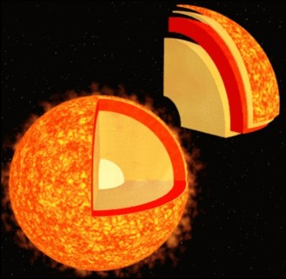
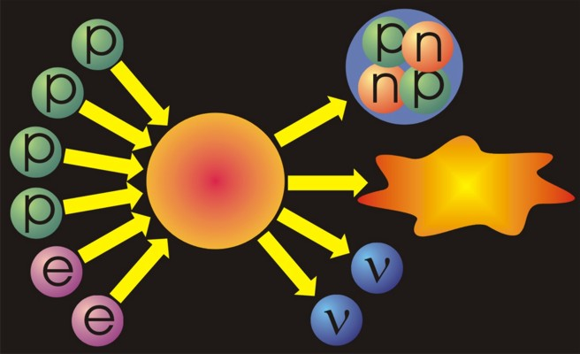
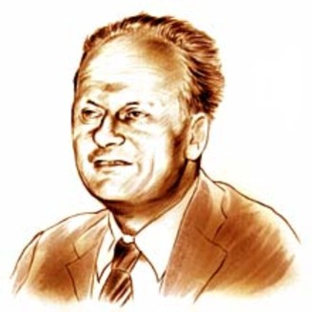
Neutrinos from the Sun
Helium
Reaction-
chains
Energy
26.7 MeV
Solar radiation: 98 % light (photons)
2 % neutrinos
At Earth 66 billion neutrinos/cm² sec
Hans Bethe (1906−2005, Nobel prize 1967)
Thermonuclear reaction chains (1938)

Slide 5
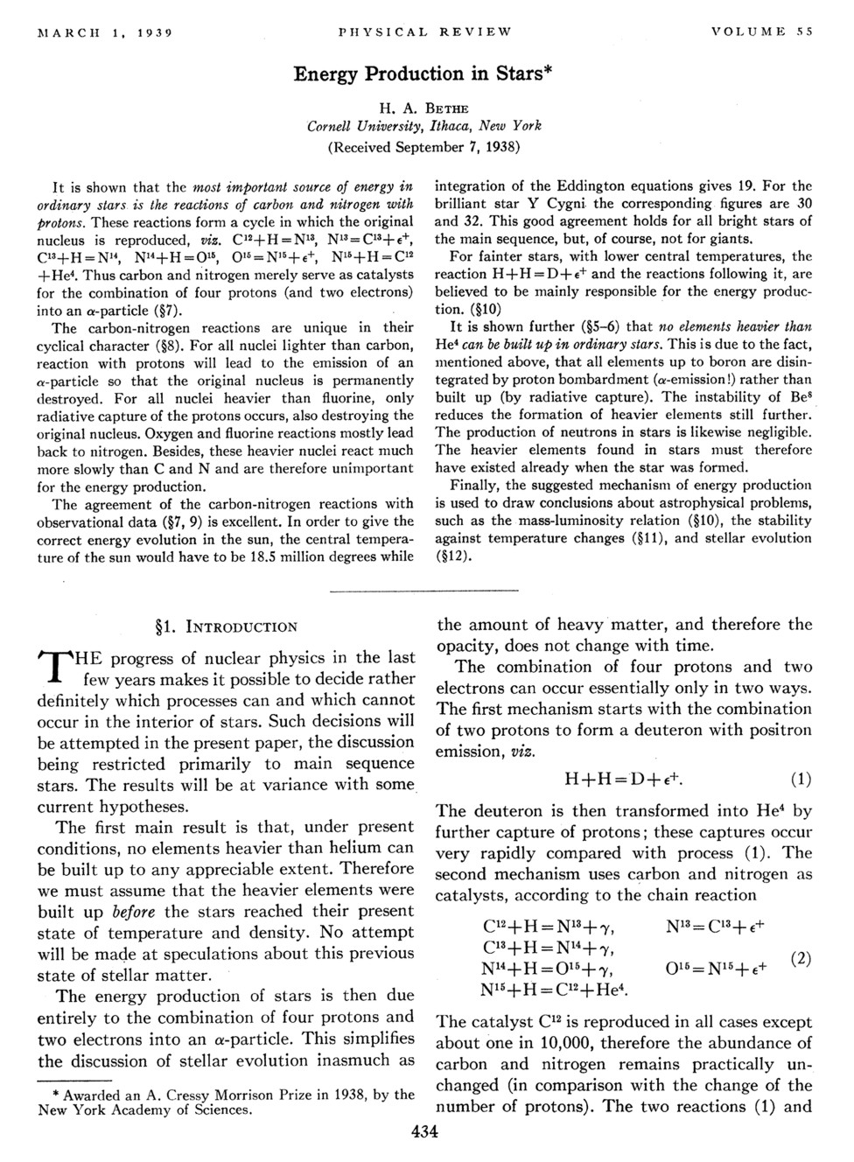
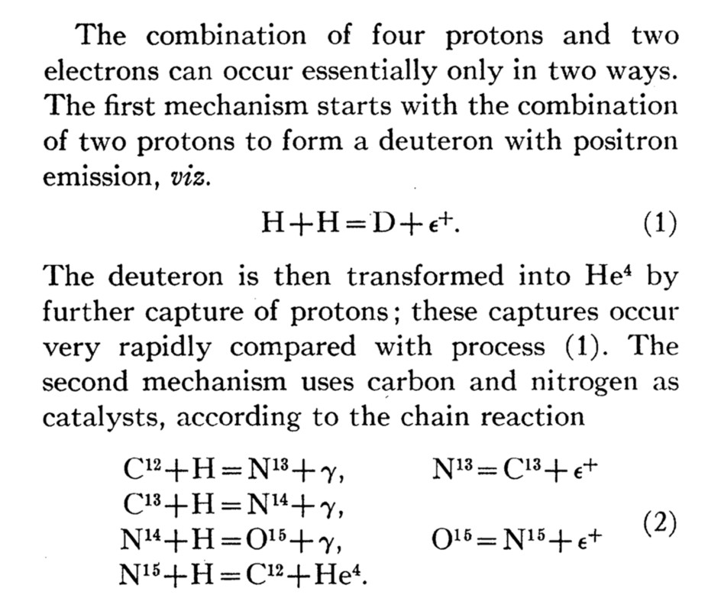
Bethe’s Classic Paper on Nuclear Reactions in Stars
No neutrinos
from nuclear reactions
in 1938 …

Slide 6
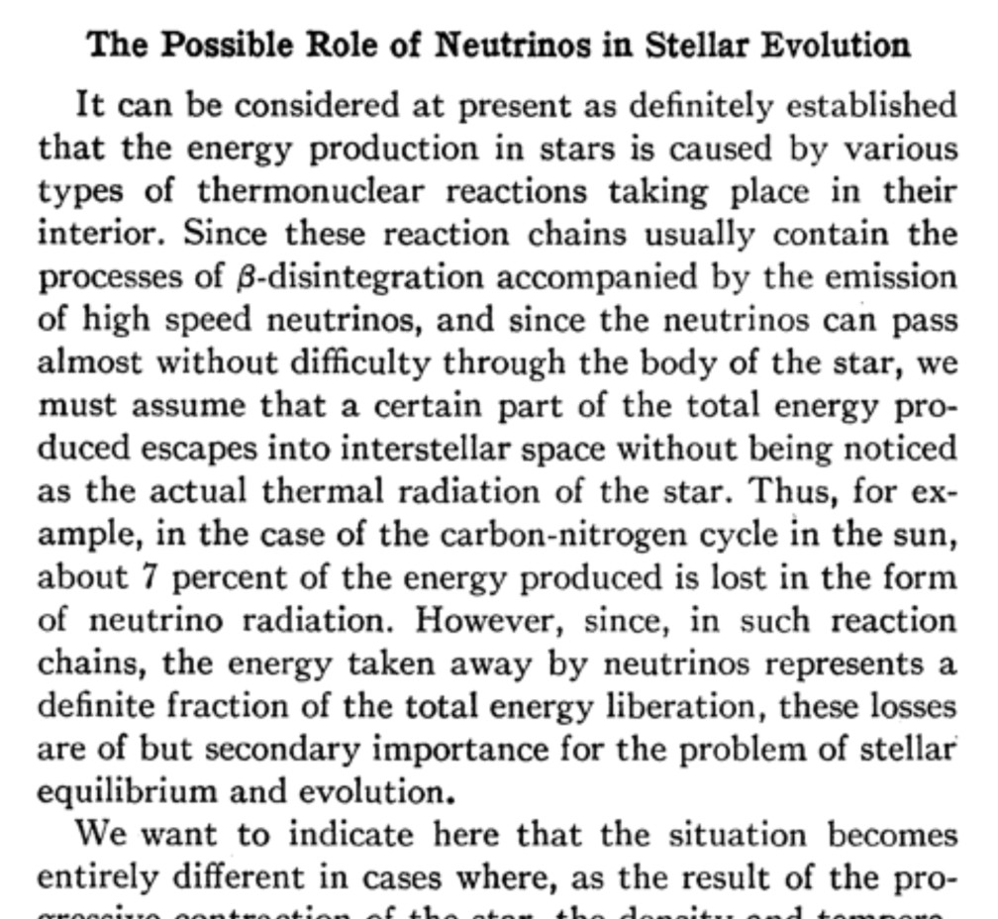
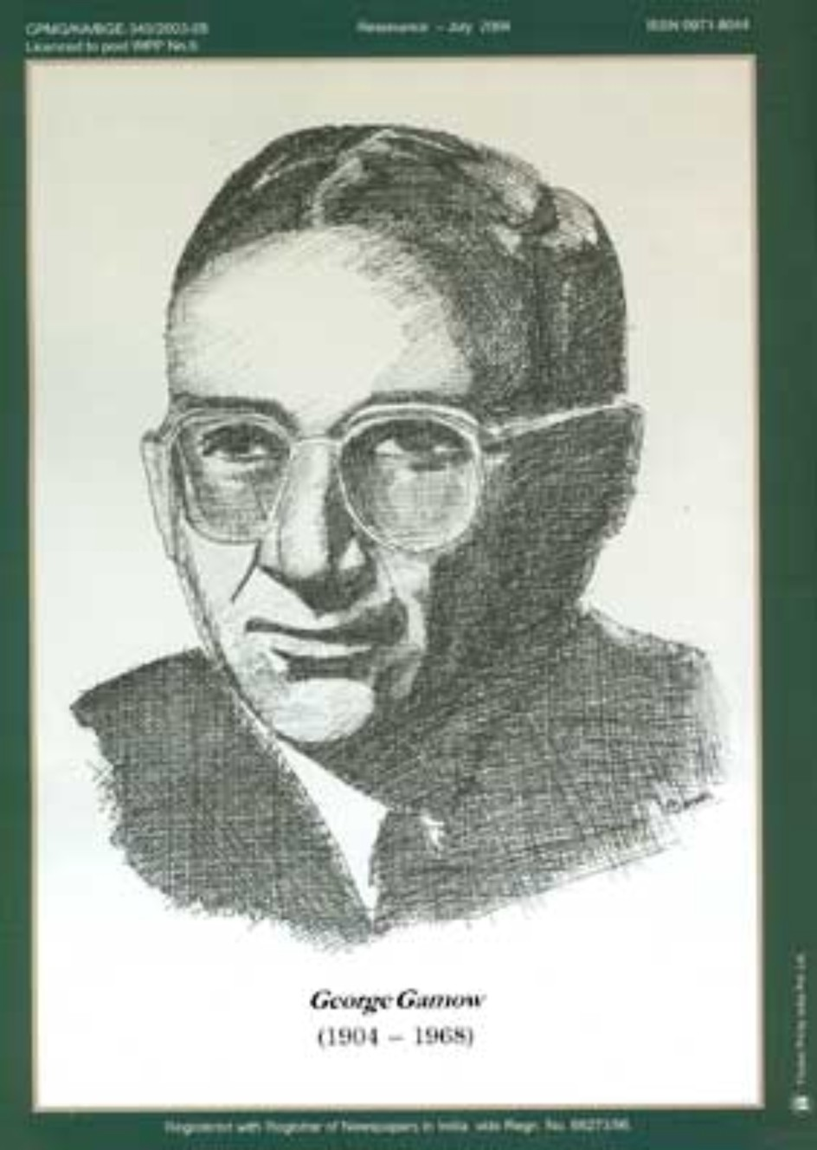
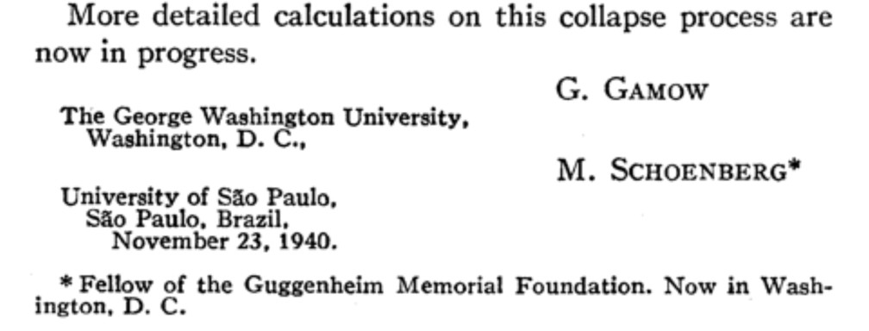
Predicting Neutrinos from Stars
Phys. Rev. 58:1117 (1940)

Slide 7
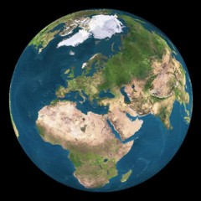
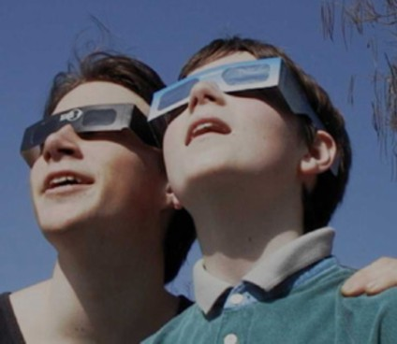
Sun Glasses for Neutrinos?
8.3 light minutes
Several light years of lead
needed to shield solar
neutrinos
Bethe & Peierls 1934:
… this evidently means
that one will never be able
to observe a neutrino.

Slide 8
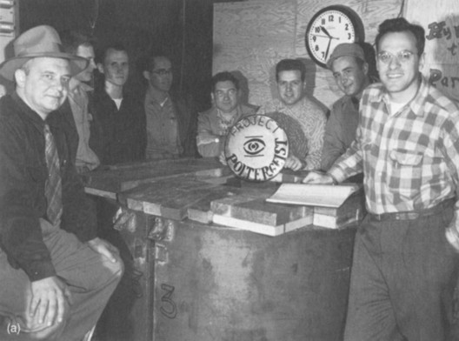
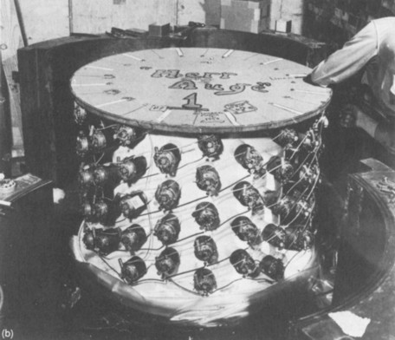

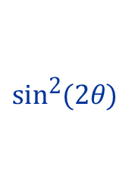

First Detection (1954 – 1956)
Clyde Cowan
(1919 – 1974)
Fred Reines
(1918 – 1998)
Nobel prize 1995
Detector prototype
Anti-Electron
Neutrinos
from
Hanford
Nuclear Reactor
γ
3 Gammas
in coincidence
n
Cd
$${\overline{ν}}_{e}$$
p
γ
$${\text{e}}^{+}$$
$${\text{e}}^{−}$$
γ

Slide 9
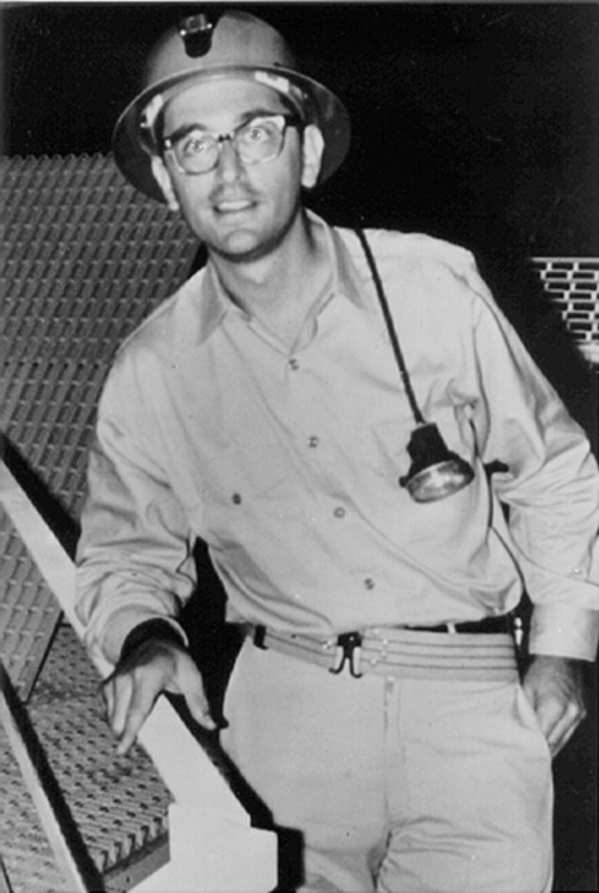
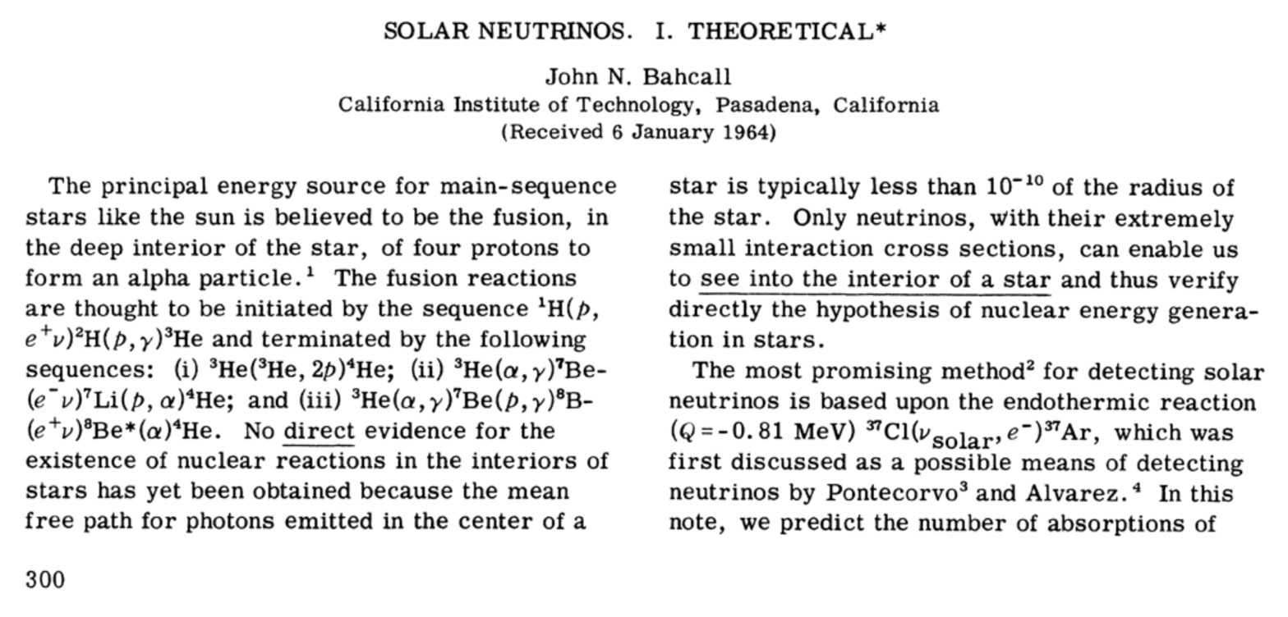
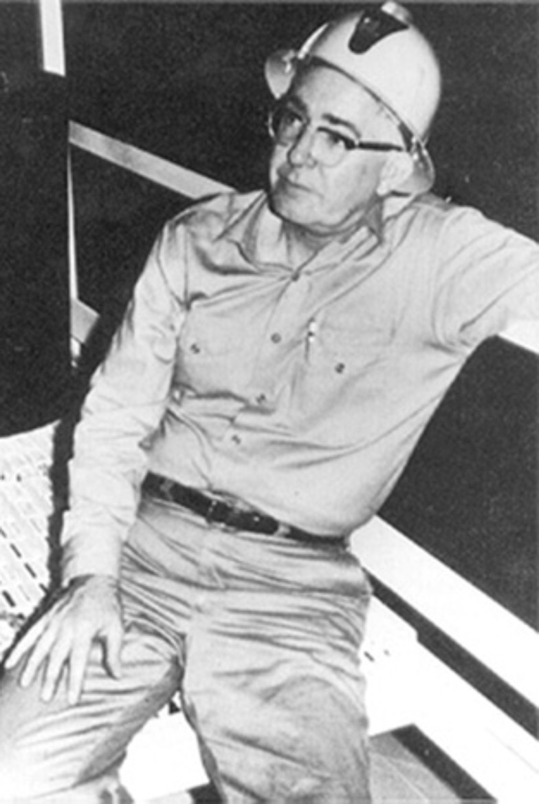
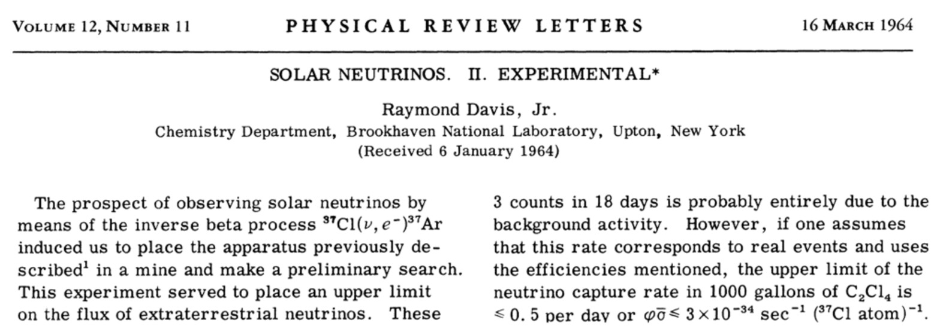
Proposing the First Solar Neutrino Experiment
John Bahcall
1934 – 2005
Raymond Davis Jr.
1914 – 2006

Slide 10
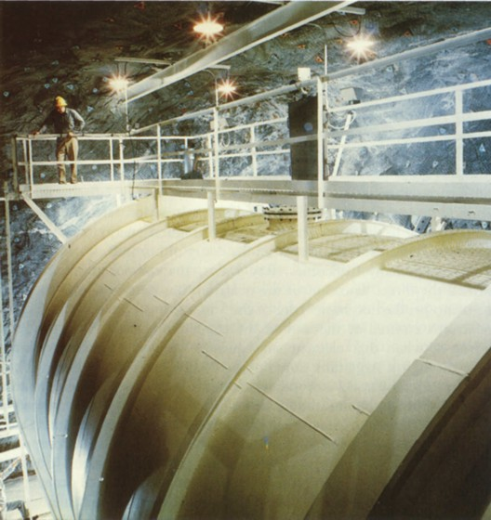
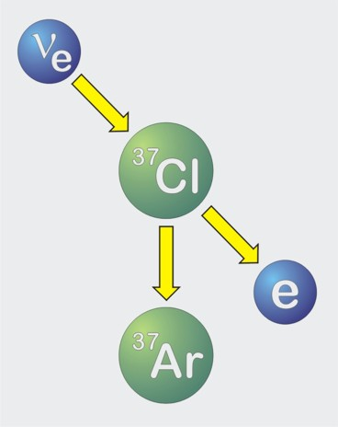
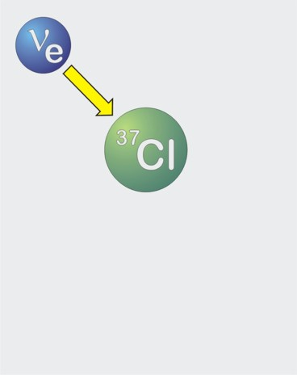
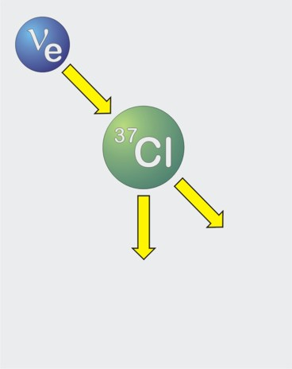
First Measurements of Solar Neutrinos
Inverse beta decay
of chlorine
600 tons of
Perchloroethylene
Homestake solar neutrino
observatory (1967–2002)

Slide 11
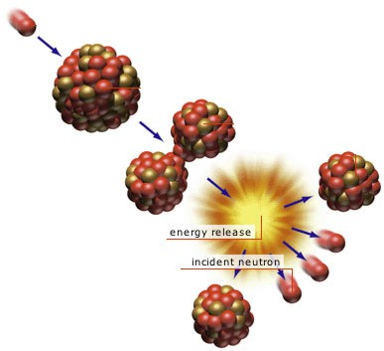
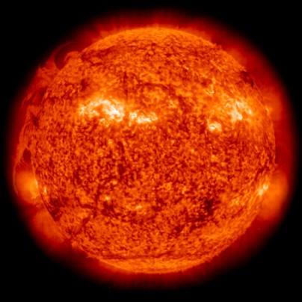


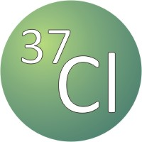
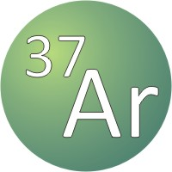








Solar Neutrinos vs. Reactor Antineutrinos
Neutron
Fissionable
nucleus
Energy
26.7 MeV
Nucleus
splitting
Ray Davis radiochemical detector (1967–1992)
Fission products
w/ neutron excess
$β$ unstable nuclei effectively decay by
Amounts to neutino capture by neutron
Detection by inverse $β$ decay
Does not work for reactor ${\overline{ν}}_{e}$ flux!
Reines and Cowan 1954–1956

Slide 12
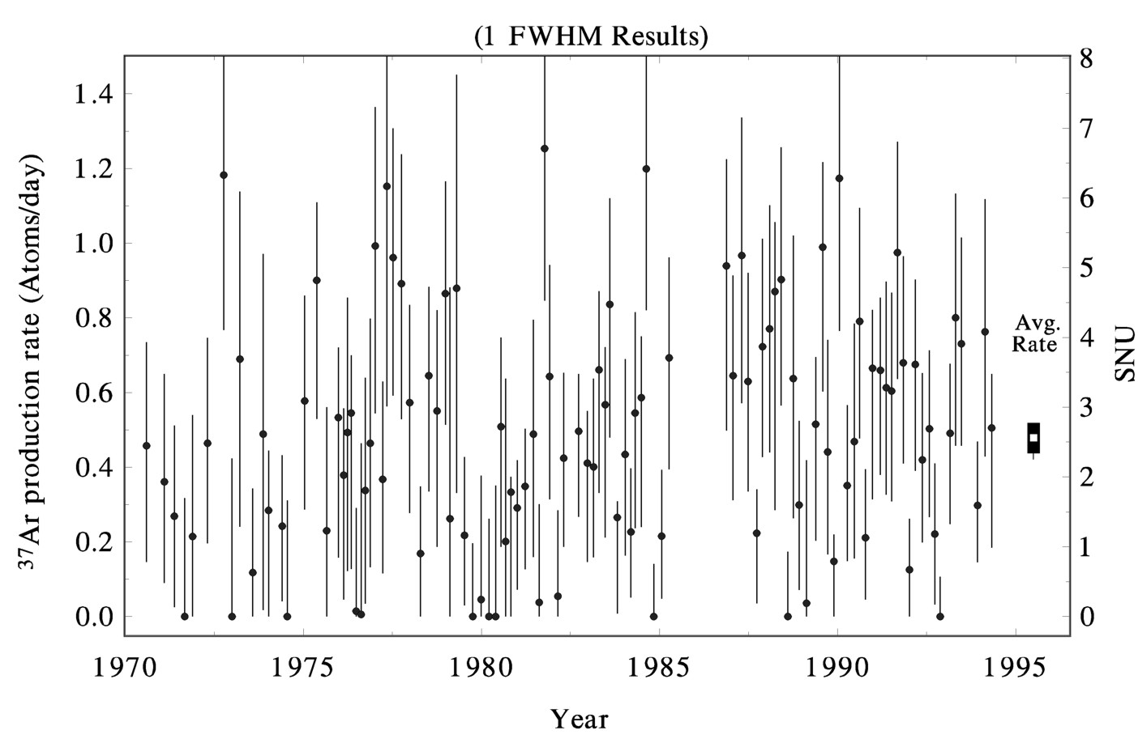
Results of Chlorine Experiment (Homestake)
ApJ 496:505, 1998
Average
Rate
Average (1970−1994) 2.56 ± 0.16_{stat} ± 0.16_{sys} SNU
(SNU = Solar Neutrino Unit = 1 Absorption / sec / 10³⁶ Atoms)

Slide 13
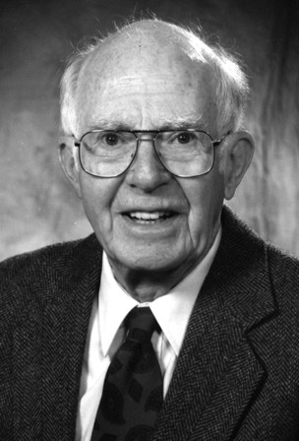
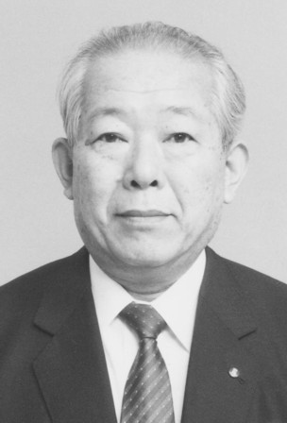
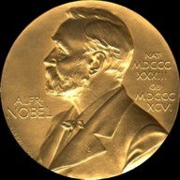
2002 Physics Nobel Prize for Neutrino Astronomy
Ray Davis Jr.
(1914–2006)
Masatoshi Koshiba
(*1926)
“for pioneering contributions to astrophysics, in
particular for the detection of cosmic neutrinos”

Slide 14
Cherenkov Effect
Elastic scattering or CC reaction
Light
Electron or Muon
(Charged Particle)
Neutrino
Light
Water
Cherenkov Ring

Slide 15
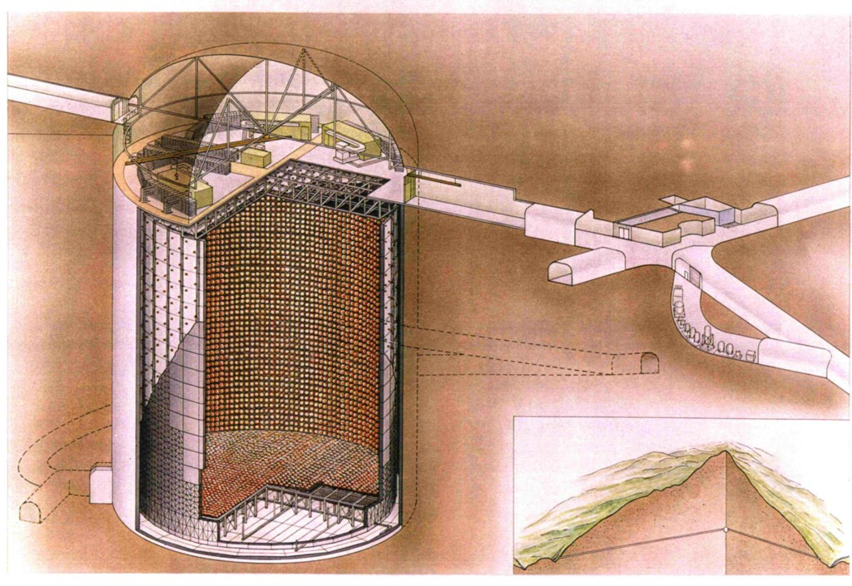
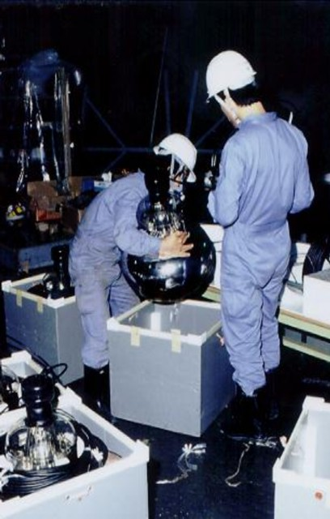
Super-Kamiokande Neutrino Detector (Since 1996)
42 m
39.3 m

Slide 16
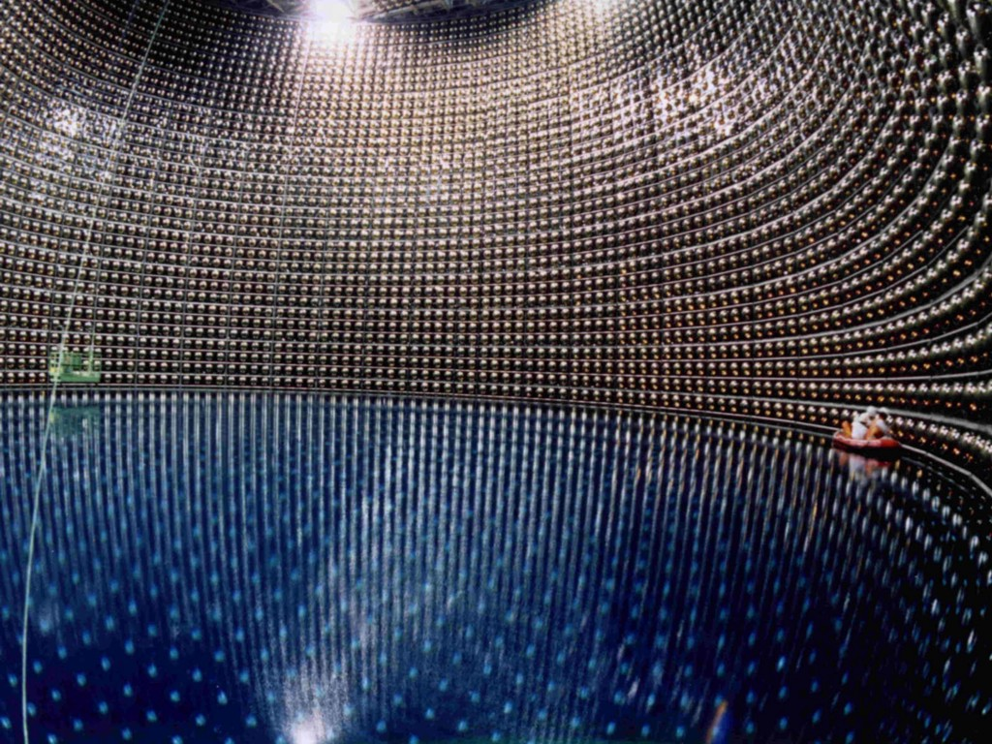
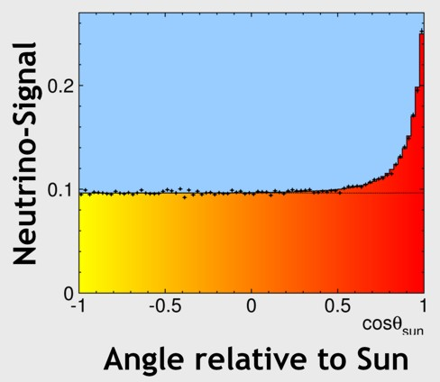
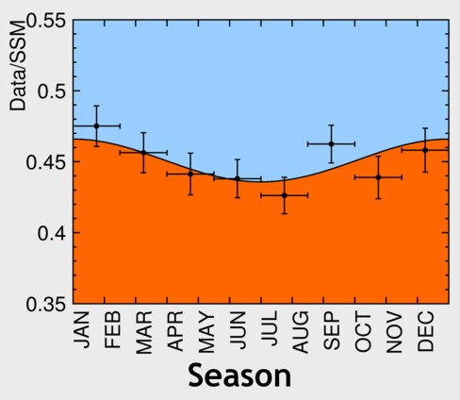
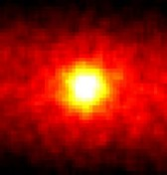
Super-Kamiokande: Sun in the Light of Neutrinos
ca. 70,000 solar neutrinos measured in Super-K (1996–2014)

Slide 17
Results of Chlorine Experiment (Homestake)
ApJ 496:505, 1998
Theoretical
Expectation
Average
Rate
Average (1970−1994) 2.56 ± 0.16_{stat} ± 0.16_{sys} SNU
(SNU = Solar Neutrino Unit = 1 Absorption / sec / 10³⁶ Atoms)
Theoretical Prediction 6−9 SNU
“Solar Neutrino Problem” since 1968

Slide 18
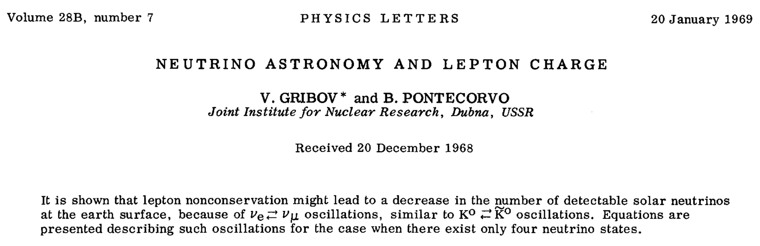
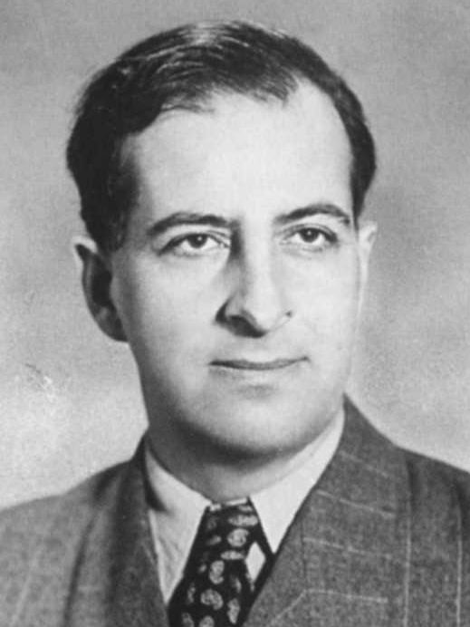
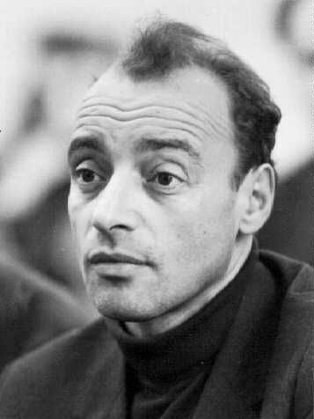
Gribov and Pontecorvo 1968
Learning about
astrophysical sources
with neutrinos
Learning about
neutrinos from
astrophysics and
cosmology
Bruno Pontecorvo
(1913–1993)
Vladimir Gribov
(1930–1997)

Slide 19





Neutrino Flavor Oscillations
Two-flavor mixing
$$\left(\begin{matrix}ν_{e} \\ ν_{μ}\end{matrix}\right)=\left(\begin{matrix}\text{c}\text{os} θ & sin θ \\ −sin θ & \text{c}\text{os} θ\end{matrix}\right)\left(\begin{matrix}ν_{1} \\ ν_{2}\end{matrix}\right)$$
Each mass eigenstate propagates as ${ e}^{ip_{1,2}z}$ with $p_{1,2}=\sqrt{E^{2}−m_{1,2}^{2}}≈E−\frac{m_{1,2}^{2}}{2E}$
Phase difference $\frac{δm^{2}}{2E}z$ implies flavor oscillations
Probability $ν_{e}→ν_{μ}$
$$sin2(2θ)$$
z
Oscillation
Length
$$\frac{4πE}{δm^{2}}=2.5 \text{m} \frac{E}{\text{MeV}} \left({\frac{\text{eV}}{δm}}^{2}\right)$$

Slide 20




Oscillation of Reactor Neutrinos at KamLAND (Japan)
Oscillation pattern for anti-electron neutrinos from
Japanese power reactors as a function of L/E
Average distance 180 km, flux 6 × 10⁵ cm⁻² s⁻¹ ,
Without oscillations $\sim$ 2 captures per day
KamLAND Scintillator
detector (1000 t)

Slide 21



Detection of First Atmospheric Neutrinos
Chase-Witwatersrand-Irvine (CWI) Coll.
Mine in South Africa, 8800 mwe
• Liquid scintillator
• Horizontal tracks
Kolar Gold Field (KGF) Collaboration
(Japan-India-UK group), 7500 mwe
• Plastic scintillator
• Flash tubes
Slide adapted from Christian Spiering

Slide 22

The Race
• The first neutrino underground (CWI, 23/2/1965)
out of 7 recorded February – July 1965
• KGF group started data taking some months later
• Sees first of 3 neutrino candidates 20/4/1965,
two months later than Reines group
• KGF publishes two weeks earlier than the CWI
KGF at August 15, 1965 (submitted 12/7/1965)
CW at August 30, 1965 (submitted 26/7/1965)
• Reines recorded the first cosmic neutrino ever,
but the formal priority is with the KGF group.
Slide adapted from Christian Spiering

Slide 23


East Rand Proprietary Mine/South Africa
- First “natural” neutrino 23 February 1965
- 23 February 1987: Neutrino burst of SN 1987A
Slide adapted from Christian Spiering

Slide 24
First Neutrino Sky Map
The first neutrino sky map with the celestial coordinates of 18 Kolar Gold Field neutrino events
(Krishnaswamy et al. 1971)
Due to uncertainties in the azimuth, the coordinates for some events are arcs rather than points. The labels reflect the numbers and registration mode of the events (e.g. S for spectrograph). Only for the ringed events the sense of the direction of the registered muon is known.
Slide adapted from Christian Spiering

Slide 25
MACRO Skymap (2002)
1356 upgoing events

Slide 26

IceCube (40 & 59 strings) Skymap
Total events: 43339 (upgoing) and 64230 (downgoing)
Livetime: 348 days (IC59) and 375 days (IC40)

Slide 27


Atmospheric Neutrino Oscillations (1998)
Atmospheric neutrino oscillations show characteristic L/E variation

Slide 28








Three-Flavor Neutrino Parameters
Three mixing angles $θ_{12}$, $θ_{13}$, $θ_{23}$ (Euler angles for 3D rotation), $c_{ij}=\cos{θ_{ij}}$,
a CP-violating “Dirac phase” $δ$, and two “Majorana phases” $α_{2}$ and $α_{3}$
v
$$\left(\begin{matrix}ν_{e} \\ ν_{μ} \\ ν_{τ}\end{matrix}\right)=\left(\begin{matrix}1 & 0 & 0 \\ 0 & c_{23} & s_{23} \\ 0 & −s_{23} & c_{23}\end{matrix}\right)\left(\begin{matrix}c_{13} & 0 & {e^{−iδ}s}_{13} \\ 0 & 1 & 0 \\ {{−e}^{iδ}s}_{13} & 0 & c_{13}\end{matrix}\right)\left(\begin{matrix}c_{12} & s_{12} & 0 \\ −s_{12} & c_{12} & 0 \\ 0 & 0 & 1\end{matrix}\right)\left(\begin{matrix}1 & 0 & 0 \\ 0 & e^{i\frac{α_{2}}{2}} & 0 \\ 0 & 0 & e^{i\frac{α_{3}}{2}}\end{matrix}\right)\left(\begin{matrix}ν_{1} \\ ν_{2} \\ ν_{3}\end{matrix}\right)$$
$${39}^{∘}<θ_{23}<{53}^{∘}$$
$${7^{∘}<θ}_{13}<{11}^{∘}$$
$${33}^{∘}<θ_{12}<{37}^{∘}$$
Relevant for
0ν2β decay
Atmospheric/LBL-Beams
Reactor
Solar/KamLAND
Normal
Inverted
Tasks and Open Questions
Precision for all angles
CP-violating phase δ ?
Mass ordering ?
(normal vs inverted)
Absolute masses ?
(hierarchical vs degenerate)
Dirac or Majorana ?
3
μ
τ
2
e
μ
τ
$Δm^{2}$
72–80 meV²
Atmosphere
Sun
1
e
μ
τ
Atmosphere
2180–2640 meV²
2
e
μ
τ
Sun
1
e
μ
τ
3
μ
τ

Slide 29

Grand Unified Neutrino Spectrum
under-
ground
optical:
- deep water
- deep ice
air showers
radio
acoustics
Christian Spiering
Slide adapted from Christian Spiering

Slide 30

Grand Unified Neutrino Spectrum
Non-atm nus
seen since 2013
Christian Spiering

