Slide 1
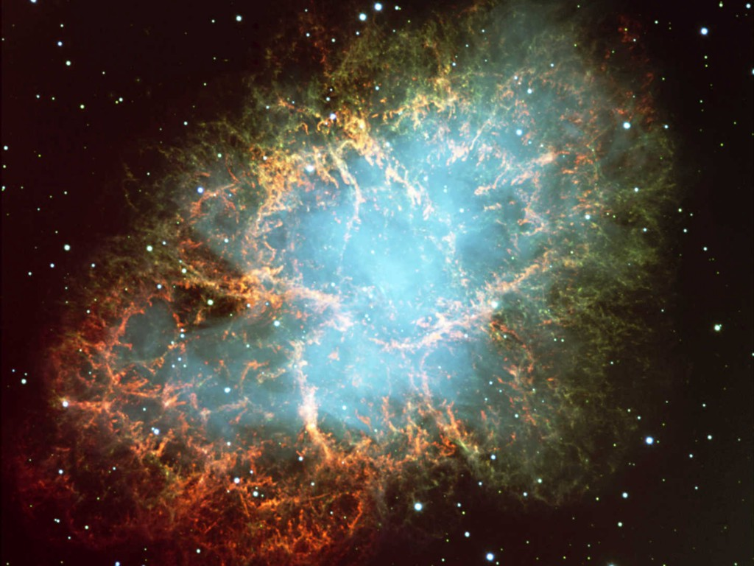
Crab Nebula
Neutrinos
in Astrophysics and Cosmology
Cosmological Neutrinos 1
Georg G. Raffelt
Max-Planck-Institut für Physik, München, Germany

Slide 2
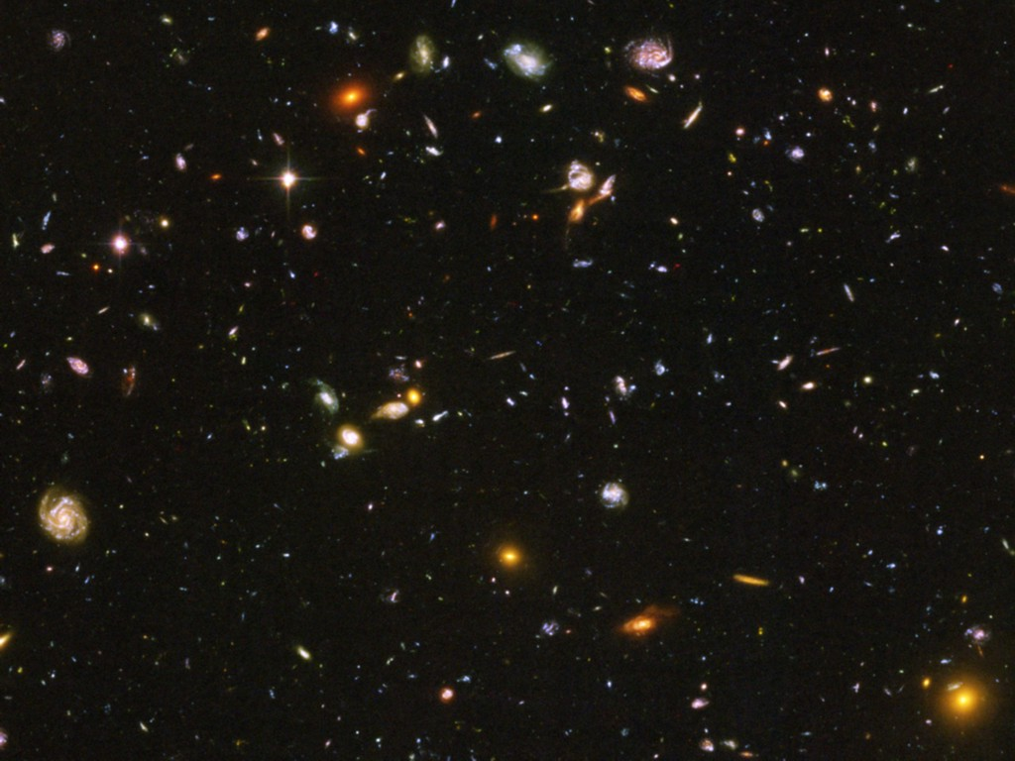
Hubble Deep Field
Luminous Matter
(mostly galaxies)
Gravitating mass
5.1 GeV/m³
“Baryonic matter” (mostly dark)
0.25 GeV/m³
Cosmic microwave photons
(T = 2.75 K) 4.11×10⁸/m³
“Dark matter”
1.3 GeV/m³
Neutrinos+Antineutrinos
per flavor 1.12×10⁸/m³

Slide 3
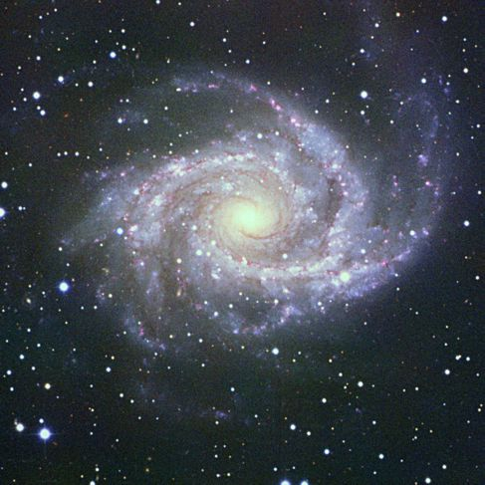
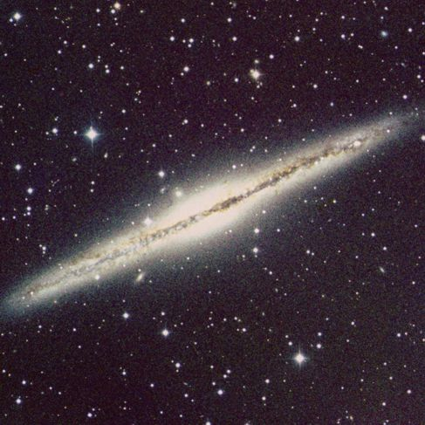
Structure of Spiral Galaxies
Spiral Galaxy NGC 2997
Spiral Galaxy NGC 891
Neutrinos in Astrophysics and Cosmology, NBI, 23–27 June 2014

Slide 4
Structure of a Spiral Galaxy
Dark Halo
Neutrinos in Astrophysics and Cosmology, NBI, 23–27 June 2014
Georg Raffelt, MPI Physics, Munich

Slide 5
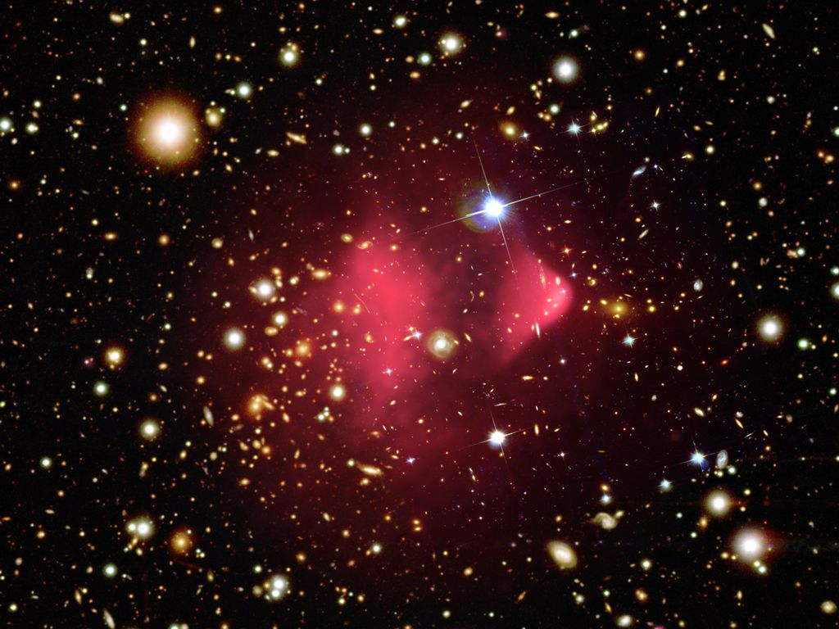
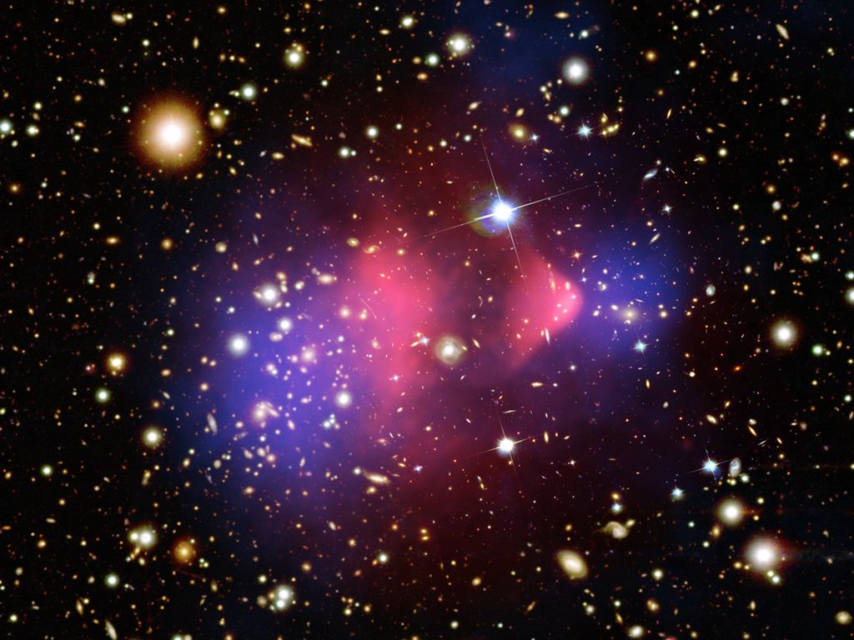
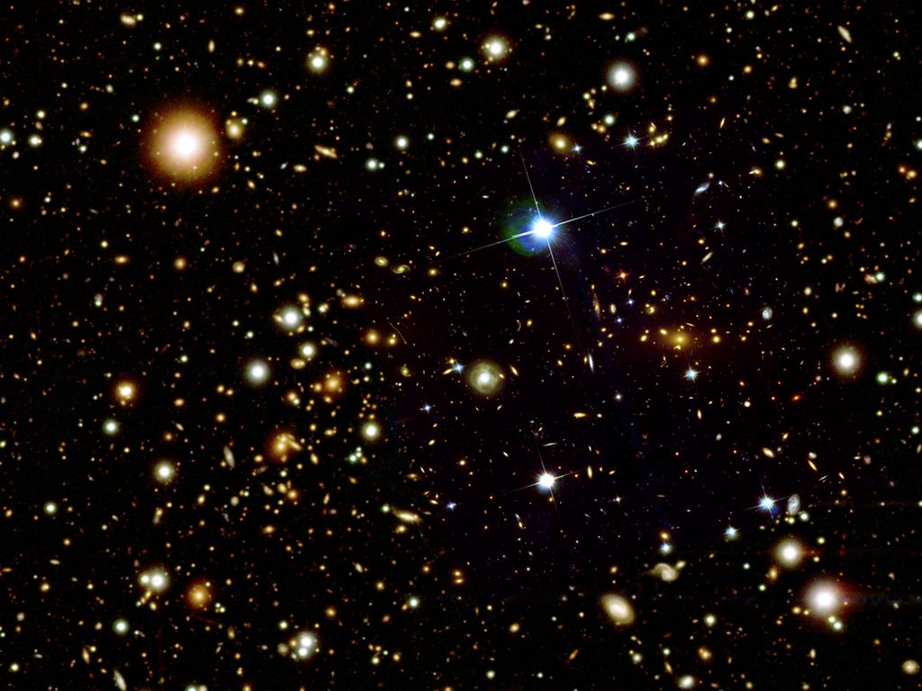
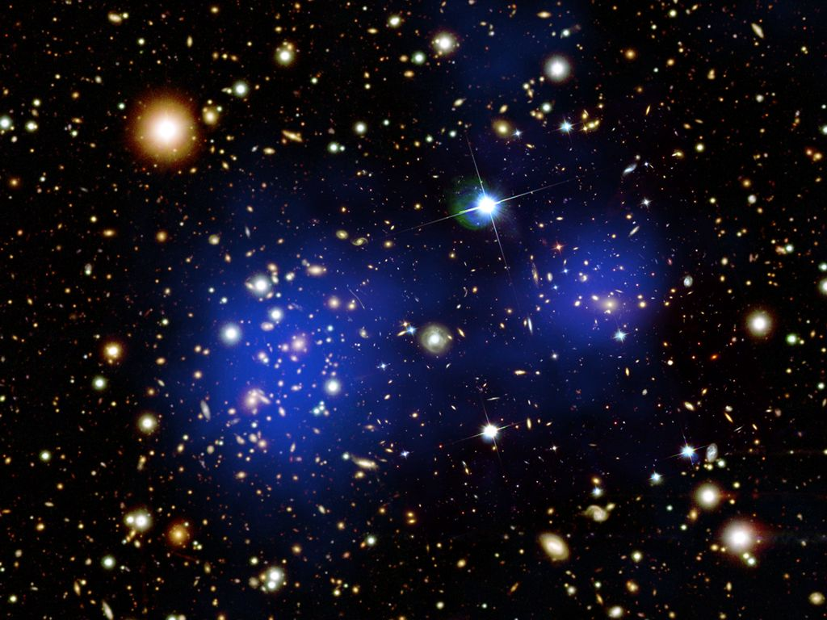
Bullet Cluster (1E 0657-56)

Slide 6
Pie Chart of Dark Universe
Dark Energy ~70%
(Cosmological Constant)
Neutrinos
0.1−1%
Ordinary Matter ~5%
(of this only about
10% luminous)
Dark Matter
~25%

Slide 7
Basics of Cosmology
• How Many Neutrinos?
(Dark radiation/sterile neutrinos?)
• Absolute mass determination and limits
• Big Bang Nucleosynthesis – BBN
(Origin of light elements)
• Leptogenesis
(Origin of Matter Abundance)

Slide 8
Basics of Cosmology
Some Basics
of Cosmology

Slide 9
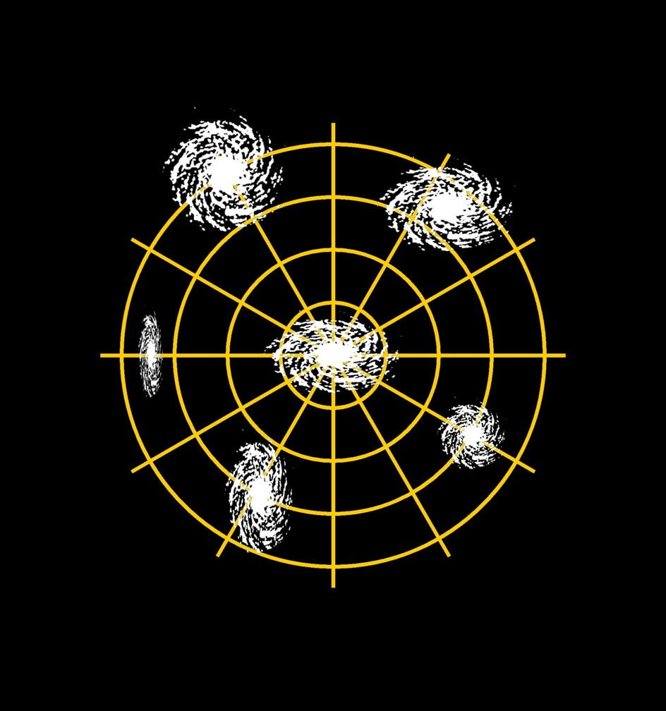
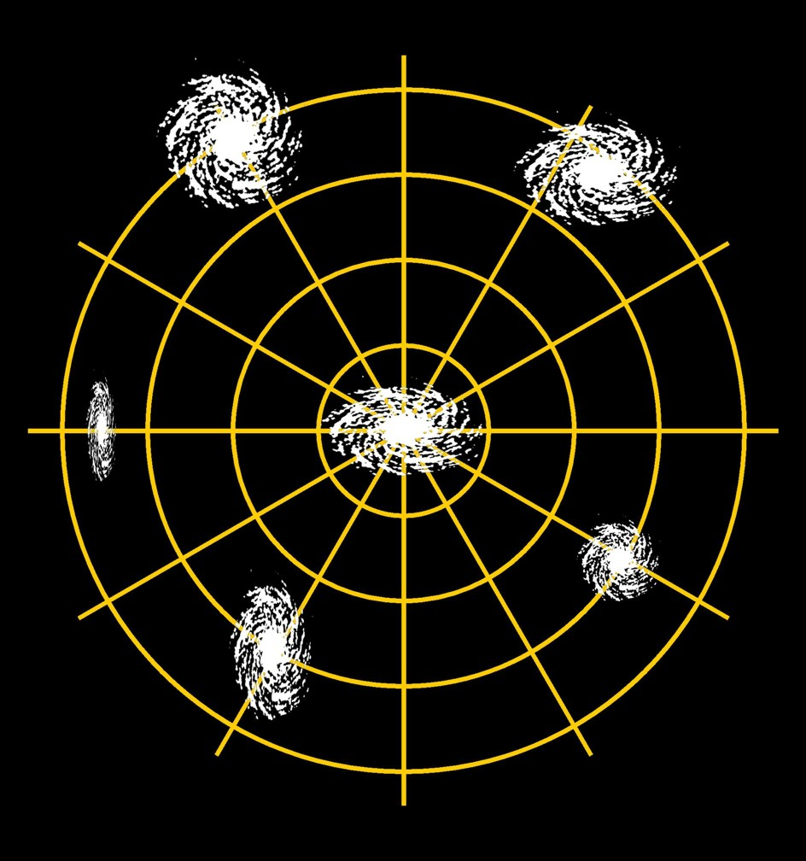
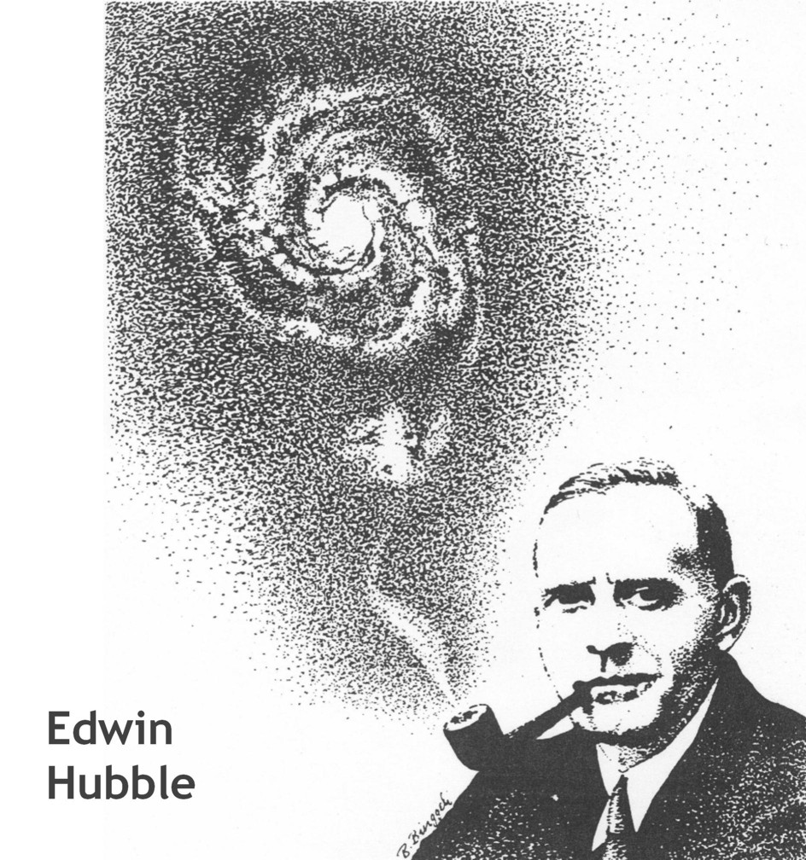
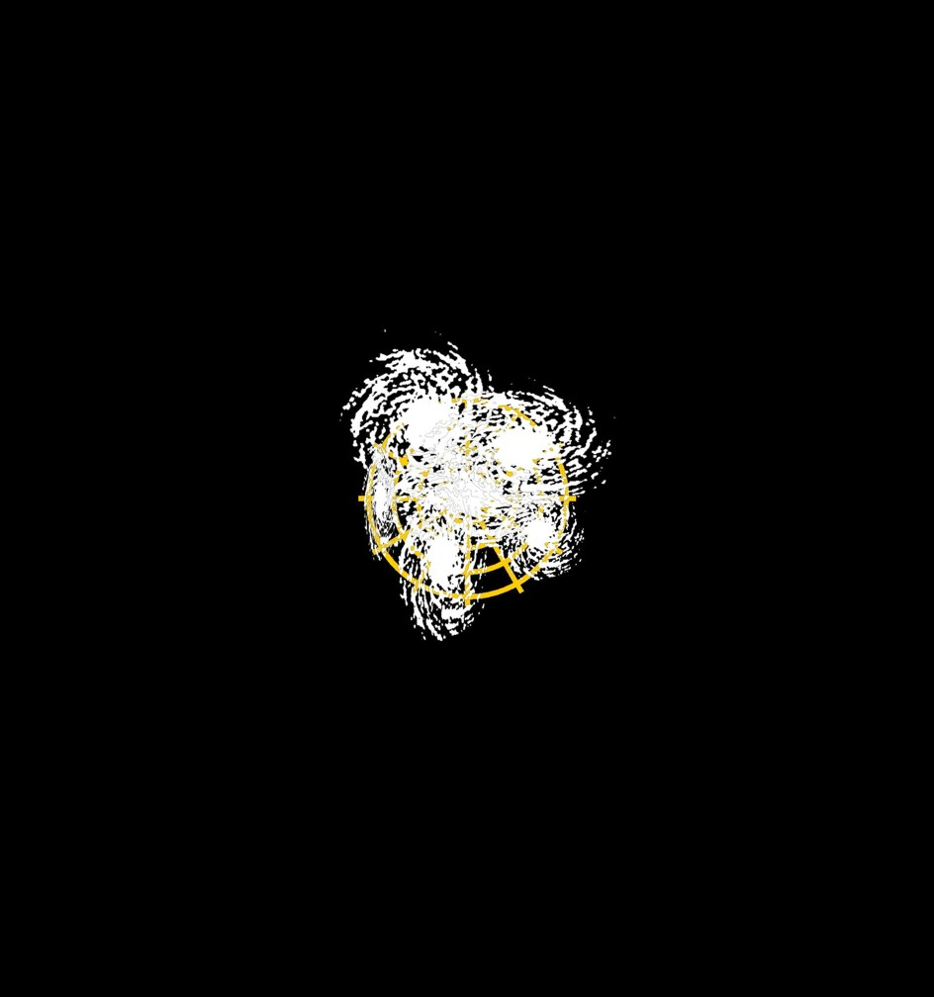
Expanding Universe and the Big Bang
Photons
Neutrinos
Charged Leptons
Quarks
Gluons
W- and Z-Bosons
Higgs Particles
Gravitons
Dark-Matter Particles
Topological defects
…
Hubble’s law
v_{expansion} = H₀ × Distance
Hubble’s constant
H₀ = 67.3 ± 1.2 km s^{–1} Mpc^{–1}
1 Mpc = 3.26 × 10⁶ lyr
= 3.08 × 10²⁴ cm
Expansion age of the universe
t₀ ≈ H₀^{–1} ≈ 14 × 10⁹ years

Slide 10
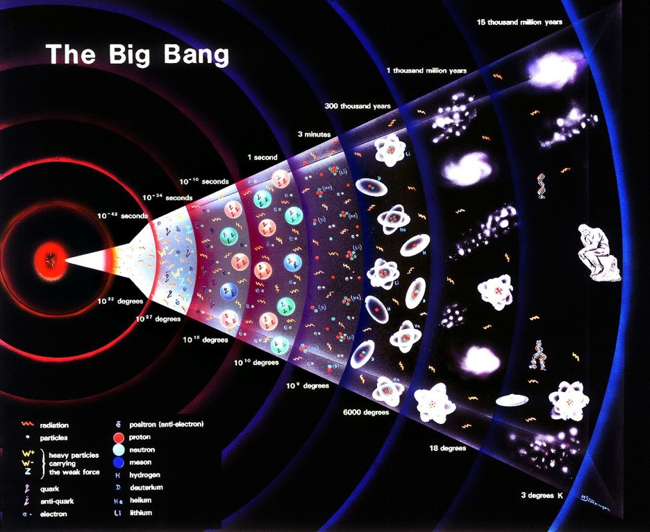
Big Bang

Slide 11
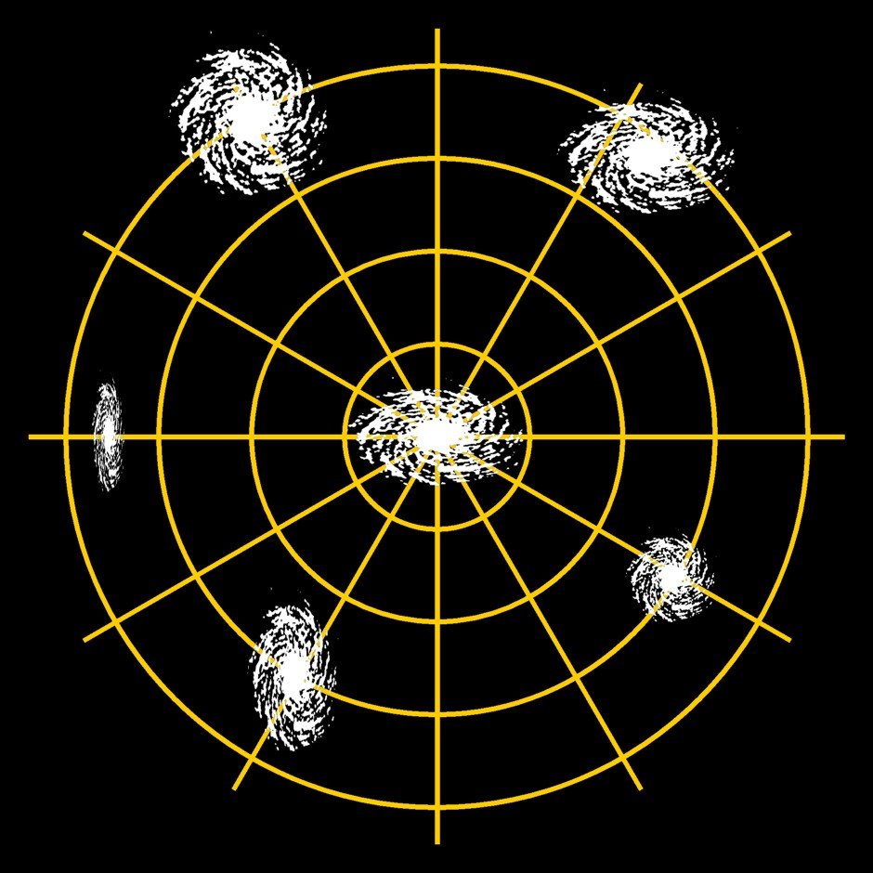
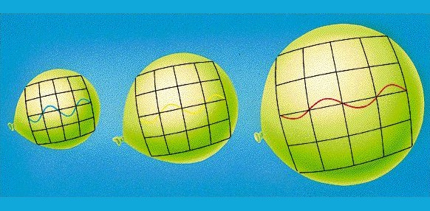
Cosmic Expansion
Cosmic Scale Factor
Cosmic Redshift
Space between galaxies grows
Galaxies (stars, people) stay the same
(dominated by local gravity
or by electromagnetic forces)
Cosmic scale factor today: $a=1$
Wavelength of light is “stretched”
Suffers redshift $z+1=\frac{λ_{today}}{λ_{then}}$
Redshift today: $z=0$
$$z+1=\frac{λ_{\text{today}}}{λ_{\text{then}}}=\frac{a_{\text{today}}}{a_{\text{then}}}$$

Slide 12
Friedman-Robertson-Walker-Lemaître Cosmology
On scales ≳ 100 Mpc, space is maximally symmetric
(homogeneous & isotropic)
The corresponding Robertson-Walker metric is
$$ds^{2}=dt^{2}−a^{2}\left(t\right)\left[\frac{dr^{2}}{1−kr^{2}}+r^{2}\left(dθ^{2}+\sin^{2}θ dφ^{2}\right)\right]$$
Clock time
of co-moving
observer
Cosmic
scale
factor
Curvature
k = 0, ±1
Co-moving spherical coordinates
r is dimensionless
k = −1
k = 0
k = +1

Slide 13
Friedman Equation: Newtonian Derivation
Birkhoff’s theorem:
Spherical symmetry implies that only
the mass interior to a radius $R$ is relevant
for the motion of a test mass $m$ at $R$
Energy conservation $V_{pot}+V_{kin}=const$
$$−\frac{G_{N}\frac{4π}{3}R^{3}ρ m }{R}+\frac{1}{2} {\dot{R}}^{2}m=const$$
$${ ⟹ \left(\frac{\dot{R}}{R}\right)}^{2}=\frac{8π}{3} G_{N}ρ+\frac{const}{R^{2}}$$
Rescale $R=a R_{C}$ with cosmic scale factor $a$ and $R_{C}$ radius of curvature today
$$H^{2}={\left(\frac{\dot{a}}{a}\right)}^{2}=\frac{8π}{3}G_{N}ρ−\frac{k}{a^{2}R_{C}^{2}}$$
with $k=0, ±1$
m
R
Density ρ
Friedman Equation

Slide 14
Critical Density and Density Parameter
Evolution of the cosmic scale factor $a(t)$ is governed by the Friedman Equation
$${ H}^{2}={\left(\frac{\dot{a}}{a}\right)}^{2}=\frac{8π}{3}G_{N}ρ−\frac{k}{a^{2}R_{C}^{2}}$$
In a flat universe ($k=0$), the relationship between $H$ and $ρ$ is unique
$${ ρ}_{crit}=\frac{3H^{2}}{8πG_{N}}=\frac{3}{8π}{\left(Hm_{Pl}\right)}^{2}$$
Cosmic density always expressed in terms of density parameters
$$Ω=\frac{ρ}{ρ_{crit}}=\frac{8πG_{N}ρ}{3H^{2}}$$
With the present-day Hubble parameter $H_{0}=67.3 km s^{−1} Mpc^{−1}$ we have
$${ ρ}_{crit}=8.51×10^{−30}g cm^{−3}=5 GeV m^{−3}={\left(2.5 meV\right)}^{4}$$
Most of this in the form of “dark energy”
critical density

Slide 15
Generic Solutions of Friedman Equation
Equation
of state
Behavior of energy-density under
cosmic expansion
Evolution of
cosmic scale factor
Radiation
$$p=\frac{ρ}{3}$$
$$ρ∝a^{−4}$$
Dilution of radiation
and redshift of energy
$$a(t)∝t^{1/2}$$
Matter
$$p=0$$
$$ρ∝a^{−3}$$
Dilution of matter
$$a(t)∝t^{2/3}$$
Vacuum
energy
$$p=−ρ$$
$$ρ=const$$
Vacuum energy not
diluted by expansion
$$a(t)∝e^{\sqrt{Λ/3} t}$$
$$Λ=8πG_{N}ρ_{vac}$$
Energy-momentum tensor of a perfect fluid with density $ρ$ and pressure $p$
$$T^{μν}=\left(\begin{matrix}ρ & & & \\ & p & & \\ & & p & \\ & & & p\end{matrix}\right) T_{vac}^{μν}=ρ g^{μν}\left(\begin{matrix}ρ & & & \\ & −ρ & & \\ & & −ρ & \\ & & & −ρ\end{matrix}\right)$$

Slide 16
Expansion of Different Cosmological Models
Cosmic scale factor $a$
$$_{M}=0.3$$
$$_{Λ}=0.7$$
$$_{M}=0$$
$$_{M}=1$$
$$_{M}>1$$
-14
-9
-7
today
Time (billion years)
Adapted from Bruno Leibundgut

Slide 17
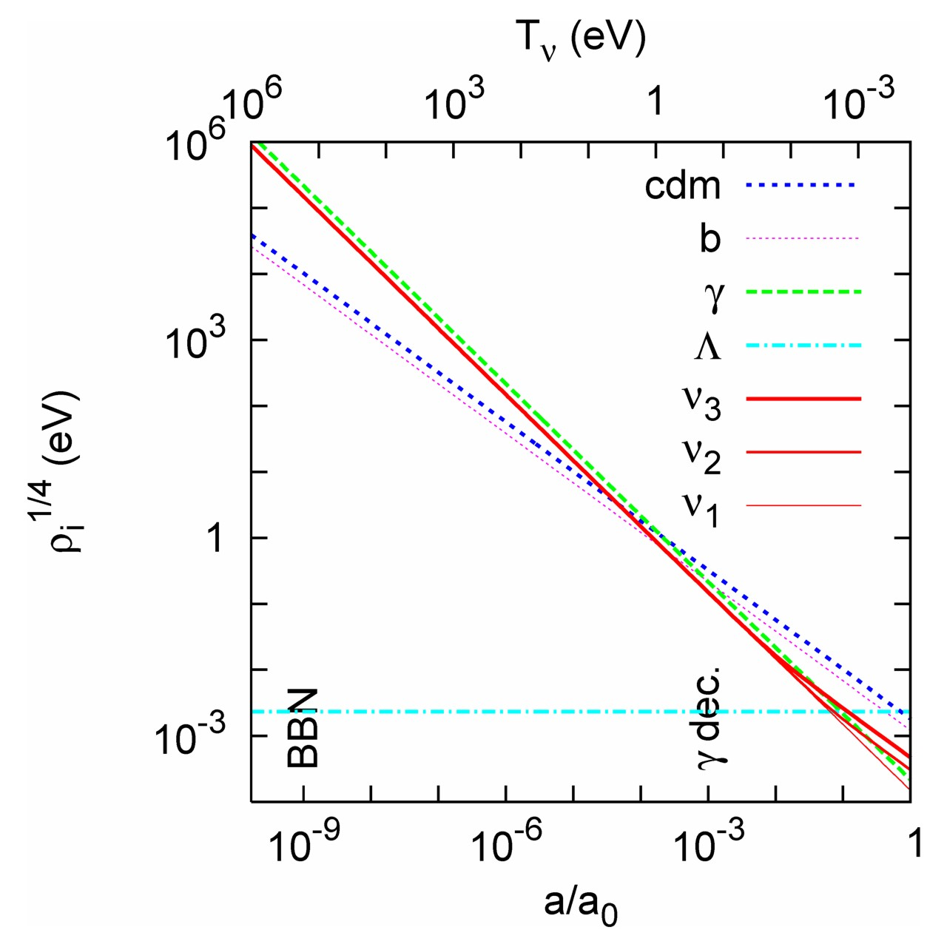
Evolution of Cosmic Density Components
Assumed neutrino masses
m₃ = 50 meV
m₂ = 9 meV
m₁ = 0
Radiation
Matter
Matter
radiation
equality
Vacuum Energy
Lesgourgues & Pastor
astro-ph/0603494

Slide 18
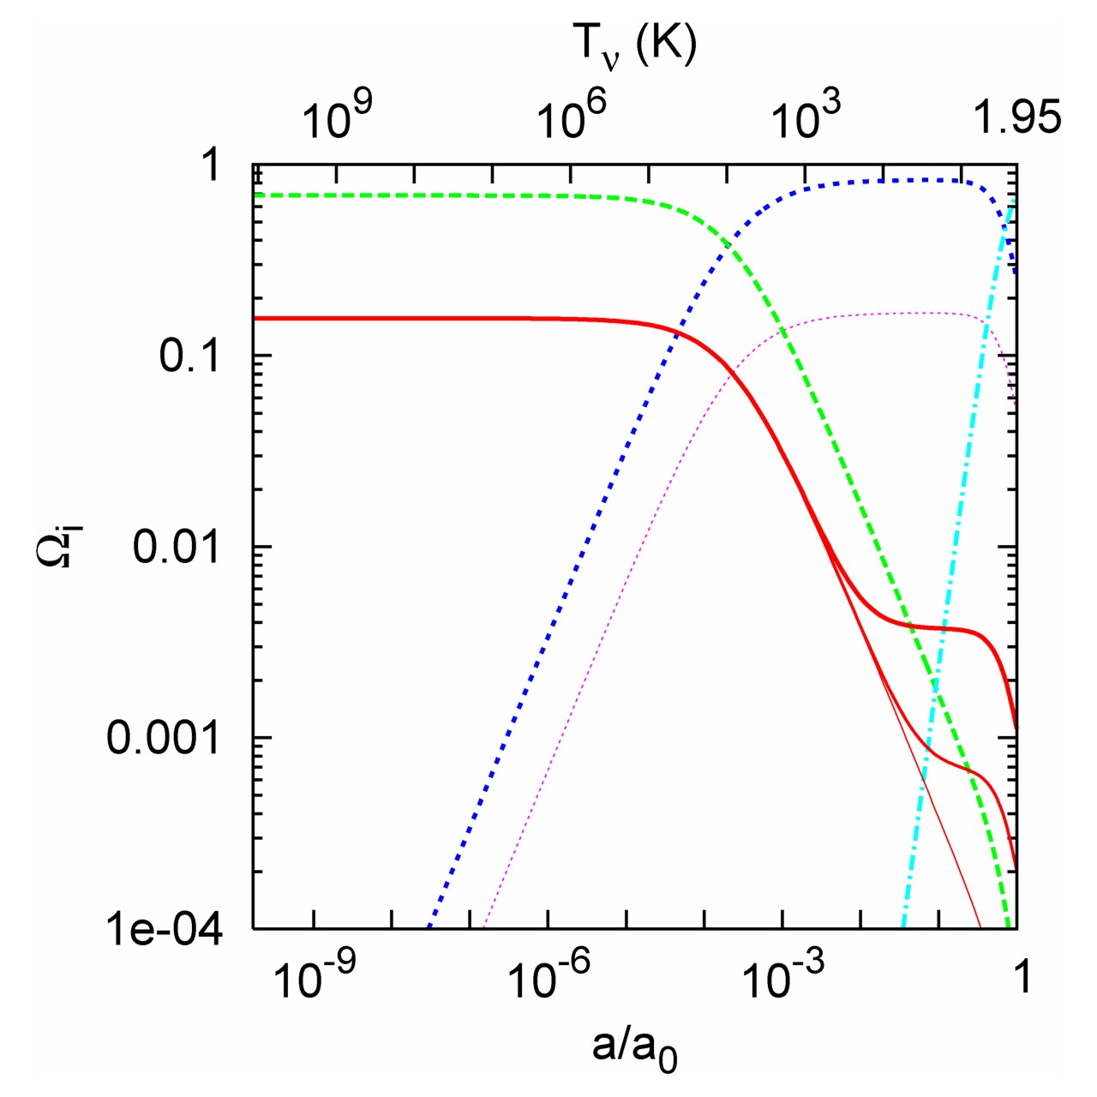
Evolution of Cosmic Density Components
Assumed neutrino masses
m₃ = 50 meV
m₂ = 9 meV
m₁ = 0
Photons
Neutrinos
Matter
radiation
equality
CDM
Baryons
Λ
Lesgourgues & Pastor
astro-ph/0603494

Slide 19
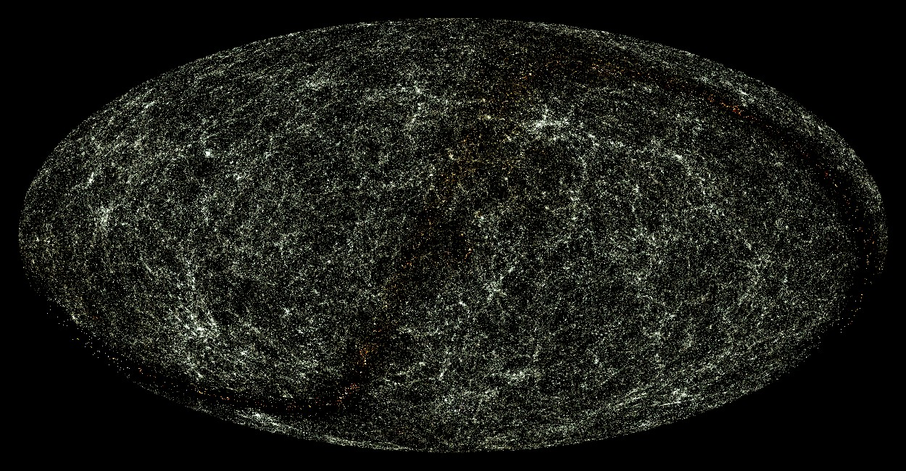
Sky Map of Galaxies (XMASS XSC)
http://spider.ipac.caltech.edu/staff/jarrett/2mass/XSC/jarrett_allsky.html

Slide 20
SDSS Survey

Slide 21
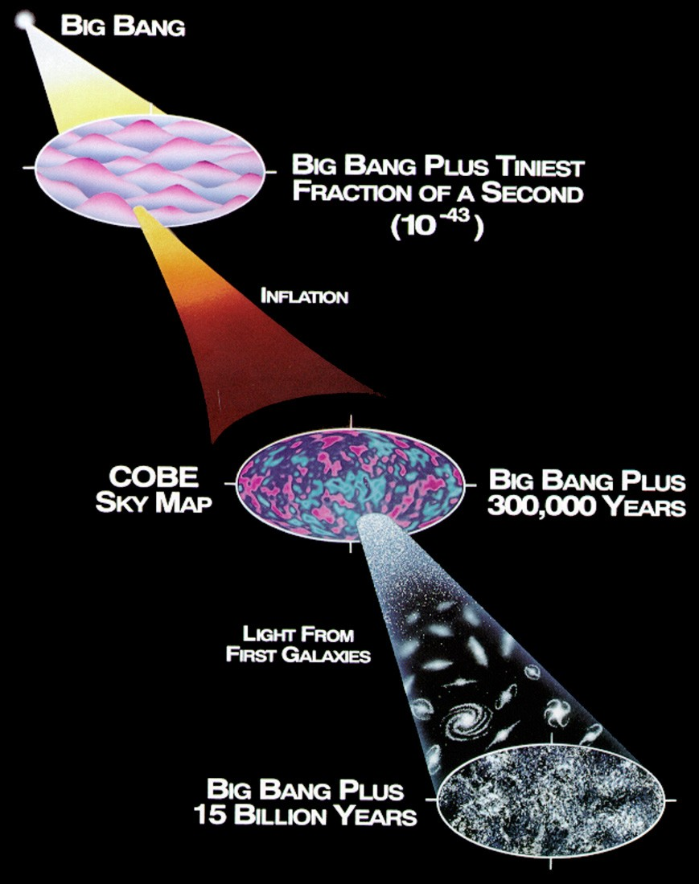
Structure Formation in the Universe
Early phase of exponential expansion
(Inflationary epoch)
Zero-point fluctuations of quantum
fields are stretched and frozen
Structure grows by gravitational
instability
Cosmic density fluctuations are
frozen quantum fluctuations

Slide 22
Power Spectrum of Density Fluctuations
Field of density fluctuations of matter (e.g. dark matter)
$$δ\left(x\right)=\frac{δρ\left(x\right)}{\overline{ρ}}$$
Fourier transform of density field
$${ δ}_{k}=∫d^{3}x e^{−ik⋅x}δ\left(x\right)$$
Power spectrum is essentially the square of the Fourier transform ($\hat{δ}$ is $δ$-function)
$$\left\langle δ_{k}δ_{k^{′}}\right\rangle ={\left(2π\right)}^{3}\hat{δ}\left(k−k^{′}\right)P(k)$$
Power spectrum is Fourier transform of two-point correlation function ($x=x_{2}−x_{1}$)
$$ξ\left(x\right)=\left\langle δ\left(x_{2}\right)δ\left(x_{1}\right)\right\rangle =\int{\frac{d^{3}k}{{\left(2π\right)}^{3}} e^{ik⋅x}P\left(k\right)=}\int{\frac{dΩ}{4π}\frac{dk}{k} e^{ik⋅x}}\underset{Δ^{2}\left(k\right)}{\underbrace{\frac{k^{3}P\left(k\right)}{2π^{2}}}}$$
Gaussian random field (phases of $δ_{k}$ uncorrelated) is fully characterized by
$P\left(k\right)={\left|δ_{k}\right|}^{2}$ Power Spectrum
or equivalently by
$$Δ\left(k\right)={\left(\frac{k^{3}P\left(k\right)}{2π^{2}}\right)}^{1/2}=\frac{k^{3/2}\left|δ_{k}\right|}{\sqrt{2} π}$$
No “non-Gaussianities” in cosmological precision data (Planck CMBR results)

Slide 23
Structure Formation by Gravitational Instability

Slide 24
Gravitational Growth of Density Perturbations
The dynamical evolution of small perturbations
$$δ\left(x\right)=\frac{δρ\left(x\right)}{\overline{ρ}}≪1$$
is independent for each Fourier mode $δ_{k}$ (linear regime)
• For pressureless, nonrelativistic matter (cold dark matter)
naively expect exponential growth by gravitational instability
• But only power-law growth in expanding universe
(competition between expansion and gravitational instability)
Sub-horizon
$$λ≪H^{−1}$$
Super-horizon
$$λ≫H^{−1}$$
Radiation dominates
$$a∝t^{1/2}$$
$$δ_{k}∝const$$
$$δ_{k}∝a^{2}∝t$$
Matter dominates
$$a∝t^{2/3}$$
$$δ_{k}∝a∝t^{2/3}$$
Density contrast grows
linearly with scale factor

Slide 25
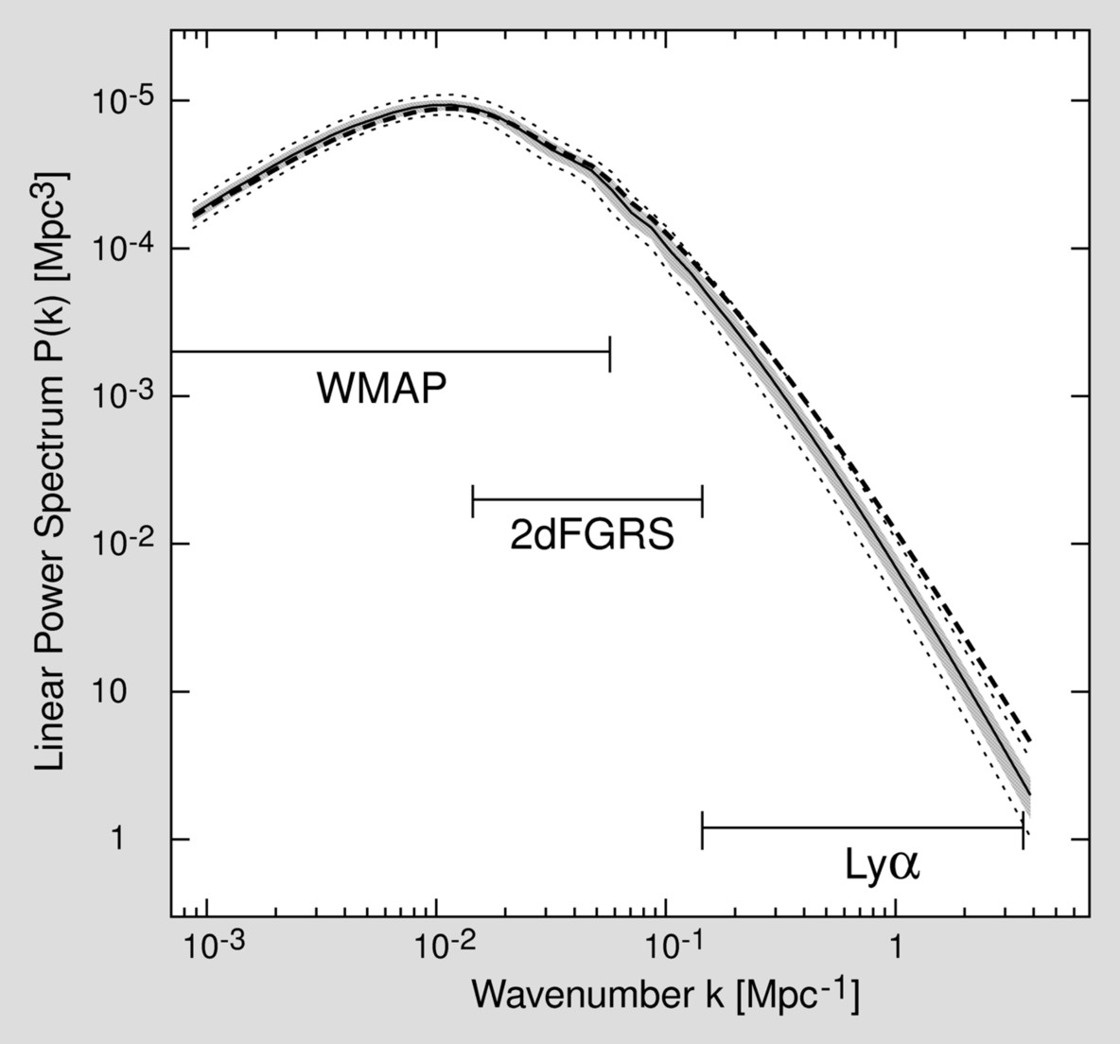
Processed Power Spectrum in CDM Scenario
Primordial spectrum
Suppressed by stagnation
during radiation phase
Primordial spectrum usually
assumed to be a power law
$$P\left(k\right)={\left|δ_{k}\right|}^{2}∝k^{n_{s}}$$
Harrison-Zeldovich spectrum
(“flat”) has $n_{s}=1$
Precision cosmology provides
$${ n}_{s}=0.960±0.007$$
in spectacular agreement with
simplest theories of inflation
CMBR
Galaxy
surveys

Slide 26
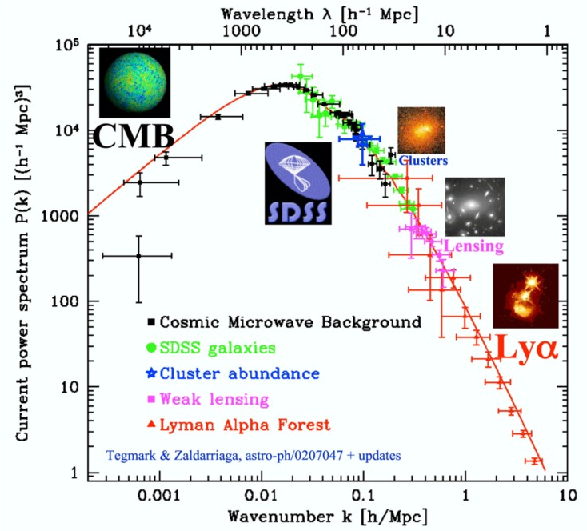
Power Spectrum of Cosmic Density Fluctuations
Tegmark, TAUP 2003

Slide 27
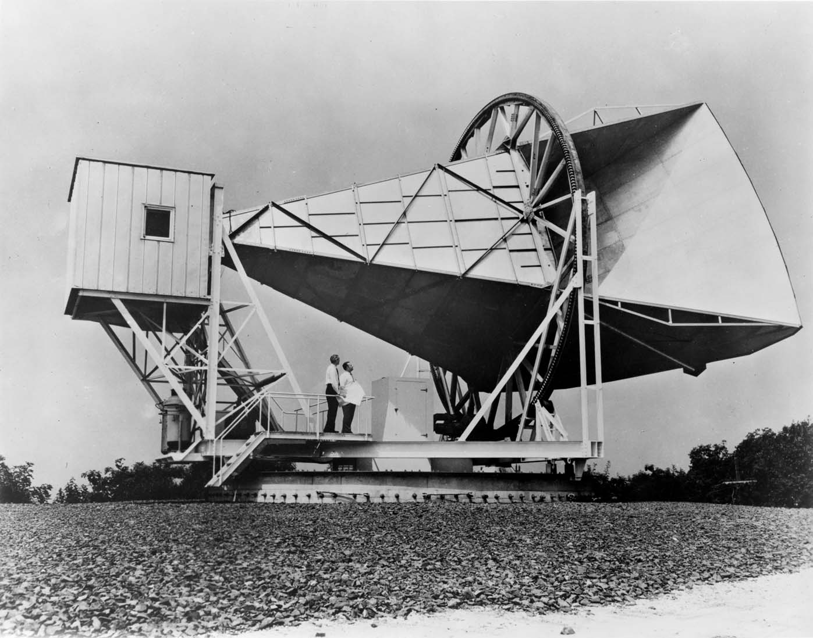
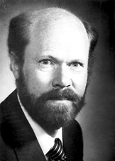
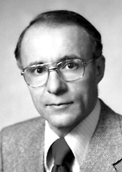
Discovery of the Cosmic Microwave Background Radiation
Robert W. Wilson
Born 1936
Arno A. Penzias
Born 1933
Discovery of 2.7 Kelvin
Cosmic microwave background radiation
by Penzias and Wilson in 1965
(Nobel Prize 1978)
Beginning of “big-bang cosmology”

Slide 28
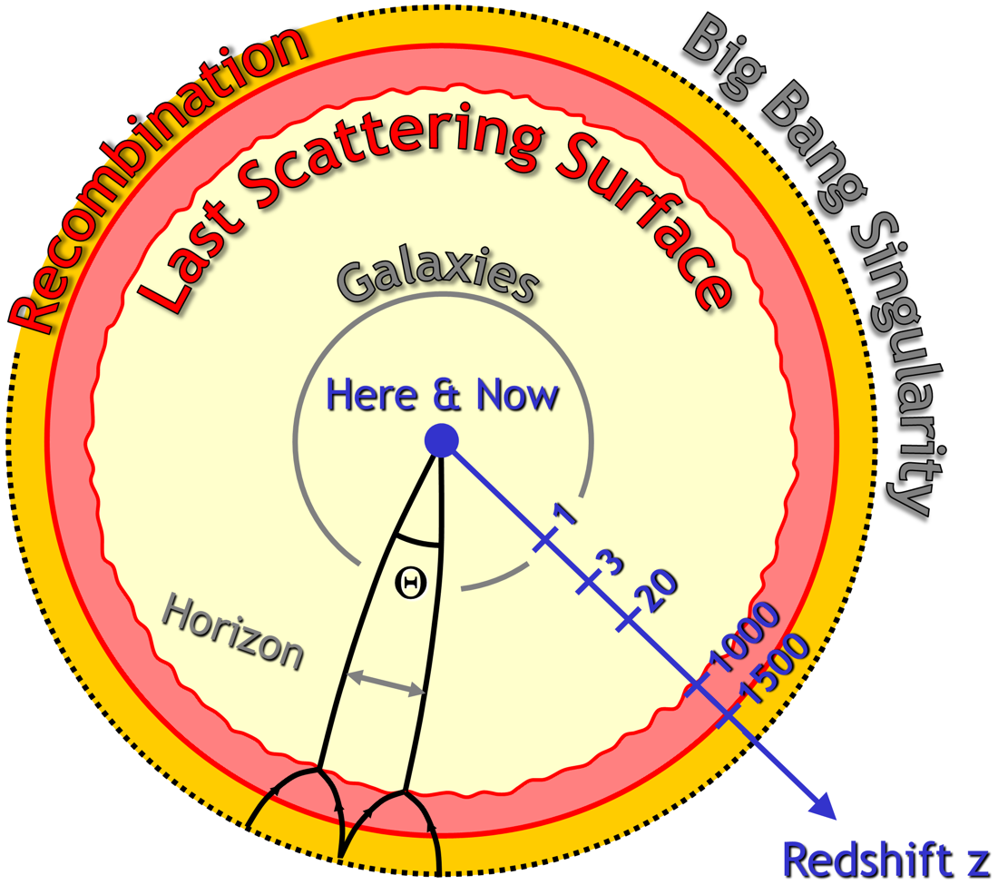
Last Scattering Surface

Slide 29
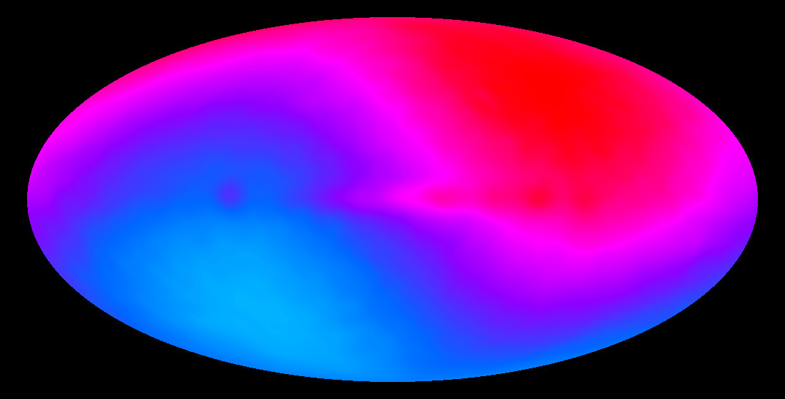
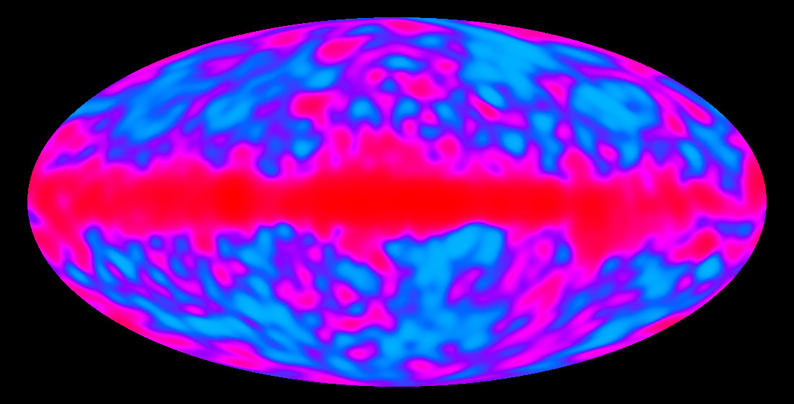
COBE Temperature Map of the Microwave Background
T = 2.725 K (uniform on the sky)
Dynamical range ΔT = 18 μK (ΔT/ T ≈ 10⁻⁵)
Primordial temperature fluctuations
Dynamical range ΔT = 3.353 mK (ΔT/ T ≈ 10⁻³)
Dipole temperature distribution from Doppler effect
caused by our motion relative to the cosmic frame

Slide 30
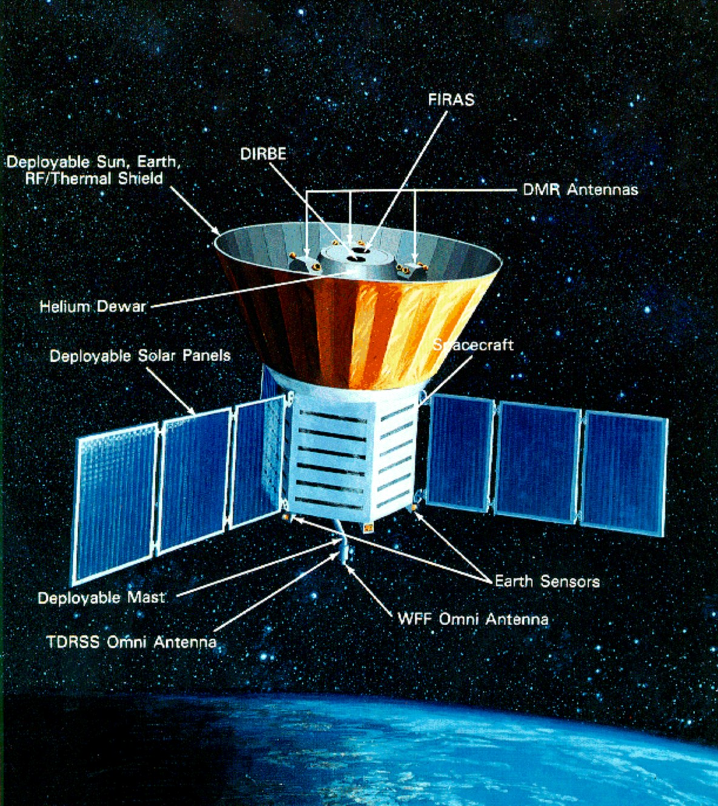
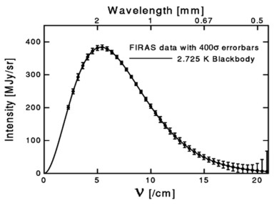
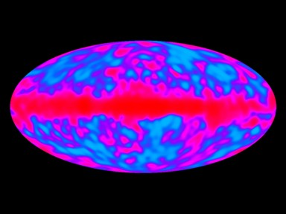
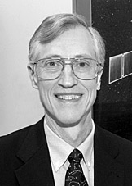
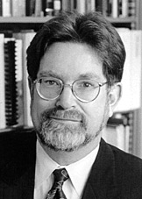
COBE Satellite
Nobel Prize 2006
John C. Mather
Born 1946
George F. Smoot
Born 1945

Slide 31
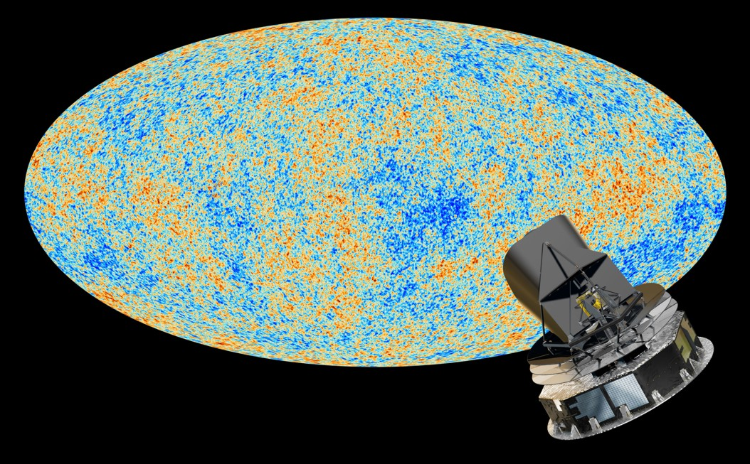
Cosmic Microwave Background (Planck 2013)

Slide 32
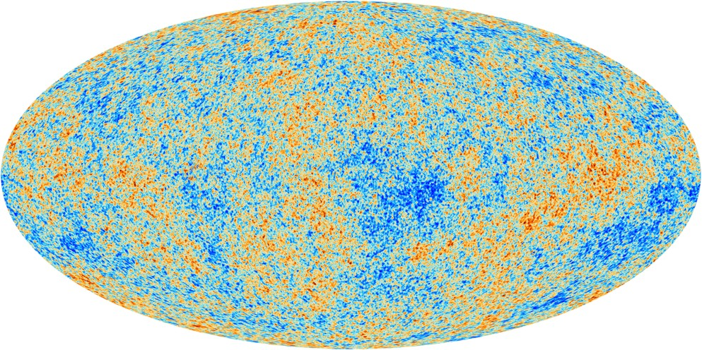
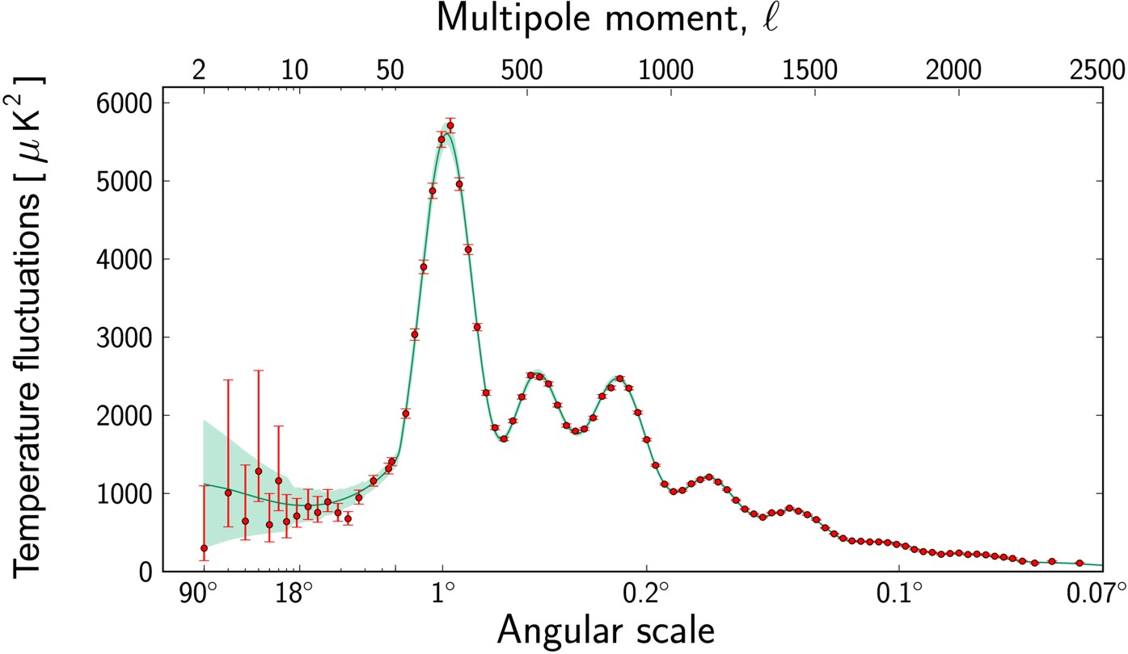
Power Spectrum of CMB Temperature Fluctuations
Sky map of CMBR temperature
fluctuations
$$Δ\left(θ,φ\right)=\frac{T\left(θ,φ\right)−〈T〉}{〈T〉}$$
Multipole expansion
$$Δ\left(θ,φ\right)=\sum_{ℓ=0}^{∞}{ \sum_{m=−ℓ}^{ℓ}{a_{ℓm}Y_{ℓm}\left(θ,φ\right)}}$$
Angular power spectrum
$${ C}_{ℓ}=〈a_{ℓm}^{∗}a_{ℓm}〉$$
$$=\frac{1}{2ℓ+1}\sum_{m=−ℓ}^{ℓ}{a_{ℓm}^{∗}a_{ℓm}}$$
Provides “acoustic peaks” and a
wealth of cosmological information
Planck
Acoustic Peaks

Slide 33
Flat Universe from CMBR Angular Fluctuations
Triangulation with acoustic peak
flat (Euclidean)
negative curvature
positive curvature
$Ω_{tot}={0.963}_{−0.049}^{+0.043}$ (CMB alone)
$Ω_{tot}={0.9995}_{−0.0066}^{+0.0065}$ (All data)
(95% ranges from Planck, arXiv:1303.5076)
Known physical
size of acoustic peak
at decoupling (z ≈ 1100)
Measured
angular size
today (z = 0)

Slide 34
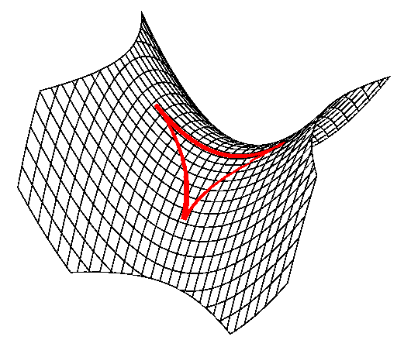
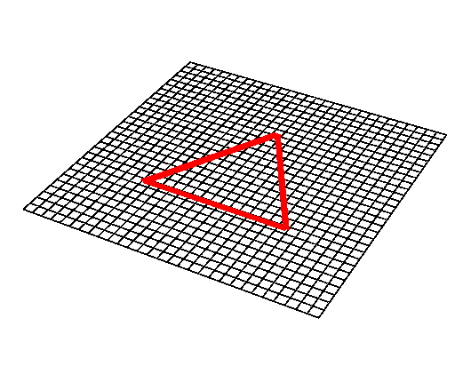
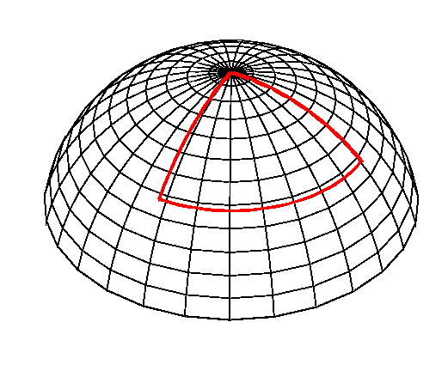
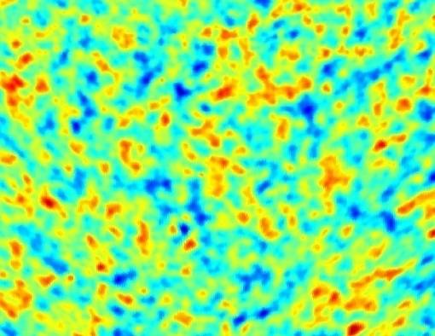
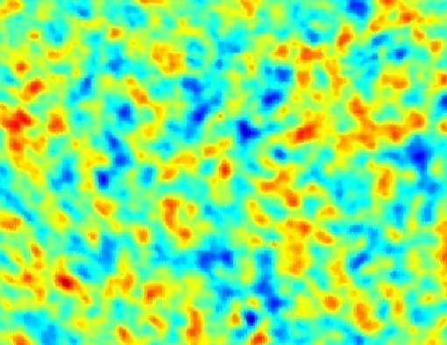
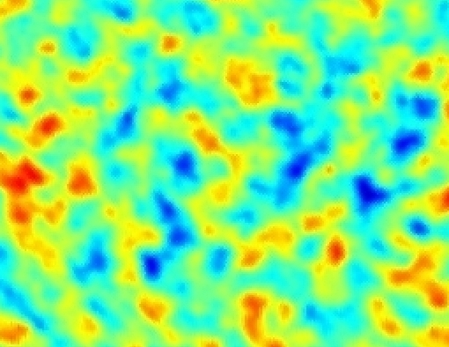
Geometry of the Universe and Angular Scales
Open Universe
Ω < 1
Flat Universe
Ω = 1
Closed Universe
Ω > 1

Slide 35
Pie Chart of Dark Universe
Dark Energy ~70%
(Cosmological Constant)
Neutrinos
0.1−1%
Ordinary Matter ~5%
(of this only about
10% luminous)
Dark Matter
~25%

Slide 36
Matter-Radiation Equality (Redshift 3400)
Dark Matter
42%
Baryons
8%
Photons
30%
Massless Neutrinos
20%

Slide 37
After Electron-Positron Annihilation (T = 100 keV)
Neutrinos
41%
Photons
59%
Relevant for Big Bang Nucleosynthesis (BBN)

Slide 38
Before Electron-Positron Annihilation (T = 1 MeV)
Neutrinos
48.8%
Photons
18.6%
Electrons/Positrons
32.6%

Slide 39
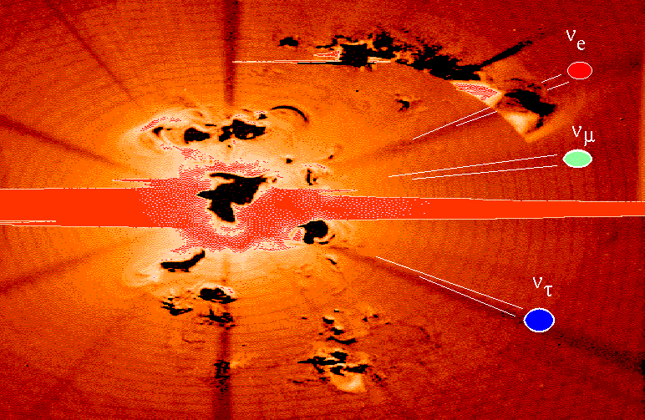
Creation of the Universe
Cosmic
Neutrino Sea

Slide 40
Neutrino Thermal Equilibrium
Neutrino reaction rate
Cosmic expansion rate
Examples for neutrino processes
Friedmann equation (flat universe)
$$e^{+}+e^{−}↔\overline{ν}+ν$$
$$\overline{ν}+ν↔\overline{ν}+ν$$
$$ν+e^{±}↔ν+e^{±}$$
$$H^{2}=\frac{8π}{3}\frac{ρ}{m_{Pl}^{2}}$$
$$\left(G_{N}=\frac{1}{m_{Pl}^{2}}\right)$$
G_{F}
Radiation dominates
$$ρ∼T^{4}$$
Dimensional analysis of reaction rate
in a thermal medium for T ≪ m_{W,Z}
Expansion rate
$$H∼\frac{T^{2}}{m_{Pl}}$$
$$Γ∼G_{F}^{2}T^{5}$$
Condition for thermal equilibrium: $Γ>H$
$$T>{\left(m_{Pl}G_{F}^{2}\right)}^{−1/3}∼{\left[{10}^{19}GeV {\left({10}^{−5}GeV^{−2}\right)}^{2}\right]}^{−1/3}=1 MeV$$
Neutrinos are in thermal equilibrium for T ≳ 1 MeV
corresponding to t ≲ 1 sec

Slide 41
Neutrino Thermal Equilibrium
Neutrino reaction rate
Cosmic expansion rate
Examples for neutrino processes
Friedmann equation (flat universe)
$$e^{+}+e^{−}↔\overline{ν}+ν$$
$$\overline{ν}+ν↔\overline{ν}+ν$$
$$ν+e^{±}↔ν+e^{±}$$
$$H^{2}=\frac{8π}{3}\frac{ρ}{m_{Pl}^{2}}$$
$$\left(G_{N}=\frac{1}{m_{Pl}^{2}}\right)$$
g
g
W,Z
Radiation dominates
$$ρ∼T^{4}$$
Dimensional analysis of reaction rate
in a thermal medium for T ≫ m_{W,Z}
Expansion rate
$$H∼\frac{T^{2}}{m_{Pl}}$$
$$Γ∼{\left({g^{2}}/{4π}\right)}^{2} T$$
Condition for thermal equilibrium: $Γ>H$
$$T<{\left({g^{2}}/{4π}\right)}^{2} m_{Pl}≈{10}^{16}GeV≈Λ_{GUT}$$
It depends on very early cosmic history when neutrinos first enter equilibrium,
presumably at reheating after inflation

Slide 42
Thermal Radiations
General
Bosons
Fermions
Number density n
$$g\int{\frac{d^{3}p}{{\left(2π\right)}^{3}}}\frac{1}{e^{{E_{p}}/T}±1}$$
$$g_{B}\frac{ζ_{3}}{π^{2}} T^{3}$$
$$\frac{3}{4} g_{F}\frac{ζ_{3}}{π^{2}} T^{3}$$
Energy density ρ
$$g\int{\frac{d^{3}p}{{\left(2π\right)}^{3}}}\frac{E_{p}}{e^{{E_{p}}/T}±1}$$
$$g_{B}\frac{π^{2}}{30} T^{4}$$
$$\frac{7}{8} g_{F}\frac{π^{2}}{30} T^{4}$$
Energy density ρ
$$g\int{\frac{d^{3}p}{{\left(2π\right)}^{3}}}\frac{E_{p}}{e^{{E_{p}}/T}±1}$$
Pressure P
$$\frac{ρ}{3}$$
Entropy density s
$$\frac{ρ+P}{T}=\frac{4}{3} \frac{ρ}{T}$$
$$g_{B}\frac{{2π}^{2}}{45} T^{3}$$
$$\frac{7}{8} g_{F}\frac{{2π}^{2}}{45} T^{3}$$
Riemann Zeta Function
$$ζ_{3}=1.2020569…$$

Slide 43
Thermal Degrees of Freedom
Mass threshold
Particles
g_{B}
g_{F}
g*
low
γ, 3ν
2
6
(7.25)
m_{e}
0.5 MeV
e±
2
10
10.75
m_{μ}
105 MeV
μ±
2
14
14.25
m_{π}
135 MeV
π⁰, π±
5
14
17.25
Λ_{QCD}
$∼$170 MeV
u, d, s, gluons
18
50
61.75
m_{c,τ}
2 GeV
c, τ
18
66
75.75
m_{b}
6 GeV
b±
18
78
86.25
m_{W,Z}
90 GeV
Z⁰, W±
27
78
92.25
m_{H}
126 GeV
Higgs
28
78
93.25
m_{t}
170 GeV
t
28
90
106.75
Λ_{SUSY}
~ 1 TeV ?
SUSY particles
118
118
213.50

Slide 44
Thermal Degrees of Freedom in the Early Universe
QCD color
confinement

Slide 45
Present-Day Neutrino Density
Neutrino decoupling
(freeze out)
$H∼Γ$
$T≈2.4 MeV$ (electron flavor)
$T≈3.7 MeV$ (other flavors)
$$\frac{dn_{ν\overline{ν}}}{dE}=\frac{1}{π^{2}}\frac{E^{2}}{e^{E/T}+1}$$
Redshift of Fermi-Dirac
distribution (“nothing
changes at freeze-out”)
Temperature
scales with redshift
$$T_{ν}=T_{γ}∝\left(z+1\right)$$
Electron-positron
annihilation beginning
at T ≈ m_{e} = 0.511 MeV
QED plasma is “strongly” coupled
Stays in thermal equilibrium (adiabatic process)
Entropy of e⁺e⁻ transfered to photons
$$g_{∗}T_{γ}^{3}{\left.​\right|}_{before}=g_{∗}T_{γ}^{3}{\left.​\right|}_{after}$$
$$\}$$
$$T_{γ}^{3}{\left.​\right|}_{before}=\frac{4}{11}T_{γ}^{3}{\left.​\right|}_{after}$$
$\overbrace{2+\frac{7}{8}4=\frac{11}{2}}$
$\overbrace{2}$
Redshift of
neutrino and photon
thermal distributions
so that today we have
$n_{ν\overline{ν}}\left(1 flavor\right)=\frac{4}{11}×\frac{3}{4}×n_{γ}=\frac{3}{11}n_{γ}≈112 cm^{−3}$
$T_{ν}={\left(\frac{4}{11}\right)}^{1/3}T_{γ}≈1.95 K$ for massless neutrinos

