Slide 1
Current Themes in High Energy Physics and Cosmology
August 25-29,2014

Slide 2
Recent Progress on
Cosmological Bounces & Bouncing Cosmologies
Current Themes in High Energy Physics and Cosmology
August 25-29,2014

Slide 3
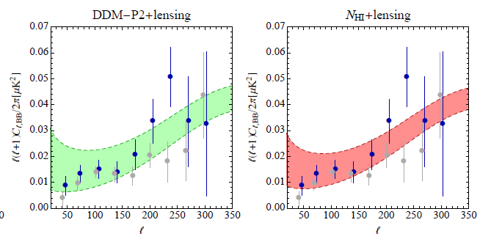
BICEP2
The null hypothesis – lensing + dust – cannot be rejected
Any claim of tensor, esp. “r=0.2”, makes no sense scientifically
No systematics paper
Planck dust map available on September Nth, where N < 4

Slide 4
“Classic” Inflationary Picture
Typical initial conditions
Simple inflaton potentials with minimum tuning
➔ inflation
➔ smooth and flat universe
+ predictions of n_{s}, α, n_{t}, r, …
outdated
Ijjas, PJS. Loeb, PLB (2013, 2014)
Guth, Kaiser, Nomura, PLB (2014)
Linde, arxiv1402.0526 (2014)

Slide 5
An Alternative Inflationary Picture?
Typical initial conditions
Simple inflaton potentials with minimum tuning
➔ inflation
➔ smooth and flat universe
+ predictions of n_{s}, α, n_{t}, r, …
Ijjas, PJS. Loeb, PLB (2013, 2014)
Guth, Kaiser, Nomura, PLB (2014)
Linde, arxiv1402.0526 (2014)

Slide 6
An Alternative Inflationary Picture?
Typical initial conditions
Ijjas, PJS. Loeb, PLB (2013, 2014)
Guth, Kaiser, Nomura, PLB (2014)
Linde, arxiv1402.0526 (2014)

Slide 7
An Alternative Inflationary Picture?
Typical initial conditions
Simple inflaton potentials with minimum tuning
➔ inflation
➔ smooth and flat universe
+ predictions of n_{s}, α, n_{t}, r, …
Ijjas, PJS. Loeb, PLB (2013, 2014)
Guth, Kaiser, Nomura, PLB (2014)
Linde, arxiv1402.0526 (2014)

Slide 8
An Alternative Inflationary Picture?
Typical initial conditions
Simple inflaton potentials with minimum tuning
➔ inflation
➔ smooth and flat universe
+ predictions of n_{s}, α, n_{t}, r, …
multiverse
Ijjas, PJS. Loeb, PLB (2013, 2014)
Guth, Kaiser, Nomura, PLB (2014)
Linde, arxiv1402.0526 (2014)

Slide 9
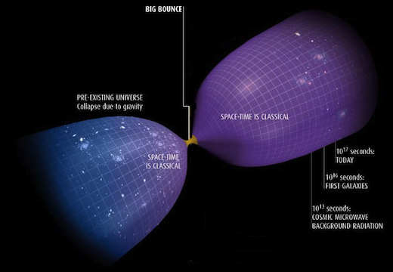
Why Bounce?
Khoury, Ovrut, PJS, Turok (2001)
PUS & Turok (2002)

Slide 10
Why Bounce?
simple solution to flatness & homogeneity problems
inhomogeneities
See also Xue et al, PRD88, 083509 (2013)

Slide 11
Why Bounce?
simple solution to flatness & homogeneity problems
evades the multiverse/unpredictability problem
can be made geodesically complete

Slide 12
Bouncing Fears?
branes & extra dimensions?
Khoury, Ovrut, PJS & Turok (2002)
no-go thm: background must be unstable
if it produces scale-invariant spectrum?
Wesley & Tolley (2007)
no-go thm: cannot produce adiabatic spectrum (directly)
Creminelli, Nicolis, Zaldarriaga (2007)
f_{NL} ~ O(10)
Lehners et al (2007); Finelli (2002)
no theory for the bounce/
incompatible with string theory

Slide 13
Ekpyrotic: ultra-slow contraction – a(t)~(-t)^{1/ε < < 1/3}
Two fields w/stable attractor solution
V
2nd field: χ
entropic pert’s
→ curvature
φ
from conversion only:
f_{NL} ~ O(few)
Li, PLB 724 (2014)
Fertig, Lehners, Mallwitz, PRD 89 (2014)
Ijjas, PJS. Lehners, PRD 89, (2014)

Slide 14
Anamorphic: scalar-tensor + ordinary contraction
but
Ijjas, PJS. Lehners, to appear, (2014)

Slide 15
Anamorphic: scalar-tensor + ordinary contraction
Li, PLB (2014)
Key differences from ekpyrotic:
  single field
  adiabatic directly (no conversion needed)
  Can adjust ξ and n to get n_{s}=0.96 and r ~0.1
  f_{NL} ~ O(1)
Ijjas, PJS. Lehners, to appear, (2014)

Slide 16
What about the bounce?
non-singular vs. singular
Bars, PJS & Turok, Fortsh Phys, to appear (2014); Bars, PJS & Turok, PRD 89, 061302 (2014);
Bars, PJS & Turok, PLB276, 50 (2013); Bars, PJS & Turok, PRD 89, 043515 (2014);
Bars, Chen, PJS & Turok, PRD 86, 083542 (2012); Bars, Chen, PJS & Turok, PLB 715, 278 (2012)

Slide 17

a proposal
Note that, near the bounce, the effective action simplifies:
+ radiation]
+ radiation]
Smooth & Flat; Can ignore potentials and gradients; Ultralocal
Bars, PJS & Turok, Fortsh Phys, to appear (2014); Bars, PJS & Turok, PRD 89, 061302 (2014);
Bars, PJS & Turok, PLB276, 50 (2013); Bars, PJS & Turok, PRD 89, 043515 (2014);
Bars, Chen, PJS & Turok, PRD 86, 083542 (2012); Bars, Chen, PJS & Turok, PLB 715, 278 (2012)

Slide 18
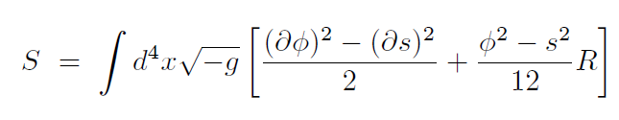

a proposal
Note that, near the bounce, the effective action simplifies:
+ radiation]
+ radiation]
Smooth & Flat; Can ignore potentials and gradients; Ultralocal
“Weyl invariant extension” (the same theory written a novel way!):
]
+ radiation
Weyl invariant: $g_{αβ}→e^{2ω(x)}$ $g_{αβ}$ , $φ→e^{−ω(x)}$ $φ$ and s$→e^{−ω(x)}$ $s$
Can choose $ω\left(x\right)$ so that $\frac{1}{12}\left(φ^{2}−s^{2}\right)=1/2κ2 to recover Einstein eqs.$

Slide 19
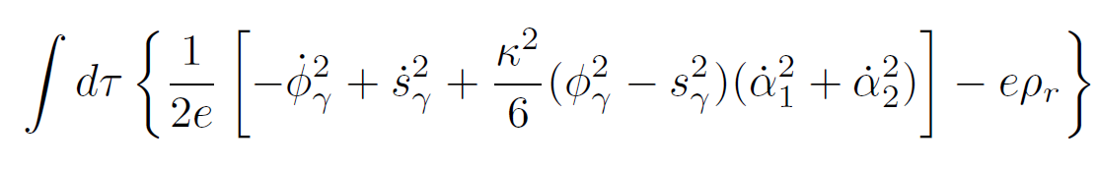
Every solution of the Einstein equations
+ radiation]
. . . is also a solution of the Weyl invariant extension . . .
]
+ radiation
. . . and also a solution of other gauge-fixed versions (e.g., g = a =1)
but … geodesically incomplete solutions in one gauge
may be geodesically complete solutions in the other !

Slide 20

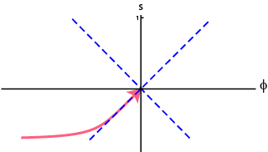
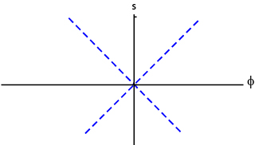
crunch
bang

Slide 21
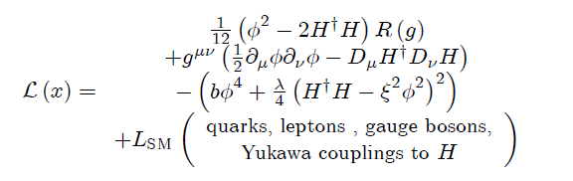
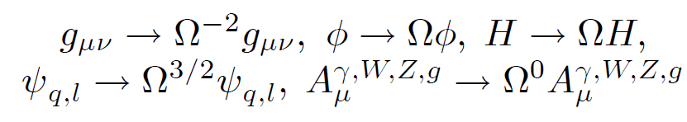
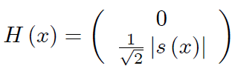
Weyl invariance can be extended
to all currently known physics
can also add dark matter and r-handed ν’s

Slide 22
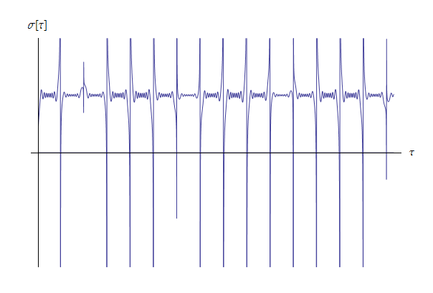
Geodesically complete!
higgs
current
vac

Slide 23
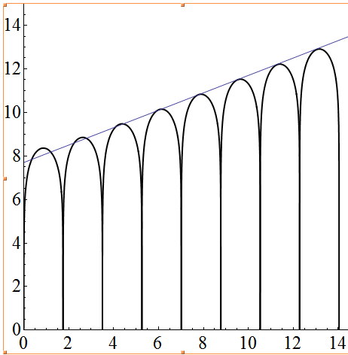
INCREASING ENTROPY EACH CYCLE BY CONSTANT FACTOR
CAUSES VOLUME TO GROW FROM CYCLE TO CYCLE
log a(t)
Geodesically complete!
(evades Borde, Guth, Vilenkin (2004) theorem & the “initial conditions” problem)

Slide 24
Bars, PJS, Turok (Fortschr Phys 2014)
can reformulate string theory with a local scale symmetry in target space without any fundamental lengths such that the fundamental length in string theory
– the string tension –
emerges from gauge fixing a field.

