Slide 1

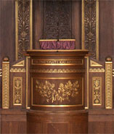
bhSPARSE: Portable Sparse Matrix and Vector Library
Weifeng Liu
Niels Bohr Institute,
University of Copenhagen, Denmark

Slide 2
Sparse Matrix
&
Sparse Matrix-Vector Multiplication
(SpMV)
Faculty of Science

Slide 3
Sparse Matrix
If the majority of entries in a matrix are zeros, we can store the matrix using a sparse representation that only records nonzero entries.
0
0
0
1
0
0
1
row index =
0
1
1
3
3
3
0
2
0
3
0
0
0
2
0
3
column index =
2
0
1
0
2
3
0
0
0
0
0
4
0
0
5
0
6
0
4
0
5
0
6
value =
0
1
0
2
0
3
0
4
0
5
0
6
A
(4x4)
dense
A
(4x4)
nnzA = 6
A (a sparse representation)
(4x4)
nnzA = 6

Slide 4
Sparse Matrix-Vector Multiplication
Multiply a sparse matrix A by a dense vector x, obtain a dense vector y.
0
1
x
0
a
=
1c
0
2
0
3
0
b
2a+3b
0
c
0
0
4
0
5
0
6
0
d
4a+5c+6d
A
(4x4)
nnzA = 6
x
(4x1)
dense
y
(4x1)
dense
Storage format of A is crucial for SpMV throughput.

Slide 5
Storage format – Compressed Sparse Row (CSR)
Store a row pointer, nonzero entries and their column indices.
0
1
row pointer =
0
1
2
6
6
6
8
0
8
0
18
0
13
0
3
0
9
column index =
0
2
0
1
2
3
4
5
value =
0
1
0
8
0
18
0
13
0
3
0
9
0
16
0
6
0
16
0
6
A
(6x6)
nnzA = 8
A (in CSR format)
(6x6)
nnzA = 8

Slide 6
CSR-based SpMV
assign a row block (multiple rows) to one core.
0
1
Core 0
0
8
Core 1
Possibly
imbalanced
computation
0
18
0
13
0
3
0
9
Core 2
Core 3
Core 4
0
16
0
6
Core 5
A
(6x6)
nnzA = 8

Slide 7
The CSR5 Storage Format (this work)
Faculty of Science

Slide 8
CSR5: Tiling
column index =
Core 0
Core 1
Tile 0
for
core 0
Tile 1
for
core 1
0
7
1
6
5
2
6
2
6
7
2
1
2
7
0
3
7
3
3
3
3
1
1
4
0
4
0
1
0
2
0
3
0
4
0
5
6
0
4
3
1
5
1
5
0
1
0
2
value =
0
1
0
5
0
2
0
6
0
3
0
2
0
6
0
3
0
7
0
8
0
1
0
2
0
3
0
4
0
5
0
6
0
7
0
2
0
1
0
3
0
7
0
1
0
3
0
7
0
4
0
1
0
2
0
3
0
3
0
2
0
4
0
1
0
2
0
4
0
1
0
5
0
1
0
2
0
4
0
1
0
5
0
2
0
1
0
5
0
2
0
6
0
1
0
2
0
3
0
4
0
5
0
6
0
7
bit-flag =
0
1
0
2
0
3
0
4
0
5
0
6
0
7
0
8
T
Evenly assign matrix to
compute units,
thus load balanced and
insensitive to sparsity structure
F
F
F
T
F
F
F
A
(8x8)
nnzA = 34
F
T
F
F
T
F
F
F
F
F
F
T
F
F
T
F
F
T
F
F
T
F
F
F

Slide 9
Using tile-wise transposed CSR data
value (CSR5) =
0
1
0
5
0
2
0
6
0
3
0
2
0
6
0
3
0
7
0
8
0
1
0
2
0
3
0
4
0
5
0
2
0
1
0
3
0
7
0
1
0
3
0
7
0
4
0
1
0
2
0
3
0
2
0
4
0
1
0
2
0
4
0
1
0
5
0
4
0
1
0
5
0
2
0
1
0
5
0
2
0
6
0
1
0
2
0
3
0
4
0
5
0
6
0
7
0
1
0
2
0
3
value (CSR) =
0
1
0
2
0
1
0
2
0
3
0
4
0
3
0
1
0
2
0
1
0
7
0
8
0
1
0
2
0
3
0
4
0
5
0
6
0
7
0
5
0
1
0
2
0
1
0
2
0
3
0
4
0
5
0
1
0
2
0
3
0
4
0
5
0
6
0
7
0
8
Directly use CSR data,
thus space-effcient and
fast format conversion
from CSR
0
2
0
3
0
4
0
5
0
6
0
7
0
1
0
2
A
(8x8)
nnzA = 34
0
6
0
7
0
1
0
2
0
3
0
4
0
5
0
6

Slide 10
CSR5: Tile Pointer array
tile pointer =
0
0
4
7
8
1
0
2
0
3
0
4
0
5
0
-0
1
0
2
0
1
0
2
0
3
0
4
0
5
0
6
0
7
value =
0
1
0
2
0
3
0
1
0
5
0
2
0
6
0
3
0
2
0
6
0
3
0
7
0
8
0
1
0
2
0
2
0
1
0
3
0
7
0
1
0
3
0
7
0
4
0
1
0
2
0
3
0
4
0
5
0
6
0
7
0
3
0
2
0
4
0
1
0
2
0
4
0
1
0
5
0
1
0
2
0
3
0
4
0
5
0
6
0
7
0
8
0
4
0
1
0
5
0
2
0
1
0
5
0
2
0
6
A
(8x8)
nnzA = 34
tile pointer[i] is the row index of the 1st entry of tile i.
set tile pointer[i] to -tile pointer[i], if at least one empty row is in tile i.

Slide 11
CSR5: Tile Descriptor information
tile pointer =
0
-0
4
7
8
1
0
2
0
3
0
4
0
5
+
+
0
1
0
2
y offset =
0
1
3
3
0
3
3
4
0
1
0
2
0
3
0
4
0
5
0
6
0
7
value =
0
1
0
2
0
3
0
1
0
5
0
2
0
6
0
3
0
2
0
6
0
3
0
7
0
8
0
1
0
2
0
2
0
1
0
3
0
7
0
1
0
3
0
7
0
4
0
1
0
2
0
3
0
4
0
5
0
6
0
7
0
3
0
2
0
4
0
1
0
2
0
4
0
1
0
5
0
1
0
2
0
3
0
4
0
5
0
6
0
7
0
8
0
4
0
1
0
5
0
2
0
1
0
5
0
2
0
6
A
(8x8)
nnzA = 34
add up tile pointer[i] and y offset[i][j]; let column j of tile i knows where to store its products,
Tile 0 needs extra work, see next slide.

Slide 12
Why it’s called CSR5?
Because this format is composed
of 5 groups of information.

Slide 13
The CSR5-based SpMV
Faculty of Science

Slide 14
CSR5-based SpMV (a tile example)
coloring by bit-flag info
G
R₁
R₂
R₃
G
R₁
R₂
R₃
0
self-sealed
G
G
G
Thread 0, or
SIMD lane 0
Thread 1, or
SIMD lane 1
Thread 2, or
SIMD lane 2
Thread 3, or
SIMD lane 3
B
R₁
sealed from top
R₂+R₃
R₃
0
G
G
G
R
sealed from bottom
B₃
B₁+R₁
B₂+R₂+R₃
R₃
B₃
B₁
B₂
B₁
B₂
0
B₃
y =
...
...

Slide 15
CSR5-based SpMV (cross-platform)
lock-step SIMD + scatter
fast segmented sum
through
prefix-sum scan primitive
(see paper for details)
G
R₁
R₂
R₃
R₁
R₂
R₃
0
G
G
G
Thread 0, or
SIMD lane 0
Thread 1, or
SIMD lane 1
Thread 2, or
SIMD lane 2
Thread 3, or
SIMD lane 3
R₁
R₂+R₃
R₃
0
G
G
G
B₃
B₁+R₁
B₂+R₂+R₃
R₃
B₃
B₁
Easy to implement on
CPUs, GPUs and Xeon Phi,
thus cross-platform
B₂
B₁
B₂
0
B₃
y =
...
...

Slide 16
Experimental Results
Faculty of Science

Slide 17
Experiment platforms
Intel Xeon E5-2667 v3 (dual-socket), 2x 8 Haswell cores @ 3.2 GHz, 2x 68.3 GB/s Bandwidth. (1) MKL-CSR [‘15], (2) BiCSB [‘11], (3) pOSKI [‘12], (4) CSR5.
nVidia GeForce GTX 980, 2048 CUDA cores @ 1.13 GHz, 224 GB/s bandwidth. (1)cuSPARSE/CUSP-CSR [‘15], (2)cuSPARSE/CUSP-HYB [‘15], (3) BRC [ICS ‘14], (4) ACSR [SC ‘14], (5) CSR5.
AMD Radeon R9 290X, 2816 Radeon cores @ 1.05 GHz, 345.6 GB/s bandwidth. (1) CUSP-CSR [‘15], (2) CSR-Adaptive [SC ‘14], (3) CSR5.
Intel Xeon Phi 5110p, 60 x86 cores @ 1.05 GHz, 320 GB/s bandwidth. (1) MKL-CSR [‘15], (2) ESB [ICS ‘13], (3) CSR5.

Slide 18
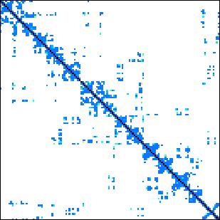
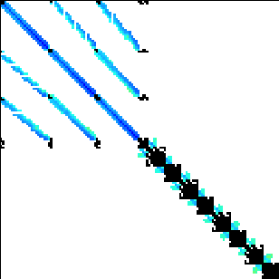

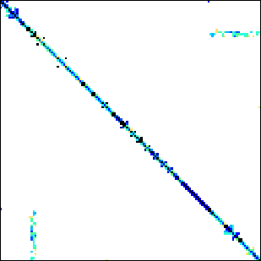
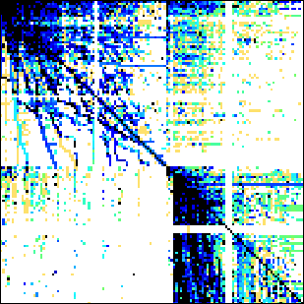
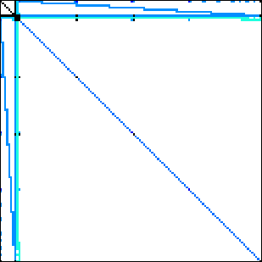
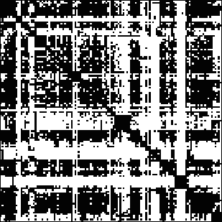
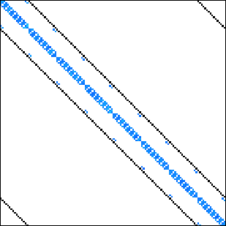

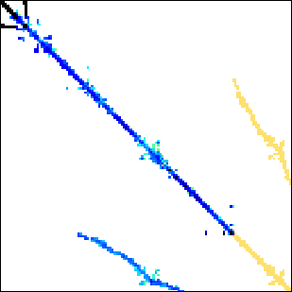
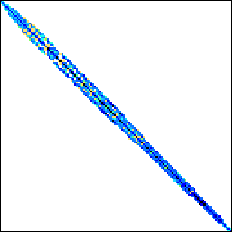

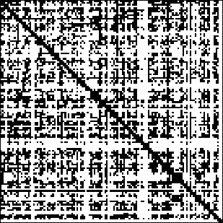
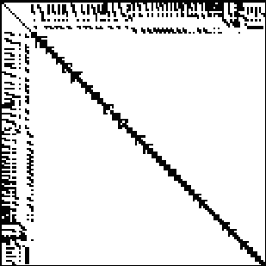
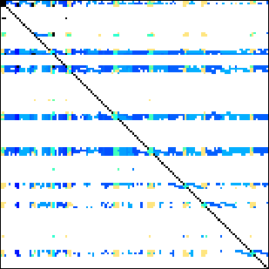
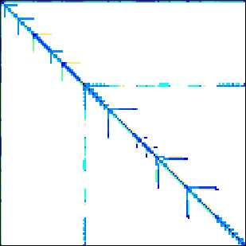
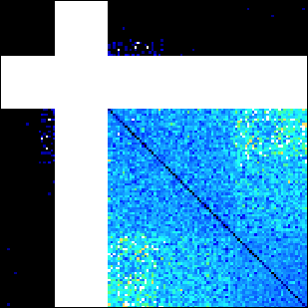
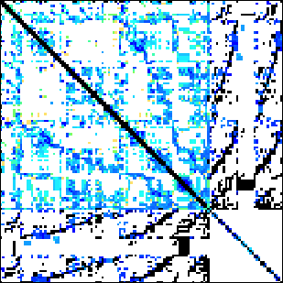
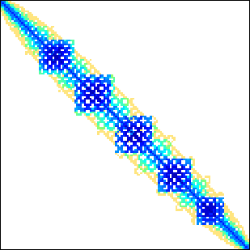
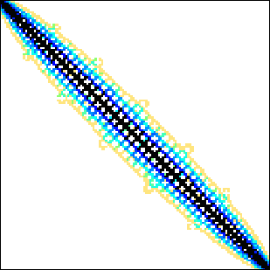
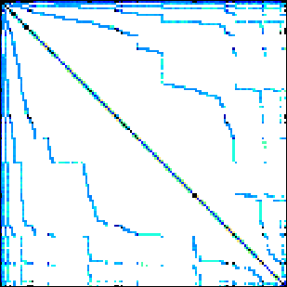
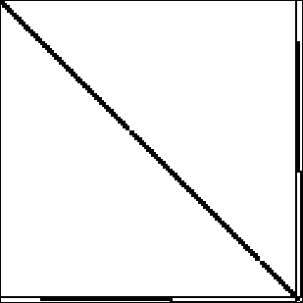
Benchmark suite
24 matrices downloadable from the University of Florida sparse matrix collection.
Dense
Protein
FEM/Spheres
FEM/Cantilever
Wind Tunnel
Webbase
LP
Circuit5M
eu-2005
QCD
Epidemiology
FEM/Harbor
FEM/Ship
Economics
in-2004
mip1
ASIC_680k
dc2
FEM/Accelerator
Circuit
Ga41As41H72
Si41Ge41H72
FullChip
ins2
14 regular matrices
10 irregular matrices

Slide 19
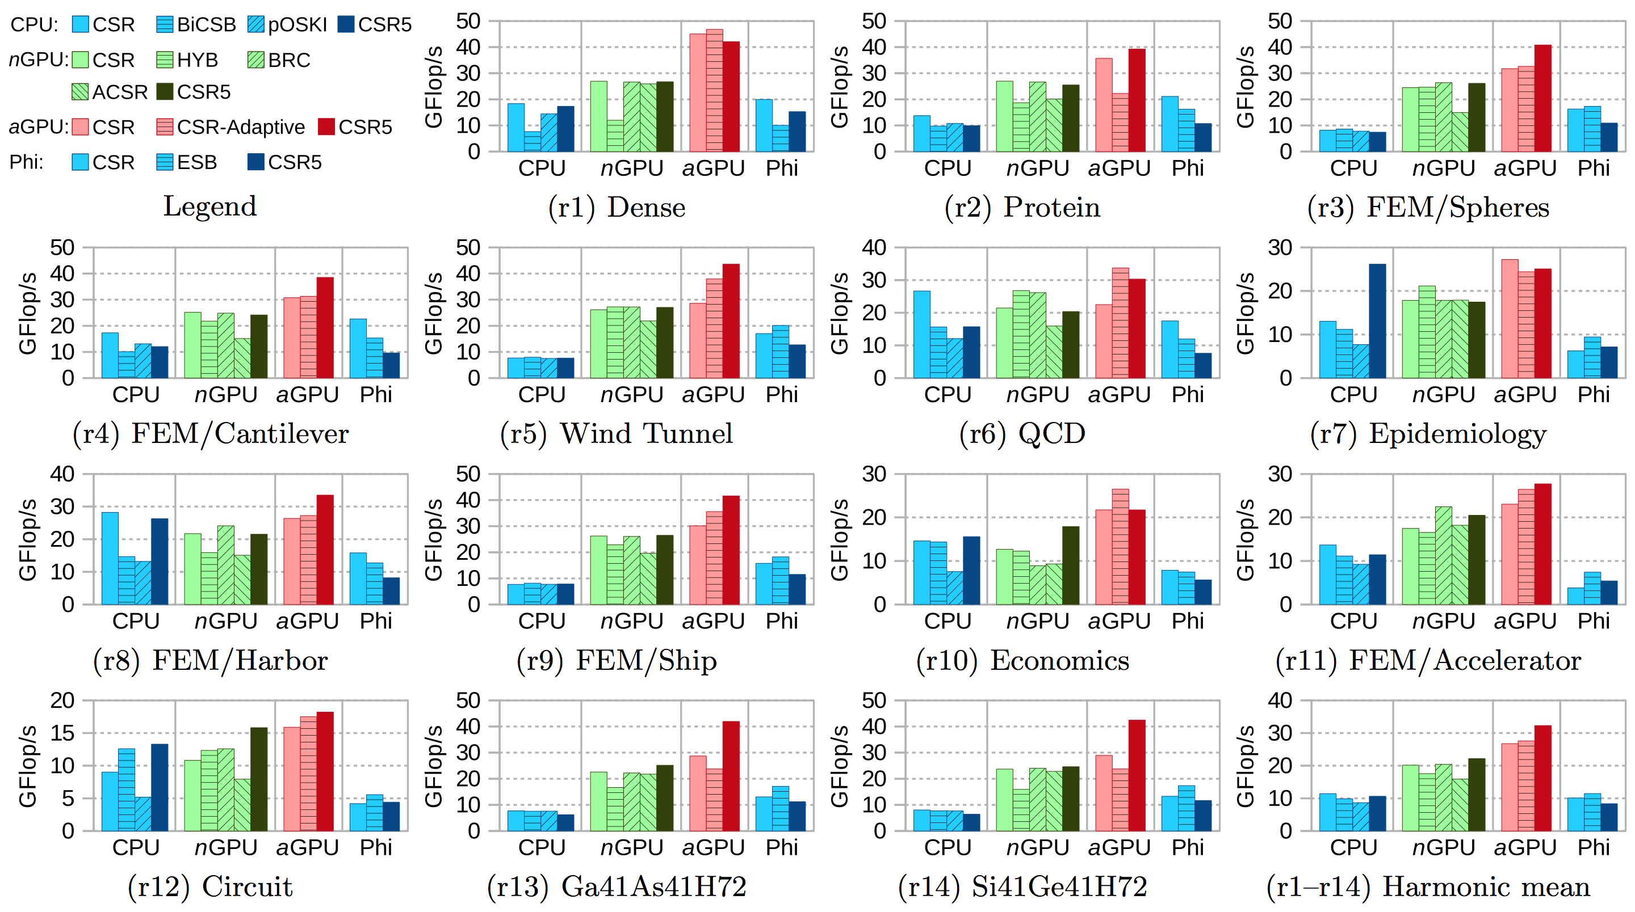
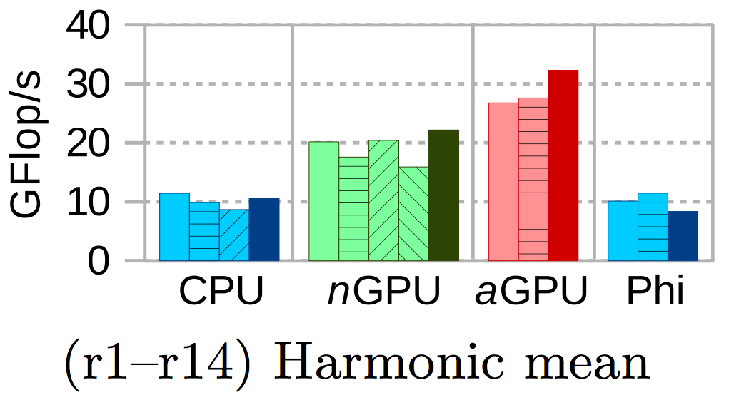
Throughput (FP64) – regular matrices
CSR5 (this work) [‘15]
Intel MKL-CSR [‘15]
Intel ESB [‘13]

Slide 20
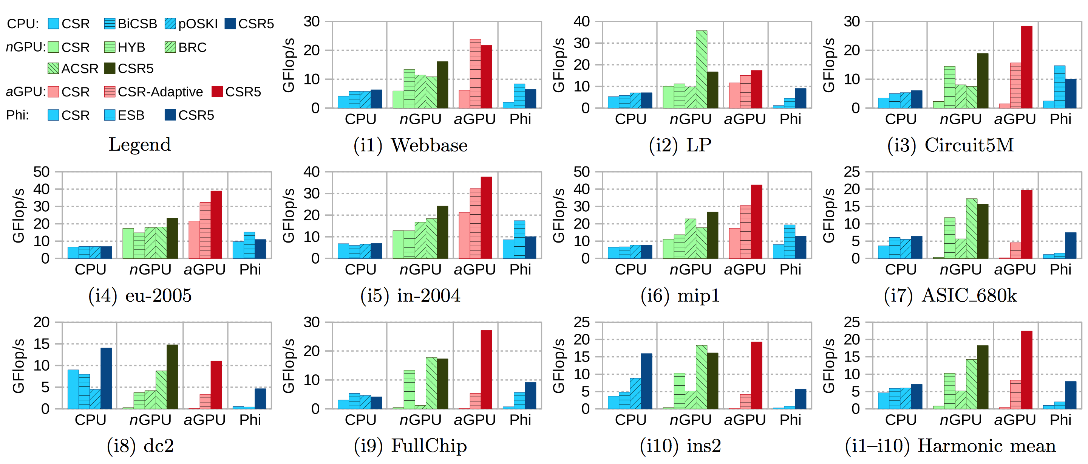
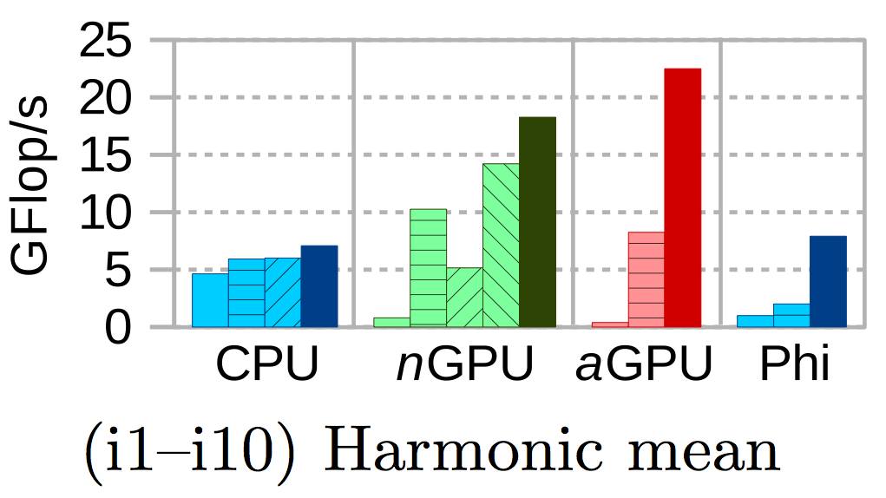
Throughput (FP64) – irregular matrices
CSR5 (this work) [‘15]
Intel MKL-CSR [‘15]
Intel ESB [‘13]

Slide 21
Experience on x86 CPUs & Xeon Phi:
SIMD intrinsics + software prefetching
Faculty of Science

Slide 22
RECALL: CSR5-based SpMV
lock-step SIMD + scatter
fast segmented sum
through
prefix-sum scan primitive
(see paper for details)
G
R₁
R₂
R₃
R₁
R₂
R₃
0
G
G
G
Thread 0, or
SIMD lane 0
Thread 1, or
SIMD lane 1
Thread 2, or
SIMD lane 2
Thread 3, or
SIMD lane 3
R₁
R₂+R₃
R₃
0
G
G
G
B₃
B₁+R₁
B₂+R₂+R₃
R₃
B₃
B₁
Easy to implement on
CPUs, GPUs and Xeon Phi,
thus cross-platform
B₂
B₁
B₂
0
B₃
y =
...
...

Slide 23
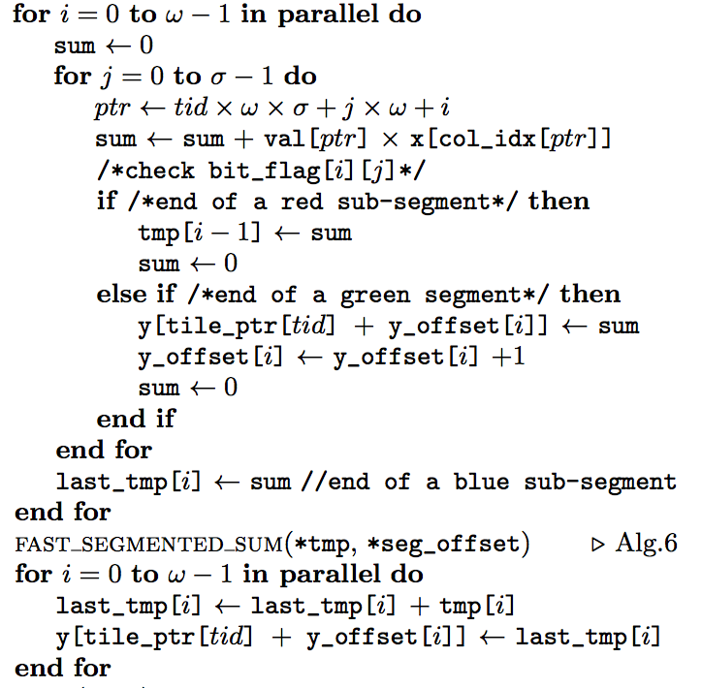
Problem to be Solved
Faculty of Science

Slide 24
x86 Serial Code and OpenMP pragma
Faculty of Science
double tmp[omega];
int other_tmps[omega];
for (int tid = 0; tid < #tile; tid++)
{
for (int i = 0; i < omega; i++)
{
for (int j = 1; j < sigma; j++)
{
tmp[i] += x[index[j*omega+i]];
}
// write tmp[i]
// write other_tmps[i]
}
seg_sum (tmp);
for (int i = 0; i < omega; i++)
{
// use tmp[i]
// use other_tmps[i]
}
}
double tmp[omega];
int other_tmps[omega];
#pragma omp parallel for
for (int tid = 0; tid < #tile; tid++)
{
#pragma simd
for (int i = 0; i < omega; i++)
{
for (int j = 1; j < sigma; j++)
{
tmp[i] += x[index[j*omega+i]];
}
// write tmp[i]
// write other_tmps[i]
}
parallel_seg_sum (tmp);
#pragma simd
for (int i = 0; i < omega; i++)
{
// use tmp[i]
// use other_tmps[i]
}
}
Serial Code
OpenMP

Slide 25
Using Explicit SIMD intrinsics
Faculty of Science
__m256d tmp256d;
__m128i other_tmps128i;
for (int tid = 0; tid < #tile; tid++)
{
for (int i = 0; i < omega; i++)
{
for (int j = 1; j < sigma; j++)
{
tmp256d += i32gather(x, index128i);
}
// write tmp256d
// write other_tmps128i
}
parallel_seg_sum (tmp256d);
for (int i = 0; i < omega; i++)
{
// use tmp256d
// use other_tmps128i
}
}
__m256d tmp256d;
__m128i other_tmps128i;
#pragma omp parallel for
for (int tid = 0; tid < #tile; tid++)
{
for (int i = 0; i < omega; i++)
{
for (int j = 1; j < sigma; j++)
{
tmp256d += i32gather(x, index128i);
}
parallel_seg_sum (tmp256d);
// use tmp256d
// use other_tmps128i
}
}
use intrinsics (futher improv.)
use intrinsics

Slide 26
Results <OMP + SIMDized by compiler>
Faculty of Science
CPU: Intel i7 4770R, quad-core @ 3.4 GHz, 34 GB/s, 128MB eDRAM
Xeon Phi: Intel 5110p, 60-core @ 1.05GHz, 320 GB/s

Slide 27
Results <OMP + SIMDized manually>
Faculty of Science
CPU: Intel i7 4770R, quad-core @ 3.4 GHz, 34 GB/s, 128MB eDRAM
Xeon Phi: Intel 5110p, 60-core @ 1.05GHz, 320 GB/s

Slide 28
Using Prefetch Intrinsics
Faculty of Science
__m256d tmp256d;
__m128i other_tmps128i;
#pragma omp parallel for
#pragma noprefetch
for (int tid = 0; tid < #tile; tid++)
{
_mm_prefetch(data[tid+1]);
for (int i = 0; i < omega; i++)
{
for (int j = 1; j < sigma; j++)
{
tmp256d += i32gather(x, index128i);
}
parallel_seg_sum (tmp256d);
// use tmp256d
// use other_tmps128i
}
}
use intrinsics (with prefetch)

Slide 29
Results <OMP + SIMDized manually + software prefetching>
Faculty of Science
CPU: Intel i7 4770R, quad-core @ 3.4 GHz, 34 GB/s, 128MB eDRAM
Xeon Phi: Intel 5110p, 60-core @ 1.05GHz, 320 GB/s

Slide 30
Conclusion
CSR5 is not sensitive to sparsity structure, thus delivers fast SpMV both for regular matrices and for irrgular matrices.
Format conversion from CSR to CSR5 is very fast (cost of a few SpMV operations).
CSR5 supports four mainstream platforms (CPUs, nVidia GPUs, AMD GPUs and Xeon Phi).
CSR5 gives speedups for scenarios with very few (tens of) iterations.
For code with more complex load/store operations, explicit SIMD intrinsics is required for high perfomance on x86 CPUs and Xeon Phi.

Slide 31
More Details in Our Paper
Weifeng Liu and Brian Vinter. 2015. “CSR5: An Efficient Storage Format for Cross-Platform Sparse Matrix-Vector Multiplication”. In Proceedings of the 29th ACM on International Conference on Supercomputing (ICS '15). ACM, New York, NY, USA, 339-350. DOI=10.1145/2751205.2751209

Slide 32
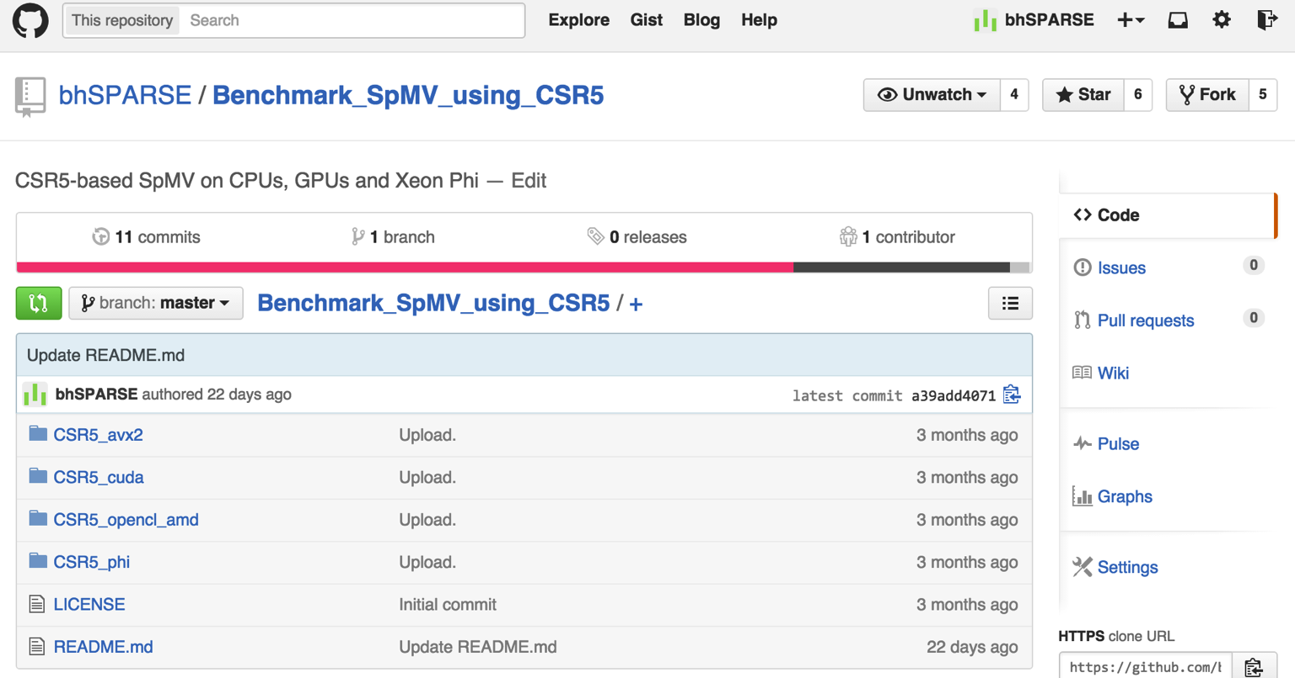
Source Code at Github
https://github.com/bhSPARSE/Benchmark_SpMV_using_CSR5

Slide 33
T k u !
A y Q s n s ?
0
4
8
9
0
2
4
7
11
12
13

