Slide 1
Lectures 2 and 3:
Structure formation in the universe
Absolute value of neutrino masses
Future observational probes
Sterile neutrinos and cosmology

Slide 3
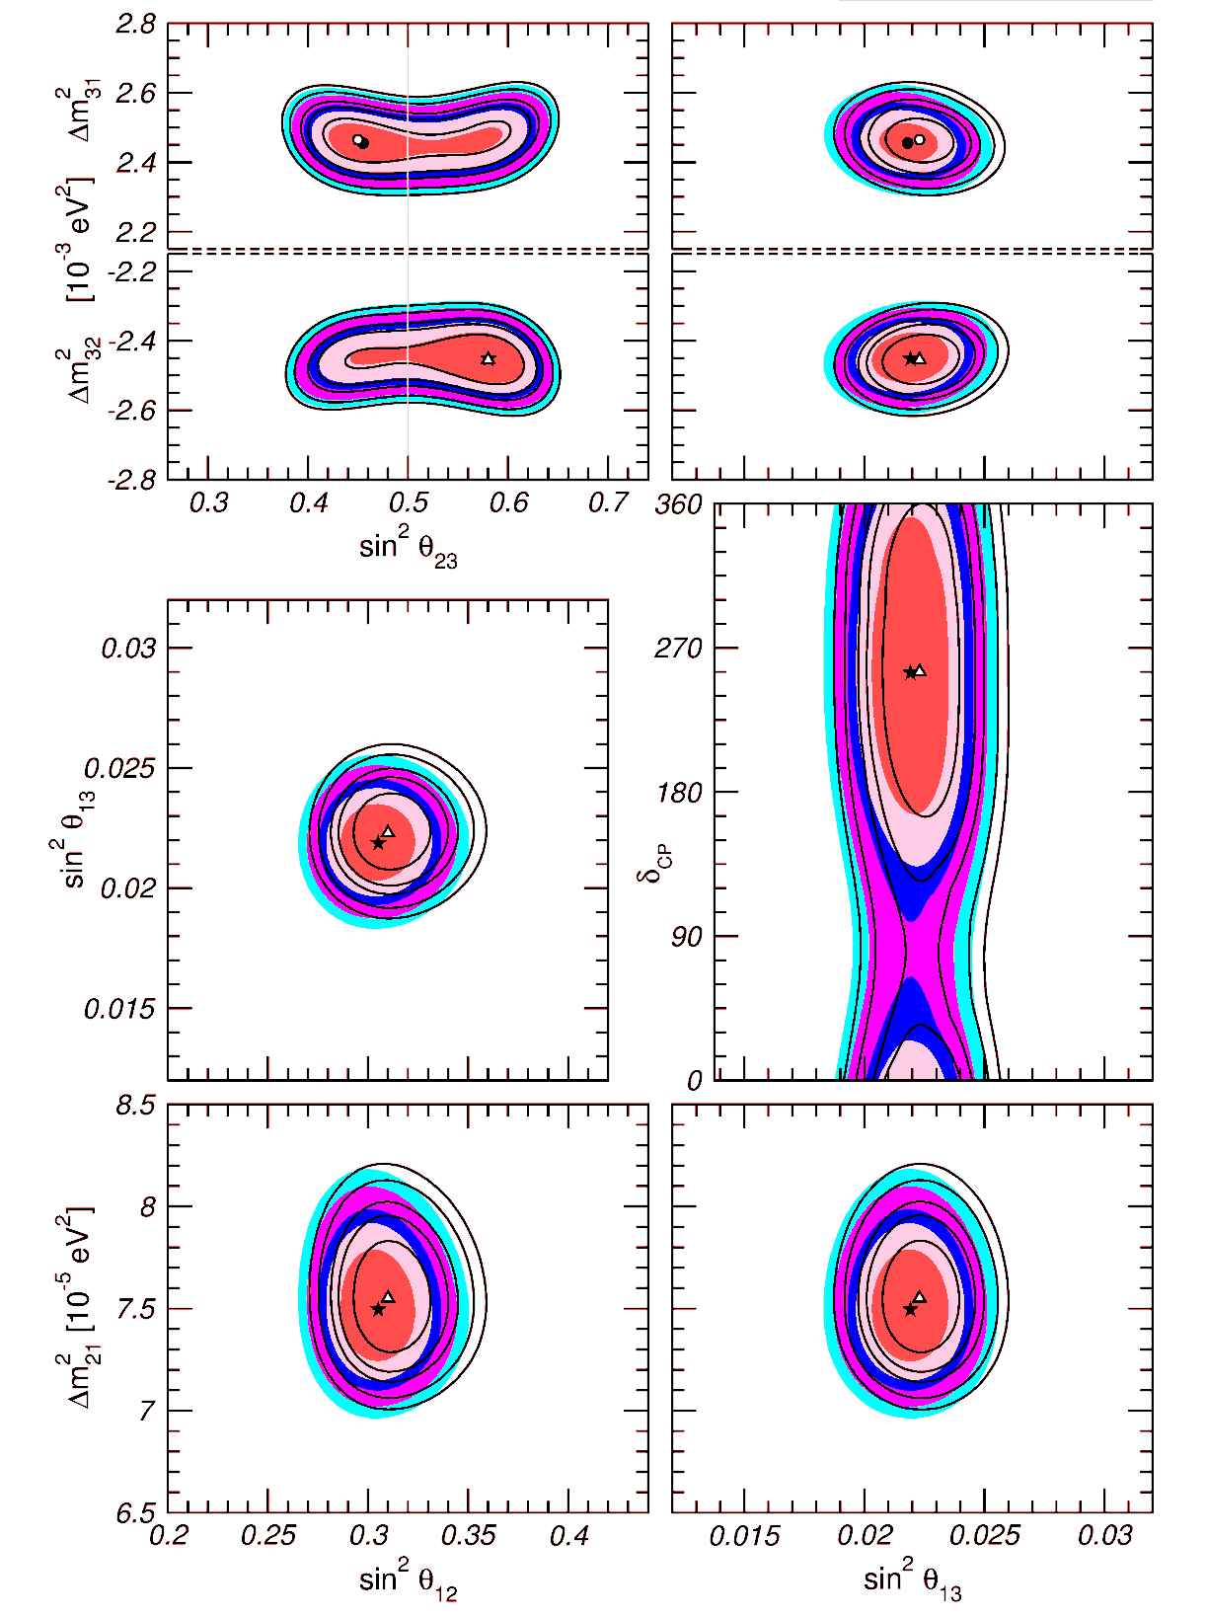
Status of 3-neutrino oscillations
Gonzalez-Garcia, Maltoni, Schwetz
1409.5439

Slide 4
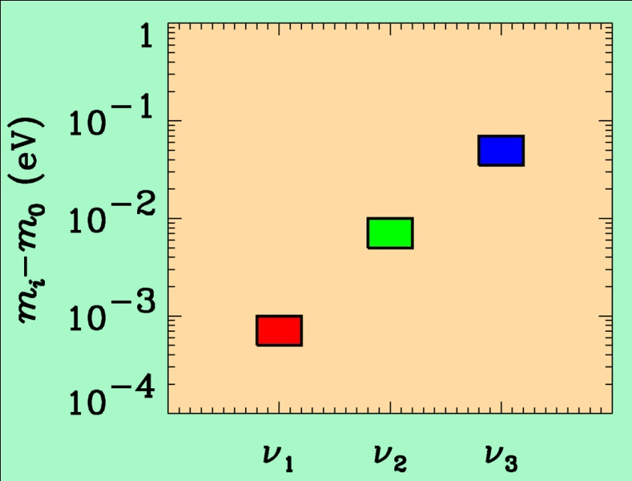
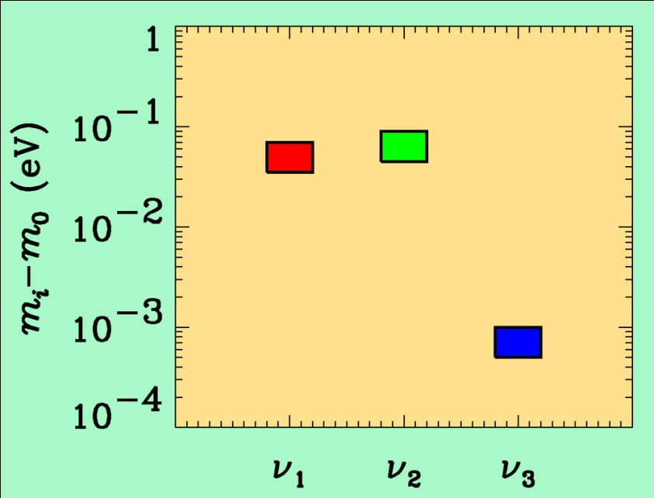
If neutrino masses are hierarchical then oscillation experiments
do not give information on the absolute value of neutrino masses
ATMO. ν
K2K
LBL
SOLAR ν
KAMLAND
Normal hierarchy
Inverted hierarchy
However, if neutrino masses are degenerate
no information can be gained from such experiments.
Experiments which rely on either the kinematics of neutrino mass
or the spin-flip in neutrinoless double beta decay are the most
efficient for measuring m₀

Slide 5
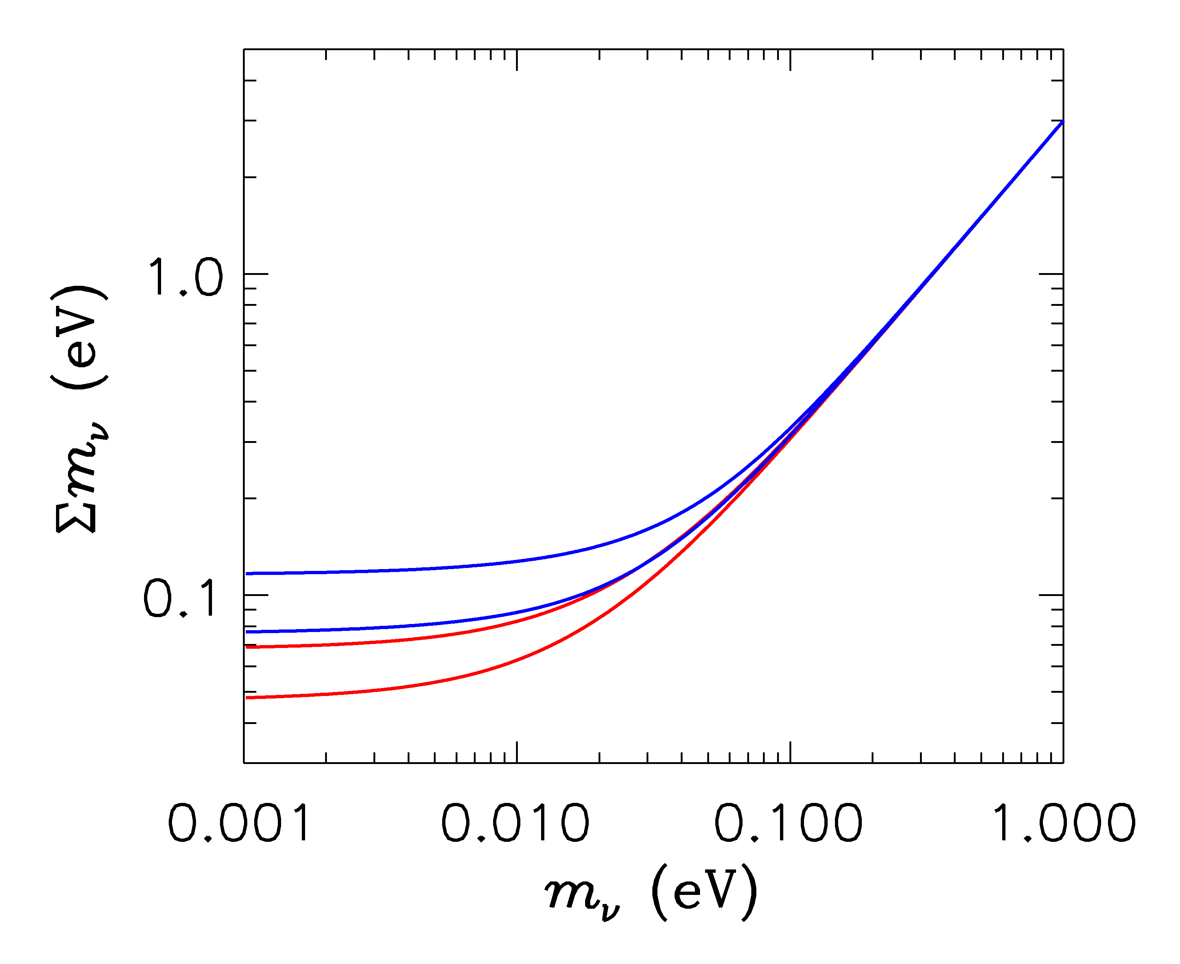
HIERARCHICAL
DEGENERATE
INVERTED
NORMAL
LIGHTEST

Slide 6
ß-decay and neutrino mass
Model independent neutrino mass from ß-decay kinematics
Only assumption: relativistic energy-momentum relation
experimental observable is m_{ν}²
T₂:
E₀ = 18.6 keV
T_{1/2} = 12.3 y

Slide 7
Tritium decay endpoint measurements have provided limits
on the electron neutrino mass
Mainz experiment, final analysis (Kraus et al.)
This translates into a limit on the sum of the three mass
eigenstates

Slide 8
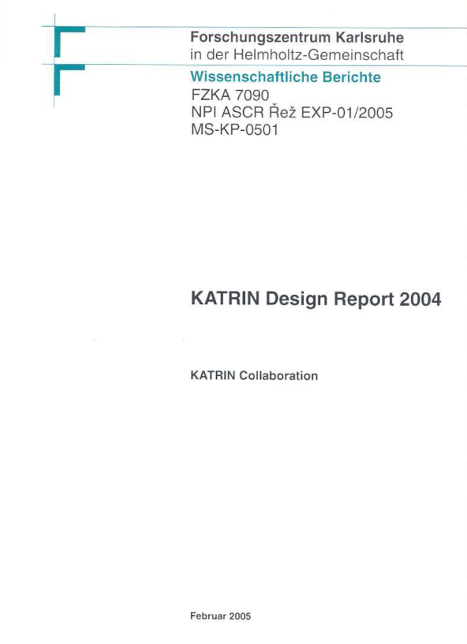
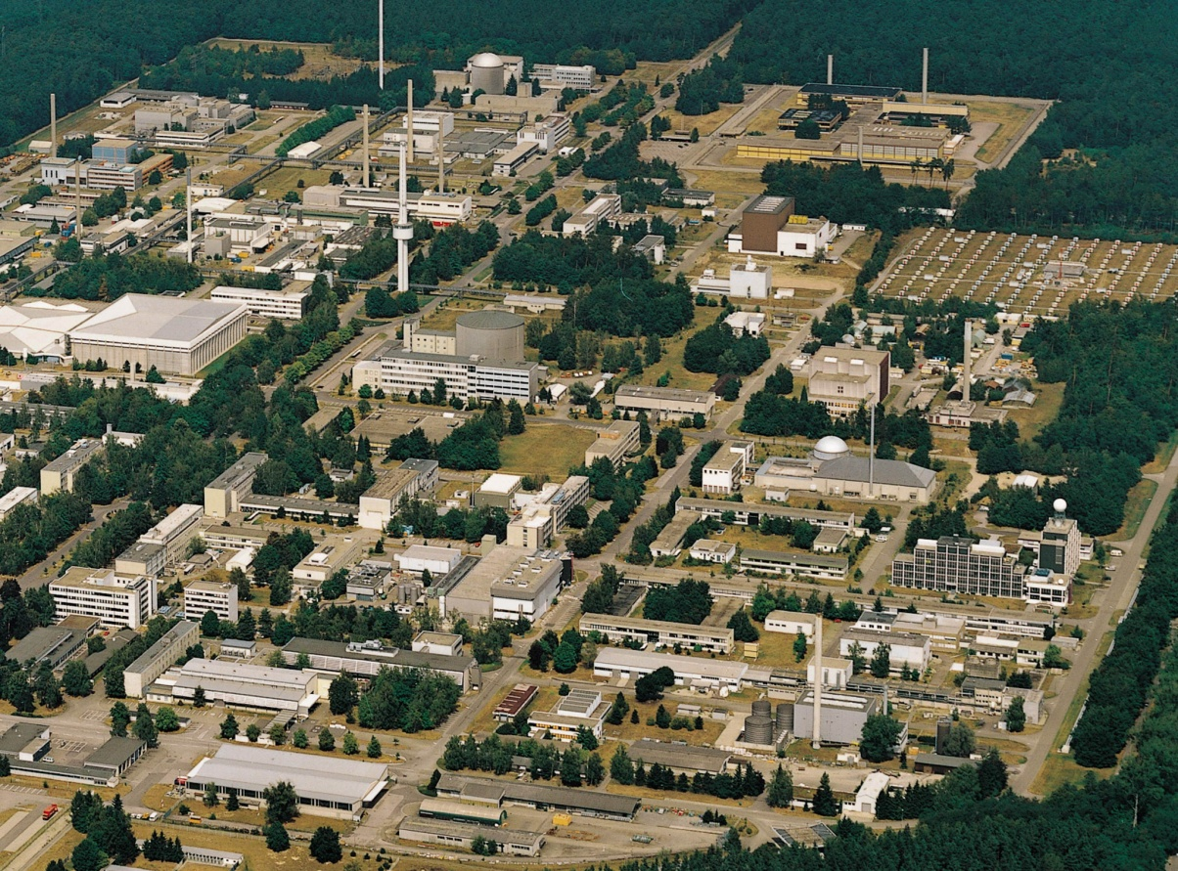
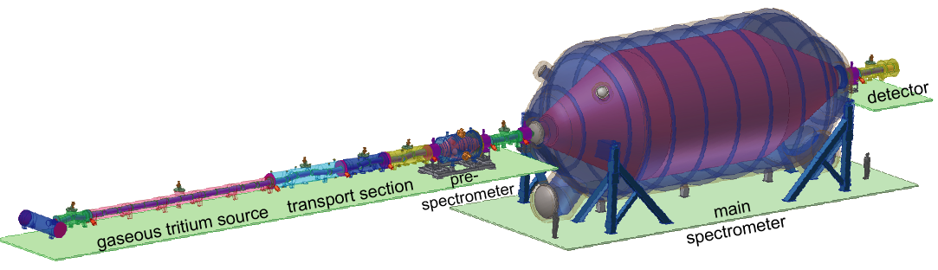
KATRIN experiment
Karlsruhe Tritium Neutrino
Experiment
Data taking by end of 2016
TLK
25 m

Slide 9
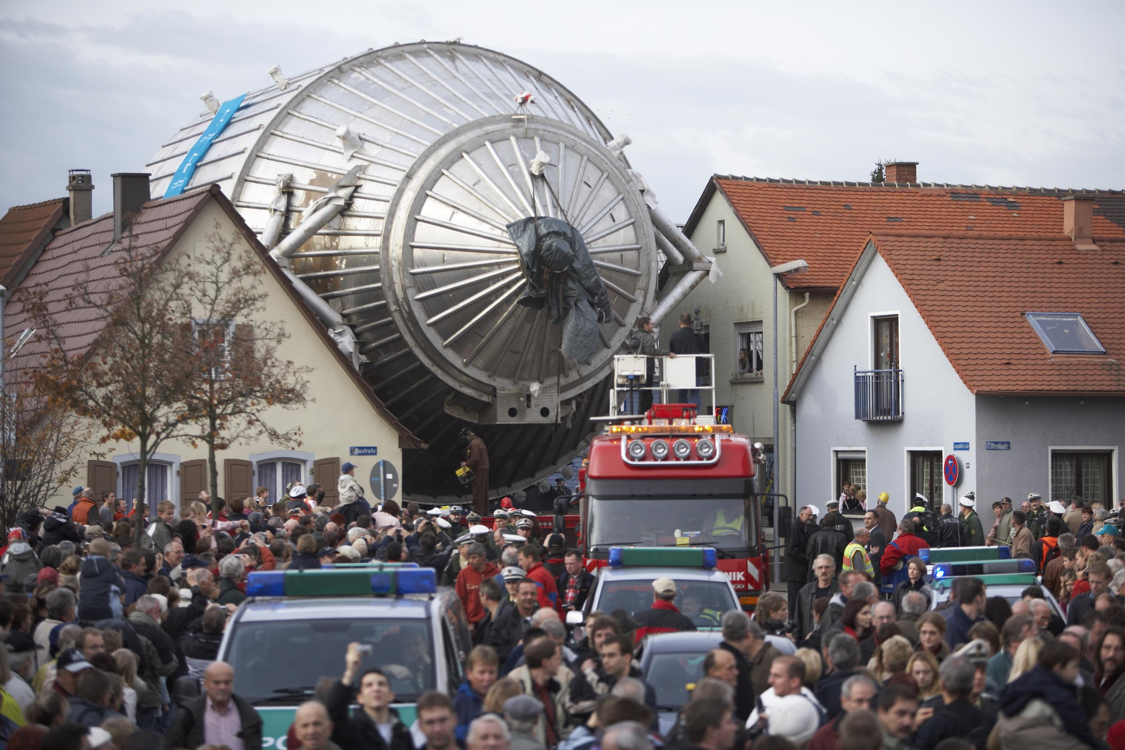

Slide 10
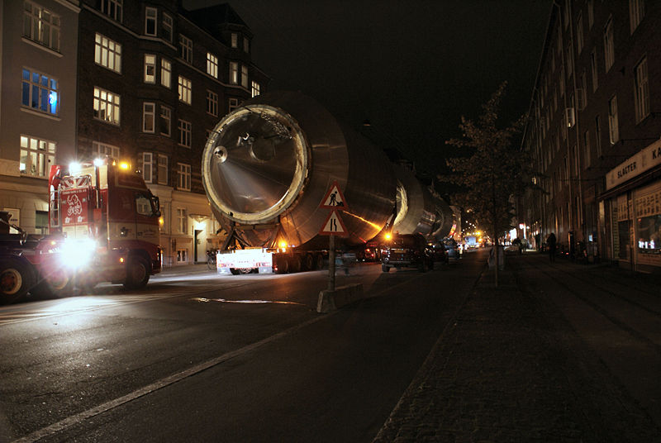
A DANISH VERSION OF KATRIN???
THE CARLSBERG NEUTRINO MASS EXPERIMENT

Slide 11
From Joe Formaggio
Potential to go below 0.1 eV?

Slide 12
NEUTRINO MASS AND ENERGY DENSITY
FROM COSMOLOGY
NEUTRINOS AFFECT STRUCTURE FORMATION
BECAUSE THEY ARE A SOURCE OF DARK MATTER
(n ~ 100 cm⁻³)
FROM
HOWEVER, eV NEUTRINOS ARE DIFFERENT FROM CDM
BECAUSE THEY FREE STREAM
SCALES SMALLER THAN d_{FS} DAMPED AWAY, LEADS TO
SUPPRESSION OF POWER ON SMALL SCALES

Slide 13
N-BODY SIMULATIONS OF ΛCDM WITH AND WITHOUT
NEUTRINO MASS (768 Mpc³) – GADGET 2
256
Mpc
T Haugboelle, Aarhus University

Slide 14
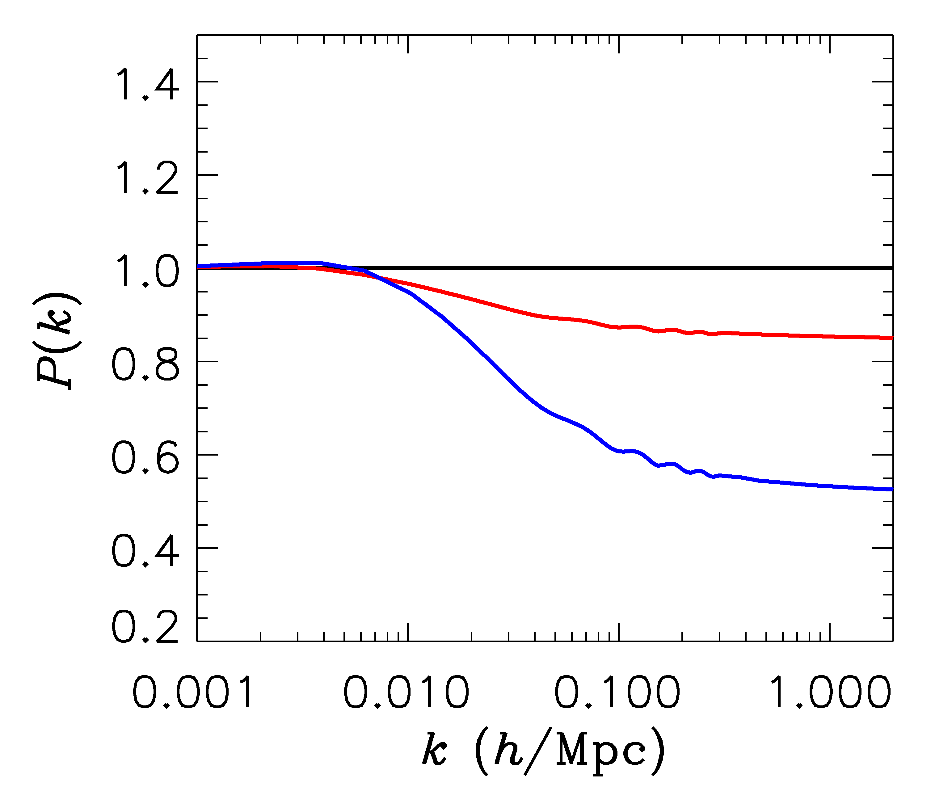
FINITE NEUTRINO MASSES SUPPRESS THE MATTER POWER
SPECTRUM ON SCALES SMALLER THAN THE FREE-STREAMING
LENGTH
Sm = 0 eV
P(k)/P(k,m_{ν}=0)
Sm = 0.3 eV
Sm = 1 eV

Slide 15
AVAILABLE COSMOLOGICAL DATA

Slide 16
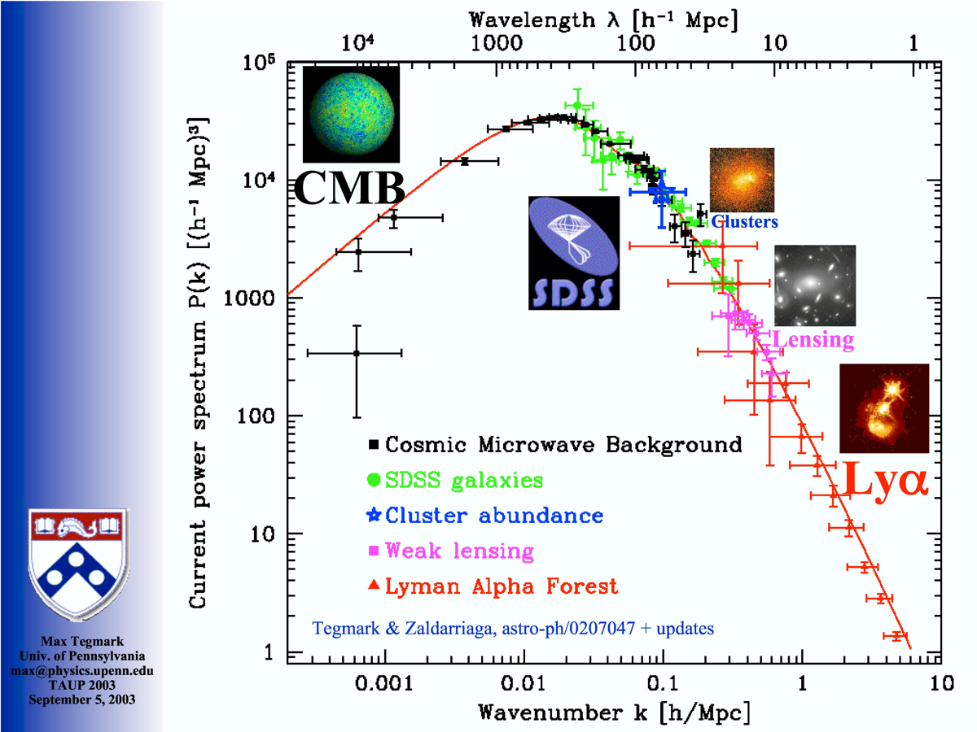
Power Spectrum of Cosmic Density Fluctuations
FROM MAX TEGMARK

Slide 17
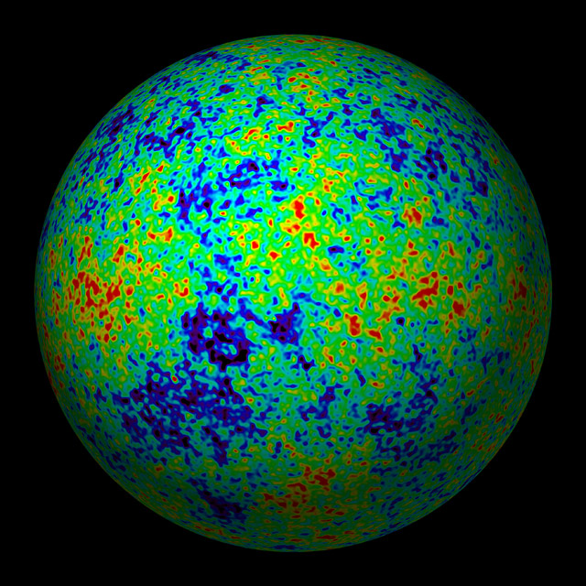
THE COSMIC MICROWAVE BACKGROUND
CMB TEMPERATURE AND POLARISATION

Slide 18
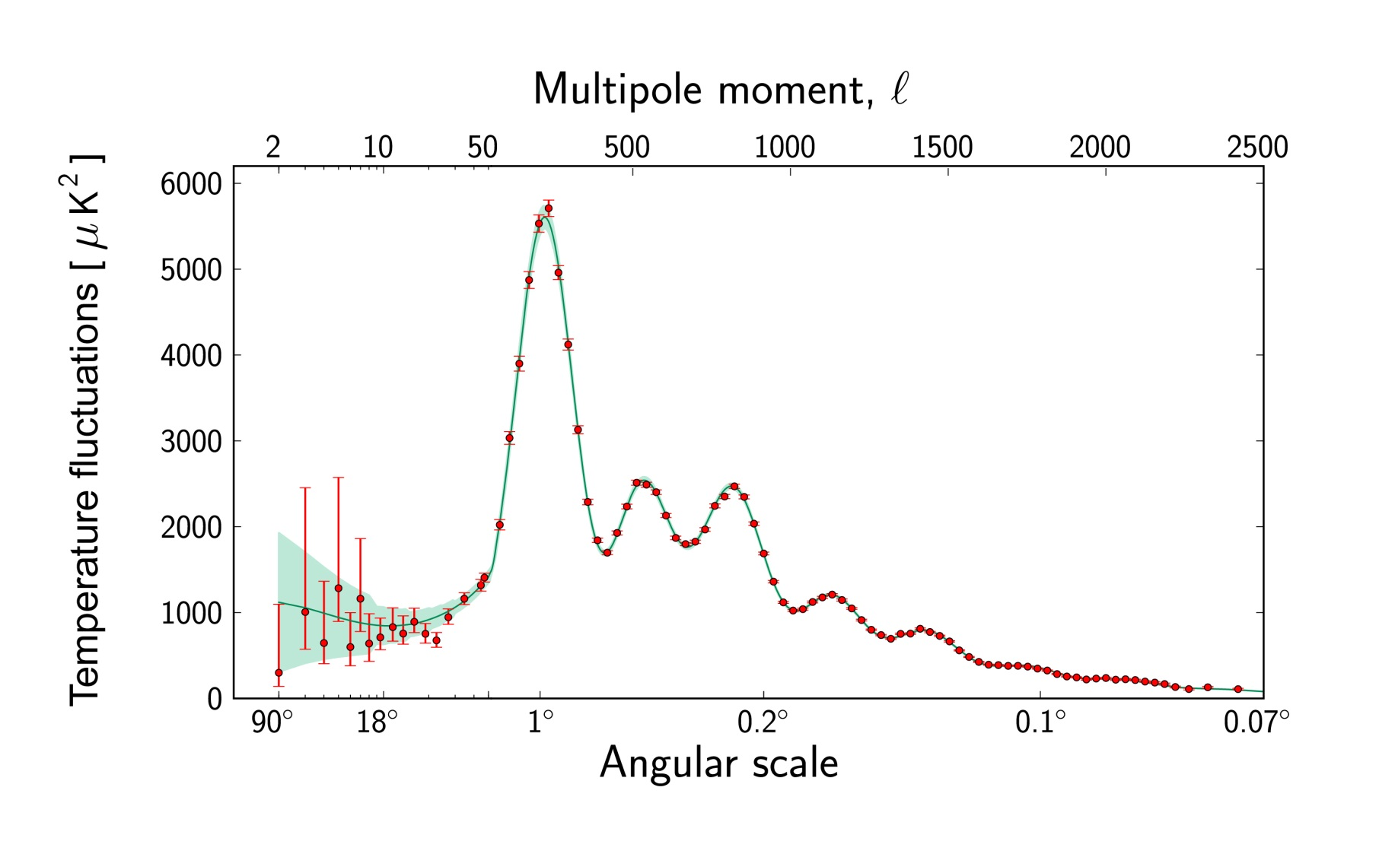
Ade et al. 2015 (Planck)

Slide 19
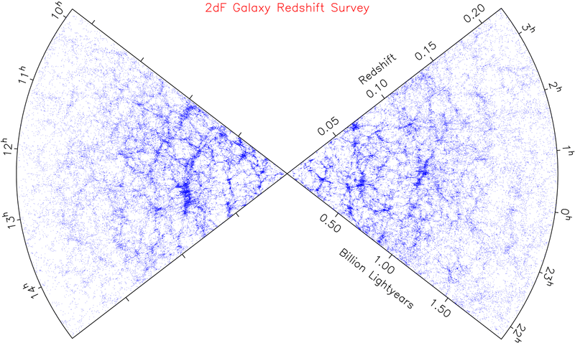
LARGE SCALE STRUCTURE SURVEYS

Slide 20
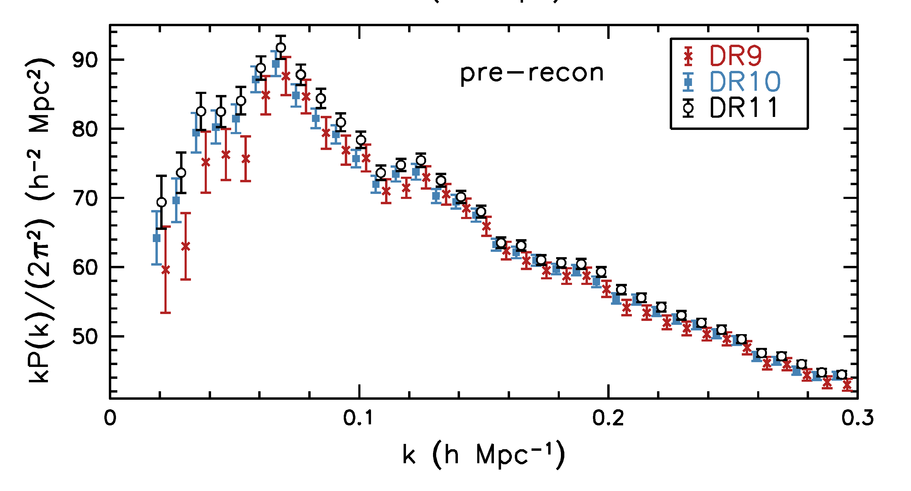
Anderson et al. 1312.4877 (SDSS)

Slide 21
FINITE NEUTRINO MASSES SUPPRESS THE MATTER POWER
SPECTRUM ON SCALES SMALLER THAN THE FREE-STREAMING
LENGTH
Sm = 0 eV
P(k)/P(k,m_{ν}=0)
Sm = 0.3 eV
Sm = 1 eV

Slide 22
NOW, WHAT ABOUT NEUTRINO
PHYSICS?

Slide 23
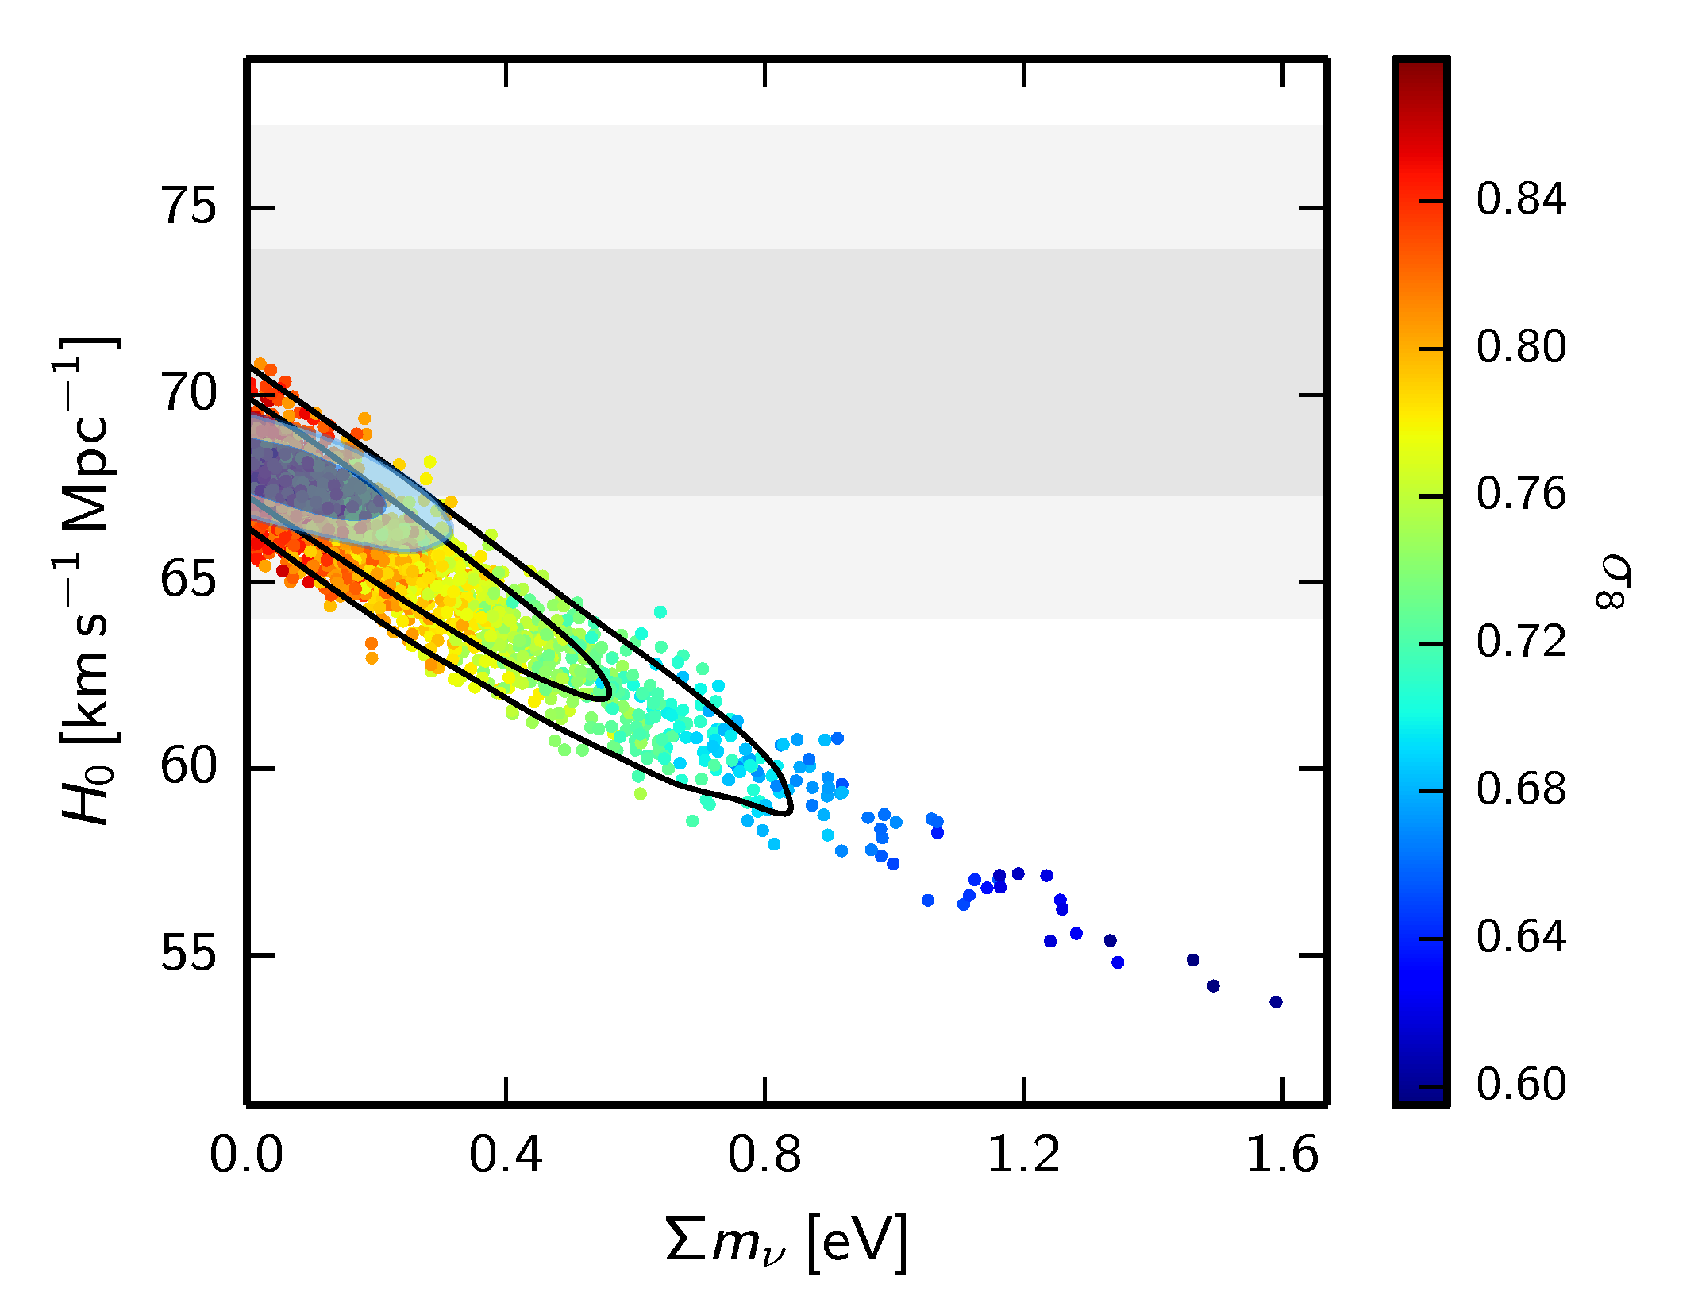
WHAT IS THE PRESENT BOUND ON THE NEUTRINO MASS?
DEPENDS ON DATA SETS USED AND ALLOWED PARAMETERS
THERE ARE MANY ANALYSES IN THE LITERATURE
ADE ET AL.
ARXIV:1502.01589

Slide 24
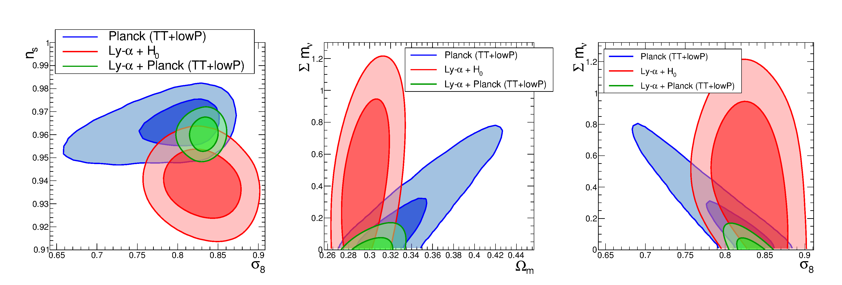
THE STRONGEST BOUND IS CURRENTLY $∑m_{ν}<0.12$ eV BUT
THIS IS DERIVED FROM THE COMBINATION OF CMB AND
LYMAN-$α$ DATA
Palanque-Delabrouille et al. 1506.05976

Slide 25
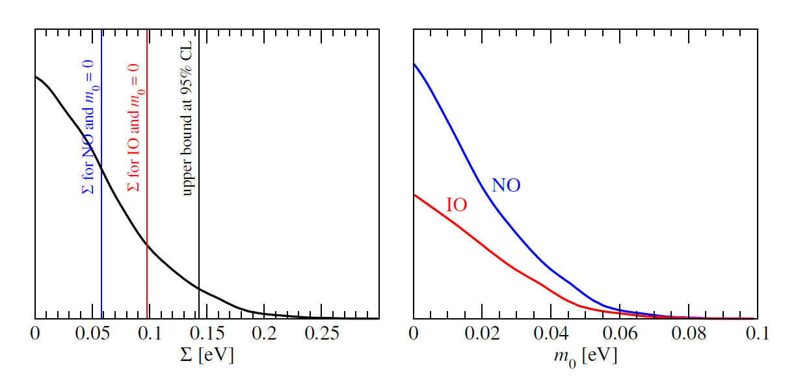
Is the inverted hierarchy already disfavoured?
Not really – a significantly better sensitivity is still required for such a statement
even with the most optimistic data combinations
STH & Schwetz, arXiv:1606.04691

Slide 26
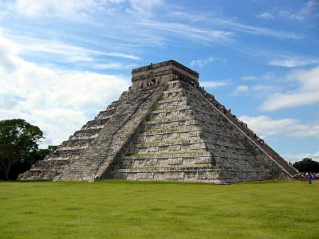
THE NEUTRINO MASS FROM COSMOLOGY PLOT
More data
+Ly-alpha
~ 0.1 eV
0.2-0.3 eV
0.2-0.3 eV
+ SNI-a
+WL
~ 0.15 eV
~0.5 eV
0.5-0.6 eV
+ SDSS
~0.15 eV
~ 0.5 eV
~0.5 eV
CMB only
0.7 eV
~ 1 eV
1.? eV
??? eV
Minimal
ΛCDM
+N_{ν}
+w+……
Larger model
space

Slide 27
HOW CAN THE BOUND BE AVOIDED?
Without modifying either cosmology or neutrino physics
The current bound is robustly below $\sum{m_{ν}<0.5}$ eV
Modifying cosmology?
Changing dark energy behaviour
Coupling neutrinos and dark energy
Modifying neutrino physics?
Make neutrinos strongly interacting

Slide 28
GOING BEYOND THE MASS
$$Ω=\frac{ρ}{ρ_{c}}=∑m_{ν,i}n_{ν,i}$$
$$n_{ν}=\frac{3}{4}{\left(\frac{T_{ν}}{T_{γ}}\right)}^{3}n_{γ}$$
Normally $T_{ν}={\left(\frac{4}{11}\right)}^{1/3} T_{γ}$ , but could be different. Normally the relativistic
energy density in neutrinos is quantified through the relation
$$ρ_{ν0}=\frac{7}{8}{\left(\frac{T_{ν}}{T_{γ}}\right)}^{4}ρ_{γ}$$
$$N_{eff}=\frac{ρ_{ν,rel}}{ρ_{ν0}}$$
$N_{eff}$ is a measure of any type of ”dark radiation”

Slide 29
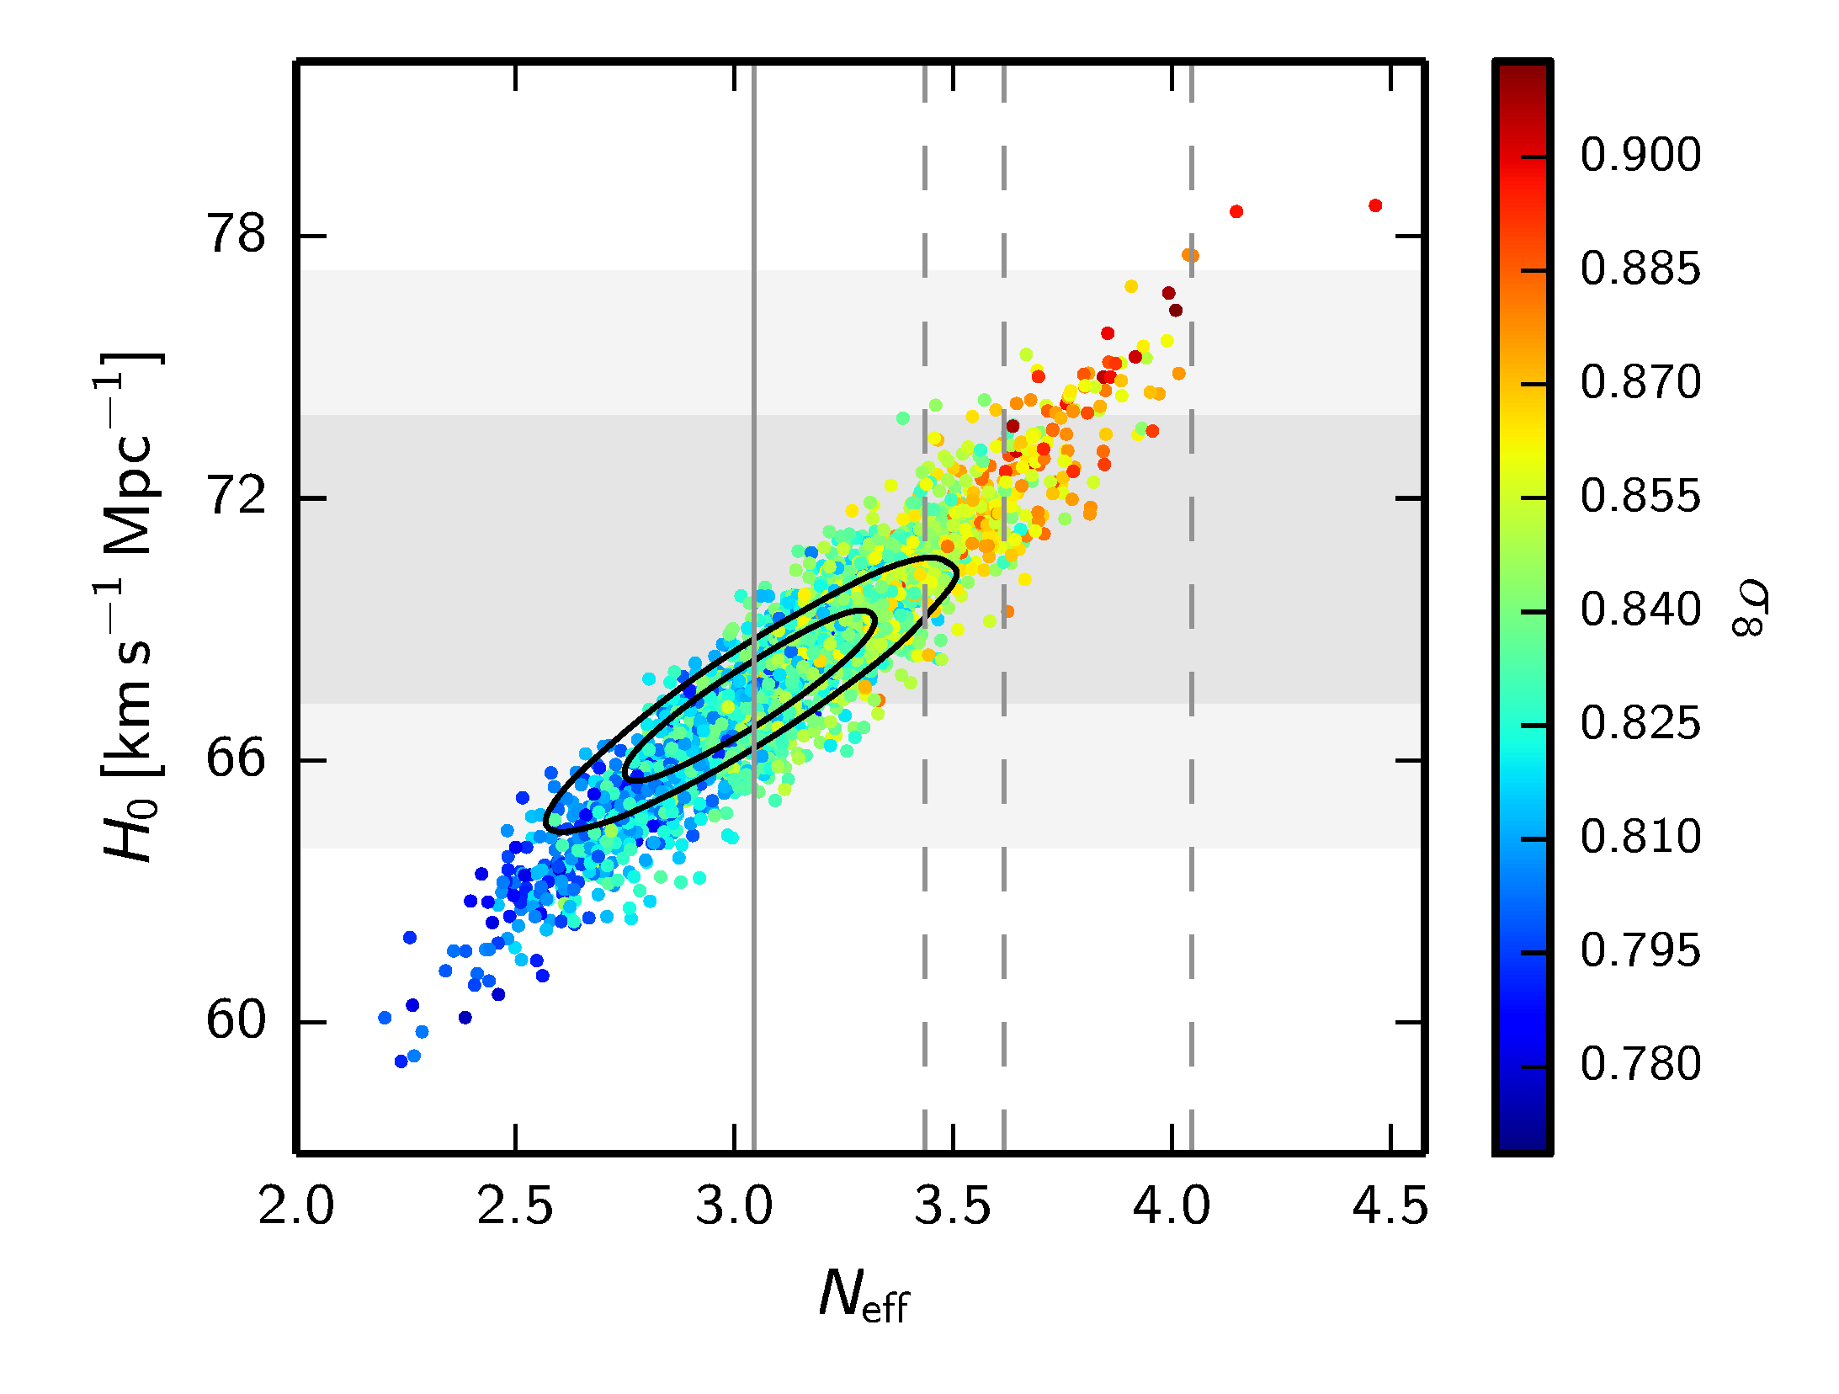
THE CONCLUSION SEEMS TO BE THAT THERE IS NO EVIDENCE
FOR ANY PHYSICS BEYOND THE STANDARD MODEL
BUT BE AWARE THAT IN EXTENDED MODELS THIS CAN BE
VERY DIFFERENT!

Slide 30
Cosmology shows no evidence for non-standard physics in the neutrino sector. However, cosmology might have to accomodate it after all.
A variety of different terrestrial experiments show hints of the presence of a 4th neutrino mass state (possibly even a 5th), most likely with a mass around 1-10 eV
However, the evidence is conflicting

Slide 31
An additional neutrino with such a mass and mixing should be fully thermalised in the early Universe and act completely like a standard model neutrino of equal mass.
This, however, is excluded by data roughly at 5.5σ

Slide 32
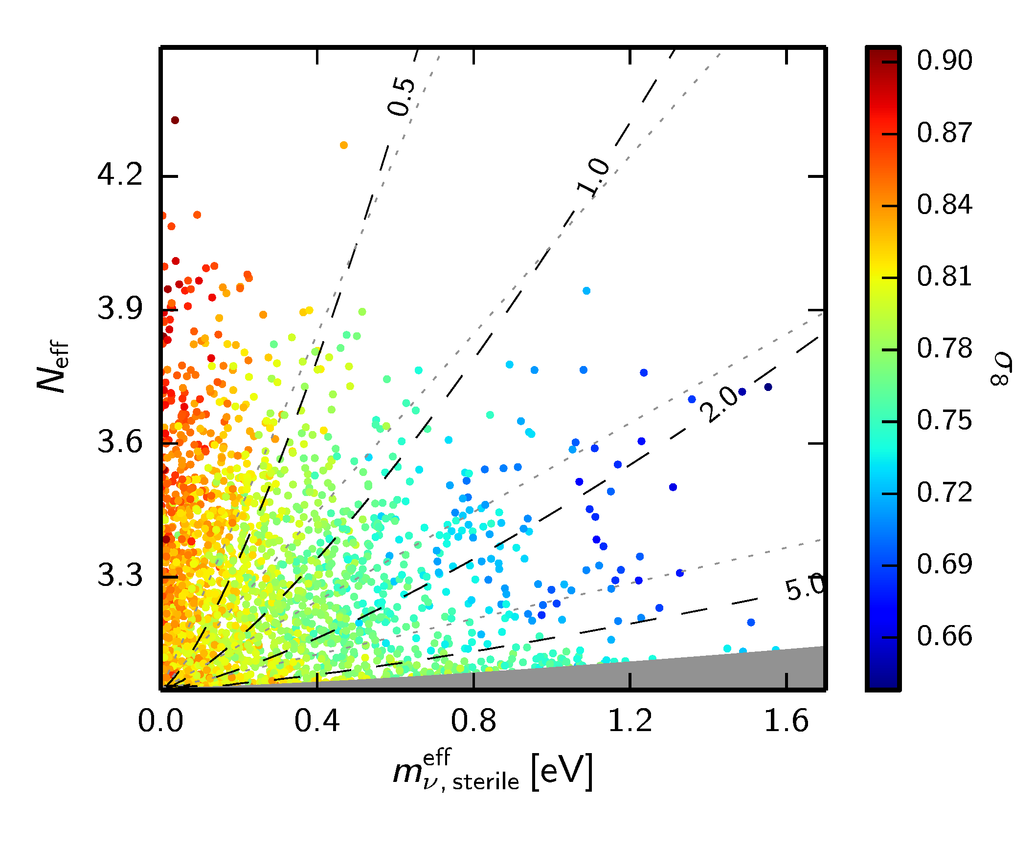
$$N_{eff}= \frac{ρ_{s}+ρ_{a}}{ρ_{ν,0}}$$
ADE ET AL. 2015 (Planck)

Slide 33
Bottom line: Sterile neutrinos in the
mass range preferred by SBL data
can be accomodated by cosmology,
but ONLY if they are not fully
thermalised

Slide 34
Sterile neutrinos are thermalised via a combination of oscillation and scattering
(Barbieri & Dolgov 91; Enqvist, Kainulainen & Maalampi 91, Raffelt & Sigl 93, McKellar & Thomson 94)
The neutrino matter potential is important and a very large potential could in principle prevent thermalisation
How can this be achieved?
A large neutrino lepton asymmetry
(see e.g. STH, Tamborra, Tram 1204.5861, Saviano et al. arXiv:1302.1200)
New, non-standard interactions in the sterile sector
(e.g. STH, Hansen, Tram, 1310.5926, Dasgupta & Kopp 1310.6337, Bringmann, Hasenkamp & Kersten 1312.4947, Archidiacono, STH, Hansen, Tram 1404.5915
Chu, Dasgupta & Kopp 1505.02795)

Slide 35
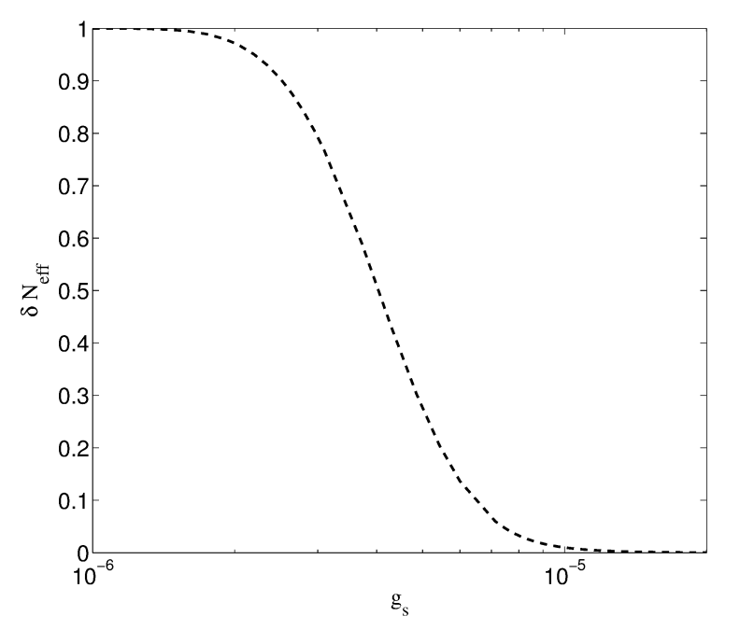
Sterile neutrinos can couple to a light or massless pseudoscalar.
In that case a background potential appears even in a CP-symmetric medium and suppressing oscillations requires only a very weak coupling.
Archidiacono,
STH, Hansen, Tram
(arXiv:1404.5915)

Slide 36
If the mediator is massless the sterile couples strongly at low temperatures
As soon as it goes non-relativistic it annihilates and leads to what is known
as the ”neutrinoless universe”
(Beacom, Bell & Dodelson 2004, STH 2004)
Very different low energy phenomenology: The combined sterile/pseudoscalar fluid is strongly self-interacting and has no anisotropic stress (STH 2004)
The model with a strongly interacting, new mass state in the eV range actually provides a better fit to all cosmological data than $Λ$CDM and favours a Hubble parameter compatible with local measurements
(Archidiacono, STH, Hansen, Tram, arXiv:1404.5915)
This conclusion is unchanged with Planck2015 data (Archidiacono, STH, Hansen, Tram 15)
Evidence further increases with new Hubble measurement (Riess et al. 16) to $Δχ^{2}>10$ from cosmology alone (Archidiacono, Gariazzo, Giunti, STH, Hansen, Laveder, Tram, in preparation)

Slide 37
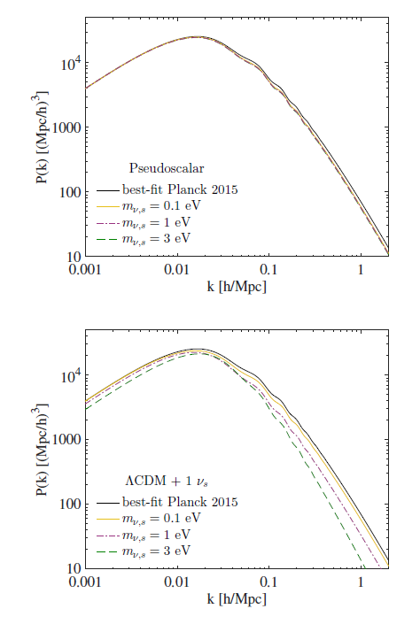
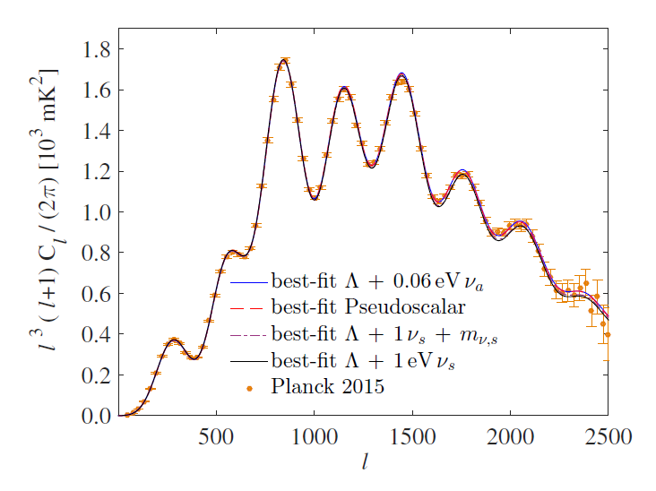
The usual suppression of matter
power does not occur because
the massive neutrinos disappear
as soon as they go non-relativistic
It does not create excess power
in the CMB spectrum
Archidiacono, STH, Hansen, Tram, arXiv:1508:02504

Slide 38
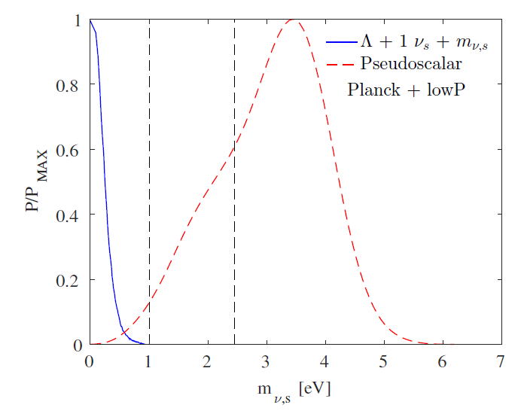
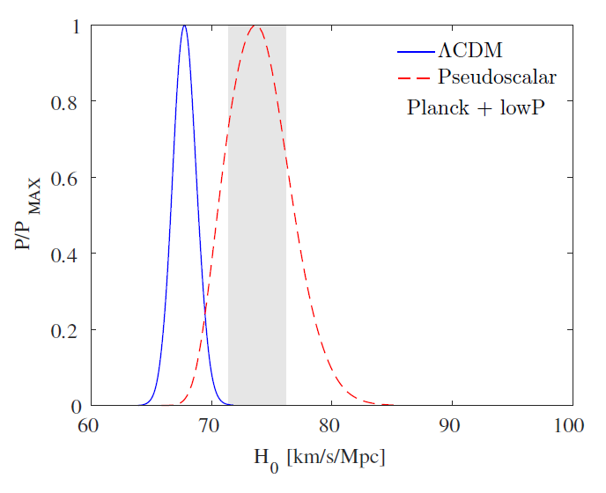
The model naturally predicts a high
value of the Hubble parameter, in
accordance with local Universe
measurements

Slide 39
TIMELINE WITH A MASSLESS MEDIATOR
$T≫1$TeV: Neutrinos and phi equilibrated (not necessary)
Entropy production $T_{ν}≫T_{s},T_{ϕ}$
$T∼1−10$ MeV: Sterile production from via oscillations plus scatterings
$T<1$ MeV: Equilibration of steriles with actives via oscillations
$T>1{ eV: ν}_{s}$ and $φ$ come into chemical equilbrium and behave as a single
fluid
$T∼1{ eV: ν}_{s}$ annihilates into $φ$

Slide 40
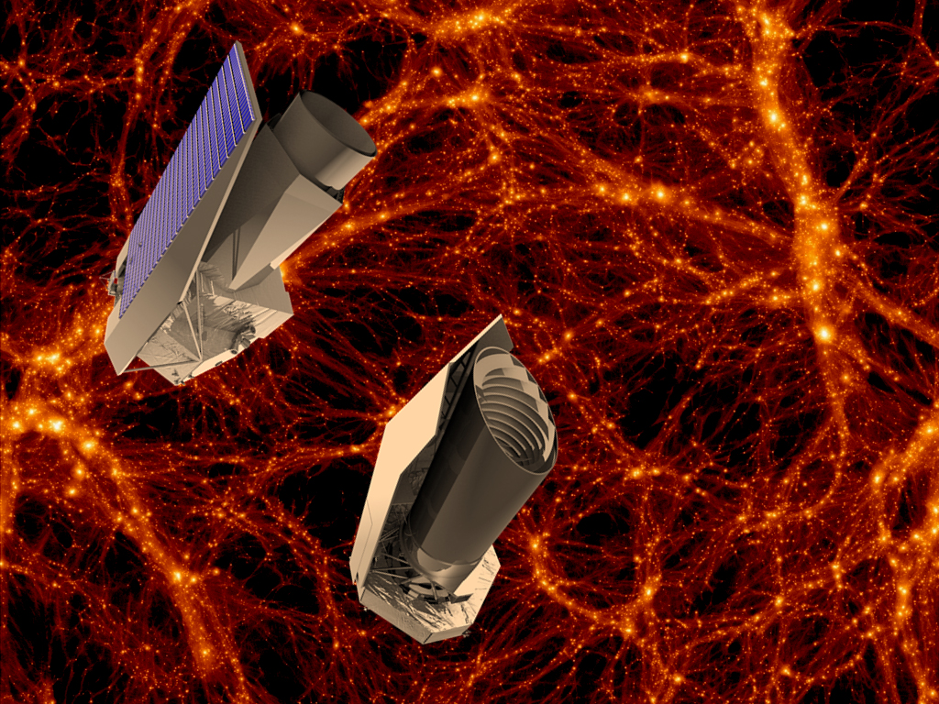
The future

Slide 41
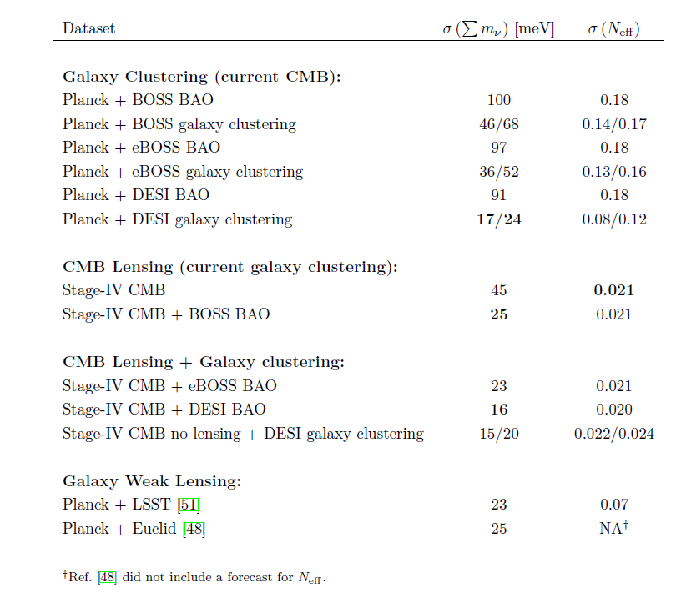
Abazajian et al., arXiv:1309.5383

Slide 42
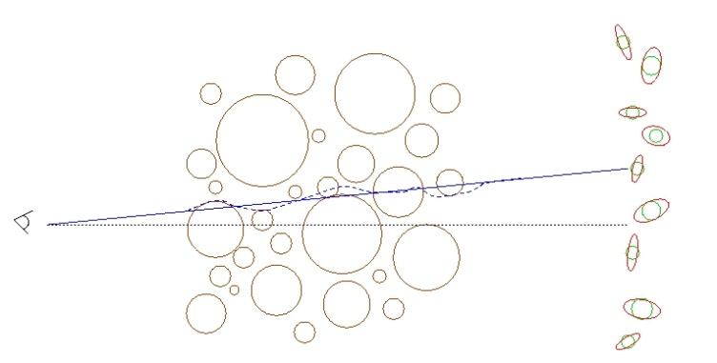
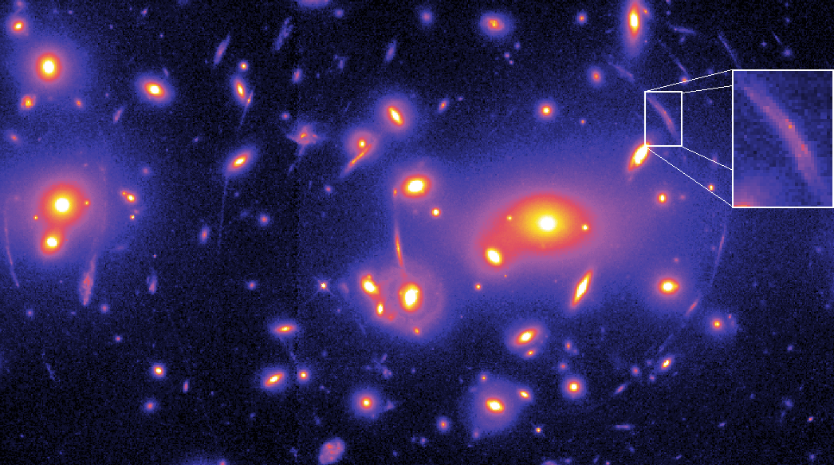
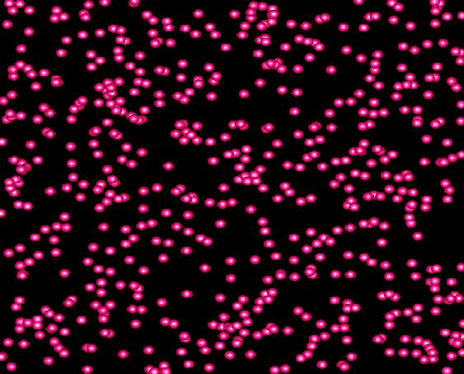
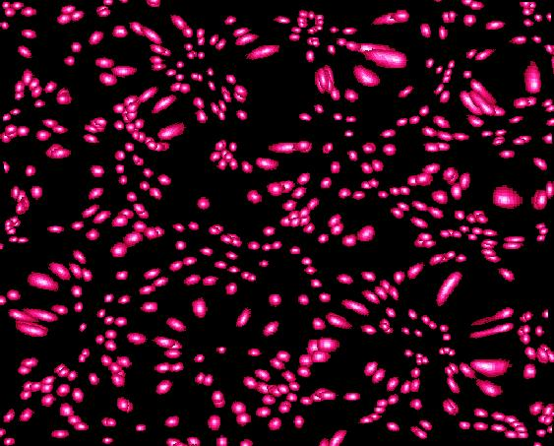
WEAK LENSING – A POWERFUL PROBE FOR THE FUTURE
Distortion of background images by foreground matter
Unlensed Lensed

Slide 43
FROM A WEAK LENSING SURVEY THE ANGULAR POWER SPECTRUM
CAN BE CONSTRUCTED, JUST LIKE IN THE CASE OF CMB
MATTER POWER SPECTRUM (NON-LINEAR)
WEIGHT FUNCTION
DESCRIBING LENSING
PROBABILITY
(SEE FOR INSTANCE JAIN & SELJAK ’96, ABAZAJIAN & DODELSON ’03,
SIMPSON & BRIDLE ’04)

Slide 44
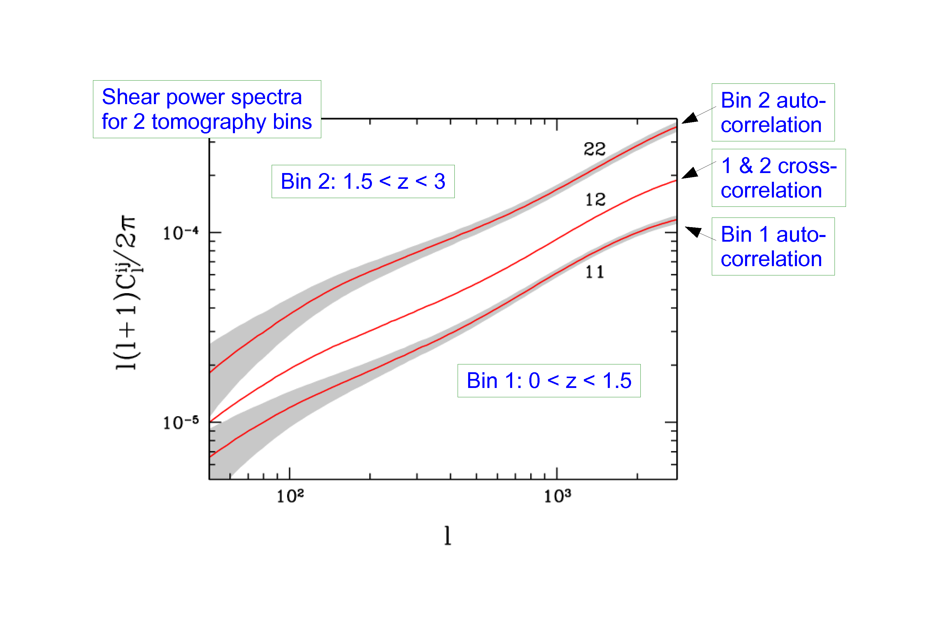
STH, TU, WONG 2006

Slide 45
EUCLID
ESA M-CLASS MISSION
2020
SELECTED OCTOBER 2011

Slide 46
EUCLID WILL FEATURE:
A WEAK LENSING MEASUREMENT OUT TO z ~ 2, COVERING
APPROXIMATELY 20,000 deg²
(THIS WILL BE MAINLY PHOTOMETRIC)
A GALAXY SURVEY OF ABOUT 10⁷ GALAXIES (10 x SDSS)
A WEAK LENSING BASED CLUSTER SURVEY

Slide 47
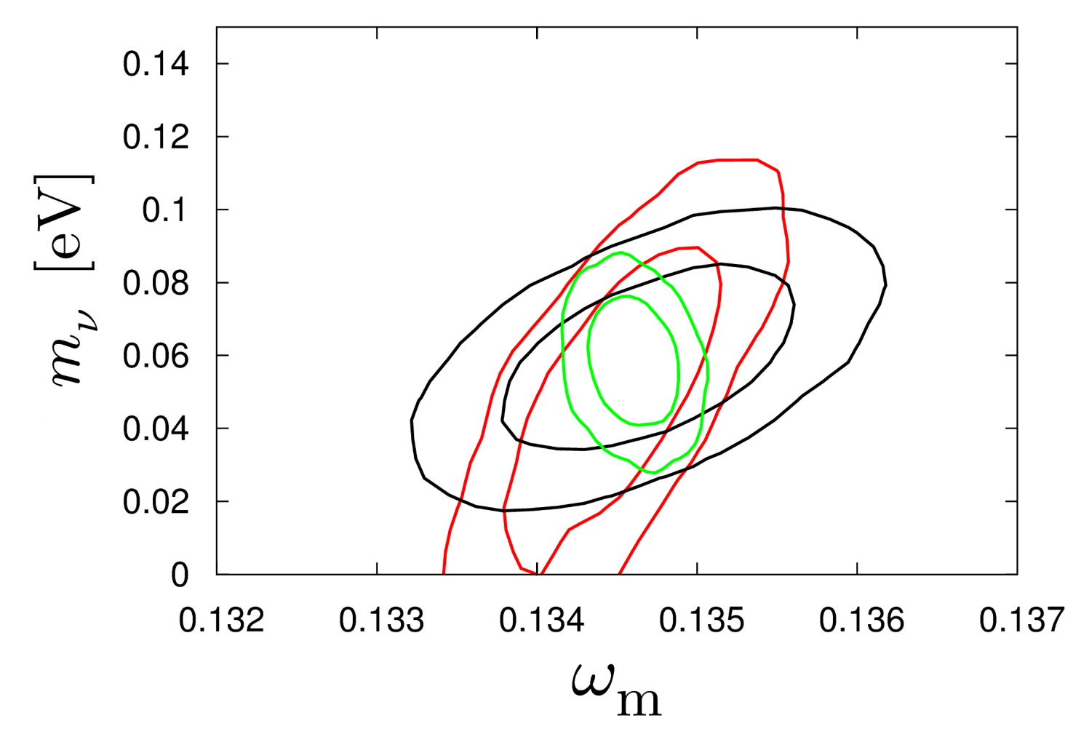
HAMANN, STH, WONG 2012: COMBINING THE EUCLID WL AND GALAXY
SURVEYS WILL ALLOW FOR AT A 2.5-5σ DETECTION OF THE NORMAL
HIERARCHY (DEPENDING ON ASSUMPTIONS ABOUT BIAS)
CMB+WL
CMB+WL+GAL
CMB+GAL
arXiv:1209.1043 (JCAP)

Slide 48
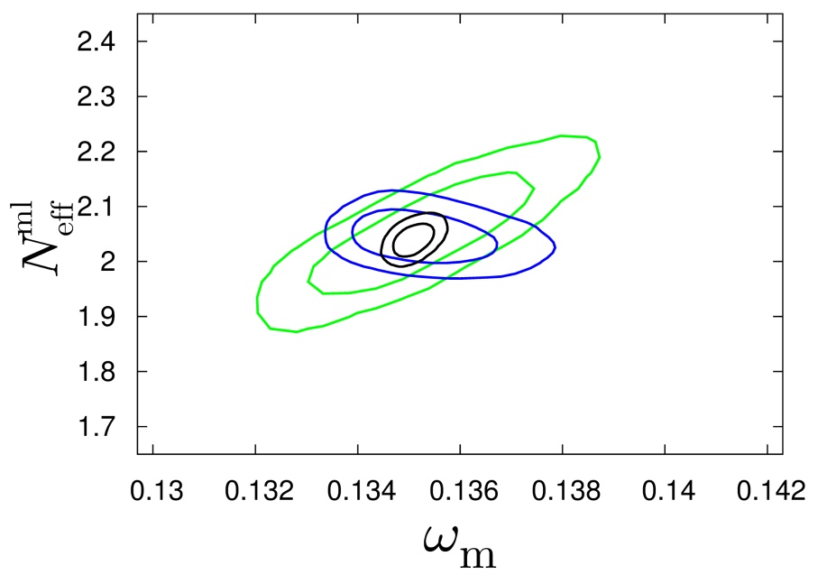
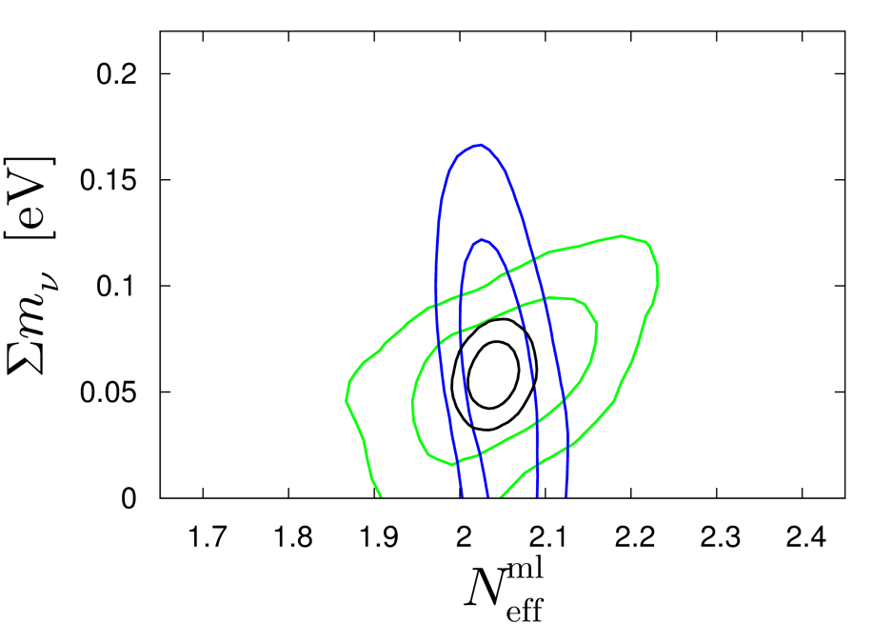
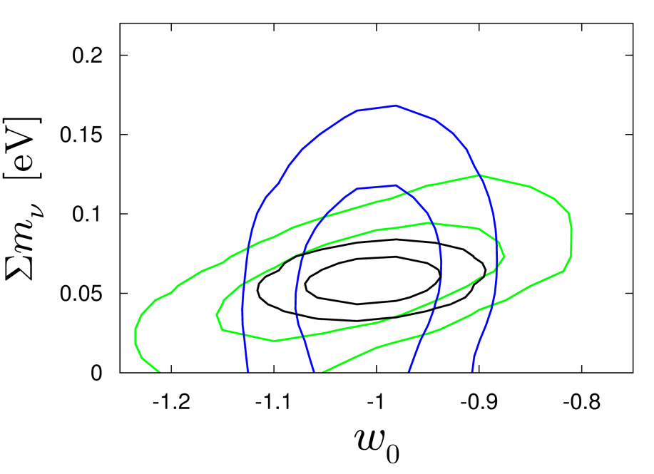
Basse, Bjælde, Hamann, STH, Wong 2013: Adding information on the
cluster mass function will allow for a 5σ detection of non-zero neutrino
mass, even in very complex cosmological models with time-varying
dark energy
arXiv:1304.2321
(JCAP)
CMB+CL
CMB+GAL+WL
ALL

Slide 49
THIS SOUNDS GREAT, BUT UNFORTUNATELY THE THEORETICIANS
CANNOT JUST LEAN BACK AND WAIT FOR FANTASTIC NEW DATA
TO ARRIVE…..

Slide 50
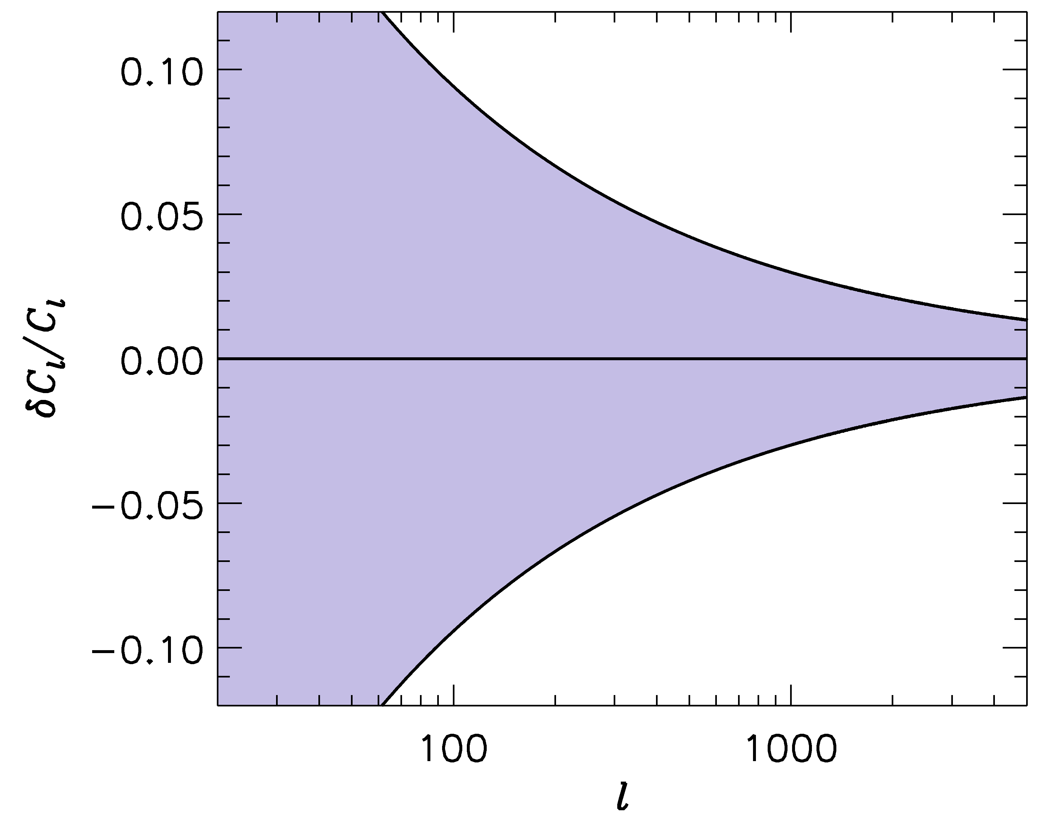
FUTURE SURVEYS LIKE LSST WILL PROBE THE POWER SPECTRUM
TO ~ 1-2 PERCENT PRECISION
-1
”LSST” ERROR BARS
WE SHOULD BE ABLE TO CALCULATE THE POWER SPECTRUM
TO AT LEAST THE SAME PRECISION!

Slide 51
IN ORDER TO CALCULATE THE POWER SPECTRUM TO 1%
ON THESE SCALES, A LARGE NUMBER OF EFFECTS MUST
BE TAKEN INTO ACCOUNT
BARYONIC PHYSICS – STAR FORMATION, SN FEEDBACK,…..
NEUTRINOS, EVEN WITH NORMAL HIERARCHY
NON-LINEAR GRAVITY
……………………..

Slide 52
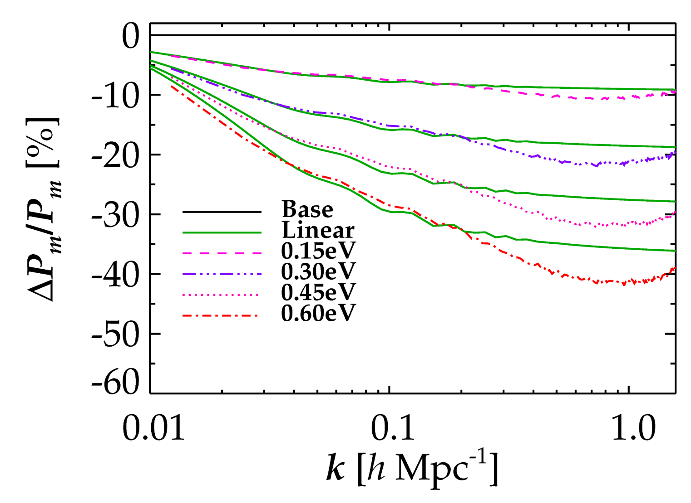
NON-LINEAR EVOLUTION PROVIDES AN ADDITIONAL AND VERY
CHARACTERISTIC SUPPRESSION OF FLUCTUATION POWER DUE TO
NEUTRINOS (COULD BE USED AS A SMOKING GUN SIGNATURE)
LINEAR THEORY
FULL NON-LINEAR
Brandbyge, STH, Haugbølle, Thomsen, arXiv:0802.3700 (JCAP)
Brandbyge & STH ’09, ’10 (JCAP), Viel, Haehnelt, Springel ’10, ……..

Slide 53
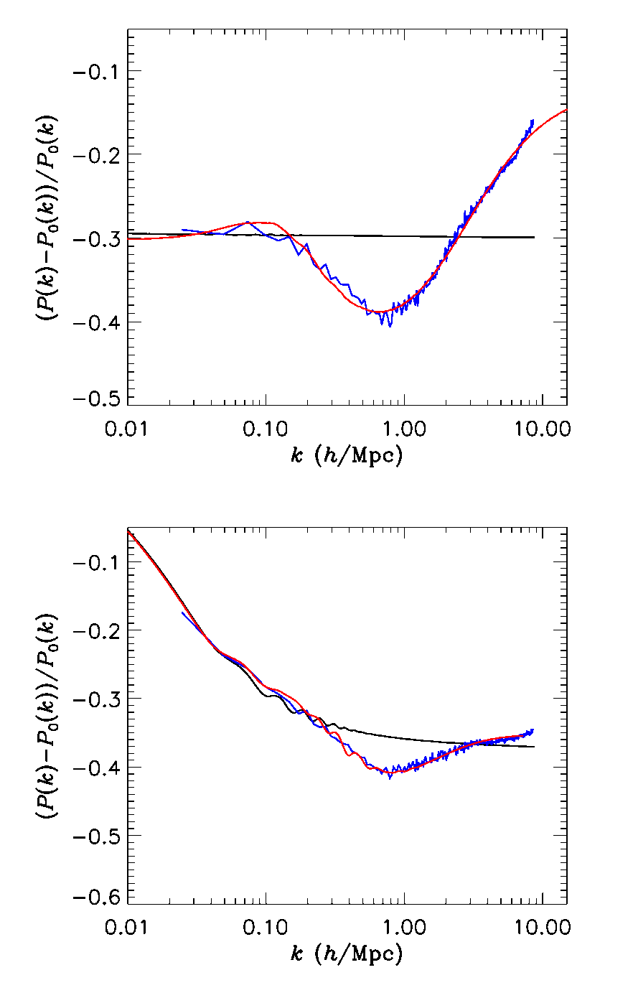
HOWEVER, IT TURNS OUT THAT THE ”DIP” IS A GENERIC FEATURE
OF ANY MODEL WITH SUPPRESSED SMALL SCALE STRUCTURE
WHERE DOES THAT EFFECT
COME FROM?
Linear theory
N-body
Analytic fit

Slide 54
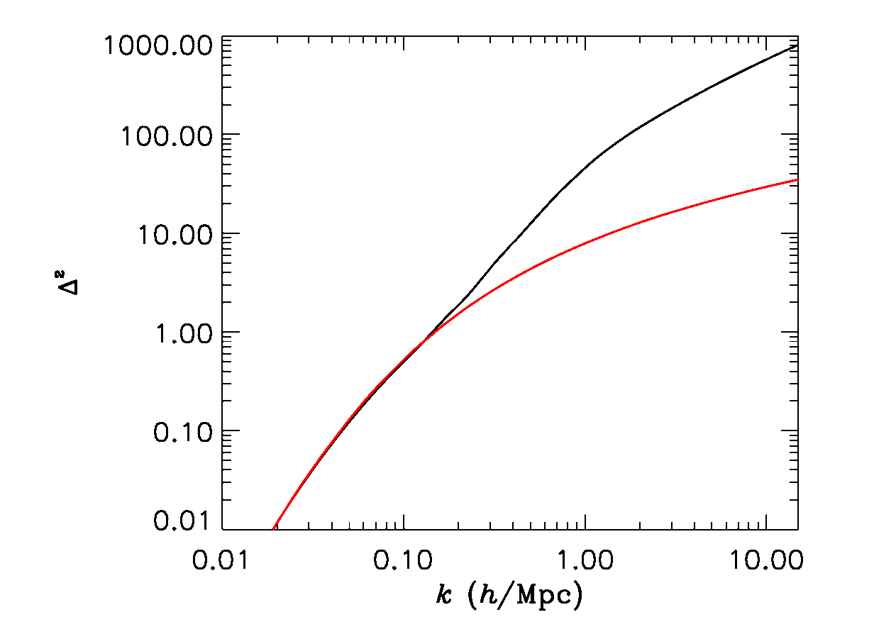
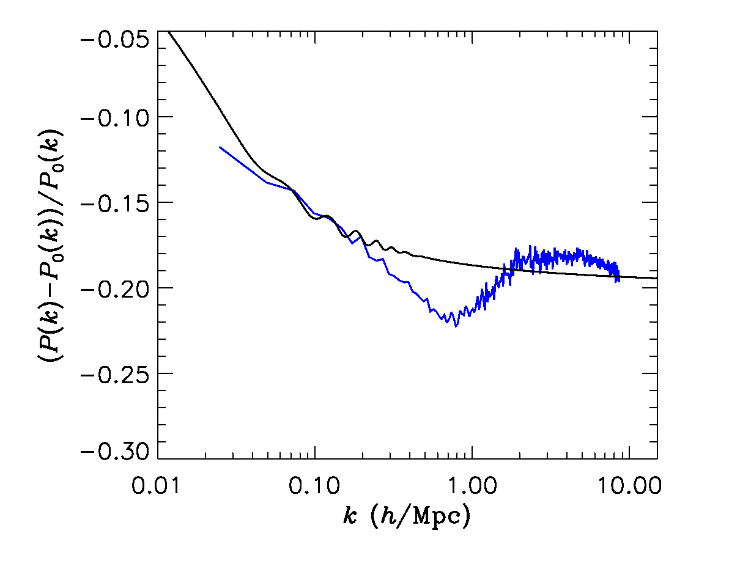
NL
IT IS SIMPLY AN EFFECT OF
THE RATE WITH WHICH
THE AMPLITUDE OF
FLUCTUATIONS GROW
THE EFFECT IS NOT
SPECIFIC TO MODELS WITH
NEUTRINOS. BUT
UNDERSTANDING IT WILL
HELP DEVELOP ACCURRATE
SEMI-ANALYTIC MODELS
OF STRUCTURE FORMATION
LINEAR

Slide 55
ANOTHER IMPORTANT ASPECT OF STRUCTURE FORMATION
WITH NEUTRINOS:
THE NUMBER OF BOUND OBJECTS (HALOS) AS WELL AS THEIR
PROPERTIES ARE CHANGED WHEN NEUTRINOS ARE INCLUDED

Slide 56
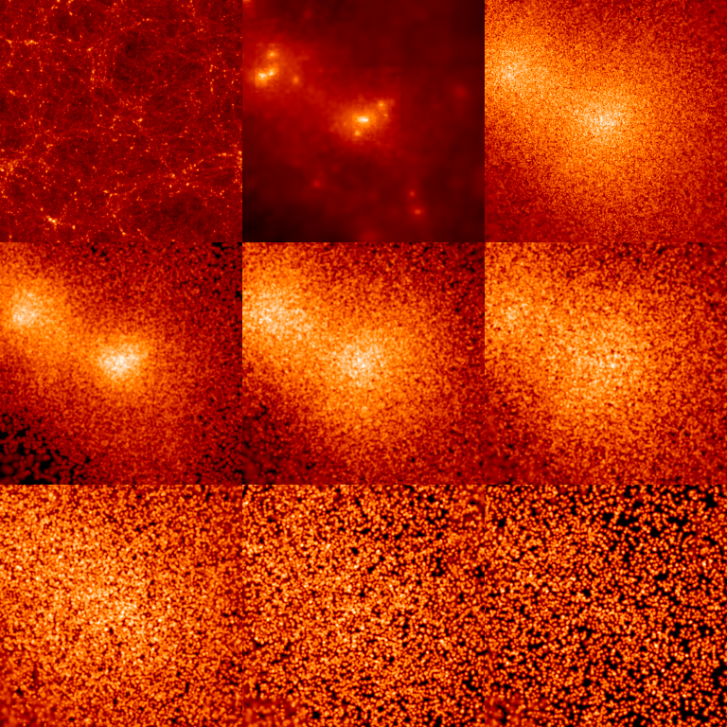
INDIVIDUAL HALO PROPERTIES
CDM
ν
512 h⁻¹ Mpc
0 < p/T < 1
1 < p/T < 2
2 < p/T < 3
3 < p/T < 4
4 < p/T < 5
5 < p/T < 6

Slide 57
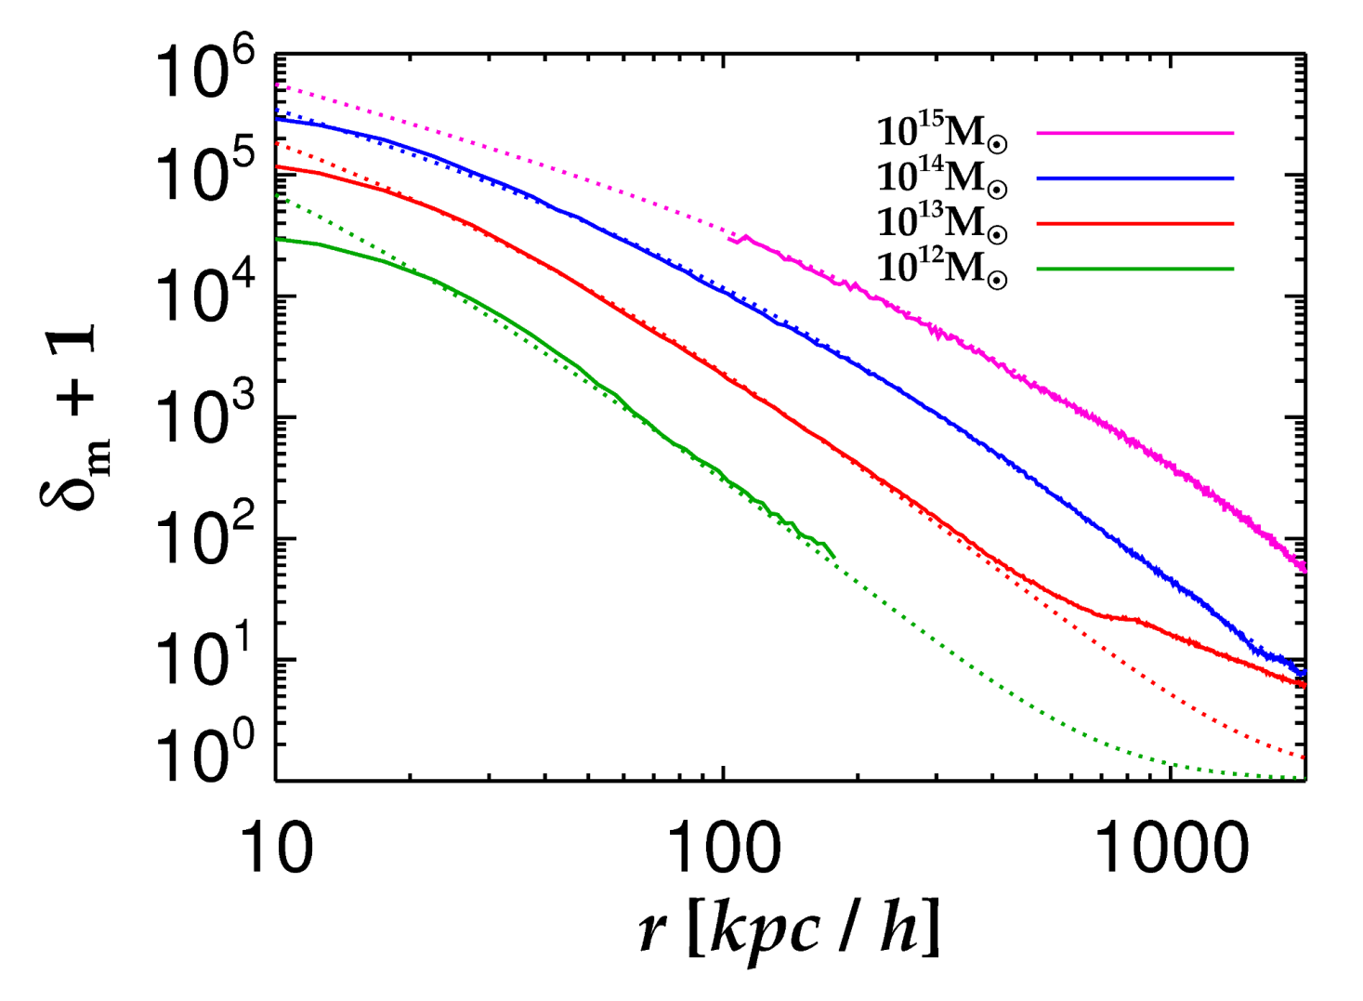
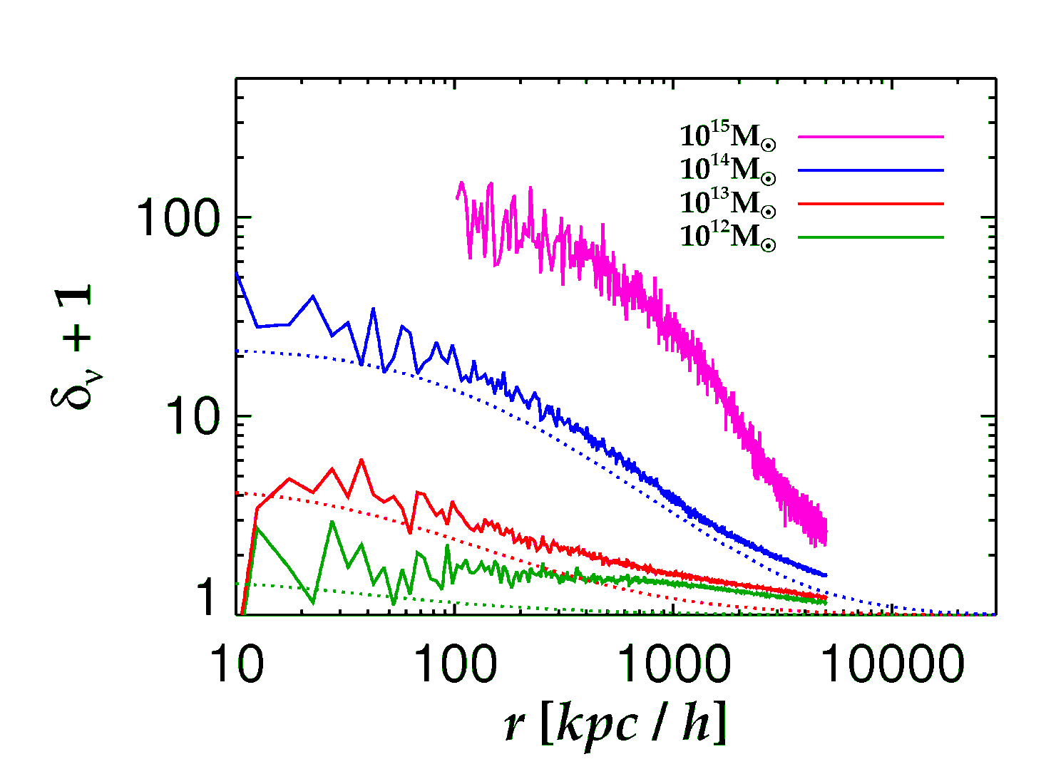
Brandbyge, STH, Haugboelle, Wong, arxiv:1004.4105
Neutrinos
Cold Dark Matter
See also Ringwald & Wong 2004

Slide 58
CONCLUSIONS
NEUTRINO PHYSICS IS PERHAPS THE PRIME EXAMPLE OF HOW
TO USE COSMOLOGY TO DO PARTICLE PHYSICS
THE BOUND ON NEUTRINO MASSES IS SIGNIFICANTLY
STRONGER THAN WHAT CAN BE OBTAINED FROM DIRECT
EXPERIMENTS, ALBEIT MUCH MORE MODEL DEPENDENT
COSMOLOGICAL DATA SHOWS NO EVIDENCE FOR NEW
PHYSICS. HOWEVER, IF eV STERILE NEUTRINOS EXIST THERE
MUST BE NEW PHYSICS IN ORDER TO RECONCILE THEM WITH
COSMOLOGY
NEW DATA FROM PLANCK AND EUCLID MAY PROVIDE A
POSITIVE DETECTION OF A NON-ZERO NEUTRINO MASS

