Slide 12
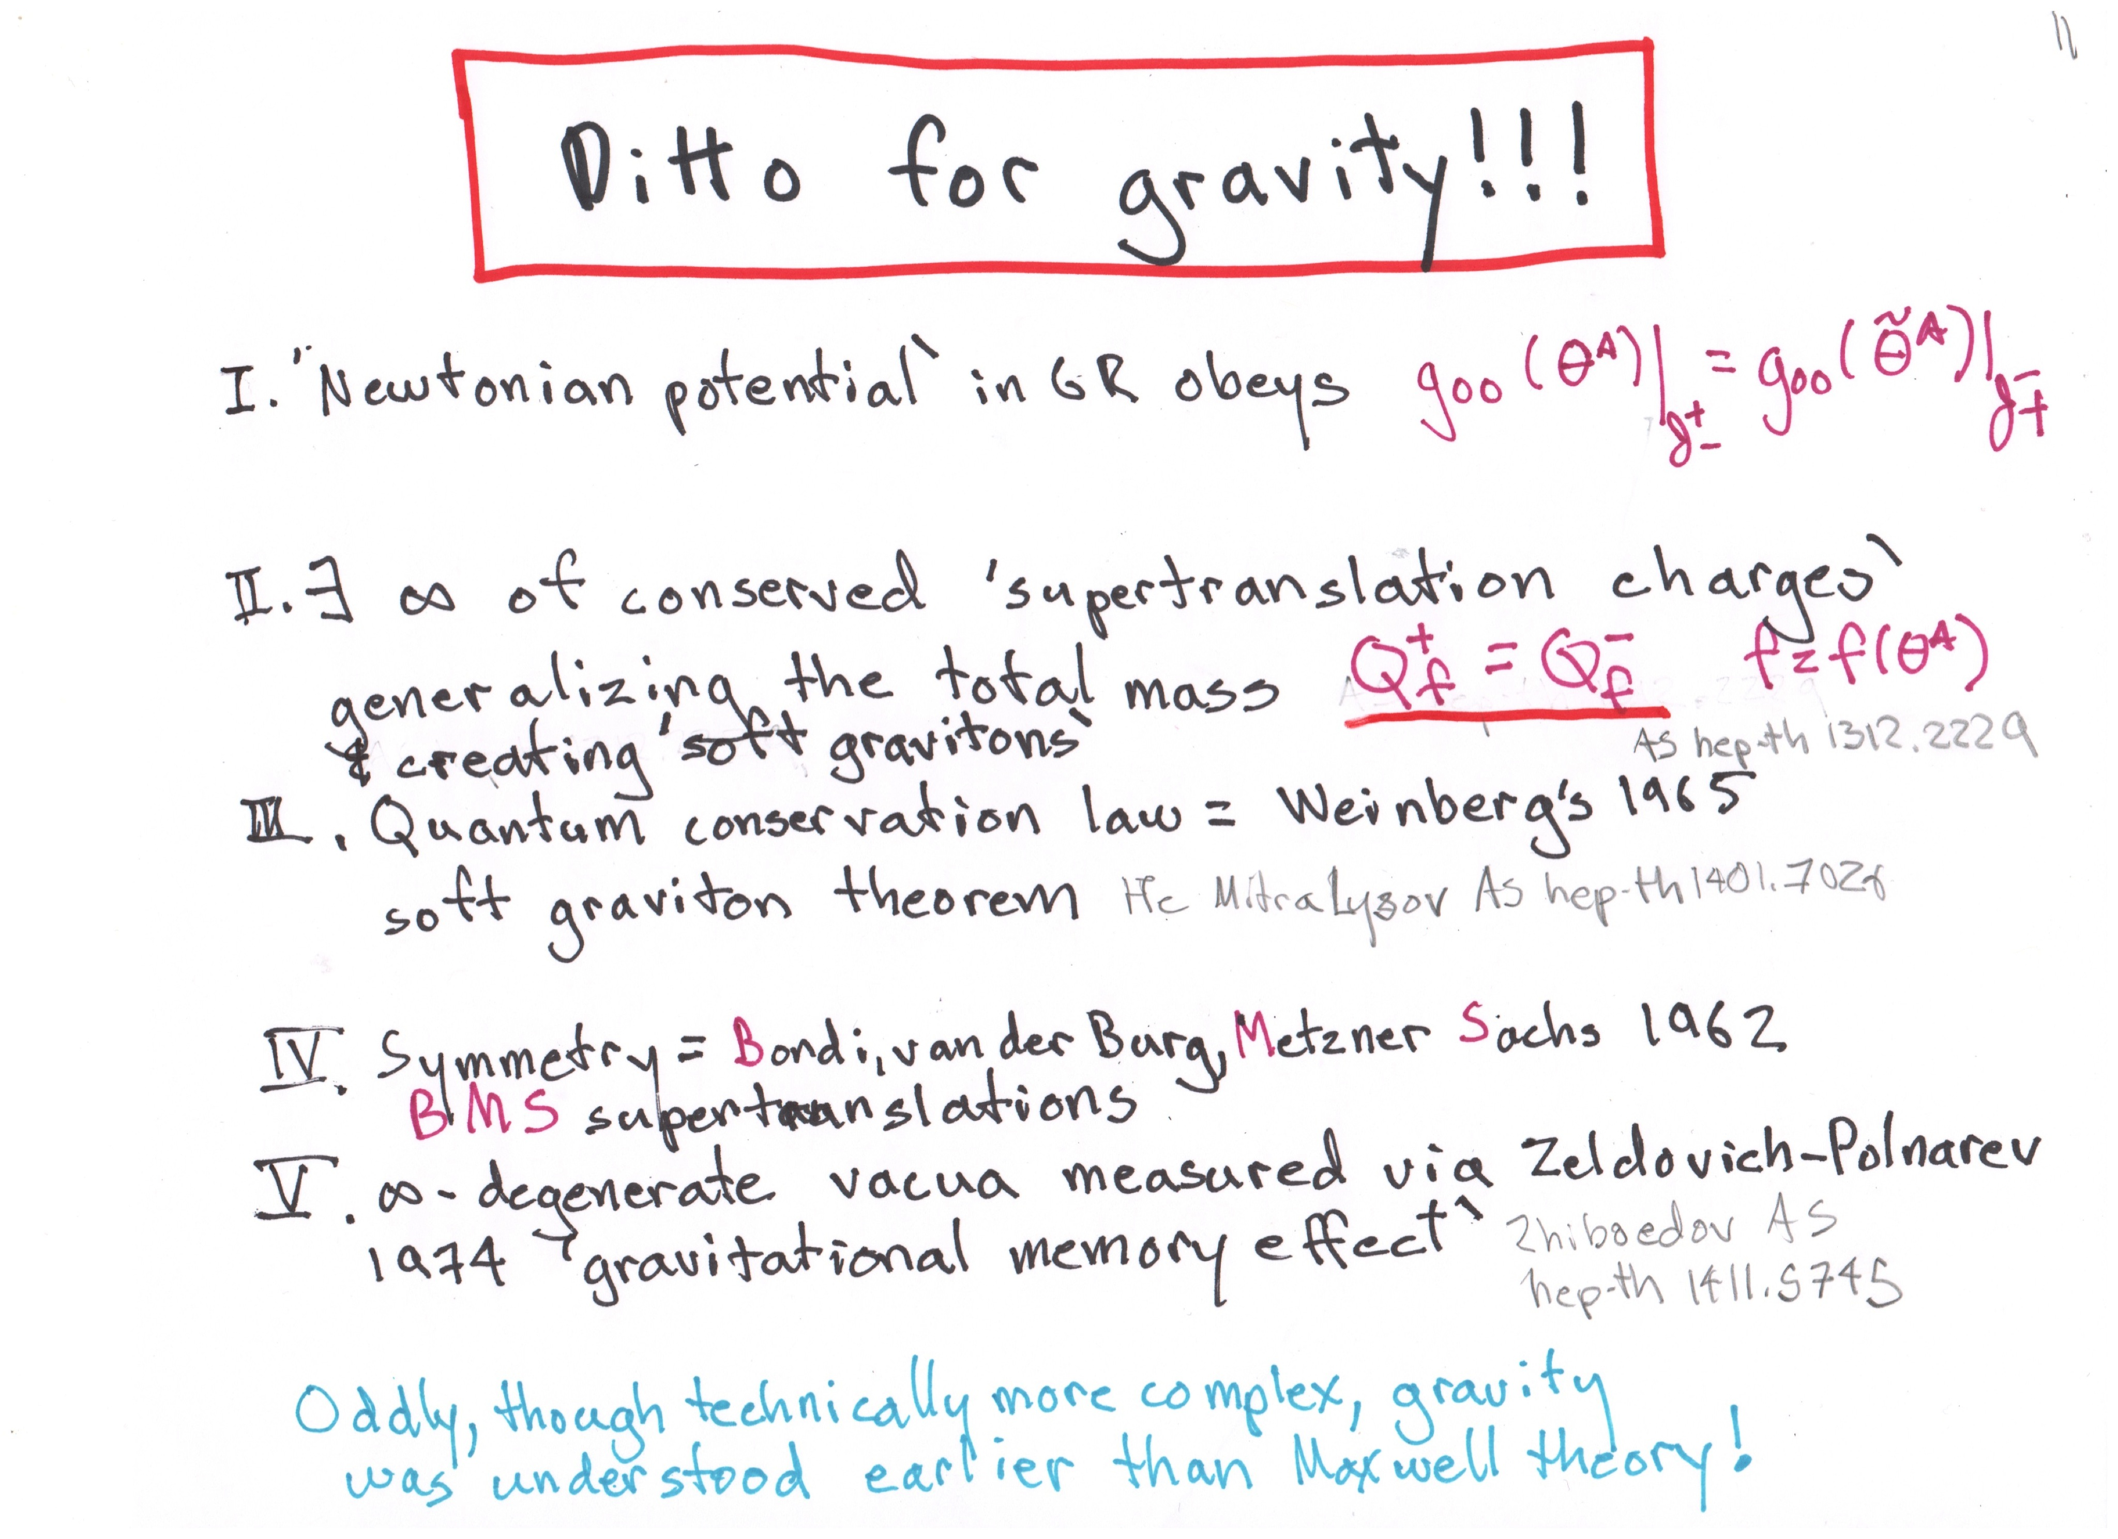

Slide 14
SOMETHING
NOW
THERE
IS
SOFT HAIR

Slide 15
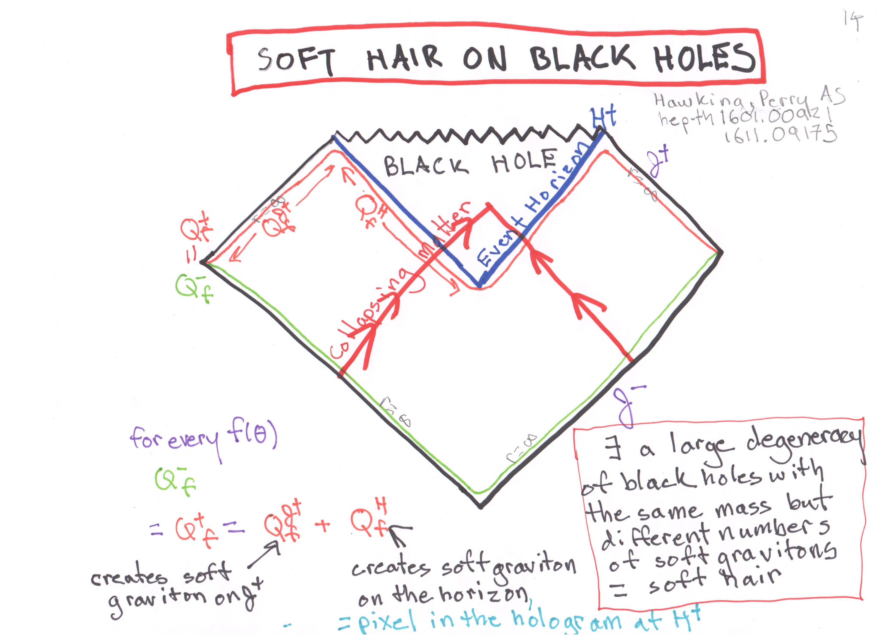

Slide 17
?

