Slide 1
Understanding Collectivity collectively Activities within the CERN LPCC MB&UE WG
Jan Fiete Grosse-Oetringhaus, CERN
Workshop on Collectivity in Small Systems
11.05.17

Slide 2
Preamble
This meeting is aimed at the LHC experiments…
… but everyone is welcome to stay and contribute

Slide 3


https://lpcc.web.cern.ch/LPCC/
Facilitate common physics effort of CERN experiments
Set of LHC working groups
Unify analysis strategies
Unify representation of results → helps theorists
Resolve data inconsistency between experiments

Slide 4
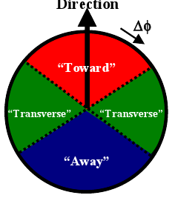
Minimum Bias and Underlying Event Group (“MB&UE”)
EPJC (2010) 68,89
First LPCC group
Did a set of baseline measurements in 2009
Minimum Bias: dN_{ch}/dη, dN_{ch}/dp_{T}, P(N_{ch}), <p_{T}> vs N_{ch}
Underlying Event: N_{ch} and p_{T,sum} vs. p_{T,lead}
Inelastic cross-section
Revived for increase in energy
Initially focused on pp
NJP13:053033,2011

Slide 5
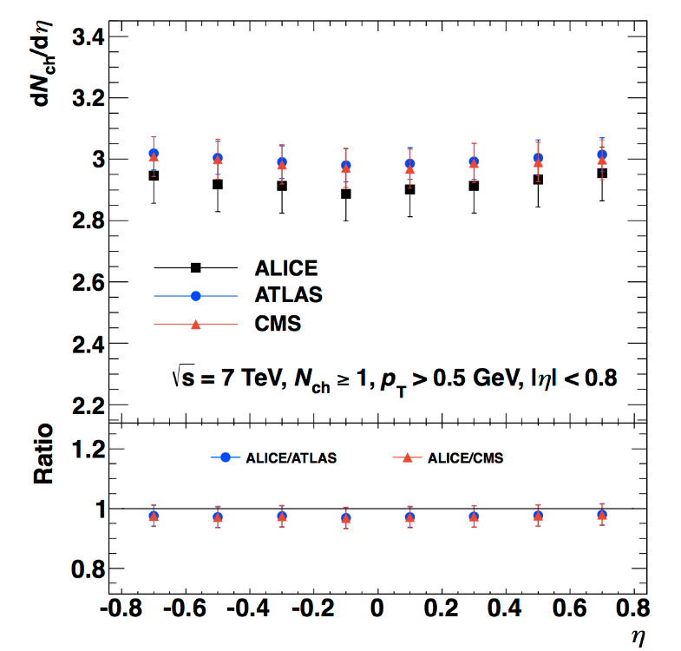
“Common Plots”
Example: dN_{ch}/dη for events which have at least one particle within |η| < 0.8 and p_{T} > 0.5 GeV/c
Idea: measure exactly the same quantity in different experiments
Detectors are different
Therefore, this means correct measurement to the same quantity
Minimize corrections, in particular model-dependent corrections
May sound simple → devil in the details
Example: dN_{ch}/dη
Primary particle definition: leptons? Strange baryons? (cτ ~ few cm)
Event classes: inelastic, non single-diffractive? → Model dependence
“INEL>0” classes = at least one charged particle within an |η| range and above some p_{T}
Purpose
Show inter-experimental agreement
Clearly defined measurement for theory comparison

Slide 6
Minimum Bias and Underlying Event Group (“MB&UE”)
Ridge and correlation studies have been discussed in the MB&UE WG “lately” (Nov ’15): https://indico.cern.ch/event/393716/timetable/
Seemed the appropriate working group
Proposal to use this group as a platform to discuss collectivity in small systems among the LHC experiments

Slide 7
Organizational Aspects
Working group has set of experimental contacts / conveners
ALICE: Jan Fiete Grosse-Oetringhaus, Valentina Zaccolo
ATLAS: Oldrich Kepka (MB), Deepak Kar (UE)
CMS: Arthur Moraes, Benoit Roland
LHCb: Michael Schmelling
TOTEM: Ken Österberg, Fabrizio Ferro
LPCC: Michelangelo Mangano
We have the option to add a “ridge”-expert as additional convener
Needs to go through experimental hierarchy (contact current conveners)
Experimental approvals
Plots typically made public in short public/conference notes
Usually approvals lightweight for LPCC-related groups
I will prepare a summary to be sent to the MB&UE group

Slide 8
Aims of today’s discussion
Clarify differences / similarities of ALICE / ATLAS / CMS methods
Identify and define “common plots”
Identify common MC + tune for method validation
Theory comparison guidelines
Focus on experimental methods, not on the interpretation of results

Slide 9
Some Slides to Guide the Discussion

Slide 10
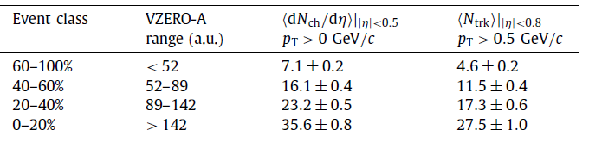
Event Selection
High-multiplicity triggers
Multiplicity, Energy
Forward, central rapidity
ALICE: mainly forward tracks (scintillator), central tracks (clusters online, tracks offline)
ATLAS: pretrigger (FCAL, forward) + tracks (HLT)
CMS: mid-rapidity: pretrigger (ECAL, HCAL) + tracks (HLT)
Slicing in event classes
What percentage classes we can all reach?
Characterisation of event classes
N_{offline,track}, N_{ch} (corrected), …

Slide 11
Phase Space
Pseudorapidity
|η| < 0.8 (ALICE, ATLAS, CMS) “narrow η”
and |η| < 2.4 (ATLAS, CMS) “wide η”
Momentum
p_{T,min} > 0.3 GeV/c

Slide 12
Example of common plot for our purpose
Two particle correlation defined as …
For primary particles defined as … in |η|, p_{T}
Corrected for secondary contamination, tracking efficiency
For events which have X … Y primary particles (thus corrected) within |η|, p_{T}
Corrected for trigger response

Slide 13



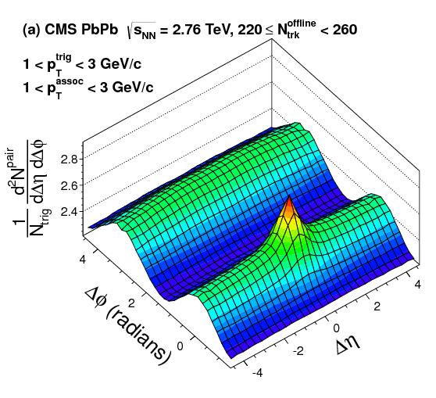
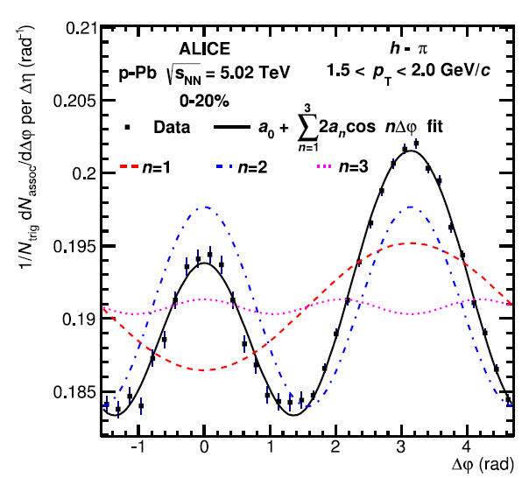
Common Observable: Two-Particle Correlation
CMS
ATLAS, ALICE
Definition
Per-trigger yield
Event averaging
Mixed event on 2D or projection?
Averaging over multiplicity bins
Binning (event class, p_{T} bins)
Corrected for tracking efficiency, secondaries
Output plots (no subtraction)
2D per-trigger yield
Projection to Δφ
v_{n} from fit vs N_{ch} (corrected), p_{T} (η-gap?)
Subtraction (next slide…)

Slide 14
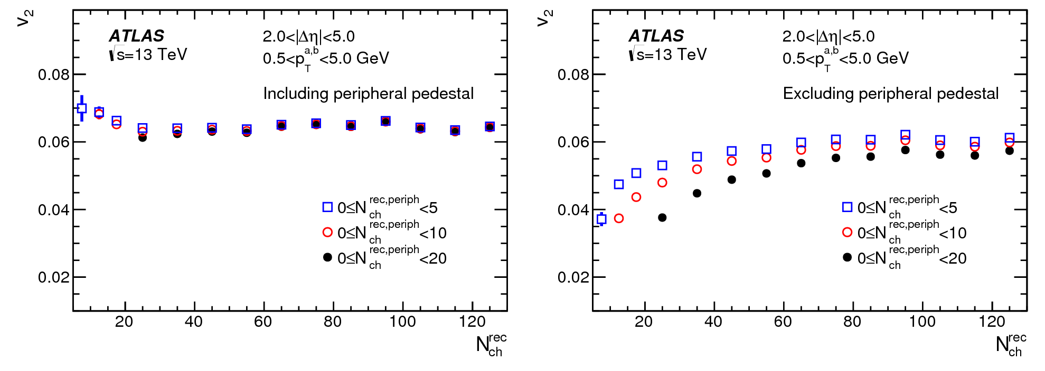
Common Observable: Two-Particle Correlation
Subtraction procedure (both)
Template fit
Peripheral subtraction
Feasible in |η| < 0.8? How much additional work for ATLAS/CMS?
Output plots
Extracted v_{n} vs. N_{ch} (corrected), p_{T}
2D plots after subtraction?

Slide 15
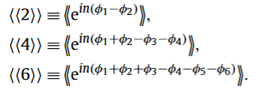

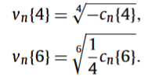
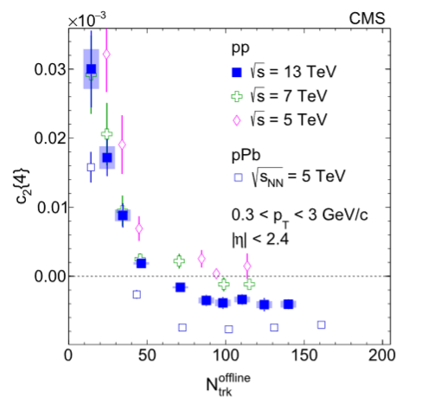
Common Observable: Cumulants
2, 4, 6, 8-particle
Definition
Averaging
No η-gap? / Sub event method?
Binning
pT ranges
Output plots
c_{n} and v_{n} vs. N_{ch} (corrected), p_{T}

Slide 16
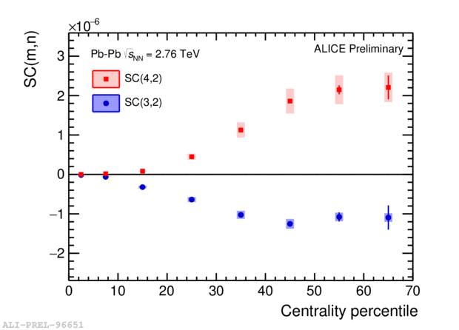
Common Observable: Symmetric cumulant
Up for discussion

Slide 17
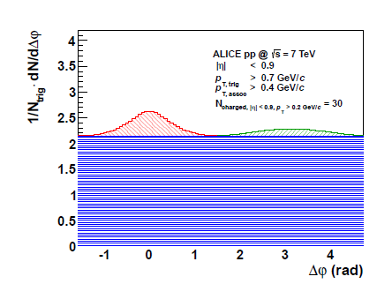
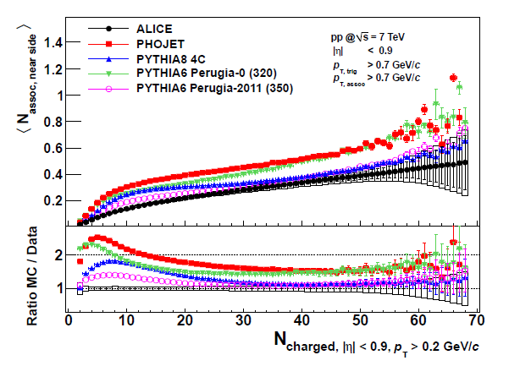
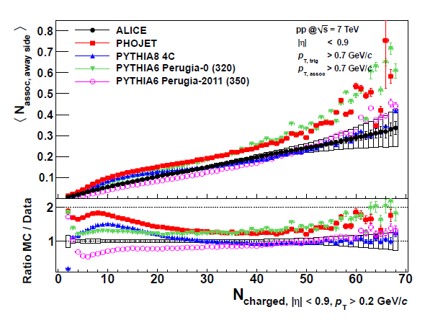
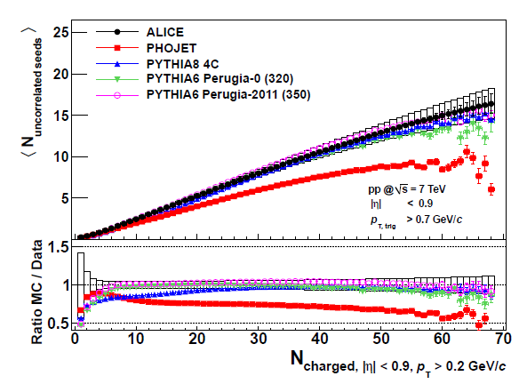
“Validation” Monte Carlo
Wei Li
Toy studies very important
Does PYTHIA 8 reproduce non-flow adequately in pp?
Let’s agree on a MC (Pythia?) and a tune for validation
Near-side peak yield
Away-side peak yield
Uncorrelated seeds
JHEP 09 (2013) 049

Slide 18
Further Ideas
Can we agree on a validation procedure? (probably dreaming…)
Theory comparisons
Guidelines how to run the subtraction procedures on MC / theory curves?

Slide 19
Backup

Slide 20

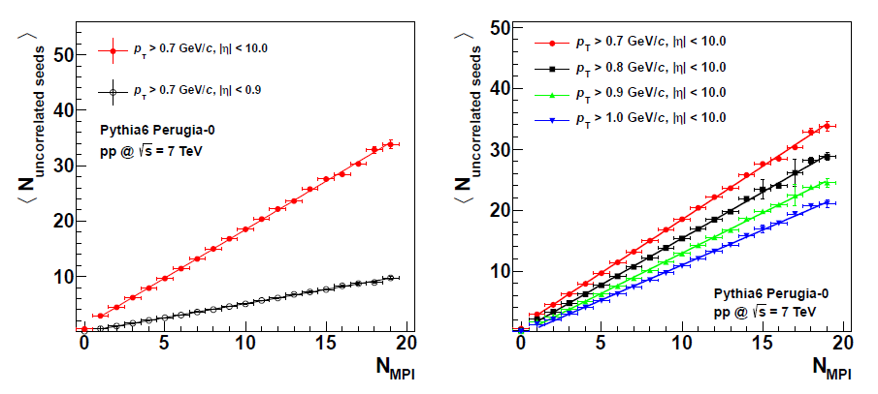
Uncorrelated Seeds ~ #MPI
JHEP 09 (2013) 049

Slide 21
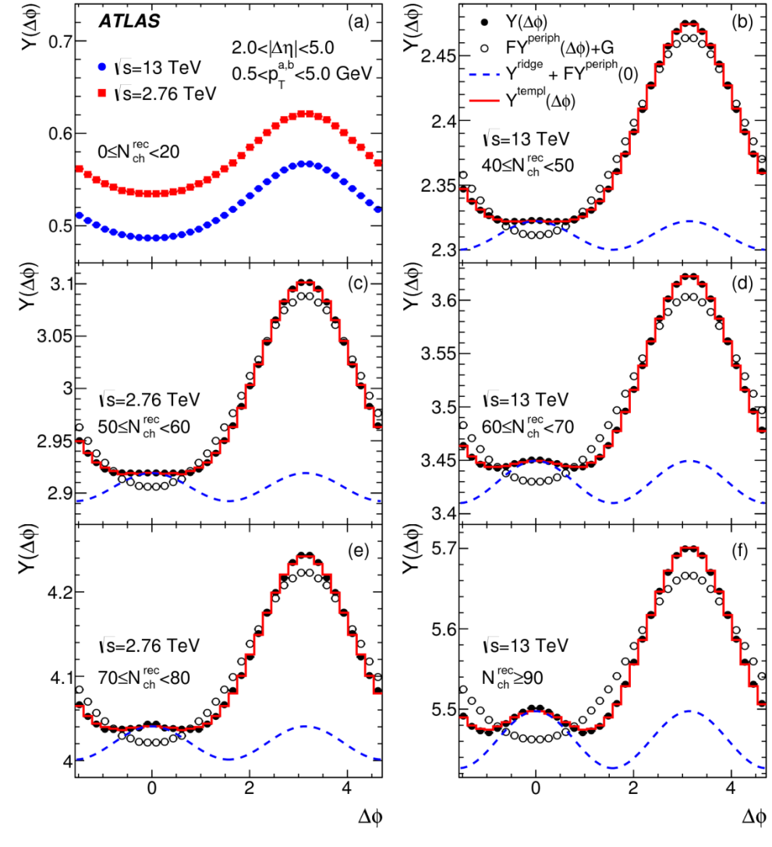
Ridge in pp
~0.16
PRL116, 172301 (2016)
Major experimental challenge
Ridge signal very small
Jet yields multiplicity dependent
Near side: η gap
Away side: jet + ridge
How to subtract jet?
Template fit at large Δη (ATLAS)
Scale low multiplicity template + v₂ (publication) + v₃ and v₄ (preliminary) contribution
Scaled subtraction in full Δη (CMS)
Scale low multiplicity such that near-side peak yields identical
A gluon jet is not a quark jet!
ATLAS
~0.24
CMS
High mult.
Low mult.
CMS-PAS-HIN-16-010

Slide 22
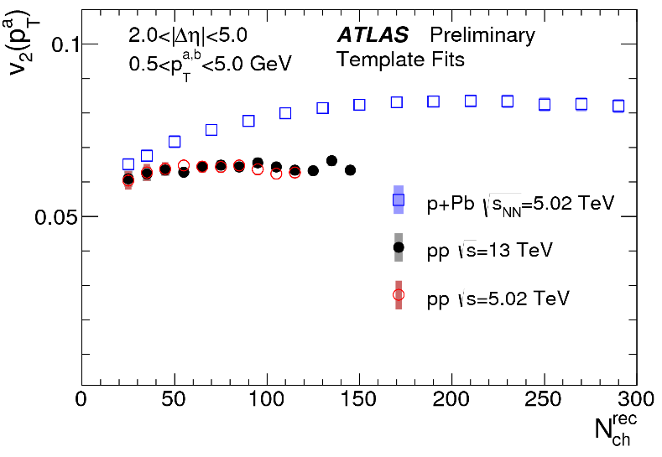
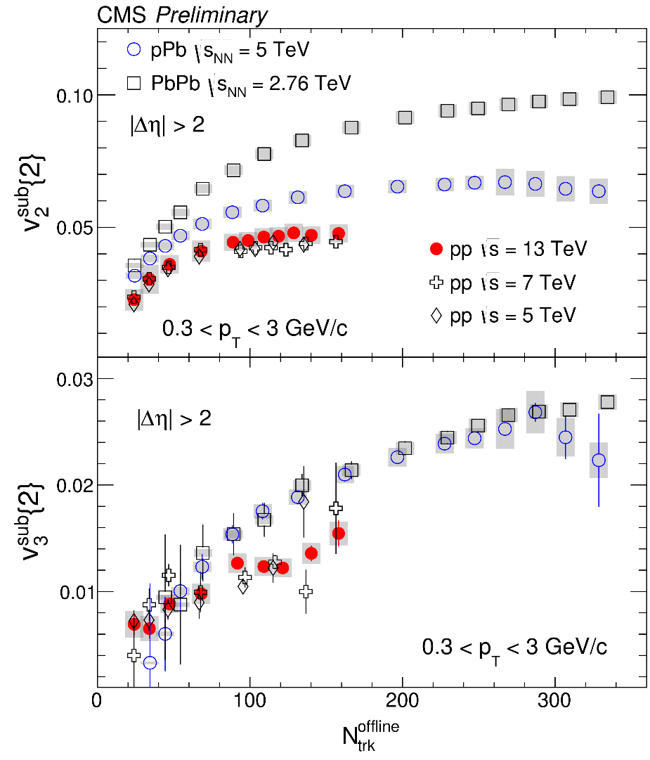
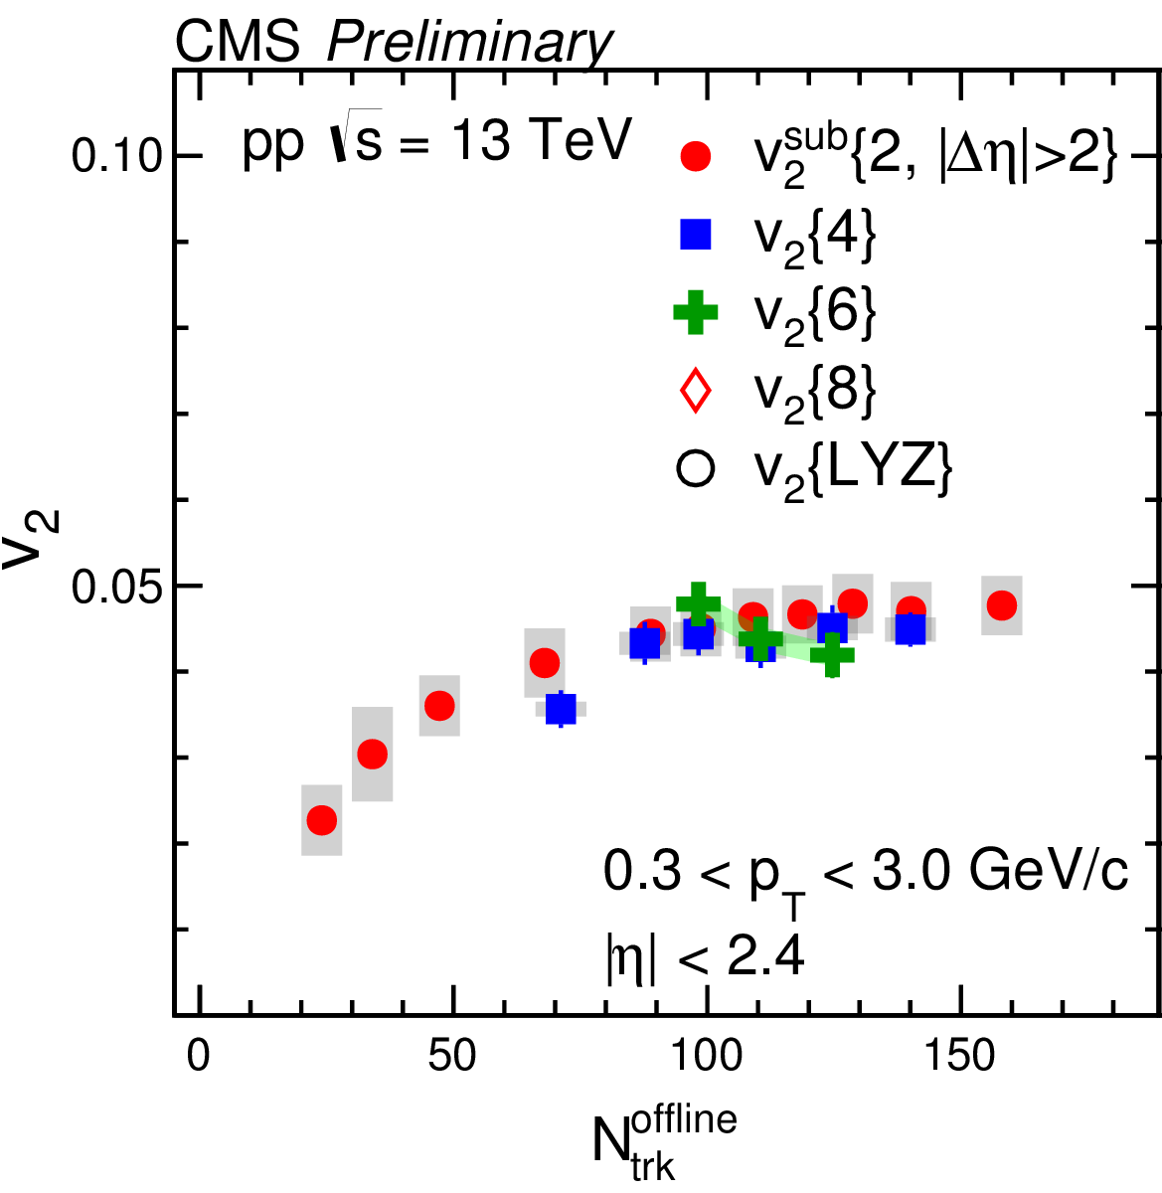
Ridge in pp (2)
v₂ vs. N_{ch}
pp 13 TeV
ATLAS-CONF-2016-026
Significant v₂, v₃, v₄ (?) found
Low N_{ch} results depend on ridge assumption at low multiplicity
v₂ collective up to 6 particles
v₂ vs. N_{ch}
v₂ vs. N_{ch}
pp 13 TeV
v₃ vs. N_{ch}
CMS-PAS-HIN-16-010
CMS-PAS-HIN-16-010
pp 13 TeV

