Slide 1
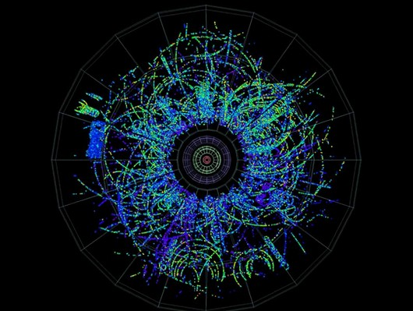
‘Collectivity’ in small systems Some random collection of Key questions
Collectivity in small systems !
Collectivity in small systems ! (depends on what you mean by 'collectivity')
Why does this matter ?
Some open questions

Slide 2
Answers …
How is it!
Macroscopic Matter properties
and new Questions
What we know:
increasingly precise measurements of macroscopic properties
η/S, ξ, q^, e^, D(iffusion), EoS, c_{s}, …
good evidence for deconfinement (J/Ψ, Υ)
J/Ψ coalescence = color conductivity, Y suppression = resonance melting
some evidence for chiral symmetry restoration, but indirect
strangeness ???, low mass l⁺l⁻ (connection between rho melting and chiral sym ?)
the relevant dof are NOT free quarks & gluons
the interaction is much too strong !
What we don't know
What ARE the relevant dof in the QGP ?
pseudoparticles, collective excitations (plasmons, ..), 'glueballs', ..
What is the dynamics ? 'looking under the hood' of the sQGP
how can it happen so fast, and in very small systems (incl. pp ?)
what makes thermal particle ratios, why expansion seems isentropic, ..
Where is the onset (if any) ?
how does collectivity & statistical behavior emerge with size & energy density ?
Equilibrium is part of the Problem (hides when and how achieved),
Out-of-Equilibrium may be a part of the Solution
Study out-of-equilibrium systems => test ‘Dynamics at work’
=> Investigate small & dilute systems (pp/pA)
Why is it so?
Microscopic Dynamics

Slide 3
Why are small systems interesting ?
'Looking under the hood': what makes the sQGP tick ?
stat. mechanics (thermo & hydro) hide very well the details: d.o.f & dynamics
strength & limitation: same results for different underlying 'stuff' (theories/models)
thermal system knows nothing about how and why it arrived in equilibrium
go towards and beyond the limits of thermo & hydro
study deviations due to finite size/finite time (=> small systems)
'Looking for the transition': how does (strong) collectivity emerge f(r, t) ?
change size & lifetime & density (pp -> pA -> AA)
'Looking for the beginning': universal aspects of soft QCQ ?
looking for connection & smooth evolution from MB pp(e⁺e⁻) to central AA, with pA the bridge in between

Slide 4
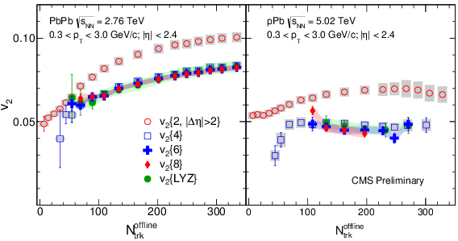
Collectivity
weak (mathematical) definition:
SIMILAR effect/probability for ALL particles (of some kind, say p_{T}/PID) in (almost) ALL events
drawn from the same inclusive single particle probability distribution (e.g. dN/dφ)
probability can be arbitrarily small ! as long as it’s the same for all particles/events
Collectivity is experimentally proven in AA & pA
v₂{2}< v₂{4}≈v₂{6}≈ … ≈v₂{∞}

Slide 5
‘Collectivity’
'Standard Model' of heavy ion physics
strong definition: {'thermo' + 'hydro'} - dynamics
emerging-f(t)- strongly interacting equilibrated matter with density/pressure gradients
hydro-dynamics:
LO: radial (v₀) & elliptic (v₂) flow for > 95% of all particles (p_{t} < few GeV)
NLO: higher harmonics v_{n}, PID (m dependence) of v_{n} ('mode mixing' of v₀ & v₂)
NNLO: non-linear mode mixing (v_{n}≠ ε_{n}), factorization violation r(p_{T}), EbE P(v_{n}), …
thermo-dynamics:
particle ratios (Statistical Model) to 10-30%
in pp/pA: γ_{s} -> 1
thermo + hydro: => Space Time Evolution (STE)
HBT f(T, β): (R(m_{T}), R(N_{ch}^{1/3}), R_{out}/R_{side} ≈ 1)
Charge Balance functions
strong Collectivity consistent with ≈ all data in pp/pA/AA to (very) good accuracy, where it was measured..

Slide 6
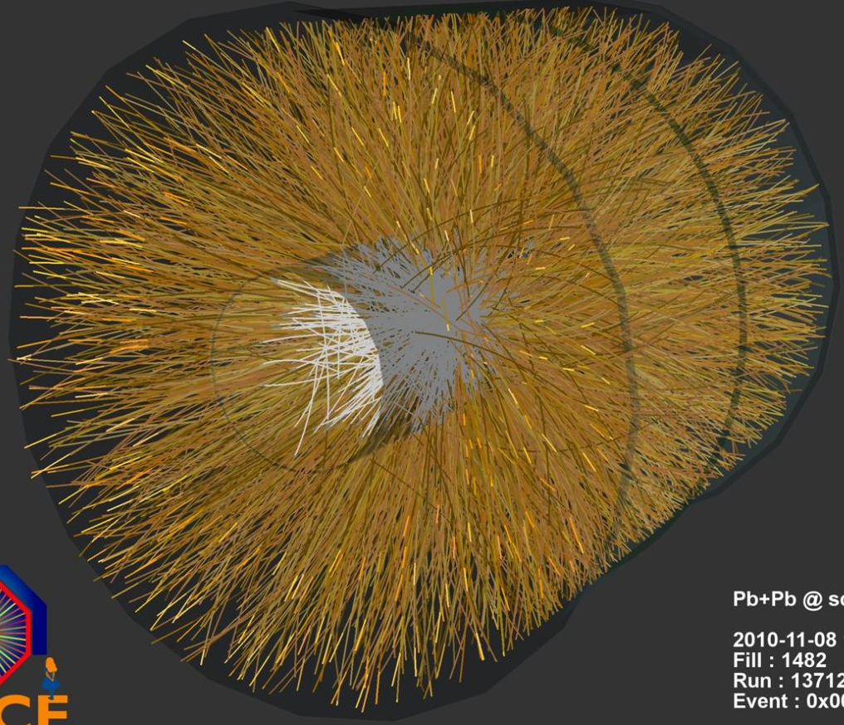
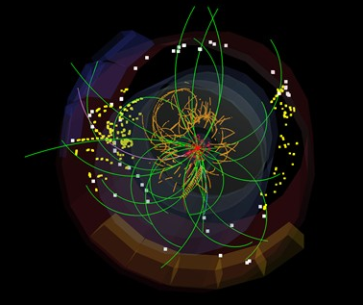
1) Strong Collectivity down to dN/dy ≈ 0 ?
=>
7 TeV pp Min Bias
Large&Dense (AA) <-> Small&Dense (centr. pA) <-> Small&Dilute (MB pp)
TH relevance:
far outside applicability of statistical mechanics (thermo/hydro)
special property of sQGP (HIP) -> generic property of QCD (HEP)
Experimental issue:
tiny signal, large background (‘non-flow’)
new analysis methods, new observables ?

Slide 7
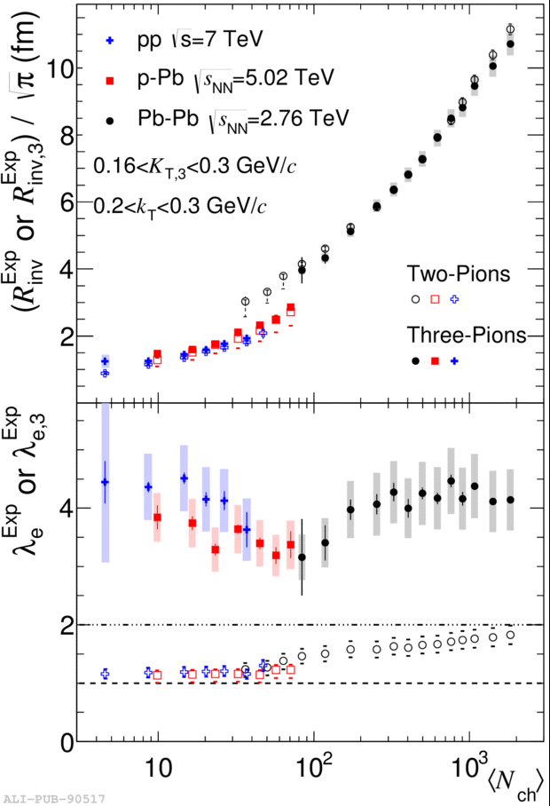
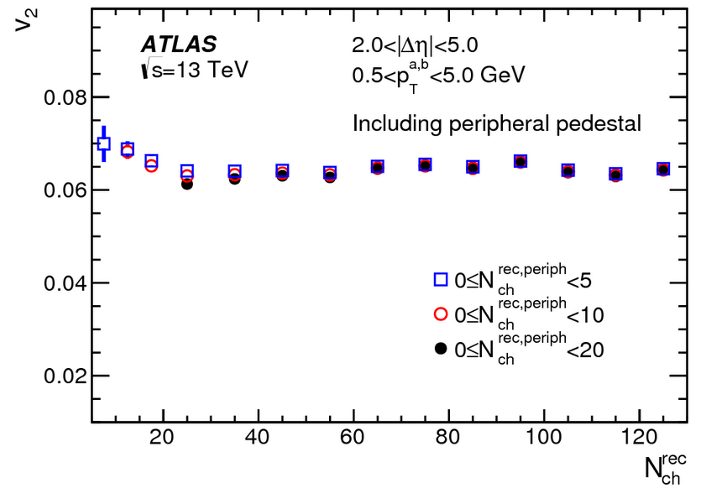
Continuous & smooth down to dN/dy ~ 0 !
HBT N_{ch} & k_{T} dependence
Charge Balance Function
space-time-momentum correlation!
PbPb
pp
ALICE EPJC 76 (2016) 86
PbPb
PbPb
pp pPb
pPb
pp, pPb
Alice 1606.07424
ALICE PRC 93 (2016) 054908
CMS 1605.06699
Strangeness Enhancement
pp
‘Elliptic flow’ v₂
ATLAS PRL 116, 172301 (2016)
PbPb
MinBias N_{rec} ~ 15
pPb
‘Radial flow’

Slide 8
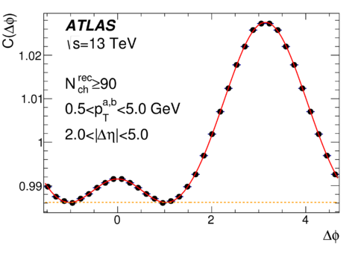
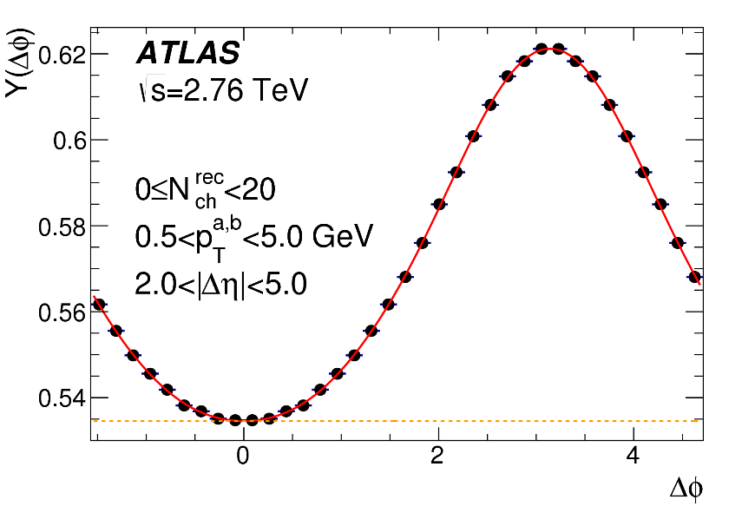
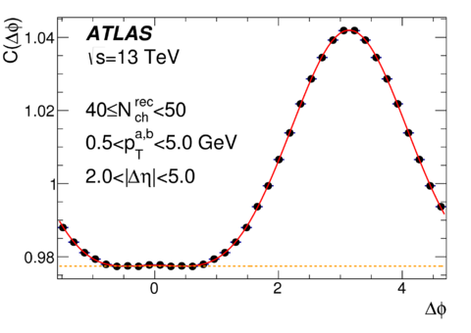
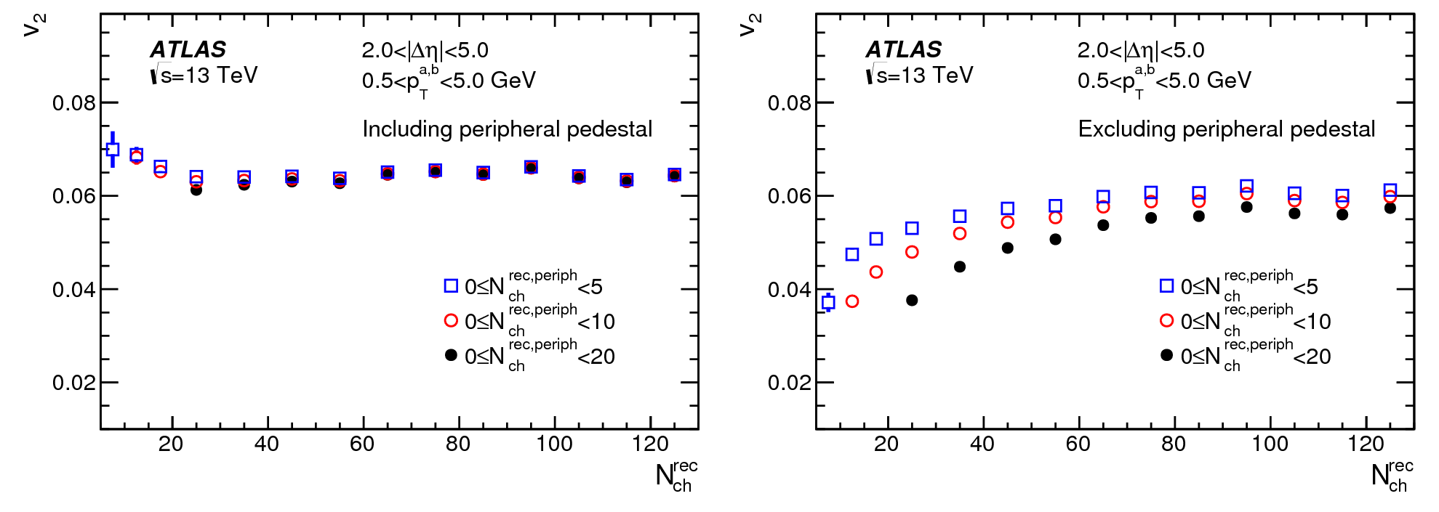
Need to know what to look for..
1) Open Questions:
- How far down in dN/dy can we find ‘collectivity’ in pp ? N_{ch} > 2 ?
What about e⁺e⁻ (no IS geometry, no MPI) ??
What is the scaling variable (dN/dy, 1/S dN/dy, ε, ..) ?
New observables/analysis methods to reduce ‘non-flow’
.. and how
Assumption: v₂(bin-0) = v₂(bin-1)
Bias could be tested with toy-model
Assumption: v₂(bin-0) = 0

Slide 9
2) Qualitative or Quantitative Change ? (same same or different ?)
=
?
7 TeV pp Min Bias
High Density Paradigm: Hydro: K= λ/R << 1; # collisions/particle >> 1
Pressure Tomography
Low Density Paradigm: Transport + ?? # collisions/particle < 1
Density Tomography
Two sides of the same coin
Or
Different physics & different observable consequences

Slide 10
Pressure or Density tomography ?
sQGP Hydro model: Pressure tomography
IS density homogeneities => pressure gradients => momentum anisotropy => spatial anisotropy dN/dφ
requires strong FSI, dense & large systems (small #K), low visc. ‘ideal liquid’
generates i) radial flow ii) azimuthal flow iii) space-time evolution STE
STE => HBT, CBF, but also some (small ?) part of non-linear mode mixing
sMOG X-ray model: Density Tomography sMOG=Mist Of Gray stuff
IS density homogeneities => direct image by scattering
requires some FSI, no problem with small or dilute systems (dilute = small contrast)
Density Tomography (‘x-ray’) => azimuthal flow
Color reconnection | Colour Ropes | hadronisation | ?? => radial flow
Free streaming + CF freeze-out (or ??) => space-time evolution
AMPT 1601.05390
Romatscke 1504.02529
sQGP or sMOG:
Same same or different ?

Slide 11
How small & dilute ?
Change of v₂/ε ≈ x 5 dAu(RHIC) -> PbPb (LHC)
Large systems/high √s: v₂(p_{T}) = c, <p_{T}> ↑
Small systems/ low dN/dy: increasing dilution K ↑
H. Niemi 1404.7327
D. Teany http://arxiv.org/abs/1312.6770
JYO: http://arxiv.org/abs/1106.4356
pp:pA:AA
dN/dy= 1:10:100
dN/dy^{1/3}= 1:2:5

Slide 12
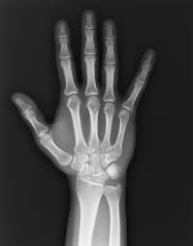
AMPT transport
Dynamics is definitely oversimplified and probably wrong
‘Micky Mouse billiard balls’ with tons of parameters
however, the hydrodynamics seems correct !
what counts is ‘lots of interacting stuff’ (string melting + few mb σ)
Common wisdom: AMPT = (a) kinetic transport underlying hydro
and as such smoothly extrapolates to dilute & small systems with large K
Monkey wrench: ‘Anisotropic parton escape is the dominant source’ (1502.05572)
escaping
d-Au
interacting
Au-Au
Information is in the
‘non-interacting’ rays !
<N_{col}> = 5 (1) in AuAu(dAu)

Slide 13
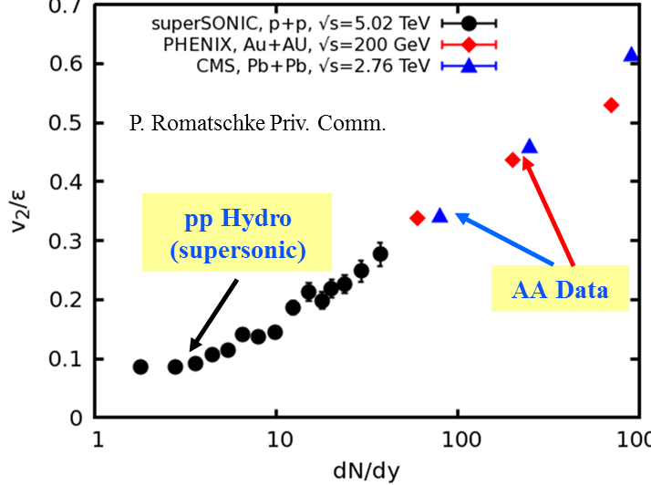
AMPT & Hydro in pp
So far, both describe small & dilute systems
2) Open Questions:
- Are HD hydro and LD transport observationally distinct ?
If yes, which regime are we in pp/pA/AA
(various indications that even AA is not in full therm+hydro equil.)
If no, why does hydro work so well where it shouldn't ?
(and what do we measure in pp, η/s means what ?)
http://arxiv.org/abs/1404.4129
1701.07145
Possible differences:
Direct photon v₂ ?
Nonlinear mode mixing (v₄~v₂²) ?
Shape evolution: pressure vs free streaming ?
Hydro:
more gradient
more flow
more N_{ch}
more γ ?
Transport:
less matter
less scattering & BS
more N_{ch}
less γ ?

Slide 14
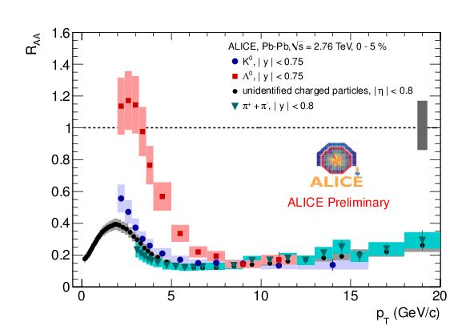
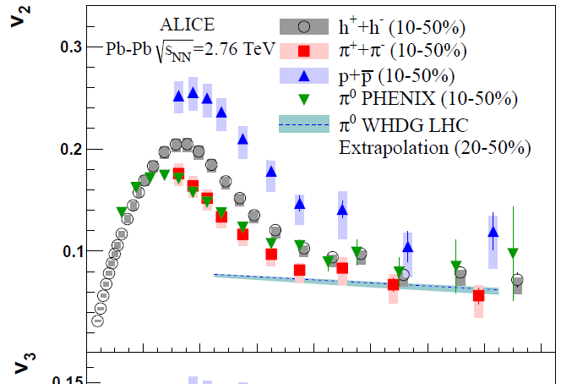

3) What happens after Hydro ?
mass matters, up to a point (again, p_{T} ≈ v₂)..
presumably, 'falling out of hydro' is a smooth process (over large p_{T} range)
do we need new physics (eg coalescence) at intermediate p_{T} (4-10 GeV) ?
or a smooth transition between (hydro+thermo) and (jets+fragmentation) ?
Hydro
?
pQCD
Varying size & density:
What effect in intermediate p_{T} ?

Slide 15
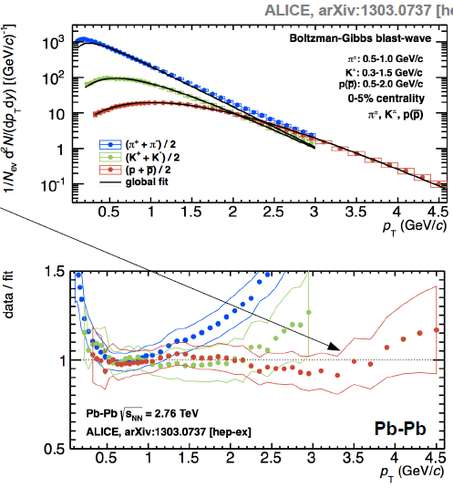
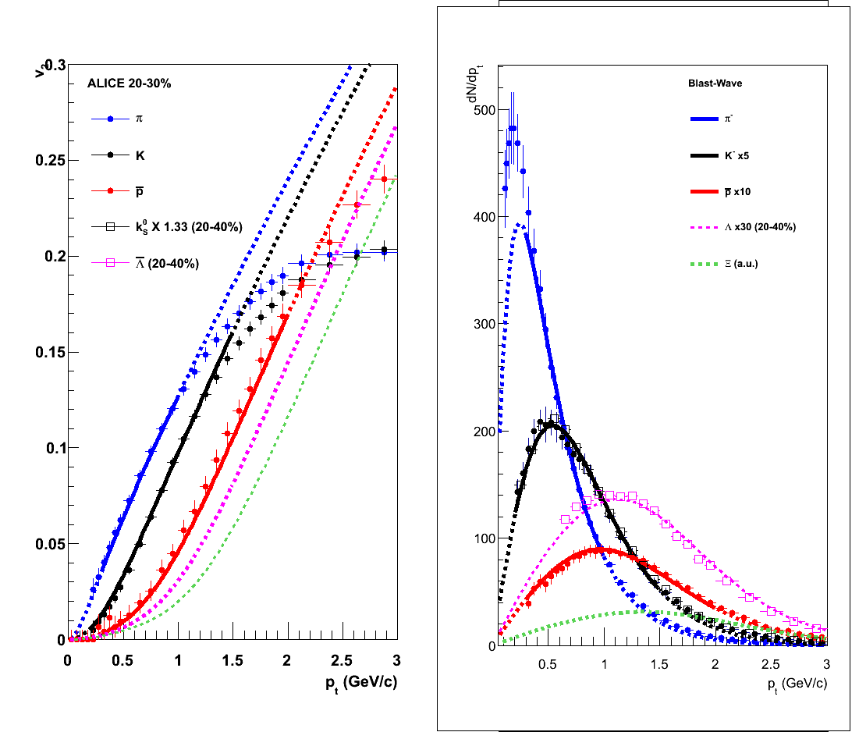
Hydro in PbPb
ideal (BW) hydro ≈ ok < 1-2 GeV(p, K), > 3-4 GeV (p, Λ, ..) in both p_{T} and v₂
deviations at high p_{T}: 'smooth decoupling ?'
deviation depends on mass
≈ same p_{T} in spectra and v₂

Slide 16
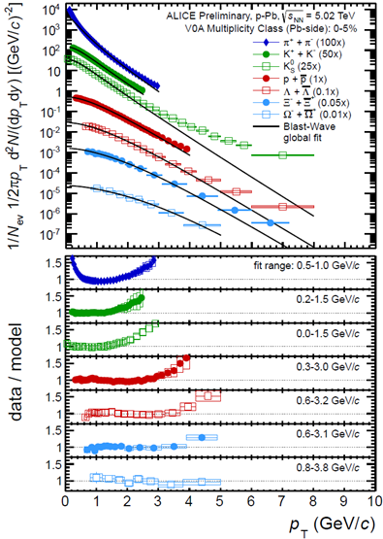
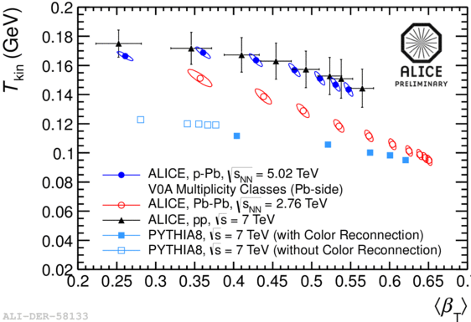
Radial Flow in pPb
3) Open Questions:
- ‘New’ or ‘smooth’ physics at intermediate p_{T} NCQ scaling vs f*hydro + (1-f) pQCD
Can density & size dependence (pp/pA) of decoupling regime tell ?
vary relative importance of sQGP vs HRG phases
earlier 'decoupling'
T_{kin} ≈ T_{chem}
β,T_{kin}(π,K,p) ≈ β,T_{kin}(Ξ, Ω)
(d, 3He) in PbPb compatible with flow
d in pPb compatible with coalescence
no (or little) hadronic rescattering ?
clear & direct view on the sQGP ??

Slide 17
4) What about ‘hard Probes’ ?
flow and jet-quenching closely connected
liquid => strong FSI => energy loss
Naïve expectation: O(20-30% effects) for MB pA

Slide 18
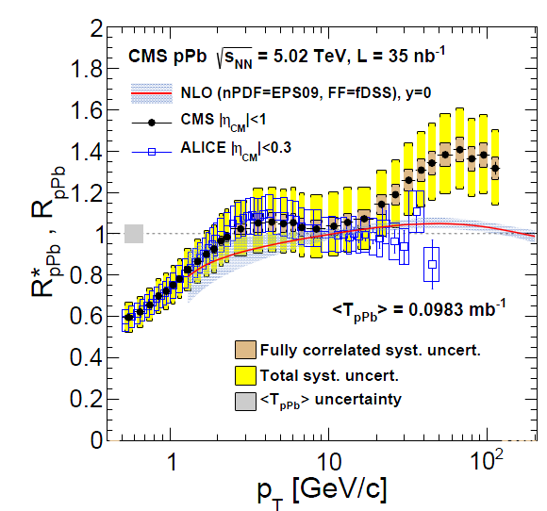
Jet Quenching & Quarkonia in pA
Conventional Wisdom: Not (non-trivially) modified in pA
beware of confounding CNM effects & limited accuracy !!
how to disentangle IS/CNM from sQGP in pp/pA if there is no comparison data ?
only quantitative comparison between expectation(theory) and data will tell !!
how much jet-quenching/quarkonia melting would actually be expected ??
J/Ψ & Ψ’ R_{pA} vs p_{T}
4) Open Questions:
- Calculate expected R_{pA}
L dependence, formation time ?
Centrality in peripheral AA and pA ?
What about pp ?? (R_{pp} vs N_{ch} ?)
New (self normalized) observables ?
v2@high p_{T}, h+jet, γ+jet, Y(2)/Y(1)..
Syst. error in MB ~ ±10-20%

Slide 19


Small Systems .. wherever they lead..
Confront and ‘digest’ the size/density systematics
Factorize & separate into different pp (CR, CGC) and AA (QGP, hydro) physics ?
naturally & economically, without epicycles..
where to put pA ?
Incorporate into a united thermo & hydro sQGP picture ?
extend ‘dense matter’ framework down to zero density, non-equilibrium (LDL)
extend ‘dilute transport’ framework up to central AA (AMPT like ?)
(personal) Hypothesis: The physics underlying soft 'collectivity' signals is the same in AA, pA, and pp (e+e- ?):
Even if dominant in AA and hardly discernable in pp
It is a generic property of all strongly interacting many-body (≥2?) systems.
The understanding of soft hadronic physics is changing under the onslaught of LHC pp data …
.. we have an interesting and challenging time ahead of us, where some of the most unexpected new LHC observations may well come in the low-p_{T} region rather than the in high-p_{T} one.
Thermodynamical String Fragmentation
T. Sjöstrand 1610.09818

Slide 20
backup

Slide 21
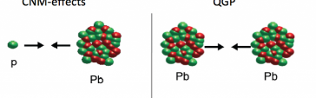


Heavy Ion Paradigm
1986
Commissioned by TD Lee
AA:
‘Hot Matter’ modifications (“R_{AA}”)
1508.03260
pA:
CNM modifications
pp: SEP
Somebody Elses Problem
e.g. (n)pQCD
p

Slide 22
Summary Hypothesis: The physics underlying soft 'collectivity' signals is the same in AA, pA, and pp:
It is a generic property of all strongly interacting many-body (≥2?) systems.
MANY similar/identical observations(@ similar N_{ch}), no inconsistency (?), ..
1) particle ratios (γ_{s} -> 1)
2) p_{T}-spectra (radial flow),
3) anisotropic flow: v_{n} ~ ε_{n}, v_{n}(p, d, ³He), v_{n}(b), v_{n}(p_{T}), v₂(LYZ), v_{n}(PID)
4) HBT r(N_{ch}, m_{T})
.. make the hypothesis increasingly more likely (but not proven, yet !)
a most 'natural' assumption, to be proven wrong rather than right
subtle is the lord, but malicious he is not
What is is the 'underlying dynamical physics' ?
sQGP: thermo + hydro dynamics ('at the edge') ?
sMOG: strongly interacting FS matter with density gradients (1502.05572)
CGC+CR+.: weakly int. dense IS matter + some conspiracies (also in AA !!)
???
Why should we care ?
leave the comfort zone of infinite size equilibrium to study dynamics
from small & dilute -> large & dense: emergence & limits of 'collectivity'
looking 'under the hood' is mandatory(and fun), whatever we may find !

Slide 23

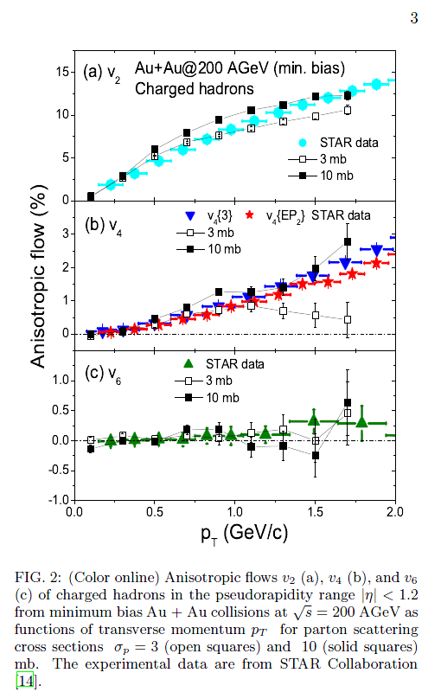
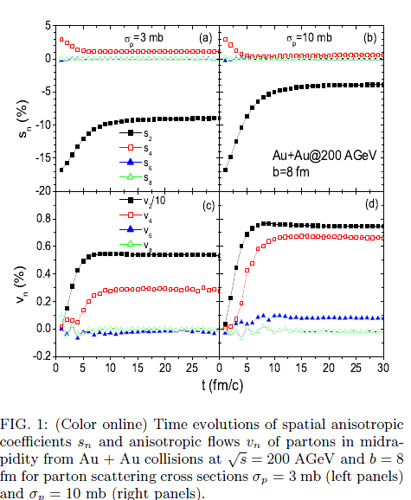
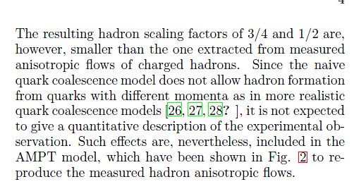
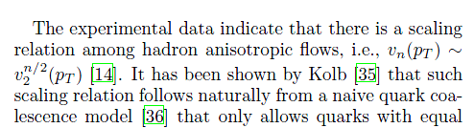
The unreasonable success of AMPT
nucl-th/0312124
AMPT in 2003 had correct higher harmonics (v₃, v₄, ..)
i.e. initial state fluctuations and nonlinear hydro,
and nobody noticed !!

Slide 24
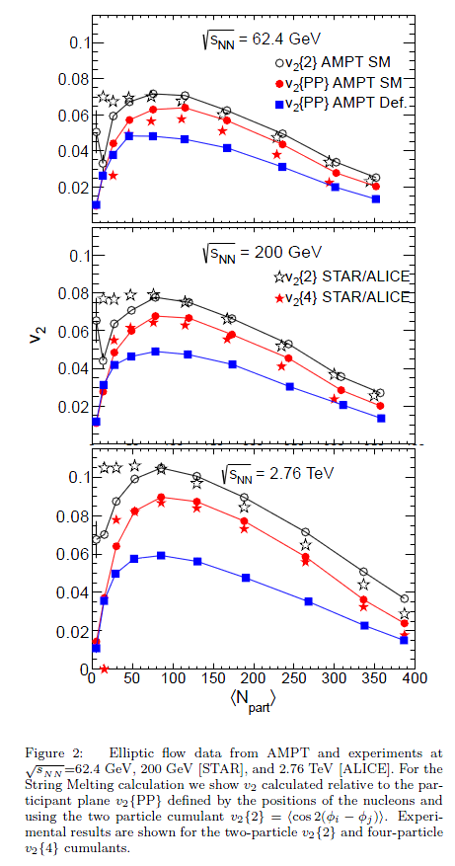
Almost as good as hydro
NNLO: mode mixing in EP correlations
http://arxiv.org/abs/1210.0512
LO: v₂
1508.03306

Slide 25
Double humped near side peak shape
http://arxiv.org/abs/1507.06194

Slide 26
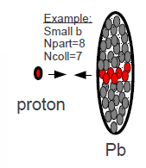
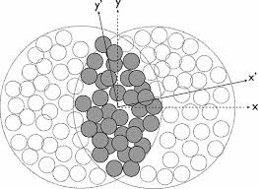
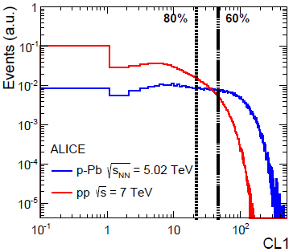
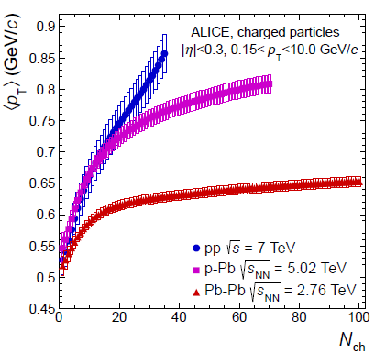
A priori: pp ≈ pA @ same dN/dy
LO pp = pA: N_{ch}, transverse size & shape => Initial State ε(x,y) similar:
experimentally verified: final state R(pp) ≈ R(pA) < R(AA) @ same N_{ch} (≈ N_{part})
IF there is collectivity in central pA, THEN there is no reason why not in 'central' pp
NLO pp ≠ pA: some differences expected
MPI vs N_{coll}, transverse ε-profile, dσ/dN => bias, jet fraction, ..
<p_{T}> vs N_{ch}
HBT:
R vs N_{ch}
BW fit: T_{kin} vs β
pp closer to pA than pA to AA
as expected…

Slide 27
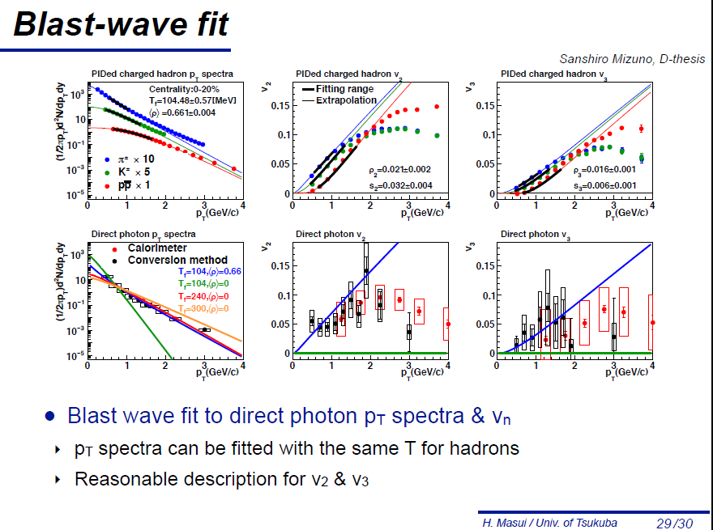
https://n-ext.inha.ac.kr/indico/event/13/contribution/14/material/slides/0.pdf
'Decoupling' at RHIC at somewhat lower p_{T}

Slide 28
Facts & 'Fiction'
Experimental facts:
weak collectivity proven in AA, essentially proven in pA, less well known in pp
'all particles in all events' must be part of any physics model
strong coll. (thermo & hydro) compatible with vast majority of data in AA & pA
some areas need work, some tests missing in pA
limited data in pp at high N_{ch}, but compatible with SC !
final state (HBT, p_{T}-spectra (v₀), ridge (PID v₂), part. ratios ): pp ≈ pA @ same N_{ch}
Hypothesis: There IS* collectivity in small systems at high N_{ch} !
1) pA ≈ AA: mostly based on measurements (@same N_{ch})
many similar phenomena <=> similar underlying physics
2) pp ≈ pA: based on a priori expectations, increasingly on measurements
similar IS & FS in pp and pA @ same dN/dy => similar collective physics
mind the jet-bias in pp !
3) ≈ ≠ =: differences are interesting and important to study !
finite size/finite time/non-equilibrium effects teach us about dynamics
* of the same type as in large systems, i.e. AA

Slide 29
pA ≈ AA: Objections
sQGP: no ideal liquid w/o jet-quenching (energy loss) (conformal scaling ?)
hydro is dimensionless (K_{n} = λ/R << 1),
R = 1-2 fm may be big: τ₀(<0.2 fm/c?), η/S ≈ 0 => λ ≈ 0; 1/<p_{t}> ≈ 0.3 fm
energy loss has dimension: ΔE ~ (Δx-a)^{n}, Δx = path length, a = formation length
ΔE_{pA} > 1/5 x ΔE_{AA} (n = 1, a = 0), and possibly much more
is measured R_{pPb} (in)compatible with quantitative expectations for ΔE ?
hydro not applicable (large K_{n}, large gradient/viscosity corrections, ..)
Why then does it still give a ‘correct’ answer ??
we may need different TH tools, not necessarily different physics ?
'hydro' : physics driven by gradients in SI matter
smoothly extends into 'partial hydro/decoupling/non-equilibrium' regime ?
difference is size is significant, but not huge !
made up (largely ?) by higher density ?
Thermalisation study
1601.03283

Slide 30
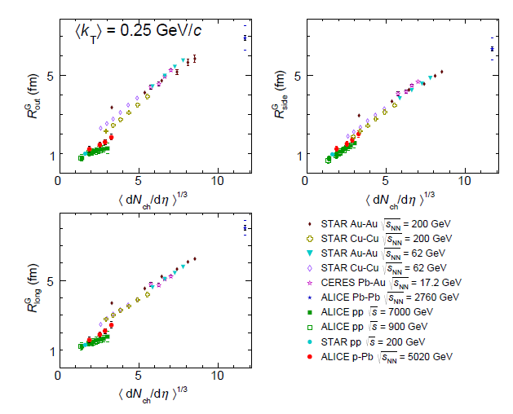
HBT radii pp, pA, AA
R_{CuCu}^{RHIC} ≈ 2R_{pPB}^{LHC} ≈ pp

Slide 31
pA ≈ AA: Objections
similar phenomena ≠> same physics
counter examples:
elliptic flow: v₂(< 2 GeV) = hydro (Δρ/Δx), v₂(> 10 GeV) quenching (ρ)
linked by geometry and SI matter, but driven by distinct physics
radial flow: AA hydro, pp: Color Reconnection ?
'hydrodynamics' similar (emission from boosted system T, β), dynamics different
likelihood argument: better if many independent phenomena are involved
'razor': What looks more natural & simple: different or similar physics ?
we should not jump to conclusions, either way, but …

Slide 32
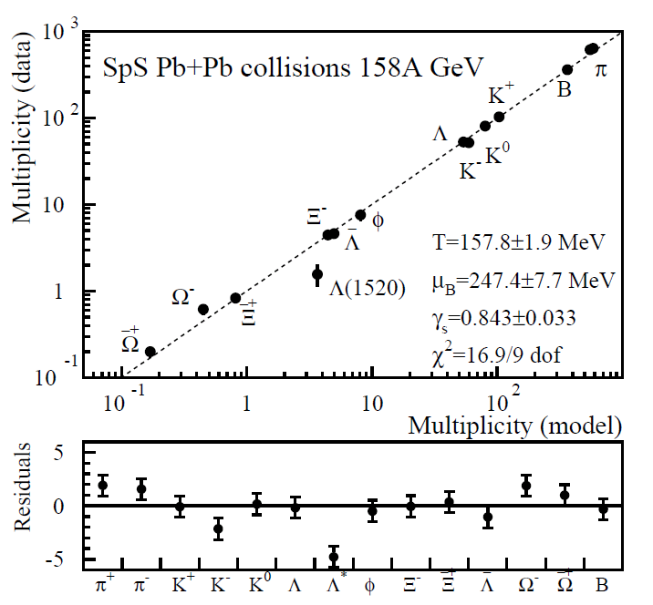
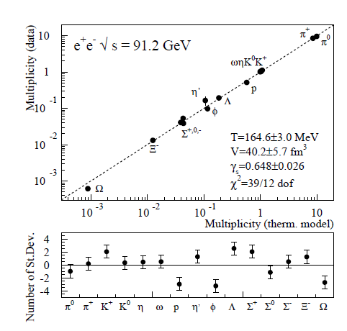
pp-pA-AA: Similarities & Differences
Similar Particle Production
Striking & very non-trivial similarities between pp(e+e-) and AA
Striking & very non-trivial difference ('strangeness enhancement):
Different Explanations & no connection (in general):
Born (pp) <-> Evolving (AA) into equilibrium
γ_{s}(GC) or r_{c} (SC) are fudge factors , i.e. not predicted/calculable as f(√(s),dn/dy, ..)
Core-Corona: e⁺e⁻ and pp ??
PbPb SPS
e⁺e⁻ LEP
Particle Production:
Data versus Thermal Model

Slide 33
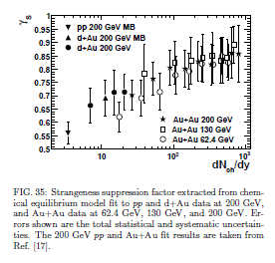
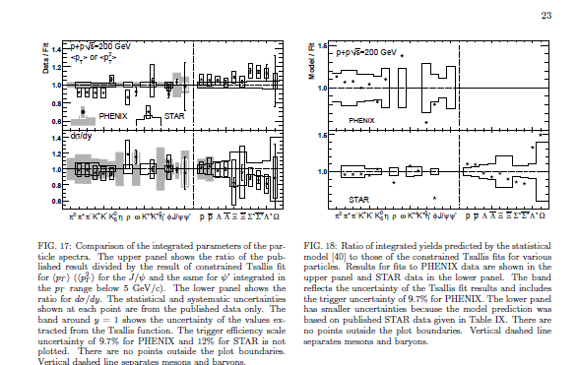

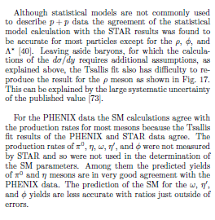
Known, but often ignored
No quantitative interpretation which smoothly describes small & large
despite evident relevance for understanding HOW we reach thermal ratios..
pp, dA, AA RHIC
pp 200 GeV
Particle production:
Data /Thermal Model
Particle production:
γ_{s} vs dN_{ch}/dy
Star http://arxiv.org/abs/0808.2041
Phenix http://arxiv.org/abs/1005.3674
STAR http://arxiv.org/abs/nucl-ex/0607033

Slide 34
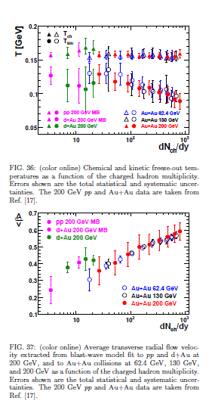
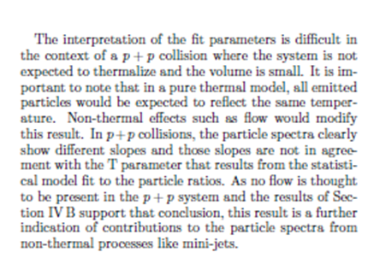
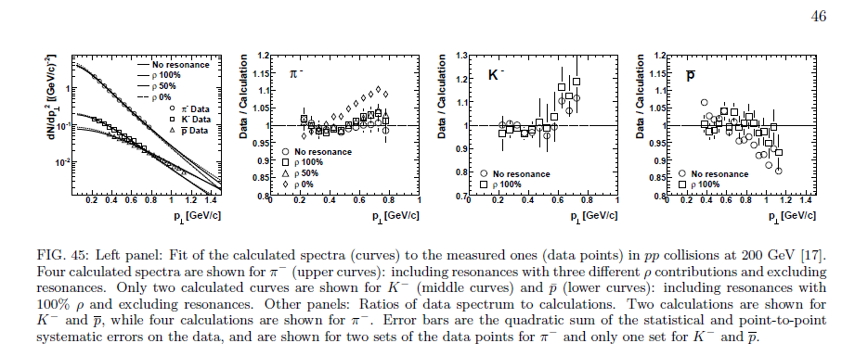
Momentum Spectra
Known, but not really understood
pp, dA, AA RHIC
Radial Flow fit (BW):
T & <β> vs dN_{ch}/dy
pp 200 GeV
Radial Flow fit (BW):
Data/Fit (π,K,p)
Star http://arxiv.org/abs/0808.2041

Slide 35
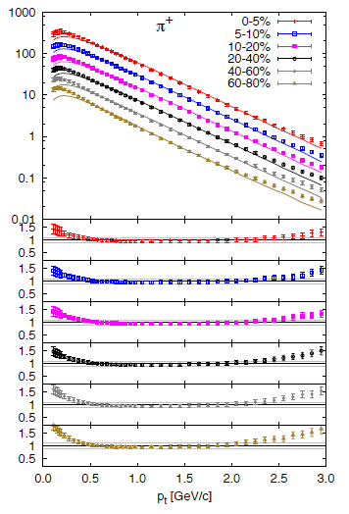
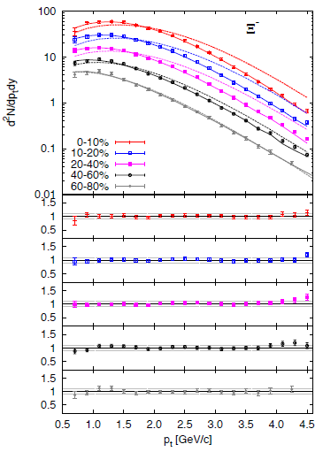
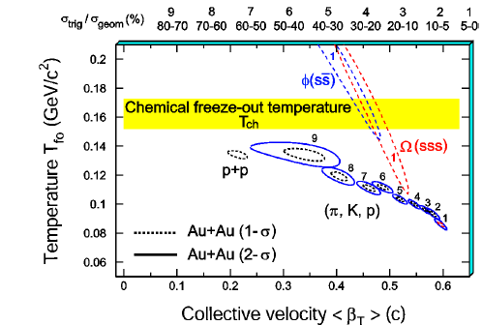




BW + Resonances (DRAGON 1502.01247)
Qual. similar, quant. diff.
π/K to 2-2.5 GeV
p to > 4.5 GeV
(Φ,Λ), Ξ, Ω require
higher T, lower β
(like at RHIC)
K⁰
p
φ

Slide 36
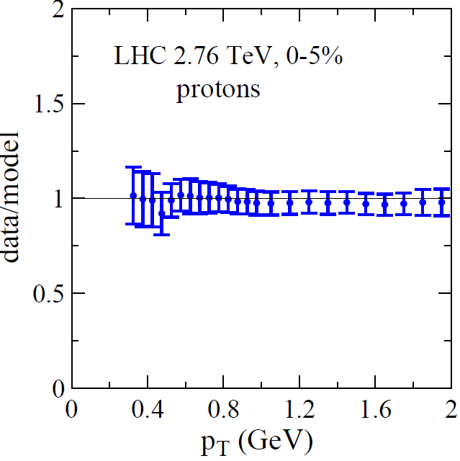
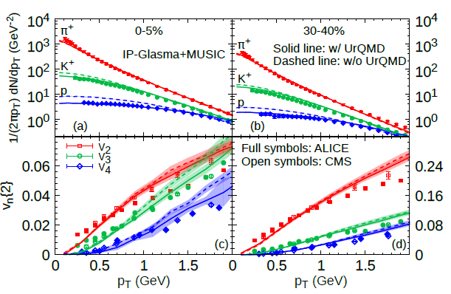
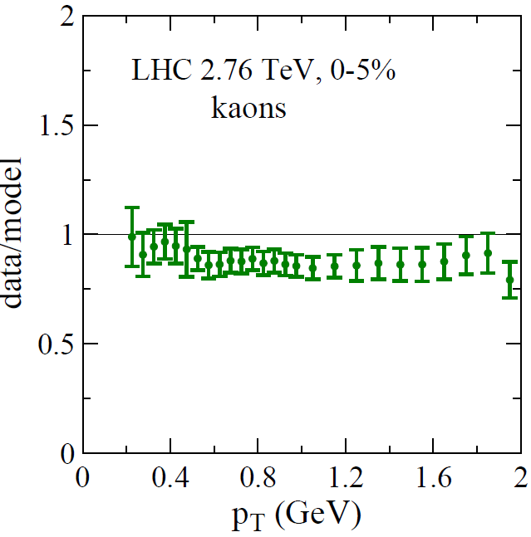
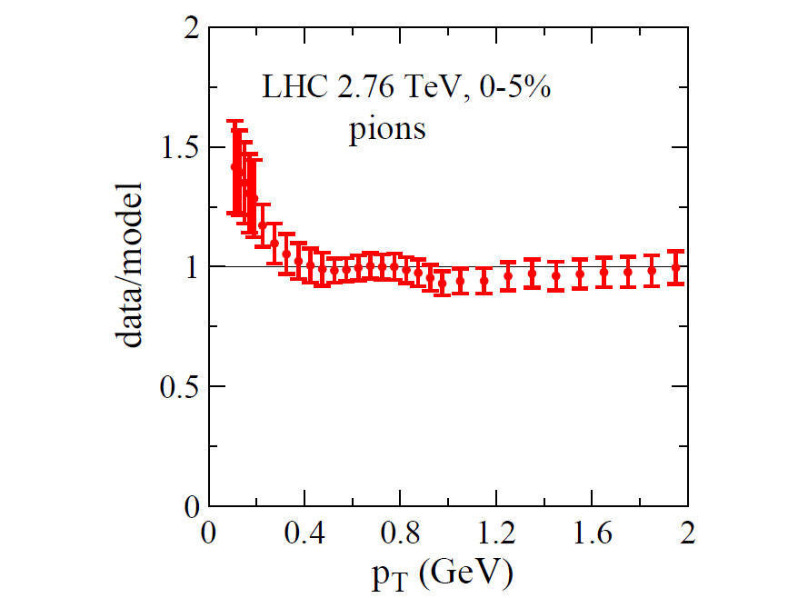
Real Hydro: IP-Glasma + Music (1502.016750)
Data/Model (almost too perfect !)
note that low p_{T} pion excess !!

Slide 37
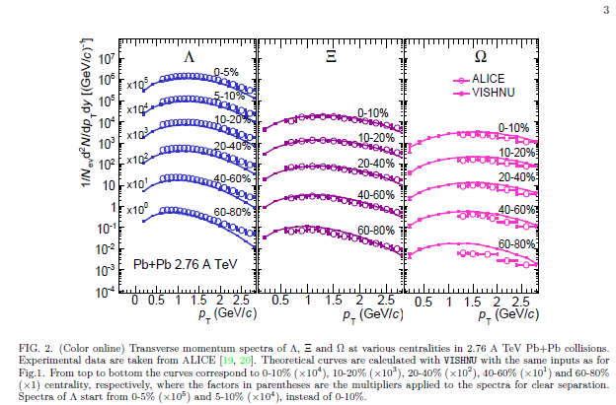
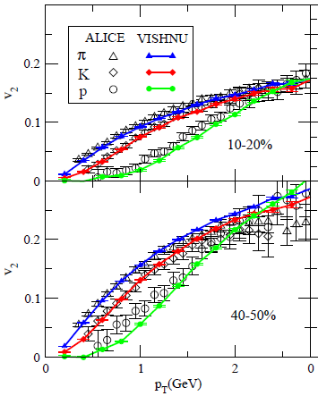
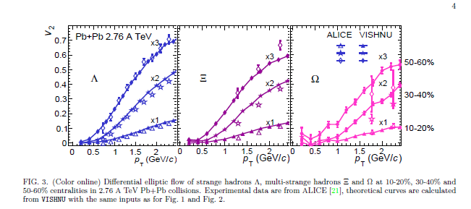
Real Hydro Comparison
Hydro + AB does very well
(T, β, v_{n})
VISHNU(Hydro + URQMD)1501.03286,
AfterBurner important:
incr. radial flow in hadron phase
=> explain differential freeze-out T_{kin} ?
=> meson-baryon crossing in v₂ ?
Would be interesting to see where data & (hydro + AB) deviate:
- Does it coincide in p_{T} & v_{n}
- Higher decoupling p_{T} for large mass ?
Ξ

Slide 38
What happens after Hydro ?
mass matters, up to a point (again, p_{T} ≈ v₂)..
presumably, 'falling out of hydro' is a smooth process (over large p_{T} range)
do we need new physics (eg coalescence) at intermediate p_{T} (4-10 GeV) ?
or a smooth transition between hydro and jets ?

Slide 39
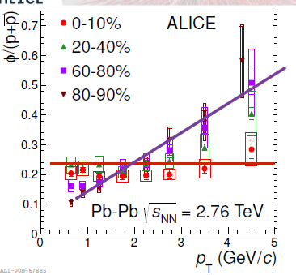


Will the φ tell ?
NCQ scaling in 40-50%
or
it's breaking in 10-20%
could be a (m, σ) effect in the HG !
If only we could switch off the HG..
φ = p
HG push ?
HG push on p ?
φ = p
HG push ?
φ = π
NCQ scaling ?

Slide 40




Collectivity in small dense systems: 'central' pA
Collectivity consistent with ≈ all data in central pA to reasonable accuracy
thermo-dynamics: particle ratios (SM, γ_{s}=1!) to ≈ 20-30%
hydro-dynamics: pA, dA, ³He-A
LO: radial & elliptic flow
NLO: higher harmonics v₃, PID v₂
NNLO: factorization violation r(p_{T})
thermo + hydro:
HBT (R(m_{T}), R(N_{ch}^{1/3}), R_{out}/R_{side} ≈ 1)
HBT: R vs K_{T}
NNLO: Factorization test
R_{out}
NLO: PID v₂
The experimental support for 'strong collectivity' is not really worse than AA
only somewhat less tested ..
particle ratios pp, pA, AA
R_{side}
LO: BW fit: T_{kin} vs β
R_{long}

Slide 41



Collectivity in small dense systems: 'central' pp
Collectivity ≈ consistent with data in high N_{ch} pp
thermo-dynamics: MB particle ratios to ≈20-40% γ_{s} < 1!
hydro-dynamics:
LO: radial & elliptic flow
NLO: v₃, PID v₂ (CMS PAS HIN-15-009)
NNLO: not yet tested
thermo + hydro:
HBT (R(m_{T}), R(N_{ch}^{1/3}), R_{out}/R_{side} ≤ 1)
HBT: R vs K_{T}
R_{out}
The Ridge
R_{side}
particle ratios pp, pA, AA
particle ratios in MB pp
The experimental support for 'strong collectivity' is much less tested ..
but were it has been tested, at high N_{ch}, it looks not so bad !
R_{long}
BW fit: T_{kin} vs β
R_{out}/R_{side}

