Slide 1
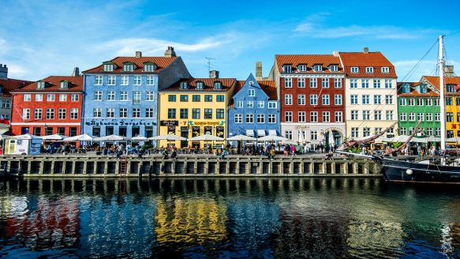

Collectivity in small system: what we have learned
Mingliang Zhou
Small system workshop, Copenhagen, May 9th

Slide 2
2-particle correlation results

Slide 3
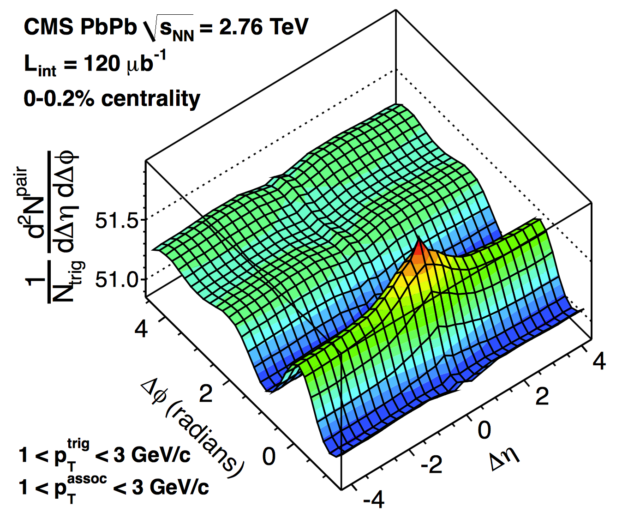
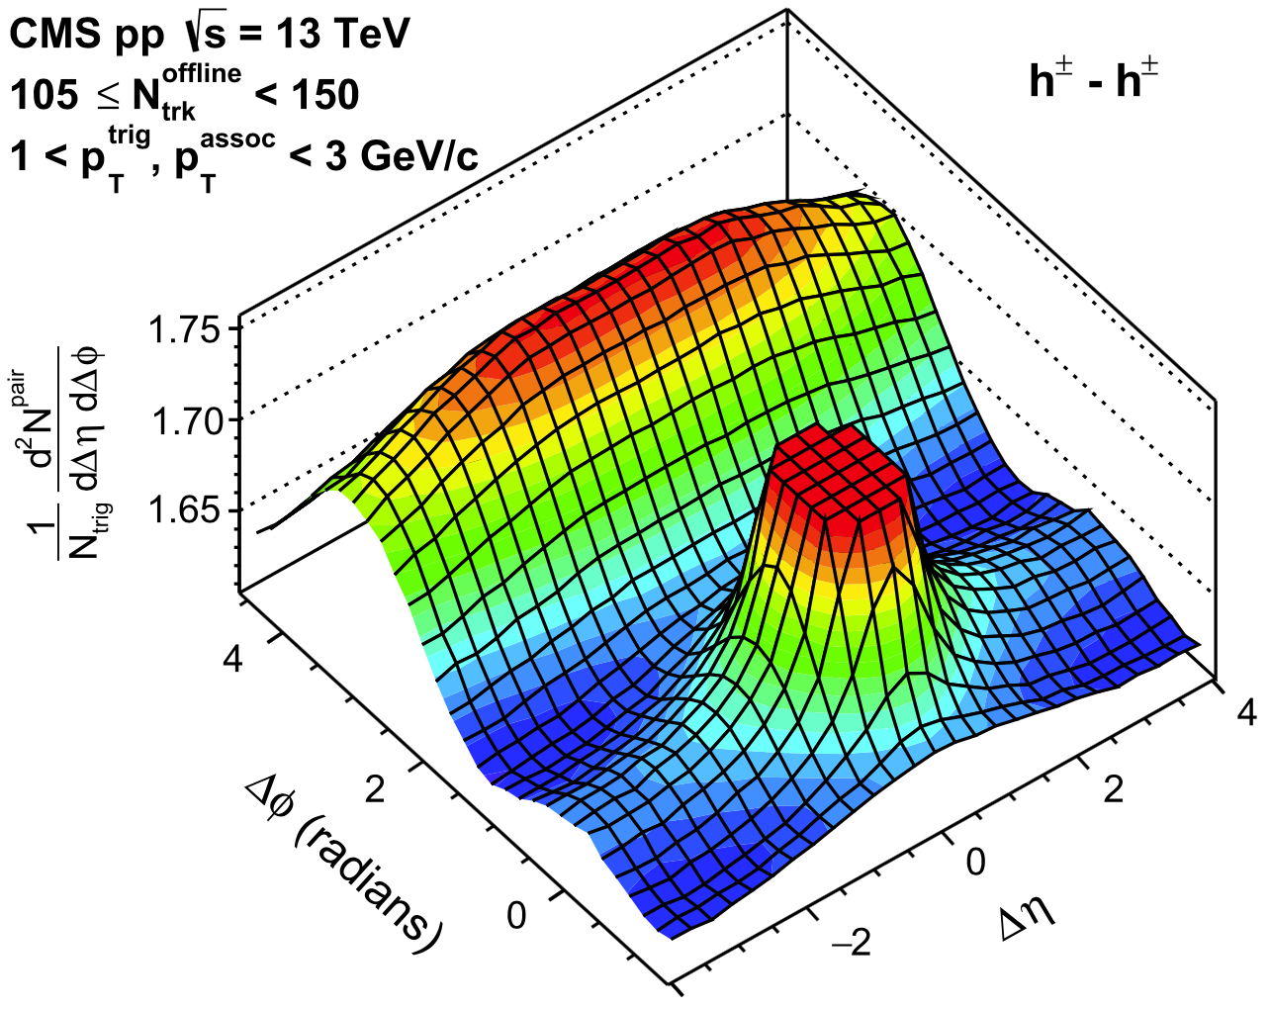
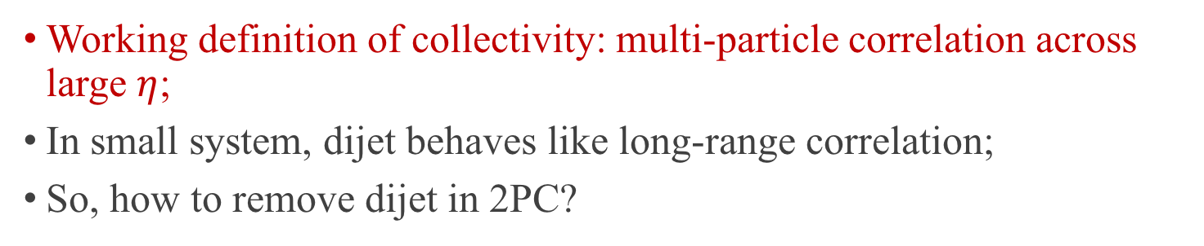
Collectivity: from large to small system
Dijet
Pb+Pb
pp
Short-range non-flow
Long-range collectivity
Working definition of collectivity: multi-particle correlation across large $η$;
In small system, dijet behaves like long-range correlation;
So, how to remove dijet in 2PC?

Slide 4
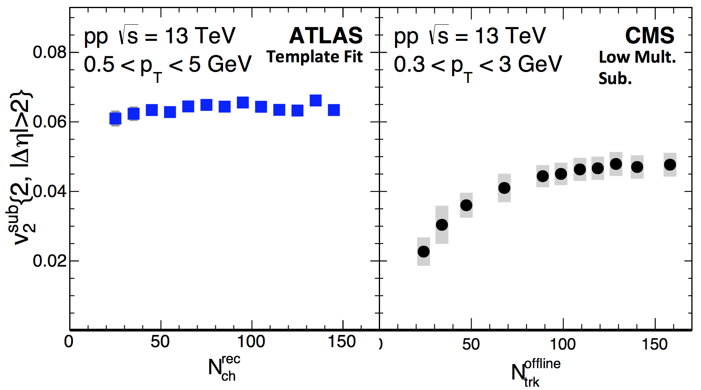
ATLAS or CMS?
PRL 116 (2016) 172301
Results are different: both trend and value;
…because methods are different!

Slide 5
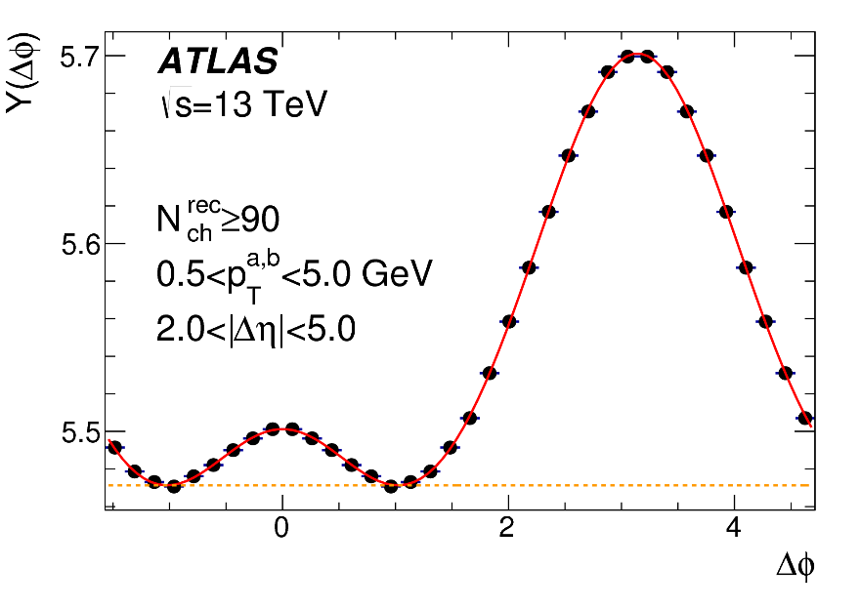
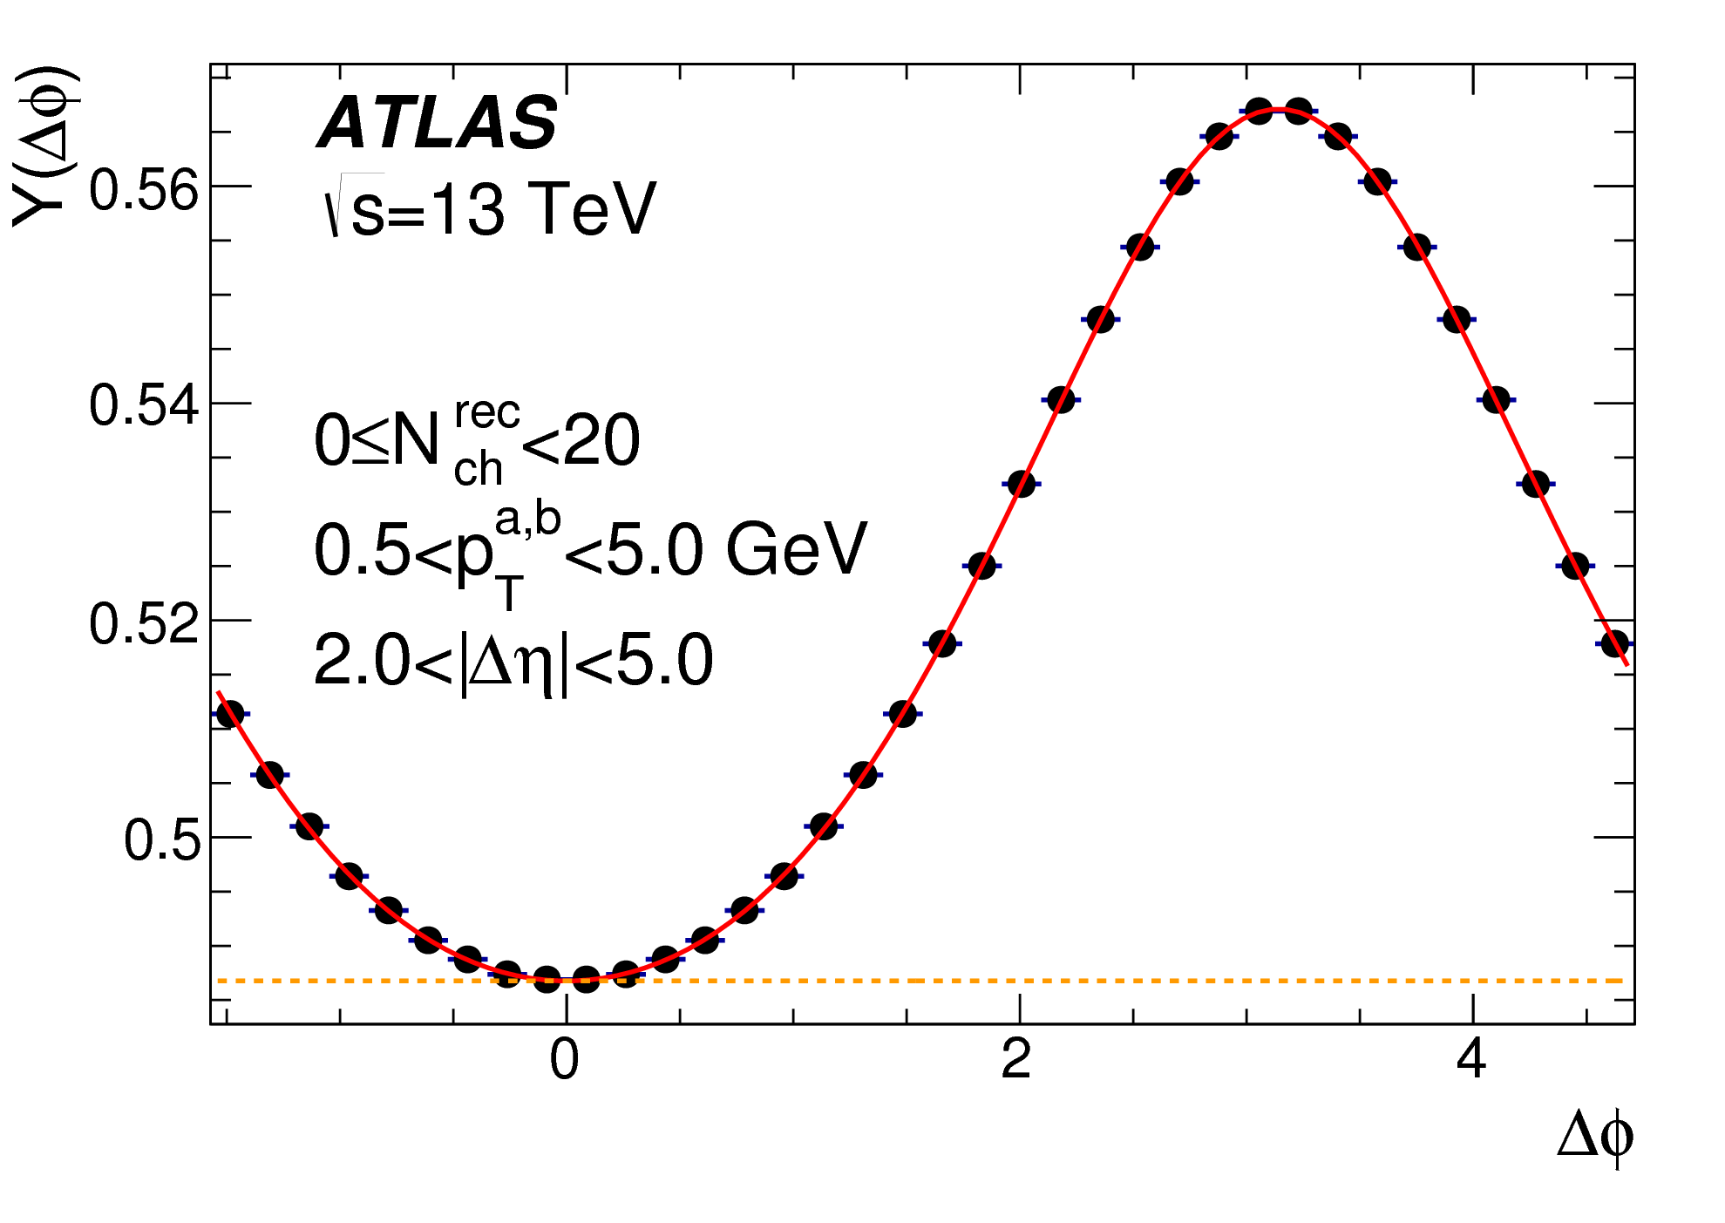
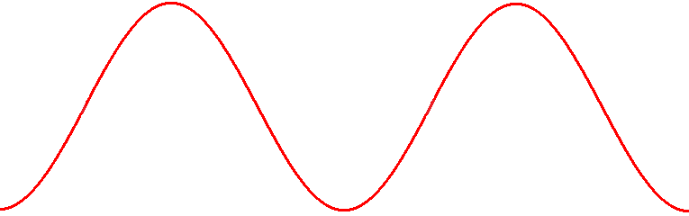
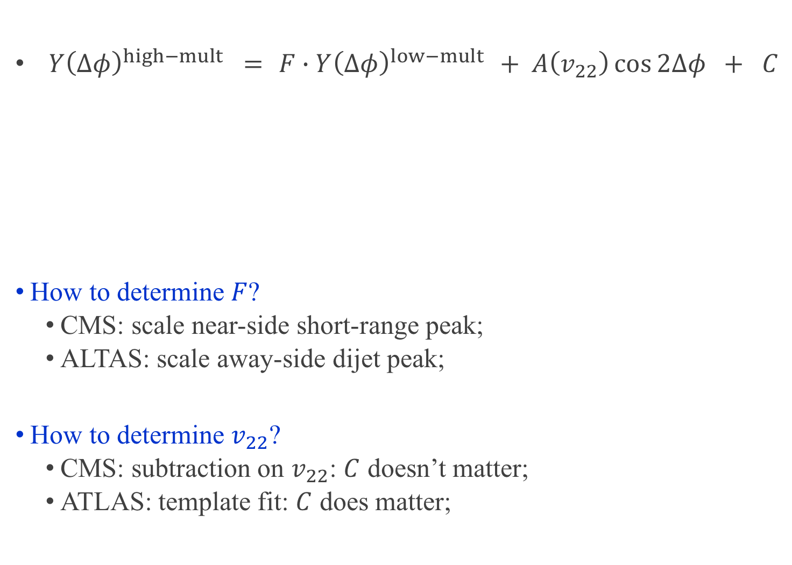
Differences between methods
${Y\left(∆φ\right)}^{high−mult} ={ F∙Y\left(∆φ\right)}^{low−mult} + A\left(v_{22}\right)\cos{2∆φ} + C$
How to determine $F$?
CMS: scale near-side short-range peak;
ALTAS: scale away-side dijet peak;
How to determine $v_{22}$?
CMS: subtraction on $v_{22}$: $C$ doesn’t matter;
ATLAS: template fit: $C$ does matter;
Makes little difference!
Makes THE difference!
So template fit will have additional normalization factor for $v_{22}$

Slide 6
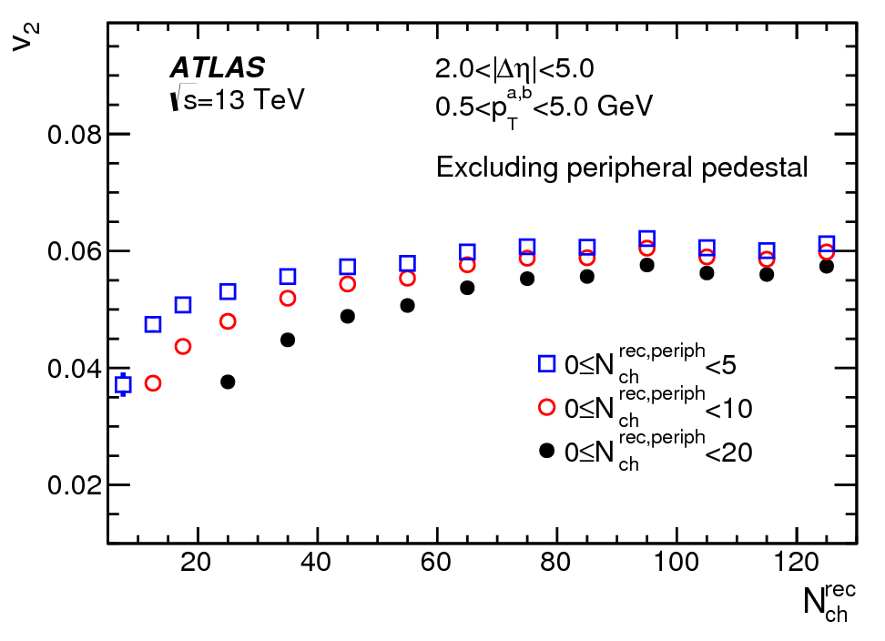
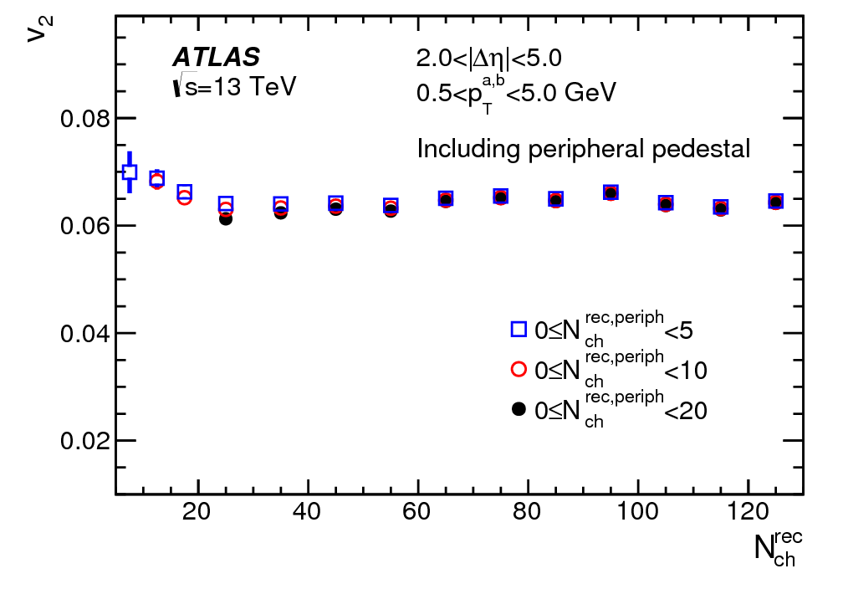


So, which is “correct”?
Measured $v_{2}$:
CMS: ${ v}_{2} =\left(v_{2}^{high−mult}−αv_{2}^{low−mult}\right)$
ATLAS: $v_{2}={\left(v_{2}^{high−mult}−αv_{2}^{low−mult}\right)}/{\left(1−α\right)}$
There is no easy way to tell which one is correct.
But template fit gives self-consistent results
$v_{2}$ independent of choice of low-mult bin;
If $v_{2}^{high−mult}=v_{2}^{low−mult}$, measured $v_{2}=v_{2}^{high−mult}$
$$α≡F\frac{N^{low−mult}}{N^{high−mult}}$$
Peripheral subtraction
Template fit

Slide 7
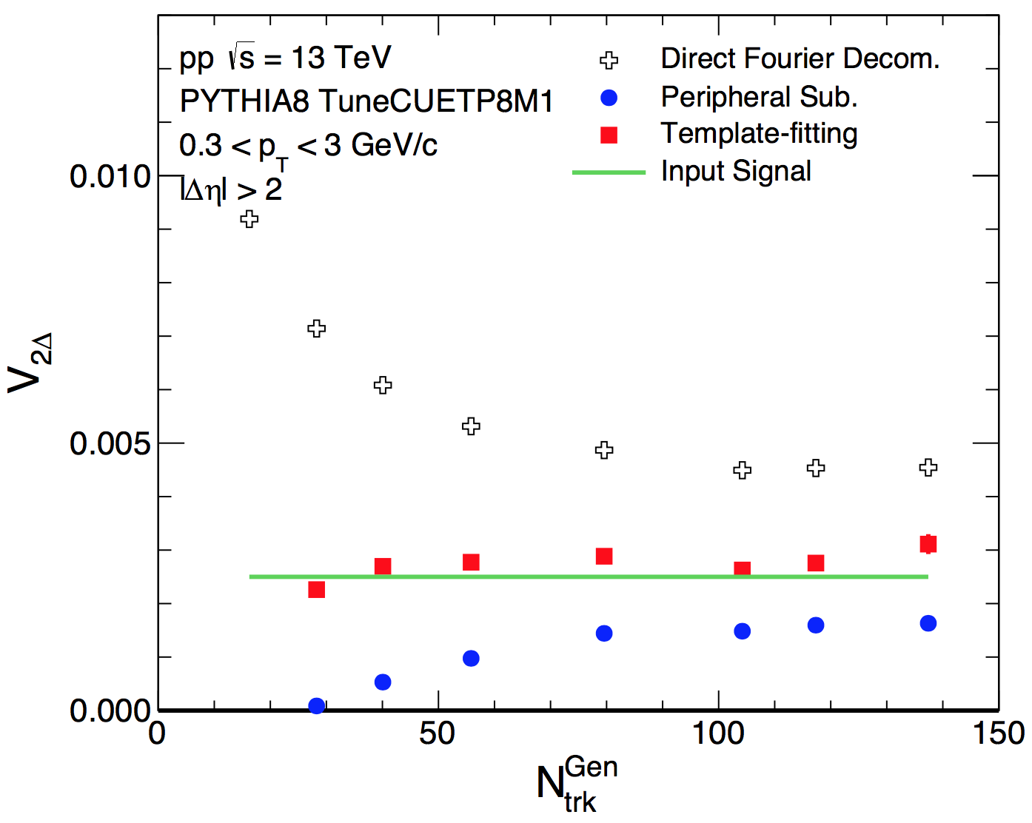
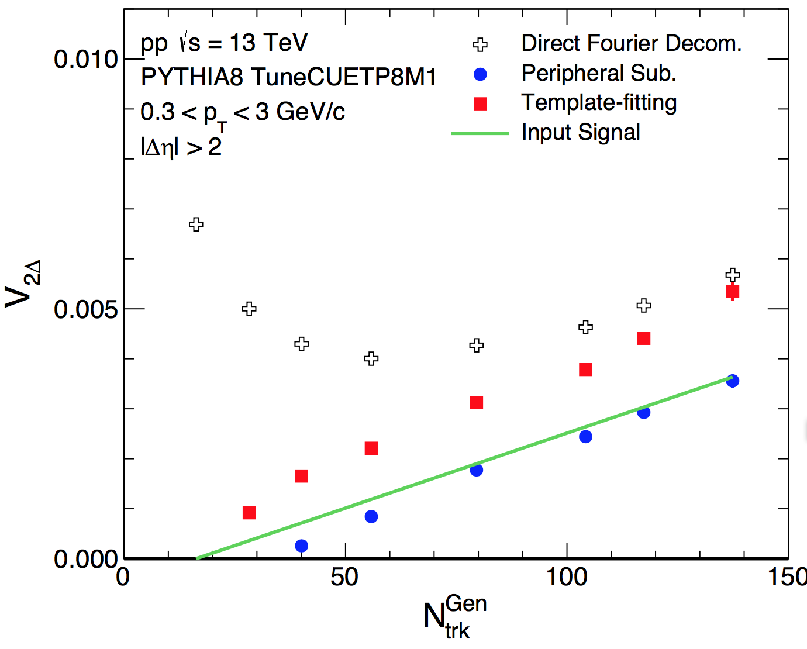
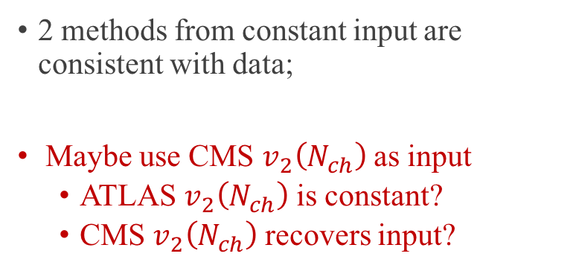
Toy model study from Wei Li
2 methods from constant input are consistent with data;
Maybe use CMS $v_{2}\left(N_{ch}\right)$ as input
ATLAS $v_{2}\left(N_{ch}\right)$ is constant?
CMS $v_{2}\left(N_{ch}\right)$ recovers input?

Slide 8
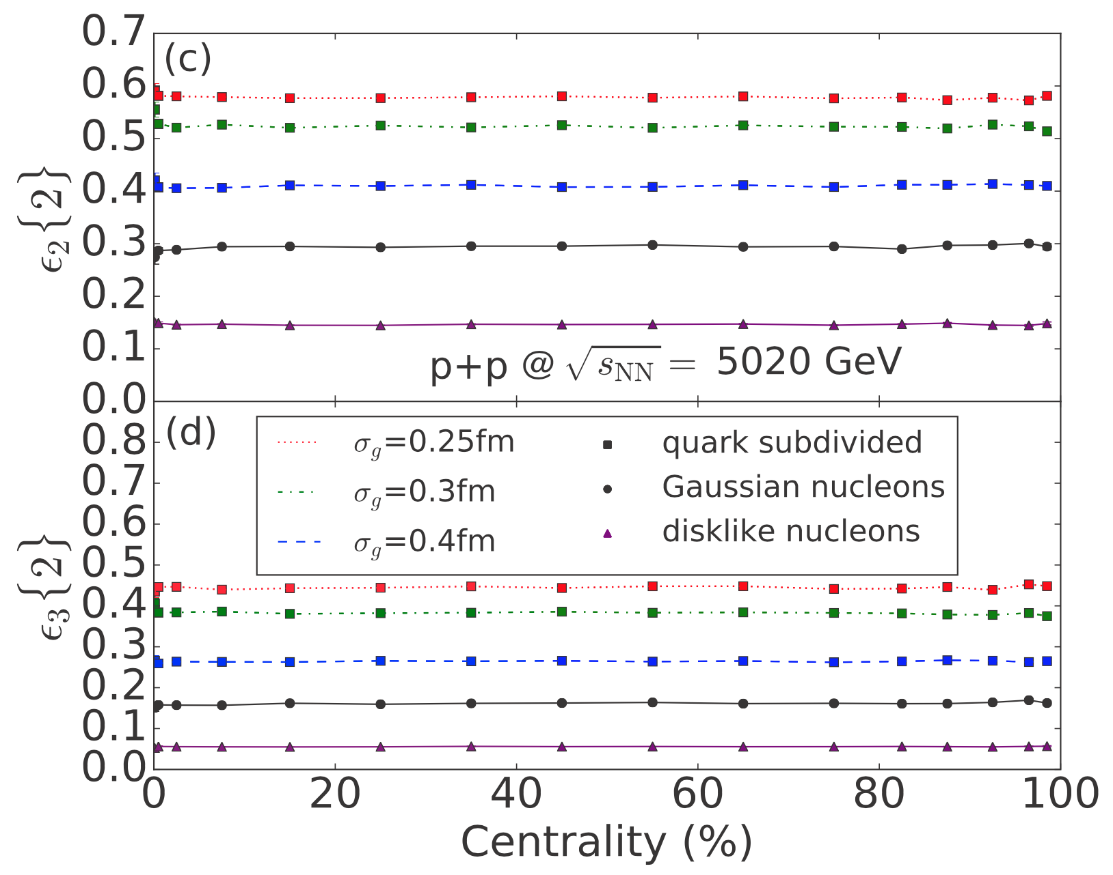
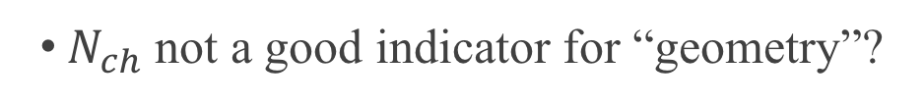
$v_{2}\left(N_{ch}\right)$: model studies
Proton substructure
PHYSICAL REVIEW C 94, 024919 (2016)
$N_{ch}$ not a good indicator for “geometry”?

Slide 9
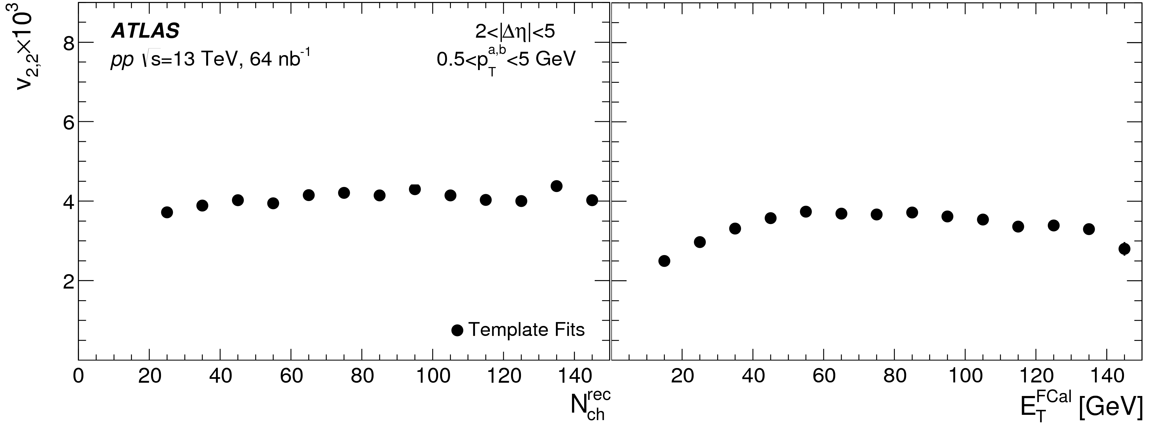
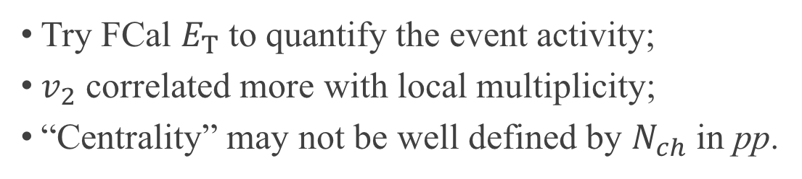
$v_{2}\left(N_{ch}\right)$ v.s. $v_{2}\left(E_{T}\right)$
Try FCal $E_{T}$ to quantify the event activity;
$v_{2}$ correlated more with local multiplicity;
“Centrality” may not be well defined by $N_{ch}$ in pp.

Slide 10
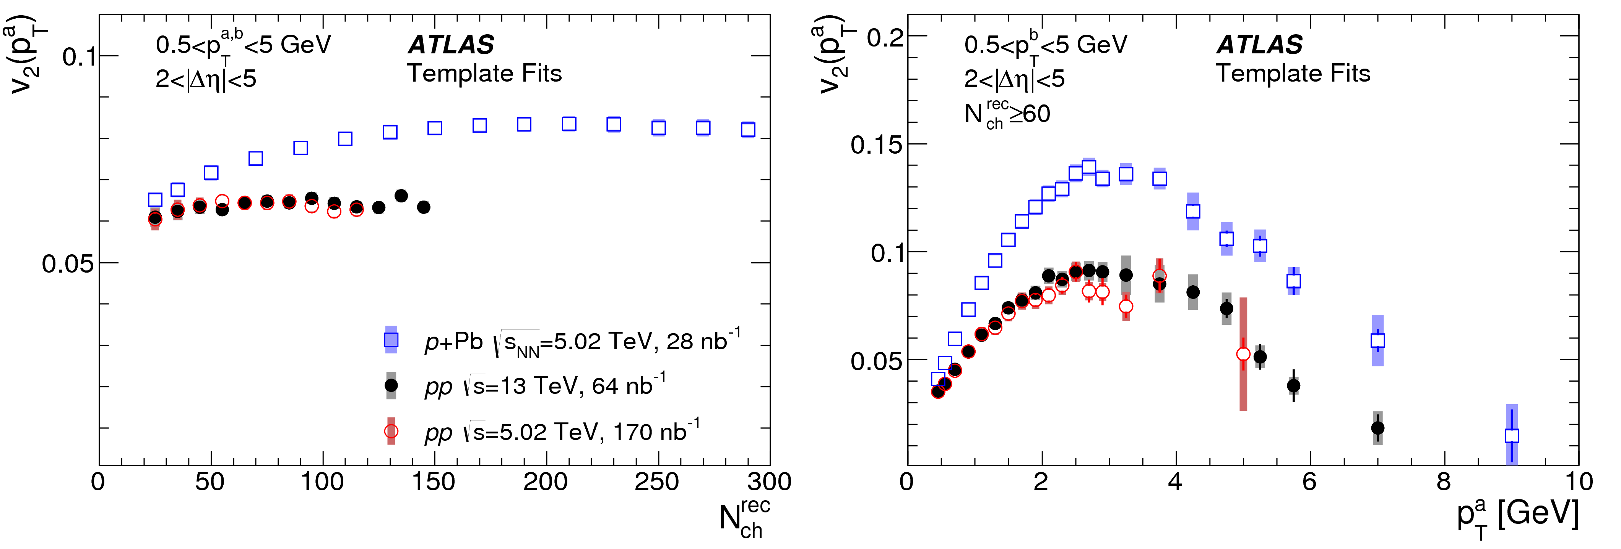
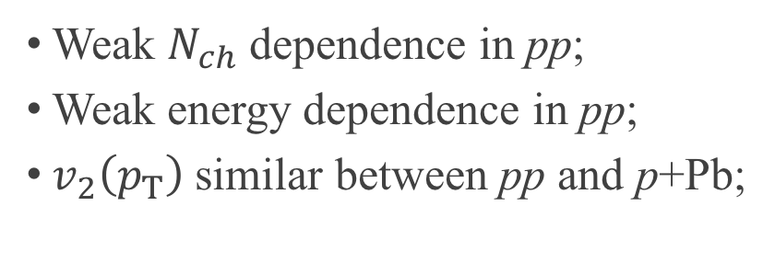
Energy and system dependence
arXiv:1609.06213
Weak $N_{ch}$ dependence in pp;
Weak energy dependence in pp;
$v_{2}\left(p_{T}\right)$ similar between pp and p+Pb;

Slide 11
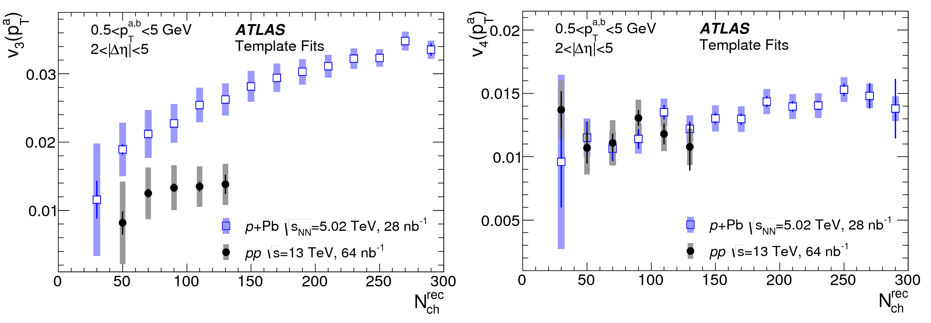
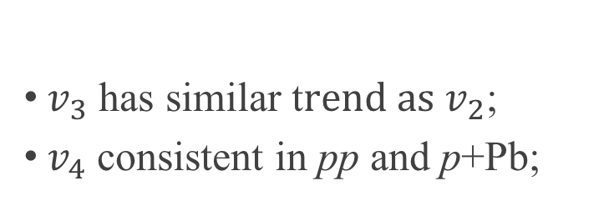
Higher harmonics between pp and p+Pb
$v_{3}$ has similar t$rend as v_{2}$;
$v_{4}$ consistent in pp and p+Pb;

Slide 12
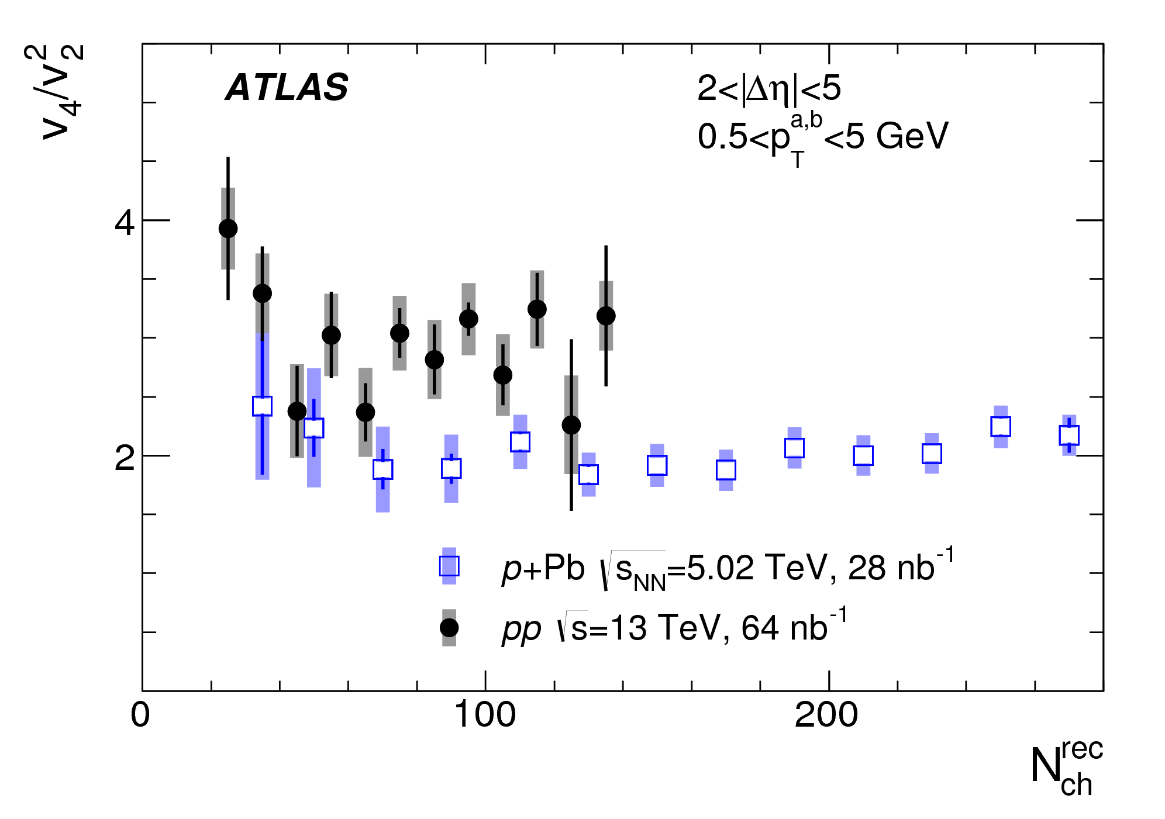

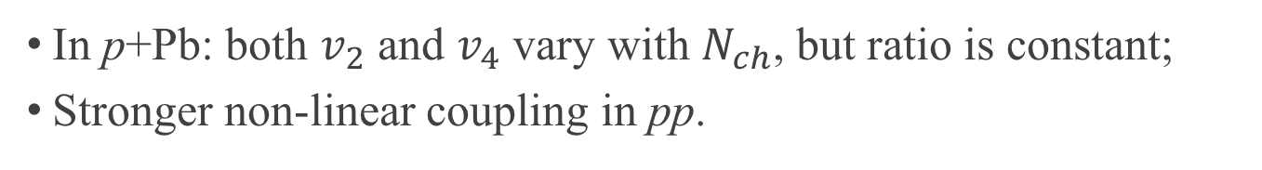
Non-linear effect
$$v_{4}=v_{4L}+χ_{4}{\left(v_{2}\right)}^{2}$$
In p+Pb: both $v_{2}$ and $v_{4}$ vary with $N_{ch}$, but ratio is constant;
Stronger non-linear coupling in pp.

Slide 13
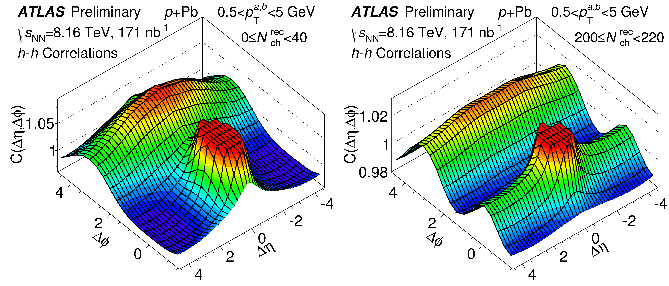
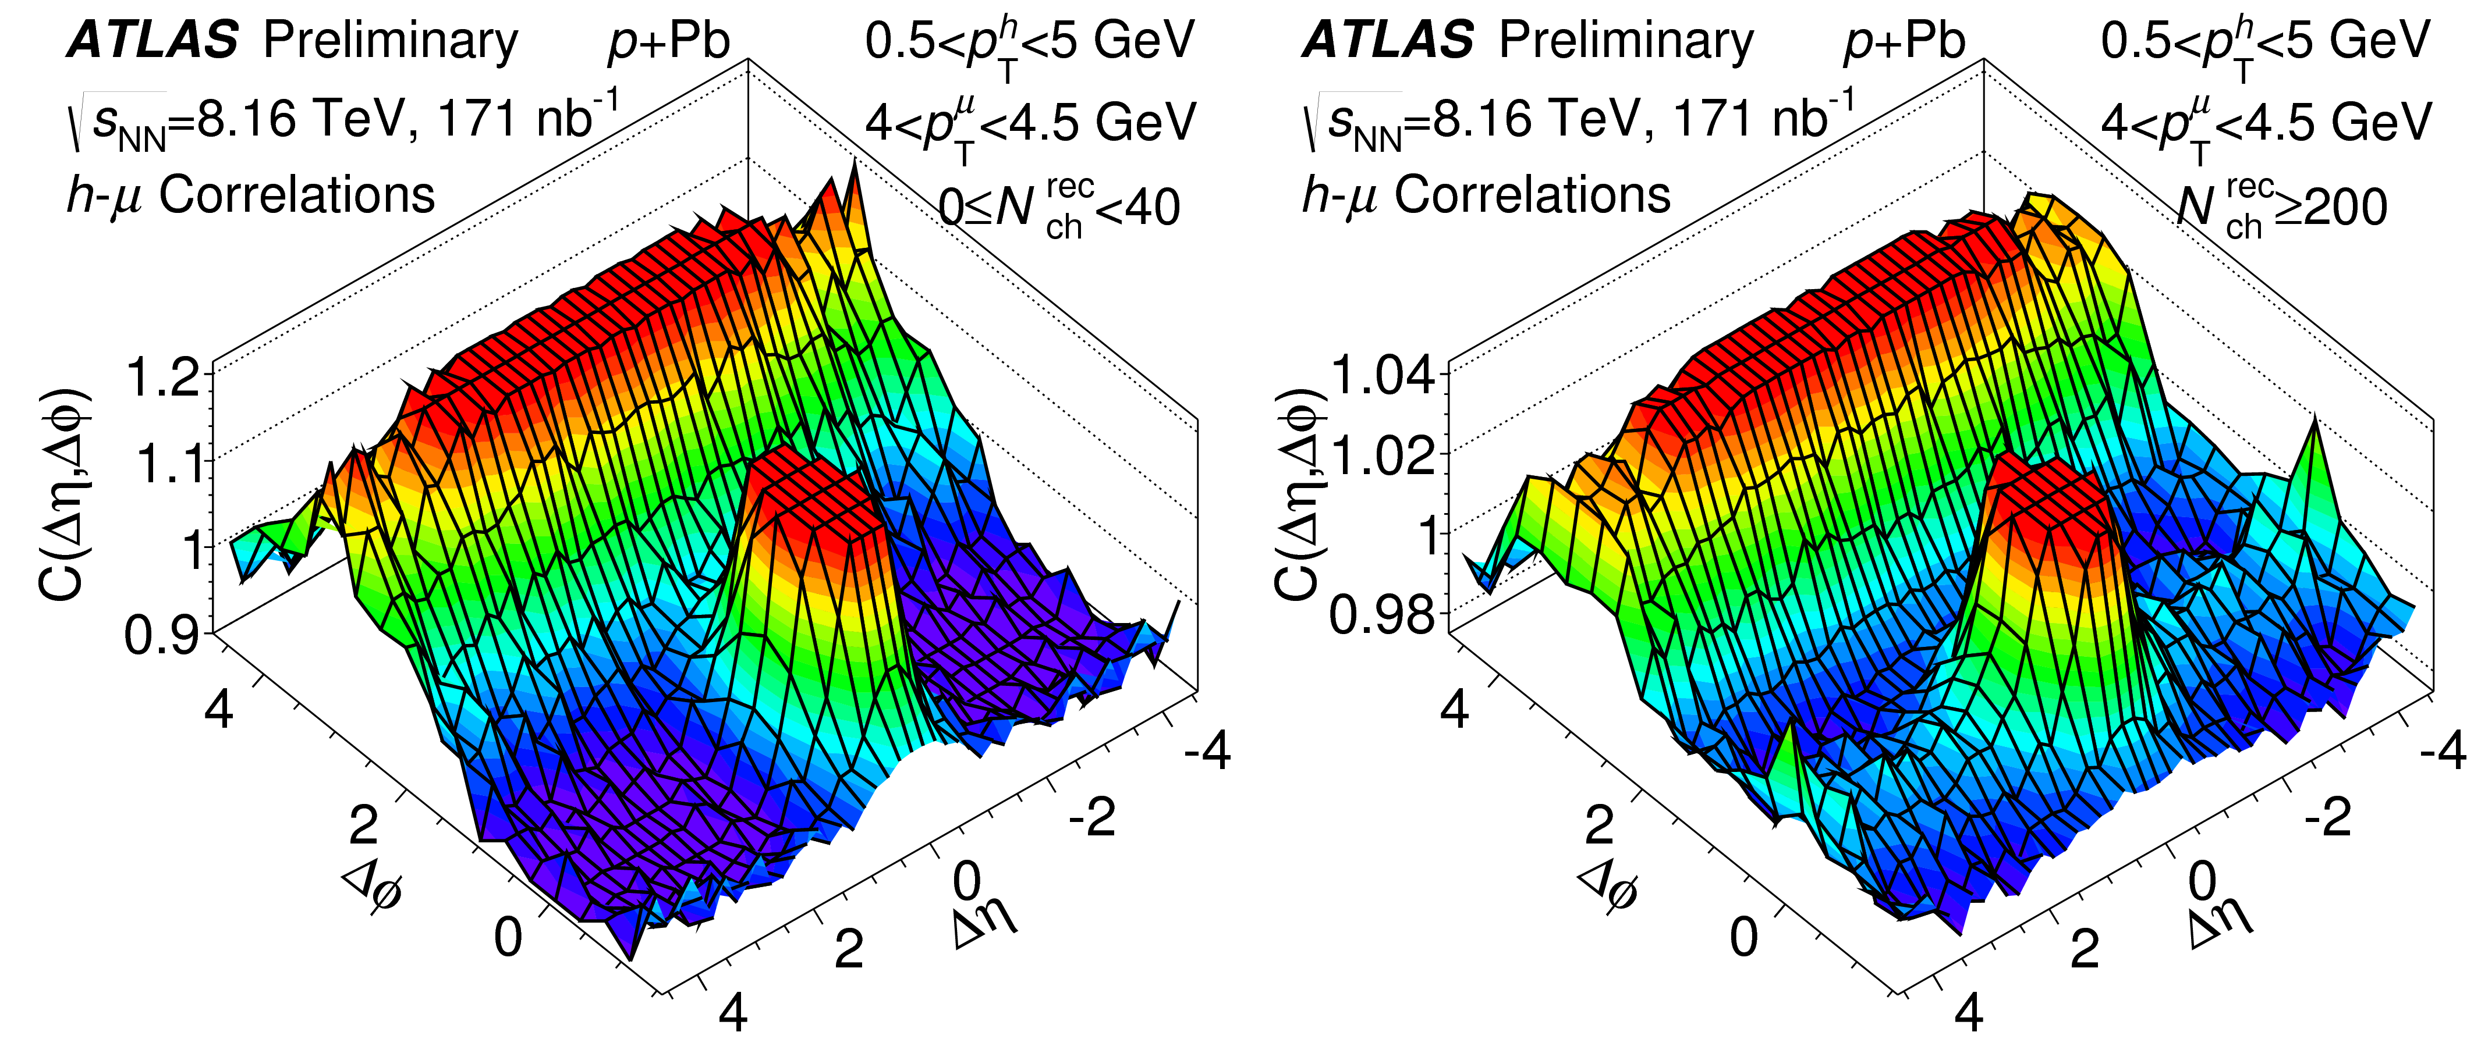
Origin of the ridge?
Initial?
Final?
Use prompt muons from decay of heavy flavor particles.

Slide 14
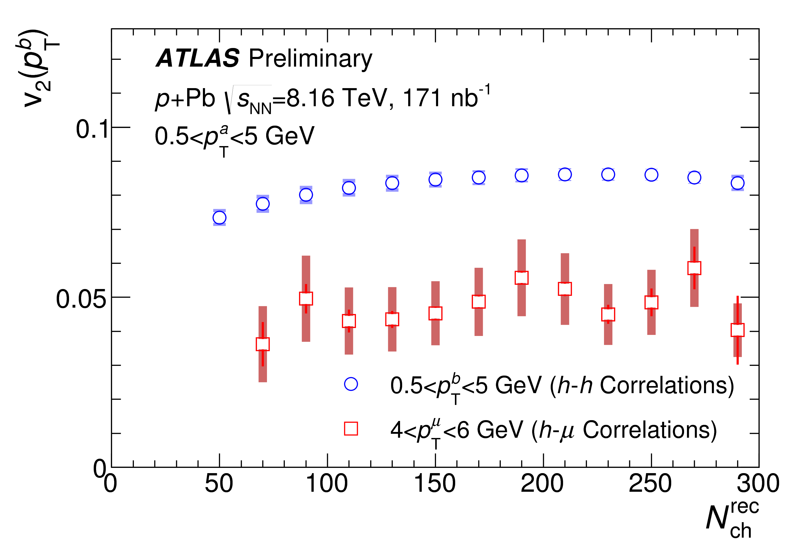
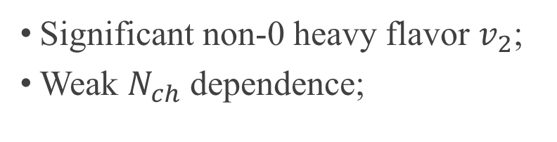
Heavy flavor $v_{2}$
ATLAS-CONF-2017-006
Significant non-0 heavy flavor $v_{2}$;
Weak $N_{ch}$ dependence;

Slide 15
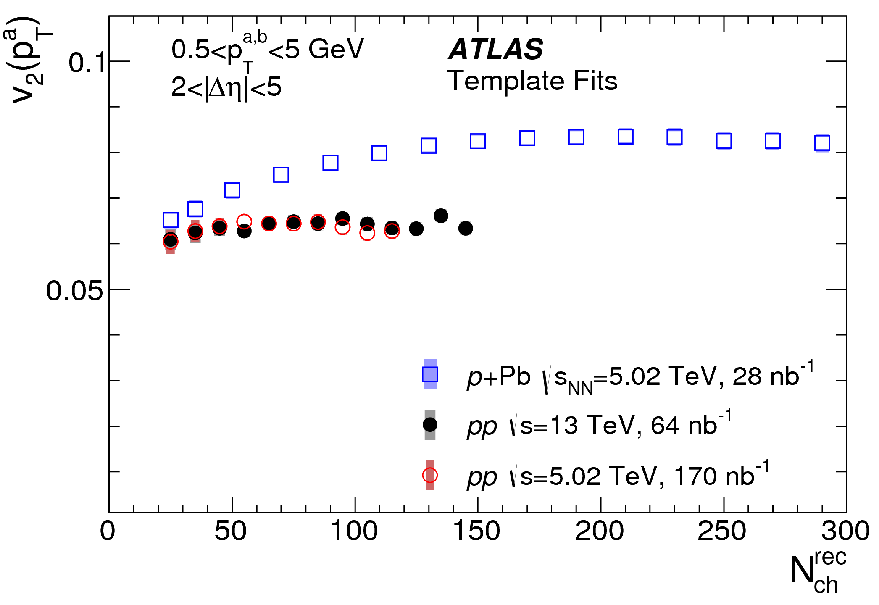


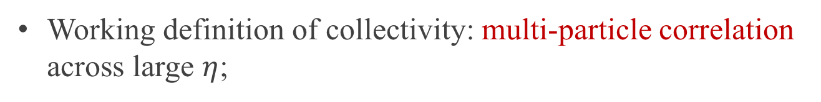
Summary of 2-particle results
Large $v_{2}$ in low-$N_{ch}$ pp.
Large HF $v_{2}$ in p+Pb.
Working definition of collectivity: multi-particle correlation across large $η$;

Slide 16
Multi-particle correlation results

Slide 17
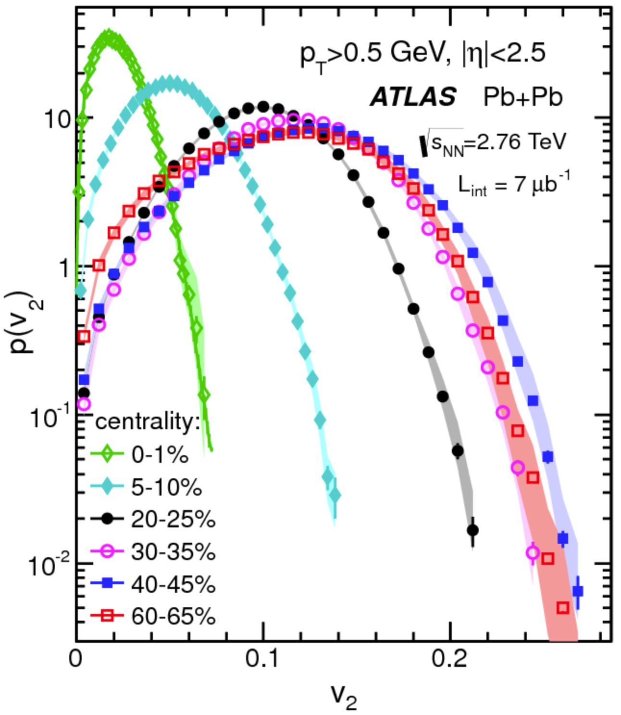
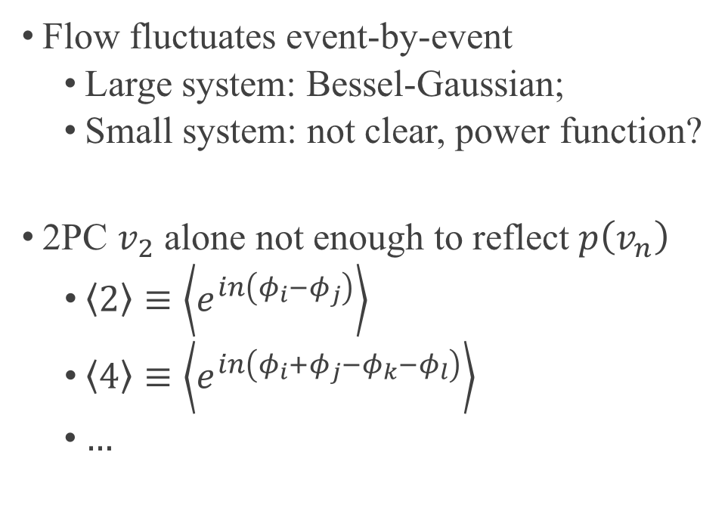
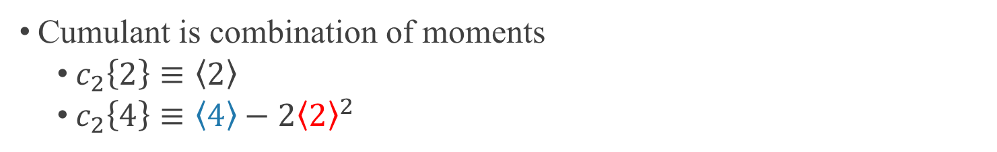
Cumulant
Flow fluctuates event-by-event
Large system: Bessel-Gaussian;
Small system: not clear, power function?
2PC $v_{2}$ alone not enough to reflect $p\left(v_{n}\right)$
$\left\langle 2\right\rangle ≡\left\langle e^{in\left(φ_{i}−φ_{j}\right)}\right\rangle$
$\left\langle 4\right\rangle ≡\left\langle e^{in\left(φ_{i}+φ_{j}−φ_{k}−φ_{l}\right)}\right\rangle$
$…$
Cumulant is combination of moments
$c_{2}\left\{2\right\}≡\left\langle 2\right\rangle$
$c_{2}\left\{4\right\}≡\left\langle 4\right\rangle −2{\left\langle 2\right\rangle }^{2}$
flow+non-flow
mostly non-flow

Slide 18
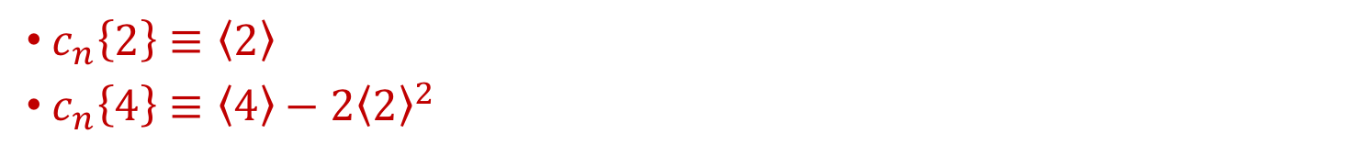
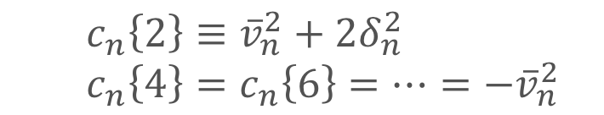
$c_{2}\left\{4\right\}<0⇔$ collectivity?
$c_{n}\left\{2\right\}≡\left\langle 2\right\rangle$
$c_{n}\left\{4\right\}≡\left\langle 4\right\rangle −2{\left\langle 2\right\rangle }^{2}$
If Gaussian
$c_{n}\left\{2\right\}≡{\overline{v}}_{n}^{2}+2δ_{n}^{2}$
$c_{n}\left\{4\right\}=c_{n}\left\{6\right\}=…=−{\overline{v}}_{n}^{2}$
Non-flow significantly larger in small system, non-Gaussian expected.
Dijet
Pb+Pb
pp
Short-range non-flow
Long-range collectivity

Slide 19




How to remove non-flow in $c_{2}\left\{4\right\}$
KEY: define new cumulant across large $η$;
$$\left\langle 4\right\rangle ≡\left\langle e^{in\left(φ_{i}+φ_{j}−φ_{k}−φ_{l}\right)}\right\rangle$$
$$\left\langle 4\right\rangle ≡\left\langle e^{in\left(φ_{i}+φ_{j}−φ_{k}−φ_{l}\right)}\right\rangle$$
Short-range non-flow dominate
Long-range non-flow dominate
$$\left\langle 4\right\rangle ≡\left\langle e^{in\left(φ_{i}+φ_{j}−φ_{k}−φ_{l}\right)}\right\rangle$$
$$\left\langle 4\right\rangle ≡\left\langle e^{in\left(φ_{i}+φ_{j}−φ_{k}−φ_{l}\right)}\right\rangle$$
Subevent cumulant measures long-range collectivity.

Slide 20

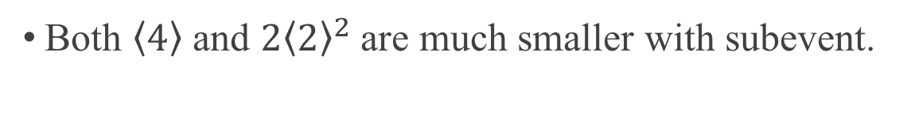




$\left\langle 4\right\rangle$ and $2{\left\langle 2\right\rangle }^{2}$
flow+non-flow
mostly non-flow
$$c_{2}\left\{4\right\}≡\left\langle 4\right\rangle −2{\left\langle 2\right\rangle }^{2}$$
$$c_{2}\left\{4\right\}$$
$$\left\langle 4\right\rangle$$
$$2{\left\langle 2\right\rangle }^{2}$$
Both $\left\langle 4\right\rangle$ and $2{\left\langle 2\right\rangle }^{2}$ are much smaller with subevent.

Slide 21
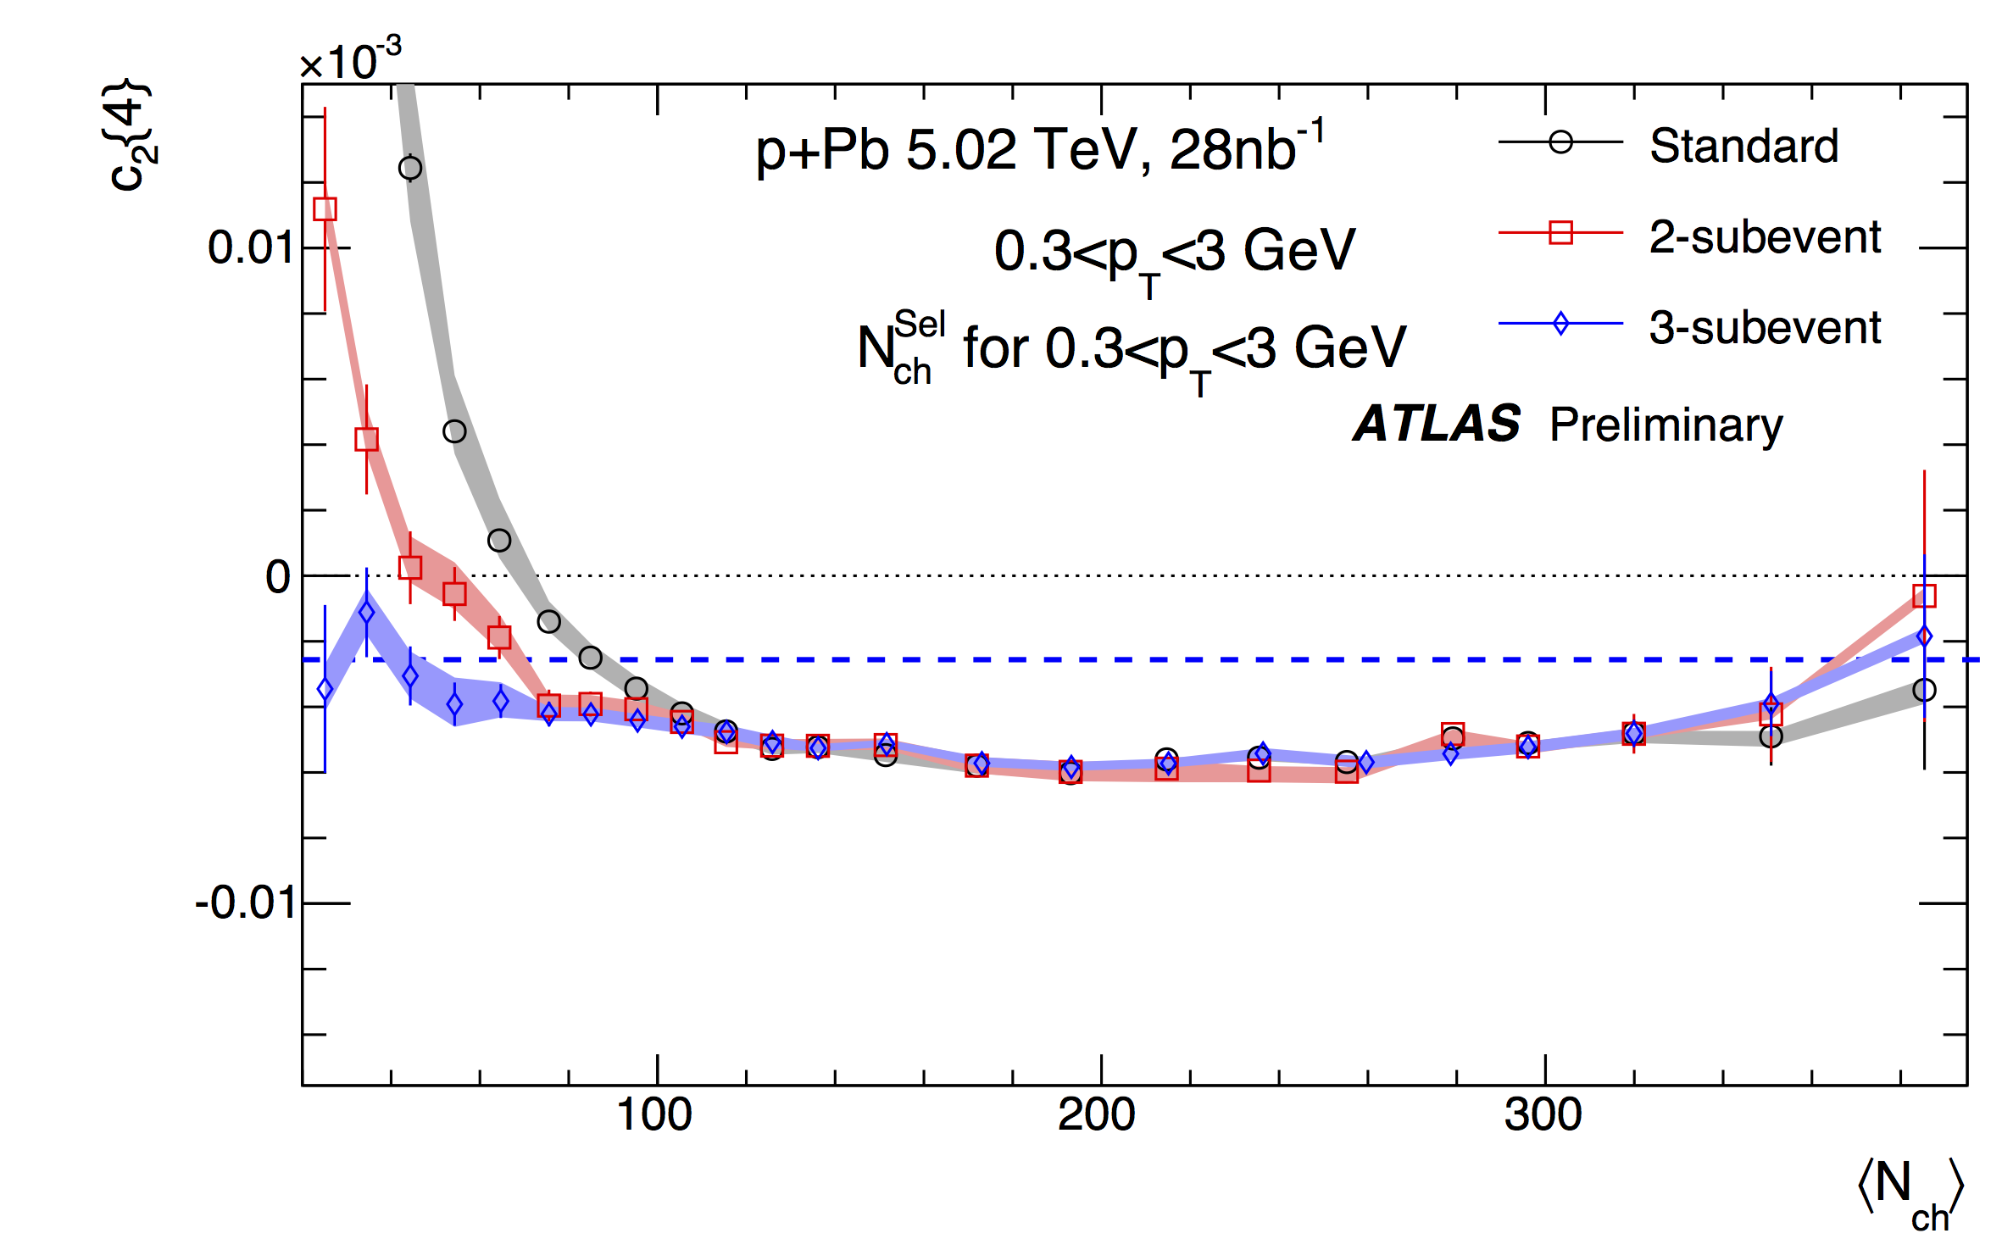
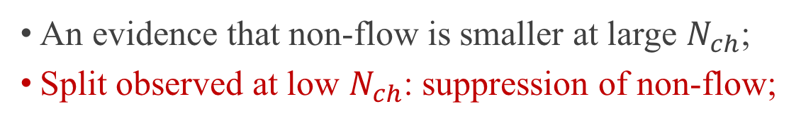
Subevent cumulant method tested in 5.02 TeV p+Pb
?
4% flow
An evidence that non-flow is smaller at large $N_{ch}$;
Split observed at low $N_{ch}$: suppression of non-flow;

Slide 22
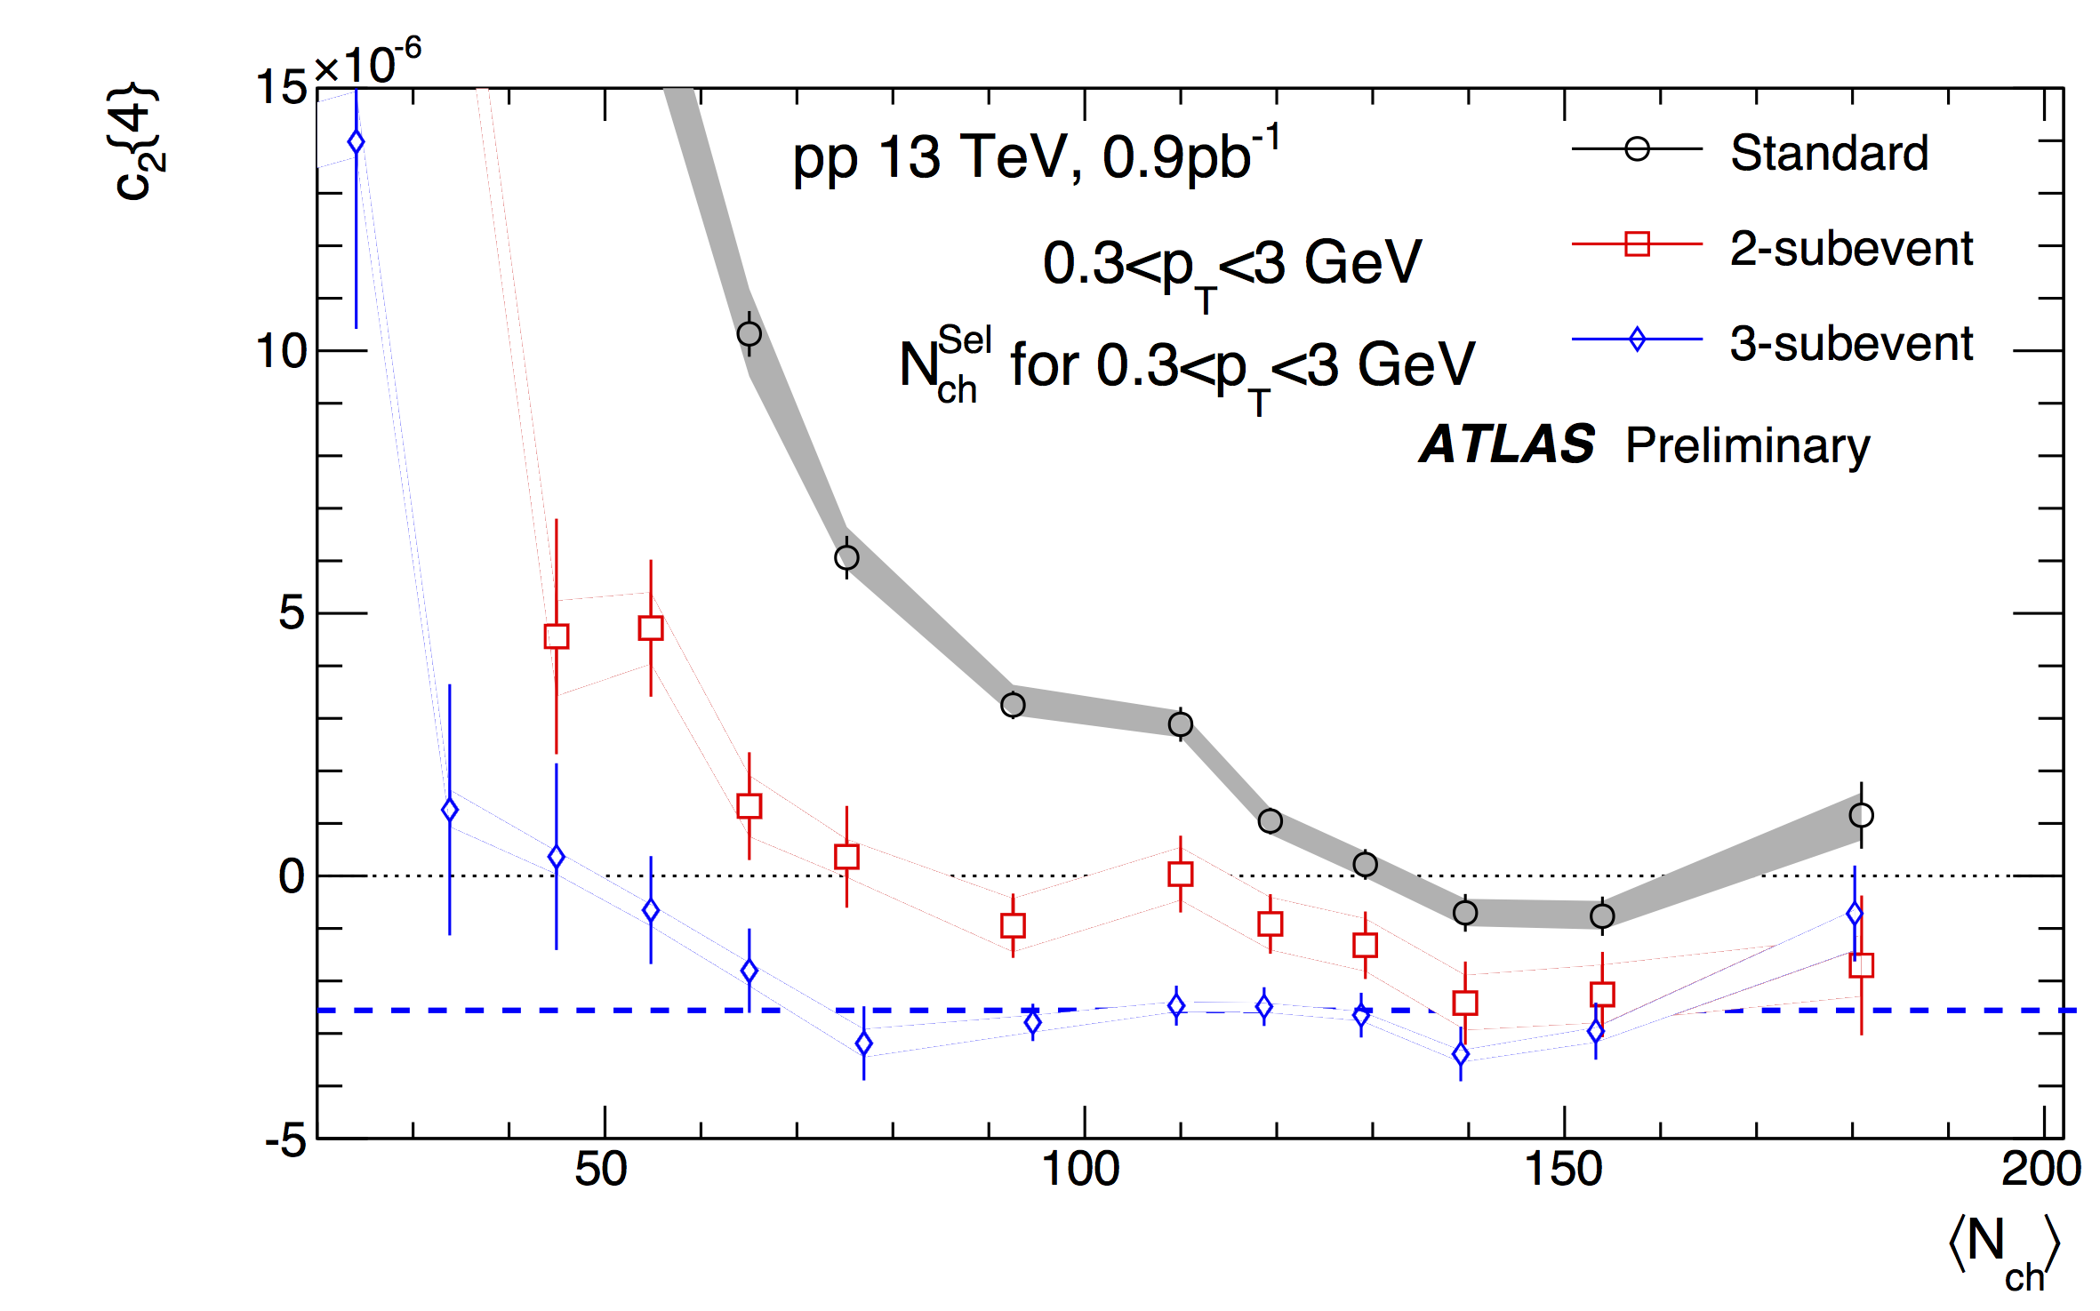
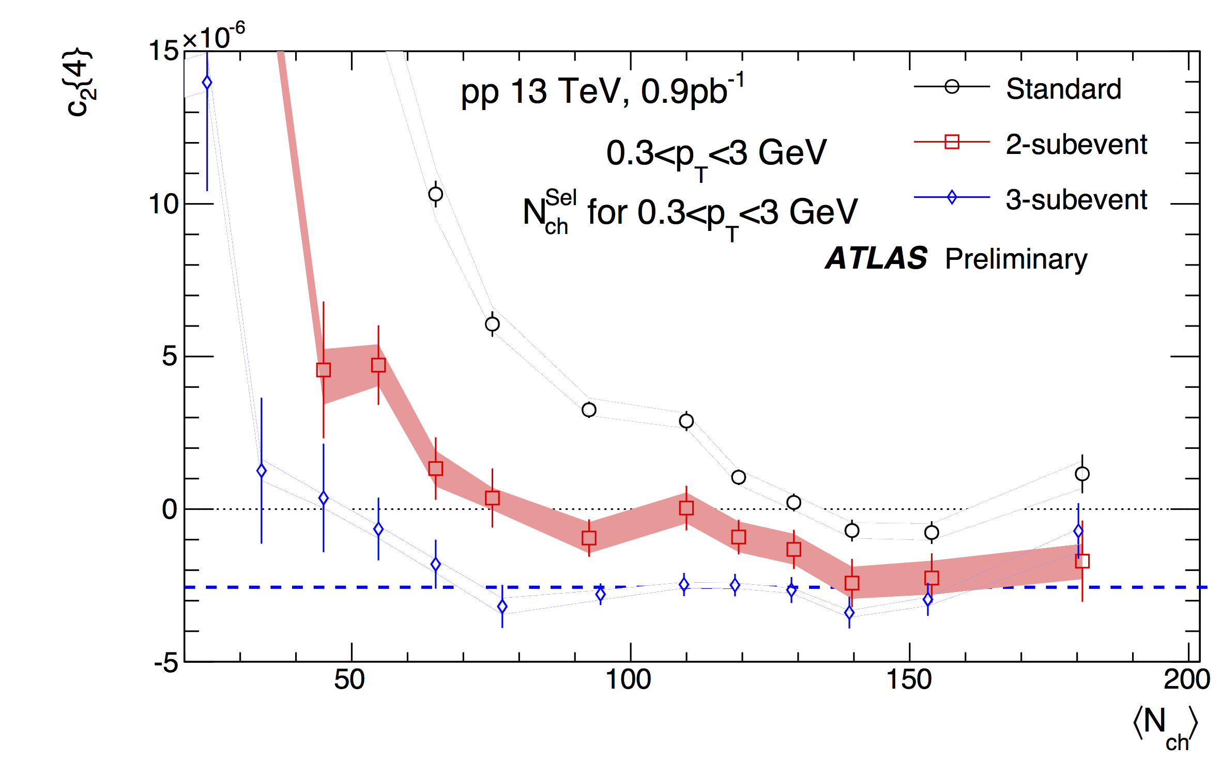
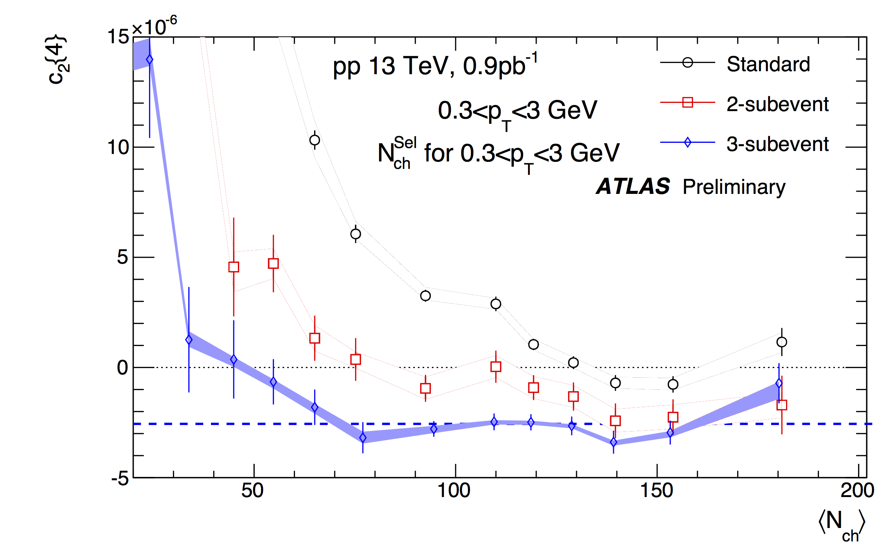
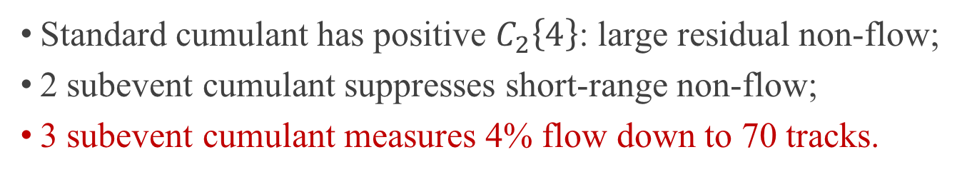
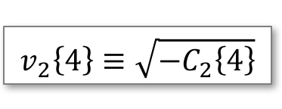
13 TeV pp: comparison of methods
$$v_{2}\left\{4\right\}≡\sqrt{−C_{2}\left\{4\right\}}$$
4% flow
Standard cumulant has positive $C_{2}\left\{4\right\}$: large residual non-flow;
2 subevent cumulant suppresses short-range non-flow;
3 subevent cumulant measures 4% flow down to 70 tracks.

Slide 23
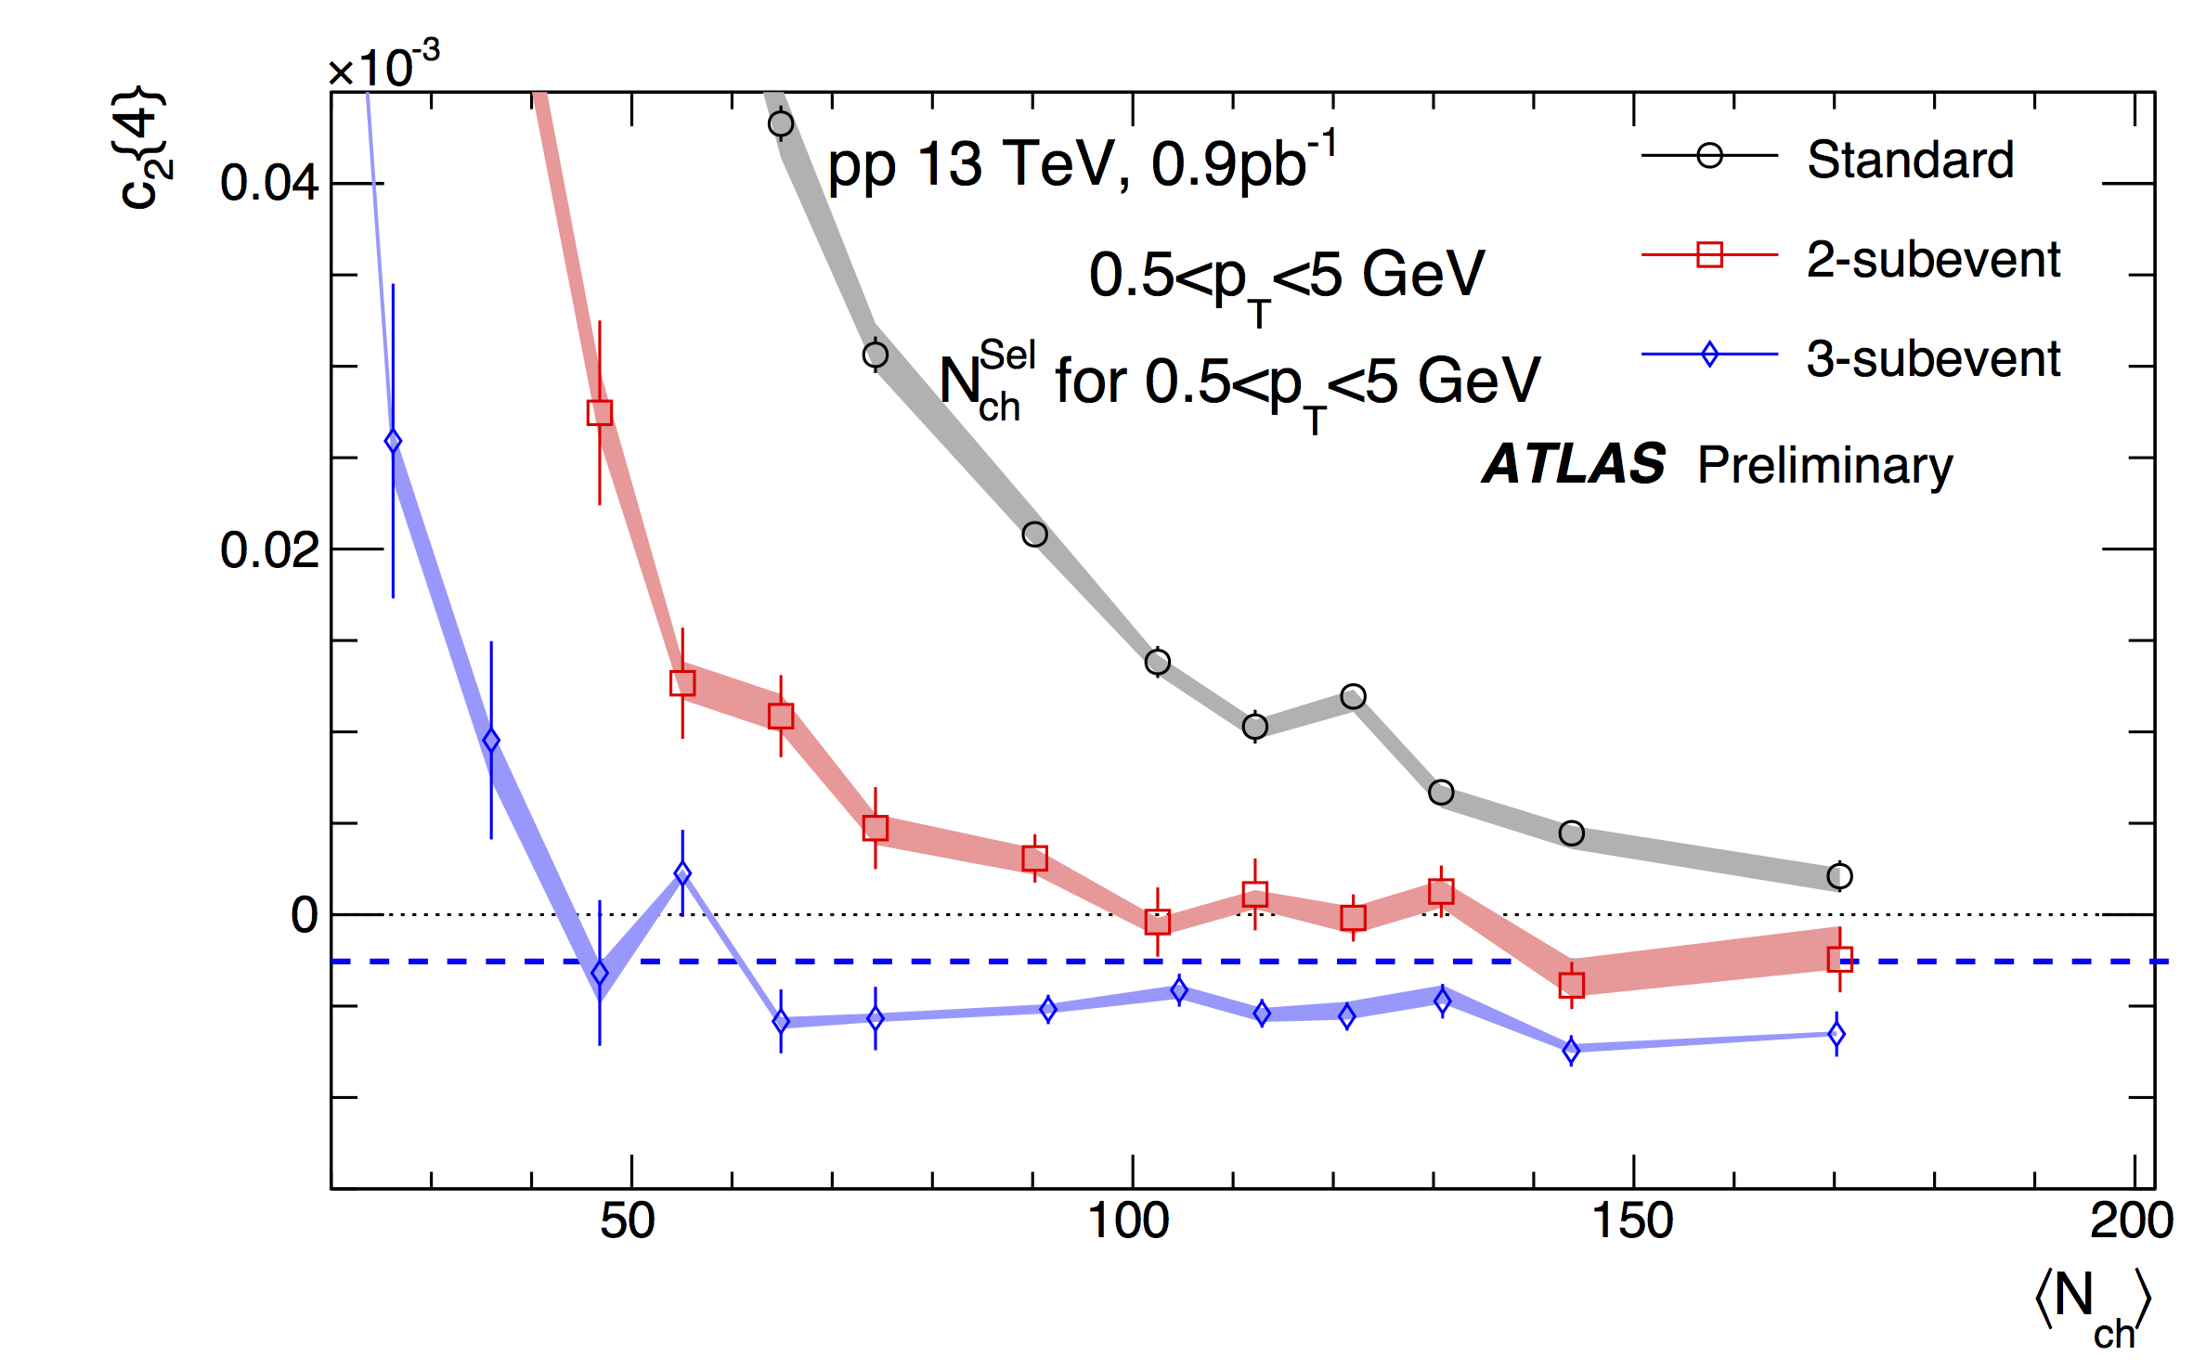
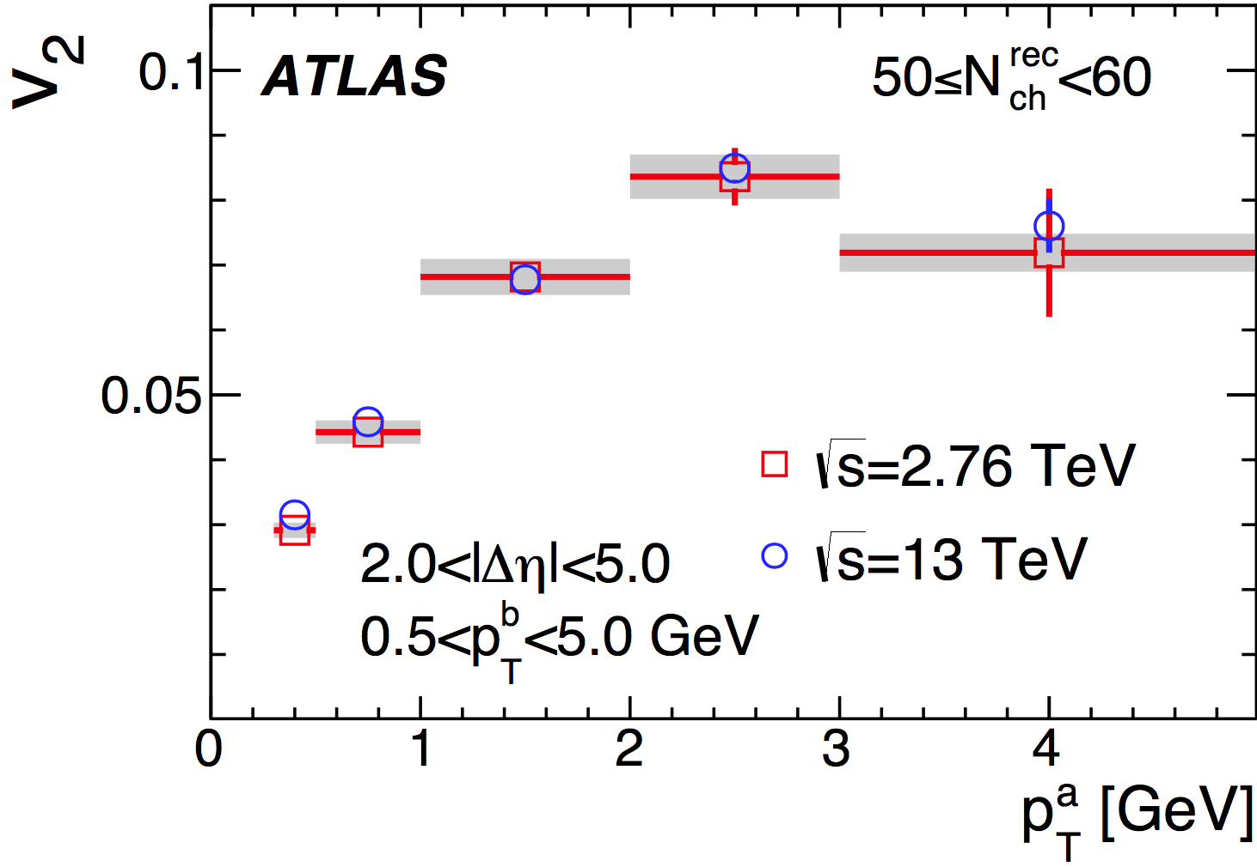
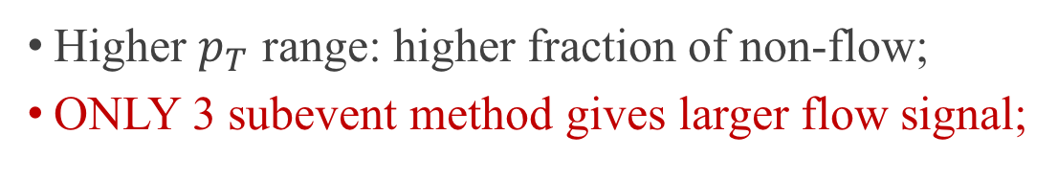
13 TeV pp: higher $p_{T}$ region
4% flow
Higher $p_{T}$ range: higher fraction of non-flow;
ONLY 3 subevent method gives larger flow signal;

Slide 24
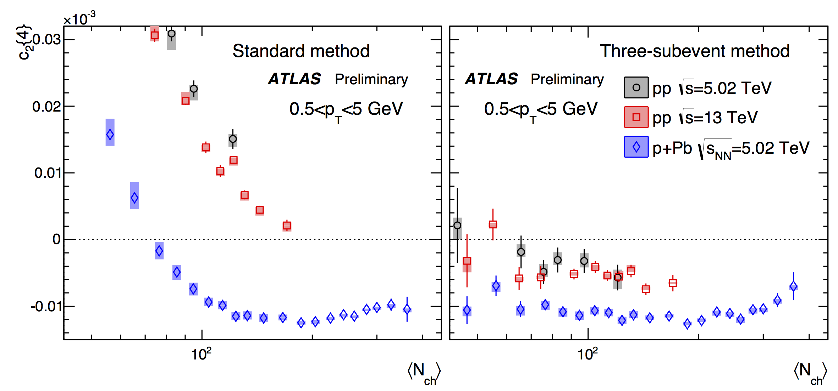
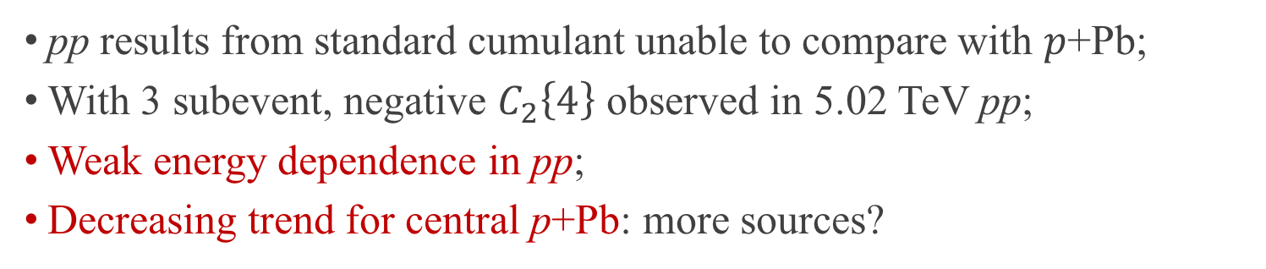
Comparison among systems
pp results from standard cumulant unable to compare with $p$+Pb;
With 3 subevent, negative $C_{2}\left\{4\right\}$ observed in 5.02 TeV pp;
Weak energy dependence in pp;
Decreasing trend for central p+Pb: more sources?

Slide 25




Third harmonic $c_{3}\left\{4\right\}$
Still residual non-flow in standard method;
$C_{3}\left\{4\right\}$ from 3 subevent is consistent with 0:
${\overline{v}}_{3}≪{\overline{v}}_{2}$
Fluctuation kills $C_{3}\left\{4\right\}$?

Slide 26






Number of sources in initial stage
$v_{2}\left\{2\right\}≠v_{2}\left\{4\right\}$: EbyE flow fluctuations associated with fluctuating initial conditions. PRL 112, 082301 (2014)
Fluctuation can be quantified to the number of sources $N_{s}$ in the initial stage:
$$\frac{v_{2}\left\{4\right\}}{v_{2}\left\{2\right\}}={\left(\frac{4}{3+N_{s}}\right)}^{1/4}$$
$$\frac{N\left(η\right)}{\left\langle N\left(η\right)\right\rangle }≈1+a_{1}η, a_{1}∝1/{\sqrt{N_{s}}}$$
$N_{s}$?
arXiv: 1606.08170
$N_{s}$ for $p$+Pb goes up to 20 at high multiplicity;
$N_{s}$ for $pp$ approximately consistent with $p$+Pb at comparable $\left\langle N_{ch}\right\rangle$ value.

Slide 27


Summary: what we know
Long-range flow-like correlation exist in small systems.
Similarity between pp and p+Pb.

Slide 28



Summary: what we don’t know
EPOS
Collectivity in models?
Origin of ridge? HF $v_{2}$
Fluctuation of higher harmonics?
Longitudinal sources in small system?

Slide 29
Back Up

Slide 30


What is collectivity?
Definition: emergent phenomenon of a many-body interacting system;
Working definition: multi-particle correlation across large pseudorapidity $η$;
Pb+Pb 2.76 TeV
Particles not from a common source: jet, resonance decay…
named non-flow
Rest particles from a common source: named collectivity (flow in A+A)

Slide 31




Origins of collectivity
$$\frac{dN}{dφ}=G\left(1+2\sum_{n=1}{v_{n}\cos{nφ}}\right)$$
Final state correlations
Hydrodynamic flow
Spatial structure from initial condition
Momentum correlations
Initial state correlations
Particles are produced with momentum space correlations

Slide 32


Why studying small systems?
Success of models in large systems.
Not so good in small systems…
Larger proton fluctuation can better distinguish different models;
What is the smallest droplet of Quark Gluon Plasma (QGP)?
On the other hand, it is important for experiments to provide more reliable results in small system. But this is not an easy task…

Slide 33




ZYAM
To quantify the strength of the ridge yield:
$$Y\left(Δφ\right)=\left(\frac{\int{B\left(Δφ\right) dΔφ}}{N^{a}\int{dΔφ}}\right)C\left(Δφ\right)$$
$$N^{a} total number of trigger number$$
$$b_{ZYAM}$$
ZYAM method estimates ridge yield in near-side (presented in EPS 2015);
ZYAM assumes pairs under pedestal $b_{ZYAM}$ are uncorrelated;
Due to the modulation of LRC in near-side, ridge yield may be underestimated.
Due to dominance of dijet, ZYAM cannot estimate LRC in away-side.
New method needed!

Slide 34



Per-trigger Yield
$$Y\left(Δφ\right)=\left(\frac{\int{B\left(Δφ\right) dΔφ}}{N^{a}\int{dΔφ}}\right)C\left(Δφ\right)$$

Slide 35




Performance of template fit
$$Y^{templ}\left(∆φ\right)=Y^{ridge}\left(Δφ\right)+FY^{periph}\left(Δφ\right)$$

Slide 36




Coefficients from template fit
$$Y^{templ}\left(Δφ\right)=FY^{periph}\left(Δφ\right)+Y^{ridge}\left(Δφ\right)$$
$$Y^{ridge}\left(Δφ\right)=G\left(1+2v_{2,2}\cos\left(2Δφ\right)\right)$$
two free parameters: $F$ and $v_{2,2}$
$G$ is fixed by $\int_{0}^{π}{dΔφ{ Y}^{templ}=\int_{0}^{π}{dΔφ Y}}$

Slide 37


Comparison of methods
Fourier transform: dijet biased $v_{2}$;
ZYAM: $v_{2}$ in low-$N_{ch}$ could bias the results;
Template fit: less bias, none if $v_{2}$ constant.

Slide 38



Factorization test
$$v_{2}\left(p_{T1}\right)=\frac{v_{2,2}\left(p_{T1},p_{T2}\right)}{\sqrt{v_{2,2}\left(p_{T2},p_{T2}\right)}}$$
Ridge arises from modulation of single-particle $φ$ distributions.

Slide 39



Nucleon substructure fluctuation
Pb
p

Slide 40

$p_{T}$ dependence between pp and p+Pb
Disagree in high $p_{T}$: change in the dijet shape.
Disagree in low $p_{T}$: not yet understood.

Slide 41

$p_{T}$ dependence of heavy flavor $v_{2}$

Slide 42




Data sets for cumulant
Studied in this analysis:
Energy dependence of $C_{2}\left\{4\right\}$ in pp;
Comparison between pp and p+Pb;
3 collision systems included:
13 TeV pp (2015+2016)
5.02 TeV pp (2015)
5.02 TeV p+Pb (2013+2016)
Two $p_{T}$ ranges: $0.3<p_{T}<3.0$ GeV and $0.5<p_{T}<5.0$ GeV;
High-multiplicity track triggers developed to enhance statistics at large $N_{ch}$:
ATLAS Inner Detector
HMT 5.02 TeV pp

Slide 43






Subevent formula (w/o weight)

Slide 44





Comparison with 2-particle correlation method
$v_{2}\left\{2\right\}$ from template fit
$v_{2}\left\{4\right\}$ from 3 subevent
$v_{2}\left\{2\right\}$ from peripheral sub.
$v_{2}\left\{4\right\}<v_{2}\left\{2\right\}$ (template fit): flow fluctuation;
$v_{2}\left\{4\right\}≈v_{2}\left\{2\right\}$ (peripheral subtraction): no flow fluctuation at all?

Slide 45
Title
Content

Slide 46

Peripheral subtraction
In the long-range region $\left|∆η\right|>2$:
$Y=Y_{LRC}+Y_{dijet}⇒\left\{\begin{aligned}Y^{H}=Y_{LRC}^{H}+Y_{dijet}^{H} \\ Y^{L}=Y_{LRC}^{L}+Y_{dijet}^{L}\end{aligned}\right.$
Assume: $Y_{dijet}^{H}≈α_{dijet}Y_{dijet}^{L}$
$Y^{\left|∆η\right|<1}=Y_{LRC}^{\left|∆η\right|<1}+Y_{dijet}^{\left|∆η\right|<1}+Y_{jet}^{\left|∆η\right|<1}$
$Y^{\left|∆η\right|>2}=Y_{LRC}^{\left|∆η\right|>2}+Y_{dijet}^{\left|∆η\right|>2}$
Got: $Y_{jet}^{H,\left|∆η\right|<1}=α_{jet}Y_{jet}^{L,\left|∆η\right|<1}$
Assume: $α_{jet}≈α_{dijet}$
$Y_{LRC}^{H,obs}≡Y^{H}−α_{jet}Y^{L}$ (CMS should use this!)
ZYAM is fine for short-range;
But very problematic for long-range;
But $G^{L}→0$, so maybe ZYAM is fine for long-range.
$v_{2}^{H,obs}=\frac{G^{H}v_{2}^{H}−α_{jet}G^{L}v_{2}^{L}}{G^{H}−α_{jet}G^{L}}$

Slide 47

Template fit
In the long-range region $\left|∆η\right|>2$:
$Y=Y_{LRC}+Y_{dijet}⇒\left\{\begin{aligned}Y^{H}=Y_{LRC}^{H}+Y_{dijet}^{H} \\ Y^{L}=Y_{LRC}^{L}+Y_{dijet}^{L}\end{aligned}\right.$
Assume: $Y_{dijet}^{H}≈α_{dijet}Y_{dijet}^{L}$
Using fit to get $α_{dijet}$
$Y_{LRC}^{H,obs}≡Y^{H}−α_{dijet}Y^{L}$
$v_{2}^{H,obs}=\frac{G^{H}v_{2}^{H}−α_{dijet}G^{L}v_{2}^{L}}{G^{H}−α_{dijet}G^{L}}$
P.S. hidden issue: $α_{dijet}$ can be determined from fit??

