Slide 1
What do hydrodynamic fits to data tell us about QCD?
Paul Romatschke
CU Boulder & CTQM

Slide 2
Heavy-Ion Experiments are Out-of-Equilibrium
[1609.02820]

Slide 3
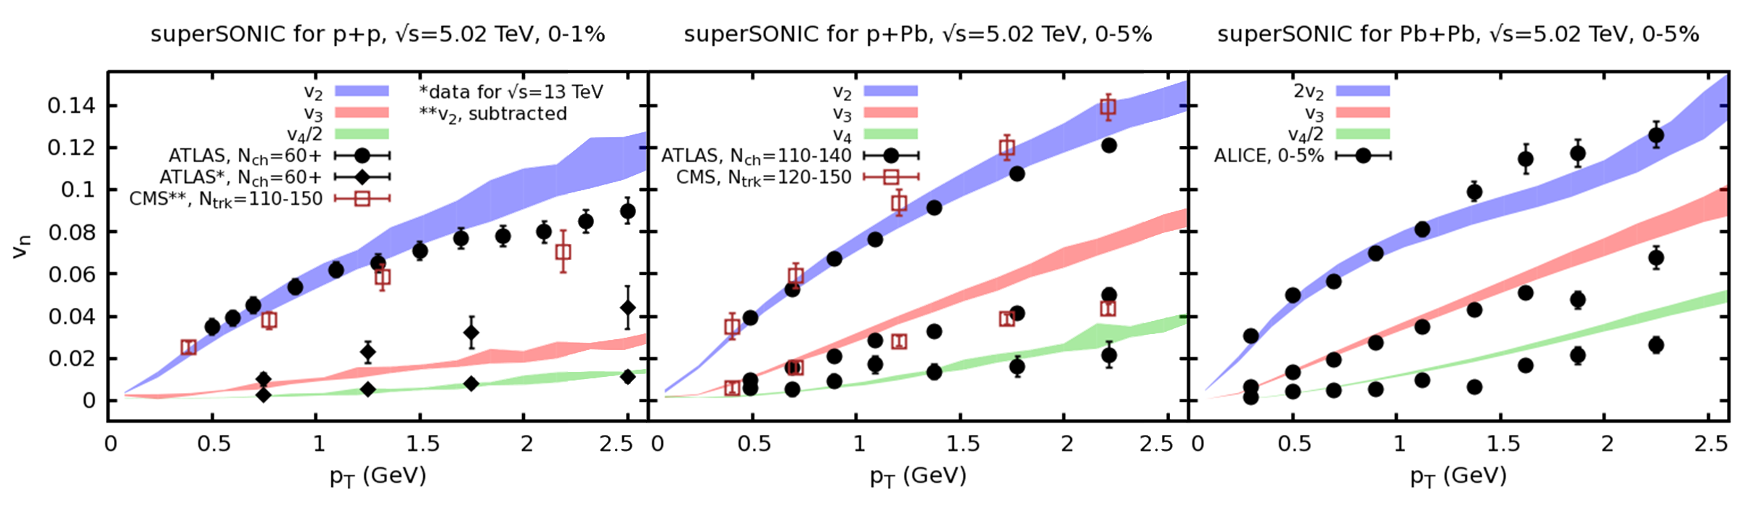
One fluid to rule them all
[1701.07145]

Slide 4
Finding 1
Relativistic Ion Collisions are Out-Of-Equilibrium but hydrodynamics able to describe data
This trivially “solves” the “Early Thermalization Puzzle”: collisions simply do not thermalize.
Ever.

Slide 5
Questions
Why is hydro applicable in out-of-equilibrium systems?
What is the limit of hydro applicability?
What do successful hydrodynamic fits to data tell us about QCD?

Slide 6
When is Hydro applicable?

Slide 7
Hydro as an EFT
Many derivations of hydro equations
Most general approach: Effective Field Theory (EFT)
Hydro = EFT of long-lived, long-wavelength excitations
EFT variables: pressure, energy density, fluid velocity

Slide 8
Hydro as an EFT
Write down quantities using EFT variables and their gradients
Energy-Momentum Tensor for relativistic fluid
No thermal equilibrium or particle description needed
Seems we need small gradients!

Slide 9
Gradient expansion example
What if we had LARGE gradients?
Example: f(x)=e^{x}, for x~1
f(x)~1+x+x²/2+x³/3!+x⁴/4!…
f(1)~1+1+1/2!+1/3!+1/4!=2.70833 ~ 2.71828=e¹
Works for any value of x because gradient expansion converges (but may need high gradient order)

Slide 10
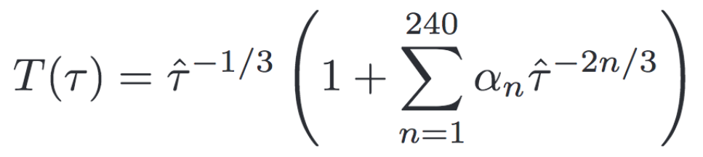
Hydro as an EFT
What if we had LARGE gradients?
Try to improve description by including higher orders in EFT gradient series
E.g. Bjorken flow, go to order 240 (AdS/CFT)
Find: α_{n}~n!, gradient series diverges
[1302.0697, 1503.07514, 1603.05344, 1608.07869, 1609.04803]

Slide 11
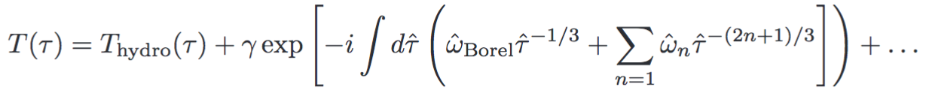
Hydro as an EFT
Gradient series diverges
But it is Borel-summable! [Heller et al, 1302.0697]
Borel-resumming AdS/CFT gradient series:
T_{hydro} is “hydrodynamic attractor”
Extra pieces non-analytic in gradient expansion; this is why grad series diverges! (Would be like f(x)=e^{x}+e^{-1/x} in our earlier example)

Slide 12
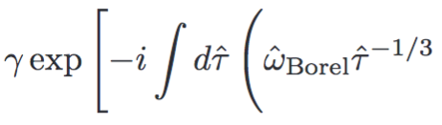


Hydro as an EFT
Borel resummation gives Hydro part and other (“Non-Hydro”) part
Non-hydro part:
w_{Borel}=±3.1193-2.7471 i [Heller et al, 1302.0697]
w_{QNM}=±3.119-2.747i [Starinets, hep-th/0207133]

Slide 13
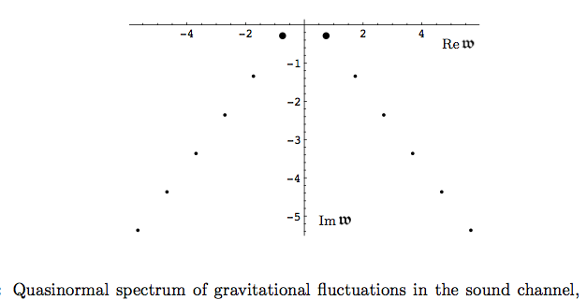
Hydro as an EFT
[Kovtun&Starinets, hep-th/0506184]

Slide 14
Finding 2
Hydrodynamic Gradient Series Diverges because of the Presence of Non-Hydrodynamic Modes

Slide 15
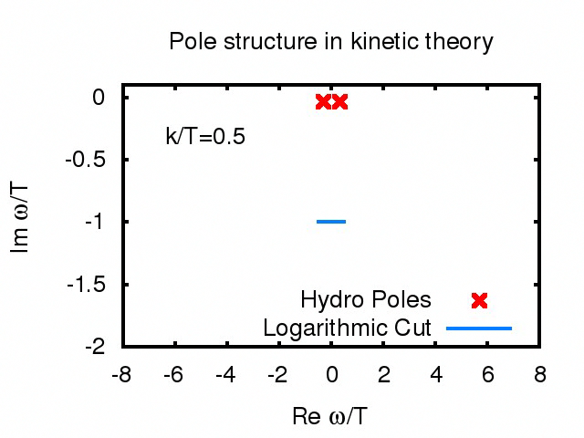
Quasi-particles!
No quasi-particles!

Slide 16
Universality
Hydrodynamic modes are universal
Consequence: hydrodynamic signals insensitive to presence/absence of quasiparticles
Non-hydrodynamic modes are not universal
Consequence: non-hydrodynamic modes are sensitive to presence/absence of quasiparticles

Slide 17
Often: non-hydro modes short-lived
Real time energy density response:
∫dk e^{ikx-iωt} G
[Kovtun&Starinets, hep-th/0506184]

Slide 18
Finding 3
Hydrodynamics is applicable and quantitatively reliable as long as contribution from non-hydro modes can be neglected¹.
¹ If a local rest frame exists.
[1609.02820]
No need of thermal equilibrium!
No need of isotropy!

Slide 19
Pushing the Envelope
Hydro Far From Equilibrium

Slide 20
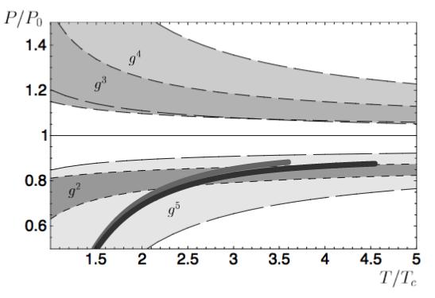
Hints from QCD thermodynamics
[Blaizot, Iancu, Rebhan, 0303045]
Perturbative Expansion for pressure is also divergent series

Slide 21
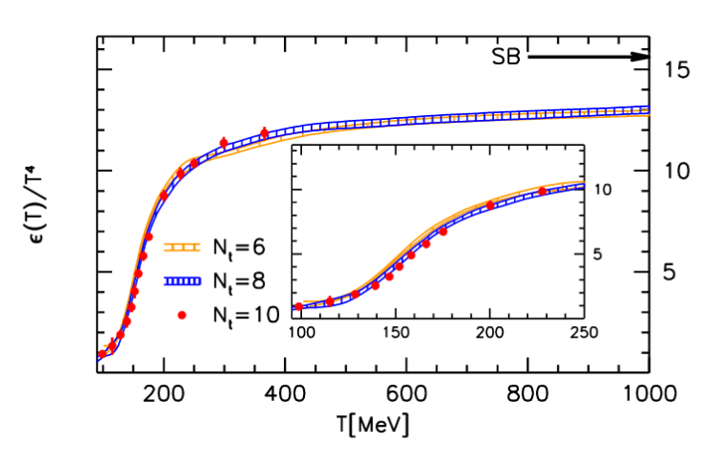
Hints from QCD thermodynamics
[Borsanyi et al, 1007.2580]
But a non-analytic result exists for all T

Slide 22
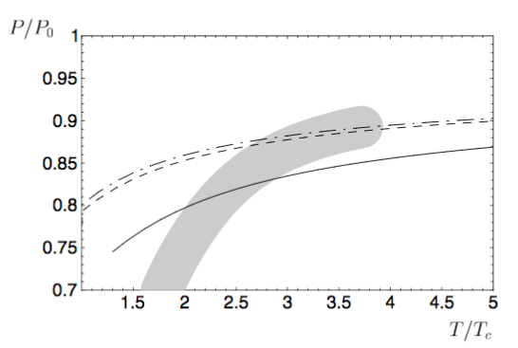
Hints from QCD thermodynamics
[Blaizot, Iancu, Rebhan, 0303045]
…and low-order pQCD is close to the full result

Slide 23
What about Borel- resummed hydrodynamics?

Slide 24
‘Borel-resummation’ : attractor solutions far from equilibrium
[ 1704.08699]

Slide 25
Finding 4
Low Order Hydrodynamics coincides with Attractor Solutions for moderate Gradients
This explains why low-order hydrodynamics works quantitatively out-of-equilibrium!

Slide 26
What do successful hydro fits tell us about QCD?

Slide 27
Far-from-equilibrium hydro
Hydrodynamic attractor solution exists even far away from equilibrium (as long as hydro modes exist)
Arbitrary initial conditions approach attractor via non-hydro mode decay
Near equilibrium, attractor becomes well-known hydrodynamic gradient expansion (e.g. ‘Navier-Stokes’)
Attractor generalizes notion of hydrodynamics to very non-equilibrium situations!

Slide 28

Far-from-equilibrium Hydro
Normal hydro:
Far-from equilibrium hydro:
where η_{B}= η_{B}(| |) depends on gradient strength
For conformal system, ε=3 P even far from equilibrium!
B
B
B
B
B
B

Slide 29
Effective (Resummed) Viscosity
[PR, 1704.08699]

Slide 30
Far-from-Equilibrium Hydro
Robust attractor solution far from equilibrium
For conformal systems, equation of state matches equilibrium equation of state
For conformal systems, effective shear viscosity typically is smaller than equilibrium shear viscosity for large gradients

Slide 31
Far-from-Equilibrium Hydro
Robust attractor solution far from equilibrium: Hydro applies to pp!
For conformal systems, equation of state matches equilibrium equation of state
For conformal systems, effective shear viscosity typically is smaller than equilibrium shear viscosity for large gradients

Slide 32
Far-from-Equilibrium Hydro
Robust attractor solution far from equilibrium: Hydro applies to pp!
For conformal systems, equation of state matches equilibrium equation of state: Hydro fits can be used to get thermal QCD EoS!
For conformal systems, effective shear viscosity typically is smaller than equilibrium shear viscosity for large gradients:

Slide 33
Far-from-Equilibrium Hydro
Robust attractor solution far from equilibrium: Hydro applies to pp!
For conformal systems, equation of state matches equilibrium equation of state: Hydro fits can be used to get thermal QCD EoS!
For conformal systems, effective shear viscosity typically is smaller than equilibrium shear viscosity for large gradients: Hydro fits will give system-dependent η which will be smaller for pp than for AA!

Slide 34
Conclusions
Hydro is far richer than expected (by me)
Generalization of hydro (attractor solution) exists far away from equilibrium
Studies of hydro attractor imply that it can be characterized by equilibrium EoS and non-equilibrium transport coefficients
This could have direct implications for interpreting hydro fits of experimental relativistic ion data

Slide 35
Bonus Material

Slide 36
What are the limits of applicability?

